Slide 1
ALEXA BASED Home Automation using ESP8266, Adafruit.IO, SINRIC and IFTTT
BY IOT GUY

Slide 2
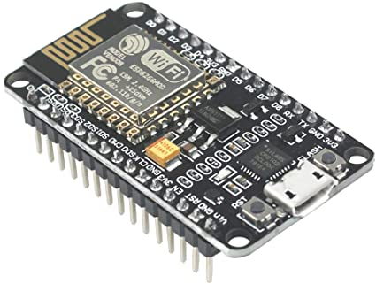
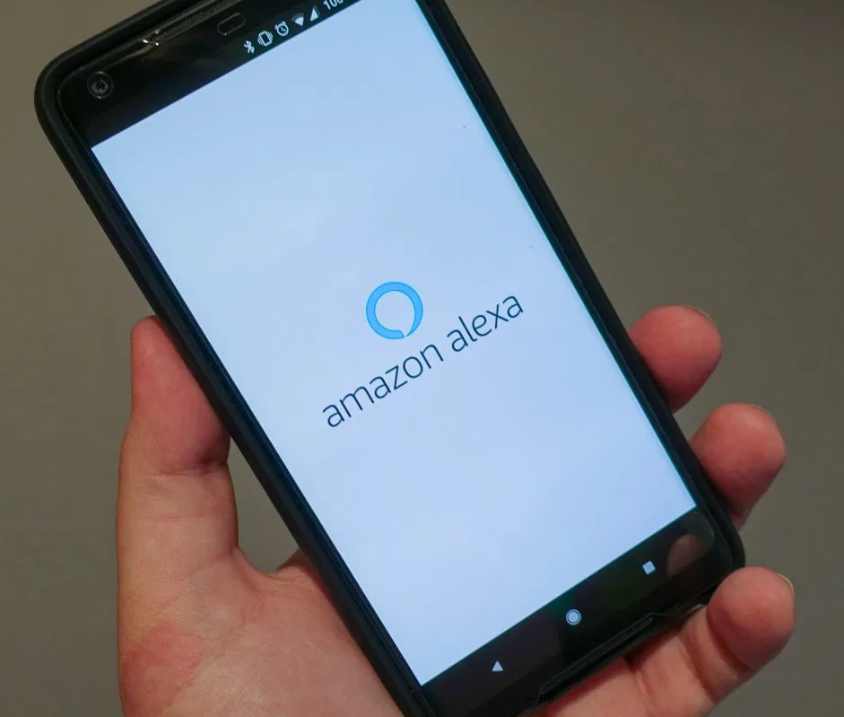

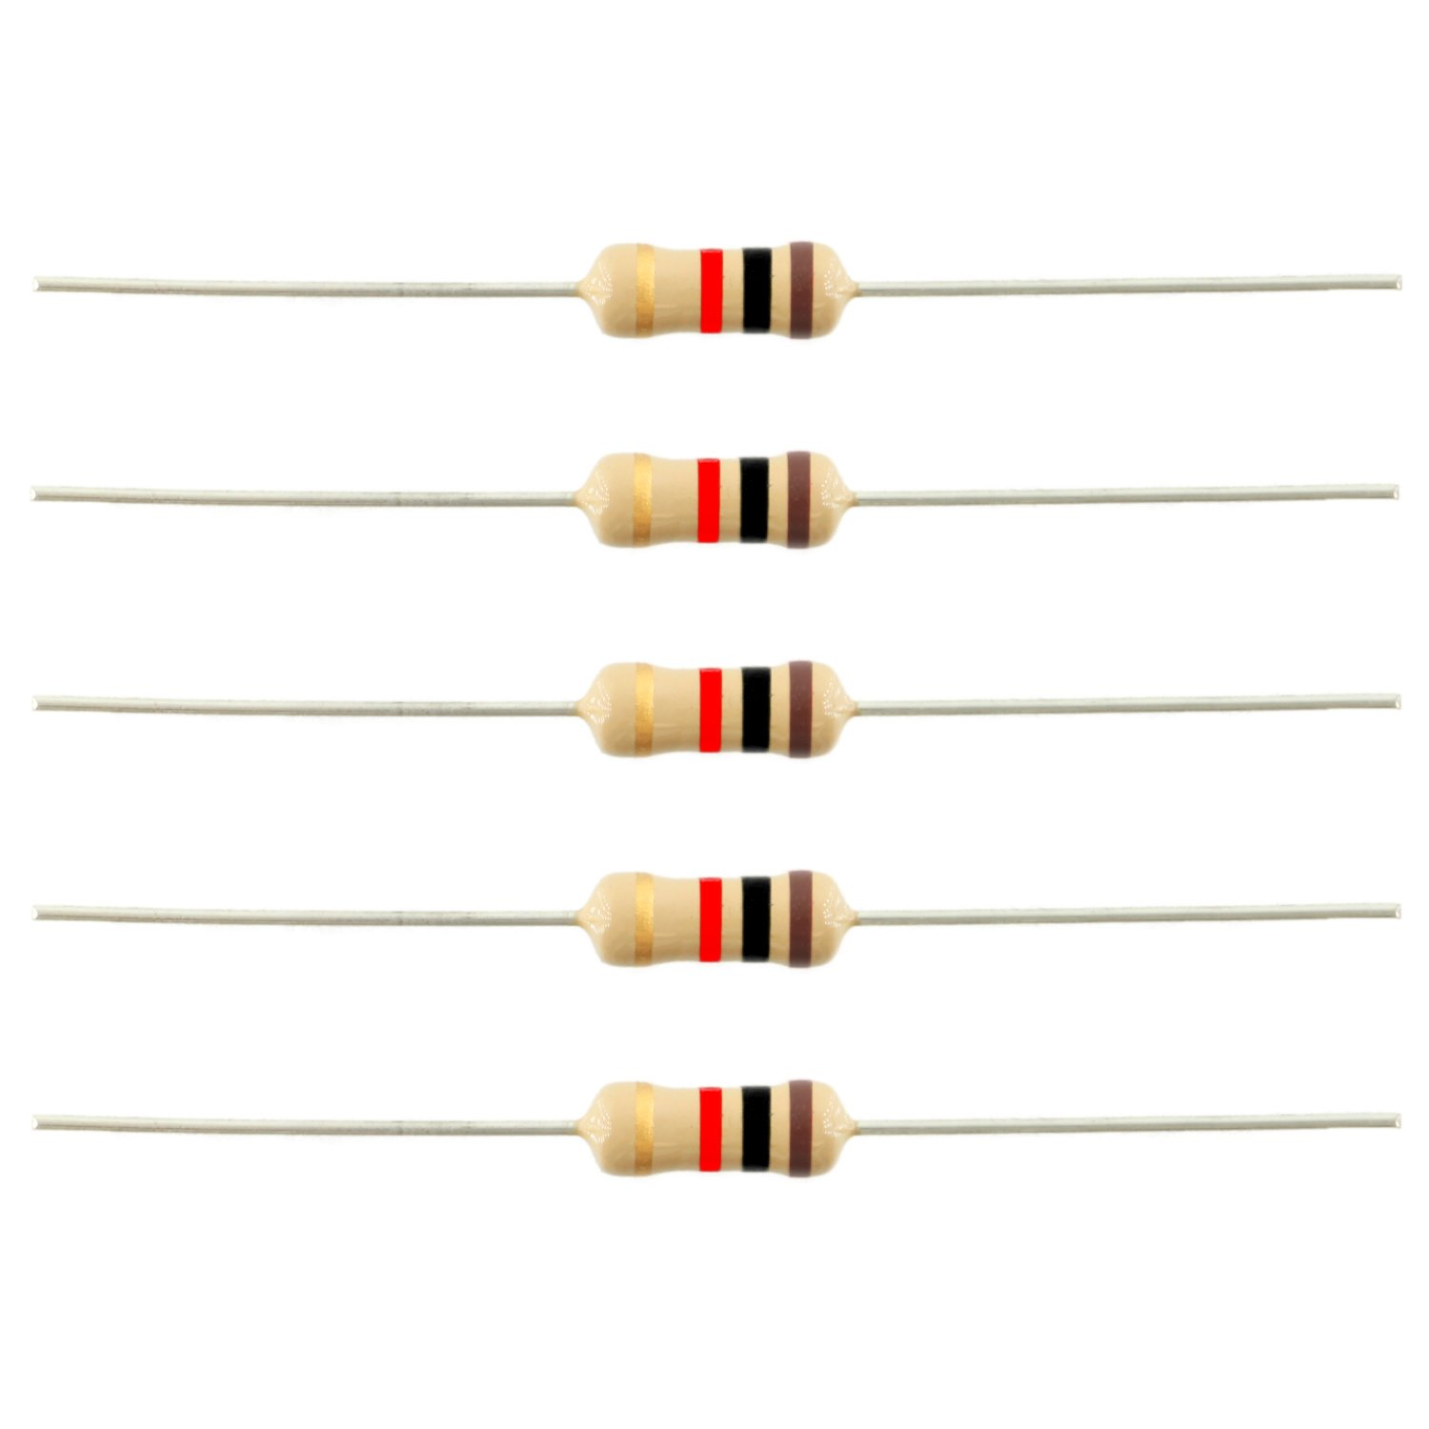
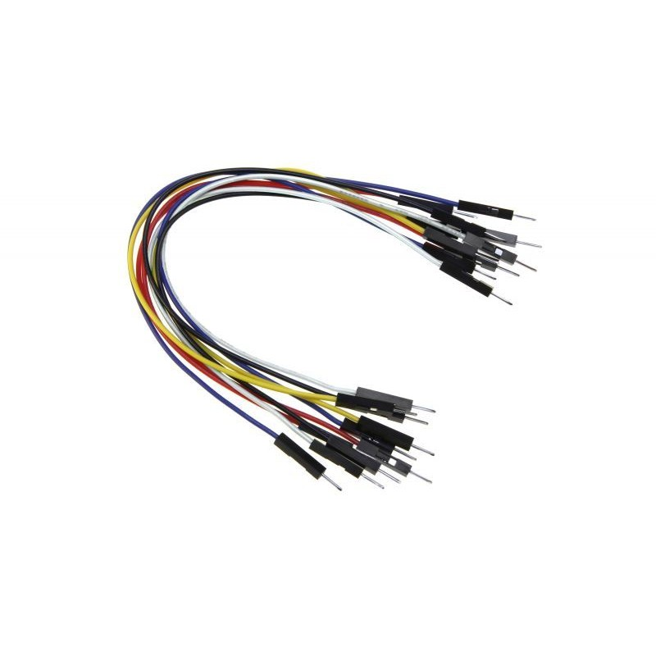
EXTRAS:-
REQUIREMENTS
NODEMCU
ANDROID PHONE WITH ALEXA APP

Slide 3
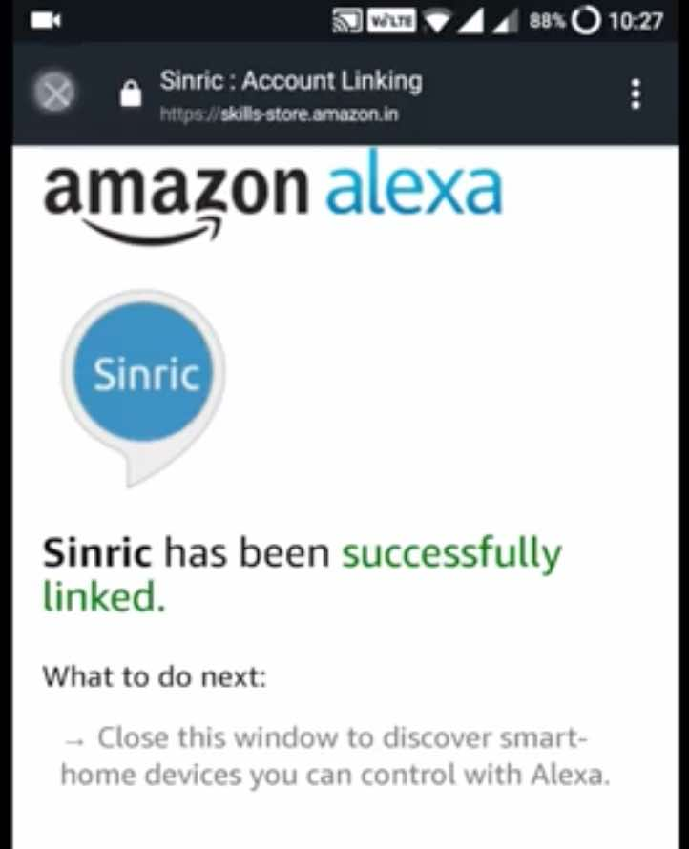

HOW TO CONNECT ALEXA CLOUD WITH ESP8266
1. USING SINRIC OR SINRICPRO SERVICE
2. USING IFTTT AND ADAFRUIT.IO

Slide 4
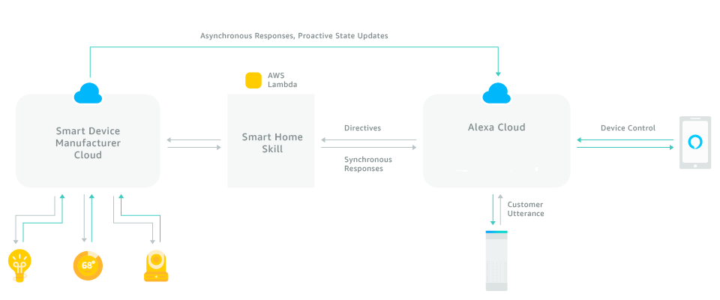
METHOD1: USING SINRIC API

Slide 5




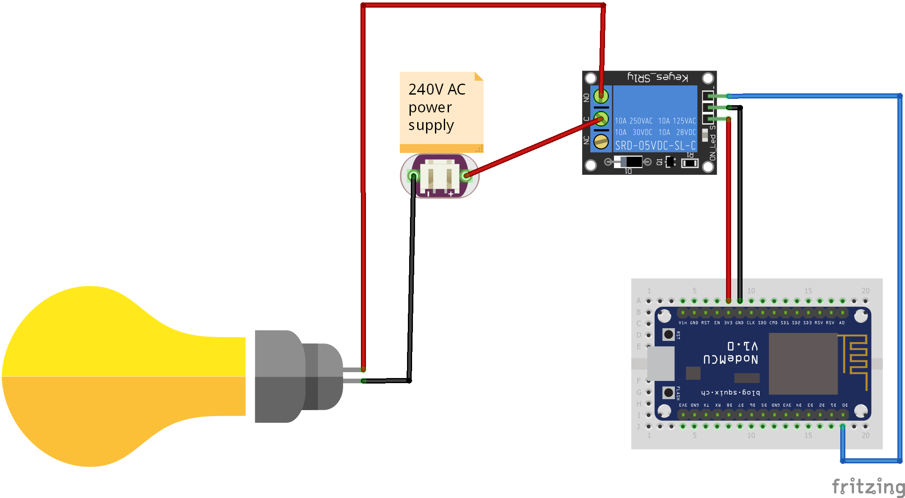
METHOD2: USING IFTTT
PUBLISH
ADAFRUIT.IO
BROKER
SUBSCRIBED

