Slide 1
Impact of type of food consumed on spread of COVID-19
Prateek Pawar

Slide 2
Architectural Decisions Steps
1. Data Source
2. Data Repository
3. Initial Data Exploration
4. Extract, transform, load (ETL)
5. Feature creation
6. Model definition
7. Model training
8. Model evaluation
9. Model deployment

Slide 3
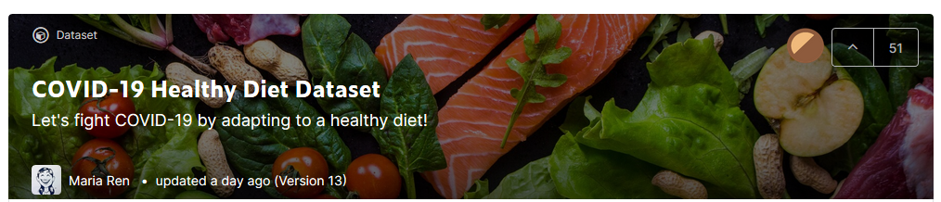
Data Source
Data is sourced from https://www.kaggle.com/mariaren/covid19-healthy-diet-dataset#Food_Supply_kcal_Data.csv.

Slide 4
Data Repository
The IBM Cloud Storage is used for storage of initial database as well as intermediate data generated during processing.
The IBM Cloud storage gives free data storage up to 5 GB and it is very easy to import in the python notebooks using boto3 library.

Slide 5
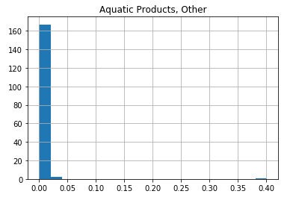
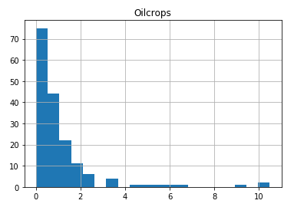
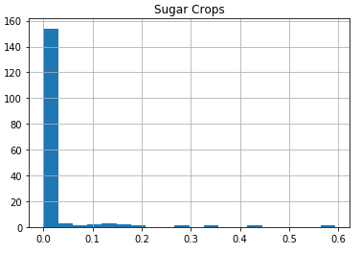
Initial Data Exploration
Helps understand The distribution of data in different features.
Reduces the features providing less information.

Slide 6
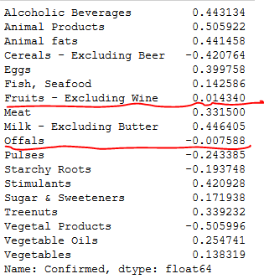

Extract, transform, load (ETL)
Used to decide the output feature and remove irrelevant input features.
Uses tools like correlation analysis to decide which features to drop.

Slide 7
Feature creation
Here most of data is in same format and hence no need for any type conversion of features.
The train and test data-sets are generated using random functionality of numpy module.

Slide 8
Model definition
We use total 4 models for this problem evaluation:
SVR model using all the features.
SVR model with feature reduction with PCA.
Deep learning model with 5 dense hidden layers.
Similar Deep learning model with Dropout and regularization.
We used IBM Watson studio Notebook with skit-learn and keras libraries.

Slide 9
Model Training:
The training set is used to train the models.
The SVR model kernel is selected to be ‘RBD’ as in default.
The deep learning models are trained for 500 epochs to fit the training data until considerable less loss is obtained.

Slide 10




Model evaluation
The model evaluation is done using “Mean-squared-error”.
It is observed that the model2 has best performance.

Slide 11
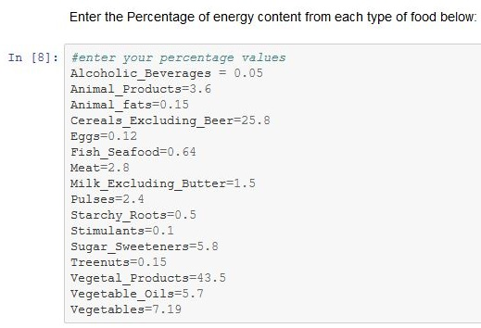
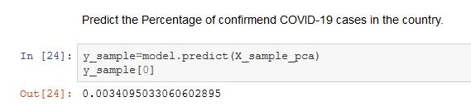
Model deployment
The deployment of model is done with a Notebook where user has to input the percentage of energy from different type of foods and it predicts the percentage of population confirmed to have corona virus.

