Slide 1


Housekeeper Scheduling System
RLL- Project
216 Java SL SG Group-5

Slide 2
Team Members
Employee Id | Name
2492201 | Pooja X
2491188 | Prateek Srivastava
2491498 | Pravinkumar M
2492348 | Prince Kumar
2492276 | Prtiksha Shankar Kashid
2492421 | Puja Ganesh Devkar (Team Lead & Front End)
2492625 | Rahul Adaki
2490232 | Rajeshwari M Shettar (Backend Lead)
2491830 | Ranjithkumar X
2492123 | Rishikesh Rajendra Kulkarni

Slide 3
INDEX
Introduction
Project Scope
Tools & Technologies
ER Diagram
Admin Module
User Module
Execution Flow Chart
Output
Conclusion

Slide 4
INTRODUCTION
Housekeeper Scheduling System has been developed to override the problems of existing manual system.
Every organization ,whether it is big or small has challenges to overcome and managing the task of hostel students such as cleaning room, desk etc.
This website is supported to eliminate and in some cases reduce the hardships faced by hostel students in this existing offline housekeeping system. Moreover this system is designed to carry out the particular operations in a smooth manner.
No formal or prior knowledge is needed for the user to use this system .Thus by this all it provides it is user-friendly.
Housekeeper Scheduling System as described above can lead to error free, secure, reliable and fast management system. It can assist the user to concentrate on their other activities rather to concentrate on the record keeping.
Thus it will help organization in better utilization of resources.

Slide 5
PROJECT SCOPE
Housekeeper Scheduling System is an application which hostel students can use to get their rooms cleaned on time.
The current management system found it difficult to schedule cleaning services as students have varying class schedules which resulted in improper utilization of hostel room cleaning services.
Stated simply, the better organized our work area is the easier it is to complete the task. Minimizing work stoppages and making a safer area for those involved.

Slide 6




TECHNOLOGIES
Front end: Angular
Server Side: Spring Boot
Back-end: Hibernate, MY SQL Database
Server: Apache Tomcat 8.5

Slide 7


PORTAL OPERATION
HOUSEKEEPR
ADMIN
STUDENT

Slide 8

ADMIN
Login/Create Account
View/Update/Delete (Request)
Receiving Cleaning Request
Housekeeper
Request Room Service
Student
Update/ Edit Profile

Slide 9
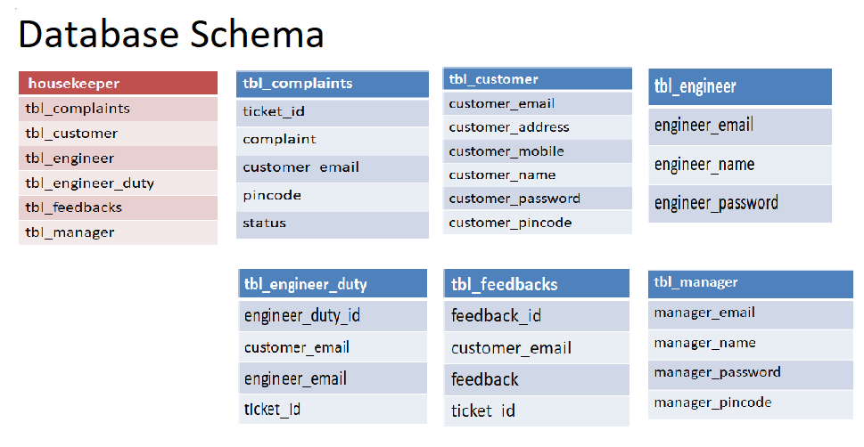
DATABASE SCHEMA

Slide 10
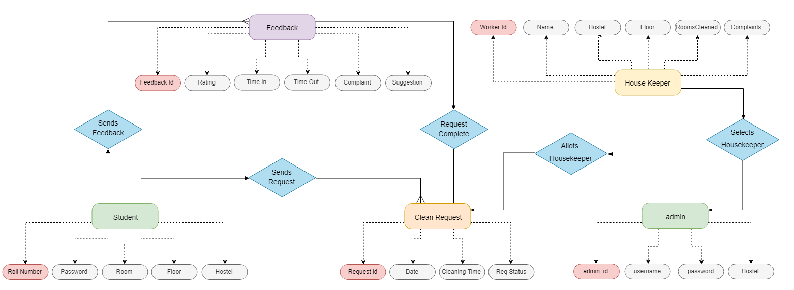
ENTITY-RELATIONSHIP Diagram

Slide 11
ADMIN MODULE
Login to portal
Create Admin Account
Accepting Request Details
Delete the Request
Student Details
Logout

Slide 12
HOUSEKEEPER MODULE
Register to the application.
Update profile details.
Sign into the application to maintain the record of
activities assigned by Admin.
Gets request for cleaning service.
Providing a seamless housekeeping scheduling
process to student.

Slide 13
STUDENT MODULE
Register to the application.
Update profile details.
Sign into the application to gets the record of
activities of housekeepers.
Request admin for room cleaning service.
Experience a seamless housekeeping scheduling
process provided by Housekeeper.

Slide 14
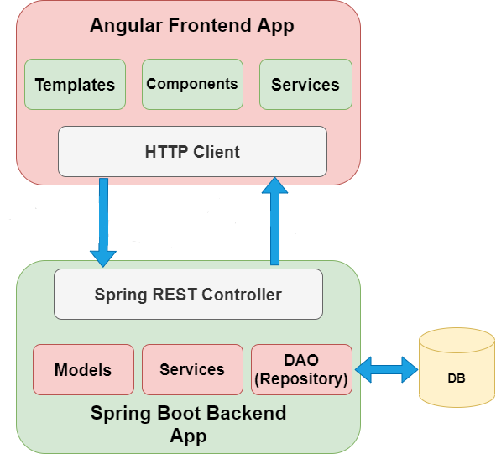
Execution Flow Chart

Slide 15
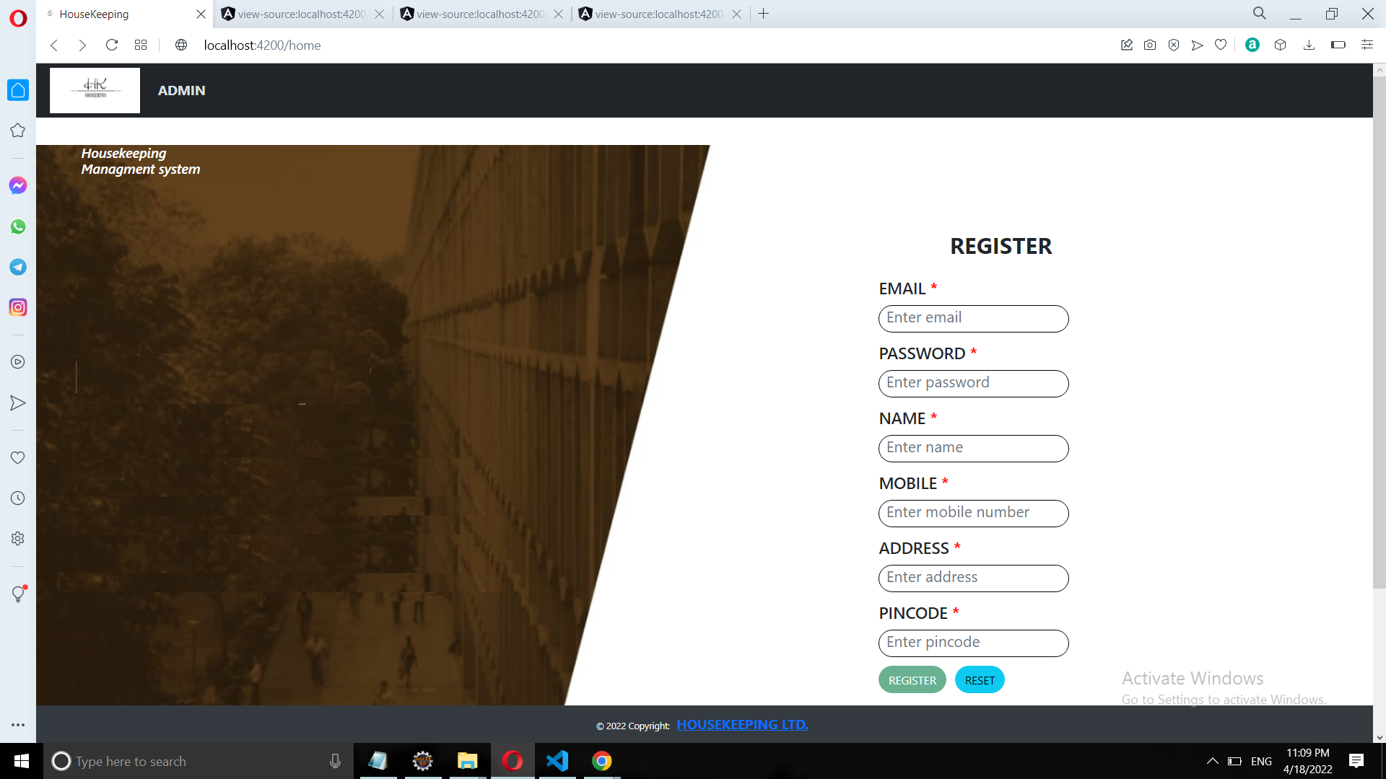
OUTPUTS SCREENS

Slide 16
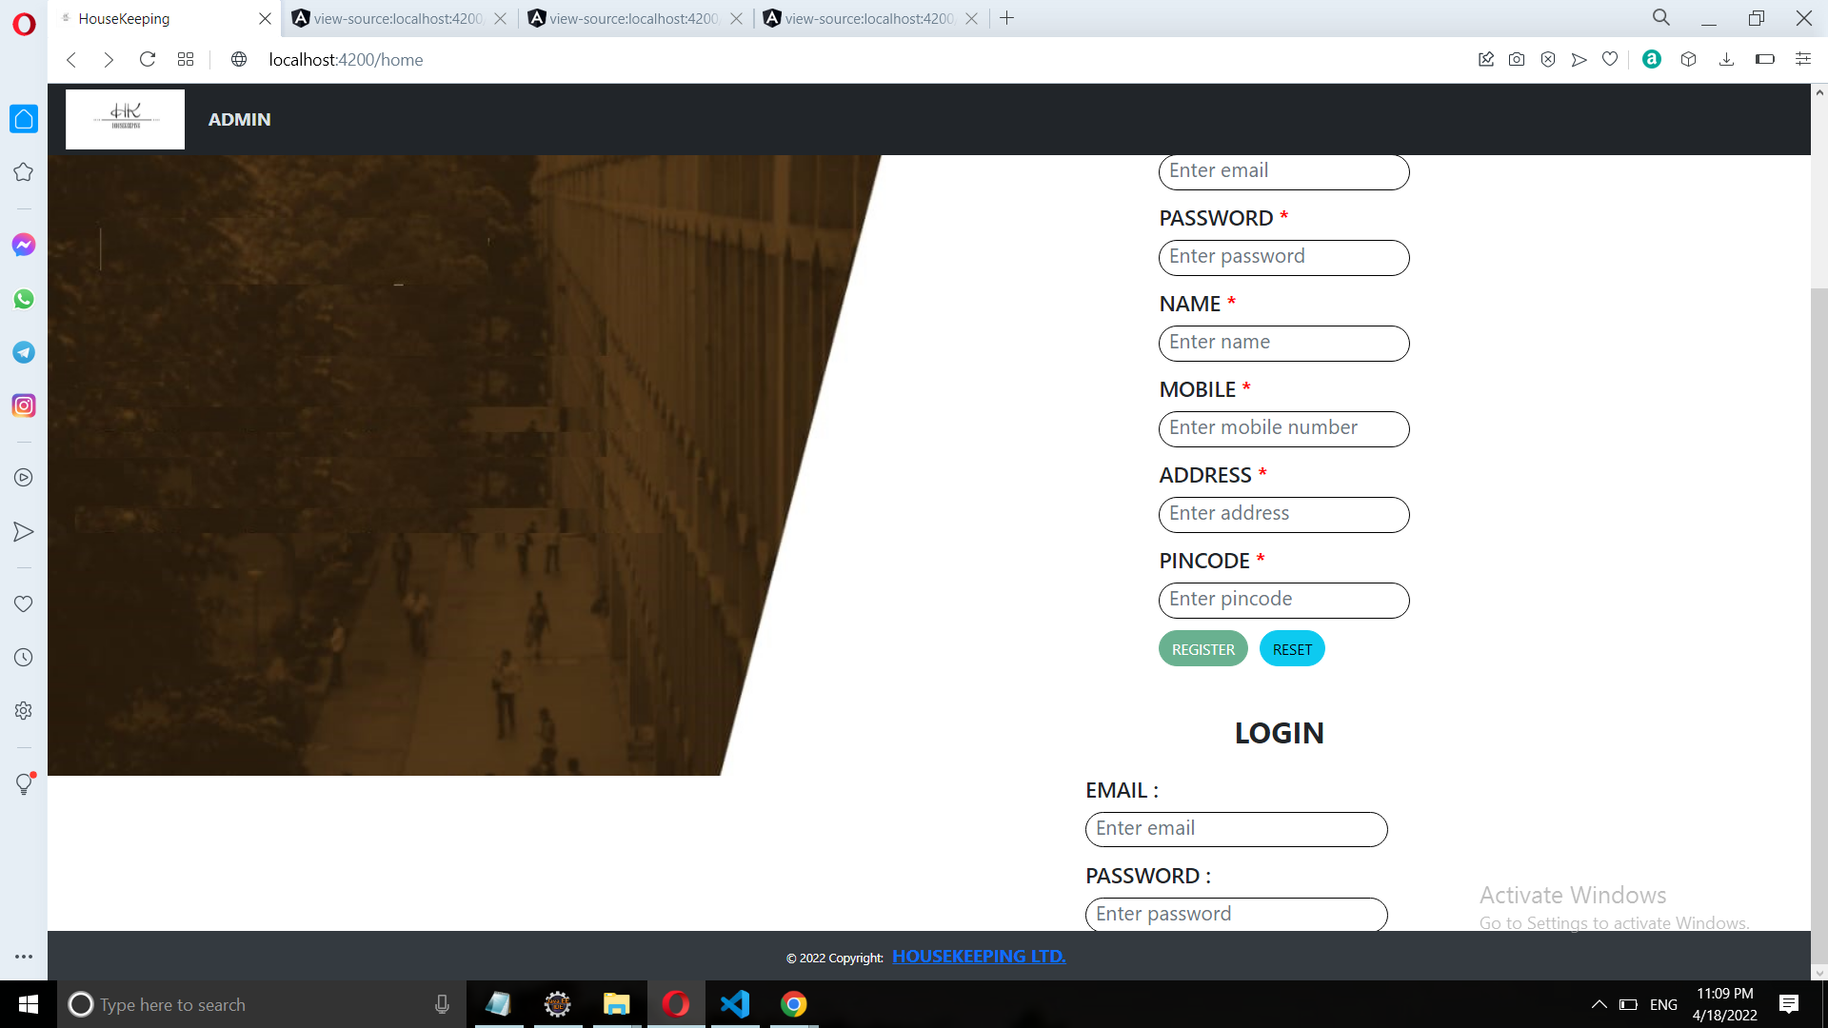

Slide 17
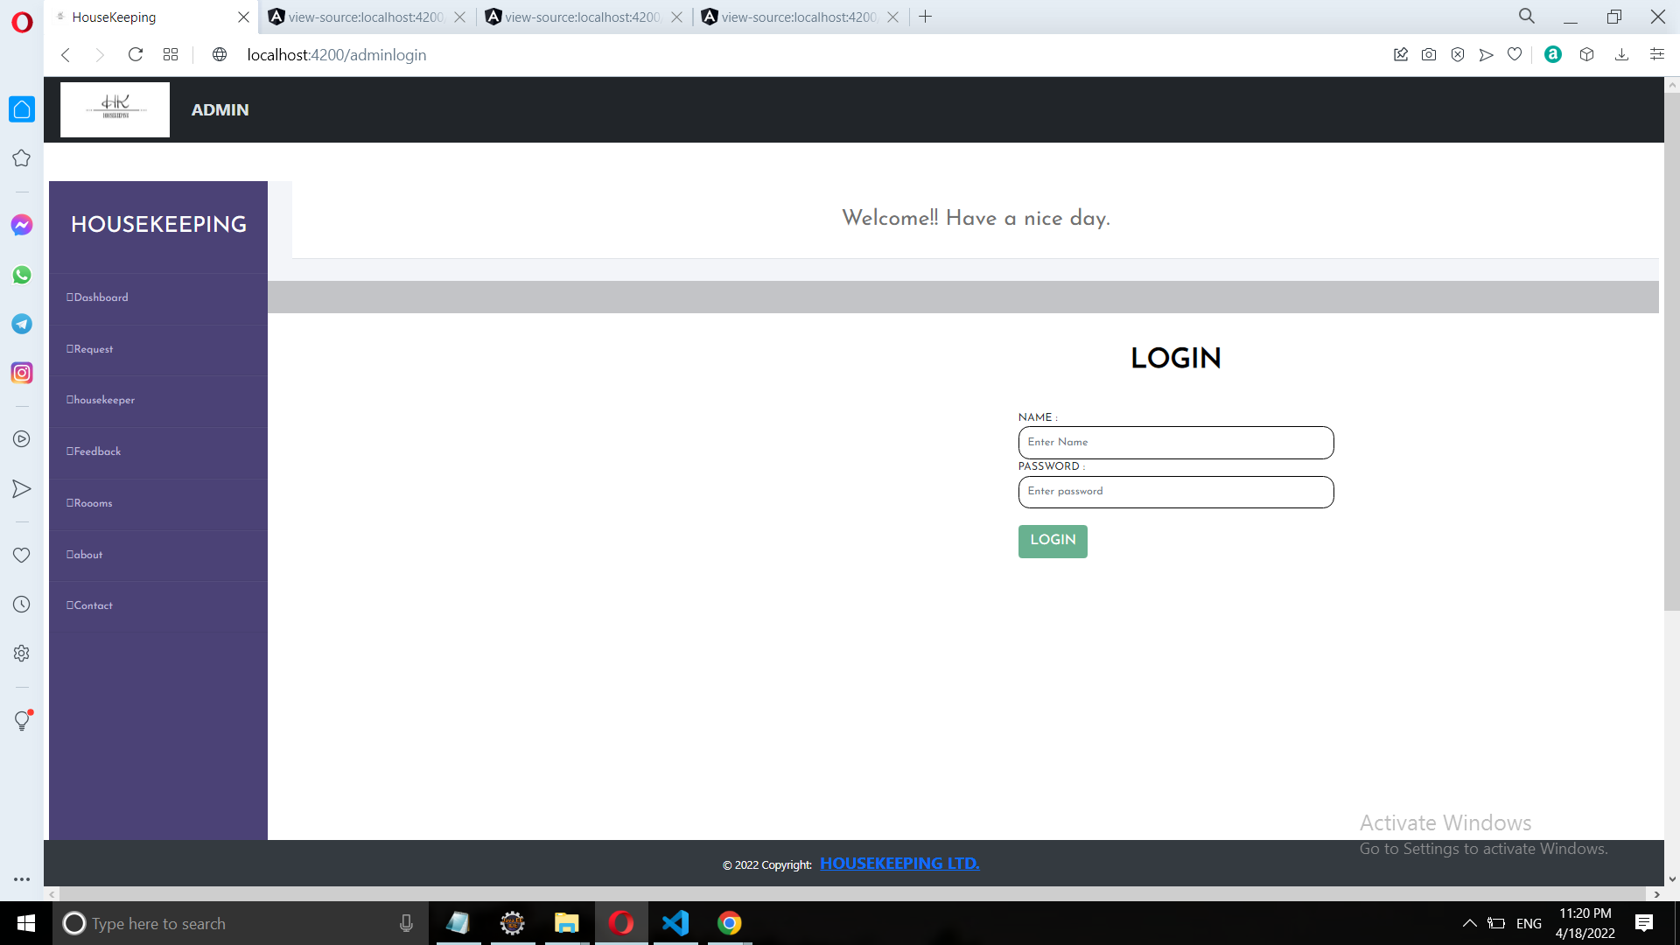

Slide 18
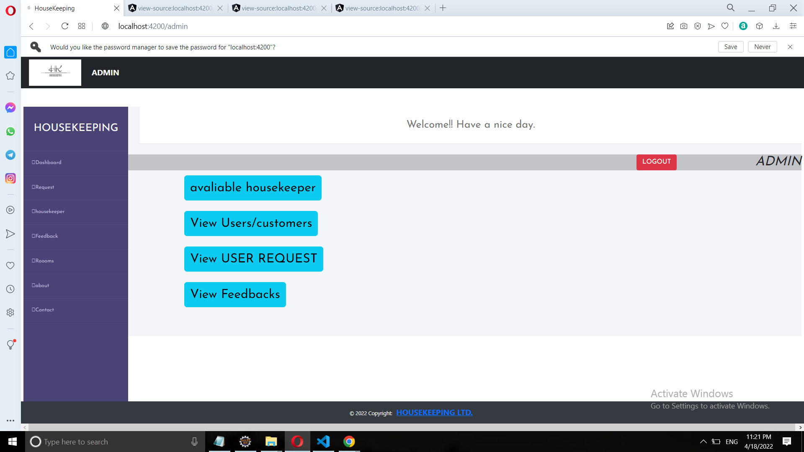

Slide 19
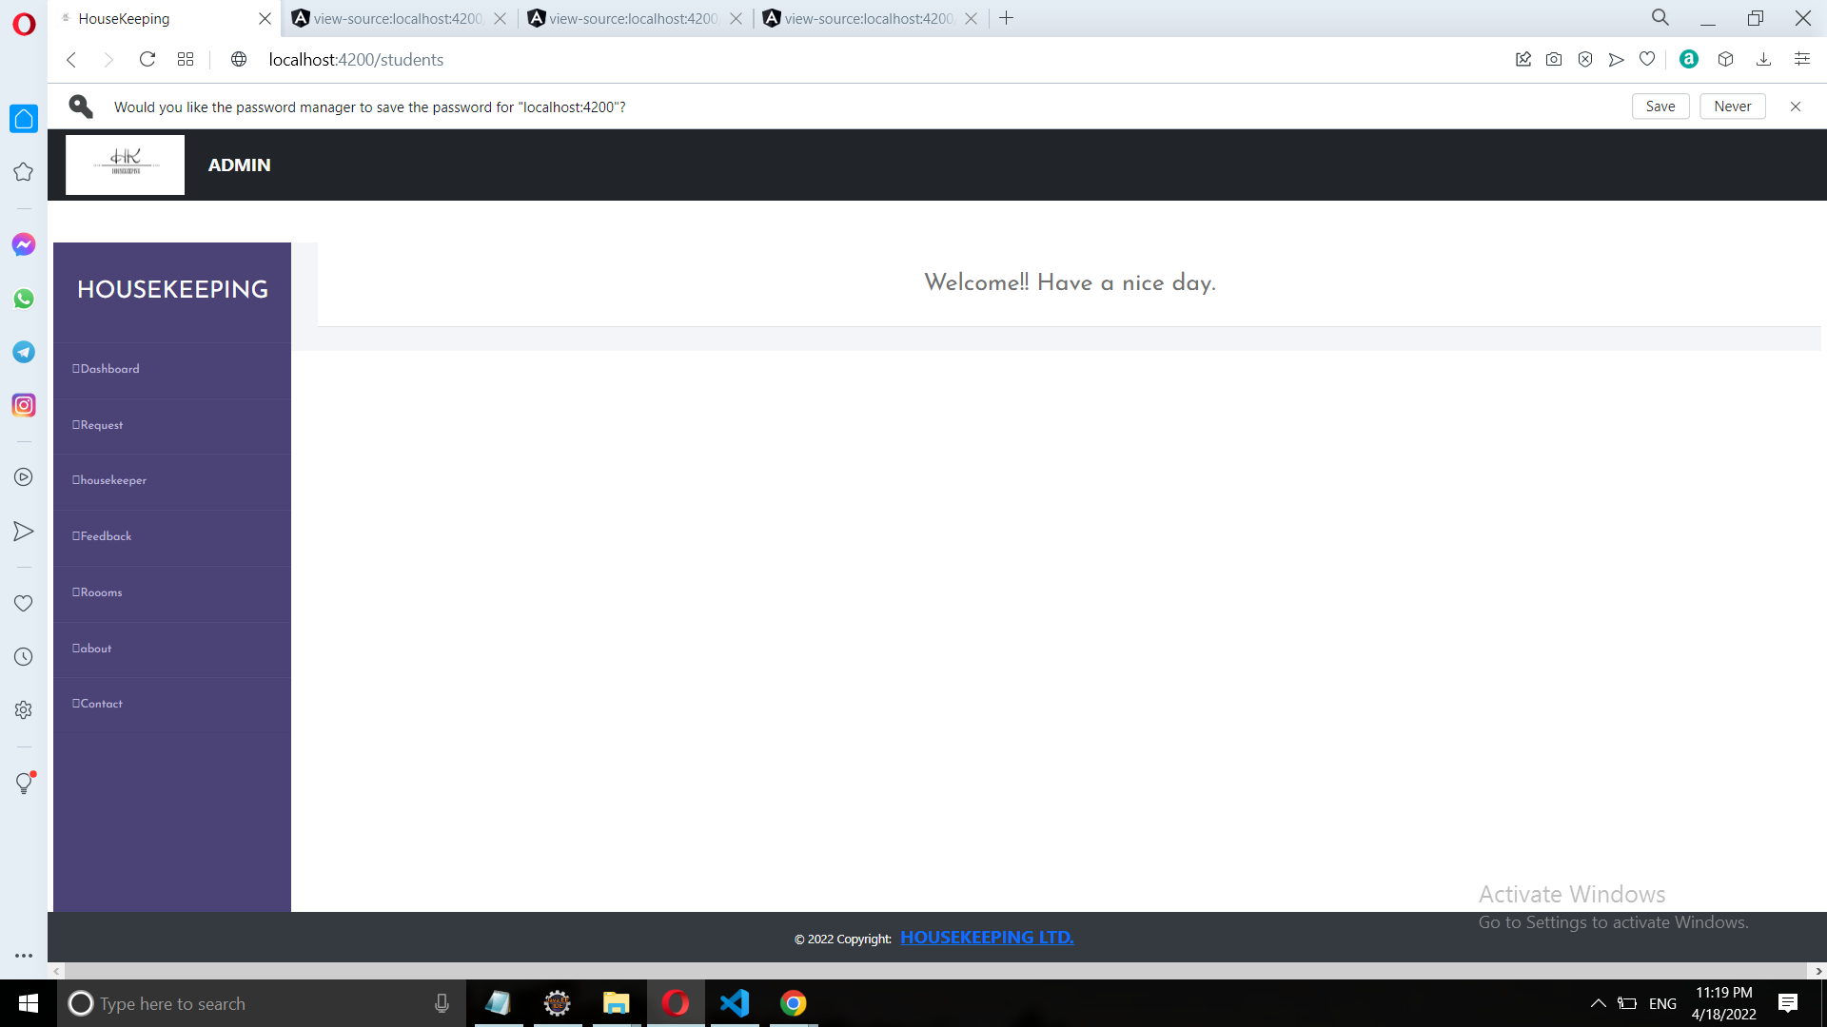

Slide 20
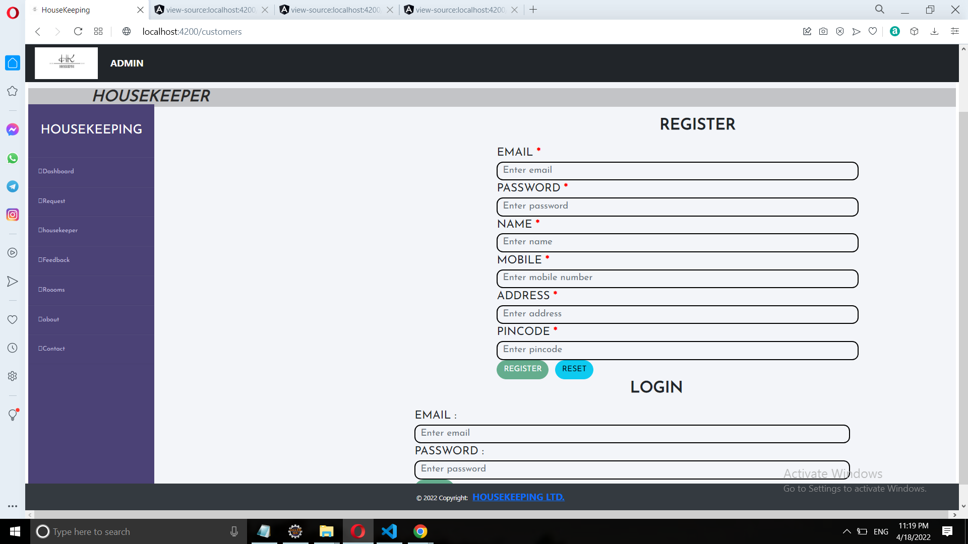

Slide 21
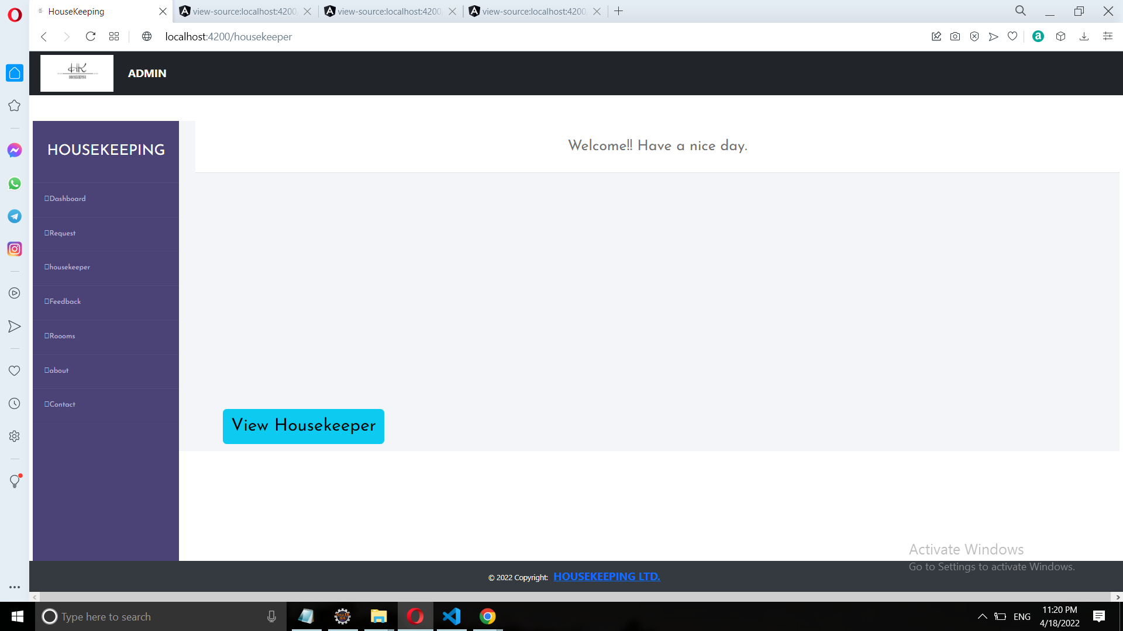

Slide 22
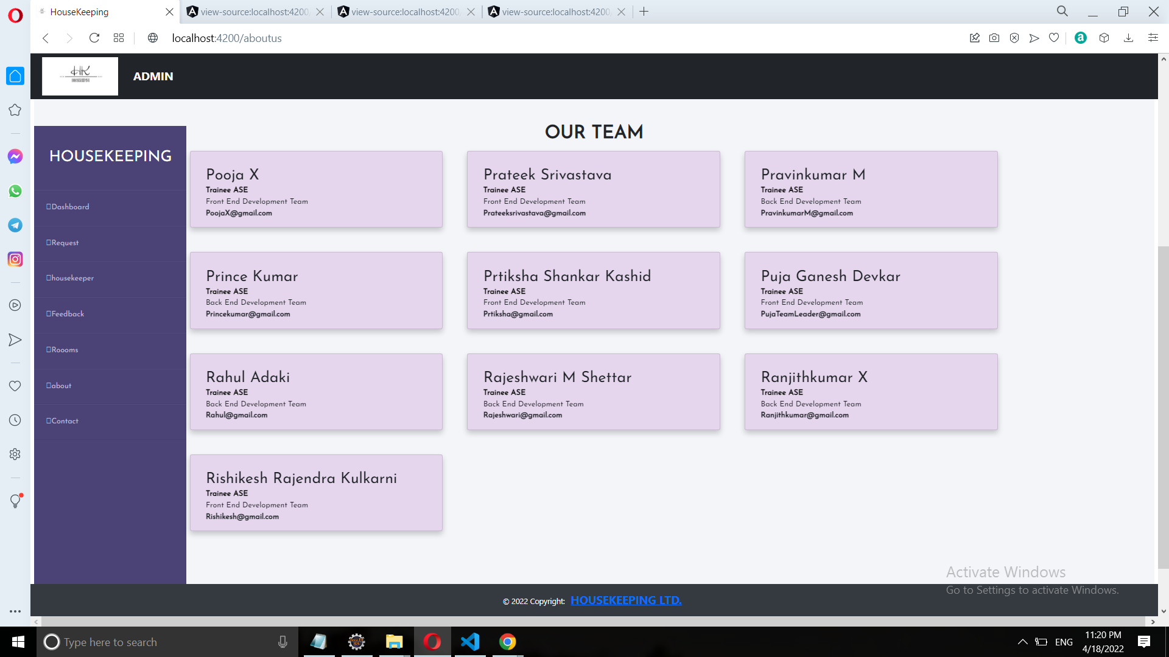

Slide 23
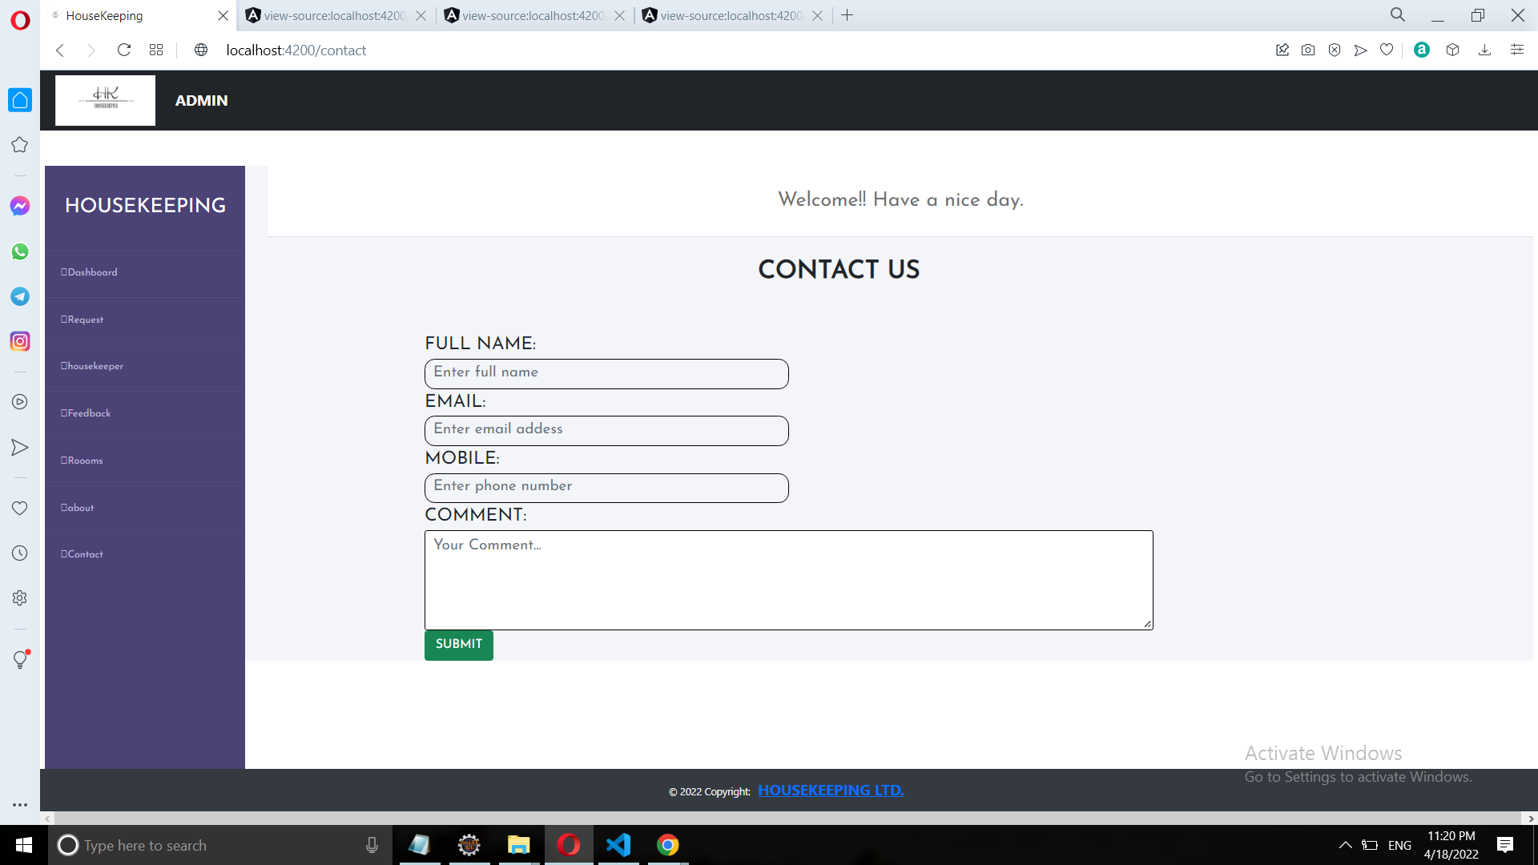

Slide 24
BENEFITS
To save your time efficiency.
Easy to gather information about Housekeeping services and
as well as student information record.
To provide easy and faster appointment of service information.
To provide user friendly environment.

Slide 25
FUTURE SCOPE
More features can be added like allowing students to
comment on individual housekeepers.
Provide a list of good housekeepers and searching facilities based
on various factors like rating.
Additional Services should be introduced during exceptional
conditions like pandemic or in case of lockdown.

Slide 26
CONCLUSION
This project is designed to meet the requirement of a Housekeeper
Scheduling System to override the problems of existing manual
system.
We have designed the project to provide user with easy retrieval
of data necessary as much as possible.
This web system has been developed with much care and free of
errors and at the same time it is efficient and less time consuming.
With the software and technological devices, exceptions are
reduced and even devices, exceptions prefer easy, quick and safe
way for every part of their student life.

Slide 27
Thank You!

