Slide 1
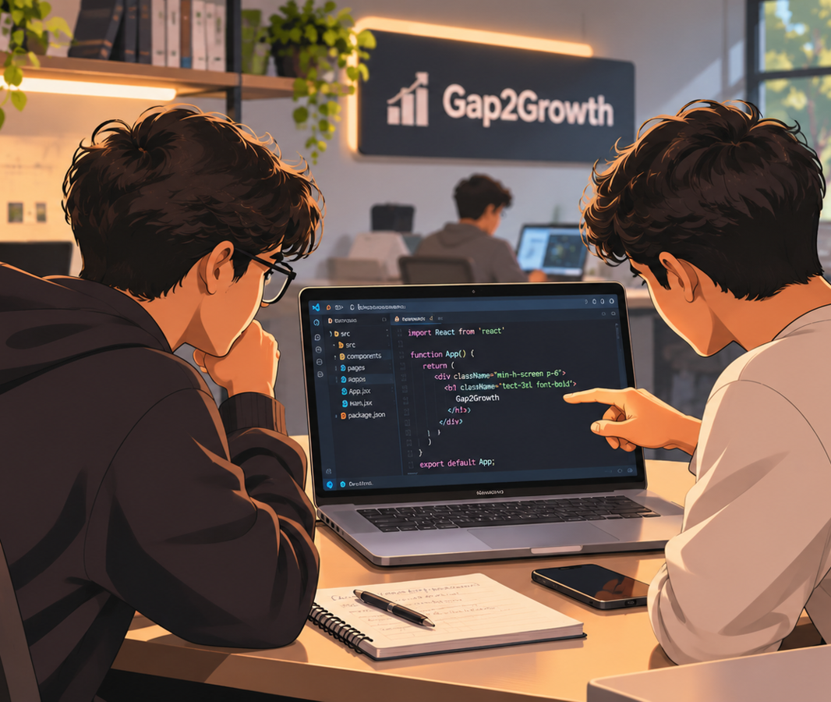
01 / 10
CAREER GAP DIAGNOSTICS
Gap2Growth
Bridging the Gap Between Your Skills and Your Dream Career.
An AI-powered career-readiness platform that identifies the gap between a candidate's existing skills and target job requirements, then provides a structured roadmap to bridge that gap.
Notes:
Introduce Gap2Growth: an AI-powered career-readiness platform that finds the gap between a candidate's skills and target job requirements and provides a structured roadmap to close it.

Slide 2








Closing the Resume-to-Job Competency Gap
02 / 10
PROBLEM STATEMENT
01 Resume-JD Mismatch
TARGET AUDIENCE
Traditional ATS tools focus on keyword matching rather than measuring actual skill proficiency and semantic alignment with job requirements.
College students
Fresh graduates
Job seekers
02 Static Career Guidance
Placement preparation candidates
Generic career advice does not provide personalized skill roadmaps to convert missing requirements into practical competencies.
PAIN POINTS
Uncertainty about missing skills
03 Unprepared Candidates
Lack of personalized preparation
Students often lack targeted practice assessments before technical interviews, resulting in poor performance despite having domain knowledge.
Difficulty demonstrating competency
Inadequate interview preparation
Notes:
Three core problems: keyword-only ATS, static career guidance, and unprepared candidates. Target audience: college students, fresh graduates, job seekers, placement candidates.

Slide 3







The Growing Need for Intelligent Career Readiness
03 / 10
MARKET OPPORTUNITY
TARGET MARKET
College students
Fresh graduates
Job seekers
Universities & placement departments
Corporate recruitment teams
EXISTING ALTERNATIVES
THE MARKET GAP, CLOSED
OPPORTUNITY
Each covers only an isolated step
Gap2Growth: one integrated platform
Rising need for personalized career guidance
ATS resume checkers
Resume analysis
Online learning platforms
Skill assessment
Demand for measurable skill development
Mock interview platforms
Personalized roadmaps
Institutions can track cohort-wide placement readiness
Job discovery portals
Practice
Recruiters can find competency-matched candidates
Traditional placement tools
Job matching
Notes:
Qualitative opportunity analysis only - no market statistics are claimed. Existing tools each address one isolated step; Gap2Growth integrates resume analysis, skill assessment, personalized roadmaps, practice and job matching.

Slide 4
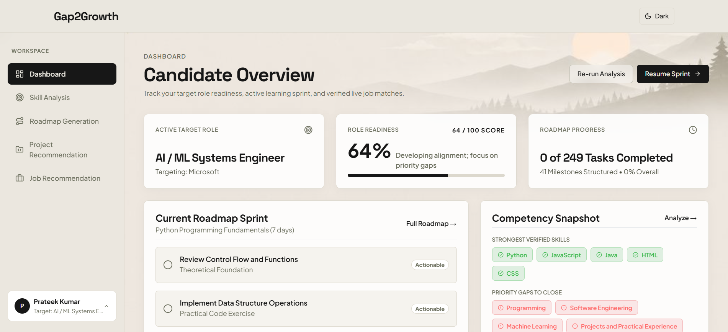

Introducing Gap2Growth
04 / 10
PROPOSED SOLUTION
1
Intelligent Resume Analysis
6
Manim-Powered Visual Learning
2
Semantic Skill Gap Detection
7
Secure Anti-Cheat Examination
3
Personalized Learning Roadmaps
8
Job Discovery & Skill Matching
AI-Based Project Recommendations
UNIQUE SELLING PROPOSITION
Certificates & Achievement Tracking
4
“Gap2Growth does not just identify missing skills; it provides a structured pathway to develop, practice, and demonstrate those skills.”
9
5
Interactive Mock Tests
10
GitHub Assistant & Repo Analysis
Resume
Skill Gap
Learning Roadmap
Practice
Assessment
Career Readiness
Notes:
Ten core features in one platform. The journey: Resume -> Skill Gap -> Learning Roadmap -> Practice -> Assessment -> Career Readiness.

Slide 5
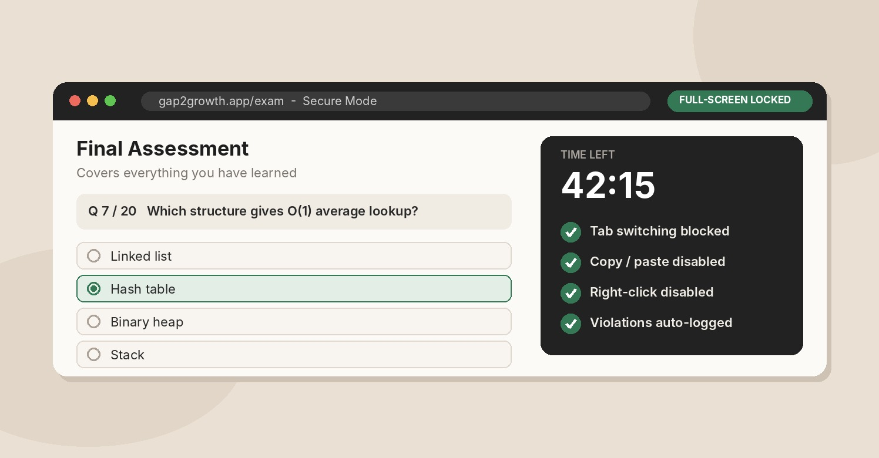


Inside the Platform
05 / 10
PRODUCT WALKTHROUGH
CANDIDATE DASHBOARD
SECURE FINAL EXAM
Role readiness, learning roadmap sprint and competency snapshot in one view.
Locked assessment with Safe Exam Browser, fullscreen, tab-switch and copy-paste protection.
Personalized Roadmaps
Project Recommendations
Job Discovery
Milestone-based learning plan built from your skill gaps.
AI-matched hands-on projects to prove missing skills.
Matches your skill profile to roles with match percentages.
Notes:
Product walkthrough using prototype screenshots: candidate dashboard and secure final exam (Safe Exam Browser, fullscreen, tab-switch and copy-paste protection), plus personalized roadmaps, project recommendations and job discovery.

Slide 6














From Resume to a Personalized Growth Plan
06 / 10
WORKING METHODOLOGY
1
2
3
4
5
Landing Page
Authentication
Initial Assessment
Resume Upload
Resume Parsing
User visits Gap2Growth
Register and log in
Complete the initial quiz
Candidate uploads resume
Extract skills & competencies
6
7
8
9
10
Skill Matching
Gap Analysis
Roadmap Generation
Practice & Learning
Final Assessment
Compare with target job needs
Find missing & weak skills
Create personalized plan
Projects, visual lessons, mock tests
Secure exams & achievements
CONNECTED DASHBOARD MODULES
Project Recommendations
Mock Tests
Certificates
GitHub Assistant
Anti-Cheat Exam
Job Discovery
Notes:
Walk the ten-step journey from landing page to final secure assessment. The dashboard modules are available after resume parsing and analysis.

Slide 7













Technologies Powering Gap2Growth
07 / 10
TECHNOLOGY STACK & IMPLEMENTATION
Frontend
Backend & Programming
Database & Storage
React 18+
Vite
Node.js
Python 3
Supabase
DB & Storage
Tailwind CSS
Next.js 15+
React, Vite and Tailwind build the responsive dashboard; Next.js 15+ powers the exam UI.
Node.js and Python 3 handle application processing and supporting logic.
Supabase provides the database and encrypted storage for user data and resumes.
AI & Intelligence
Learning & Practice
Security & Assessment
NLP semantics
Resume parsing
Mock tests
Roadmaps
Safe Exam Browser
Fullscreen API
Skill matching
Gap detection
Project ideas
Certificates
Tab/focus detection
Copy-paste block
Matches resume skills to job needs beyond keywords; drives recommendations.
Delivers practice assessments, personalized roadmaps and certificate tracking.
Safe Exam Browser plus fullscreen, tab-switch and copy-paste restrictions.
Notes:
Technologies are grouped by function with a one-line reason for each. Only technologies from the original project are shown.

Slide 8





Diversified Business Model
08 / 10
BUSINESS MODEL
Diversified engine driving consumer utility and enterprise business value channels.
PROPOSED MODEL
PILLAR 1
PILLAR 2
PILLAR 3
B2C Freemium Model
B2B Institutional SaaS
B2B Corporate Recruitment
TARGET CUSTOMERS
TARGET CUSTOMERS
TARGET CUSTOMERS
Individual students
Universities & college placement cells
Corporate recruiters & hiring organizations
Basic analytics open to all students
Annual packages for university placement departments
Pay-per-hire revenue model
Free access reveals current skill gaps
Evaluate cohort-wide student progress
Access to pre-vetted candidate pools
Premium unlocks advanced Manim-generated visual media
Cohort-wide progress maps
Advanced semantic lookup filters
Premium unlocks formal examinations
Monitor development and placement readiness
Identify candidates by competencies and job requirements
REVENUE MECHANISM
REVENUE MECHANISM
REVENUE MECHANISM
Freemium → Premium Subscription
Annual Institutional Subscription
Pay-Per-Hire
Notes:
Three proposed monetization pillars: B2C freemium to premium subscription, institutional B2B annual subscription, and corporate B2B pay-per-hire. This is a proposed model - no pricing, projections or revenue are claimed.

Slide 9

Why Gap2Growth Stands Apart
09 / 10
COMPETITIVE ADVANTAGE · IMPACT · FUTURE SCOPE
A
Competitive Advantage
B
Expected Impact
C
Future Scope
AVAILABLE NOW
EXPECTED OUTCOMES
PROPOSED – NOT YET BUILT
Integrates resume analysis, skill gaps, roadmaps, assessments and job discovery
Better career readiness
More job role integrations
Converts identified skill gaps into actionable learning plans
More focused preparation
Expanded AI-based recommendations
Combines theoretical learning with practical assessments
Improved visibility into skill deficiencies
More assessment domains
Uses Manim-generated videos for visual explanations
Better understanding of job requirements
Institutional deployment
Provides secure final assessments
Stronger evidence of competencies
Enhanced analytics and career tracking
Connects students, institutions and recruiters in one platform
More structured placement preparation
Improved candidate-recruiter matching
Notes:
A and B describe what the platform does and the impact expected. C is proposed future scope only - these are not completed features.

Slide 10



10 / 10
CONCLUSION & Q&A
THANK YOU
Bridging the Gap Between Skills and Opportunities
“Empowering students with intelligent career guidance by transforming skill gaps into actionable growth opportunities.”
Intelligent resume analysis
Personalized roadmaps
AI-based project recommendations
Mock tests & secure assessments
Visual learning
Career & job matching
Open for Questions & Answers
Notes:
Recap the six capabilities and invite questions.

