Slide 1

IAS CHALLENGE 3.0
TEAM BLUEEAGLE
Tableau Public Link: https://goo.gl/WzHBwv
Team Members:
Anurag Laddha
Prateek Rawat
Rahul Dhar
Takesh Sahu

Slide 2
ASSUMPTIONS
We have created custom categories as below for visualization simplification:
AGE
Young ( 0 – 19 Years )
Adult ( 20 - 39 Years )
Seniors ( 40 – 69 Years)
Aged ( 70+ Years)
EDUCATION
School ( 9th, 10th, 11th, 12th, HighSchool)
College ( Associate Degree, Bachelor, Some Collge, Professional Degree)
Advanced Degree ( Masters, Doctoral )
SOCIAL STATUS
Very Low Income ( 0 – 10k )
Low Income ( 10 – 50k )
Medium Income ( 50 – 100k )
High Income ( 100k+ )
ACTIVITIES
Socializing and Relaxing, Television
Playing with Children, Caring for children
House Work, Food and Drink Preparation

Slide 3






SUMMARY ( Year – 2012)
Maximum Time Spent Activities
Category distribution in %
Normal Work (6 - 8 Hours) : 7%
Over Time (8 - 12) : 37%
Under Work (Below 6 Hours) : 51%
Workaholics(12+ Hours) : 5%
Sleep Socializing Work
& Relaxing
Minimum Time Spent Activities
Normal Sleep (6 - 8 Hours) : 25%
Under Sleep (Below 6 Hours) : 7%
Over Sleep (8 - 12 Hours) : 59%
Excess Sleep (12+ Hours) : 9%
Running Job Search Golfing

Slide 4

SUMMARY (Year – 2012)
42% of time spent on Socializing comprised of TV Watching
Females spend 65% more time on childcare than Males
Only 2% of people are Spending time on Sports
Highest Salary : $150000
95% of them have attended College or completed Advanced Degree
Men outnumbered Women for maximum salary by 240%

Slide 5
Summary Based on Age ( Year – 2012 )

Slide 6
Summary Based on Age ( Year – 2012 )

Slide 7
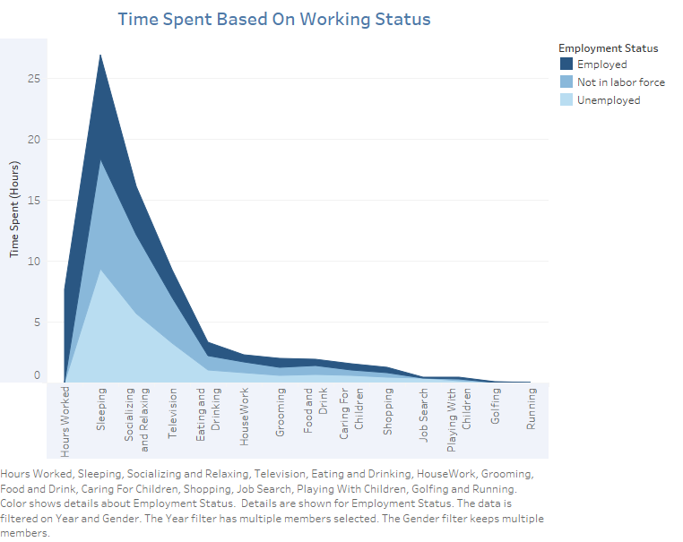
TIME SPENT BASED ON WORKING STATUS
Major activities across all work groups is sleeping with Unemployed getting maximum sleep followed by Not in labor force and then Employed
Not in labor force category spends higher time on socializing followed by Unemployed group. Employed spend the least.
Rest of the activities take up to around one hour or less across all the work groups
Promotion from Adult to Seniors Reduces Work Load by 13.6 % but Increases Wage by 10%

Slide 8
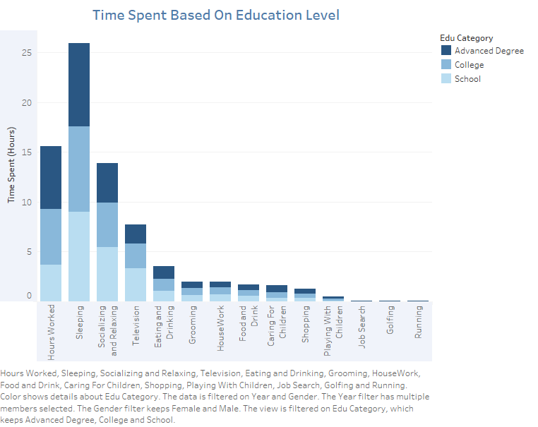
TIME SPENT BASED ON EDUCATION CATEGORY
Sleeping takes major time across all education levels. Sleeping time decreases as education level increases
People with higher education level spend considerable time on working
In general, with increase in education level, time spent on socializing and relaxing decreases

Slide 9
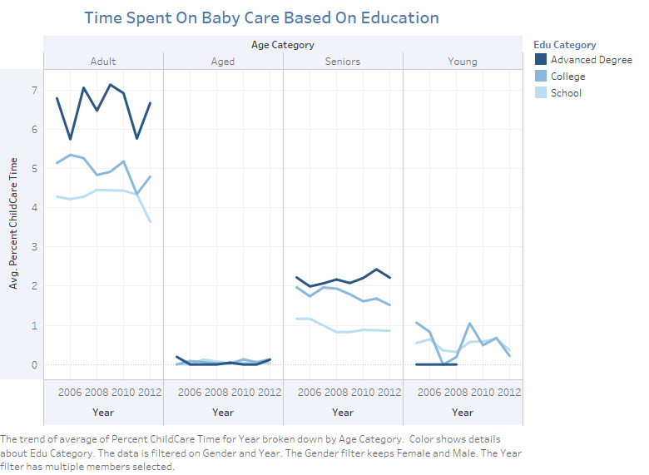
TIME SPENT ON BABYCARE
Level of education is directly proportional to time spend on baby care i.e. higher level of education reflects more time spent on baby care

Slide 10
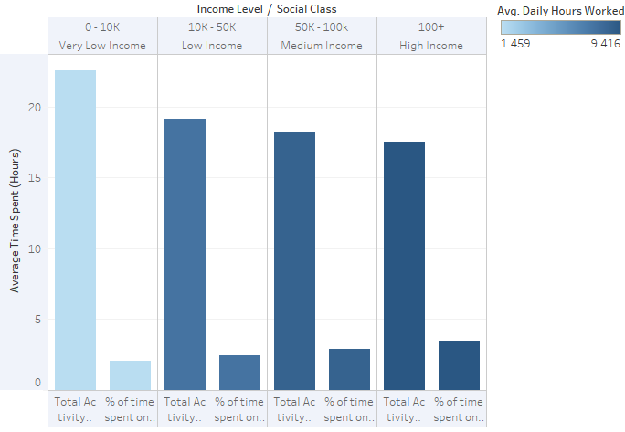
TIME SPENT BASED ON INCOME AND WORKING HOURS
Higher working hours and Income is directly related to time spend on baby care i.e. people who spend more time working and earn more spend a considerable amount of time on baby care

Slide 11
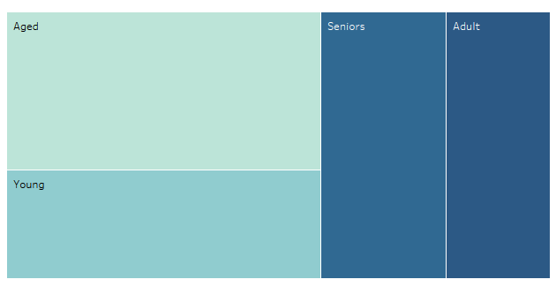
Time Spent On Leisure Based On Working Hours
Leisure Time : Adult > Seniors > Young > Aged
Aged Spend 1.7 times more on Leisure Activities than Adult
Seniors spend 21% more time than Adults on Leisure Activities compared to Hours Worked

Slide 12

RECESSION
The great recession was in 2008 and we can observe that average weekly working hours started to decrease from this year and continued to drop up to 2011. This drop can be attributed to the fact that average number of employed people also decreased from 2008-2011 while average unemployed and not in labor force increased. Recovery from Great depression started from 2012 with decrease in average number of unemployed leading to increase in average weekly hours worked.
Immediate surge in time spent on job search activity both for employed and unemployed is observed for the year 2008. But this trend does not persist for subsequent years

Slide 13
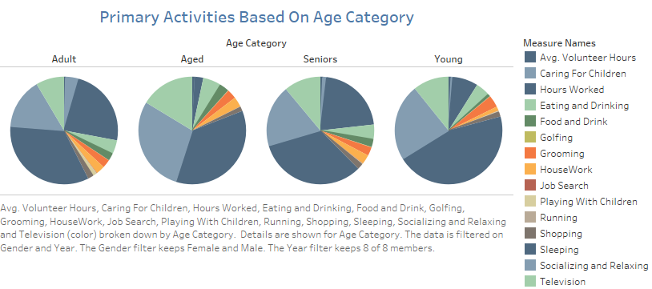
Primary Activities Based on Age
Sleeping is primary activity across all age groups.
Followed by
Working for Adult and Seniors
Socializing and Relaxing for Aged and Young

Slide 14
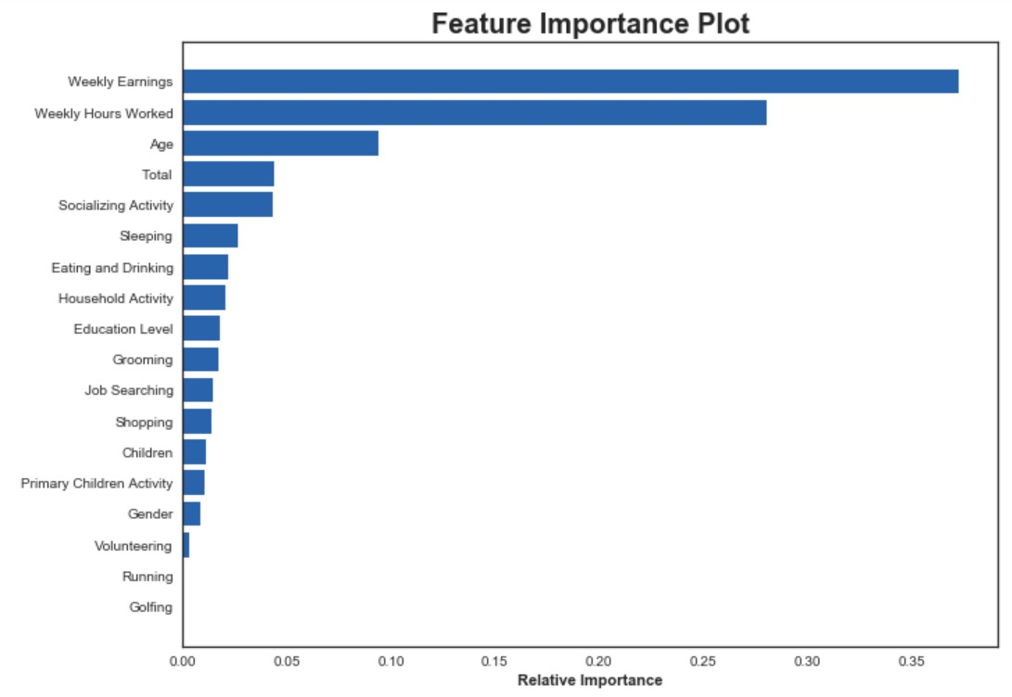
Feature Importance Plot
Prominent Features for classification
using Random Forest:
Weekly Earnings
Weekly Hours Worked
Age
Total
Social Activity
Sleeping

Slide 15
THANK YOU

