Slide 1
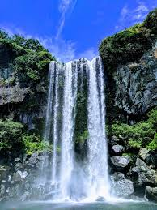
KARNATAKA
DAMS

Slide 2
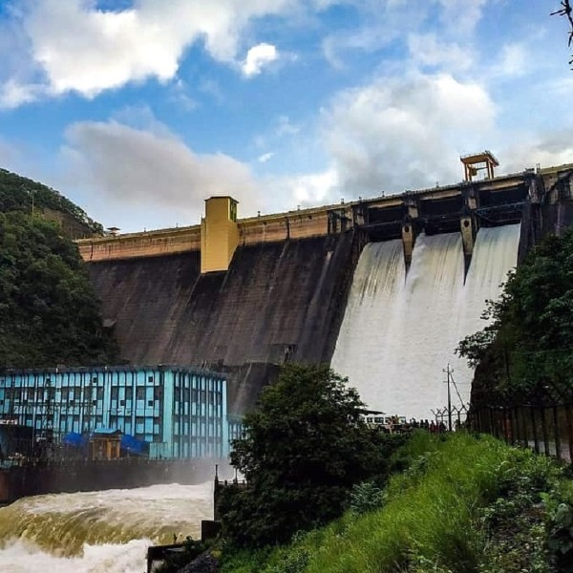
SUPA DAM
THIS IS ONE OF LARGEST DAMS IN THE WELL KNOWN DANDELLI PLACES TO VISIT . THIS DAM IS BUILT TO MANAGE THE WATER OF KALINADI RIVER
………..
THE DAM WAS BUILT BY HINDUSTAN STEEL WORKS CONSTRUTION LIMITED
(HSCL) AND IS NOW OPERATED BY KARNATAKA
POWER CORPORATION
LIMITED
BENEFITS OF LARGE DAMS
WATER FOR DRINKING AND INDUSTRIAL USE
IRRIGATION
FLOOD CONTROL
HYDRO POWER GENERATION.
INLAND NAVIGATION.
RECREATION

Slide 3
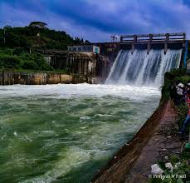
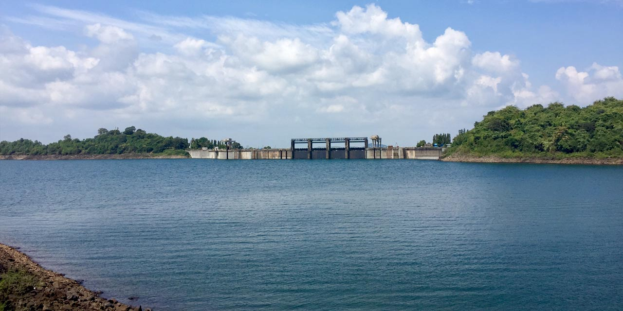
BHADRA
DAM
The bhadra dam or lakkavalli dam, which has created the bhadra reservoir, is located on the bhadra river a tributary of tungabhadra and tarikere, in the western part of karnataka in india.
What is thehistory of bhadra dam?
thouigh construction started in 1947, this multipurpose dam, (194 ft ,in height , 5604 ft in lenth) could not be commission till 1965. built across bhadra river , it is tarikere taluk . The dam , named after this village , is better known as lakkavalli dam.
______

Slide 4
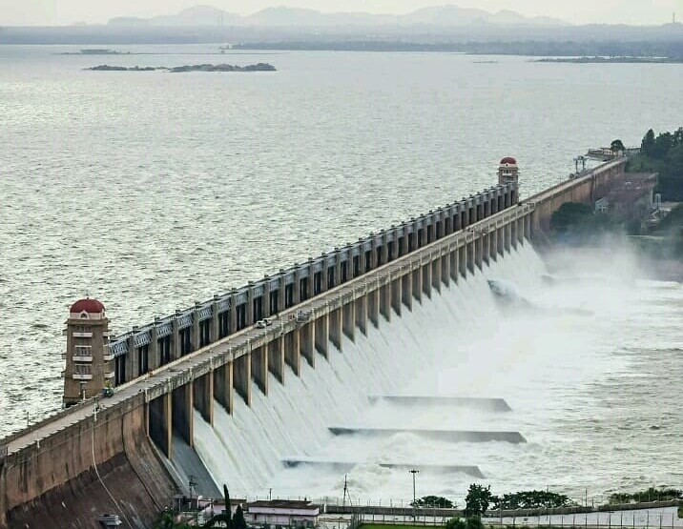
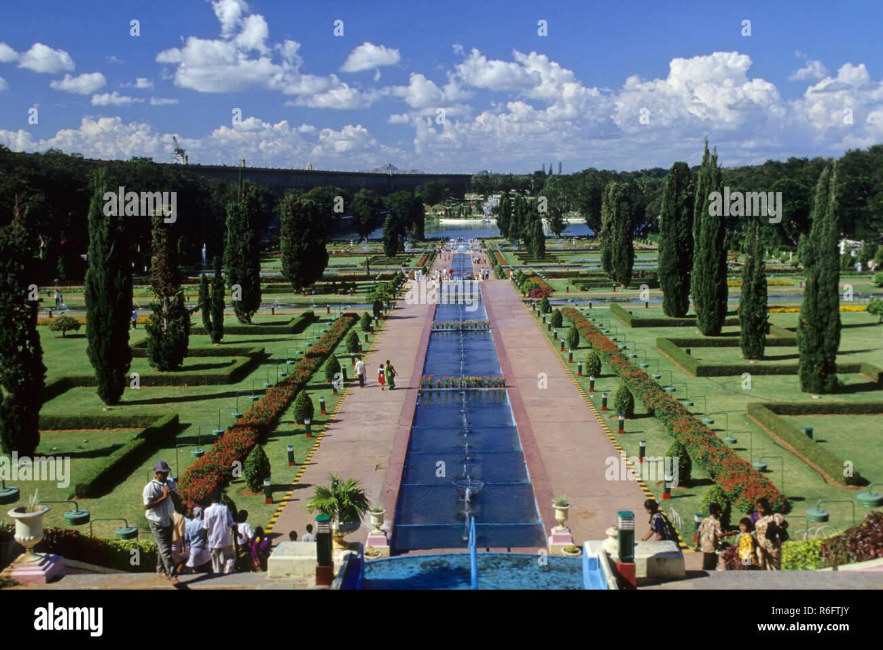
krishna
DAMS
Krishna Raja Sagar Dam or KRS Dam in Mysore is a popular tourist attraction. It is located in Krishnarajasagara, Mysuru, Karnataka. KRS Dam is an important source of drinking water for the cities of Mysore and Bangalore. The River Cauvery accounts for the main supply of water harnessed from the dam. The dam is another main source of irrigation water in Mysore and Mandya. Krishna Raja Sagar Dam in Mysore is considered as the first irrigation dam of India. People from nearby cities can easily come here for a visit as it is well-connected by roads and rails.
The Almatti Dam is a dam project on the Krishna River in North Karnataka, India which was completed in July 2005.

Slide 5
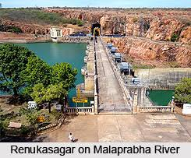
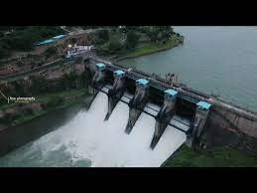
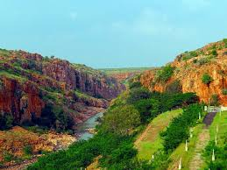
MALAPRABHA
The Malaprabha dam is the shortest dam in Karnataka. It was built across the Malaprabha river in Belgaum. It is a tributary of the famous Krishna river. It is located in small town called Saundatti in Belagavi.
This dam has been designed to meet the drinking water requirements of the people of Belgaum, Dharwad, Gadag and Bagalkot.
Check out: The Shirur Dam In Belgaum

Slide 6
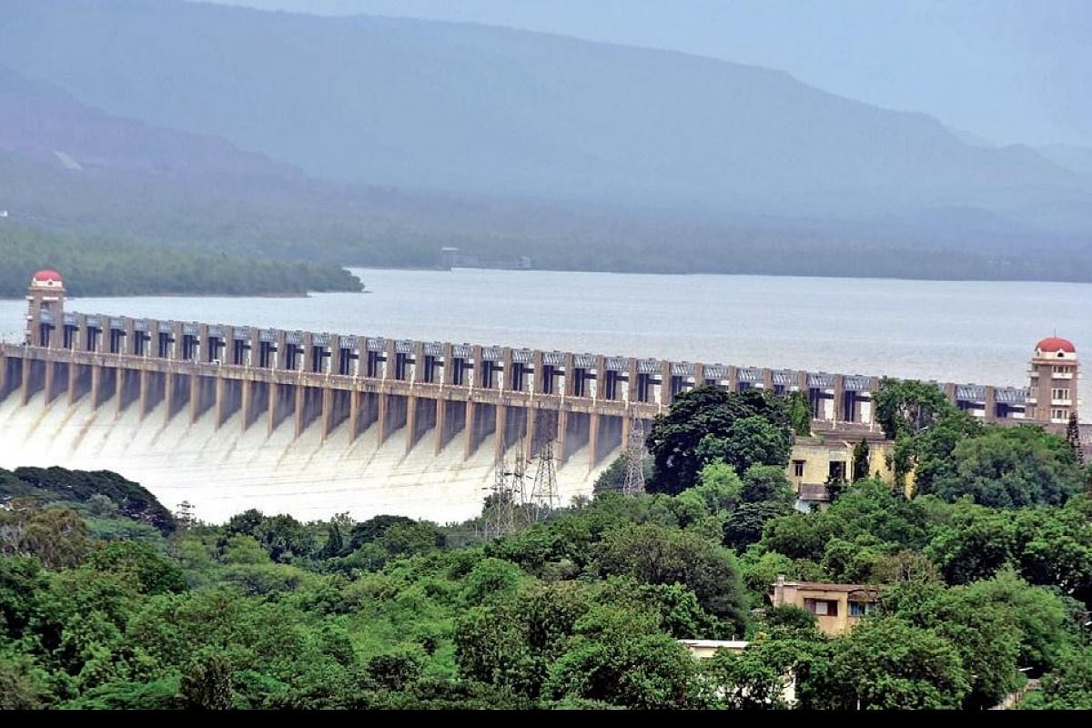
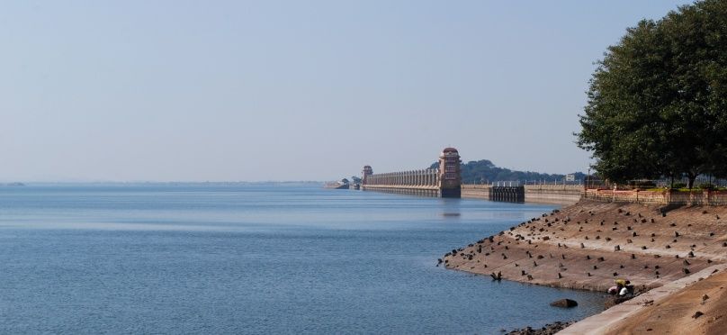
TUNGABHADRA
TUNGABHADRA DAM IS THE LARGEST DAM IN KARNATAKA AND IS SITUATED 5KM AWAY FROM HOSPET TOWN
The Tungabhadra Dam, also known as Pampa Sagar, is a water reservoir constructed across the Tungabhadra River in the city of Hosapete in Vijayanagara district, Karnataka, India. It is a multipurpose dam serving irrigation, electricity generation, flood control, etc. for the state. It is one of the only two non-cement dams in India, the other being the Mullaperiyar Dam in Kerala. The dam is built of surki mortar, a combination of mud and limestone, commonly used at the time of its construction.
The dam was a joint project undertaken in 1949 by the erstwhile Kingdom of Hyderabad and Madras Presidency when the construction began;^{[1]} later, after India's constitution into a republic in 1950, it became a joint project between the governments of Mysore State (now Karnataka) and Hyderabad State (now Telangana). The construction was completed in 1953. The Tungabhadra Dam has withstood the test of time for over 70 years and is expected to well cross many more decades.
The chief architect of the dam was Vepa Krishnamurthy, an engineer from Madras Public Works Department (PWD). He envisioned it as being built with a large contingent of material and manual labour, as best suited to Indian labour availability and employment at that time. The chief contractor for the dam was Venkat Reddy Mulamalla from Konour, a village in Mahabubnagar, Telangana.

Slide 7
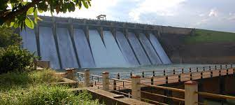
GHATAPRABHA
The Ghataprabha river is a tributary of the Krishna River and flows in state of Karnataka, India. It originates in the Western Ghats at an altitude of 884 meters and flows eastward for a distance of 283 kilometers before its confluence with the Krishna River. The river basin is 8,829 square kilometers wide and stretches across Karnataka and Maharashtra states. The Hiranyakeshi River and the Markandeya River are tributaries of the Ghataprabha.The Ghataprabha river rises in the Western Ghats and flows eastwards for a length of 283 km before joining the Krishna. The river debouches by 53 metres at Gokak Falls in Belgaum (Belagaavi) District. Belgaum district is located in the Northwest region of Karnataka State. The ancient name of the Belgaum was Venugrama (in Sanskrit) meaning village of Bamboos. Till 1961, Belgaum was a part of the Bombay state. With creation of states based on the languages, Belgaum was brought under Karnataka State. The languages spoken here are Kannada and Marathi.

Slide 8
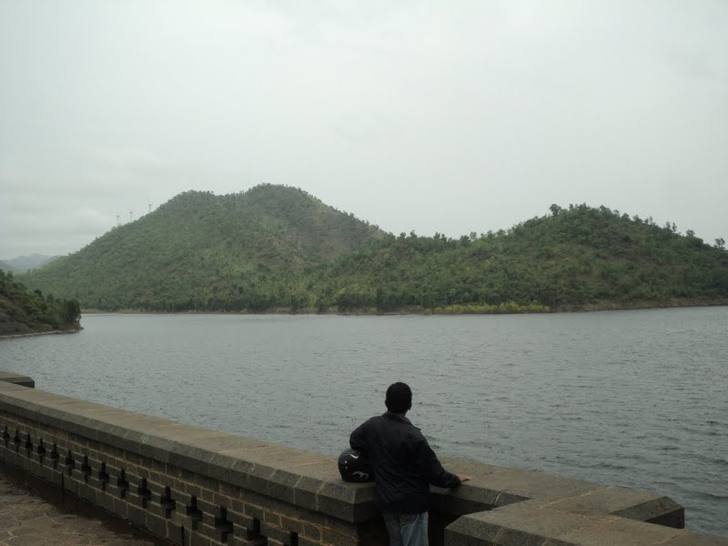
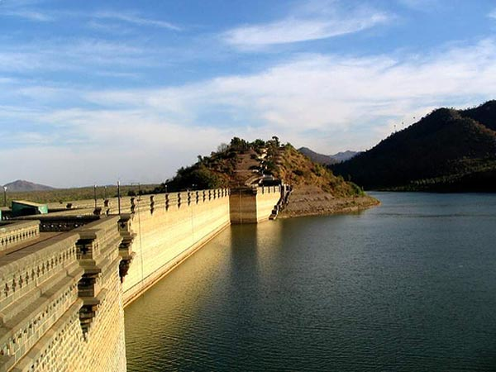
VEDAVATHI
The Vedavathi is a river in India. It rises from the Bababudanagiri Mountains of Western Ghats and flows through the states of Karnataka and Andhra Pradesh. The Vedavathi is also called the Hagari in Bellary District of Karnataka and parts of Andhra Pradesh. Two rivers, the Veda and Avathi, arise in the eastern part of the Sahyadri Hill range in Bababudangiri mountain ranges, flow east, and join near Pura to form the Vedavathi River. From there the river flows through Kadur Taluk Of Chikkamagalur District. Then it enters Hosadurga Taluk, Hiriyur Taluk and Challakere Taluk of Chitradurga district, respectively.
The Vedavathi river then flows from Hiriyur towards Narayanapura, Parashurampaura, Vrindavanahalli, where river flows circularly, hence village called Vrindavana Halli and then to Jajur (moodala jajur) Nagagondanahalli, Janamaddi and then enters Andhra Pradesh i.e. Bhairavani Thippa Dam (BT Project).

