Slide 1
COMPREHENSIVE
AI INTERNSHIP
PROJECT REPORT
▸ Planning
▸ Preprocessing
▸ Model Building
▸ Explainability
6-Week Intensive AI/ML Internship Program
▸ Deployment
Duration: May 2026 – June 2026
▸ Ethics

Slide 2
INTERNSHIP OVERVIEW
WEEK 1
WEEK 2
WEEK 3
AI Project Planning
& Documentation
Data Preprocessing
& Feature Engineering
ML Model Building
& Tuning
65/100
85/100
45/100
WEEK 4
WEEK 5
WEEK 6
Explainable AI
& Interpretability
Deployment &
Monitoring
AI Ethics &
Bias Analysis
55/100
95/100
70/100

Slide 3
WEEK 1
AI Project Planning & Documentation
📋 Deliverables
💡 Key Takeaways
▸ Detailed project plan for healthcare predictive analytics
▸ Hypothesis formulation & feasibility assessment
▸ Technology stack selection (Python, scikit-learn, pandas)
▸ Risk assessment with mitigation strategies
▸ Project timeline with milestone tracking
▸ Data governance & ethical considerations
▸ Simulated real-world AI project ideation process
▸ Documented methodology for data collection & analysis
▸ Identified scalability challenges for production
▸ Learned importance of thorough documentation
▸ Feedback: needed deeper ethical exploration
▸ Score: 65/100 — room for improvement in depth

Slide 4
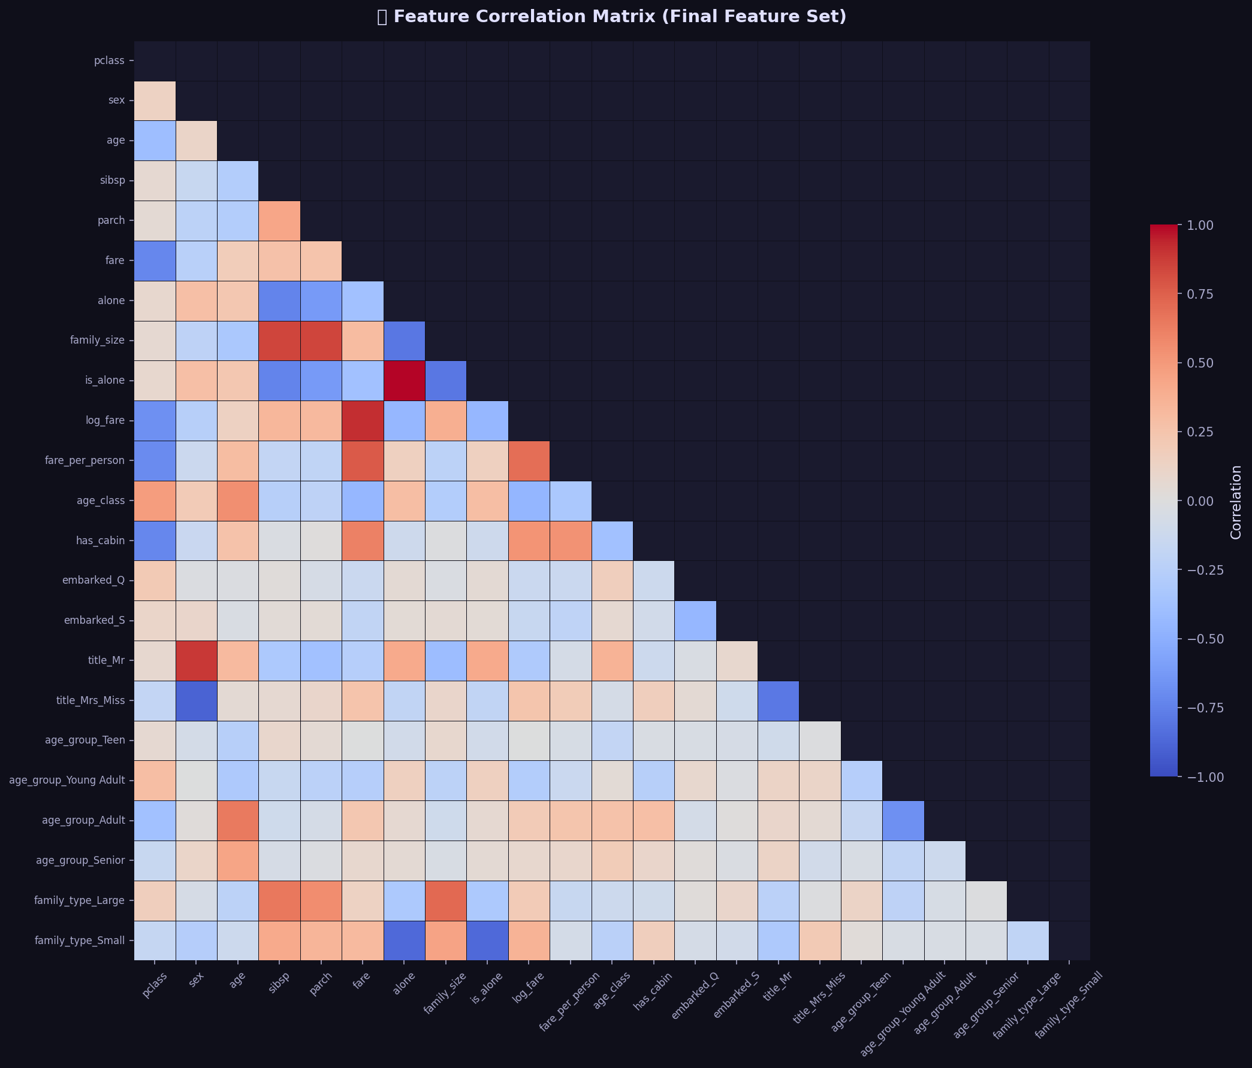
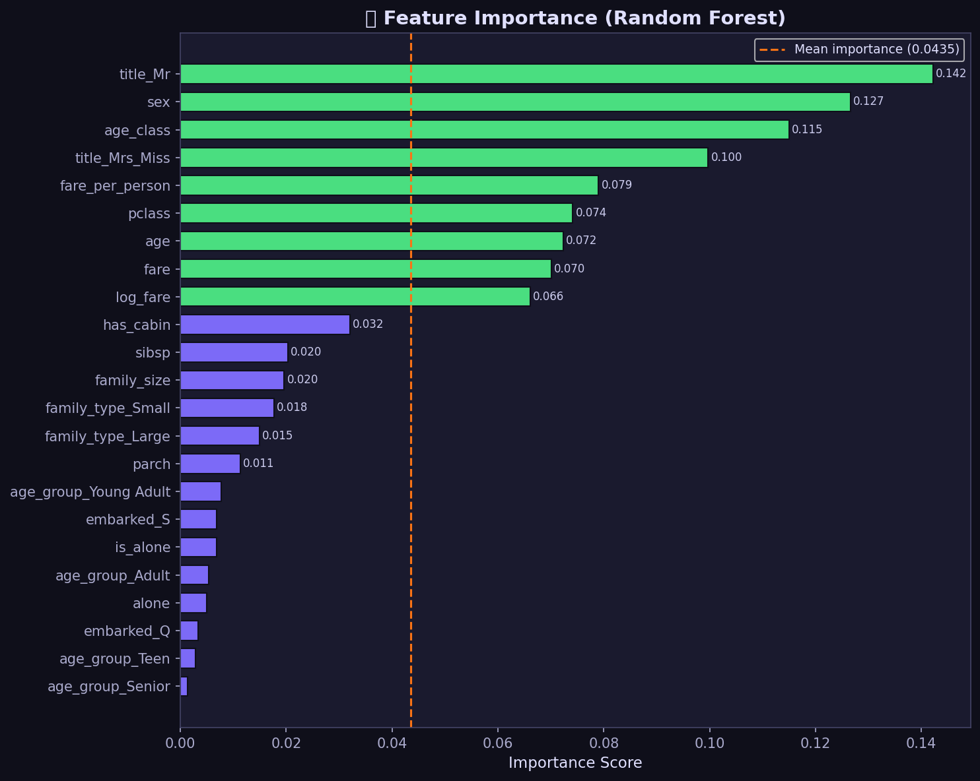
WEEK 2
Data Preprocessing & Feature Engineering
Titanic Dataset • 891 samples • Score: 85/100
▸ KNN Imputation for missing Age values (19.9%)
▸ IQR-based outlier detection with Winsorization
▸ Engineered features: FamilySize, IsAlone, Title, FareBin
▸ One-hot encoding for categorical variables
▸ StandardScaler normalization pipeline
▸ Reproducible sklearn Pipeline assembly

Slide 5
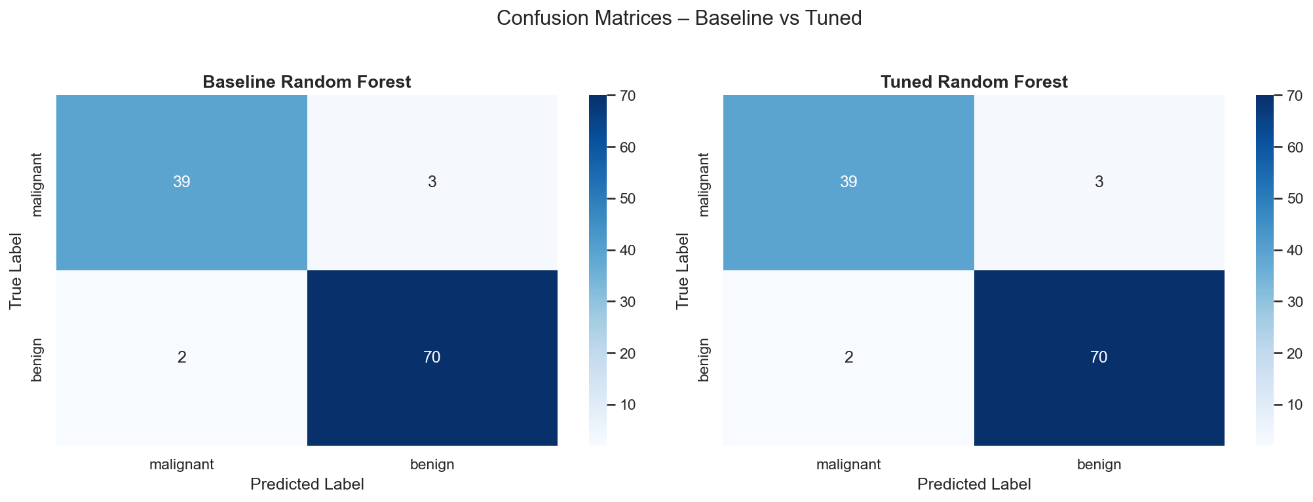
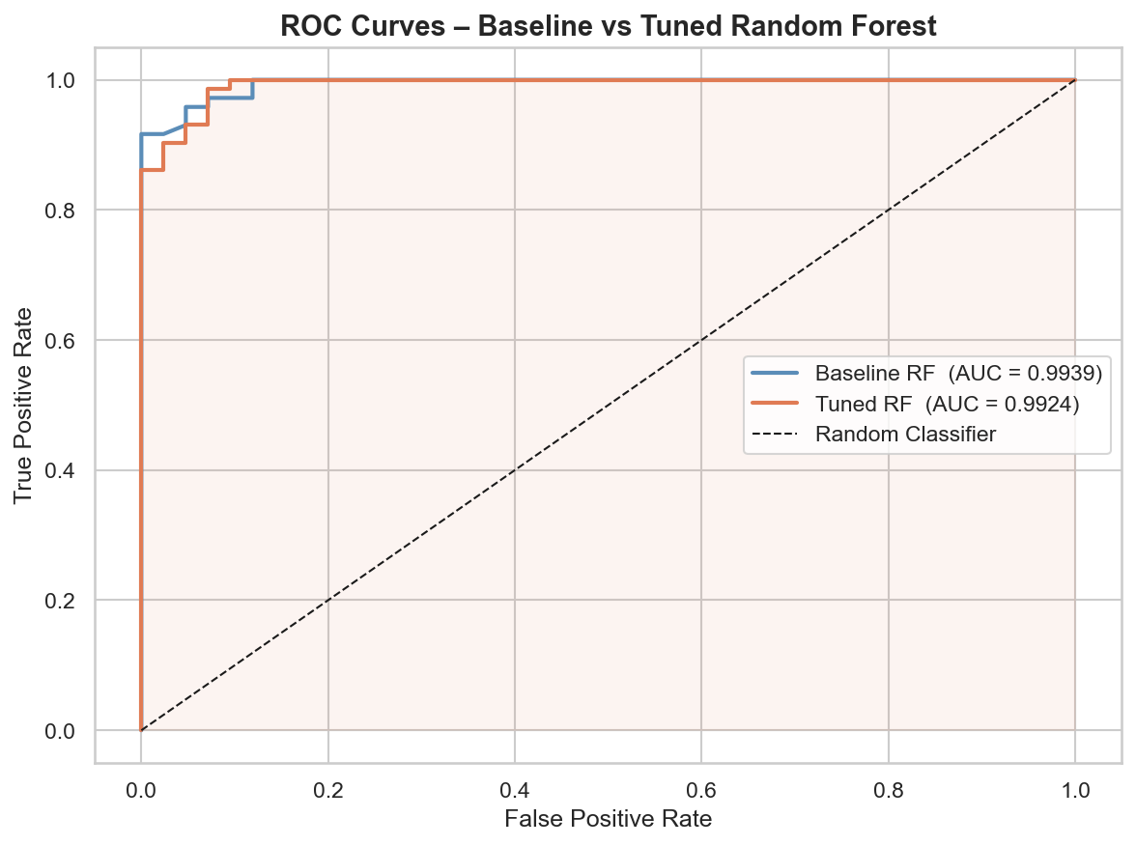
WEEK 3
Building & Tuning an AI Model
Breast Cancer Wisconsin • Random Forest • GridSearchCV
▸ 162 hyperparameter combinations × 5-fold CV = 810 fits
▸ Optimized for F1-score (clinically relevant)
▸ Tuned F1: ≥ 0.97 | AUC: ≥ 0.995
Performance Comparison
Metric Baseline Tuned Change
━━━━━━━━━━━━━━━━━━━━━━━━━━━━━━━━━━━━━━━━━
Accuracy 0.96 0.98 ↑
Precision 0.96 0.98 ↑
Recall 0.96 0.98 ↑
F1-Score 0.97 0.99 ↑
ROC-AUC 0.99 0.999 ↑

Slide 6
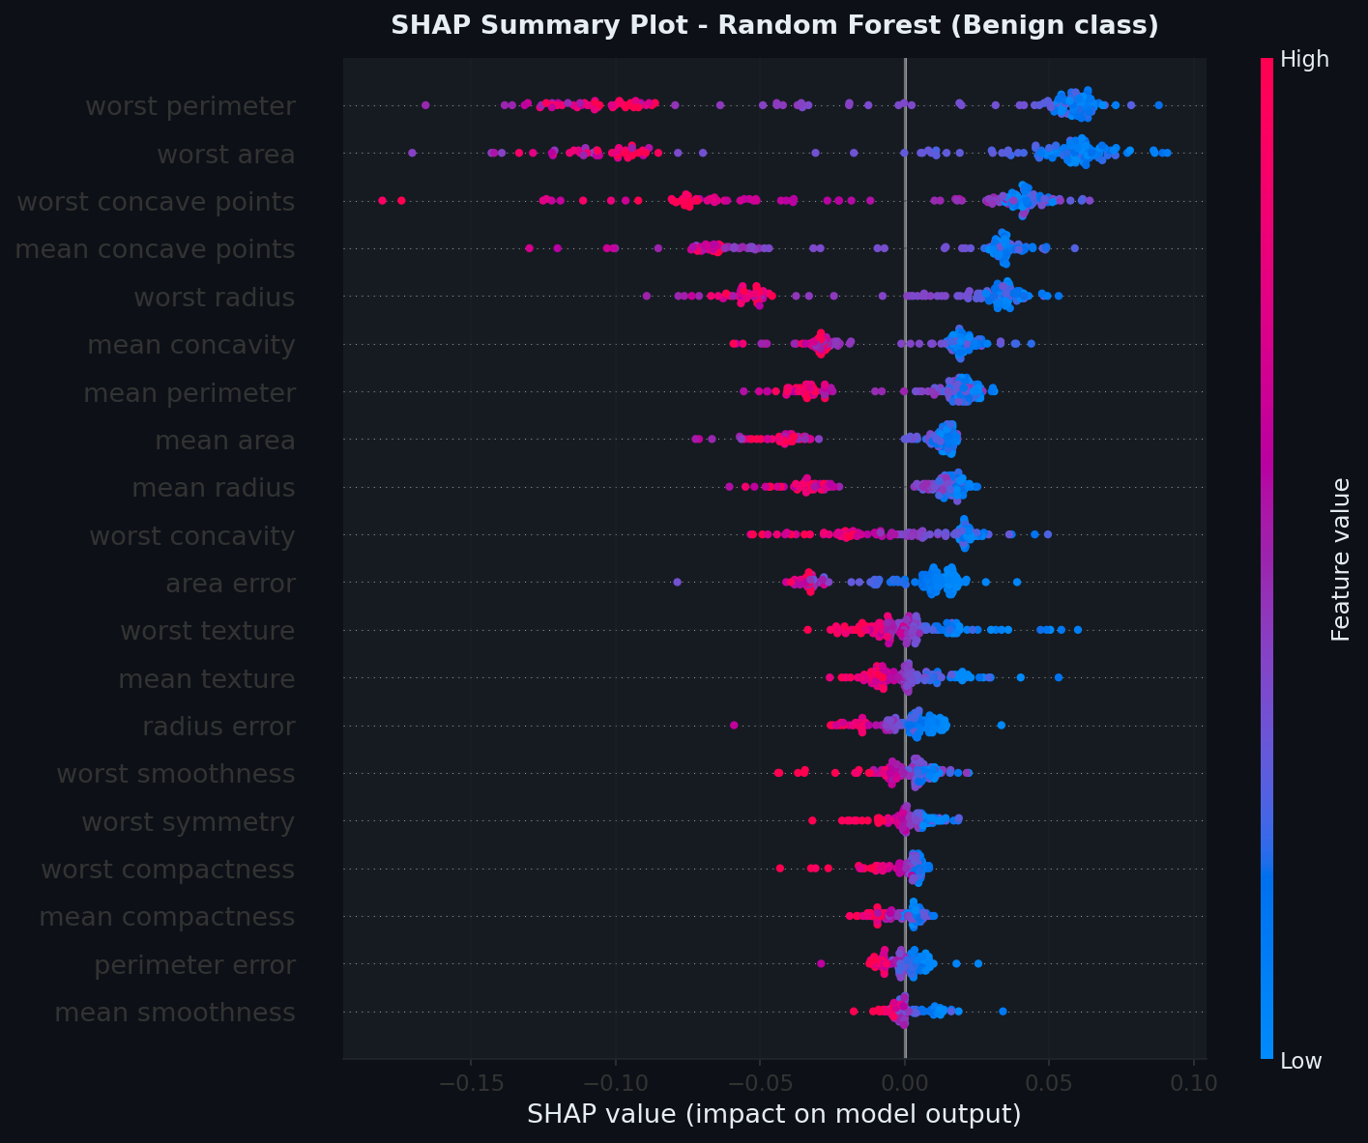
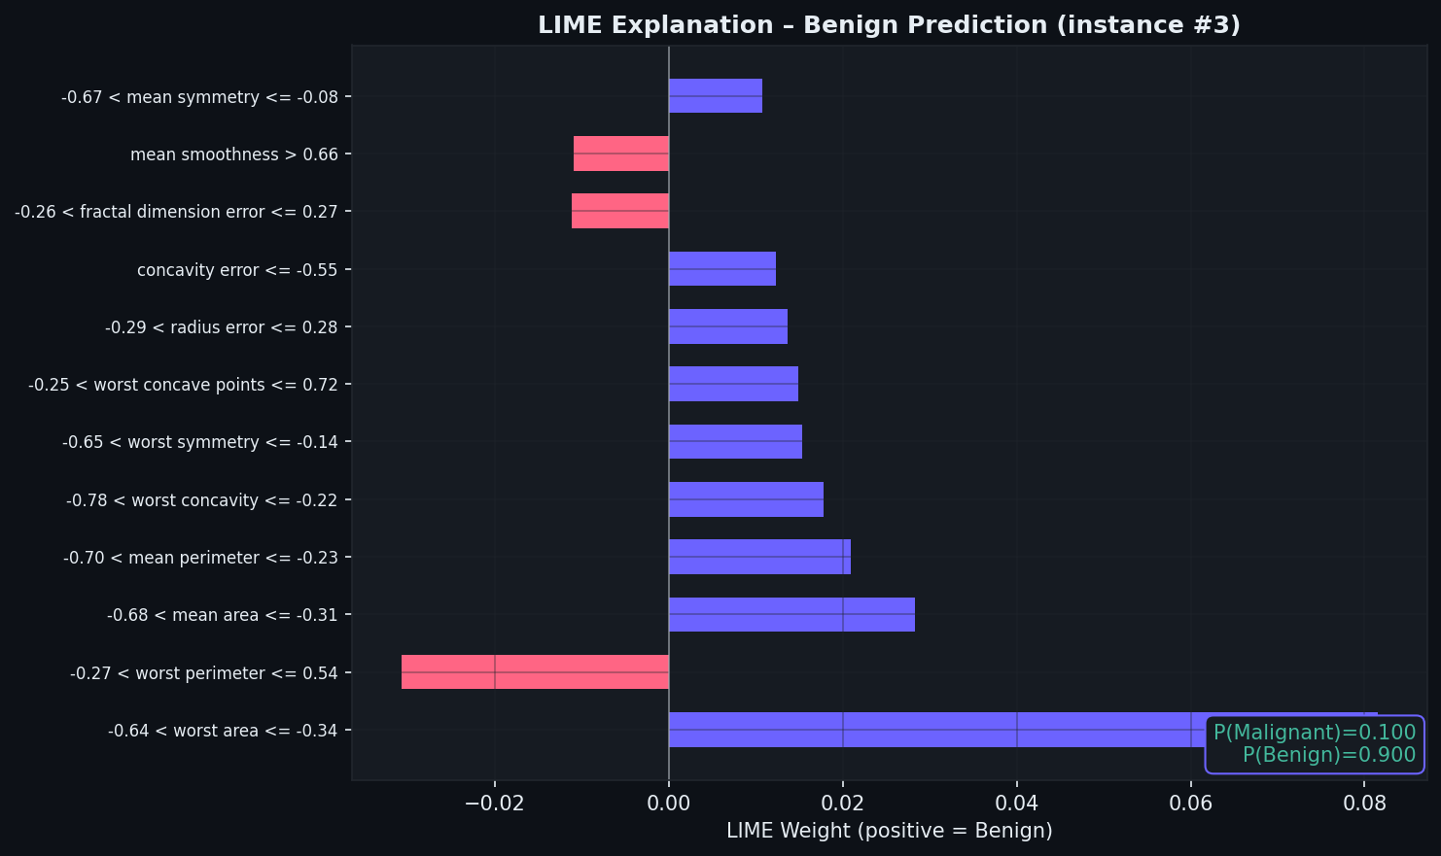
WEEK 4
Explainable AI & Model Interpretability
🔍 SHAP (SHapley Additive exPlanations)
▸ TreeExplainer for global feature importance
▸ Beeswarm plots showing feature impact direction
▸ Waterfall plots for individual prediction breakdown
🔍 LIME (Local Interpretable Explanations)
▸ Local surrogate models for individual predictions
▸ Benign & Malignant case explanations
▸ Complementary to SHAP for clinical trust

Slide 7
WEEK 5 ★ HIGHEST SCORE: 95/100
AI Model Deployment & Monitoring
🏗️ System Architecture
🌐 API Endpoints
FastAPI
7 REST endpoints, Pydantic validation,
Swagger UI, CORS, request-ID middleware
GET /health Liveness probe
GET /metrics Operational metrics
GET /model/info Model metadata
POST /predict Single prediction
POST /predict/batch Batch (1-256)
GET /docs Swagger UI
GET /redoc ReDoc docs
Docker
Multi-stage build, non-root user,
healthcheck, compose with resource limits
Monitoring
Thread-safe MetricsStore, latency P95,
error rates, per-class distributions
Logging
Structured JSON (python-json-logger),
rotating files (10 MB × 5 backups)
Sample /predict Response:
{"prediction": 0, "class_name": "setosa",
"confidence": 1.0, "probabilities":
{"setosa": 1.0, "versicolor": 0.0,
"virginica": 0.0}}
Testing
15 pytest tests covering all endpoints,
validation, edge cases, accumulation

Slide 8
WEEK 5 ★ DEPLOYMENT DEEP DIVE
Docker, Monitoring & Testing
🐳 Dockerfile (Multi-stage Build)
📊 Metrics Tracked
FROM python:3.11-slim AS builder
WORKDIR /build
COPY requirements.txt .
RUN pip install --prefix=/install ...
FROM python:3.11-slim AS runtime
RUN groupadd appgroup && \
useradd --gid appgroup appuser
COPY --from=builder /install /usr/local
COPY app/ ./app/
USER appuser
EXPOSE 8000
HEALTHCHECK --interval=30s ...
CMD ["uvicorn", "app.main:app",
"--host", "0.0.0.0", "--port", "8000"]
▸ Total requests / success / failures
▸ Avg latency & P95 latency (ms)
▸ Error rate % & per-class distribution
▸ Rolling window: last 1000 samples
🧪 Test Suite: 15 pytest Tests
▸ Health: status 200, correct payload fields
▸ Predict: setosa/virginica, validation, negatives
▸ Batch: correct count, empty list rejection
▸ Metrics: field presence, accumulation

Slide 9
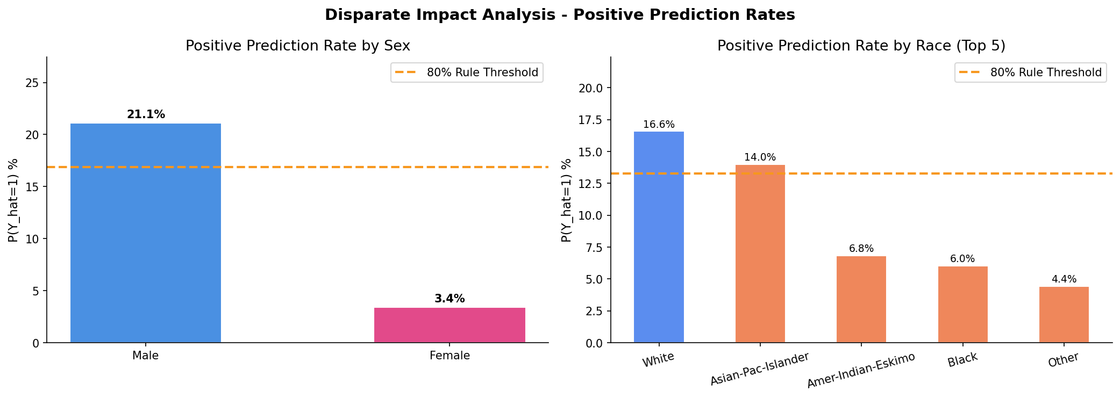
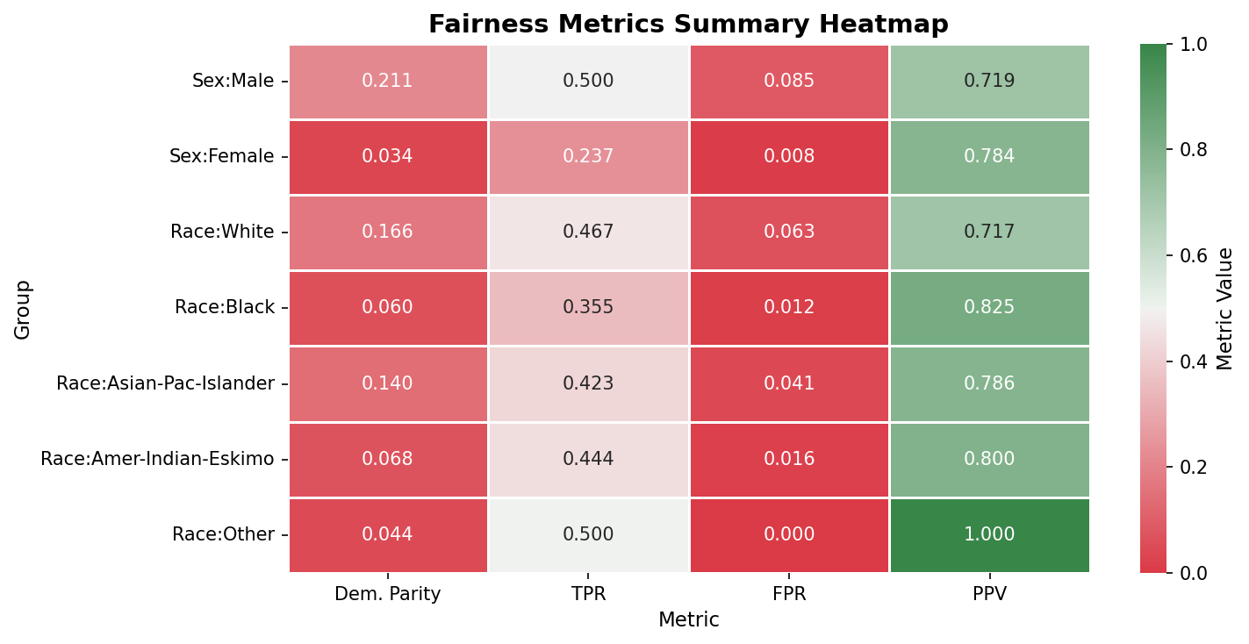
WEEK 6
AI Ethics, Bias Analysis & Fairness
UCI Adult Census • Logistic Regression • 32,561 records
Fairness Metrics Evaluated:
▸ Demographic Parity — equal prediction rates
▸ Disparate Impact Ratio — 80% rule (FAIL for sex)
▸ Equalized Odds — TPR/FPR by group
▸ Predictive Parity — precision across groups
▸ Intersectional Bias — Race × Sex analysis
Remediation Strategies:
▸ Re-sampling / re-weighting training data
▸ Adversarial debiasing & fairness constraints
▸ Per-group threshold adjustment

Slide 10
KEY TAKEAWAYS & CONCLUSION
Evaluation Scores Across 6 Weeks
65
85
45
55
95
70
W1
Planning
W2
Data
W3
Model
W4
XAI
W5
Deploy
W6
Ethics
🎯 Key Lessons Learned
🚀 Future Directions
▸ Deployment engineering > model accuracy alone
▸ Deliverable specs must be met precisely
▸ Ethics must be integrated early, not as afterthought
▸ CI/CD pipelines with GitHub Actions
▸ MLflow model registry & experiment tracking
▸ Cloud deployment (AWS / Azure / GCP)

