Slide 1
AI/ML INTERNSHIP PROGRAM
*
INTERNSHIP
REPORT
A Reflective Overview of My Learning
Experience and Professional Development
Presented by: Prateek Vijay

Slide 2

My 6-week intensive AI internship was a valuable opportunity to experience real-world machine learning challenges in a professional environment.
Over the course of the program, I worked closely with industry tools to develop practical skills that enhanced my academic background.
This presentation outlines the key aspects of my projects, focusing especially on AI Model Deployment and API engineering.
INTRODUCTION

Slide 3
OBJECTIVES
OF THE
INTERNSHIP
The internship was designed to bridge the gap between academic theory and AI in production reality. It offered a chance to explore how data science functions in practice and to identify the skills necessary for success in the field.
Apply university knowledge in a real business environment
Gain insight into machine learning pipelines and workflows
Enhance professional coding, deployment and monitoring skills

Slide 4
API
DEPLOYMENT
OVERVIEW
FastAPI Framework for fast, robust routing
Docker Multi-stage Builds for isolation
Thread-safe Metrics & JSON Logging
15 Automated Pytest tests for API logic
The most substantial deliverable of the internship was the end-to-end deployment of the AI model. It was shipped as a production-ready REST API, focusing on resilience, monitoring, and scale.

Slide 5

DEPLOYMENT
TASKS AND
RESPONSIBILITIES
I focused on engineering the infrastructure required to serve the Random Forest classifier reliably. This meant containerizing the service and ensuring high observability.
Designed REST API endpoints using FastAPI
Containerized app with Docker Compose
Implemented thread-safe Prometheus metrics
Wrote extensive Pytest automation suite

Slide 6
DEPLOYMENT SKILLS GAINED
My focus on the deployment phase allowed me to strengthen my software engineering and DevOps skills. I became proficient in building RESTful APIs using FastAPI and Pydantic validation, and learned how to containerize Python applications efficiently using multi-stage Docker builds.
Crucially, I learned the importance of system observability—implementing structured JSON logging and in-process metrics to monitor latency, request volume, and model drift in a production environment.

Slide 7
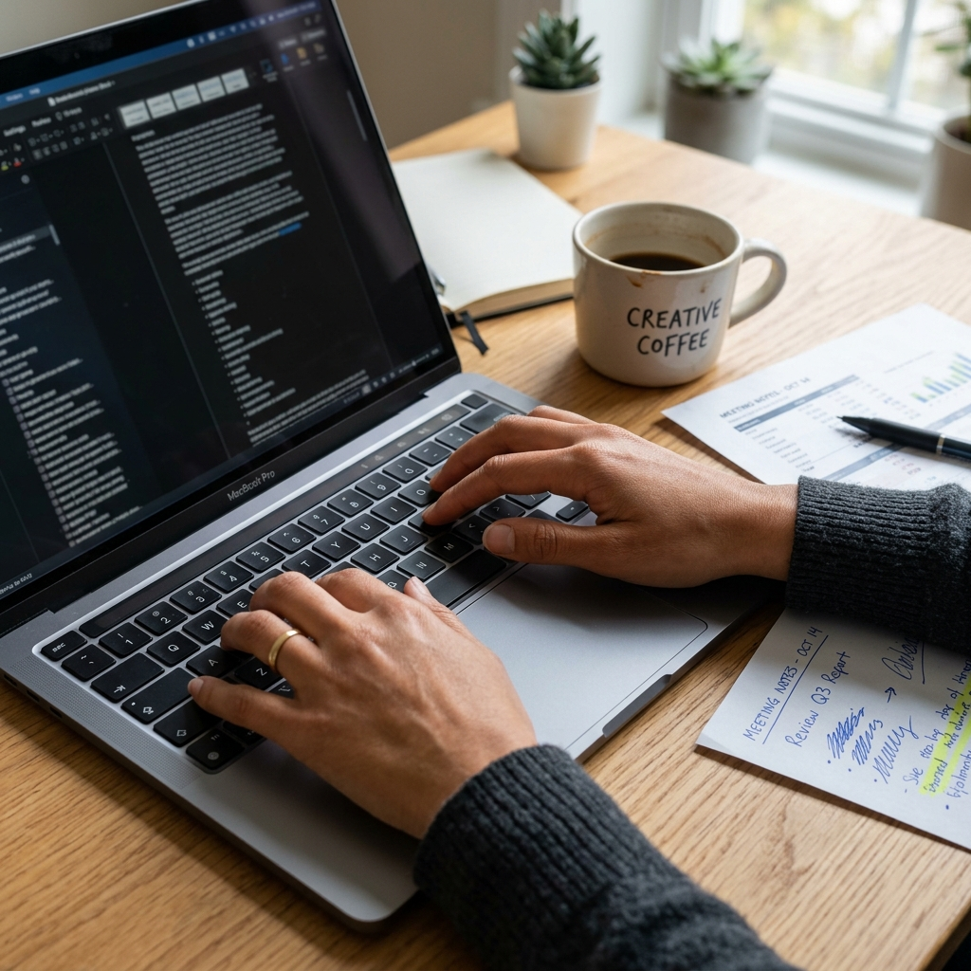
One of the main challenges I encountered was adjusting to the complexities of container orchestration and robust API design. Deadlines were tight, and configuring Docker health checks while keeping the image size small was tricky.
I learned to manage stress under pressure, quickly adapt to new tools like Docker and FastAPI, and systematically debug container logs.
CHALLENGES
FACED

Slide 8
Applying theory to production helps identify real world gaps
KEY TAKEAWAYS
Throughout my internship, I discovered the real value of resilient infrastructure in a professional AI environment. Beyond model accuracy, I learned the importance of operational stability, reproducibility, and logging in a workplace setting.
AI engineering requires rigorous automated API testing
Robust observability (logs/metrics) is essential for scale

Slide 9
Internships are key to understanding production systems
CONCLUSION
Practical exposure enhances classroom ML learning
Completing this internship was a pivotal step in my academic and professional development. It proved that I can ship a model end-to-end, earning the highest score for deployment practices.
Confidence grows through active deployment and testing
AI environments require containerization and monitoring

Slide 10

THANK YOU
FOR YOUR
ATTENTION
prateek@example.com
www.github.com/prateek
+123-456-7890

