Slide 1
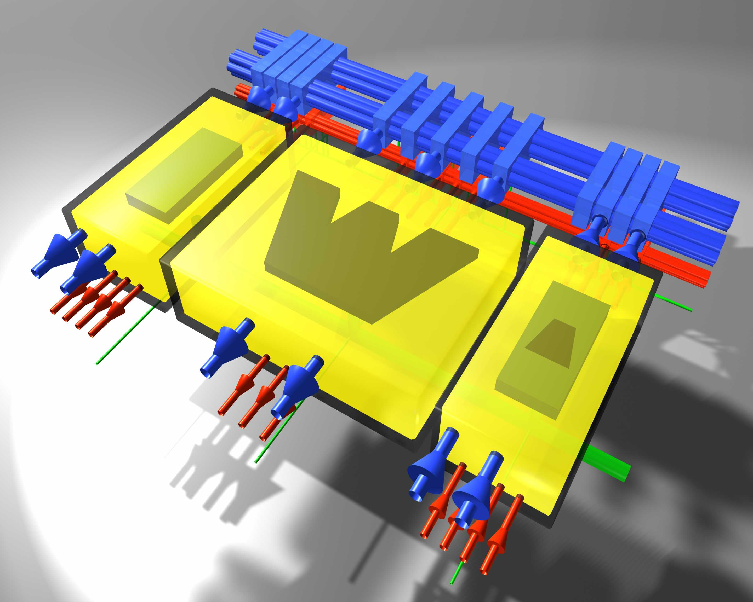



16 Tap FIR Filter
Omar F. Mousa/Chintan Daisa
Professor: Scott Wakefield

Slide 2
Design Objectives
To have a register based storage of 16 latest input values and the 16 impulse response coefficients on-chip.
To utilize a clocked architecture to synchronize input and output values.
Reduce the Number of Multiplier and Adder needed that is Optimize area and Power and cost.
By Achieving the above the speed will not be compromised

Slide 3
Design Objectives
Future scalability for input data as well as coefficient bits.
Signed or unsigned input data as well as coefficients.
Fast MAC operation on signed or unsigned data with future scalability.
Synchronization of Input/Output data
Configurable Output Precision

Slide 4
Design Objectives
16 taps of delay line.
8 bits of Input/Output bit resolution
Burst mode of data transfer at Input supporting 32 elements of the desired resolution in one burst
Main Issue of concern when designing FIR Filter
Sharp Response
Number of Taps
Numerical Precision
Fully Parallel

Slide 5
Advantages and Disadvantages
Advantages:
  Always stable (assume non-recursive implementation).
  Quantization noise is not much of a problem.
  Transients have a finite duration.
Disadvantages:
  A high-order filter is generally needed to satisfy the stated specification – so more coefficients are needed with more storage and computation.

Slide 6
Review of discrete-time systems
Linear time-invariant (LTI) systems
Causal systems:
for all input x[k]=0, k<0 -> output y[k]=0, k<0
Impulse response :
input 1,0,0,0,... -> output h[0],h[1],h[2],h[3],...
input x[0],x[1],x[2],x[3] -> output y[0],y[1],y[2],y[3],...
x[k]
y[k]

Slide 7
Overview
FIR filter equation
y[n] = x[n] * h [n]
where n is the number of “taps” or coefficients in the FIR filter.
For a 16-tap FIR filter
y[n] = a₀x[n] + a₁x[n-1] + a₂x[n-2] + a₃x[n-3]+…+ a₁₅x[n-15]

Slide 8
Different Filter Representations
Difference equation
Recursive computation needs y[-1] and y[-2]
  For the filter to be LTI, y[-1] = 0 and y[-2] = 0
Transfer function
  Assumes LTI system
Block Diagram Representation
x[k]
Σ
y[k]
Unit
Delay
1/2
y[k-1]
Unit
Delay
1/8
y[k-2]

Slide 9
Discrete-Time Systems
Z-Transform:

Slide 10
Discrete-Time Systems
`Popular’ frequency responses for filter design :
low-pass (LP) high-pass (HP) band-pass (BP)
band-stop multi-band …

Slide 11
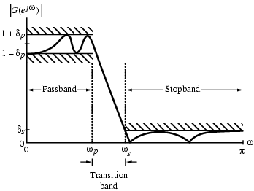
Digital Filter Specifications
For example the magnitude response of a digital lowpass filter may be given as indicated below

Slide 12
Structured Streams
Hierarchical Structures:
  Pipeline
  SplitJoin
  Feedback Loop

Slide 13
Different Strategies
Map filter per tile and run
forever
Pros:
  No filter swapping overhead
  Reduced memory traffic
  Localized communication
  Tighter latencies
  Smaller live data set
Cons:
  Load balancing is critical
  Not good for dynamic behavior
  Requires # filters ≤ # processing elements

Slide 14
Discrete-Time Systems
`FIR filters’ (finite impulse response):
Moving average filters (MA)
N poles at the origin z=0 (hence guaranteed stability)
N zeros (zeros of B(z)), `all zero’ filters
corresponds to difference equation
Impulse response

Slide 15
Speeding Up FIR Filter
FIR speed-up
y(0) = c(0)x(0) + c(1)x(-1) + c(2)x(-2) + . . . + c(N-1)x(1-N);
y(1) = c(0)x(1) + c(1)x(0) + c(2)x(-1) + . . . + c(N-1)x(2-N);
y(2) = c(0)x(2) + c(1)x(1) + c(2)x(0) + . . . + c(N-1)x(3-N);
. . .
y(n) = c(0)x(n) + c(1)x(n-1) + c(2)x(n-2)+ . . + c(N-1)x(n-(N-1));
Run MAC at double frequency, read two 32-bit numbers
FIR filtering: two outputs in parallel
Two outputs = 4N reads, 2N MAC’s, 2 writes

Slide 16
Direct Form Realization
u[k]
u[k-1]
u[k-2]
u[k-3]
u[k-4]
bo
b1
b2
b3
b4
x
x
x
x
x
y[k]
+
+
+
+

Slide 17
Retiming FIR Filter Realizations
Select subgraph (shaded)
  Remove delay element on all inbound arrows
  Add delay element on all outbound arrows
u[k]
u[k-1]
u[k-2]
u[k-3]
u[k-4]
bo
b1
b2
b3
b4
x
x
x
x
x
y[k]
+
+
+
+

Slide 18
Retiming
u[k]
u[k-1]
u[k-2]
u[k-3]
bo
b1
b2
b3
b4
x
x
x
x
x
y[k]
+
+
+
+

Slide 19
Four Tap Direct Form Realization
u[k]
u[k-1]
u[k-2]
u[k-3]
bo
b1
b2
b3
x
x
x
x
+
+
y[k]
+

Slide 20
Transposed Direct-Form Realization
u[k]
bo
b1
b2
b3
b4
x
x
x
x
x
y[k]
+
+
+
+

Slide 21
Lattice Form Realizations
u[k]
u[k-1]
u[k-2]
u[k-3]
u[k-4]
bo
b1
b2
b3
b4
x
x
x
x
x
b4
b3
b2
b1
bo
x
x
x
x
x
y[k]
+
+
+
+
~
y[k]
+
+
+
+

Slide 22
FIR Filter Realizations
Lattice Form
u[k]
bo
x
y[k]
+
+
+
+
x
x
x
x
ko
k1
k2
k3
~
x
x
x
x
y[k]
+
+
+
+
i.e. different software/hardware, same i/o-behavior

Slide 23
Efficient Direct Form Realization
Efficient Direct-Form realization.
u[k]
+
+
+
+
+
bo
b1
b2
b3
b4
x
x
x
x
x
y[k]
+
+
+
+

Slide 24
Pin Diagram
Vdd
Gnd
x[0]
Drive
x[1]
y[0]
…..
y[1]
x[15]
16-bit
16-tap
FIR
Filter
y[2]
a[0]
y[3]
a[1]
y[4]
…..
y[5]
a[15]
y[6]
Reset
….
y[31]
Coeffin
Din
Clk
Synthesis using Synopsys Design Compiler
  Initial Target Frequency: 100 MHz (typical)

Slide 25
Specifications
Input Specifications
16-bit unsigned integers for data inputs.
16-bit unsigned integers for coefficients.
Output Specifications
32-bit unsigned integer output.

Slide 26
System Components
Memory - Input and Coefficient
Control - Mod-4 and Mod-8 counters
- 3-8 Decoder
- Combinational logic
Multiplier - Radius-8 Booth multiplier
- Multiplier register
Adder - 9-bit Carry Save adder
- Adder register
Output Register

Slide 27
Specifications
Drive Signal(Output Signal)
A new output is available.
Inputs or coefficients to be applied only when Drive is asserted.
Coefficients
Any coefficient changed implies a new filter definition.
Input Memory cleared – new data to be entered.

Slide 28
Specifications
System Clock
One clock-cycle for the filter = 32 input clock pulses.
One Tap-cycle = 8 input clock pulses described as 8 phases.
4 such Taps for each output.
System Reset
Active High

Slide 29
System Timing
mod8 counter states
Φ₀
Φ₁ Input or Coefficient memory enable
Φ₂ Multiplier propagation delay
Φ₃ Multiplier propagation delay
Φ₄ Multiplier Register enable
Φ₅ Add Register Enable
Φ₆ Output Register Enable
Φ₇

Slide 30
System Timing Strategy
Two phase clocking
Generation of internal lower frequency clocks using mod-4 and mod-8 counters
Each state of mod-4 counter used for computation of one filter tap
Output available at the end of one cycle of mod-4 counter

Slide 31
2-Parallel FIR Filtering Structure
x(2k)
H₀
+
y(2k)
H₁
x(2k+1)
H₀
+
y(2k+1)
H₁
D
z⁻²

Slide 32
Hardware-Efficient 2-Parallel FIR Filter
Y₀ = X₀ H₀ + z⁻²X₁H₁
Y₁ = X₀ H₁ + X₁ H₀
= (H₀ + H₁) (X₀ + X₁) – H₀X₀ – H₁X₁
x(2k)
H₀
+
y(2k)
+
H₀+H₁
+
+
y(2k+1)
x(2k+1)
H₁
D
z⁻²

Slide 33
Savings in the New Structure
Originally,
  2N multiplications + 2(N-1) additions for two inputs
In the new structure
  3*(N/2) = 1.5N multiplication
  3(N/2 –1) + 4 = 1.5N + 1 additions

Slide 34
Design Flow FIR 16 Tap Delay
VHDL
Deign Entry
Functional
Verification
Synthesis
EDIF
Floor planning
Timing
Verification
SDF
PDEF
Parasitic
PDEF
Place & Route
Physical
Verification

Slide 35
The FIR Filter
Implementation of 16 Tap FIR Filter, the coefficients are represented as fixed point 16-bits 2’s complement numbers. It is assumed that either or both of the coefficients and data are fractional numbers.

Slide 36
FIR Filter(Critical Path)
In order to save area and improve the critical path performance, we decided to add the 12-bit sum and carry results of the multiplier during the accumulation operation. Therefore, the adder has to add three 12-bit numbers. To do that, the first stage of the adder is a 3-to-2 combiner, which is just a CSA. The next stage is a CPA (Carry Propagate Adder) arranged in a static Manchester carry chain form. The chain is divided into four sections, each one has three carry stages. Buffers are used between sections to reduce the overall delay.

Slide 37
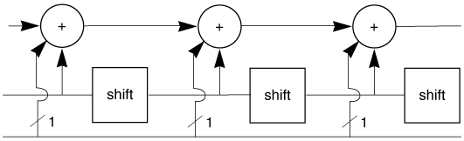
Survey of Multiplier
Combinational Multiplier: uses n adders, eliminates registers:

Slide 38
Multiplier Design
4×4 multiplication
X₃ X₂ X₁ X₀ multiplicand
Y₃ Y₂ Y₁ Y₀ multiplier
X₃Y₀ X₂Y₀ X₁Y₀ X₀Y₀
X₃Y₁ X₂Y₁ X₁Y₁ X₀Y₁
X₃Y₂ X₂Y₂ X₁Y₂ X₀Y₂
X₃Y₃ X₂Y₃ X₁Y₃ X₀Y₃
Z₇ Z₆ Z₅ Z₄ Z₃ Z₂ Z₁ Z₀ Result
P.P.

Slide 39
Radix-2 Unsigned Multiplication
Use a single n-bit adder, three registers (P, A, B), and a testing circuit for A₀
Initialization: Place the unsigned numbers in registers A and B. Set P to zero.
1: If A₀ is 1,
then register B, containing b_{n-1}b_{n-2}...b₀ is added to P;
otherwise 00...00 (nothing) is added to P. The sum is placed back into P.
2. Shift register pair (P, A) one bit right.
The last bit of A is shifted out (not used).

Slide 40
Array Multiplier
Array multiplier is an efficient layout of a combinational multiplier.
Array multipliers may be pipelined to decrease clock period at the expense of latency.

Slide 41
Array Multiplier Organization
0 1 1 0
x 1 0 0 1
0 1 1 0
+ 0 0 0 0
0 0 1 1 0
+ 0 0 0 0
0 0 0 1 1 0
+ 0 1 1 0
0 1 1 0 1 1 0
Multiplicand
Multiplier
skew array
for rectangular
layout
Product

Slide 42
Unsigned Array Multiplier
x₂y₀
x₁y₀
x₀y₀
0
0
+
x₁y₁
+
x₀y₁
+
x₁y₂
+
x₀y₂
x_{n}y₀
+
+
0
P(2n-1)
P(2n-2)
P₀

Slide 43
Array Multiplier Organization
Array Multiplier cell
X_{i}
X_{i} Y_{i}
P_{in}
Y_{i}
P_{in}
C_{out}
FA
C_{in}
C_{out}
⊕
C_{in}
P_{out}
P_{out}
Critical Path
M-1
N-1 P.P
t_{mult}≈(M-1) t_{carry} +(N-1) t_{sum} + t_{and}
For small t_{mult}, t_{carry}
t_{sum}
Beneficial to make t_{carry} = t_{sum}
→ Differential Logic (DCVS)

Slide 44
Architecture of Array Multiplier
X₃ X₂ X₁ X₀
Y₀
Y₁
Y₂
Y₃
Z₀
Z₁
Z₂
×
HA
⊕
⊕
⊕
⊕
×
HA
⊕
⊕
⊕
⊕
×
HA
⊕
⊕
⊕
⊕
×
HA
Z₇ Z₆ Z₅ Z₄ Z₃

Slide 45
Advantages of Array Multiplier
Array multipliers
  Partial product generation and accumulation are merged
  Identical cells
  High-rate pipelining
p₉
a₄x₄
p₈
a₄x₃
a₃x₄
p₇
a₄x₂
a₃x₃
a₂x₄
p₆
a₄x₁
a₃x₂
a₂x₃
a₁x₄
p₅
a₄
x₄
a₄x₀
a₃x₁
a₂x₂
a₁x₃
a₀x₄
p₄
a₃
x₃
a₃x₀
a₂x₁
a₁x₂
a₀x₃
p₃
a₂
x₂
a₂x₀
a₁x₁
a₀x₂
p₂
a₁
x₁
a₁x₀
a₀x₁
p₁
a₀
x₀
a₀x₀
p₀

Slide 46
Array Multiplier
  Array multiplier for Unsigned numbers
a₄x₀
a₃x₀
a₂x₀
a₁x₀
a₀x₀
0
0
0
0
a₄x₁
a₃x₁
a₂x₁
a₁x₁
a₀x₁
a₄x₂
a₃x₂
a₂x₂
a₁x₂
a₀x₂
a₄x₃
a₃x₃
a₂x₃
a₁x₃
a₀x₃
a₄x₄
a₃x₄
a₂x₄
a₁x₄
a₀x₄
0
p₉ p₈ p₇ p₆ p₅ p₄ p₃ p₂ p₁ p₀

Slide 47
Array Multiplier for Two’s Complement
    type I cell
      ordinary full adder
    type II cell
      x + y - z = 2c - s
      s = (x + y - z) mod 2
      c = [(x + y - z) + s] / 2
      type I cell with
      inverted z and s
      z=1-z’, s=1-s’
z
weight = -1
y
II
x
c
s
x + y - z 2c - s
0 0 0 0 0
0 0 1 0 1
0 1 0 1 1
0 1 1 0 0
1 0 0 1 1
1 0 1 0 0
1 1 0 1 0
1 1 1 1 1

Slide 48
Array Multiplier for Two’s Complement
    type II’ cell :
      - x - y + z = - 2c + s
      ⇒ x + y - z = 2c - s
      ⇒ identical to the type II cell
z
y
weight = -1
II’
x
c
s
weight = -2

Slide 49
Architecture of Carry-Save Multiplier
Carry-Save Multiplier
carry propagation : diagonally downwards
instead of to left
→ Requires additional adder (vector-merging adder)
→ You can make this final adder very fast
using CLA or CSA scheme
4×4 multiplier
⊕
⊕
⊕
⊕
⊕
⊕
⊕
⊕
⊕
⊕
⊕
⊕
ripple-carry based multiplier

Slide 50
Architecture of Carry-Save Multiplier
Carry-Save Multiplier (4×4)
⊕
⊕
⊕
⊕
⊕
⊕
⊕
⊕
Critical path
⊕
⊕
⊕
⊕
⊕
⊕
⊕
⊕
Vector-merging adder
carry-save multiplier
t_{mult}=(N-1) t_{carry} + t_{and} + t_{vma}

Slide 51
Baugh-Wooley Multiplier
Algorithm for two’s-complement multiplication.
Adjusts partial products to maximize regularity of multiplication array.
Moves partial products with negative signs to the last steps; also adds negation of partial products rather than subtracts.

Slide 52
Serial-Parallel Multiplier
Used in serial-arithmetic operations.
Multiplicand can be held in place by register.
Multiplier is shifted into array.

Slide 53
Serial-Parallel Multiplier
Serial Multiplier
reset
G2
Full adder
S
Serial to parallel
register
X
G1
Y
N-1 stages
Ci
Co
Delay element ; F/F
M+N bits M*N cycles

Slide 54
Serial-Parallel Multiplier
Y0
Y1
Y2
Yn-1
X

Slide 55
Serial-Parallel Multiplier
X3
X2
X1
X0
Y0
X3Y0
X2Y0
X1Y0
X0Y0
Y1
X3Y1
X2Y1
X1Y1
X0Y1
Y2
X3Y2
X2Y2
X1Y2
X0Y2
Y3
X3Y3
X2Y3
X1Y3
X0Y3
P7 P6 P5 P4 P3 P2 P1 P0

Slide 56
Serial-Parallel Multiplier
Xi
Yi
Ci+1
+
Ci
Pi+1

Slide 57
The Architecture of the Booth Algorithm
The Booth Multiplier
  High performance, low power multiplier units are necessary in many situations, such as DSP systems.

Slide 58
Carry Save Addition
X7 X6 X5 X4 X3 X2 X1 X0
Y0
Y1
Y2
……..
……..
……..
FA
FA
FA
Y7
FA
FA
FA
CLA adder
. . . . . . . . .

Slide 59
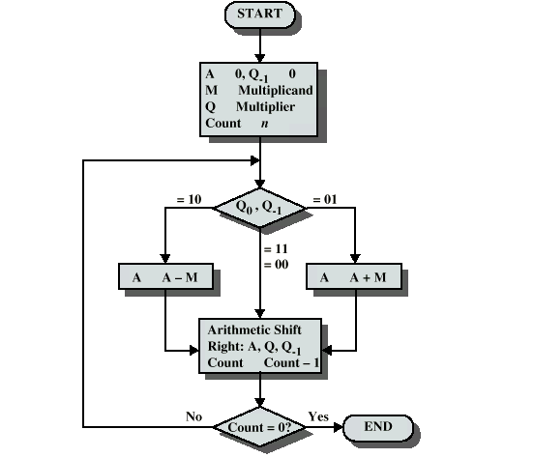
Booth’s Algorithm

Slide 60
Booth Algorithm
1st order(radix-2)
2nd order(radix-4)
3rd order(radix-8)
4th order(radix-16)

Slide 61
Booth Encoding
Encode a number by taking groups of 3 bits
where each 3-bit group overlaps by 1 bit
Consider multiplier B with (n + 1) bit
  Pad B with 0 to match the first term
  if B has an odd number of bits,
  then extend the sign B_{n}B_{n}B_{n-1}...B₀0

Slide 62
Booth Multiplier
Encoding scheme to reduce number of stages in multiplication.
Performs two bits of multiplication at once—requires half the stages.
Each stage is slightly more complex than simple multiplier, but adder/subtracter is almost as small/fast as adder.

Slide 63
Booth Encoding
Two’s-complement form of multiplier:
  y = -2^{n}y_{n} + 2^{n-1}y_{n-2} + 2^{n-2}y_{n-2} + ...
Rewrite using 2ª = 2^{a+1} - 2ª:
  y = -2^{n}(y_{n-1}-y_{n}) + 2^{n-1}(y_{n-2} -y_{n-1}) + 2^{n-2}(y_{n-3} -y_{n-2}) + ...
Consider first two terms: by looking at three bits of y, we can determine whether to add x, 2x to partial product.

Slide 64
Booth Actions
y_{i} y_{i-1} y_{i-2} increment
0 0 0 0
0 0 1 x
0 1 0 x
0 1 1 2x
1 0 0 -2x
1 0 1 -x
1 1 0 -x
1 1 1 0

Slide 65
Booth Multiplier
x8
………….
x0
x
2x
Inverter/shift
x
2x
Booth
decoder
y8
4
y7
selector
y6
y5
y4
y3
y2
y1
Wallace Tree
y0
CLA
CLA
CLA

Slide 66
  Array Multiplier Cell for Booth’s Algorithm
(-A)_{i}
(A)_{i}
0
(-2A)_{i}
(2A)_{i}
select
MUX
c_{in}
Full Adder
s_{in}
c_{out}
s_{out}

Slide 67
Sign Extension Reduction
S0 S0 S0 S0 S0 S0 S0 S0 - - - - - - - -
Sign
extension
S1 S1 S1 S1 S1 S1 - - - - - - - -
S2 S2 S2 S2 - - - - - - - -
S3 S3 - - - - - - - -
1 S3 1 S2 1 S1 1 S0+1

Slide 68
Wallace Tree
Reduces depth of adder chain.
Built from carry-save adders:
  three inputs a, b, c
  produces two outputs y, z such that y + z = a + b + c
Carry-save equations:
  y_{i} = parity(a_{i},b_{i},c_{i})
  z_{i} = majority(a_{i},b_{i},c_{i})

Slide 69
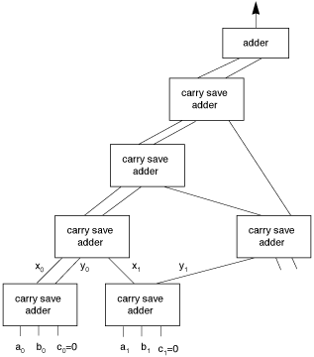
Wallace Tree Structure

Slide 70
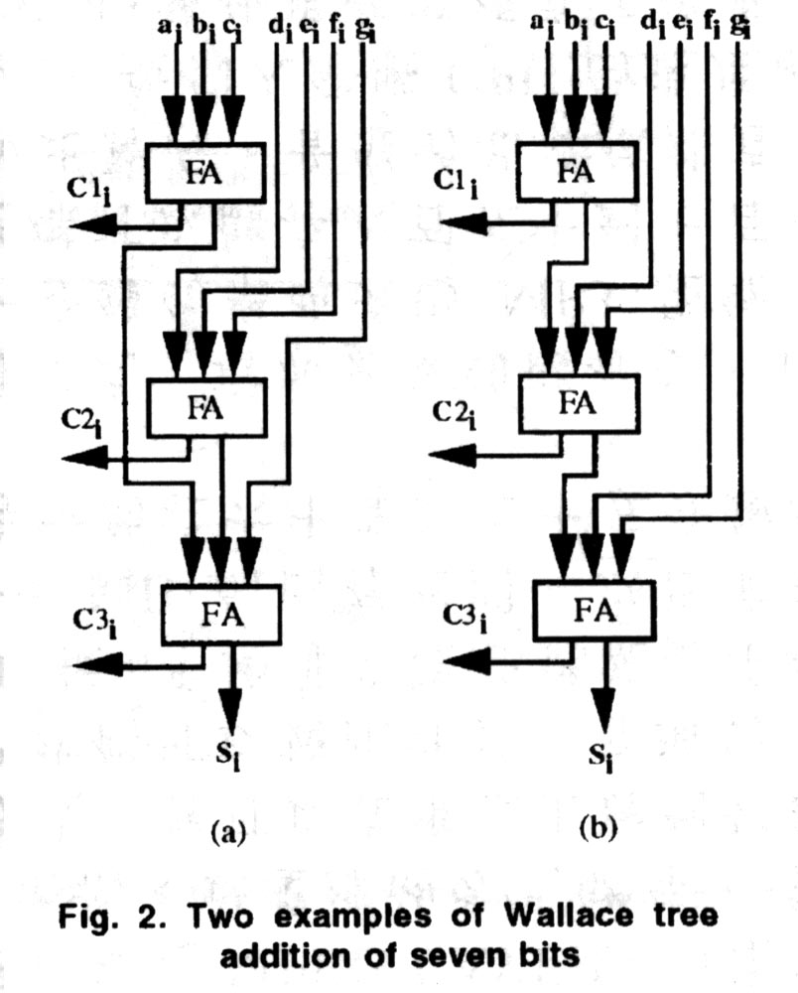
7-bit Wallace Tree Addition

Slide 71
Wallace Tree Operation
At each stage, i numbers are combined to form ceil(2i/3) sums.
Final adder completes the summation.
Wiring is more complex.
Can build a Booth-encoded Wallace tree multiplier.

Slide 72
CSA vs. Wallace Tree
1
2
3
FA
FA
FA
4
FA
FA
5
FA
FA
6
FA
C S
C S

Slide 73
    Radix-4 Modified Booth’s Algorithm
    A 0 1 0 1 1 0 22
    X X 0 0 1 0 1 1 11
    Y(recoded multiplier) 0 1 0 1 0 1
    1
    1 0 0 1 0 1 0
    1 0 0 1 0 1 0
    1 1 1 0 1 1 0
    1 0 0 0 1 1 1 1 0 0 1 0

Slide 74
Wallace-Tree
Collapse the chain of FAs y₀-y₅ (5 adders delays) to the Wallace tree consisting of (4 adders delays)

Slide 75
Floor Plan of Multiplier
1) Square Floor Plan
X₃ X₂ X₁ X₀
X
Y₀
Y₁
Y₂
Y₃
Y
Z₀
|
Z₃
Z₇ Z₆ Z₅ Z₄ Z₃ Z₂ Z₁ Z₀
Z₇ — Z₄

Slide 76
Floor Plan of Multiplier
In The Actual Datapath
x
Y
M₁
M₂
or
M3
L
S
B
MSB
LSB

Slide 77
Floor Plan
Input
Memory
Control Block
Coefficient Memory
Multiplier
Multiplier Reg
Routing
Adder
Add Reg
Out Reg

Slide 78
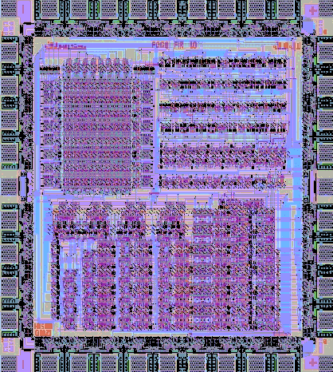
Floor Planning

Slide 79
Results
Cell | Number of Ports
Number of Ports | 34
Number of Nets | 157
Number of Cells | 32
Combinational Area | 24286.050781
Non-Combinational Area | 14935.535156
Total Area | 39221.585938

Slide 80
Power Consumption & Area
Cell Internal Power = 419.5078 uW (57%)
Net Switching Power = 315.0848 uW (43%)
Total Dynamic Power = 734.5925 uW (100%)
Cell Leakage Power = 248.1773 nW

Slide 81
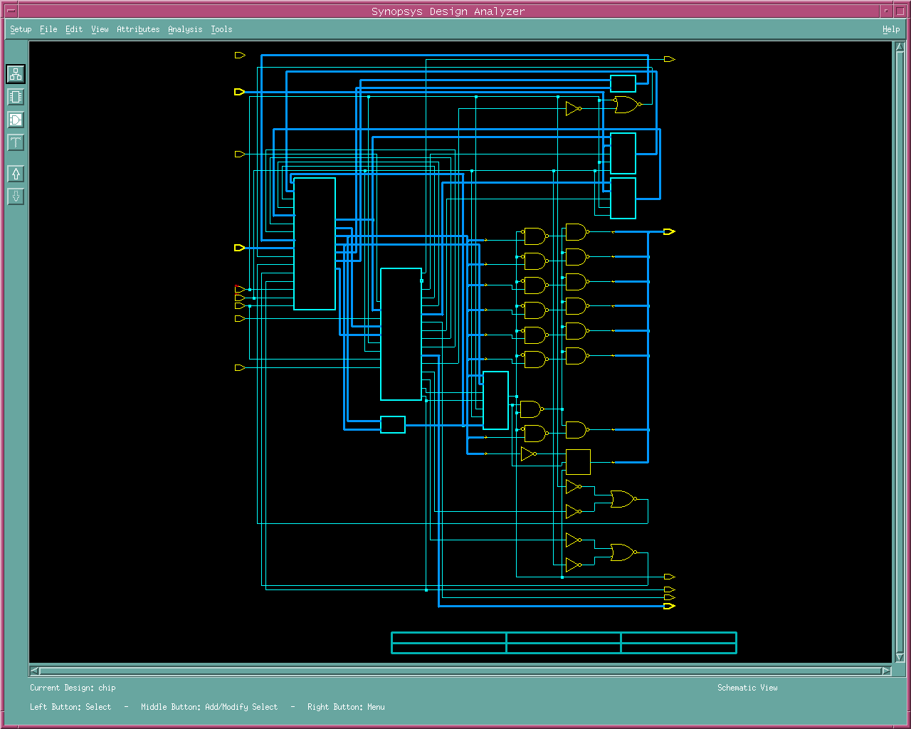
Main Module

Slide 82
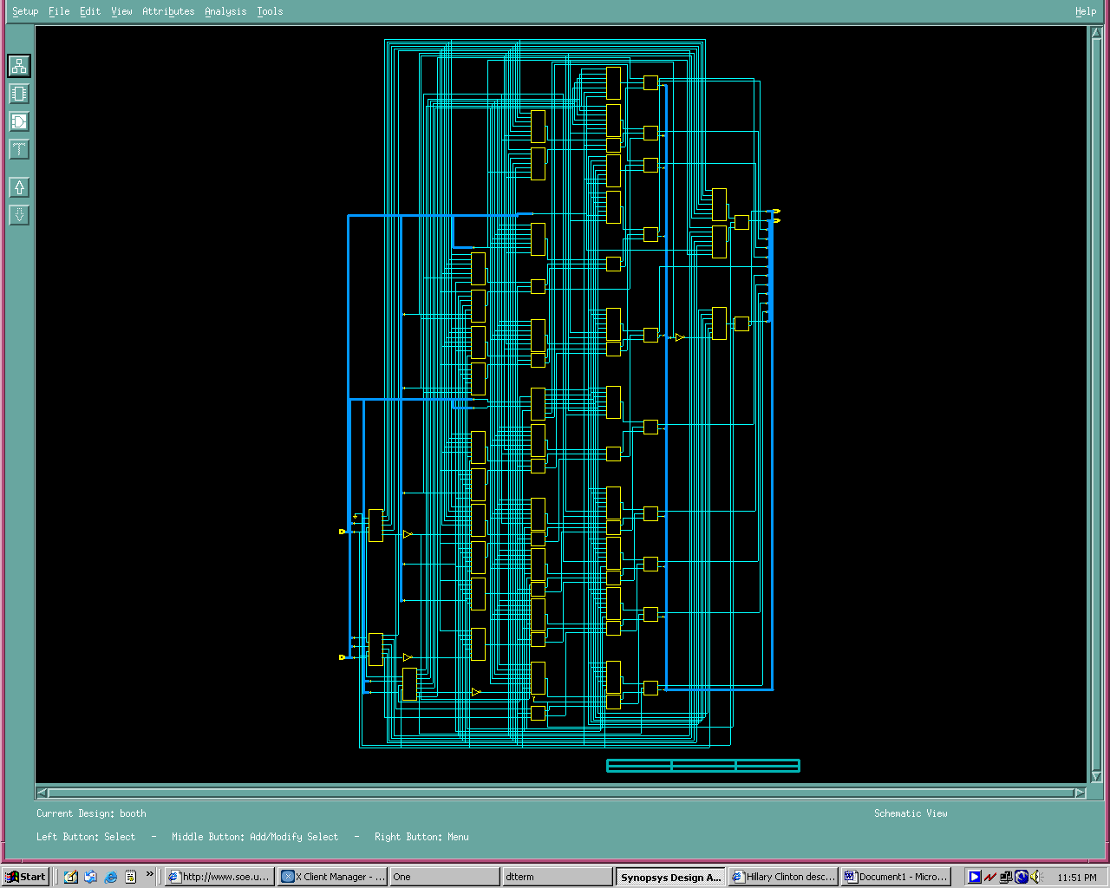
Booth Multiplier

Slide 83
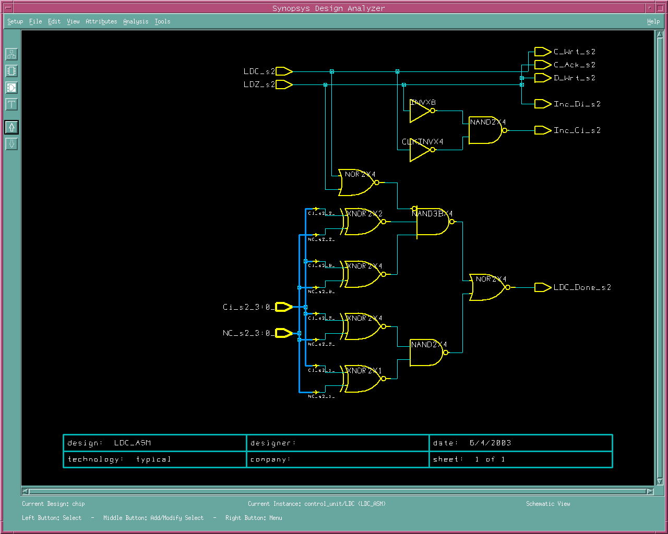
Core Module

Slide 84
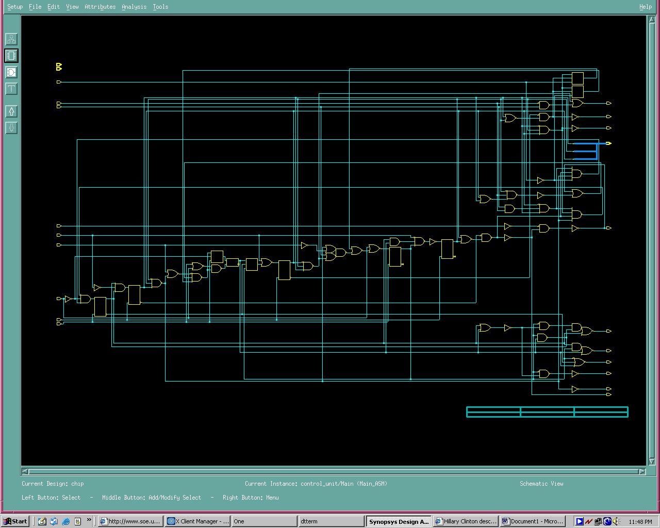
Controller Module

Slide 85
Conclusion
Good Design Experience.
Using Parallel FIR Filter Realization Reduced the number of Multiplier and Adder needed therefore Area was shrunk and power consumption was lowered
Timing Strategies Using non-blocking in Verilog reduced number of states needed for implementation.
Partitioning the design into submodules made design more manageable and optimized.
Performance Optimization was reached with slack time equal to +9.54.

