Slide 1
Need of Autonomous Vehicles
Physically Challenged/ Aged people
Comfort and convenience
Independence and better time utility
Safety
Notes:
Vision problem, handicapped people, slower reaction times, fear of speed, diseased and ill.
Long distance, people can relax and work, enjoy time with family, utilize time in doing something productive.
No need to rely on drivers. Children and elderly need not rely on adults to drive them to certain places.

Slide 2
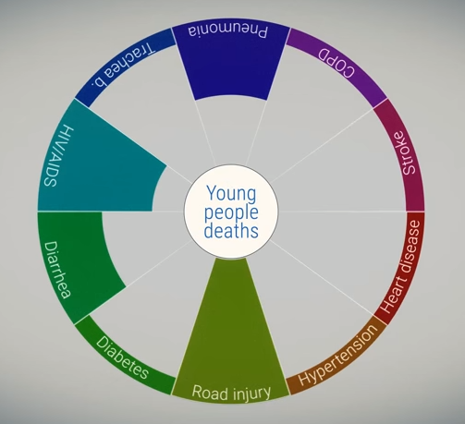
Safety!
In the United States in 2011, there were more than 5.3 million automobile crashes, resulting in more than 2.2 million injuries and more than 32,000 fatalities.
Of the more than 2 million roadway injuries in 2011, 69,000 were pedestrians and 48,000 were cyclists, demonstrating that crash risks are not limited to occupants of the vehicles.
1.25 million people died in 2015 in car accidents. It is the 8th leading cause of death globally and the number one cause for young people.

Slide 3
Science and Technology!
Audio: 3-51
Video:4-51 (when ony cars is there no company logo)
Extend the 4th sec to fill 3rd sec space.
Remove watermarks and logo
https://www.youtube.com/watch?v=rmY1irCK3iw
Road Paint detector
Obstacle Detector
Fast vehicle detector uses millimeter wave radar to detect fast approaching vehicles.
Minimal reliance on GPS
radars, cameras, laser scanner,ultrasonic sensors monitor complete 360 degree surroundings
3-D Digital maps.

Slide 4
Key Technological Aspects!
No better alternative?
Innovation in sensors, cameras, Ultrasonic RADAR technology.
Powerful Data centres and cloud computing servers.
Rapid evolution of Self learning algorithms.
Higher precision in GPS navigation, sattelite imaging and 3-D digital maps.
Complete automation in airplanes and metro networks.
Last mile connectivity.
Highly efficient and reliable.

Slide 5
Levels of Autonomous Vehicles!
Level 0: The human driver is in complete control of all functions of the car.
Level 1: One function is automated.
Level 2: More than one function is automated at the same time (e.g., steering and acceleration), but the driver must remain constantly attentive.
Level 3: The driving functions are sufficiently automated that the driver can safely engage in other activities.
Level 4: The car can drive itself without a human driver.

Slide 6
ECONOMY
Insurance
Ticket Money
United States Automobile Insurance Market:
Revenue: $220 billion
Annual Growth: 1.9%
Employment: 277,383
Autonomous vehicles: lower chances of accidents.
Autonomous cars are programmed to be saints. They don't speed. They don't drive drunk, run red lights, or park where they're not supposed to.
Speeding tickets, red light violations, parking violations contribute huge money to city and state treasuries.

Slide 7
Parking
Oil Demand/ Fuel Efficiency
Cars can be programmed to park efficiently, with minimum space wastage
They can park themselves in a distant place, with no need for us to drive till there.
Oil demand decreases, due to economically efficient driving.
Each day 420,000 barrels of fuel is lost due to traffic.
Hybrid cars (Electric cars) which would impact companies like British Petroleum, Indian Oil Corp and others.

Slide 8
Life!
The official value of a statistical life used by the Department of Transportation is $9.2 million, so if autonomous cars can save 30,000 lives a year this is a yearly benefit of $276 billion. In addition to the lost lives, the CDC estimates that the deadly crashes in 2005 also lead to $41 billion in medical and work loss costs. So the total cost of deadly crashes per year is around $317 billion.
More lives saved is more contribution to a nation’s wealth.
Time is money! More time can be used to do something productive (obviously).

Slide 9
Social issues, Society and culture
Pros
Expansion of Suburbs, resulting in City expansion.
Inclintion towards Sustainable Energy.
Less traffic, Less accidents, More comfort, Convenient.
Better Implementation of Emergency systems.
Anyone can use it
Faster transportation with lower risk
Police officers can focus on heinous crimes

Slide 10
Social issues, Society and culture
Cons
Employment issues in transportation industry.
Vunerabilities in the system(Hacking, complete control or silent modification in system)
Can be used for illegal activities and terrorism.
Privacy Issues (Location tracking)
Handing over your life to a computer.

Slide 11
Politics and societal control
How, if at all, should the use of AVs be regulated, and at what level?
How should the safety of AVs be tested, and by whom? To what safety standards should AVs be held?
To what extent should policymakers encourage the adoption of Avs
question of who bears responsibility for an autonomous car that crashes.
an increase in the number of cyber attacks and the government needs to prepare for coping up with such attacks.

