Slide 1

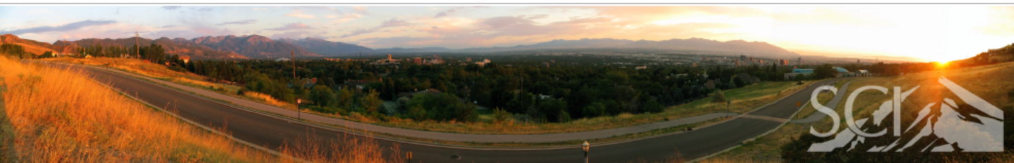
Stereo using
Rectified Images
Prateep Mukherjee
Praful Agrawal

Slide 2
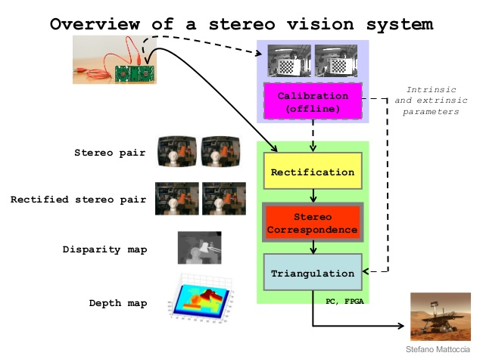
Bigger picture …

Slide 3



What we are doing …

Slide 4

What we are doing …

Slide 5

Project overview …
Goal
Improve disparity map quality using image cues, intensity information.
Improve brute-force search over every pixel by using faster techniques based on edge information.
Handle occlusions.
Contributions
Find good correspondences between two images.
Discuss algorithms !!
Good disparity maps for depth reconstruction
Image Processing for noise removal
Evaluation

Slide 6
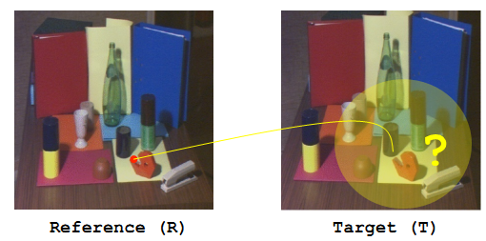
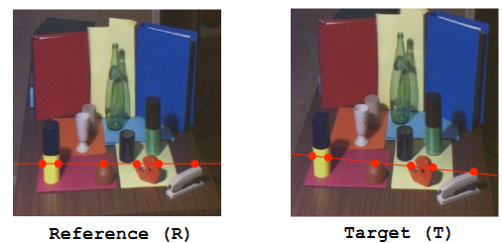
Good correspondence …
Brute Force
Input:
Search in patches around reference pixel for correspondence.
Cost(I_1,I_2) :
- squared difference
- normalized cross-
correlation
Output:

Slide 7
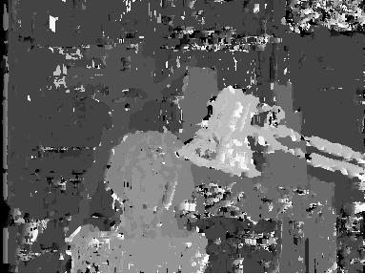
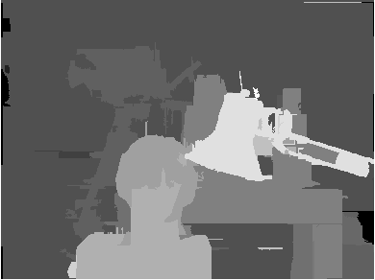
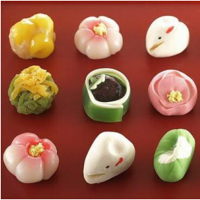

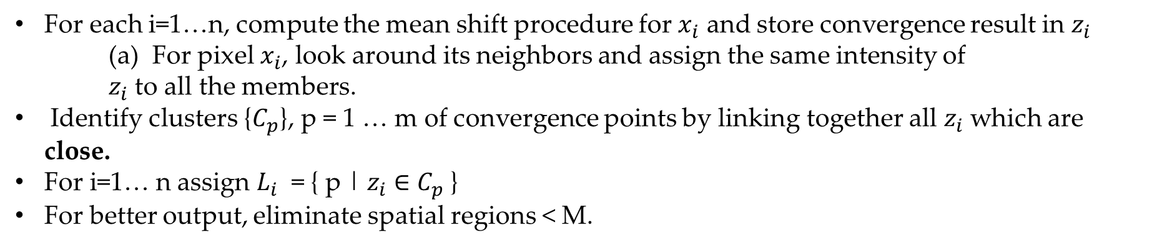
With Post-processing …
Mean Shift Segmentation[3] …
For each i=1…n, compute the mean shift procedure for $x_{i}$ and store convergence result in $z_{i}$
(a) For pixel $x_{i}$, look around its neighbors and assign the same intensity of $z_{i}$ to all the members.
Identify clusters {$C_{p}$}, p = 1 … m of convergence points by linking together all $z_{i}$ which are close.
For i=1… n assign $L_{i}$ = { p | $z_{i}$ $∈C_{p}$}
For better output, eliminate spatial regions < M.
Disparity map : before smoothing
Disparity map : after smoothing
Input
Output

Slide 8
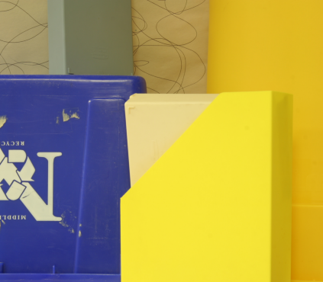
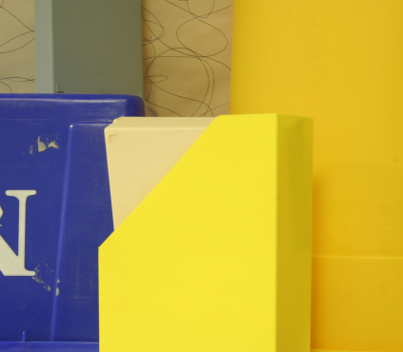
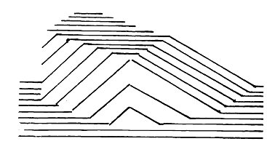
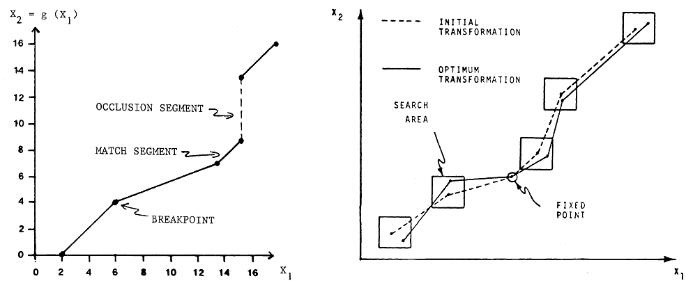



Good correspondence …
Sequential Matching of scan-lines(Miller et al. 1979)
Stereo images …
$$g\left(x_{1}\right)=x_{2}$$
Edge profile …
$$X_{1}$$
$$X_{2}$$
Broken segment matcher…

Slide 9
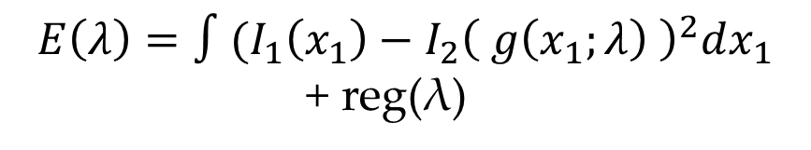
Good correspondence …
Sequential Matching of scan-lines(Miller et al. 1979)
Stereo images …
$$g\left(x_{1}\right)=x_{2}$$
Edge profile …
$$X_{1}$$
$$X_{2}$$
$$E\left(λ\right)=∫(I_{1}\left(x_{1}\right)−I_{2}{\left( g\left(x_{1};λ\right) \right)}^{2}dx_{1}$$
+ reg(λ)
λ is the set of parameters describing the optimal transformation. Consider NO noise.
PRO: Separates occluded pixels(infeasible λ).
Broken segment matcher…

Slide 10
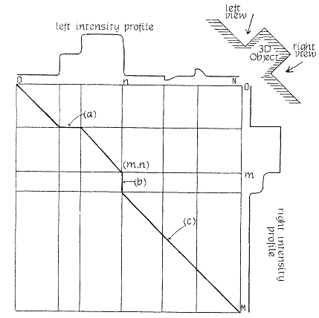
Good correspondence …
Dynamic Programming (Ohta & Kanade, 1985)
Intra-scanline search: Path finding using DP

Slide 11
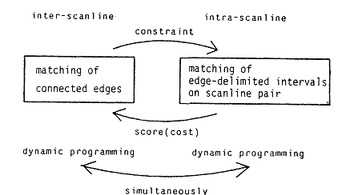
Good correspondence …
Dynamic Programming (Ohta & Kanade, 1985)
Algorithmic overview
Intra-scanline search: Path finding using DP

Slide 12
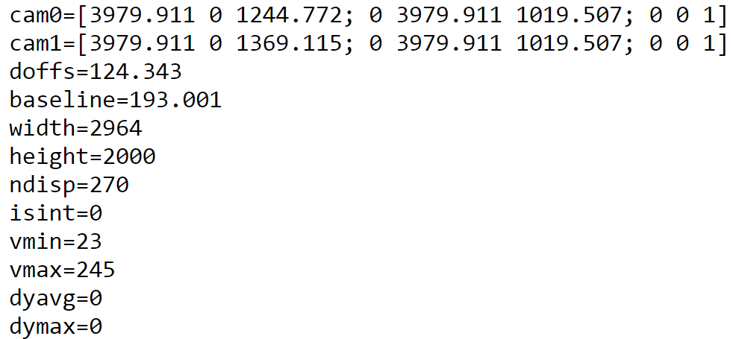
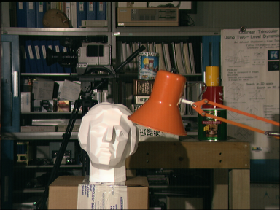
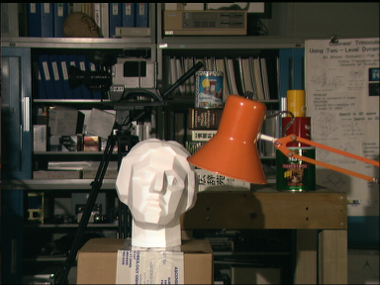
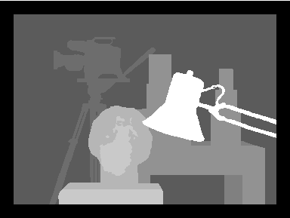
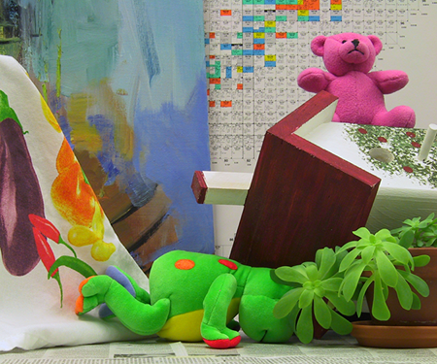
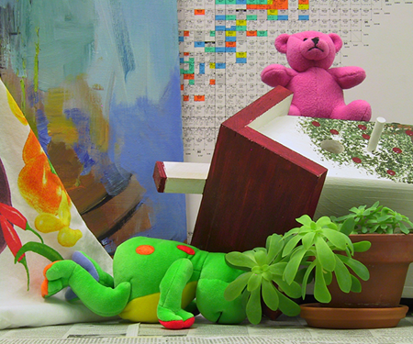
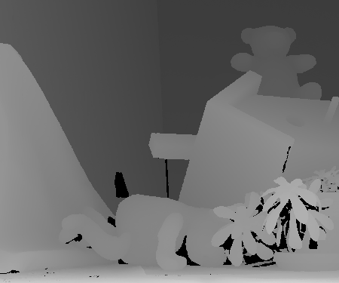
Experimental Setup …
Middlebury datasets(http://vision.middlebury.edu/stereo/data/)
Ground-truth(GT) and camera calibration values provided.
Images rectified using given parameters.
Experiments evaluated for “tsukuba” and “bear” datasets.
Calibration Matrix
Left
Right
GT
Left
Right
GT

Slide 13
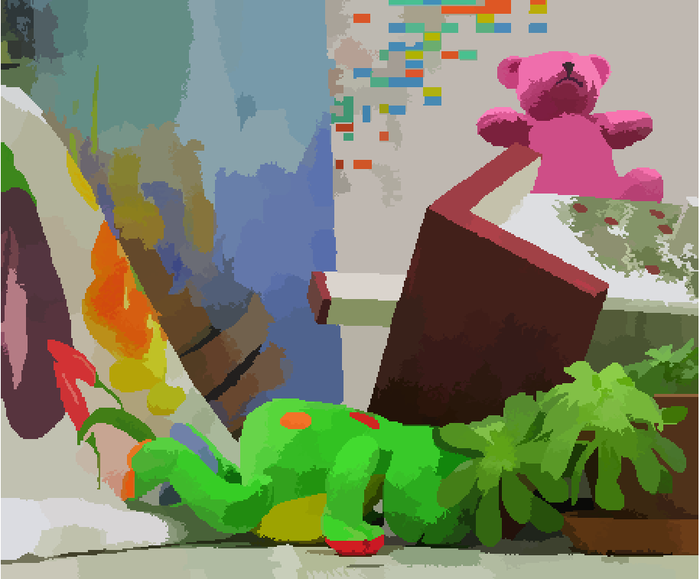
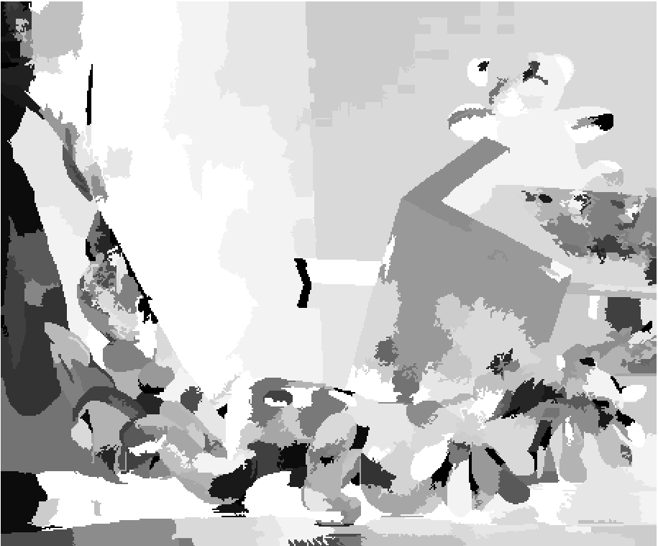

Evaluation …
Segmentation
Ours
Ground-Truth

Slide 14
Effect of Window-sizes

Slide 15
References
[1] Hirschmuller, H., and Scharstein, D., “Evaluation of cost functions for stereo matching”, In IEEE Conference on Computer Vision and Pattern Recognition (2007), pp. 1–8.
[2] Ohta, Y., and Kanade, T., “Stereo by intra- and inter- scanline search using dynamic programming”, IEEE Transactions on Pattern Analysis and Machine Intelligence PAMI-7, 2 (1985), 139–154.
[3] http://luthuli.cs.uiuc.edu/~daf/courses/CS-498-DAF-PS/Segmentation.pdf
[4] Robert L. Henderson ; Walter J. Miller ; C. B. Grosch; “Automatic Stereo Reconstruction Of Man-Made Targets”, Proc. SPIE 0186, Digital Processing of Aerial Images, 240 (September 4, 1979); doi:10.1117/12.957520.

