Slide 1
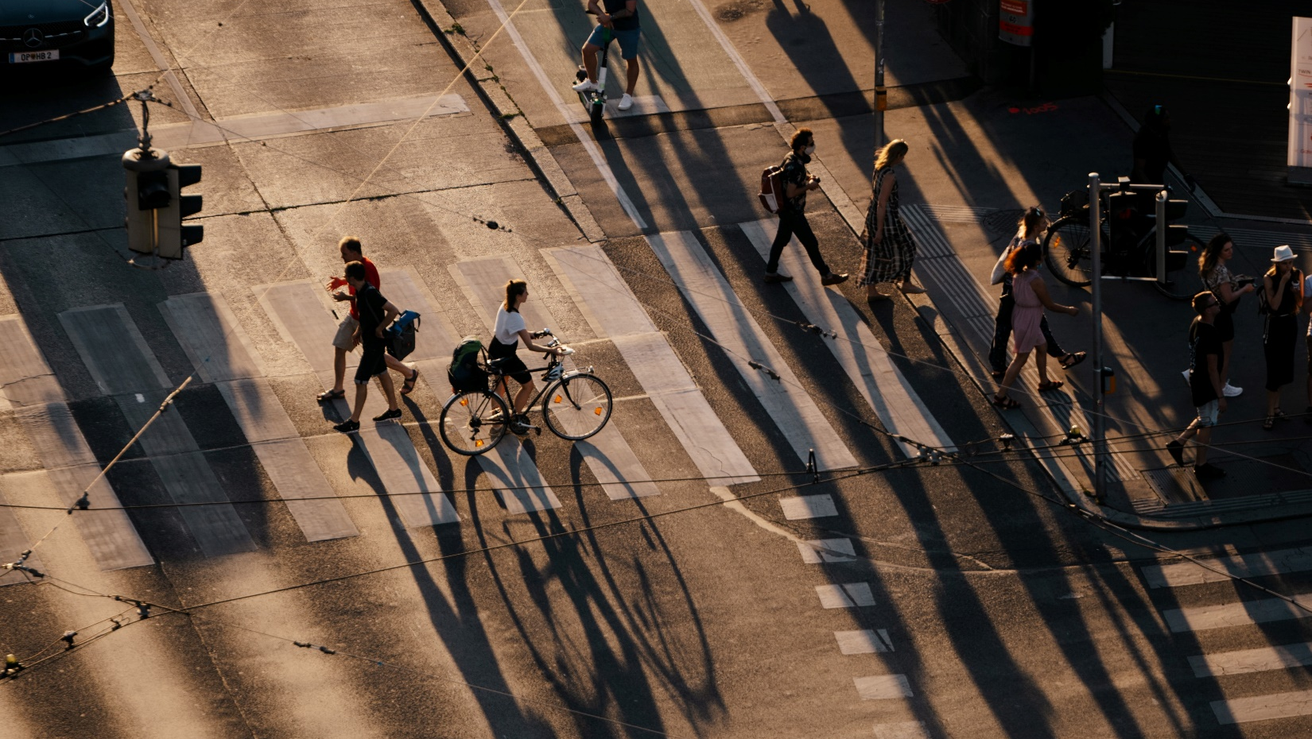
Challenge:
„Sharing Mobility“

Slide 2
Problem
Bike Rides Stagnated
Emissions
Public Space Distribution
Mental & Physical health
for Companies
for Institutions
Human
Environmental
COSTS

Slide 3
Solution = Bike Riding
Redistribution of public space
Lower emissions
Healthier, happier citizens
Reducing companies‘ costs – 2000€ employee/year
Increasing companies‘ productivity
Contribution to SDGs

Slide 4









Slide 5




Gamification
Competition
Reward System
Community

Slide 6
Thanks for your attention
Any questions?

