Slide 1
Vehicle Service Management System
A Modern Full-Stack Web Application
Presented by
Pratyush Singh

Slide 2
2
Project Overview
  Business Context and Problem Statement
  Project Objective
  Solution and Key Features
  Technology Stack
  System Architecture
  User Roles
  System Flowchart
  Security Features
  Quality Assurance and Testing
  Project Screenshots

Slide 3
Business Context and Problem Statement
Business Context
  Automobile service centers handle multiple vehicle service requests daily
  Many centers still rely on manual or semi-automated systems
  This leads to operational inefficiencies and management challenges
Key Challenges
  Service Tracking Issues
    Difficulty tracking service requests and vehicle service history
  Technician Management Issues
    Poor scheduling and uneven workload distribution
  Inventory & Parts Issues
    Low-stock situations and parts availability delays
  Billing & Payment Issues
    Manual invoice generation and payment tracking delays
  Reporting & Analytics Issues
    Lack of consolidated reports on revenue and workload
  Customer Experience Issues
    Limited visibility into service status and billing details

Slide 4
4
Proposed Solution
Centralized Vehicle Service Management System
  Develop a centralized and secure system to manage service center operations
System Capabilities
  Service Management
    Create, track, and manage vehicle service requests
  Technician Management
    Assign technicians and monitor service progress
  Inventory Management
    Track spare parts and low-stock situations
  Billing & Payments
    Automate invoice generation and payment tracking
  Reporting & Analytics
    Dashboards and reports for revenue, workload, and service trends

Slide 5
5
Project Objective
Primary Goal
  To design and develop a secure, scalable, full-stack Vehicle Service Management System
  To digitize and automate service center operations 6.Vehicle Management System\
Core Development Goals
  Modern Full-Stack Architecture
    ASP.NET Core Web API (Backend) + Angular (Frontend)
  Role-Based Security
    JWT-based authentication with RBAC (Admin, Service Manager, Technician, Customer)
  Data Accuracy & Maintainability
    Clean Architecture, EF Core, and LINQ-based querying
  Real-World Workflow Automation
    Service lifecycle: Requested → Assigned → In Progress → Completed → Closed Billing/Invoice).
Expected Outcomes
  Efficient service request management and tracking
  Better technician assignment and workload visibility
  Improved parts inventory and billing visibility
  Dashboards and reports for decision-making and transparency

Slide 6

Solution and Key Features
Service Request Management
  Create, update, cancel service requests
  Track lifecycle: Requested → Assigned → In-Progress → Completed → Closed
  Priority-based handling (Normal / Urgent)
Technician Assignment & Tracking
  Assign technicians to service requests
  Technician updates service status
  Workload visibility through LINQ-based reports
Billing & Payments
  Auto-generate invoices from services and parts used
  Tax and labor charge calculations
  Invoice lifecycle: Generated → Paid
  Customer payment tracking
Inventory & Parts Management
  Real-time spare parts tracking
  Low-stock alerts
  Automatic stock deduction when parts are used
Reports & Analytics (LINQ)
  Monthly service & revenue reports
  Technician workload analysis
  Vehicle service history
  Category-wise service and revenue analysis

Slide 7
7
Technology Stack
Backend
  Framework: ASP.NET Core Web API (.NET 8)
  ORM: Entity Framework Core
  Querying: LINQ
  Authentication: JWT + ASP.NET Identity
  Database: SQL Server
Frontend
  Framework: Angular (Latest)
  UI: Angular Material
  Forms: Reactive Forms
  Language: TypeScript
Tools & Testing
  Swagger – API documentation
  Postman – API testing
  xUnit – Unit & integration testing

Slide 8
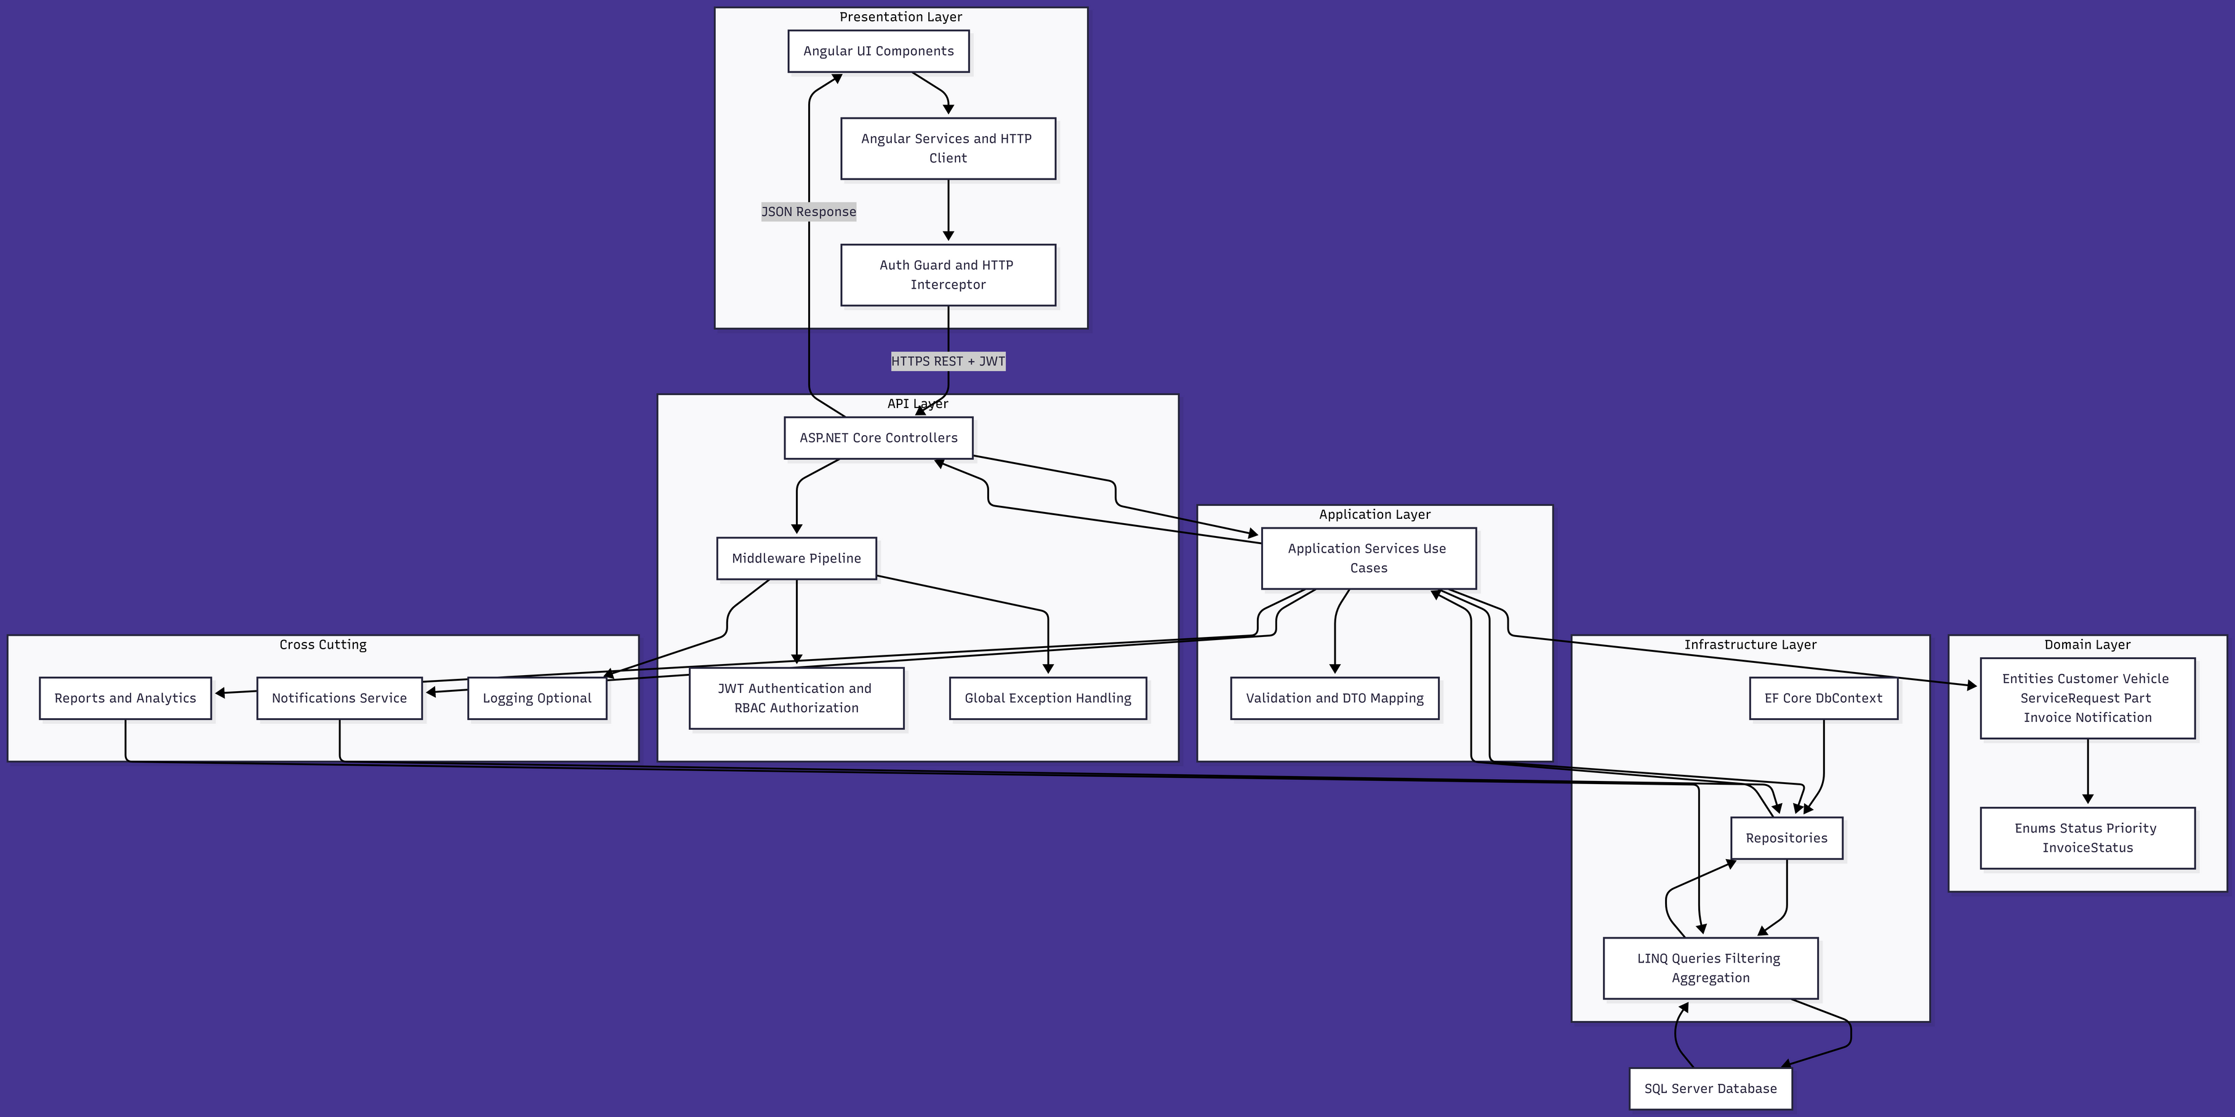
8
System Architecture

Slide 9

User Roles
Service Manager
  Full access to reports
  Assign technicians
  Monitor service
Admin
  User management & role assignment
  System configuration
  Manage service categories
Technician
  View assigned service requests
  Update service status
  Record parts usage
Customer
  Register vehicles
  Create service requests
  Track service status
  View and pay invoices

Slide 10
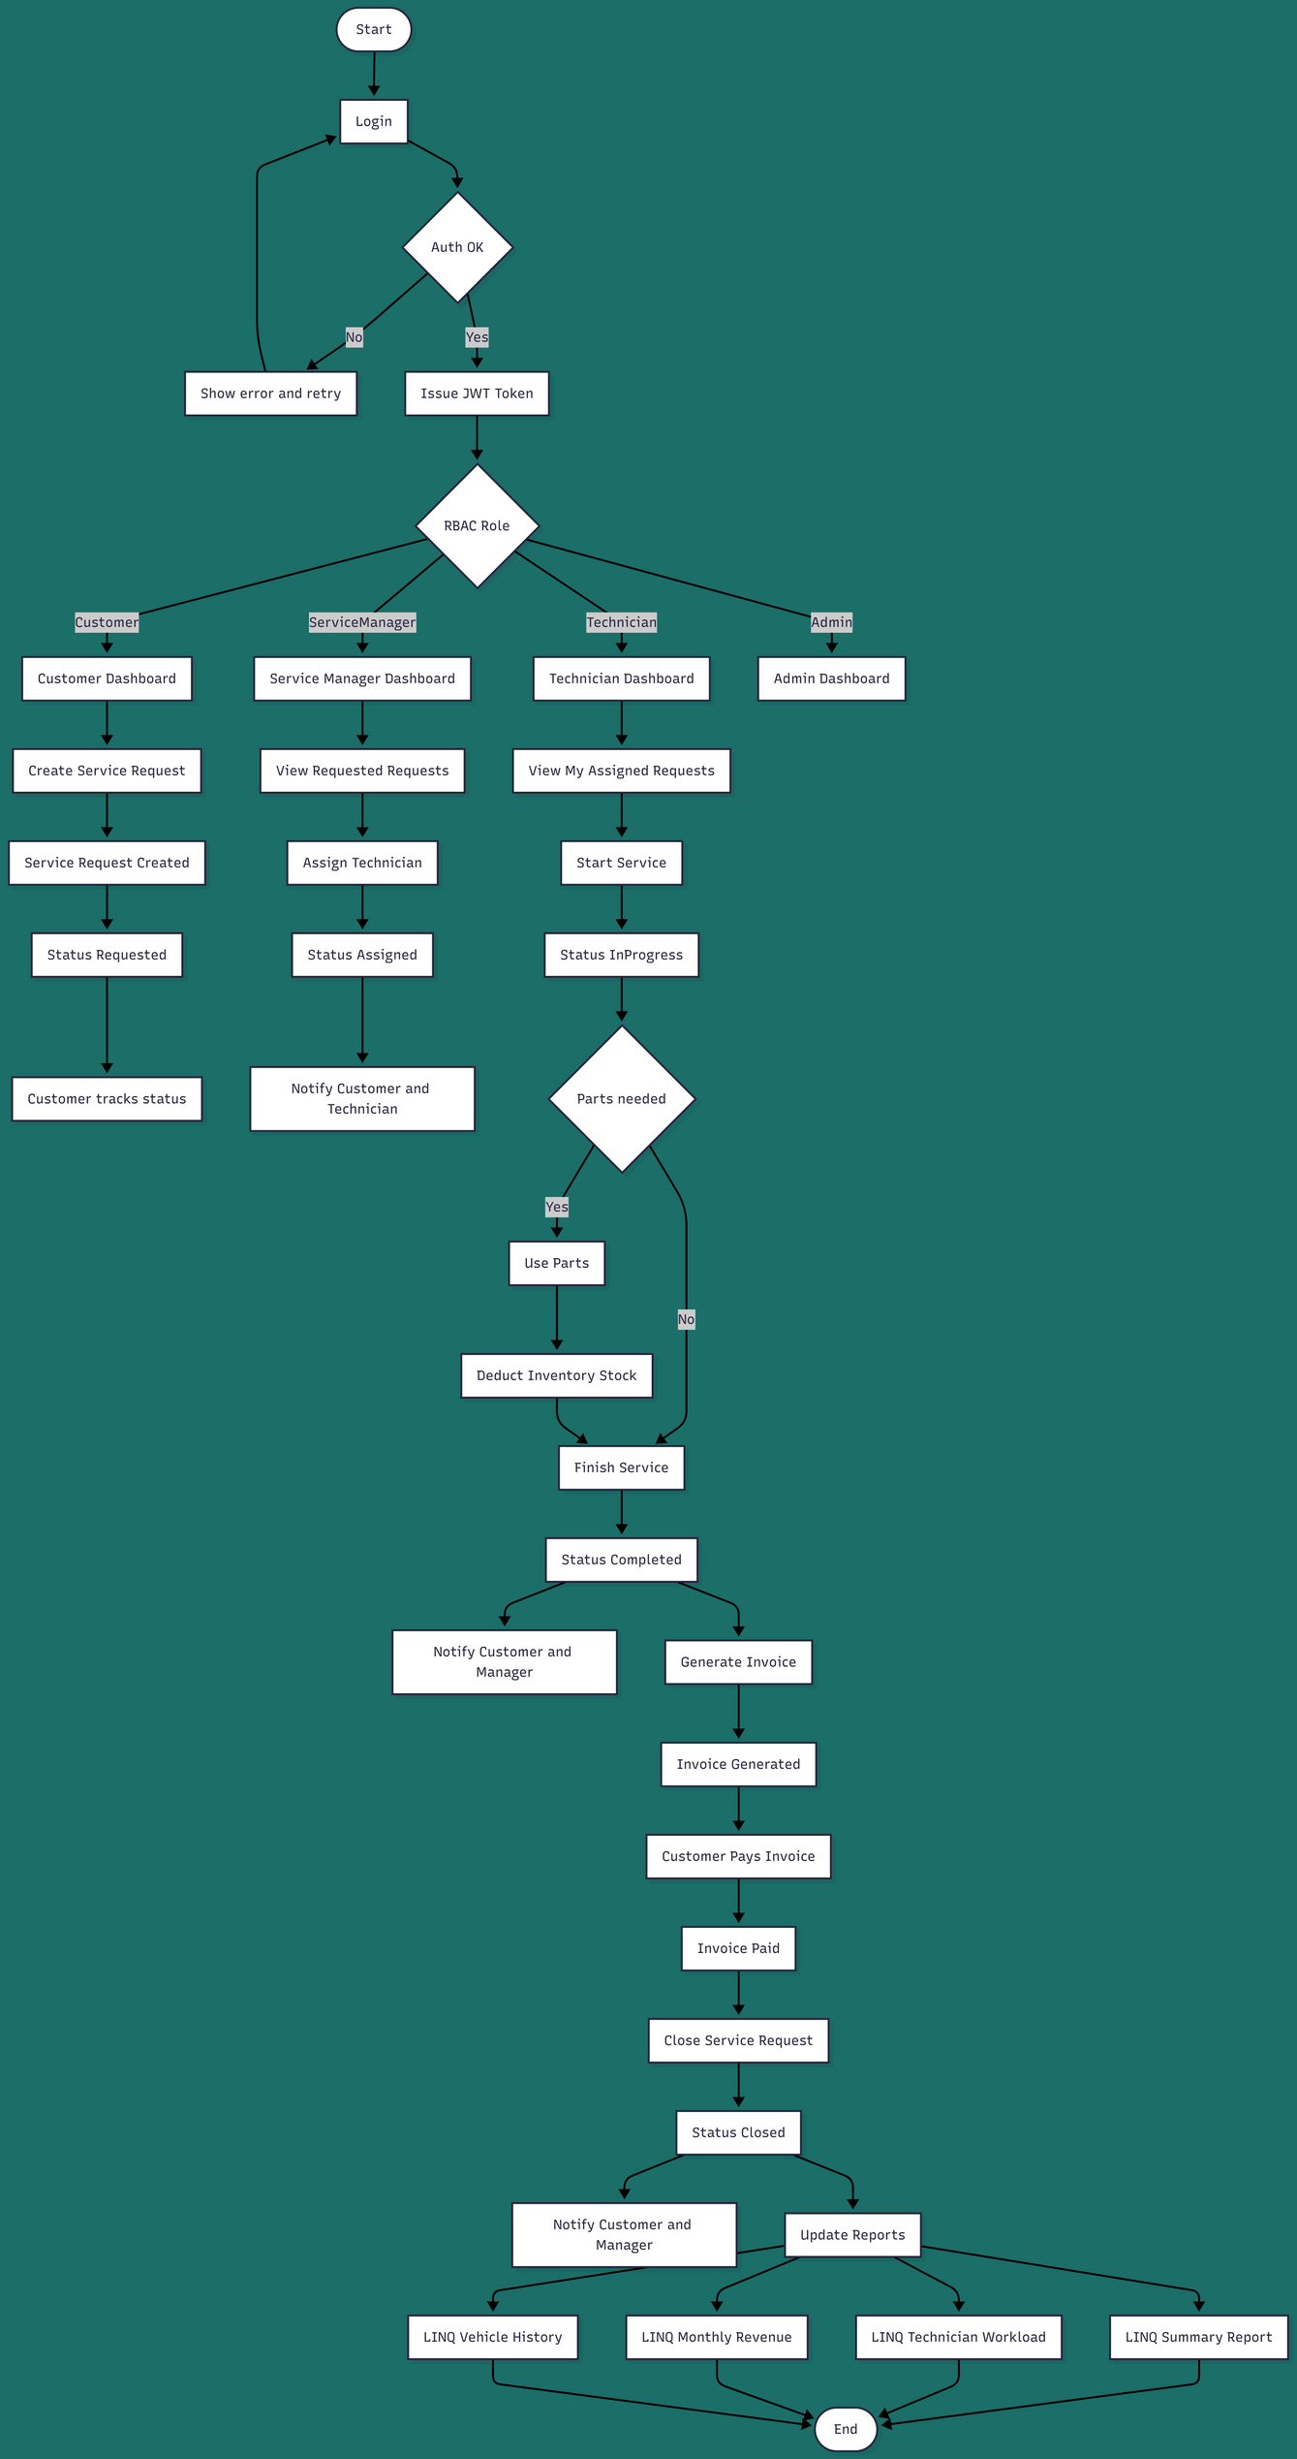
System Flowchart
10

Slide 11
Security Features
11
Core Security
  JWT Authentication for all APIs
  Role-Based Access Control (RBAC)
Backend Security
  DTO-based data exposure
  Protected endpoints
  Global exception handling middleware
Frontend Security
  Angular route guards
  HTTP interceptors for JWT
  Secure role-based navigation

Slide 12
12
Quality Assurance and Testing
Your Testing Strategy
  xUnit Testing
    Service logic validation
    Billing and inventory calculations
    LINQ-based report correctness
  Postman Testing
    Endpoint validation
    Auth & RBAC checks
    Error and edge cases
Documentation
  Swagger OpenAPI for all endpoints text

Slide 13
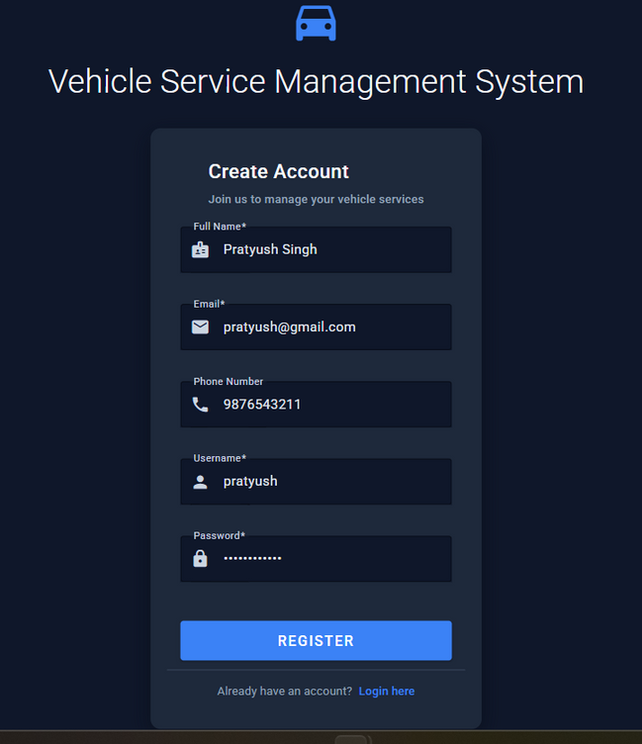
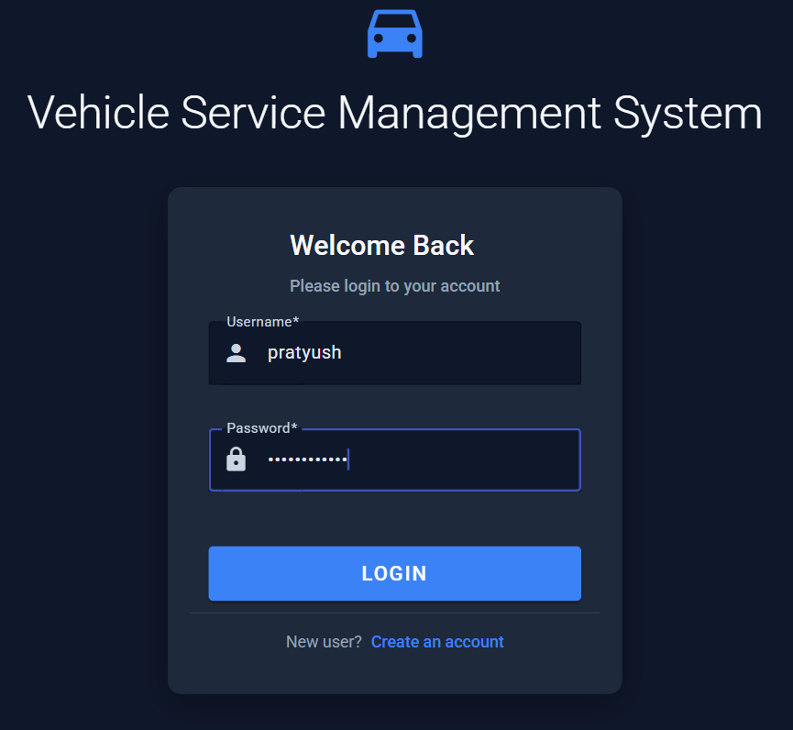
User Authentication & Onboarding
Register( Default as Customer)
Registered Customer Login
13

Slide 14
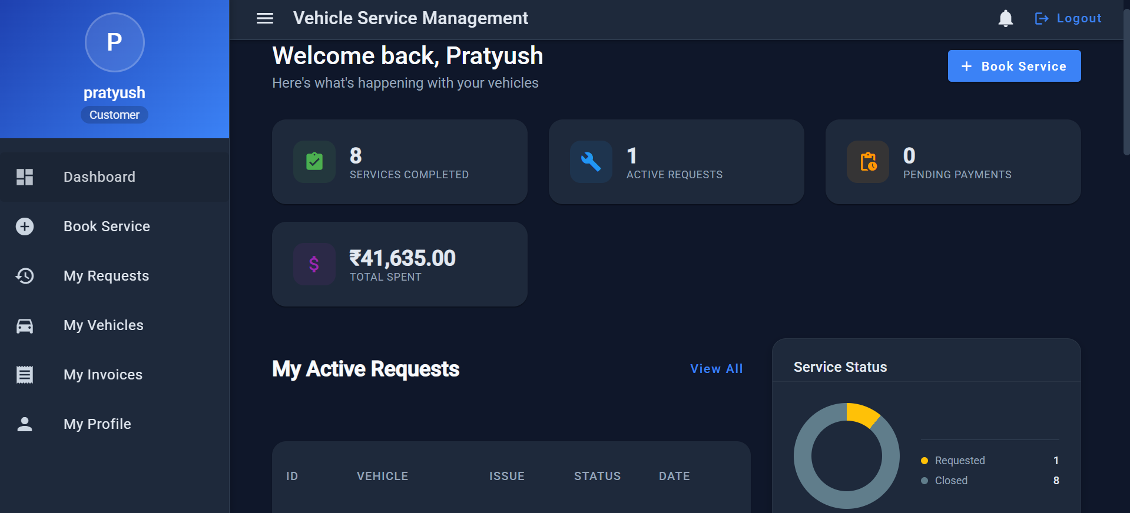
Customer’s Dashboard
14

Slide 15
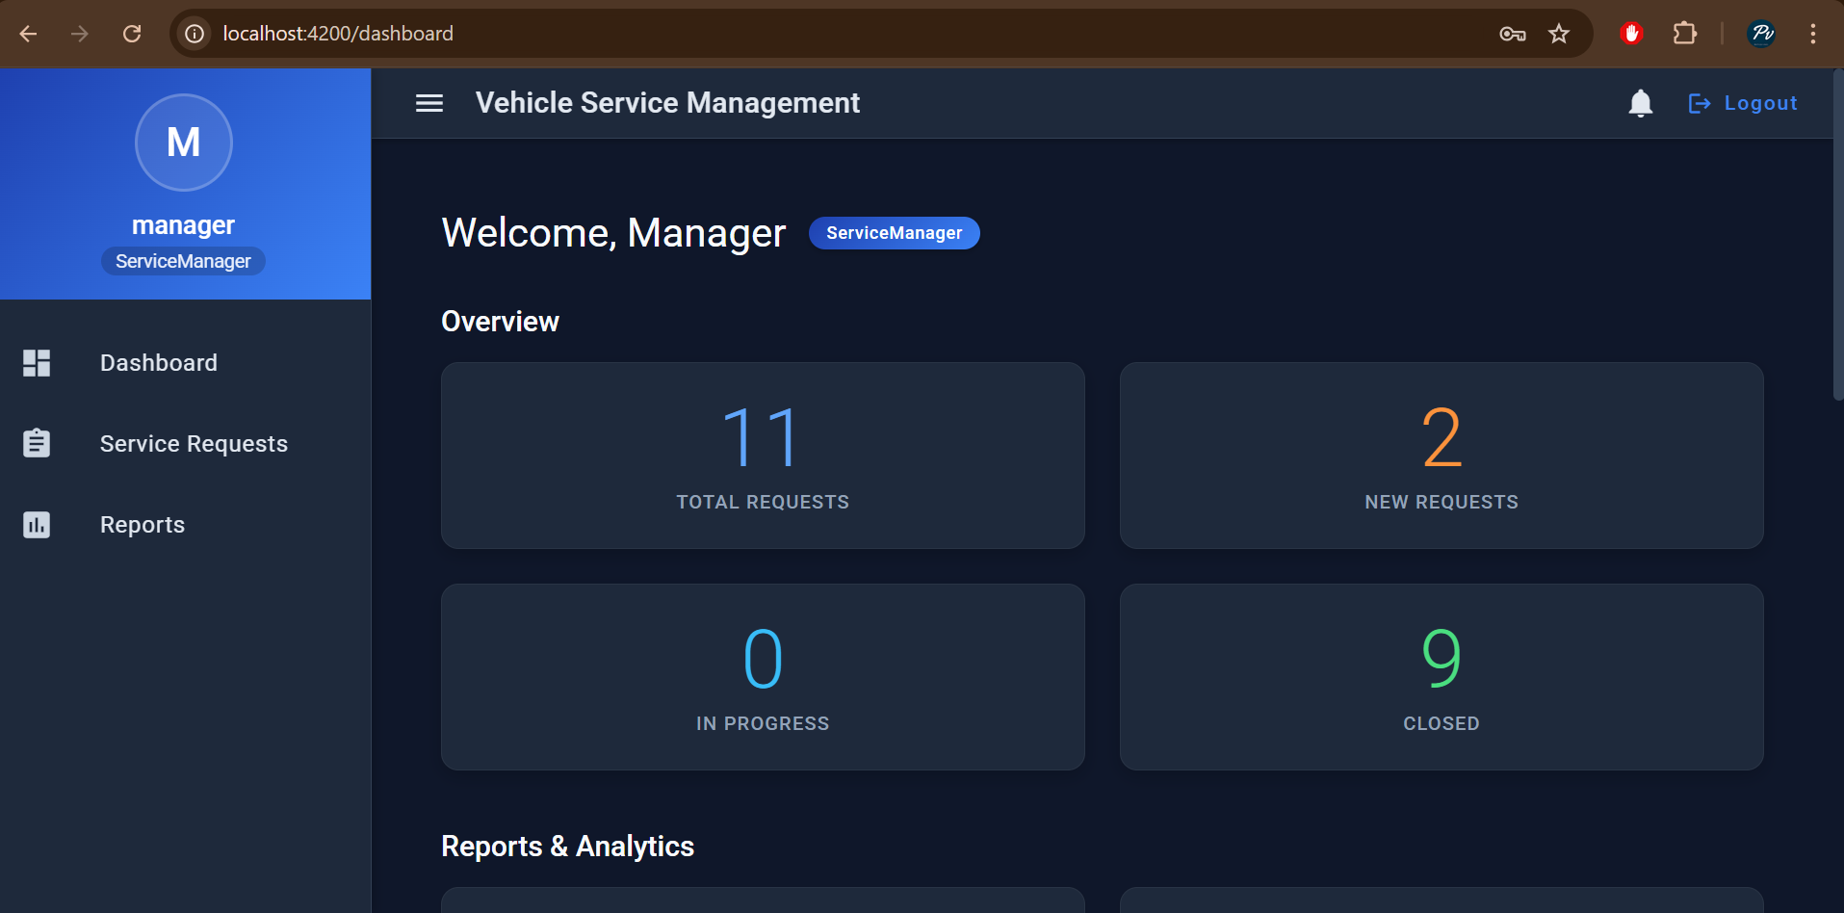
15
Manager’s Dashboard

Slide 16
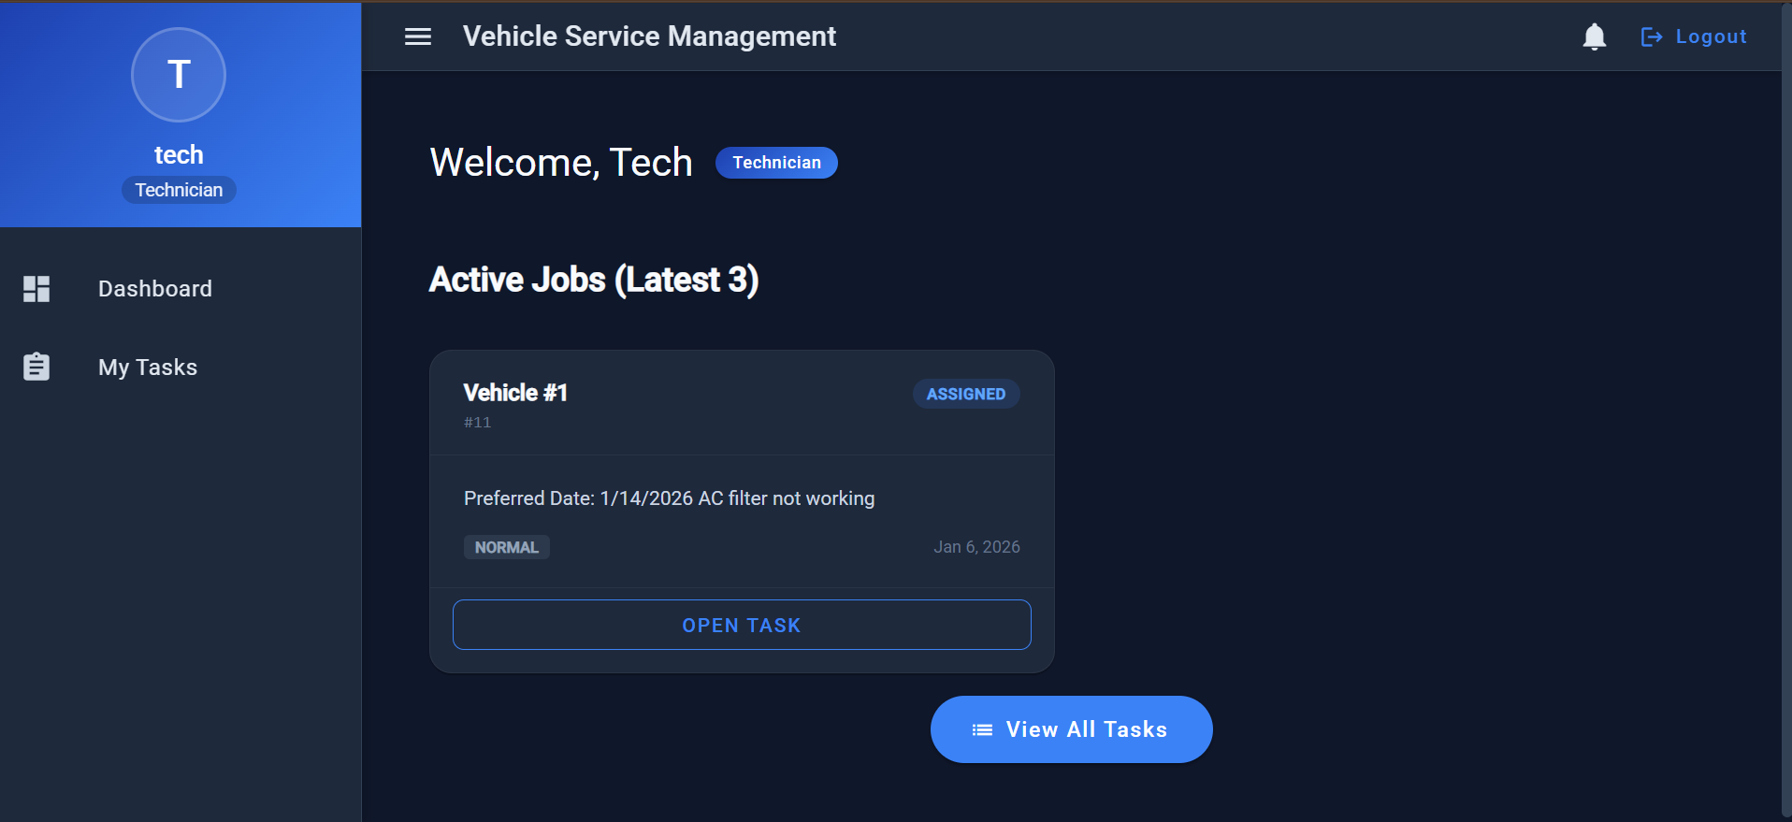
16
Technician’s Dashboard

Slide 17
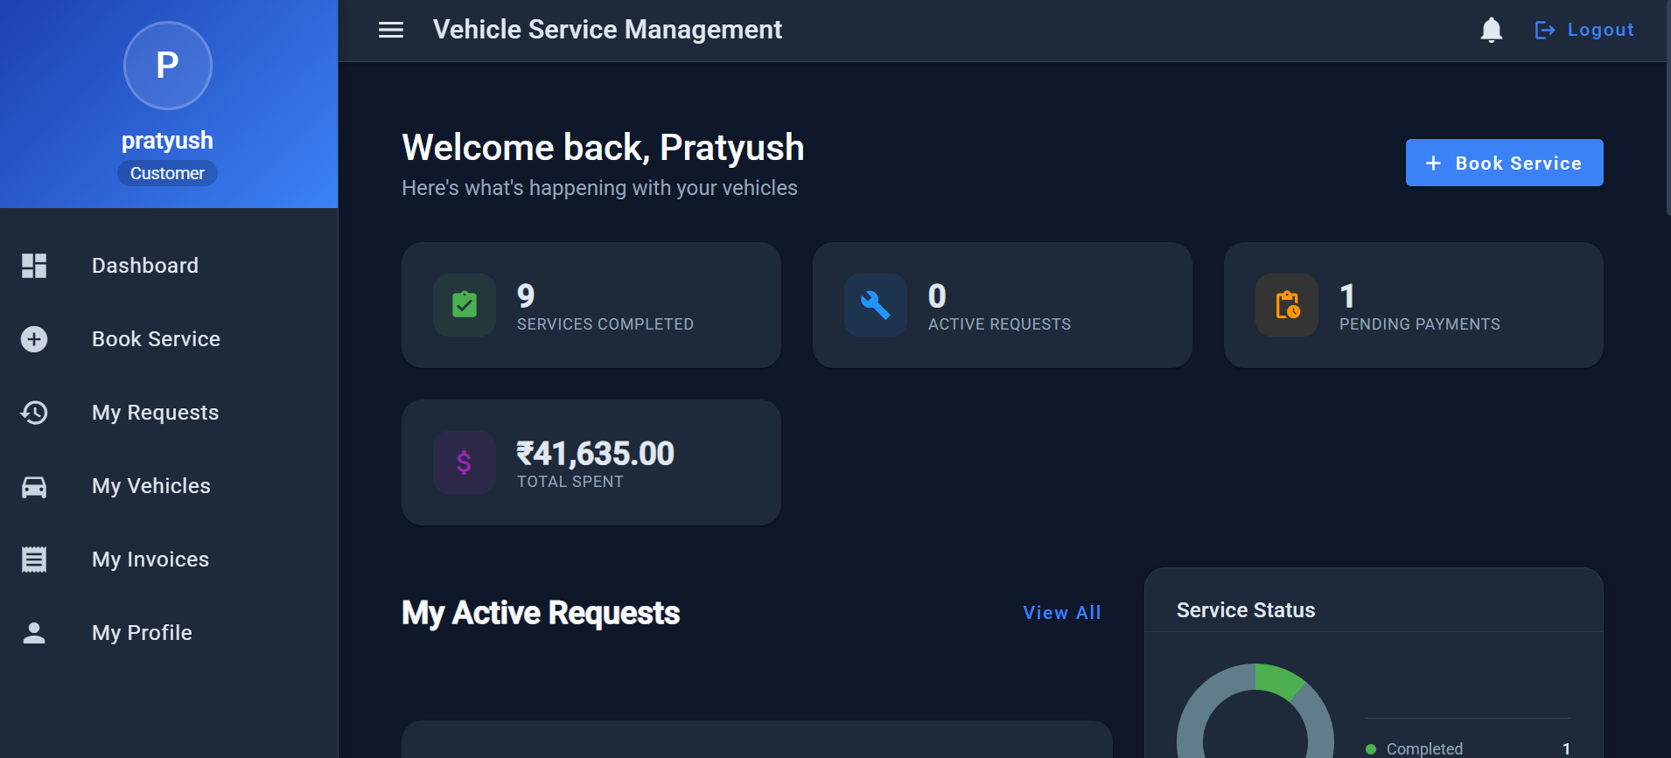
17
Customer Pending due update

Slide 18
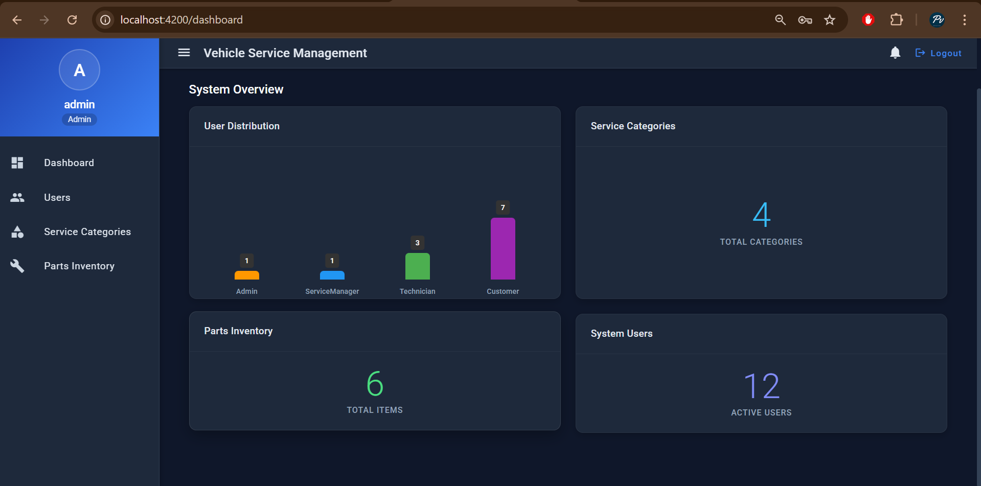
18
Admin’s Dashboard

Slide 19
19
LIVE DEMO

Slide 20

20
THANK YOU

