Slide 1

Optimized TimeTable Generator
By :-
Bhairu Ghavane - 31335
Prathmesh Pawar - 31359
Internship Guide : Prof. R.a.kulkarni

Slide 2

Content
Problem Definition
Objectives
Algorithms
Block Diagram
Features and Functionality
Technology
Implementation
Future Scope
References
Conclusion

Slide 3
Problem Defination
Efficient Timetable generation system for the college.
In any educational institution, creating an efficient timetable is not just a logistical challenge; it's a crucial component of smooth operations and student satisfaction.
Traditionally, this process has been manual, time-consuming, and prone to errors. Our college faced similar challenges, which prompted us to embark on the journey of developing a solution that could streamline and optimize the timetable generation process.
Time-Consuming Manual Process: Historically, timetable creation involved manual coordination between departments, faculty members, and administrative staff. This not only consumed significant time and resources but also led to scheduling conflicts and inefficiencies.
Complexity of Constraints: The complexity of our college's scheduling constraints added another layer of difficulty. These constraints included varying faculty availability, room capacities, course dependencies, and student preferences, making it challenging to create balanced and satisfactory timetables manually.
Dynamic Nature of Scheduling: Furthermore, the dynamic nature of scheduling, with changes in course offerings, faculty availability, and student enrollments each semester, compounded the difficulty of maintaining an optimized timetable consistently.

Slide 4
Objectives
Automation of Timetable Generation:
Our primary objective was to develop a system that automates the entire timetable generation process, eliminating the need for manual intervention and reducing the potential for errors.
By automating repetitive tasks and leveraging computational algorithms, we aimed to streamline the scheduling process and free up valuable time for faculty and administrators.
Optimization of Resource Utilization:
We sought to optimize the utilization of college resources, including classrooms, faculty members, and time slots, to maximize efficiency and minimize waste.
By intelligently assigning courses, classrooms, and faculty to time slots, we aimed to ensure that resources are utilized effectively and equitably across the college.
Minimization of Scheduling Conflicts:
One of our key objectives was to minimize scheduling conflicts and constraints, such as overlapping class times, double-booked classrooms, and faculty availability issues.
Through the use of sophisticated algorithms and conflict resolution techniques, we aimed to generate timetables that are both feasible and satisfactory to all stakeholders.
Enhancement of User Experience:
We aimed to enhance the overall user experience for students, faculty, and administrators by providing intuitive interfaces, interactive tools, and real-time updates.
By prioritizing user feedback and usability testing, we sought to ensure that our system meets the needs and expectations of its users effectively and efficiently.
Adaptability to Changing Requirements:
Our objective was to develop a flexible and adaptable system that can accommodate changing requirements, such as new course offerings, faculty hires, and student enrollments.
By designing the system with modular architecture and configurable parameters, we aimed to facilitate future updates and enhancements without significant disruption to operations.
Improvement of Overall College Experience:
Ultimately, our overarching objective was to improve the overall college experience for students, faculty, and administrators by providing a more efficient, transparent, and equitable scheduling process.
By optimizing the timetable generation process, we aimed to contribute to a positive learning environment, enhance academic outcomes, and support the broader mission of our college.

Slide 5
ALGORITHMS
Genetic Algorithm
Brute Force Algorithm

Slide 6
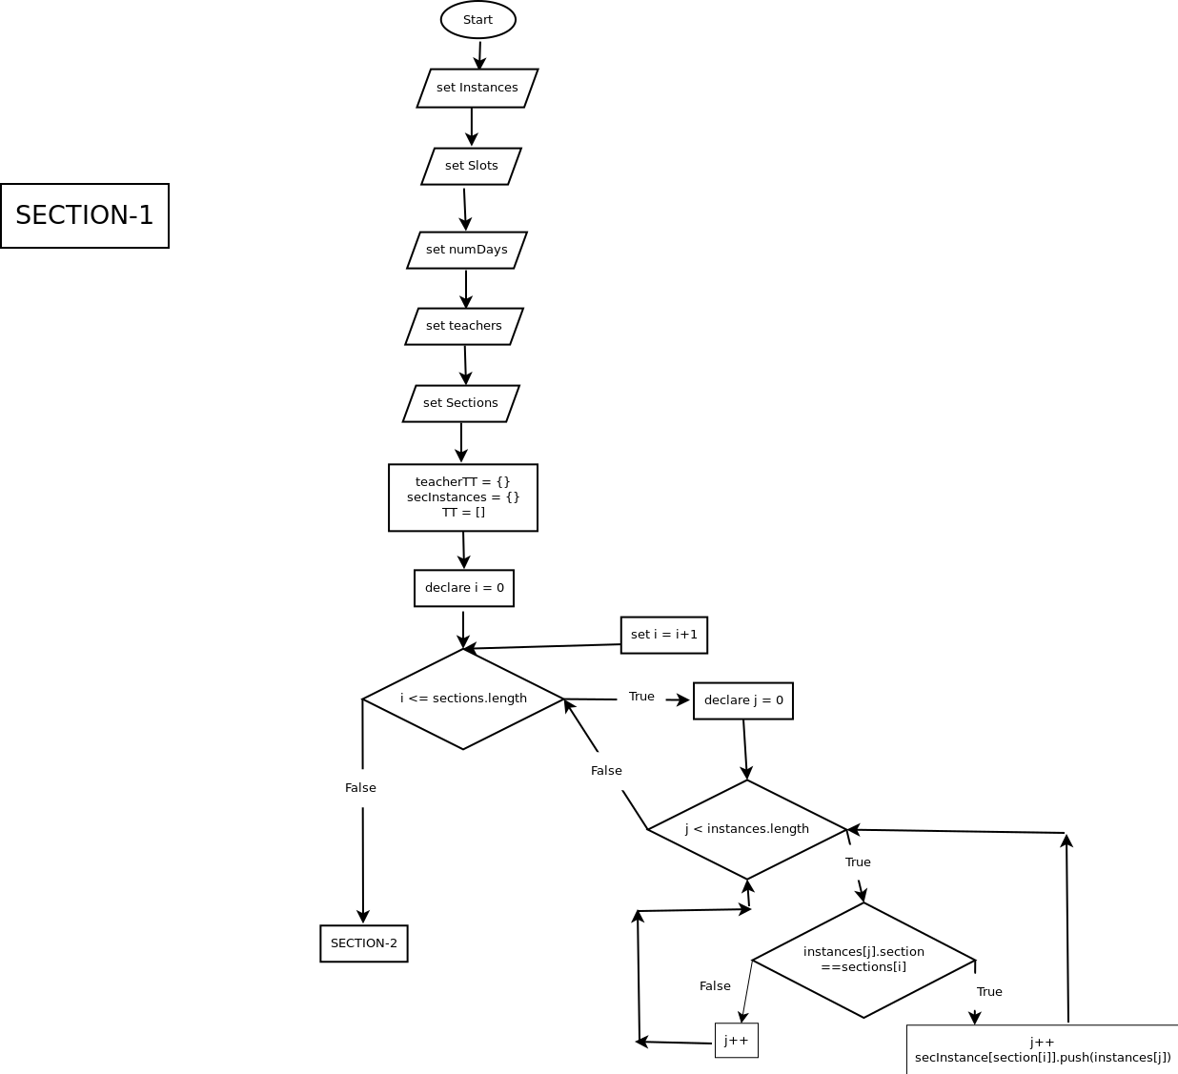
BLOCK DIAGRAM

Slide 7
FEATURES AND FUNCTIONALITY
Automated Timetable Generation:
Our system automates the entire timetable generation process, eliminating the need for manual intervention and reducing the likelihood of human errors.
By leveraging advanced algorithms and optimization techniques, the system efficiently assigns courses, classrooms, and faculty to time slots, taking into account various constraints and preferences.
Interactive User Interface:
Our user-friendly interface provides an intuitive platform for users to input constraints, preferences, and other parameters into the system.
Users can interactively explore and visualize the generated timetables, making it easy to understand the schedule's structure and make adjustments as necessary.
Conflict Resolution:
Our system identifies and resolves scheduling conflicts automatically, such as overlapping class times or double-booked classrooms.
Through sophisticated conflict resolution algorithms, the system iteratively adjusts the timetable to minimize conflicts while optimizing other scheduling objectives, such as room utilization and faculty workload.
Customizable Constraints and Preferences:
Users can input a wide range of constraints and preferences into the system, including faculty availability, room capacities, course dependencies, and student preferences.
The system intelligently incorporates these constraints and preferences into the timetable generation process, ensuring that the resulting schedules are both feasible and satisfactory to stakeholders.
Integration with Existing Systems:
Our system is designed to seamlessly integrate with existing college systems, such as student information systems (SIS) and learning management systems (LMS), to facilitate data exchange and interoperability.
By leveraging APIs and standard data formats, the system ensures compatibility with a variety of platforms and technologies commonly used in educational institutions.
Version Control:
This Platform is storing the versions of timetables.
We can access any version at any time with easy user interface

Slide 8
TECHNOLOGY
Frontend
ReactJS
HTML
JavaScript
Backend
NodeJS
ExpressJs
Database
MongoDB Atlas
Mongoose
TailwindCSS

Slide 9
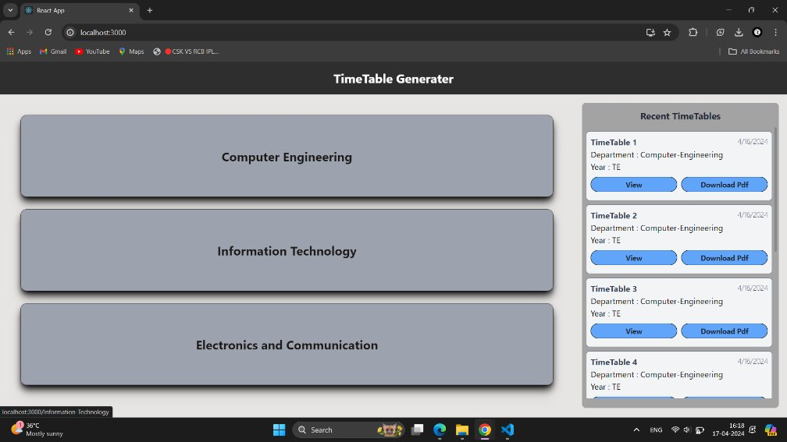
IMPLEMENTATION
Click Here For
Implementation :
Timetable Generator

Slide 10
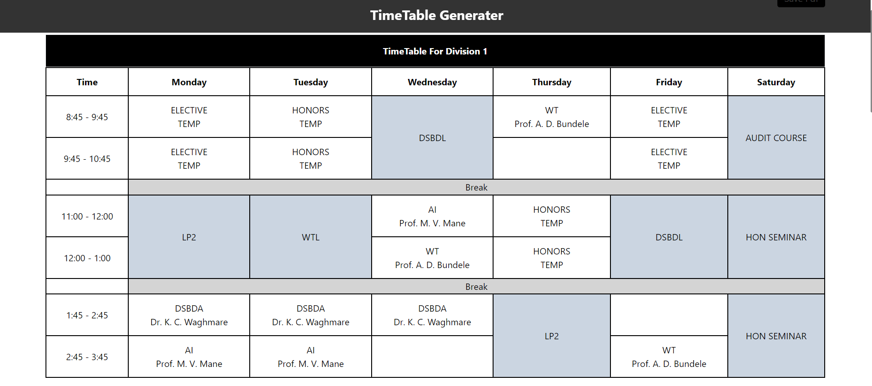
Output

Slide 11
FUTURE SCOPE
Scalability and Performance Optimization:
Optimize the scalability and performance of the system to handle larger datasets and increasing computational demands as the college grows.
Explore parallel processing techniques, distributed computing architectures, and cloud-based solutions to improve scalability and responsiveness.
Machine Learning Integration:
Explore the integration of machine learning algorithms to continuously improve the scheduling process based on historical data and user feedback.
Develop predictive models to anticipate scheduling patterns and proactively address potential conflicts or bottlenecks.
Integration with IoT Devices:
Explore the integration of Internet of Things (IoT) devices, such as smart classroom sensors, to provide real-time feedback on room utilization and environmental conditions.
Leverage IoT data to optimize room assignments, energy consumption, and facility management practices.
Enhanced User Interfaces:
Enhance the user interface with interactive visualization tools and analytics dashboards to provide stakeholders with actionable insights into scheduling trends and performance metrics.
Incorporate user-friendly mobile applications to enable on-the-go access to timetable information and communication features.
Collaborative Decision Support Systems:
Develop collaborative decision support systems that allow multiple stakeholders, including students, faculty, and administrators, to participate in the timetable generation process.
Implement features for collaborative scheduling negotiations, consensus-building mechanisms, and conflict resolution strategies.
User Feedback Mechanisms:
Implement mechanisms for collecting user feedback and performance metrics to inform future iterations of the system.
Conduct regular surveys, usability tests, and focus groups to solicit input from stakeholders and identify areas for improvement.
Dynamic Adjustment Mechanisms:
Develop dynamic adjustment mechanisms to accommodate unforeseen events, such as last-minute class cancellations or changes in faculty availability.
Implement real-time rescheduling algorithms that can quickly adapt to changing circumstances while minimizing disruptions to the overall timetable.
Personalized Scheduling:
Implement features to allow students to personalize their class schedules based on their individual preferences, learning styles, and extracurricular commitments.
Utilize machine learning techniques to recommend personalized schedules that optimize both academic and non-academic activities.

Slide 12
REFERENCES
Bagul, M. R., Pushkar R. Patil, S. C., & Nagare, S. N. (October 2015). A Novel Approach for Automatic Timetable Generation . International Journal of Computer Applications
01
M, S., & Pranav Kiran Vaze, P. M. (MAY 2017). Automatic Time Table Generator. International Journal of Advanced Research in Computer Science and Software Engineering.
02
Genetic Algorithm For University Course Timetabling Problem Achini Kumari Herath University of Mississippi
03
Automatic Timetable Generator Using Genetic Algorithm
04

Slide 13
CONCLUSION

