Slide 1

NYC TAXI TRIP DURATION PREDICTION (YELLOW TAXI TRIPS, 2016)

Slide 2
Topics Covered
Data import
Data cleaning and wrangling
EDA
Inference
Preparing data attributes for modeling
Building and tuning ML models
Comparing different models
Conclusion and future work

Slide 3
Goal
Identify the main factors influencing the daily taxi trips of New Yorkers.
Build a ML model to predict the taxi trip duration from point A to point B at any given time and day within NYC.
GitHub link to the EDA and ML notebooks and utility functions can be found here.
Policy researchers at the TLC* and NYC can use the project observations and ML models to observe changing traffic trends within the city and make informed decisions regarding transportation planning.
* Taxi and Limousine Commission

Slide 4
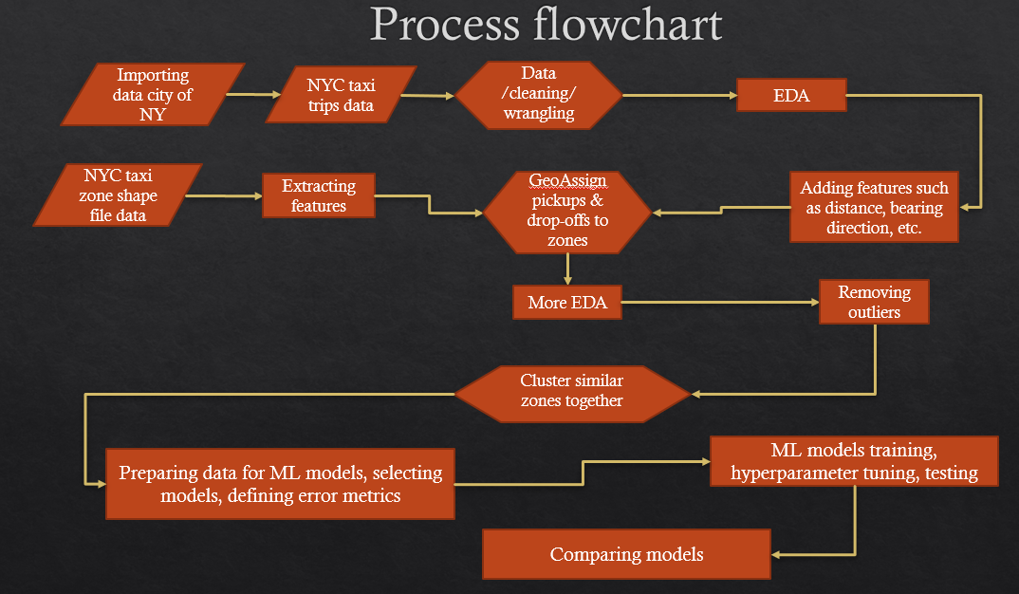

Slide 5
NYC taxi trip Data
Parsed from New York’ city’s website using SQL queries enabled by Socrata’s API.
4.2M taxi trips out of 131M total trips in 2016 were extracted
Only those trips with exact pickup and dropoff geo-coordinates were extracted (only first 6 months of 2016)
700,000 trips from each month of January to June, 2016.

Slide 6
Data fields
vendor_id - a code indicating the provider associated with the trip record
pickup_datetime - date and time when the meter was engaged
dropoff_datetime - date and time when the meter was disengaged
passenger_count - the number of passengers in the vehicle (driver entered value)
pickup_longitude - the longitude where the meter was engaged
pickup_latitude - the latitude where the meter was engaged
dropoff_longitude - the longitude where the meter was disengaged
dropoff_latitude - the latitude where the meter was disengaged
store_and_fwd_flag - Y or N where Y=store in vehicle memory due to bad connection & then forward
trip_distance - distance of the trip recorded in miles (was removed to avoid data leakage)

Slide 7
Data Cleaning
Removing potential outliers:
trip_duration < 60 seconds OR trip_duration > 99.8th percentile value of the trip duration
The pickup and dropoff latitudes and longitudes should be within the NYC boundary limits defined as, nyc_long_limits = (-74.257159, -73.699215), nyc_lat_limits = (40.471021, 40.987326))
haversine_distance* between the pickup and dropoff points is > 0 and < its 99.8th percentile value.
speed_mph > 0.5mph and speed_mph < 50mph
* Distance between two points on the globe calculated using the haversine formula, an approximation for the ellipsoidal distance.

Slide 8
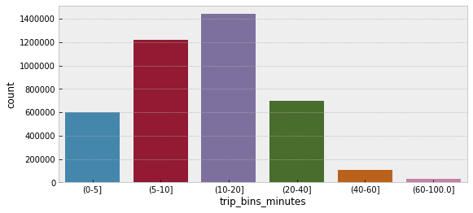
Trip duration statistics
Total number of trips = 4,086,440 (after cleaning)
1% of the trips were below 1.83 minutes
25% of the trips were below 6.68 minutes
50% of the trips were below 11.08 minutes
75% of the trips were below 17.95 minutes
95% of the trips were below 34.70 minutes
99% of the trips were below 54.60 minutes
99.8% of the trips were below 73.42 minutes

Slide 9
Trips on latitude vs longitude map

Slide 10
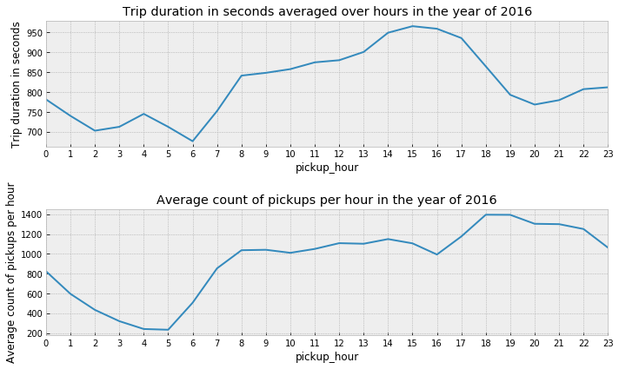
Taxi Trips Count and Mean Trip Duration

Slide 11
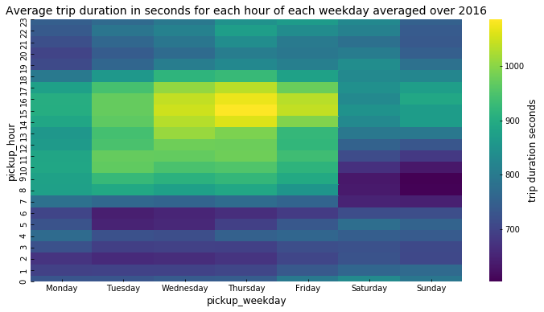
Average Weekly Taxi Trip Duration

Slide 12
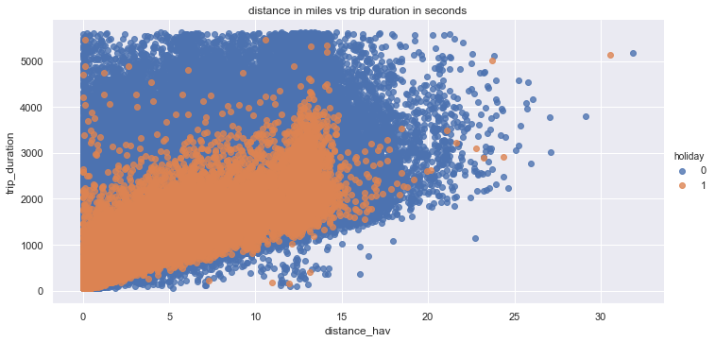
Distance vs Trip Duration

Slide 13
Count of Trips within each Taxi Zone

Slide 14
Zone-wise Mean Trip Duration

Slide 15
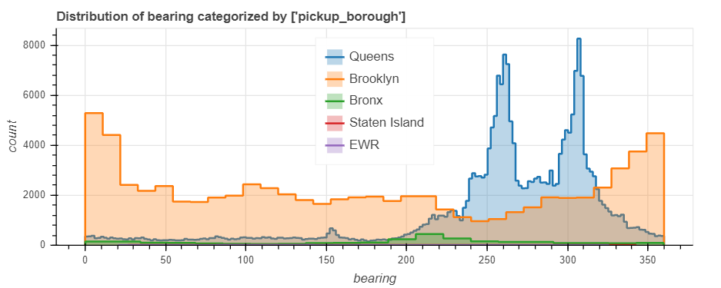
Trip directions for all boroughs except Manhattan
North = 0 deg, E = 90 deg, S = 180 deg, W = 270 deg, North = 360

Slide 16
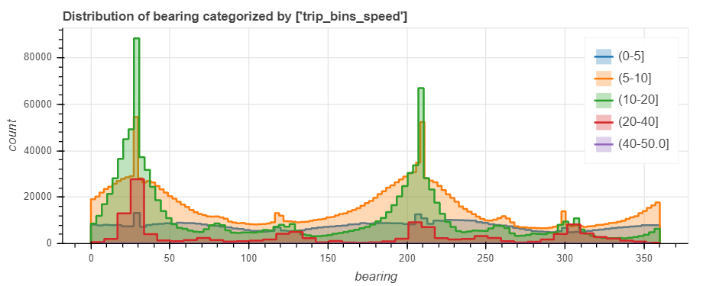
Trip direction of all boroughs categorized by speed_mph

Slide 17
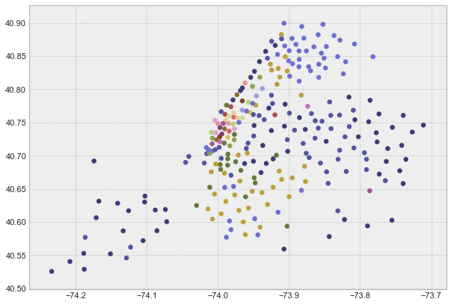
Clustering similar zones
Original taxi zones didn’t have any order
There were total 263 taxi zones
So, to reduce the number and cluster the similar zones together based on their lat, lon and outbound and inbound traffic, Hierarchical clustering was used.
Reduced from 263 to 50

Slide 18
Machine Learning models
Baseline prediction
Elastic Net Linear Regression
Random Forest
XGBoost

Slide 19
Data to Fit the Models
cols_to_use* = ['vendorid', 'passenger_count', 'pickup_longitude', 'pickup_latitude', 'dropoff_longitude', 'dropoff_latitude', 'pickup_month', 'pickup_day', 'pickup_hour', 'pickup_weekday', 'holiday', 'distance_hav', 'bearing', 'pickup_zone_cluster', 'dropoff_zone_cluster', 'trip_duration’]
Total 16 variables used
70% Training and 30% Test
Only 500,000 trips were used from a total of 4.2M for modeling.
The best model trained on this small sample was then used to make predictions on all the 4.2M trips.
* For Elastic Net Regression only distance, hour and weekday variables were used.

Slide 20
Error Metrics
Main
RMSLE* (Root Mean Squared Log Error)
Others
R2 score
RMSE (Root Mean Square Error)
MAE (Mean Absolute Error)
MAPE (Mean Absolute Percentage Error)
* RMSLE was used here as the determining metric because we didn’t want large errors to be significantly more penalized than smaller ones.

Slide 21
Baseline to compare all models with
Baseline => assuming the average trip duration in the training data for all the trips in the test data.
Performance on Test set:
RMSE or Root mean squared error: 639.34
RMSLE or Root mean squared log error: 0.77
Variance score: -0.00
Mean Absolute Error: 460.26
Mean Absolute Percentage Error: 94.37 %

Slide 22
Elastic Net Linear Regression
Only distance, hour and weekday features used because other variables will require significant data pre-processing since most of them are categorical or non-linear.
Hour and Weekday converted to smooth functions using Fourier Transform.
Error metrics for model Tuned Elastic Net on Test set:
RMSE or Root mean squared error: 383.49
RMSLE or Root mean squared log error: 0.49
Variance score: 0.64
Mean Absolute Error: 266.99
Mean Absolute Percentage Error: 47.76 %

Slide 23
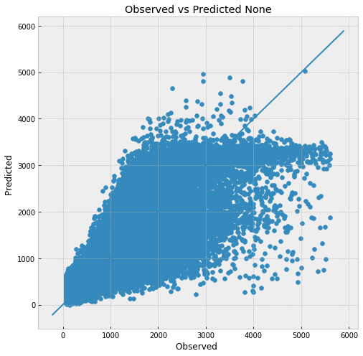
Elastic Net Linear Regression Plots

Slide 24
Random Forest
The error metrics for the tuned RF using all the variables are as below:
RMSE or Root mean squared error: 334.61
RMSLE or Root mean squared log error: 0.39
Variance score: 0.73
Mean Absolute Error: 225.01
Mean Absolute Percentage Error: 34.82 %

Slide 25
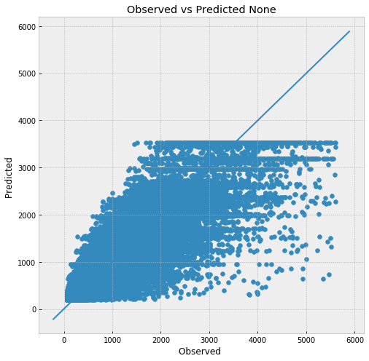
Random Forest Plots
The flattening in the predicted values is a result of how the values are averaged over all the leaf nodes for a regression tree.
If we allow the trees to grow deeper (increase max_depth), then this behavior is not observed, but it results in overfitting.

Slide 26
XGBoost
Error metrics for model Tuned XGBoost
RMSE or Root mean squared error: 272.96
RMSLE or Root mean squared log error: 0.32
Variance score: 0.82
Mean Absolute Error: 178.24
Mean Absolute Percentage Error: 26.38 %

Slide 27
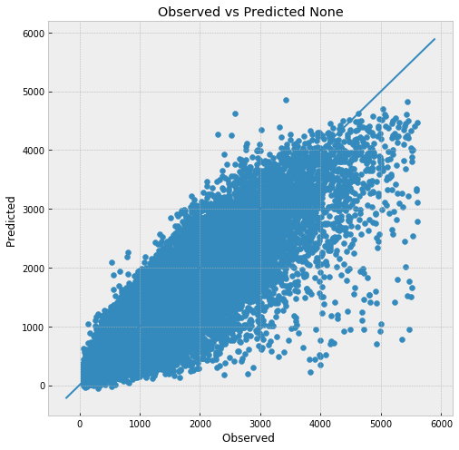
XGBoost Plots
The model doesn’t overfit as training and test R2 scores both were 0.82.
Figure on left shows that the entire range of the trip duration was predicted very well except a few extreme values.

Slide 28
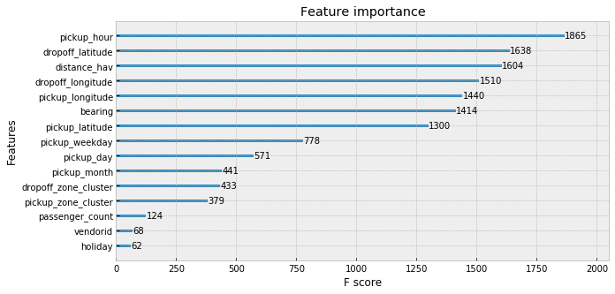
XGBoost Feature Importance

Slide 29
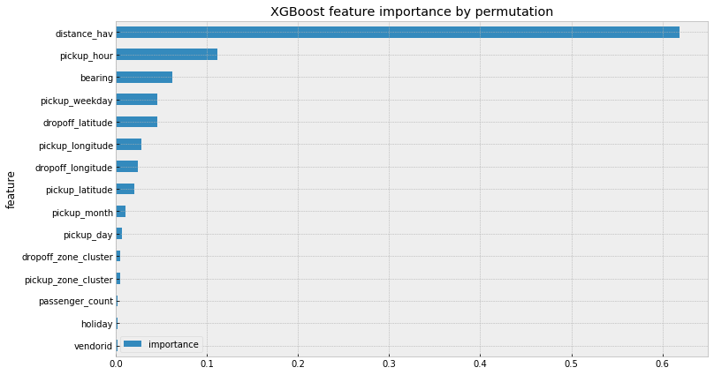
XGBoost Feature Importance Using Permutation

Slide 30
Trained XGBoost model on the entire dataset (~4M taxi rides)
Error metrics for model Tuned XGBoost on entire dataset
RMSE or Root mean squared error: 272.42
RMSLE or Root mean squared log error: 0.33
Variance score: 0.82
Mean Absolute Error: 178.12
Mean Absolute Percentage Error: 26.34 %

Slide 31
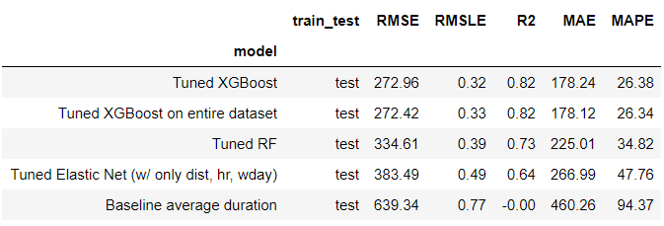
Comparing the Models
XGBoost wins here with better performance across all error metrics used.
It also generalizes well over the entire 4M dataset even if fit only on 500k rows.

Slide 32
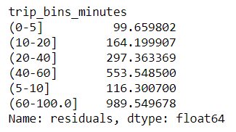
What the errors mean?
The median trip duration for the original dataset (4M rows) and the sampled dataset used for modeling = ~664 seconds.
MAPE = 26.38%
That is, our model predicts the trip duration as 178.24 seconds more or less than the actual on an average.
Which is just 3 minutes and given a busy city like NYC, that’s a very good performance.
And we have used only the variables that were readily available to us.
Shorter duration trips predicted better than longer durations.
Note: 97% of the trips are <= 40 minutes (2400 seconds)
Absolute residuals are in seconds and groupings are trip duration bins in minutes.

Slide 33
Important Predictors
hour of the day
weekday
pickup and dropoff Lat Lon
bearing (trip direction)
even the day of the month and pickup and dropoff zone clusters seem to have some importance in the predictions.

Slide 34
Checking which areas had low and high errors
Residuals = (true - predicted) minutes
Residuals = (true - predicted) minutes

Slide 35
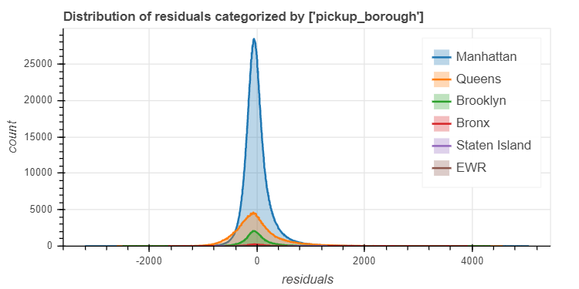
Distribution of residuals categorized by NYC boroughs
Low errors for short to mid-range duration trips originating and ending in Manhattan.
The median error in trip duration minutes is -0.595.
All important locations including the 5 boroughs (except Staten island) and the airports were predicted within -2 to +2 minutes error by the model.
Other areas represented a small % of the data, so maybe the model treated them as extreme points.

Slide 36
Future Work
Add zone to zone average speed as a feature. The average zone to zone speed can be added as a variable along with the distance variable.
Add weather variables to see the effect of extreme weather events and temperature on the trip duration. The extreme events like heavy snow in Jan of 2016 were observed to cause the taxi trips to decline significantly but otherwise no significant effect of the weather in general on the taxi trip duration was seen. Temperature can have some effect, for example high temperatures in summer or very low temperatures in winter can cause people to use more taxis, thus increasing the traffic overall.
Implement deep learning models to fit the data. Since we have millions of taxi trips in this data, we can use multi-layer neural network models to see if they give better performance compared to the other models tried in this notebook.
Build a simple web application such that a user can input the pickup and dropoff latitudes and longitudes and the web app will throw out the estimated trip duration (using our best model).

Slide 37
Future work (Contd.)
(From EDA notebook) Potential additions to the EDA and general visualizations:
Subway stations and other important information about potential busy areas can be added into the data and traffic trend around these areas of interest can be verified.
A network graph to check how the zones are connected to each other based on the pickups and dropoffs.
  Betweenness centrality can be added for each node in the graph.
  Shortest path for any ride can be found and the nodes/edges through which the taxi has to pass to reach the destination
  can be determined. Then an average speed score can be assigned to that path based on the speed score of each edge the taxi is traversing through. This can be used as a new feature.

Slide 38

THANKS
Github Link

