Slide 1
Introduction
PrintBridge is an IoT-powered cloud printing solution operating on a "Printer as a Service" (PaaS) model.
It transforms traditional, localized printing into a fully automated, self-service ecosystem.
The platform seamlessly integrates cloud storage, secure online payment gateways, and intelligent IoT edge controllers.
It features live data streaming and real-time remote monitoring via the ThingSpeak IoT analytics platform

Slide 2
Objectives
To develop a cloud-based printing system accessible from any internet-enabled device.
To implement true IoT-based autonomous payment verification using an Arduino Uno R4 WiFi.
To eliminate document mixing in the output tray using sequential ticket numbers and a progressive hardware timeout system.
To provide real-time cloud analytics and remote monitoring capabilities for administrators

Slide 3
Problem Statement
Severe Congestion: Physical queues create significant time loss for students and staff in high-traffic educational environments.
Manual Bottlenecks: Shop owners are forced to manually download files, initiate print commands, and verify cash or UPI screens, leading to severe operational inefficiencies.
Document Confusion: High-volume output often results in mixed pages in the printer tray, making it difficult for users to identify and collect their specific documents

Slide 4
Our Proposed System
Remote Upload & Pay: Users upload their PDFs to a custom web portal and pay securely online from anywhere.
IoT Automation: An independent Arduino controller polls the cloud server to autonomously verify payments and triggers the local printer without human intervention.
Smart Queueing & Feedback: The system assigns sequential ticket numbers and uses visual (RGB LED), audio (Buzzer), and IR proximity sensors to manage a 15-second progressive timeout for paper collection.

Slide 5
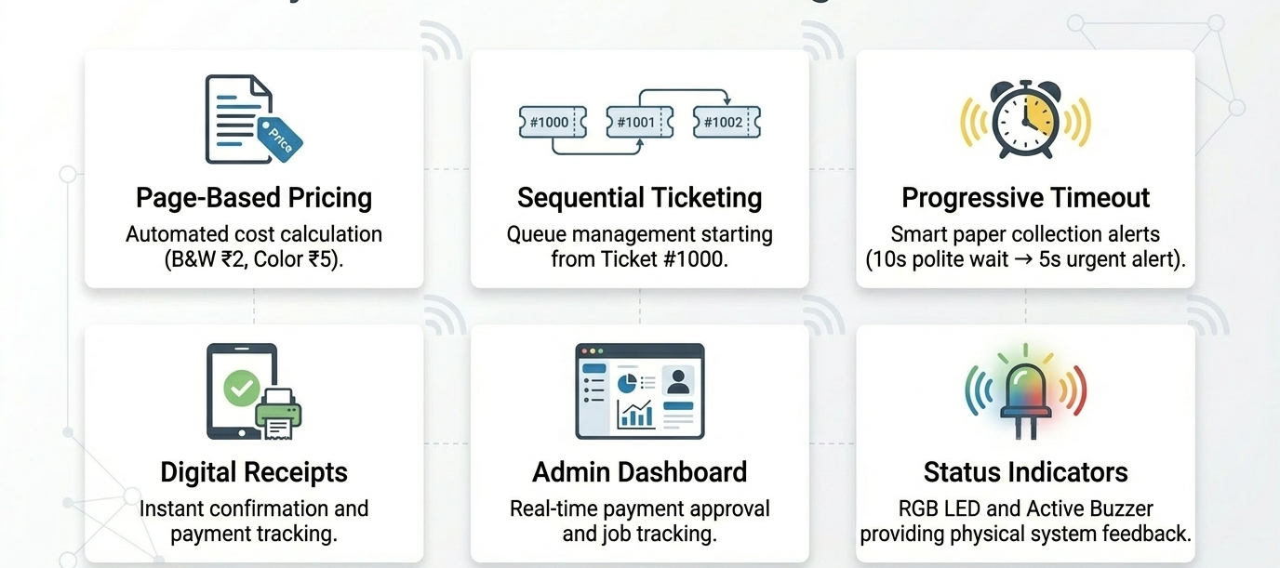
Our Proposed System
Key Features:

Slide 6
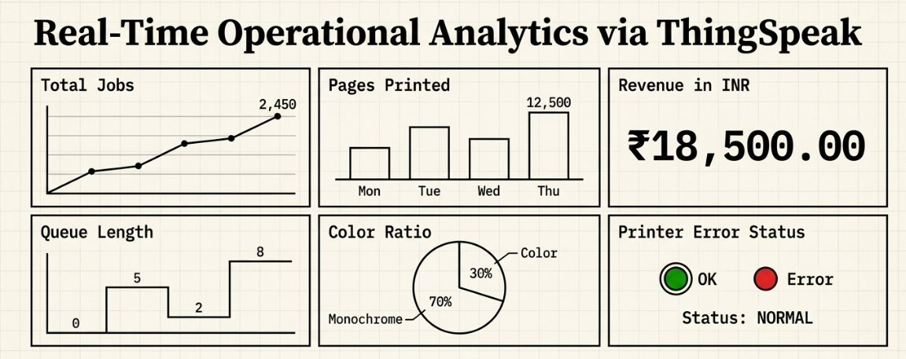
Our Proposed System
Key Features:

Slide 7
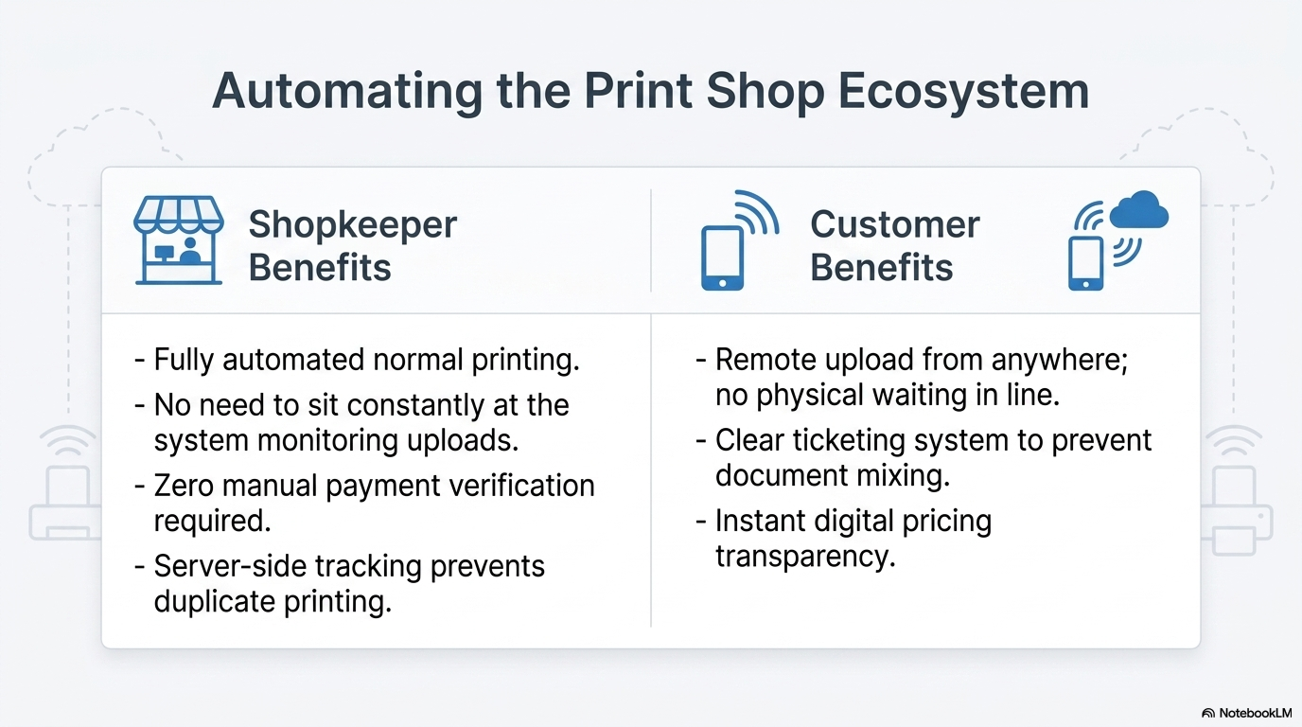
Our Proposed System

Slide 8
Methodology
We utilized a Hybrid IoT Architecture model. This involves a decentralized approach where the sensing/processing (Arduino) and the application (Node.js Printer Agent) run locally, while the storage (Cloudinary) and core logic run on a cloud server (Render). Communication is handled via secure HTTPS polling.

Slide 9
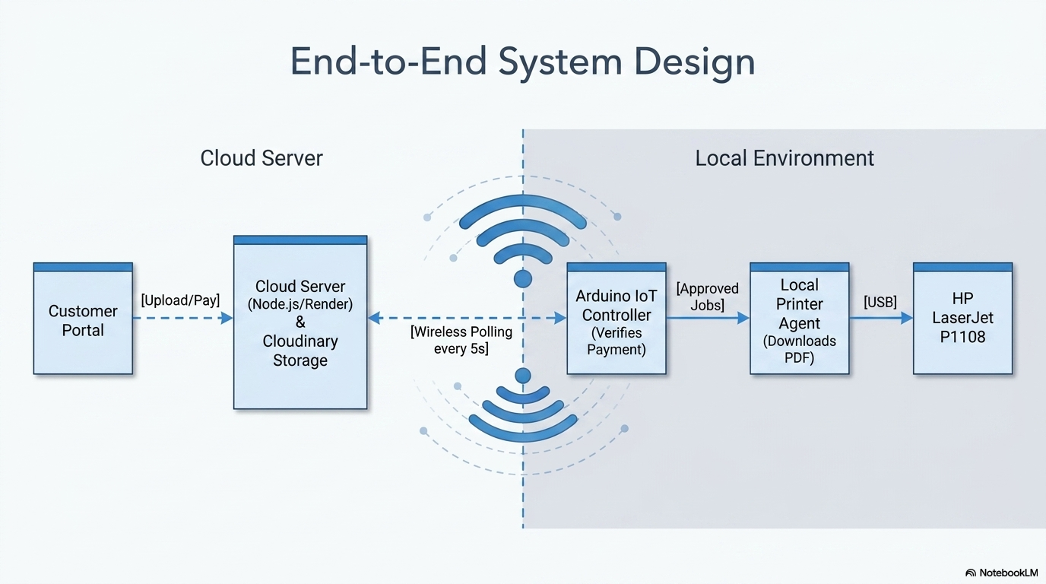
Methodology

Slide 10
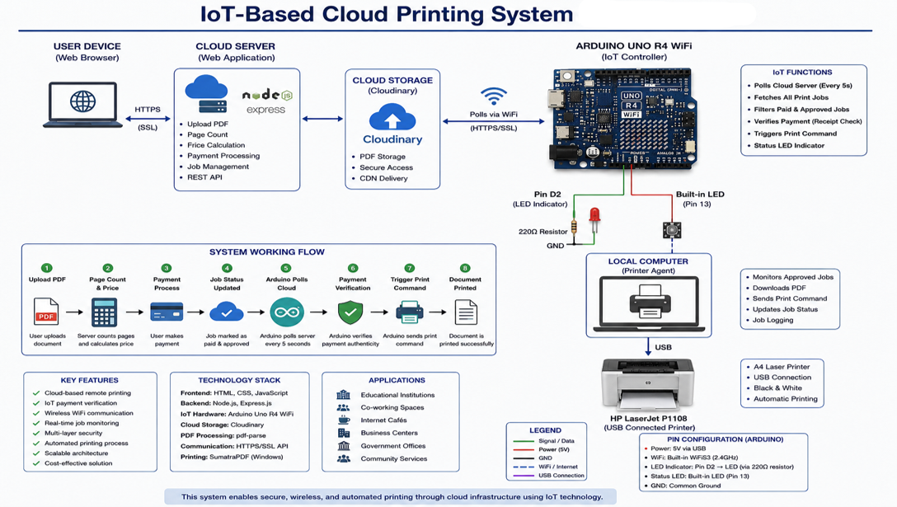
Methodology

Slide 11
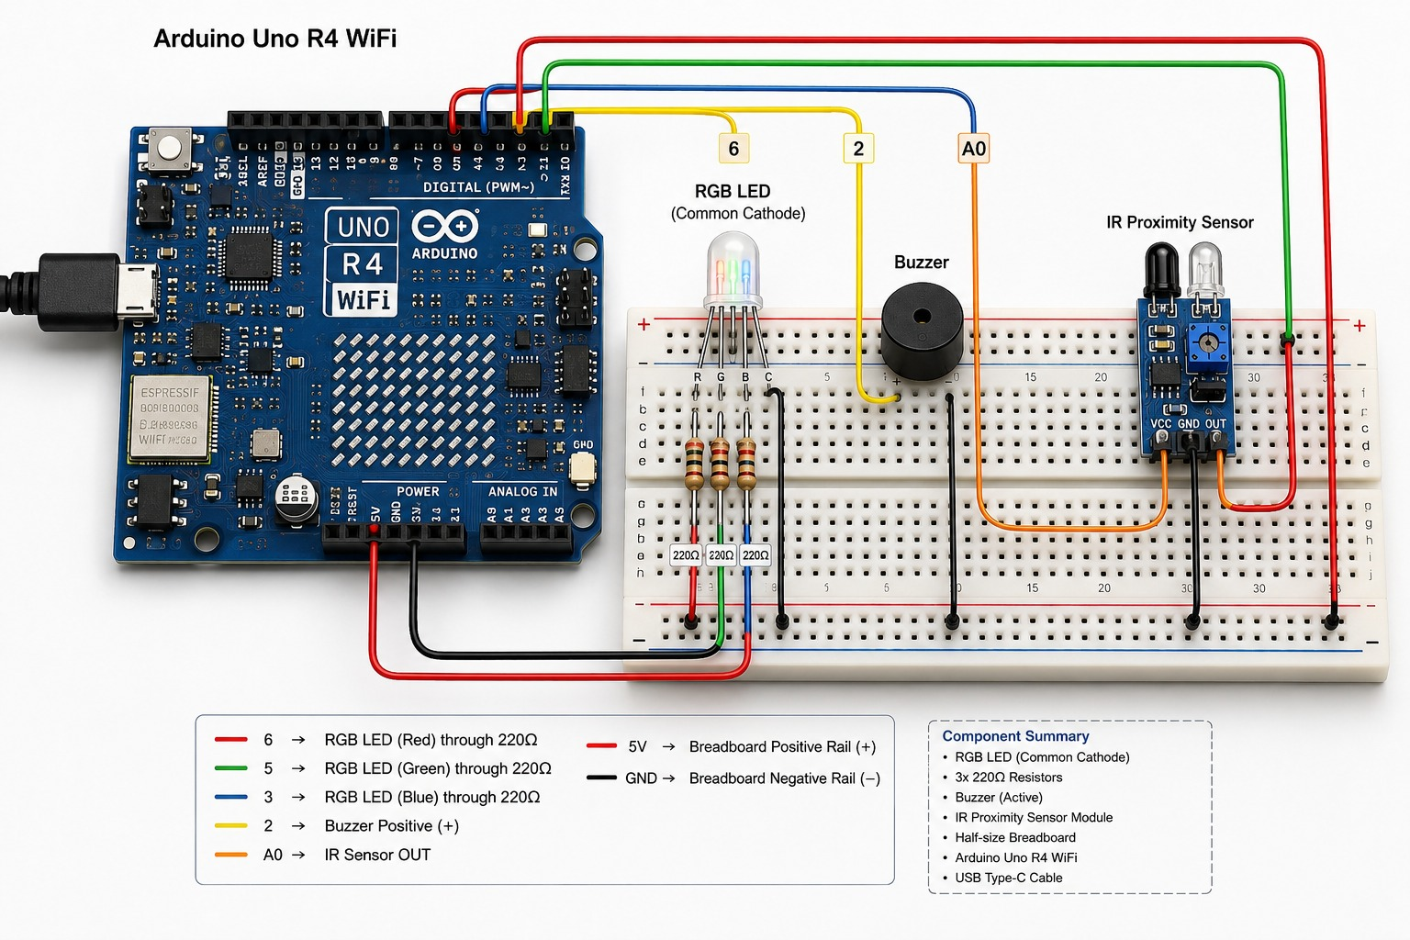
Implementation

Slide 12
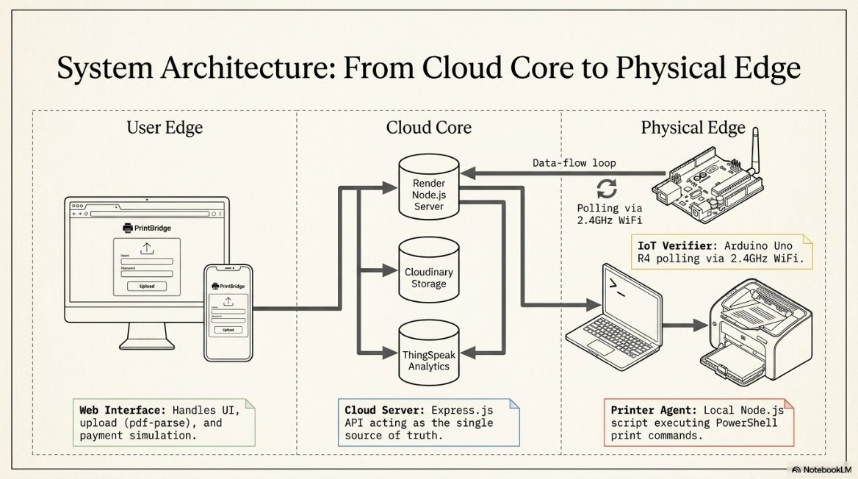
Architecture

Slide 13
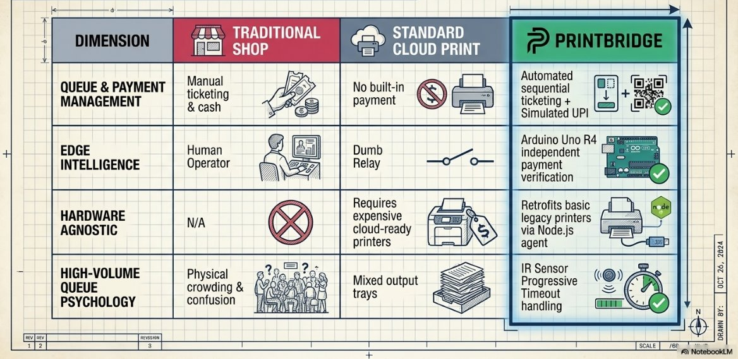
Architectural Comparison

Slide 14
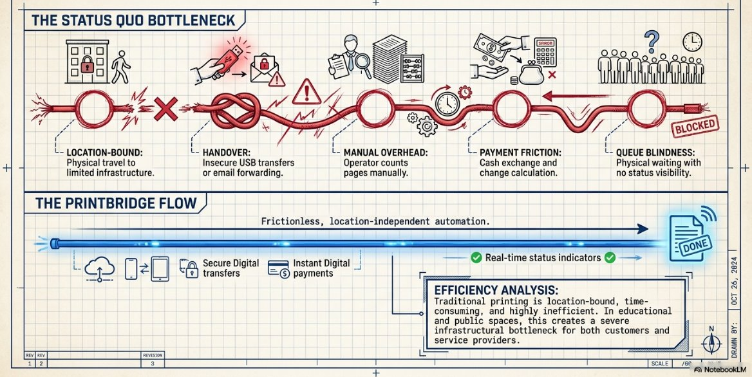
Workflow

Slide 15
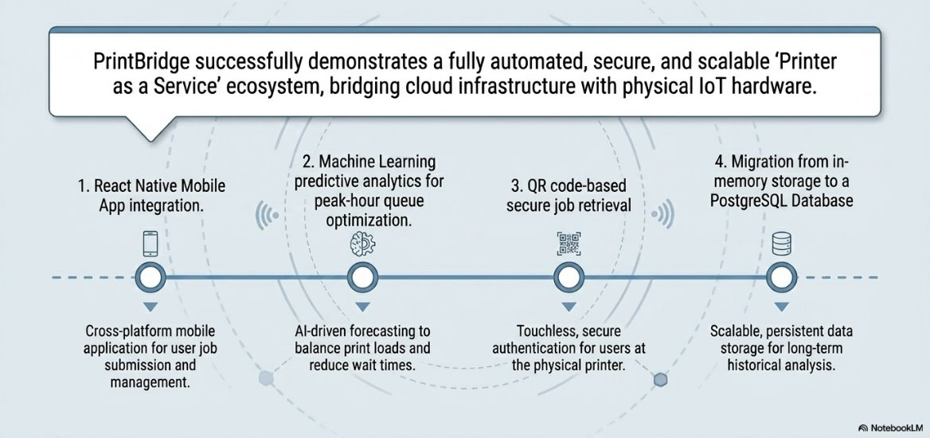
Future Enhancements

Slide 16
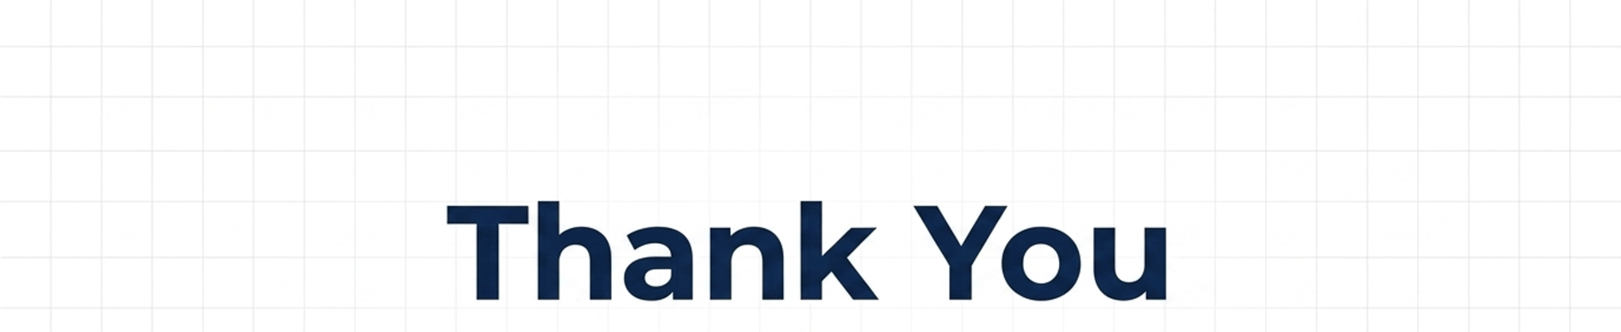
Any Questions?

