Slide 1
Mutual Fund Regulatory Assistant
An Instant, Reliable Way to Answer Regulatory Questions

Slide 2
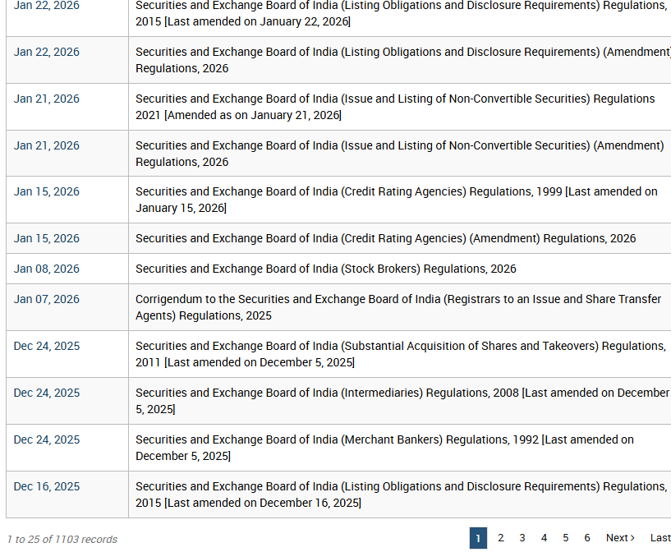
The Problem
Regulatory teams rely on a large number of circulars, master directions, and updates from SEBI
Finding the right clause today means manually opening and searching through many lengthy PDF documents
Employees spend significant time scanning long documents to find a single fact, number, or rule
Important details can be missed when reading is rushed, leading to slower decisions or incorrect interpretations
There is no easy way to ask a plain question and instantly find which document an answer came from
Insert screenshot:
Example of a long SEBI
circular employees currently
search through manually
2

Slide 3
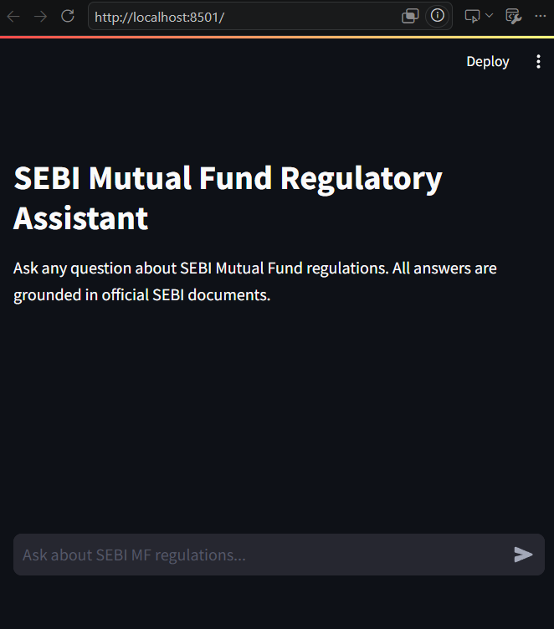
The Solution
A simple chat assistant that answers regulatory questions in plain English
Employees type a question the same way they would ask a colleague
The assistant reads through all indexed documents in seconds
It responds with a short, direct answer along with the exact document and page it came from
No manual searching, no scrolling through hundreds of pages
3

Slide 4
How It Works
1
2
3
4
Ask
Search
Answer
Verify
An employee types a question in plain language
The system searches every document for the most relevant information
It writes a short, direct answer using only what it found
Every answer shows exactly which document and page it came from
Behind the scenes, the system combines meaning-based search with keyword search, then double-checks the results before answering, so the answer is both accurate and traceable.
4

Slide 5
Business Impact
Time Saved
Answers in seconds instead of minutes of manual document searching
Reduced Risk
Every answer is traceable to its exact source, reducing compliance errors
Consistency
Every employee gets the same accurate answer, regardless of experience level
Scalability
The same approach extends to legal, HR, or product documents in the future
5

Slide 6
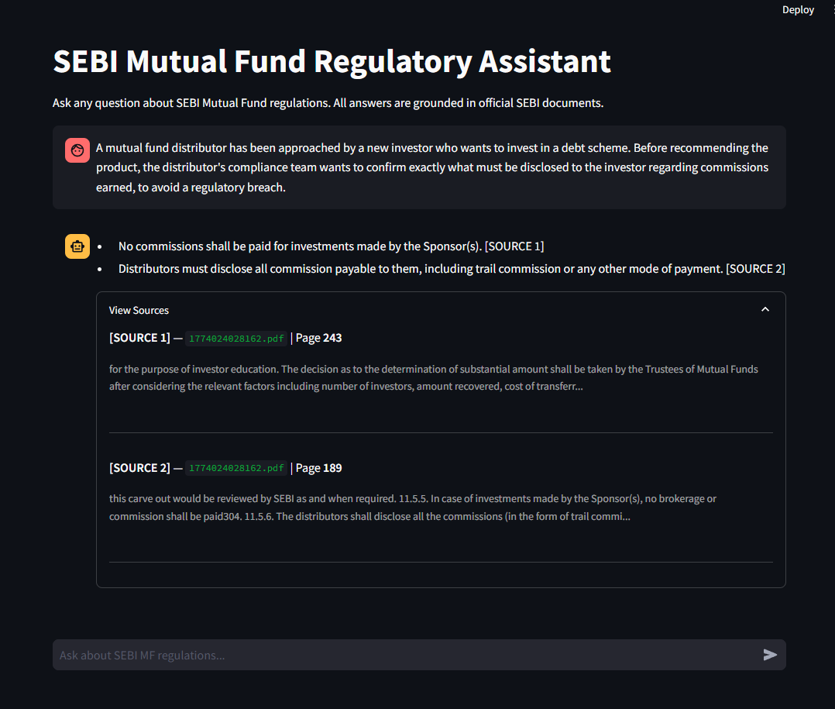
Real World Use Case
Scenario
A mutual fund distributor has been approached by a new investor who wants to invest in a debt scheme. Before recommending the product, the distributor's compliance team wants to confirm exactly what must be disclosed to the investor regarding commissions earned, to avoid a regulatory breach.
Previously: open the relevant master circular, scroll through dozens of pages, manually locate the clause
Now: type the question directly into the assistant
Result
A precise answer is returned in seconds, with the exact circular and page number cited for verification
6

Slide 7
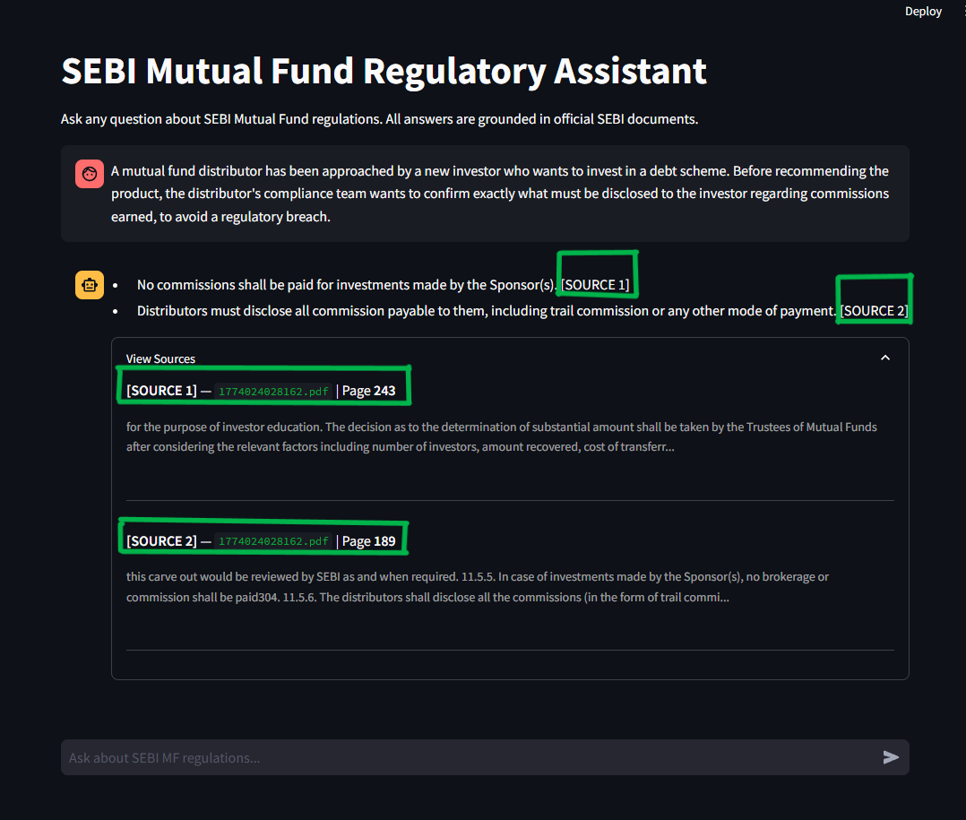
Why the Answers Can Be Trusted
The assistant only uses information found inside the uploaded documents - it does not guess or make up facts
Every answer includes the exact document name and page number it was drawn from
If the documents do not contain an answer, the assistant says so clearly instead of providing a wrong answer
This makes every response easy to verify before being relied upon for a business or compliance decision
7

Slide 8
What's Next
Integrate a bigger LLM for a wider contextual window and better answer generation.
Extend the same assistant to other document types, such as legal contracts, HR policies, or product manuals
Add support for follow-up questions within the same conversation
Allow new documents to be added without rebuilding the entire system
8

