Slide 1
AIRCAST
RESEARCH QUESTION
Beyond the latest reading.
Independent recurrent models and calibrated hybrid corrections
for one-hour PM2.5 forecasts.
Measured comparisons. Validation-based selection. Explicit limitations.
Samarth Khera / 2401010407
Pratham Malhotra / 2401010343
Adityaraj Pal / 2401010042
Tattva Rajput / 2401010478
Himanshu / 2401010188
CSAI PROJECT 19 / PHASE 2 · DEEP LEARNING AND HYBRID FORECASTING
01 / 12
Notes:
Phase 2 asks whether independent recurrent networks and a calibrated correction improve on strong classical references. The team is carried forward exactly from the existing project. All 2014 results are exploratory because the year was already inspected in Phase 1.

Slide 2
AIRCAST
01 / AUDIT AND REPAIRS
Fix the experiment before interpreting scores
The initial code and its benchmark needed separate scientific and inference corrections.
Training boundary
Fit preprocessing only on actual training windows; never learn from prediction
batches.
Independent benchmark
Standalone LSTM and Bi-LSTM use the full eligible outer training window.
Honest hybrid targets
Freeze the base before a later calibration block; fit only out-of-sample
residuals.
Verified inference
Share sequence-aware CLI/dashboard prediction and verify saved model
hashes.
CSAI PROJECT 19 / PHASE 2 · DEEP LEARNING AND HYBRID FORECASTING
02 / 12
Notes:
The first audit fixed full-dataset scaling, batch-dependent imputation, ignored masks, dropped wind direction, in-sample residual fitting and suppressed errors. This continuation also fixed bidirectional state extraction without attention and added independent full-window benchmarks. A zero or invalid training mask fails rather than silently relaxing the boundary.

Slide 3
AIRCAST
02 / INFORMATION BOUNDARIES
Observed history in. A future concentration out.
All hours follow the Beijing local clock; the target is one hour after the origin.
TRAIN + PREPROCESS
SELECT ON 2013
COMPARE ON 2014
2010–2012 initially
Four expanding quarters
Freeze selection first
Available labels only
Screen candidates + ablations
Same observed target hours
Preserve gaps and valid
Three predefined seeds
Exploratory historical result
peaks
No target-hour measured weather. No random train/test split. No filled evaluation labels.
CSAI PROJECT 19 / PHASE 2 · DEEP LEARNING AND HYBRID FORECASTING
03 / 12
Notes:
UCI 381 has 43,824 hourly rows and 2,067 missing concentrations. The same engineered features and common evaluation mask are used for all models. At each quarterly boundary, only labels available at the first forecast origin enter training. 2014 remains exploratory even though individual fits respect chronology.

Slide 4
AIRCAST
03 / NEURAL FORMULATION
A sequence model can predict a level or a change
The delta formulation adds a learned correction to the latest observed concentration.
Recurrent representation
Standardized target + reconstruction
24 or 48 observed hours
Level: next concentration
LSTM or Bi-LSTM
Delta: next minus current concentration
32 or 64 hidden units per direction
Training-only target statistics
Attention or final hidden states
Reconstruct and clip at zero
Without attention, both terminal Bi-LSTM states summarize the full observed window.
CSAI PROJECT 19 / PHASE 2 · DEEP LEARNING AND HYBRID FORECASTING
04 / 12
Notes:
Input and target scaling are fitted only on training windows. Delta targets use current pollution as a fixed offset; missing current pollution uses its saved training median. Standardized Huber loss, AdamW, gradient clipping and fixed epochs train the model. The bidirectional network reads backward within the observed window, never beyond the forecast origin. Directionality comparisons have matching hidden width but different parameter counts.

Slide 5
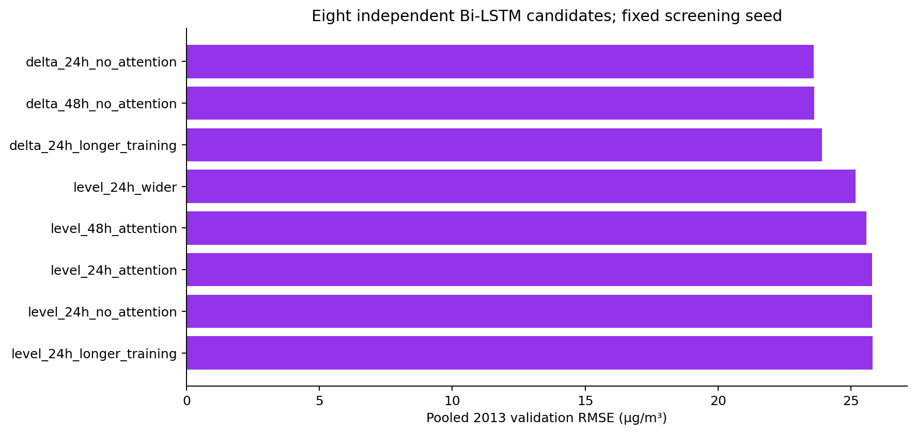
AIRCAST
04 / CANDIDATE SCREENING
Eight candidates. One validation year.
Sequence length, width, duration, attention and target formulation; screening seed fixed at 42.
CSAI PROJECT 19 / PHASE 2 · DEEP LEARNING AND HYBRID FORECASTING
05 / 12
Notes:
The complete grid is saved before results are inspected. Initial screening uses seed 42 on all four 2013 quarters. This is a finite staged search, not exhaustive optimization or nested cross-validation. Unsuccessful candidates remain in the CSV and checkpoint outputs. The winning template supplies the matched ablations.

Slide 6
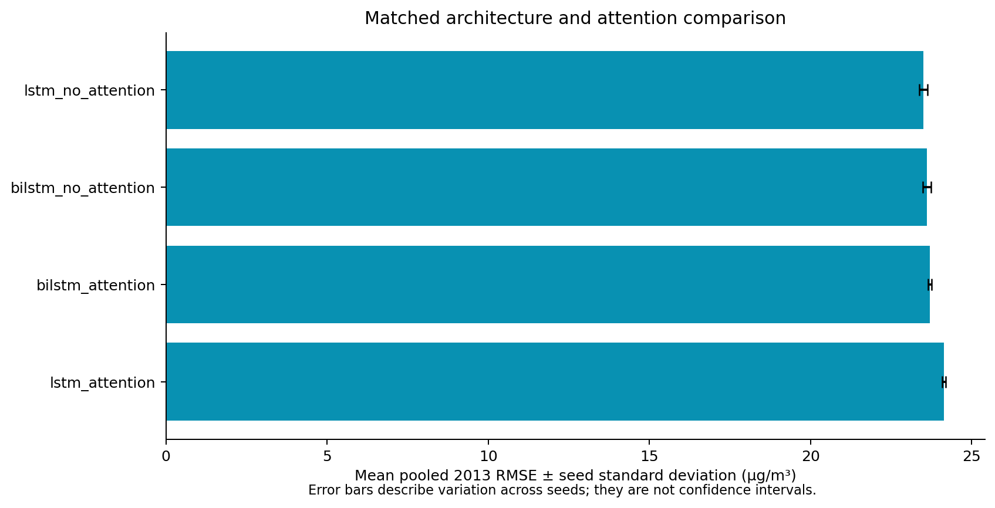
AIRCAST
05 / MATCHED ABLATIONS
Does attention or a backward direction help?
Each matched variant is run at seeds 42, 137 and 2026 on identical validation hours.
CSAI PROJECT 19 / PHASE 2 · DEEP LEARNING AND HYBRID FORECASTING
06 / 12
Notes:
Compare LSTM and Bi-LSTM with attention enabled and disabled at the selected template settings. Selection uses mean pooled validation RMSE across seeds. Error bars show sample standard deviation across seeds; they are not confidence intervals. Attention weights do not establish causal feature importance.

Slide 7
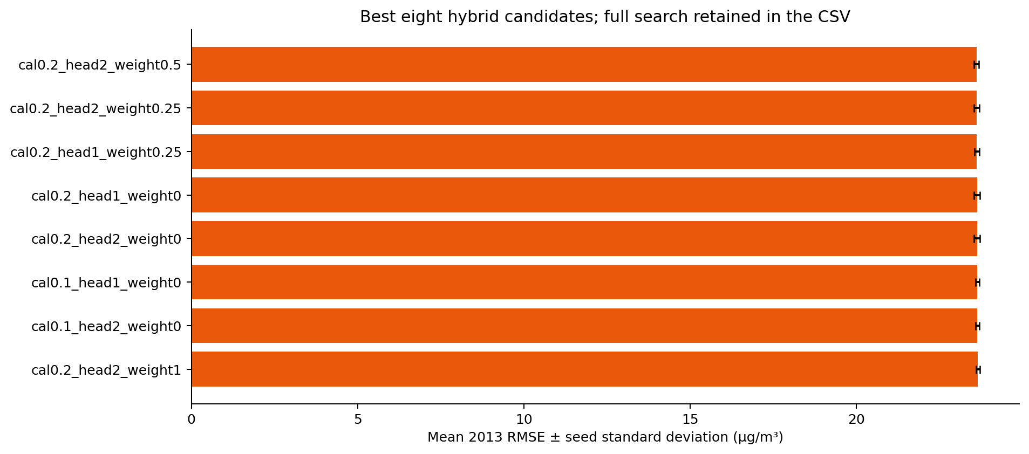
AIRCAST
06 / HYBRID SELECTION
Calibrate later. Shrink the correction.
Selected calibration: 20% of eligible origins; correction weight: 0.5.
CSAI PROJECT 19 / PHASE 2 · DEEP LEARNING AND HYBRID FORECASTING
07 / 12
Notes:
Reserve the last 10% or 20% of training origins for calibration. The base is trained earlier with a label-availability gap and then frozen. Two XGBoost settings and weights 0, .25, .5 and 1 are scored using three validation seeds. The zero-weight control can reject an unhelpful correction. The hybrid intentionally has less base-training data than the independent neural benchmark.

Slide 8
AIRCAST
07 / HISTORICAL COMPARISON
Report every model on the same target hours
8,531 common 2014 hours. RMSE and MAE in µg/m³. Comparison seed fixed before scoring.
Model
MAE
RMSE
R²
LSTM
11.299
20.726
0.9506
Bi-LSTM
11.457
20.799
0.9503
Bi-LSTM + XGBoost
11.483
20.919
0.9497
Ridge
11.825
21.063
0.9490
XGBoost
11.833
21.088
0.9489
Persistence
11.926
22.033
0.9442
Daily seasonal naive
67.296
98.754
-0.1205
Validation-based model preference: LSTM.
CSAI PROJECT 19 / PHASE 2 · DEEP LEARNING AND HYBRID FORECASTING
08 / 12
Notes:
These rows use the identical observed 2014 targets. Classical predictions are reused from the audited Phase 1 experiment and checked for exact origins, labels and fold alignment. The preferred model comes from validation, not this final ranking. Small differences do not establish significance, and a lower RMSE does not guarantee a lower MAE or better peak behavior.

Slide 9
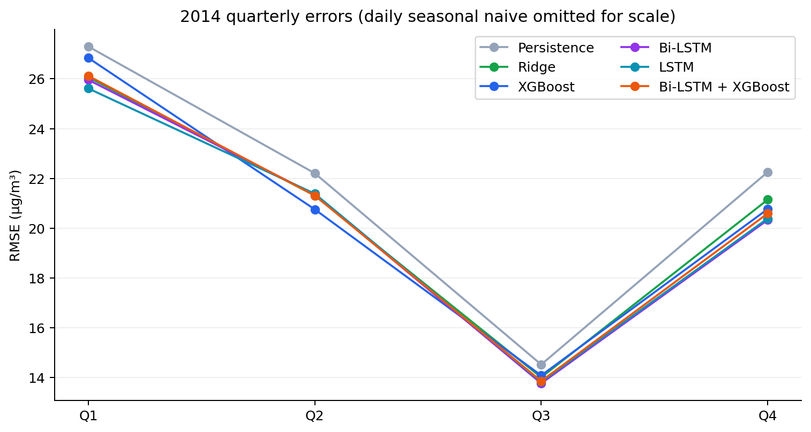
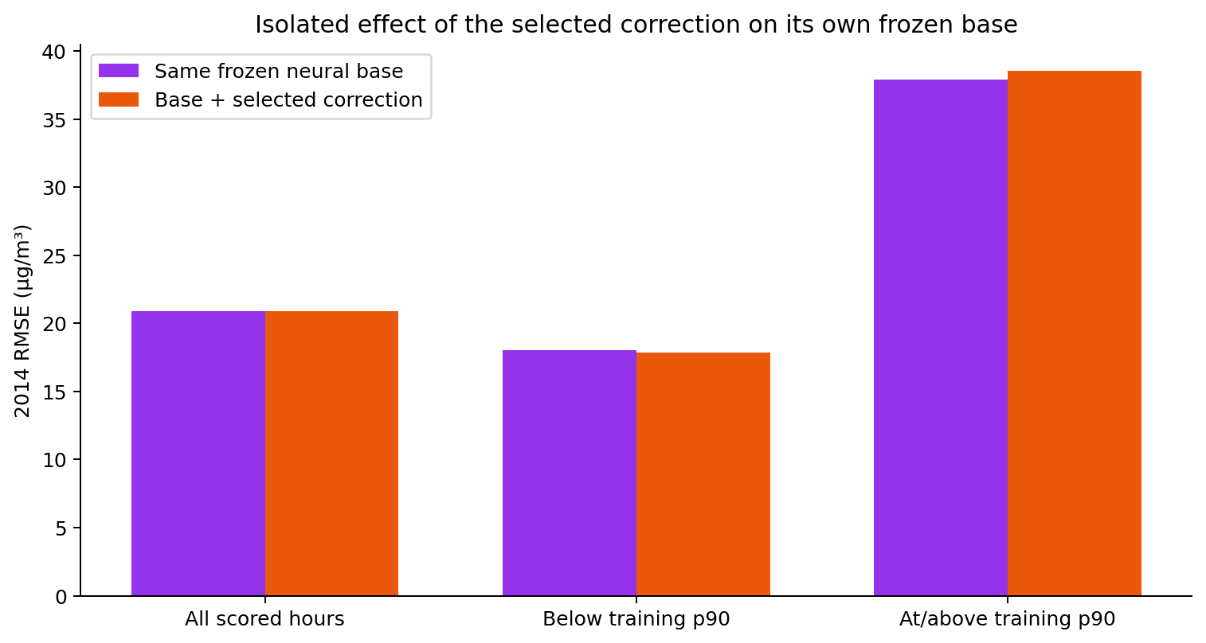
AIRCAST
08 / QUARTER AND REGIME
A pooled score hides changing behavior
Quarterly and pollution-regime diagnostics retain identical hours within each comparison.
High pollution: at least 218 µg/m³, fixed from the 2010–2012 training distribution.
CSAI PROJECT 19 / PHASE 2 · DEEP LEARNING AND HYBRID FORECASTING
09 / 12
Notes:
The high-pollution threshold is fixed using initial training data only. There are 865 peak hours and 7,666 lower-pollution hours in the common 2014 set. Compare peak RMSE and bias with Ridge and persistence, not just with a weaker neural base. Seasonal changes and differences between full and reduced training windows complicate attribution; the diagnostics are descriptive, not causal.

Slide 10
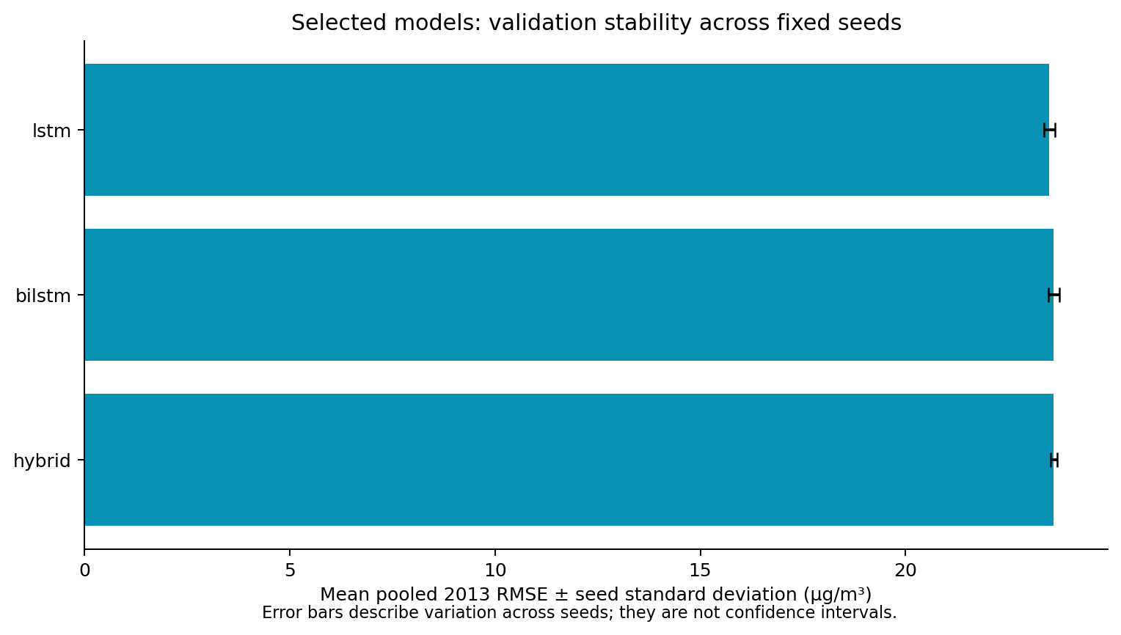
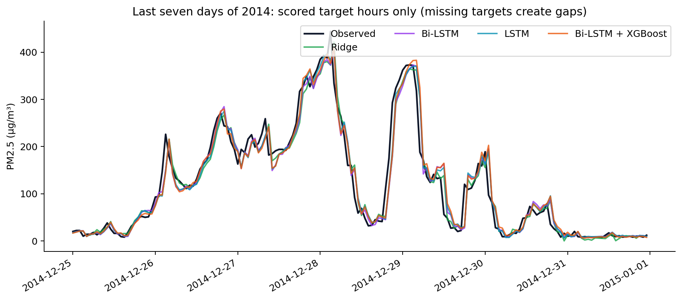
AIRCAST
09 / STABILITY AND FORECAST TRACE
Repeatability and a concrete forecast sequence
The last week is selected by time; missing target hours remain visible as gaps.
Predeclared deployment seed 42. Seed variation is measured on validation.
CSAI PROJECT 19 / PHASE 2 · DEEP LEARNING AND HYBRID FORECASTING
10 / 12
Notes:
The left panel shows variation across the three predefined validation seeds for selected model configurations. The right panel shows a time-selected forecast interval rather than a hand-picked success. We do not choose a deployment seed using holdout performance. No calibrated prediction intervals are supplied.

Slide 11
AIRCAST
10 / REPRODUCIBLE DEMONSTRATION
Saved models, shared features, checked results
The notebook and package retain enough evidence to inspect and repeat the experiment.
Traceable experiment
Input/source/model hashes, frozen selection, seed scores and fold audits.
Runnable local demo
Independent Bi-LSTM, LSTM and hybrid alongside classical models.
Consistent forecasts
CLI and dashboard share features and retain 168 + 24 raw hourly slots.
Submission artifacts
IEEE report, editable slides, slide PDF, notebook and packaged weights.
CSAI PROJECT 19 / PHASE 2 · DEEP LEARNING AND HYBRID FORECASTING
11 / 12
Notes:
The local dashboard verifies model hashes from a completed real-data manifest before exposing models. The hosted classical deployment does not include PyTorch. The notebook loads measured results by default and has an explicit switch to rerun the complete experiment. The archive excludes environments, credentials and training checkpoints, and includes source, model weights, the attributed dataset and comparison evidence.

Slide 12
AIRCAST
11 / CONCLUSION AND DISCUSSION
The measured result is the contribution.
Validation preference: LSTM
Independent benchmarks, honest calibration, matched ablations
and reproducible evidence are now in place.
2014 is exploratory. New blind accuracy claims need untouched data.
Thank you. Questions?
CSAI PROJECT 19 / PHASE 2 · DEEP LEARNING AND HYBRID FORECASTING
12 / 12
Notes:
Explain why the standalone model is independent, why calibration residuals must be out of sample, why the bidirectional window is causal, why all models share a target mask, and why 2014 remains exploratory. Discuss seed variation without claiming a confidence interval. Do not assume a hybrid must beat Ridge. All five team members and enrollment numbers are listed on the opening slide, with no invented contribution allocations.

