Slide 1
AIRCAST
CSAI PROJECT 19 / PHASE 1 RESEARCH PRESENTATION
Air quality,
THE PHASE 1 WORKFLOW
one hour ahead.
01 Literature + problem framing
02 Data audit + training-only EDA
Can pollution history and weather improve on simply
03 Features + four forecasting models
repeating the latest reading?
04 Selection + rolling backtests
05 Diagnostics + Aircast demonstration
43,824
4
+1 hour
hourly records
models compared
forecast horizon
UCI Beijing · 2010–2014 · PM2.5 concentration in µg/m³
Measured outcome: modest pooled gains, a near tie with Ridge, and unresolved peak errors.
CSAI PROJECT 19 / PHASE 1 · MACHINE LEARNING
01 / 10
Notes:
We estimate the observed PM2.5 concentration one hour ahead. After receiving the 10:00 reading, predict 11:00 using pollution and measured weather available through 10:00. Future calendar values are known, but measured target-hour weather is not. The output is concentration in µg/m³. The question is the incremental benefit beyond persistence, not whether a complex model can achieve a large R². Phase 1 delivered literature review, a validated hourly archive, training-only EDA, causal feature engineering, persistence and daily seasonal naive, Ridge and XGBoost, chronological selection, rolling holdout backtests, diagnostics, saved inference, notebooks/CLI, Aircast, tests and documentation. The figures in this deck are built from the completed real-data run, not synthetic fixtures. Separate deep-learning or hybrid modules do not add results to the Phase 1 tables. We will show both gains and limitations, including the strong validation baselines and the difficult high-pollution subset.

Slide 2
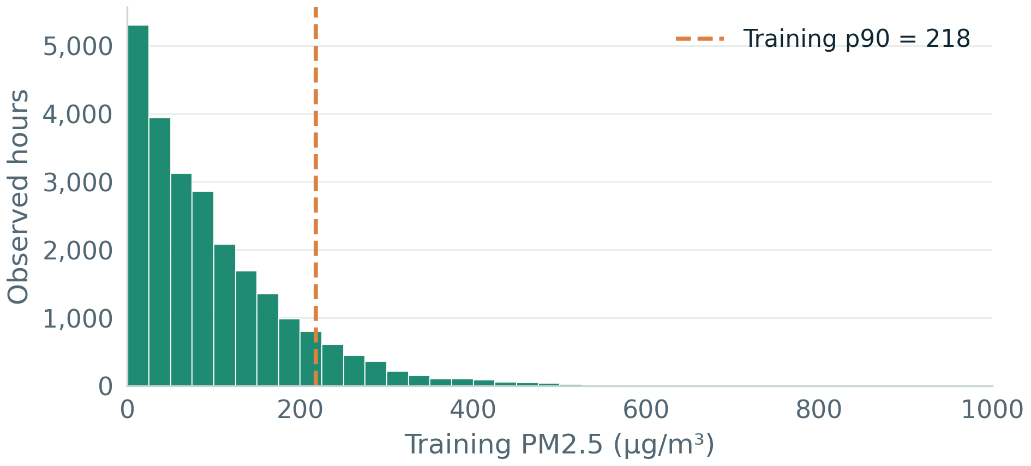
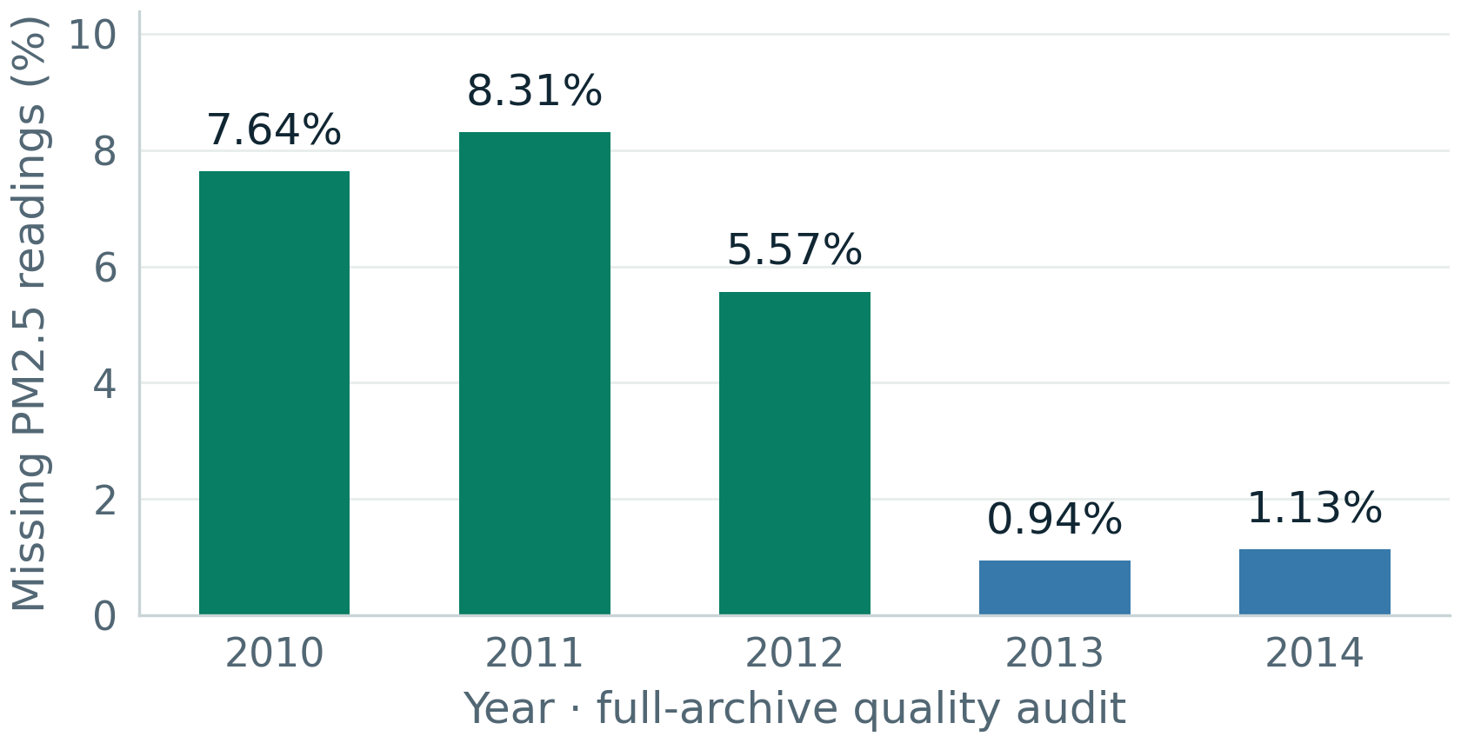
AIRCAST
01 / DATASET AND CLEANING
Preserve the clock, the gaps, and the peaks
UCI Beijing PM2.5 · January 2010–December 2014 · pollution and airport weather use different sites.
43,824
2,067
155 h
Regular hourly timestamps
Missing concentrations
Longest missing run
0 duplicates; 0 absent timestamp rows
4.72% of the archive; weather complete
214 concentration-gap runs in total
Training concentration distribution
Missingness varies by year
Cleaning: validate schema and dates → preserve hourly slots → retain valid peaks → exclude row ID
SOURCE: UCI 381; supplied CSV audit; concentration distribution uses 2010–2012 only.
02 / 10
Notes:
The original UCI 381 file has 43,824 hourly rows, sorted unique timestamps, no absent timestamp rows and 2,067 missing PM2.5 measurements (4.72%). Numeric weather is complete. The gap audit finds 214 concentration runs, with a maximum length of 155 hours. We leave missing measurements in their hourly slots: deleting the 10:00 row would incorrectly make a one-row shift at 11:00 point to 09:00. The loader validates dates, numeric fields and duplicate timestamps, sorts and regularizes before features are built, and removes the No identifier. No target interpolation is used for scoring. Valid high concentrations remain: a statistical outlier is not automatically a recording error. The histogram uses only 2010–2012, with 24,418 measured values, mean 97.82, median 73, range 0–994, skewness 1.70 and p90 218 µg/m³. The missingness plot is a descriptive full-archive quality audit, not an EDA-based predictor decision using holdout outcomes. Missing counts are 669, 728, 489, 82 and 99 in 2010–2014 respectively. Pollution was recorded at the US Embassy and weather at Beijing Capital International Airport, introducing a spatial mismatch. Dataset: https://archive.ics.uci.edu/dataset/381/beijing+pm2+5+data ; DOI 10.24432/C5JS49, CC BY 4.0. Environmental context: Liang et al. (2015), DOI 10.1098/rspa.2015.0257.

Slide 3
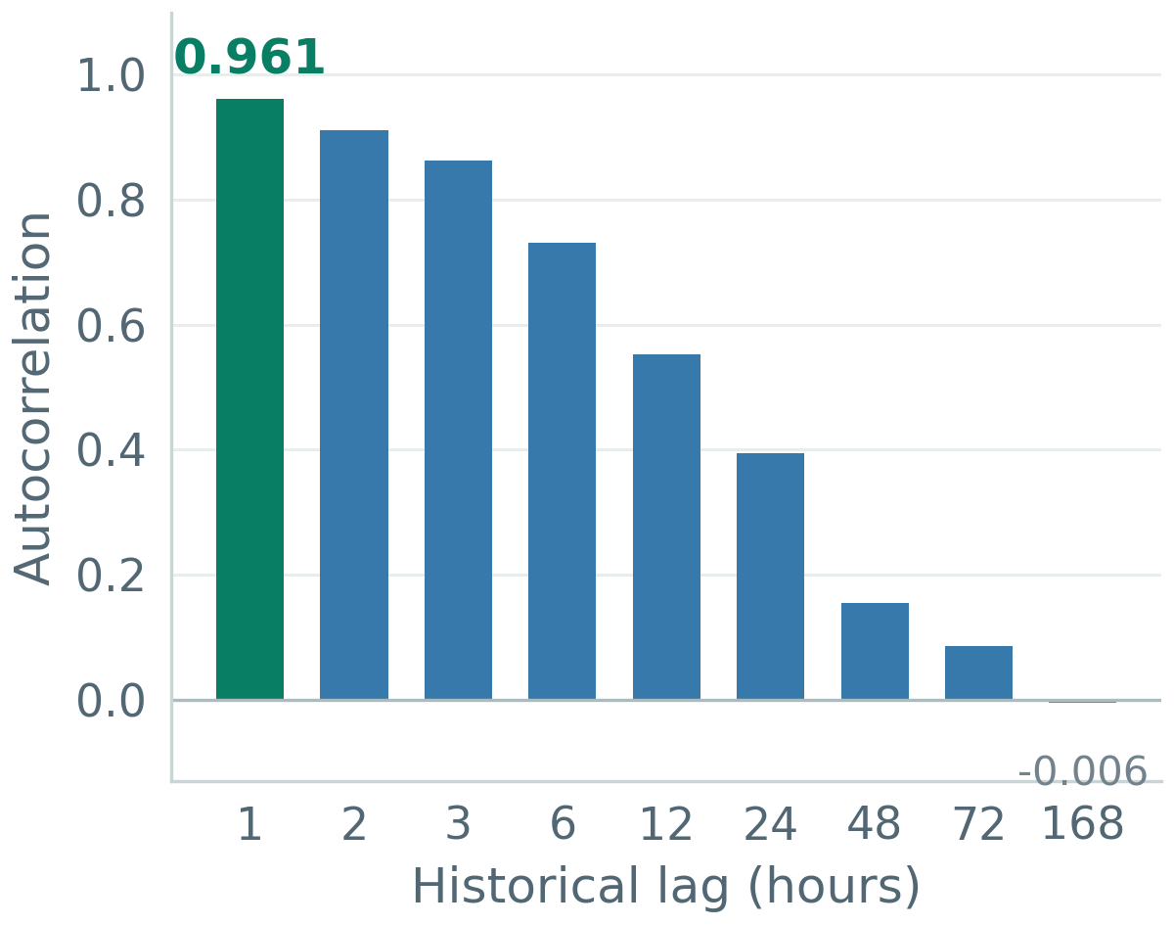
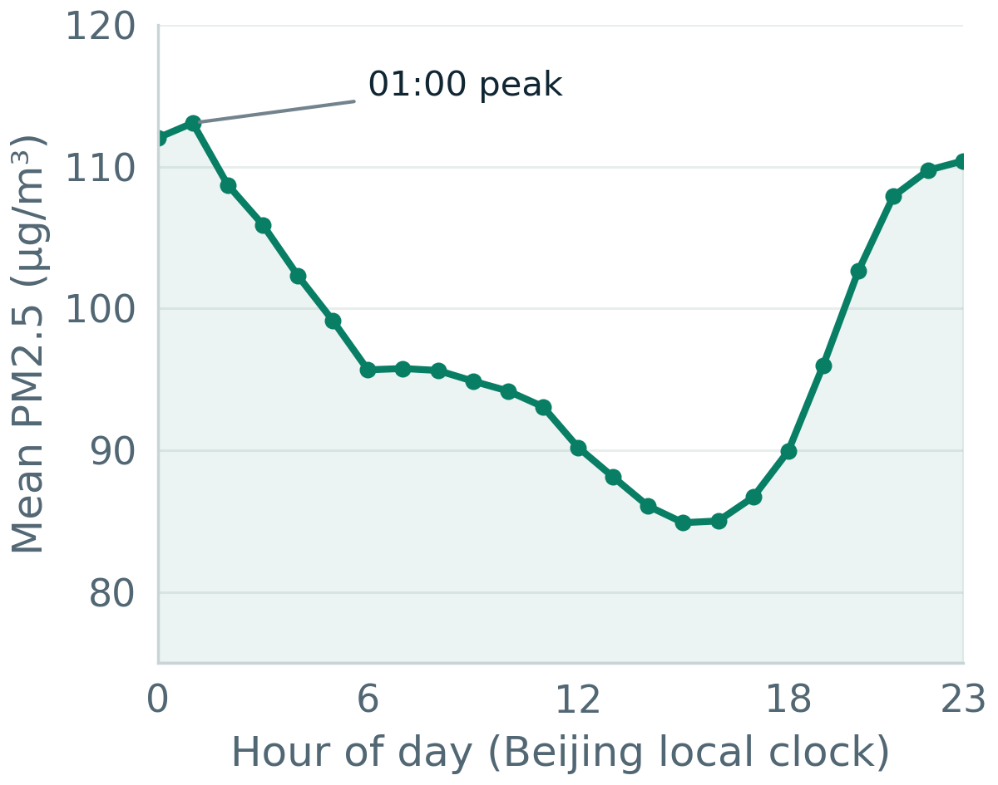
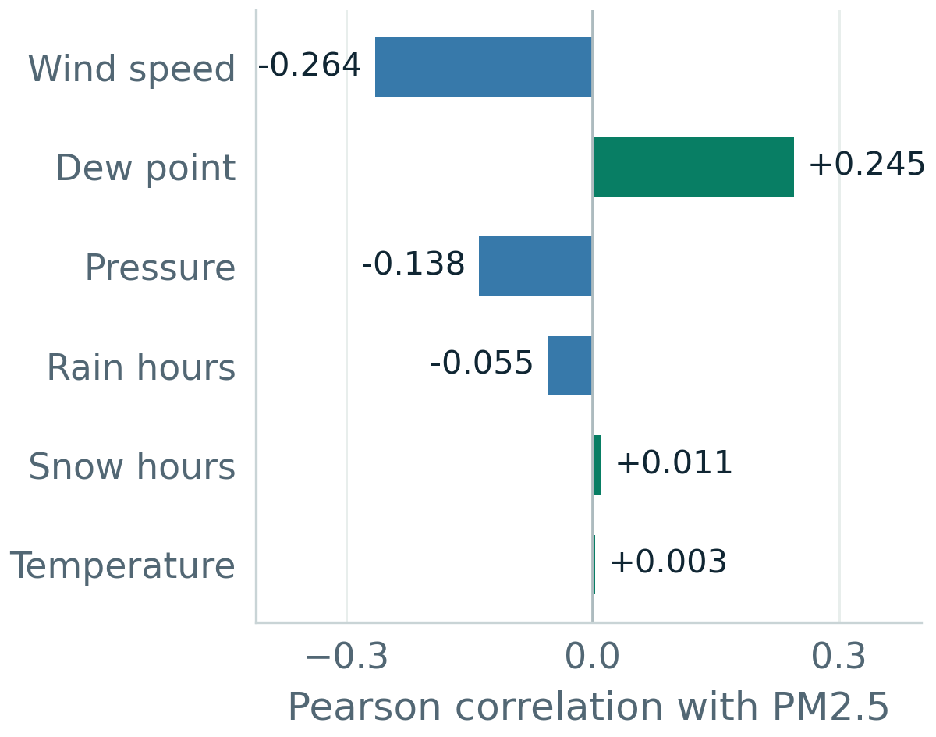
AIRCAST
02 / WHAT TRAINING-ONLY EDA TELLS US
Recent history is the strongest starting point
All three graphs use 2010–2012 only; associations guide candidate features, not causal claims.
Temporal dependence
Average daily pattern
Weather associations
Take persistence seriously
Encode the clock cyclically
Validate the extra information
1-hour ACF 0.961; 24-hour 0.394.
The pooled mean peaks at 01:00.
Wind r = −0.264; dew point +0.245.
A weekly dependency is not established.
Averages do not predict each event.
Correlation alone does not imply cause.
SOURCE: Training autocorrelation, hourly profiles and Pearson correlations; saved EDA outputs.
03 / 10
Notes:
The lag autocorrelations are measured on the regular hourly training grid without deleting gaps. One-hour autocorrelation is 0.961, 24-hour is 0.394 and 168-hour is approximately −0.006. Strong short-term dependence motivates persistence and recent lags. It does not prove each proposed lag is useful; grouped ablation later tests additions. The hourly graph pools the 2010–2012 values by hour of day. The highest mean is at 01:00 (113.08, based on 1,020 observations). October has the largest monthly mean (118.17) in the saved training profile, though the deck focuses on the daily graph for readability. Calendar features are candidates, not a claim that every day repeats yesterday. Numeric weather correlations with PM2.5 include wind speed −0.264, dew point +0.245, pressure −0.138, rain hours −0.055, snow hours +0.011 and temperature +0.003. Small Pearson correlations do not exclude nonlinear predictive effects. Spatial mismatch and correlated weather variables prevent a causal interpretation. The right tail and 7.17% training missingness motivate retaining peaks and reporting historical support. These findings justify features and diagnostics before inspecting the holdout, while chronological validation determines whether additions improve forecasts.

Slide 4
AIRCAST
03 / FEATURES AND MODEL FORMULATION
Build one forecast row without future information
Predict y(t + 1) from measured history through t · 70 raw columns → 73 with the four observed wind categories.
ORIGIN t = 10:00
→
TARGET t + 1 = 11:00
Observed PM2.5 + weather + trailing history
Only the future calendar is already known
Four feature groups
Four models, one target
20
Pollution lags + missingness
Persistence
ŷ(t + 1) = y(t)
Offsets 0, 1, 2, 3, 6, 12, 24, 48, 72, 168 h
Strong latest-reading reference
18
Trailing statistics
Daily seasonal naive
ŷ(t + 1) = y(t − 23)
3, 6, 12, 24, 72, 168 h: mean, std, observed fraction
Same target hour on the previous day
7
Known target calendar
Ridge regression
Squared error + L2 penalty (α = 10)
Hour / weekday / month sine–cosine + weekend
Fold-fitted median imputation and scaling
25
Weather + wind direction
XGBoost
Additive trees + complexity penalty
6 weather fields at 0 / 1 / 24 h; flags + wind encoding
Native numeric missing splits; outputs clipped ≥ 0
Safeguards: 168-hour warm-up · windows end at t · fold-fitted preprocessing · evaluation targets stay observed
CSAI PROJECT 19 / PHASE 1 · MACHINE LEARNING
04 / 10
Notes:
The ten PM2.5 offsets are 0, 1, 2, 3, 6, 12, 24, 48, 72, 168, each with a missingness flag (20 columns). Lag zero is the current observed y(t), not the future label. Six trailing windows each supply mean, population standard deviation (ddof 0) and observed fraction (18). Missing summaries remain missing when the support is empty. Seven calendar columns use sine/cosine for known target hour, weekday and month plus weekend. Six numeric weather fields at 0, 1 and 24 hours contribute 18 columns, current weather missing flags contribute six, and current wind contributes one categorical column. Total 70; four observed wind categories give 73 encoded columns. Encoders and Ridge medians/scalers are learned inside each fold. Persistence repeats y(t); the seasonal source is t−23, which is one day before the target t+1. Using t−24 would be the wrong clock hour. Ridge fits squared error plus an L2 penalty with alpha 10. XGBoost builds F_K(x)=b+sum eta f_k(x), penalizing tree leaves and leaf weights; gradients/Hessians yield leaf score −G/(H+lambda). Depth, child weight, shrinkage, sampling and regularization control complexity. Learned outputs are clipped at zero consistently in all phases. Sources: Chen and Guestrin (2016), https://arxiv.org/abs/1603.02754 ; Hoerl and Kennard (1970), DOI 10.1080/00401706.1970.10488634.

Slide 5
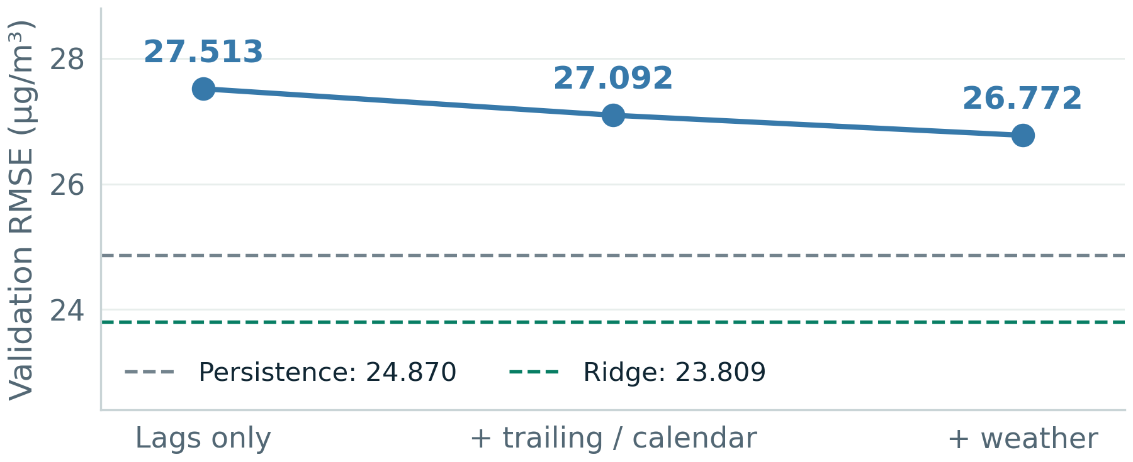
AIRCAST
04 / CHRONOLOGICAL DESIGN AND SELECTION
Tune on 2013, then freeze the settings
Quarterly expanding refits · observed histories update hourly within each evaluation block.
2010–2012
2013
2014
Initial training + EDA
Q1 Q2 Q3 Q4 · validation
Q1 Q2 Q3 Q4 · holdout
Does extra information help XGBoost?
Selection and label-availability rules
Selected parameters fixed; validation dates only
Three-candidate grid → lowest pooled validation RMSE
Candidate RMSE: 26.772 / 26.801 / 26.953
Selected: 300 trees · depth 3 · learning rate 0.05
Child weight 5 · row 0.8 / column 0.9 · L2 = 5
For target block B: latest training label ≤ B − 1 h
No holdout tuning or early stopping; fit preprocessing per fold.
Same observed targets and naive inputs for all models.
Features improve XGBoost; simpler validation models remain stronger.
SOURCE: configs/phase1.toml, selection.json and validation_ablation.csv; rolling-origin forecasting principles.
05 / 10
Notes:
The 2010–2012 period is initial training and EDA. Four expanding quarterly folds in 2013 choose parameters using pooled validation RMSE. Four quarterly 2014 folds then evaluate the frozen setting. The figure shows XGBoost validation RMSE falling 27.513 → 27.092 → 26.772 as trailing/calendar and weather groups are added. The selected settings remain fixed during this comparison; it is not separate optimal tuning for every group. Dashed reference lines show persistence 24.870 and Ridge 23.809, both better than full XGBoost on validation. Candidate RMSEs are 26.772, 26.801, 26.953, a narrow separation rather than a globally proven optimum. Selected XGBoost has 300 trees, depth 3, learning rate 0.05, child weight 5, subsample 0.8, colsample 0.9 and lambda 5, with seed 42, histogram trees and two threads. There is no test-based early stopping. For block start B, the first forecast origin is B−h and every training label must be known by that origin. Q1 2014 uses labels through 31 December 2013 at 23:00, with 32,951 eligible training rows; Q4 has 39,447. Later observed quarters can enter later fits under the same policy. The shared mask requires warm-up, a real target and both naive inputs, yielding 8,563 validation and 8,531 holdout targets. Exclusion counts overlap. Methodological basis: https://otexts.com/fpp3/toolbox.html

Slide 6
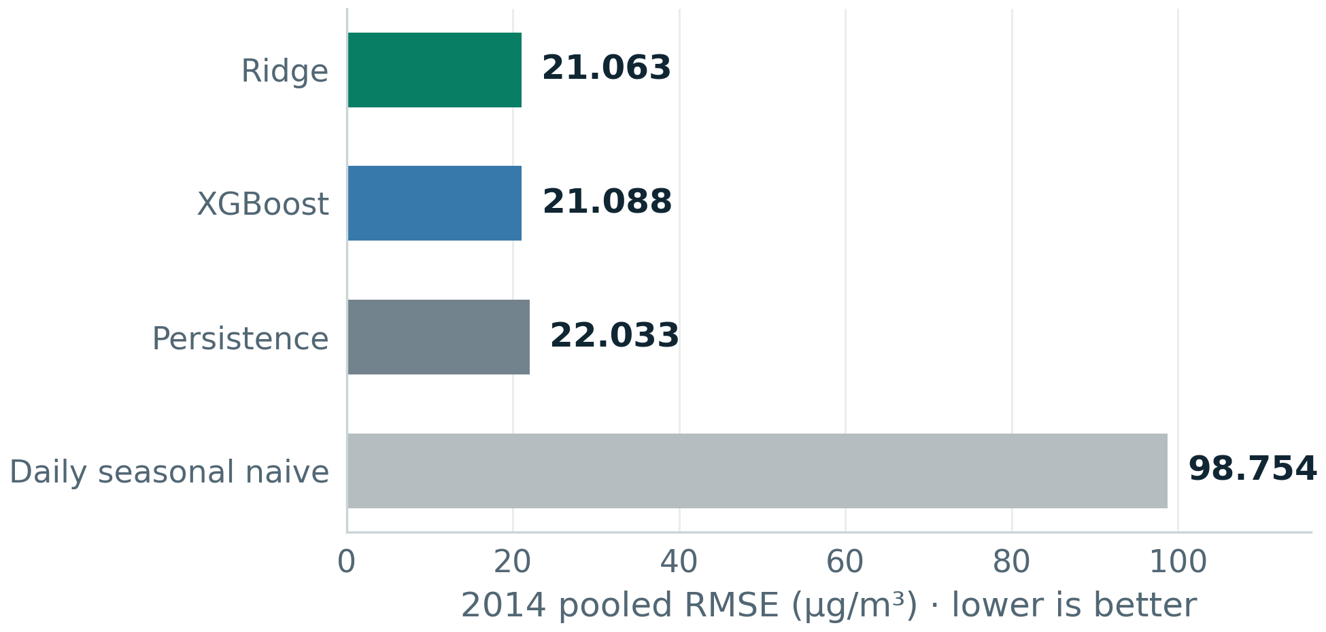
AIRCAST
05 / POOLED HOLDOUT COMPARISON
The gain is useful, but modest
Same 8,531 observed 2014 target hours for all four models · MAE / RMSE in µg/m³; R² is dimensionless.
4.29%
4.41%
97.39%
XGBoost RMSE improvement
Ridge RMSE improvement
Holdout target coverage
Relative to persistence, on common hours
The linear comparator is slightly better
8,531 / 8,760 expected hours; 229 excluded
Annual RMSE comparison
All required metrics
Model
MAE
RMSE
R²
Persistence
11.926
22.033
0.9442
Seasonal naive
67.296
98.754
-0.1205
Ridge
11.825
21.063
0.9490
XGBoost
11.833
21.088
0.9489
Ridge has lower RMSE by 0.025 µg/m³. The significance of this difference has not been tested.
SOURCE: Real-data metrics.csv; pooled errors recomputed from saved out-of-fold predictions.
06 / 10
Notes:
All four methods are scored on the same 8,531 observed target hours out of 8,760 in 2014: 97.39% coverage. The 229 excluded hours lack a target or at least one naive input; the exclusion counts overlap. The graph starts at zero and shows the weak seasonal reference without hiding its large error. Persistence MAE 11.926, RMSE 22.033 and R² 0.9442; daily seasonal naive 67.296, 98.754 and −0.1205; Ridge 11.825, 21.063 and 0.9490; XGBoost 11.833, 21.088 and 0.9489. XGBoost improves RMSE 4.29% over persistence, while Ridge improves 4.41%. The learned-model gap of about 0.025 is not a tested statistically significant difference. MAE averages absolute errors; RMSE square-roots the mean squared error and emphasizes large misses. R² compares squared errors with the observed-period mean denominator, may be negative and must not be called percentage accuracy. The negative seasonal R² is retained. Pooled metrics use all errors rather than averaged quarterly RMSEs. XGBoost's favorable 2014 comparison does not erase its weaker 2013 validation comparison. Historical point errors do not give calibrated intervals for future predictions.

Slide 7
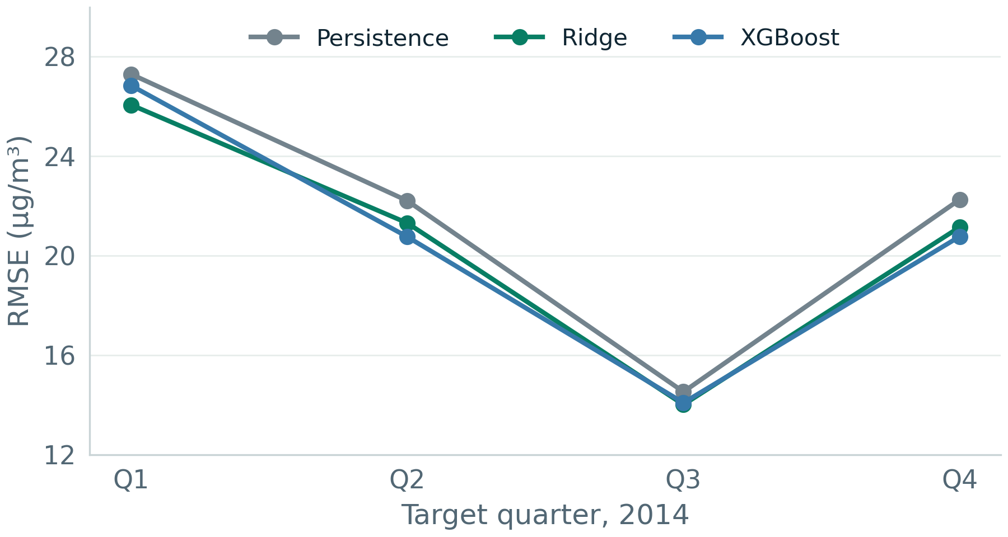
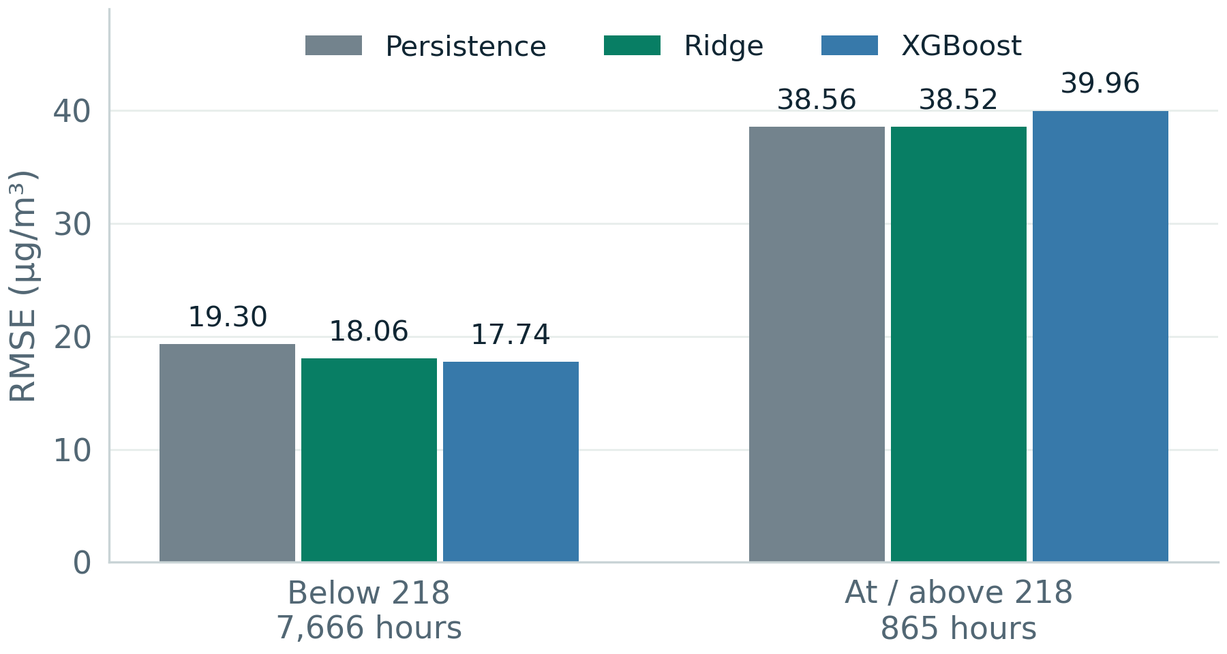
AIRCAST
06 / STABILITY AND HIGH-POLLUTION DIAGNOSTICS
A single annual score hides important differences
Quarterly model rankings change, and XGBoost's pooled advantage does not extend to the high-pollution subset.
Quarterly holdout RMSE
Errors by observed pollution level
Both learned models beat persistence each quarter.
High-pollution RMSE: XGBoost 39.959 vs 38.557.
Ridge leads Q1 / Q3; XGBoost leads Q2 / Q4.
High-pollution bias: XGBoost −11.912; Ridge −13.313.
In Q1, XGBoost's MAE still exceeds persistence.
Both learned models underpredict this subset on average.
SOURCE: fold_metrics.csv and errors_by_pollution_regime.csv; high threshold fixed at training p90 = 218 µg/m³.
07 / 10
Notes:
Quarterly RMSE makes temporal variation visible. Persistence is 27.298, 22.208, 14.527 and 22.255; Ridge 26.063, 21.311, 14.012 and 21.148; XGBoost 26.839, 20.758, 14.087 and 20.770. Both learned methods beat persistence on RMSE each quarter, but Ridge leads Q1 and Q3 and XGBoost Q2 and Q4. XGBoost's Q1 MAE is worse than persistence despite the smaller RMSE. We fix the high-pollution threshold at 218 using the 2010–2012 p90, without consulting the holdout distribution. There are 865 high and 7,666 lower-pollution common hours. On high hours, persistence RMSE is 38.557, Ridge 38.522 and XGBoost 39.959. Below 218, errors are 19.301, 18.062 and 17.740, so the pooled XGBoost gain is largely associated with the lower-pollution subset. High-pollution bias is −5.534 for persistence, −13.313 for Ridge and −11.912 for XGBoost. Negative bias means underprediction. These are descriptive subsets, not a new optimized experiment. No significant ranking or causal mechanism is inferred from the differences. A practical peak-focused use case needs a separately evaluated peak-error objective.

Slide 8
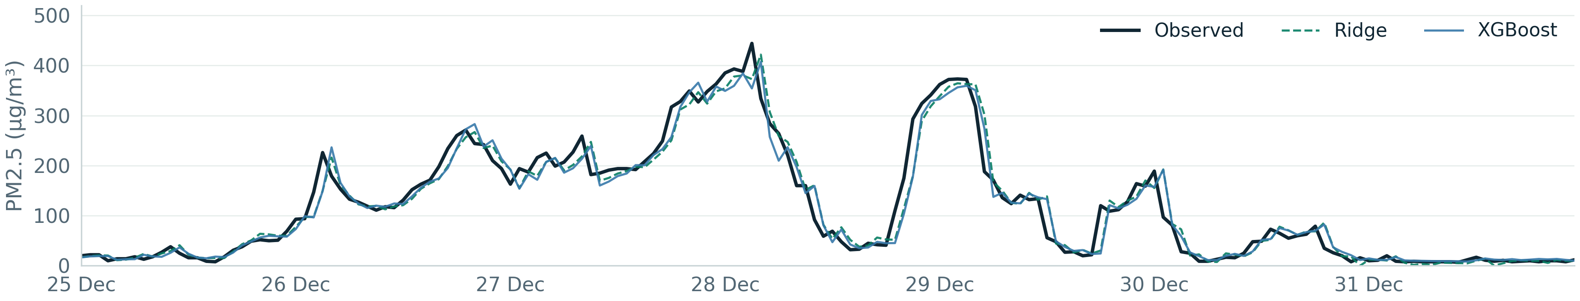
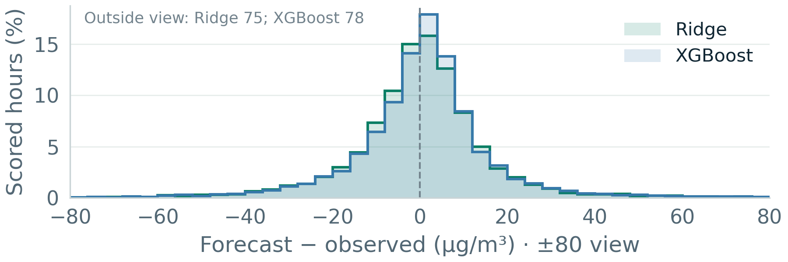
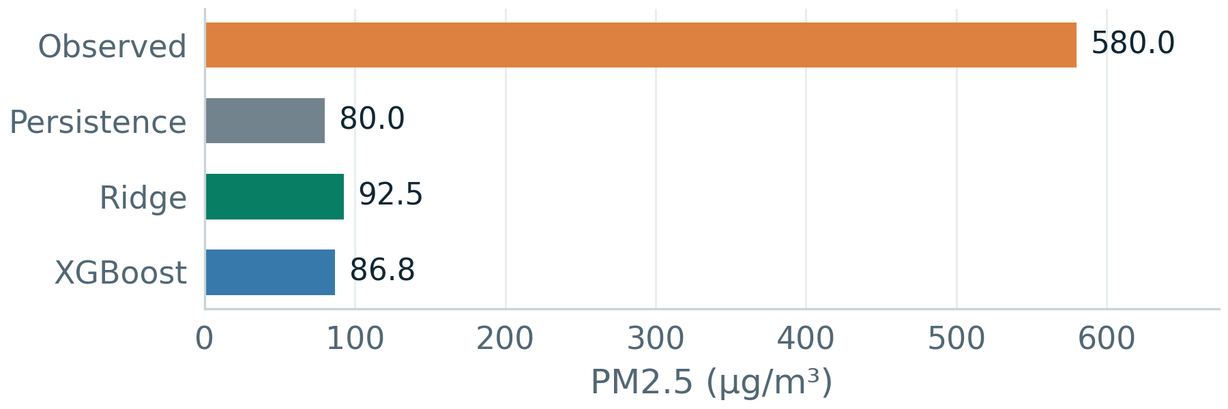
AIRCAST
07 / FORECAST TRACE AND FAILURE ANALYSIS
Look at the predictions, not just the summary
Saved rolling backtest forecasts · the final deployment refit is never used to generate these historical scores.
Actual versus predicted · final seven days of 2014
Signed residuals across the full holdout
Largest spike miss · 9 April 2014, 20:00
SOURCE: 2014 predictions.csv; trace shows 25–31 December; the spike is the largest XGBoost holdout miss.
08 / 10
Notes:
The upper graph plots every common forecast hour in the final seven days of 2014, with missing scored hours represented as breaks. Observed concentration, Ridge and XGBoost share the same timestamps. These are saved out-of-fold predictions made by quarterly fitted models, not the final archive-trained models. Tracking the recent level does not guarantee anticipating a sharp change. The lower-left graph uses signed residuals prediction minus observation from all 8,531 holdout hours. Its display is restricted to ±80 µg/m³ for legibility: 78 XGBoost and 75 Ridge errors lie outside this view; histogram percentages retain the denominator of all 8,531 hours. Thus the tails are not silently removed from metrics. Negative residuals are underpredictions. XGBoost median absolute error is 6.88, p90 26.28 and p95 37.46; these empirical quantiles are not prediction intervals. One-hour residual autocorrelation is 0.120 for XGBoost and 0.063 for Ridge, so residual structure remains. The lower-right graph is the largest XGBoost miss, chosen explicitly as a failure case. PM2.5 rises from 80 to 580 in one hour; persistence predicts 80, Ridge 92.469, XGBoost 86.801, an XGBoost absolute miss of about 493.199. Without an independent sensor-quality flag, we retain this target. The visual example explains a failure mode rather than proving all peaks have one cause.

Slide 9
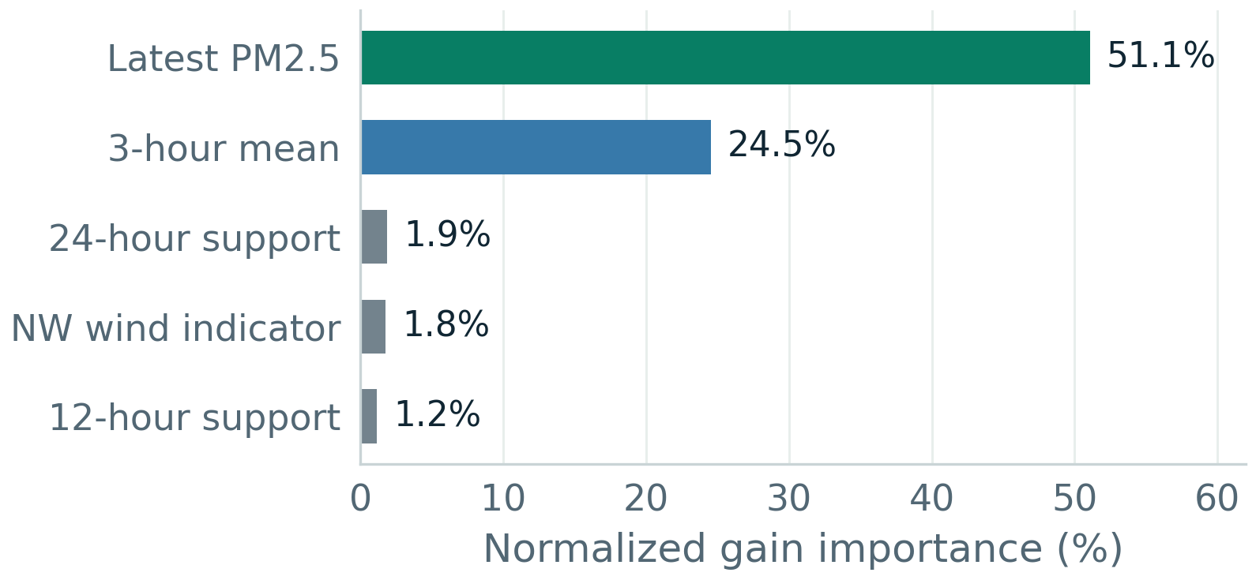
AIRCAST
08 / IMPLEMENTATION, EXPLANATION AND NEXT STEPS
From experiment artifacts to the Aircast demo
The interface invokes the original Python feature builder and saved pipelines; training and inference are separate.
INPUT
→
VALIDATE
→
PREDICT
→
EXPLORE
Manual observation / hourly
Flask + revalidated history
Saved Ridge / XGBoost
History chart + forecast
CSV
pipeline
export
What the final XGBoost refit uses
Reproducibility and practical limits
Top five features · gain importance is not causation
17,062
refitted predictions reproduced
Maximum numeric difference < 6e−14 in the recorded audit.
Retained: config, hashes, versions, fold audits, predictions,
cleaning exports, feature dictionary, CLI / notebook and tests.
Limits: historical Beijing; peak errors; assumed data availability.
Next: fresh evaluation, peak-focused methods and uncertainty.
Demo scenarios are historical. No calibrated intervals or AQI mapping.
SOURCE: Saved deployment-refit gain importance and the recorded historical/local prediction audit.
09 / 10
Notes:
Aircast lets a user append a manual reading or upload an hourly CSV, select an available model, inspect history, generate a next-hour forecast, export results and open the report. The frontend is HTML/CSS/JavaScript with an SVG chart, and Flask validates data before invoking the original feature builder. Uploads need at least 169 hourly slots, unique valid timestamps and physical numeric values, and are bounded at 4 MB / 100,000 rows or hourly slots. The normalized recent window travels with each request and is revalidated, so different server instances can forecast without shared upload sessions. Final model artifacts are refitted only after evaluation and reject histories ending before their fit endpoint. Gain importance belongs to that final refit: latest PM2.5 51.1% and three-hour mean 24.5%; it is not causal attribution, a stability study or holdout feature selection. The recorded independent audit refitted both learned methods across four holdout quarters, reproducing all 17,062 predictions with maximum floating-point difference below 6e−14. It also checked actual targets, references, recomputed metrics, manual-input response and stateless upload parity. Data/source hashes, configuration, versions, selection, fold audits, predictions, model artifacts, preparation exports and tests remain inspectable. Synthetic fixtures test behavior and do not supply scores. Vercel reported Ready; the existing record does not independently verify hosted inference or browser rendering. Sample data is historical. The original uploaded archive gives 2015-01-01 00:00 predictions XGBoost 11.92273 and Ridge 13.63978, unscored because the target is outside the archive. No AQI mapping or calibrated prediction interval is supplied. Future peak objectives, uncertainty methods and sequence/hybrid models require fresh evaluation or an exploratory label after inspecting 2014.

Slide 10
AIRCAST
TEAM / QUESTIONS AND DISCUSSION
Thank you.
Questions & discussion
TEAM MEMBER
ENROLLMENT NUMBER
Samarth Khera
2401010407
Pratham Malhotra
2401010343
Adityaraj Pal
2401010042
Tattva Rajput
2401010478
Himanshu
2401010188
Phase 1: a reproducible pipeline, modest pooled gains, and clear evidence for the next experiment.
CSAI PROJECT 19 / PHASE 1 · MACHINE LEARNING
10 / 10
Notes:
Thank the audience and invite questions. Team: Samarth Khera — 2401010407; Pratham Malhotra — 2401010343; Adityaraj Pal — 2401010042; Tattva Rajput — 2401010478; Himanshu — 2401010188. No email addresses or invented individual contribution allocations are included. Phase 1 delivers a complete classical ML workflow and Aircast demonstration. The measured conclusion is modest 2014 pooled improvement beyond persistence, a close Ridge/XGBoost comparison and unresolved peak performance. Explain lag zero, t−23 seasonal alignment, training-label availability, common scoring hours, the weak 2013 validation comparison and the difference between final refits and historical backtests. The first common target is 2014-01-01 00:00: origin latest PM2.5 23, previous reading 20, three-hour mean 22, observed target 24, persistence 23, Ridge 26.688, XGBoost 21.078 and seasonal 84. It is chosen by time rather than model success and shows why an individual forecast does not determine a year-long ranking. New model choices motivated by inspected holdout errors need fresh evaluation. References and derivations are retained in the seven-page report, the slide notes and the Phase 1 literature review.

