Slide 1
Visual communication end-term project
Group - F

Slide 2
Project Topic
Collection and Analysis of eye-fixations on images with respect to colors and their relative positions.

Slide 3
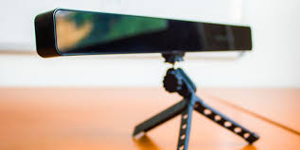
DESCRIPTION
EYE TRACKER
The eye tracker used in our project is the TOBII Eye tracker.
//Write specifications.

Slide 4
DESCRIPTION
SOFTWARE USED
OpenCV was used for image processing and generation of visuals.
Visual Studio along with Tobii EyeTracker SDK was used for building the computer application for recording the data.

Slide 5
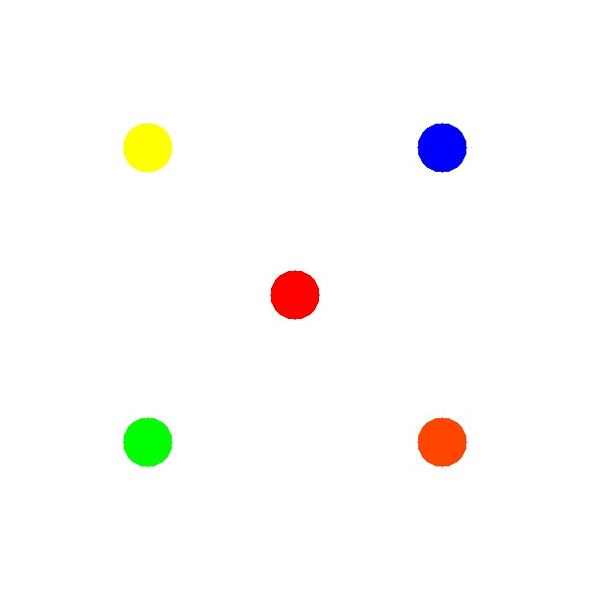
DESCRIPTION
APPROACH
Image Creation
Five colors were taken and permuted over the 5 main areas of focus. Thus 5! = 120 images were created which were randomly partitioned in 4 sets of 30 each.
In a set an image was displayed for 3 seconds and then a pause was given for 1 second.

Slide 6
DESCRIPTION
APPROACH
Data Collection
Each image was then shown to 25 people, and raw data obtained was in the form of gaze positions and corresponding time durations.

Slide 7
DESCRIPTION
APPROACH
Analysis Methods
Readings were recorded and subsequently analyzed using R, RStudio and C++ programming. Different graphs, pie charts, heatmaps and gaze traces were generated.

Slide 8
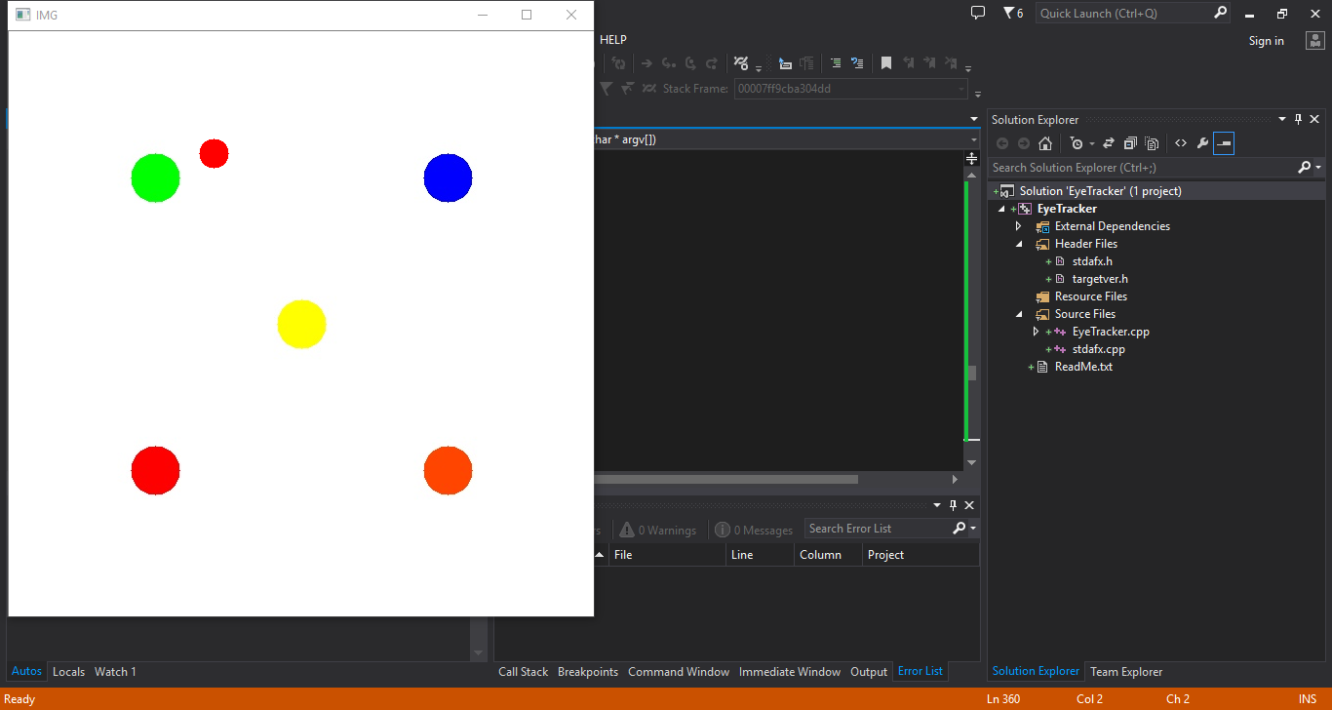
SAMPLE WORKING

Slide 9
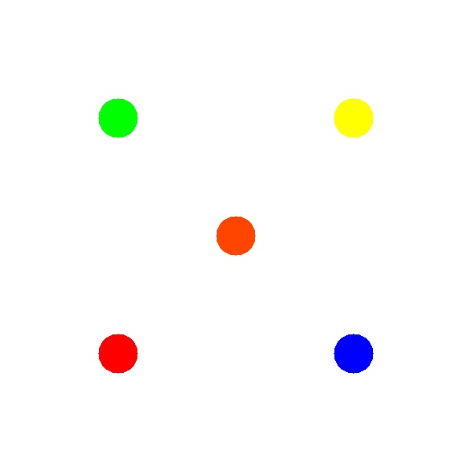
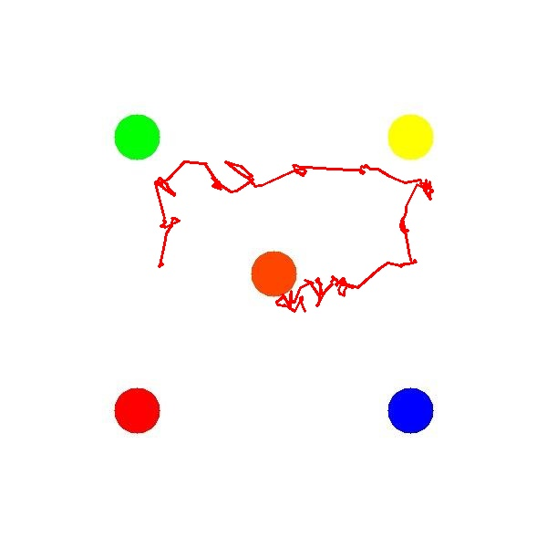
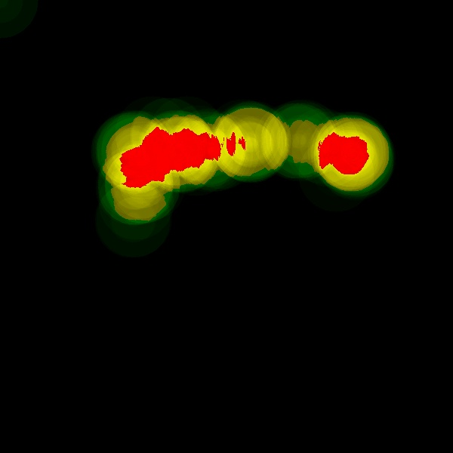
SAMPLE OUTPUT
Image
Gaze Trace
Heat Map

Slide 10
ANALYSIS
COLOR ANALYSIS GRAPHS
BLUE
Let’s see the analysis for color BLUE.

Slide 11
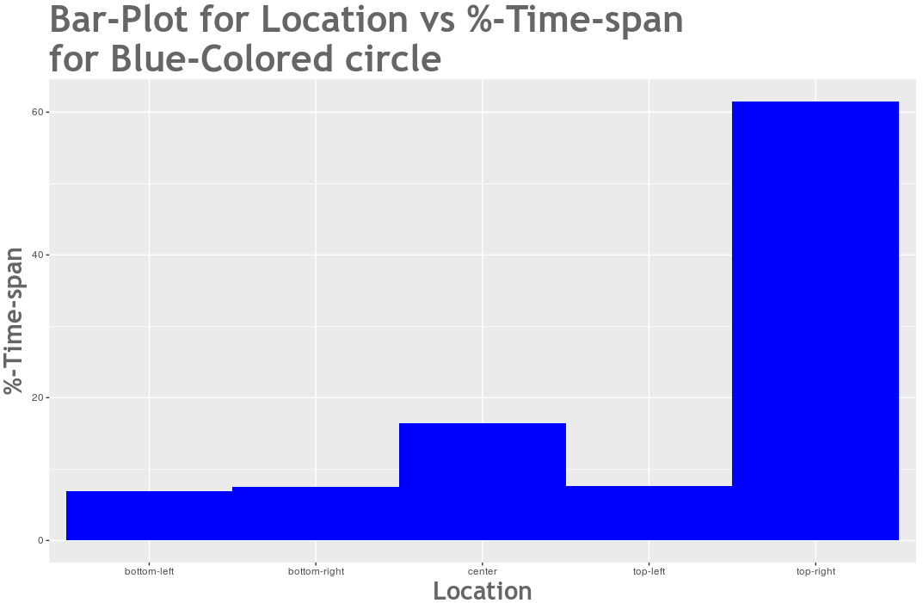

Slide 12
ANALYSIS
COLOR ANALYSIS GRAPHS
RED
Let’s see the analysis for color RED.

Slide 13
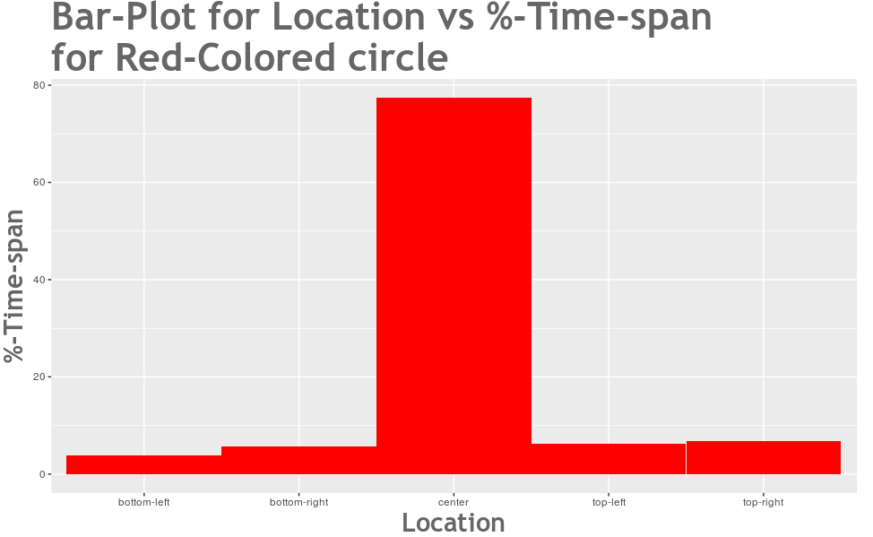

Slide 14
ANALYSIS
COLOR ANALYSIS GRAPHS
GREEN
Let’s see the analysis for color GREEN.

Slide 15
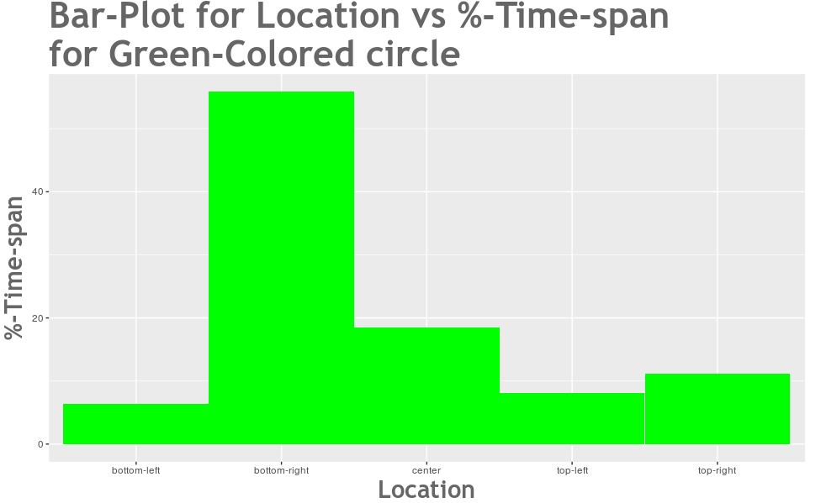

Slide 16
ANALYSIS
COLOR ANALYSIS GRAPHS
YELLOW
Let’s see the analysis for color YELLOW.

Slide 17
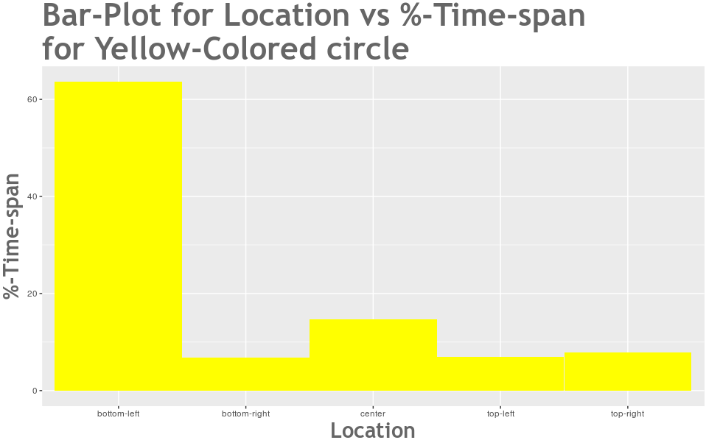

Slide 18
ANALYSIS
COLOR ANALYSIS GRAPHS
ORANGE
Let’s see the analysis for color ORANGE.

Slide 19
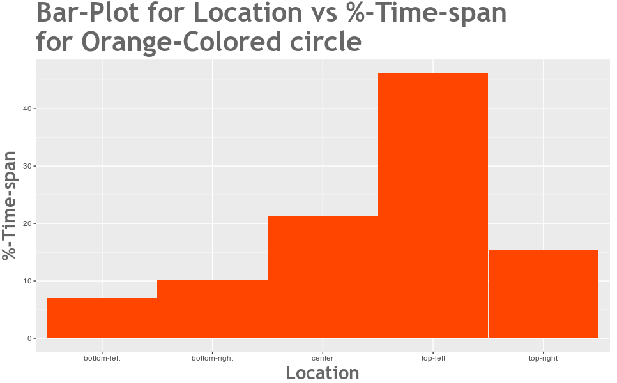

Slide 20
ANALYSIS
COLOR ANALYSIS GRAPHS
OVERALL
Let’s see the OVERALL analysis for colors.

Slide 21
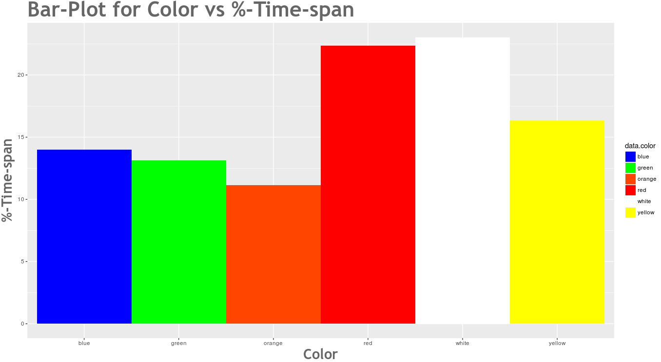

Slide 22
ANALYSIS
COLOR ANALYSIS PIE-CHARTS
BLUE
Let’s see the analysis for BLUE.

Slide 23
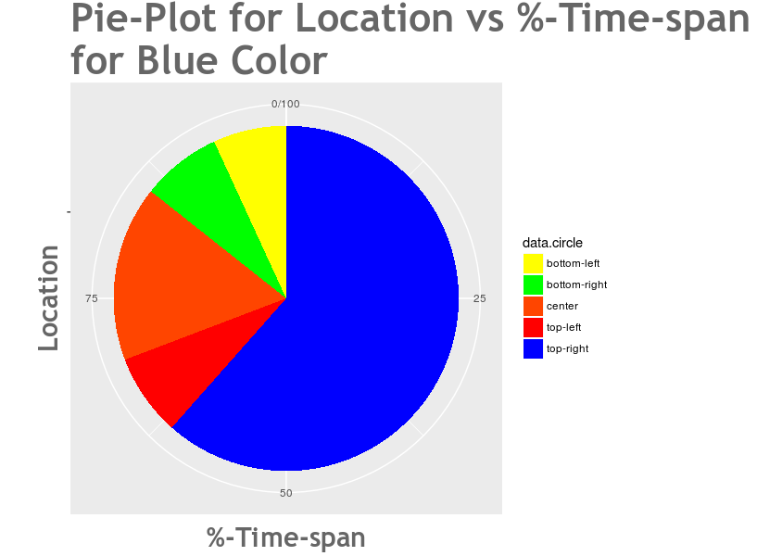

Slide 24
ANALYSIS
COLOR ANALYSIS PIE-CHARTS
RED
Let’s see the analysis for RED.

Slide 25
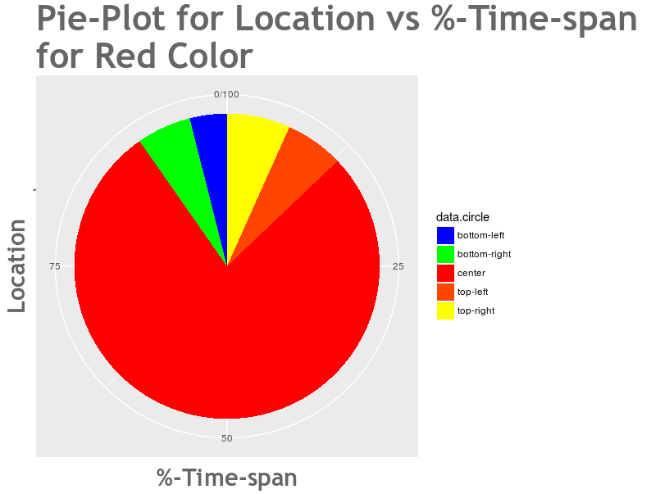

Slide 26
ANALYSIS
COLOR ANALYSIS PIE-CHARTS
GREEN
Let’s see the analysis for GREEN.

Slide 27
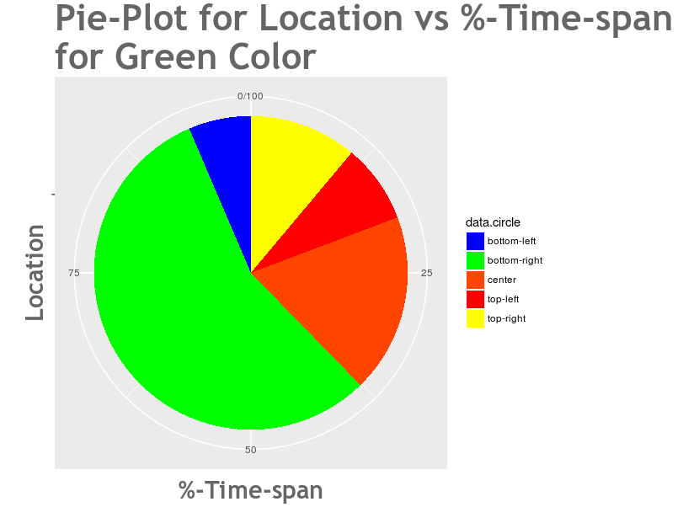

Slide 28
ANALYSIS
COLOR ANALYSIS PIE-CHARTS
YELLOW
Let’s see the analysis for YELLOW.

Slide 29
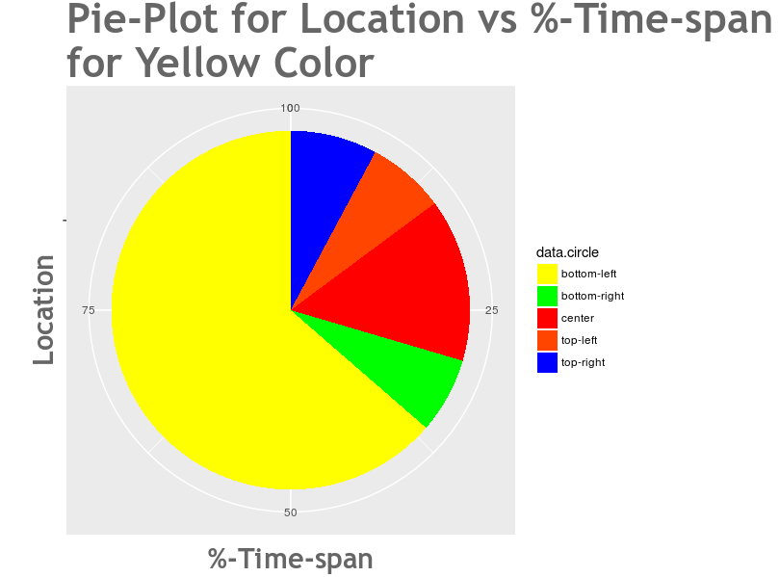

Slide 30
ANALYSIS
COLOR ANALYSIS PIE-CHARTS
ORANGE
Let’s see the analysis for ORANGE.

Slide 31
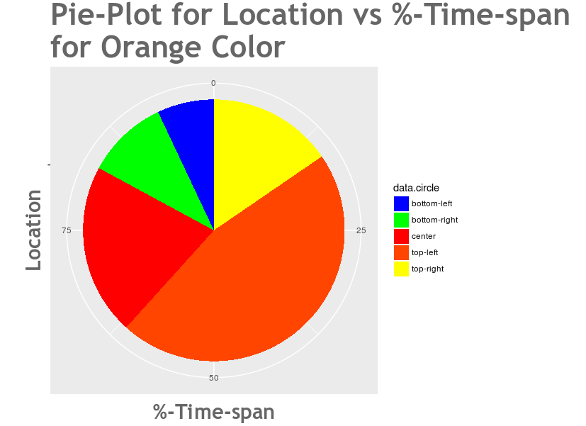

Slide 32
ANALYSIS
COLOR ANALYSIS PIE-CHARTS
OVERALL
Let’s see the OVERALL analysis for colors.

Slide 33
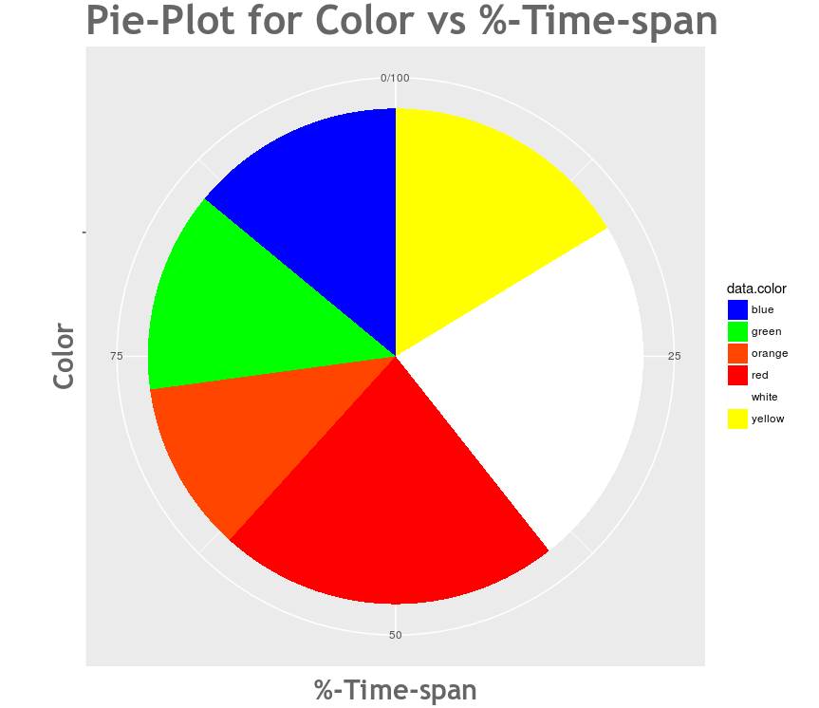

Slide 34
ANALYSIS
FOCUS ANALYSIS GRAPHS
BOTTOM-LEFT CIRCLE
Let’s see the analysis for the bottom-left focus point.

Slide 35
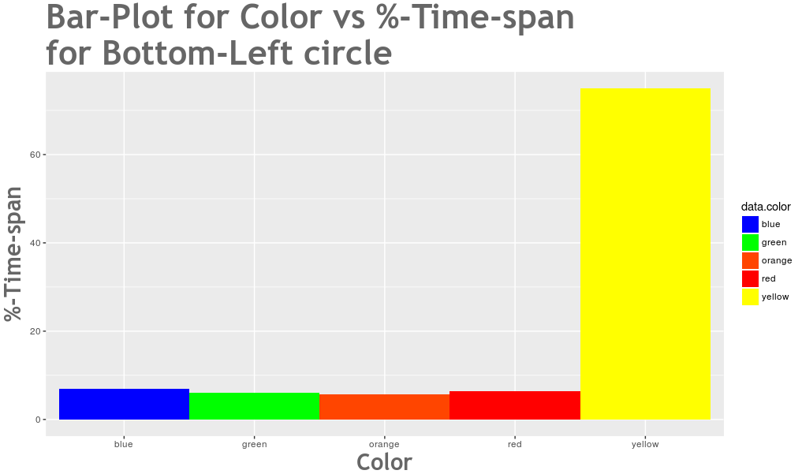

Slide 36
ANALYSIS
FOCUS ANALYSIS GRAPHS
BOTTOM-RIGHT CIRCLE
Let’s see the analysis for the bottom-right focus point.

Slide 37
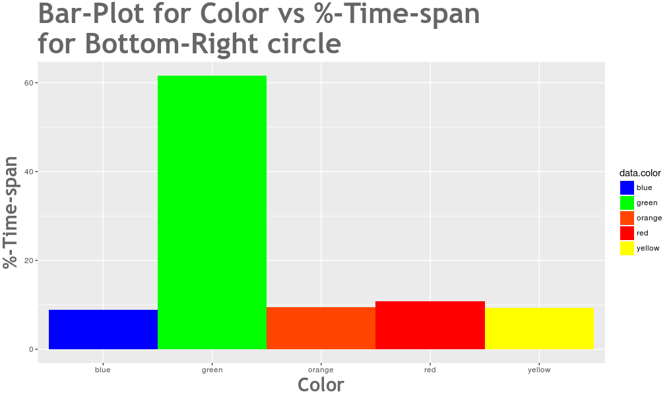

Slide 38
ANALYSIS
FOCUS ANALYSIS GRAPHS
CENTRE CIRCLE
Let’s see the analysis for the Centre focus point.

Slide 39
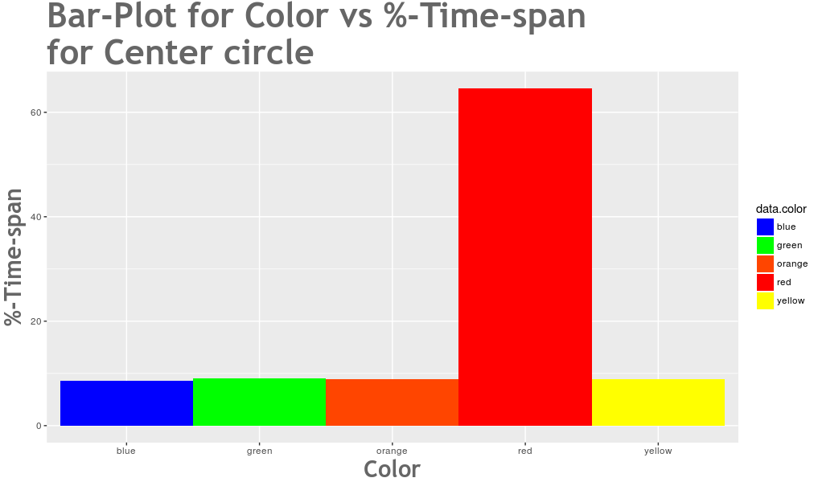

Slide 40
ANALYSIS
FOCUS ANALYSIS GRAPHS
TOP-LEFT CIRCLE
Let’s see the analysis for the Top-left focus point.

Slide 41
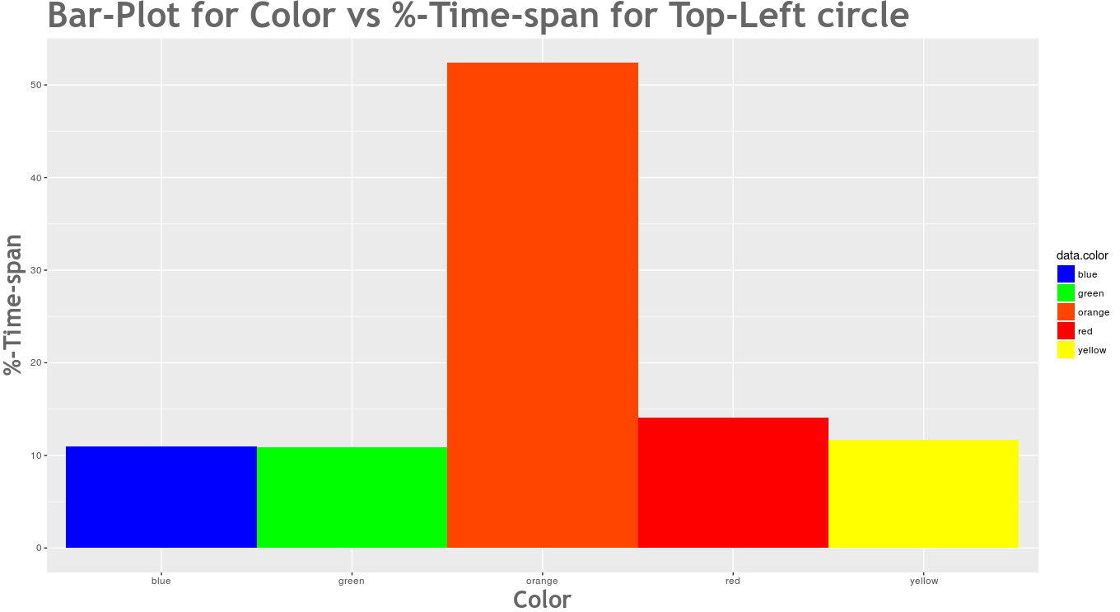

Slide 42
ANALYSIS
FOCUS ANALYSIS GRAPHS
TOP-RIGHT CIRCLE
Let’s see the analysis for the Top-right focus point.

Slide 43
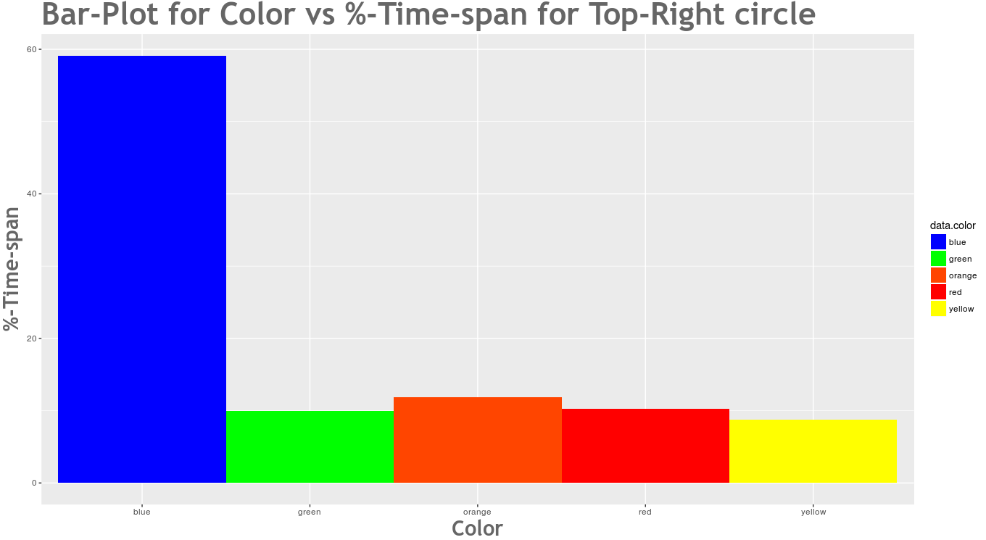

Slide 44
ANALYSIS
FOCUS ANALYSIS GRAPHS
OVERALL FOCUS ANALYSIS
Let’s see the overall analysis for all the focus points.

Slide 45
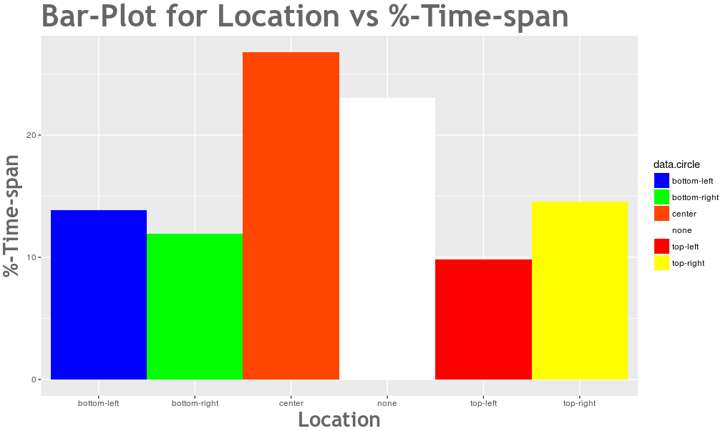

Slide 46
ANALYSIS
FOCUS ANALYSIS PIE-CHARTS
BOTTOM-LEFT FOCUS
Let’s see the analysis for the Bottom-left focus point.

Slide 47
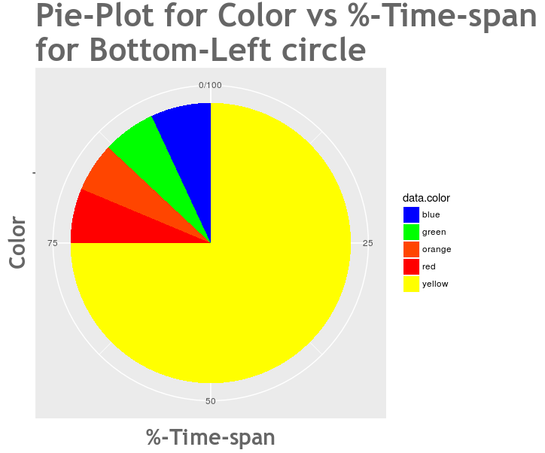

Slide 48
ANALYSIS
FOCUS ANALYSIS PIE-CHARTS
BOTTOM-RIGHT FOCUS
Let’s see the analysis for the Bottom-right focus point.

Slide 49
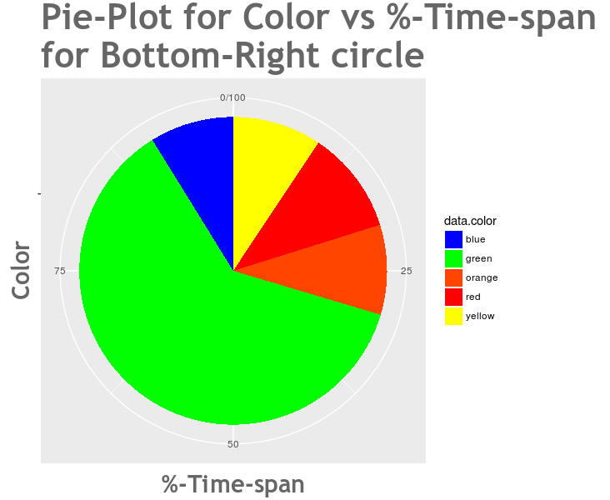

Slide 50
ANALYSIS
FOCUS ANALYSIS PIE-CHARTS
CENTRE FOCUS
Let’s see the analysis for the Centre focus point.

Slide 51
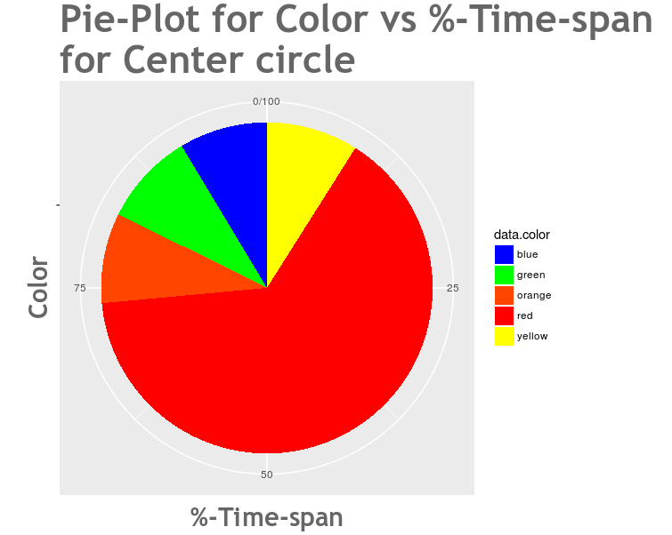

Slide 52
ANALYSIS
FOCUS ANALYSIS PIE-CHARTS
TOP-LEFT FOCUS
Let’s see the analysis for the Top-left focus point.

Slide 53
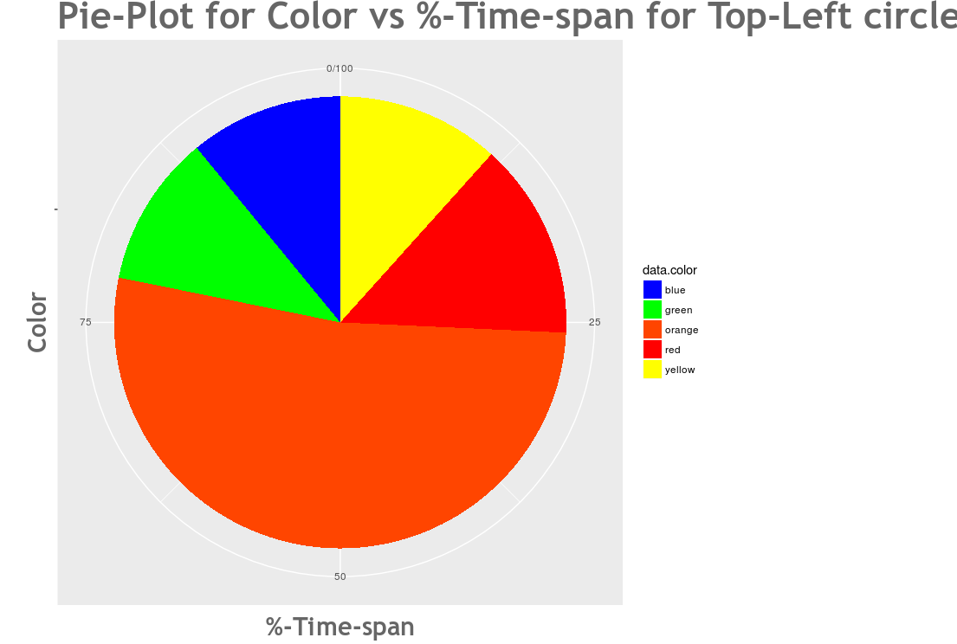

Slide 54
ANALYSIS
FOCUS ANALYSIS PIE-CHARTS
TOP-RIGHT FOCUS
Let’s see the analysis for the Top-right focus point.

Slide 55
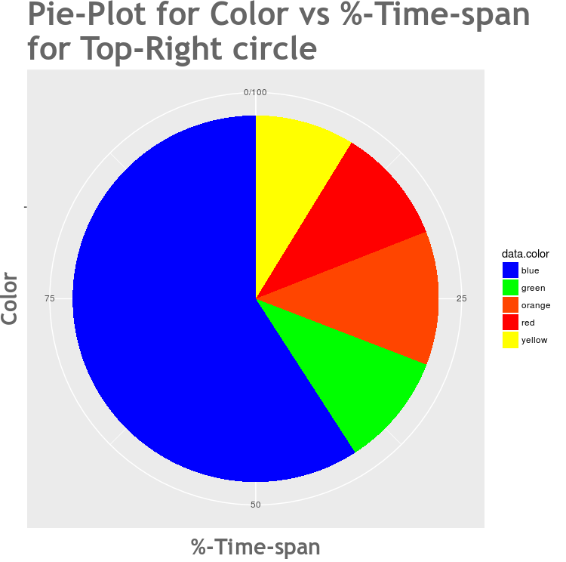

Slide 56
ANALYSIS
FOCUS ANALYSIS PIE-CHARTS
OVERALL FOCUS
Let’s see the overall analysis for all the focus points.

Slide 58
ANALYSIS
OVERALL ANALYSIS GRAPH
OVERALL FOCUS
Let’s see the overall analysis for all the focus points.

Slide 59
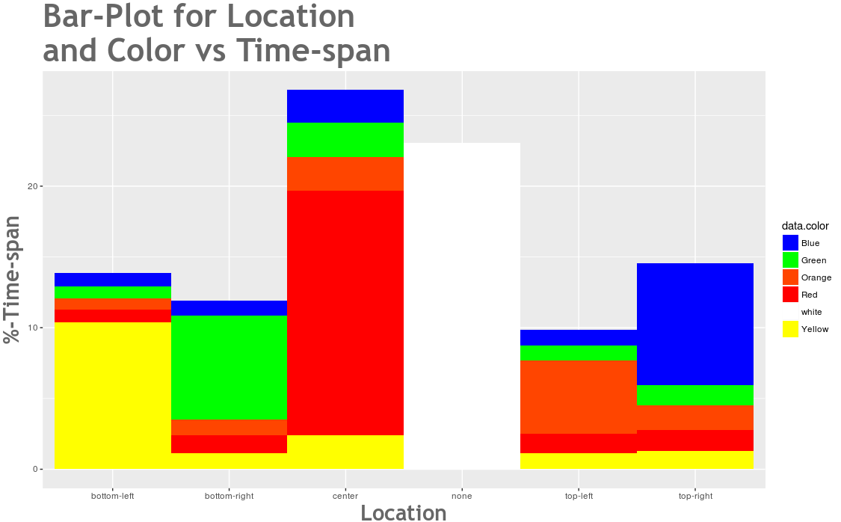

Slide 60
ANALYSIS
FOCUS POINT ANALYSIS GRAPH
FIRST FOCUS FOR COLOUR
Let’s see the overall analysis for the first focus points for colours.

Slide 61
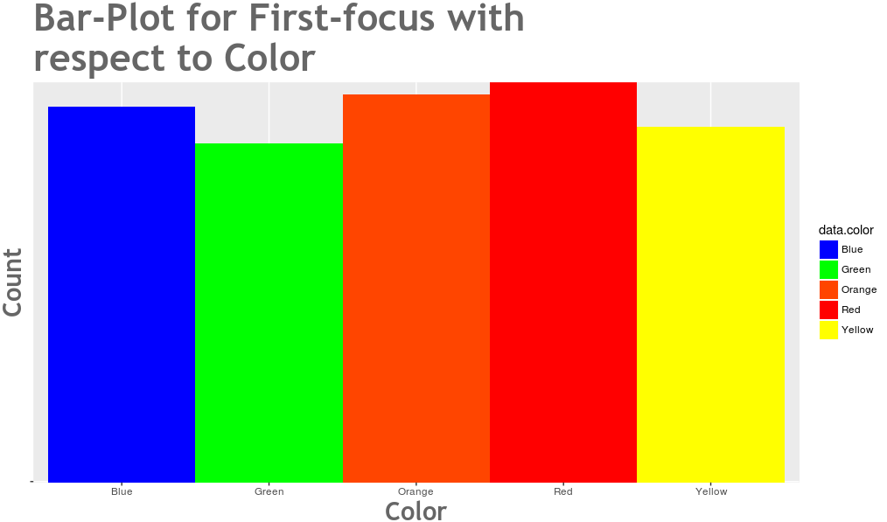

Slide 62
ANALYSIS
FOCUS POINT ANALYSIS GRAPH
SECOND FOCUS FOR COLOUR
Let’s see the overall analysis for the second focus points for colours.

Slide 63
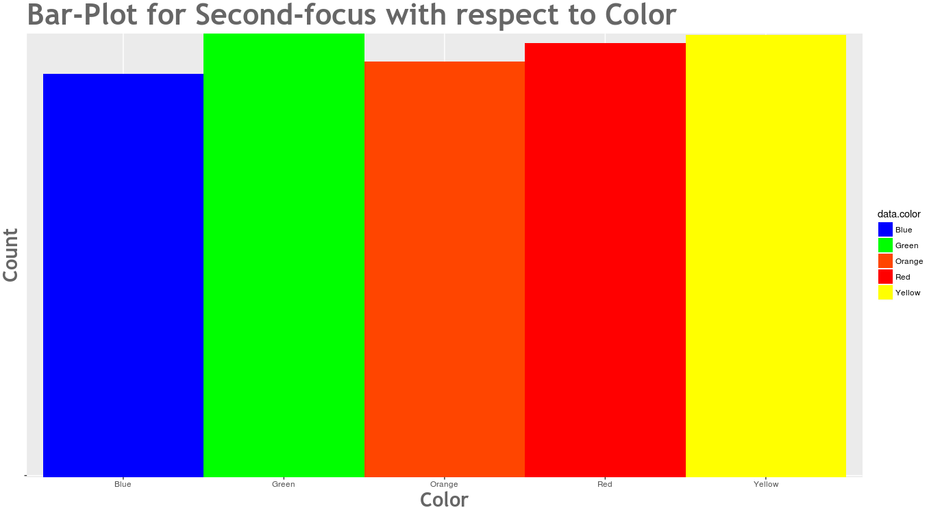

Slide 64
ANALYSIS
FOCUS POINT ANALYSIS GRAPH
FIRST FOCUS FOR LOCATION
Let’s see the overall analysis for the first focus points for locaions.

Slide 65
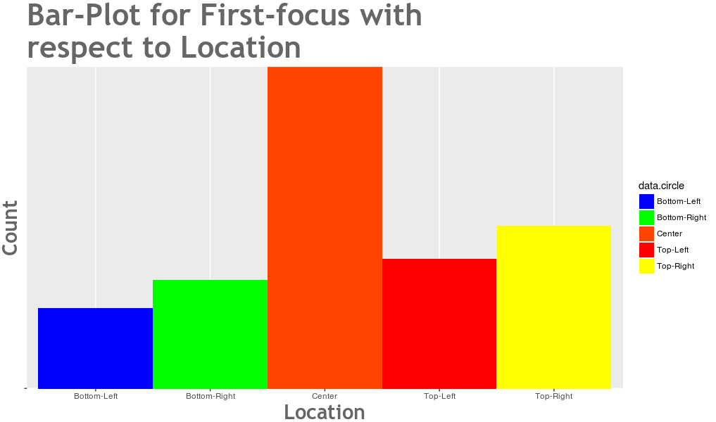

Slide 66
ANALYSIS
FOCUS POINT ANALYSIS GRAPH
SECOND FOCUS FOR LOCATION
Let’s see the overall analysis for the second focus points for locations.

Slide 67
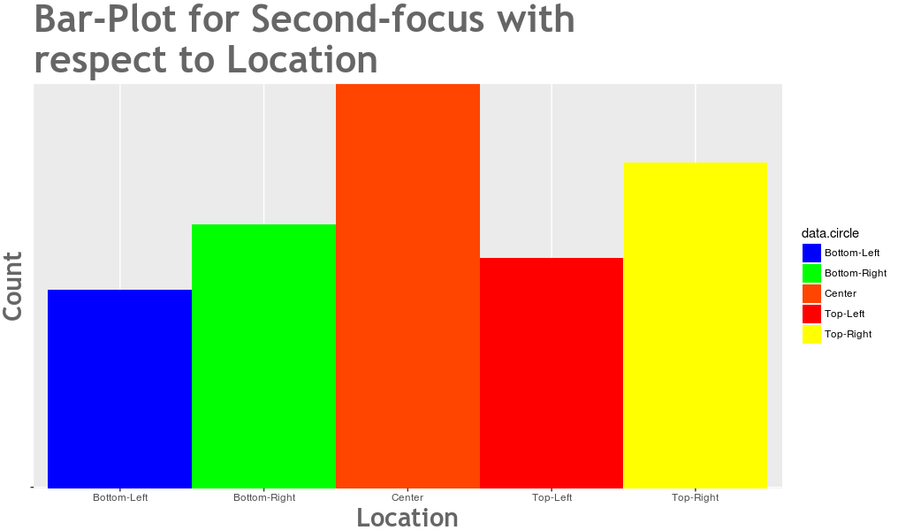

Slide 68
CONCLUSIONS
Blue color is most viewed at top-right position.
Red color is most viewed at center position.
Green color is most viewed at bottom-right position.
Yellow color is most viewed at bottom-left position.
Orange color is most viewed at top-left position.
It seems that first focus is more or less independent of colors.
The first focus in an image is found to be predominantly at the center position.
It seems that the second focus is more or less independent of colors.
The second focus in an image is found to be at the center position.

Slide 69
APPLICATIONS
POSTERS
Results of this project can be used to design creative and visually attractive images. We can display the important message in a particular colour and location, so that it is caught by the viewer easily.

Slide 70
APPLICATIONS
ADVERTISEMENTS
Advertisements usually need to be catchy. So, with the help of this project, we can predict the position and other visual elements which will catch the eye of public.

Slide 71
APPLICATIONS
MAGAZINES
An image is worth a thousand words. So, the image should be attractive enough so as to convey the message. This can be implemented using the conclusions drawn from this project.

Slide 72
FURTHER POSSIBLE WORK
COLORS, SHAPES & LOCATIONS
Number of colors can be increased from 5 to as many as possible.
Shapes other than a circle can be used with proper logic and reasoning.
Number of locations can be increased from 5 to as many as possible.

Slide 73
FURTHER POSSIBLE WORK
DATA COLLECTION
The number of people from whom data is collected can be increased from 100 to as much as possible.
More amount of data will ensure better accuracy and thus better results.

Slide 74
FURTHER POSSIBLE WORK
MACHINE LEARNING
On increase of input parameters and sample data, efficient machine learning algorithms can be used to not only generate statistical data but also PREDICT eye fixations on new images such as paintings, magazine articles, newspaper advertisements etc.

Slide 75
Group Members
Aayush Gupta 15CS10001
Siddhant Meshram 15CS10042
Yashvardhan Singh 15CS10056
Achal Gupta 15CS30001
Chavan Prathamesh 15CS30008
Chandan Patil 15CS30009
Sumeet Shirgure 15CS30035

