Slide 1
PUBG ML Project
Shubhanshu Agrawal - IMT2020078
Pratham Dandale - IMT2020038

Slide 2
Overview about problem
In a PUBG game, up to 100 players start in each match (matchId). Players can be on teams (groupId) which get ranked at the end of the game (winPlacePerc) based on how many other teams are still alive when they are eliminated. In game, players can pick up different munitions, revive downed-but-not-out (knocked) teammates, drive vehicles, swim, run, shoot, and experience all of the consequences -- such as falling too far or running themselves over and eliminating themselves.

Slide 3
About Dataset
We are given with a large number of anonymized PUBG game stats, formatted so that each row contains one player's post-game stats. The data comes from matches of all types: solos, duos, squads, and custom; there is no guarantee of there being 100 players per match, nor at most 4 player per group.

Slide 4
Problem Statement
We have to create a model which predicts players' finishing placement based on their final stats, on a scale from 1 (first place) to 0 (last place).

Slide 5
Pre-processing the data
Importing the required modules. (pandas, numpy, sklearn)
Reading the data from csv files
Removing rows with missing value in any feature.
There was 1 row with ‘winPlacePerc’ as missing value. This row is removed from dataset
Removing duplicate rows
There were no duplicate rows

Slide 6
Pre-Processing (Continued)
Label Encoding the categorical features
We have 1 categorical feature, i.e., ‘matchType’. It has 16 unique feature but it can be classified as solo,duo and squad.
duo-fpp, duo, crashtpp, crashfpp :- DUO
Solo-fpp, solo, normal-solo-fpp :- solo
Rest all are squad
‘Id’, ‘groupId’, ‘matchId’ are object type, so we have also label encoded them

Slide 7
Pre-Processing (Continued)
Removing related column using correlation matrix
Making the heatmap of correlation matrix
We will remove the column which has correlation of ≥ 0.8 or ≤ -0.8
There were total 4 columns which were removed,i.e, ‘killStreaks’, ‘rankPoints’, ‘killPoints’ and ‘maxPlace’

Slide 8
Pre-Processing (Continued)
Removing Outliers
Made a function to remove the outlier
Made boxplots for each columns
If there are distinct values, we will not remove the outliers from them
If there are continuous value in column, we will remove outliers from them

Slide 9
EDA
Plotted various features against winPlacePerc:
Plot of kills showed most kills scattered between 0,10 and players with more kills had lesser rank
Plot of assists showed most assists lied between 0,5 and players with more assists had less rank
Plot of totalDistance showed players with higher totalDistance had lower rank

Slide 10
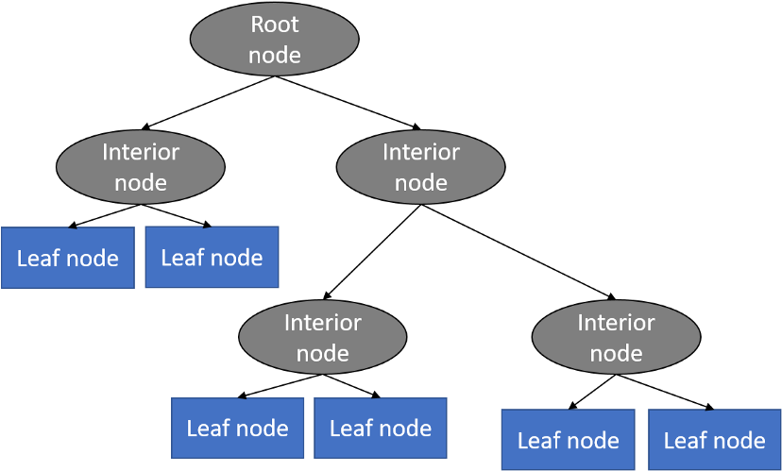
Decision Tree Regression Model
Tree-structured classifier with three types of nodes.
Root Node is the initial node which represents the entire sample and may get split further into further nodes.
The Interior Nodes represent the features of a data set and the branches represent the decision rules.
Leaf Nodes represent the outcome.

Slide 11
Decision Tree Regression Model
Train-test-split percentage :- 90% train 10%test
Size of training data :- 21,79,012
Size of test data :- 9,33,863
Accuracy Score (Mean squared error) :- 0.014

Slide 12
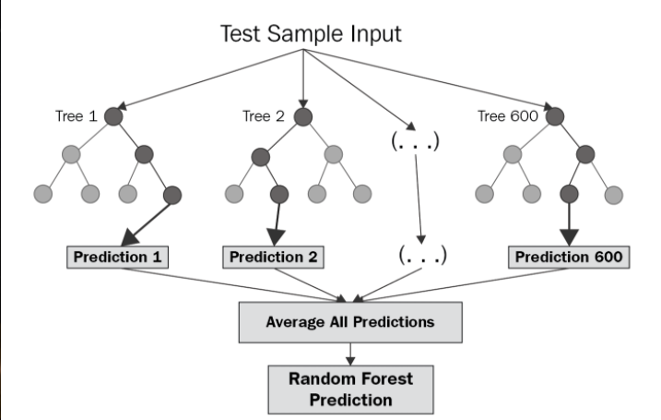
Random Forest Regression Method
Pick at random k data points from the training set.
Build a decision tree associated to these k data points.
Choose the number N of trees you want to build and repeat steps 1 and 2.
For a new data point, make each one of your N-tree trees predict the value of y for the data point in question and assign the new data point to the average across all of the predicted y values.

Slide 13
Random Forest Regression Model
Train-test-split percentage :- 90% train 10%test
Size of training data :- 21,79,012
Size of test data :- 9,33,863
Accuracy Score (Mean squared error) :- 0.093

Slide 14
Gradient Boosting Regression
Gradient boosting regression trees are based on the idea of an ensemble method derived from a decision tree
Gradient boosting is a technique for repeatedly adding decision trees so that the next decision tree corrects the previous decision tree error.
Compared to Random forest, the results are more sensitive to parameter settings during training. However, with the correct parameter settings, you will get better test results than random forest.

Slide 15
Gradient Boosting Regression
Train-test-split percentage :- 90% train 10%test
Size of training data :- 21,79,012
Size of test data :- 9,33,863
Accuracy Score (Mean squared error) :- 0.023

Slide 16
Light gradient boosting machine
LightGBM is a gradient boosting framework based on decision trees
It uses two novel techniques: Gradient-based One Side Sampling and Exclusive Feature Bundling (EFB)
It is based on three important principles:
Weak learners (decision trees)
Gradient Optimization
Boosting Technique

Slide 17
Light Gradient Boosting machine
Train-test-split percentage :- 90% train 10%test
Size of training data :- 21,79,012
Size of test data :- 9,33,863
Accuracy Score (Mean squared error) :- 0.0091

Slide 18
Kaggle Results
Random Forest without feature engineering :- 0.00676
LGBM without feature engineering :- 0.0112

Slide 19
References
https://levelup.gitconnected.com/random-forest-regression-209c0f354c84
https://towardsdatascience.com/machine-learning-basics-decision-tree-regression-1d73ea003fda
https://www.youtube.com/watch?v=UhY5vPfQIrA
https://www.youtube.com/watch?v=v6VJ2RO66Ag

