Slide 1

Retail Performance Analysis
A data-driven deep dive into North American retail performance — powered by Python and PostgreSQL — spanning $233K in revenue, 3,900 customers, and actionable insights across product, behavior, and loyalty.
EXECUTIVE SUMMARY
NORTH AMERICA

Slide 2
Business Overview
A Stable, High-Value Retail Ecosystem
$233K
$59.76
Total Revenue
Avg. Order Value
Consistent performance across all seasons and categories
Stable AOV signals reliable, predictable transaction behavior
3.75
3,900
Avg. Rating /5
Customers
Positive sentiment with meaningful room to reach "Excellent" tier
Active customer base across the North American market
Clothing leads all categories in revenue, followed by Accessories. Seasonality is remarkably flat — Fall edges ahead with an AOV of $61, while Summer trails slightly at $58.

Slide 3

The Male Gap
Is Gender Skew a Strategy — or an Opportunity?
What the Data Tells Us
Male customers represent 68% of the base — a significant skew that raises a key strategic question: is this an intentional brand positioning, or an untapped growth channel?
Male·68%
·68%
·
Female·32%
·32%
·
Lean In
Expand
Double down on male-targeted product lines and marketing
Target female segments to diversify and grow the base

Slide 4
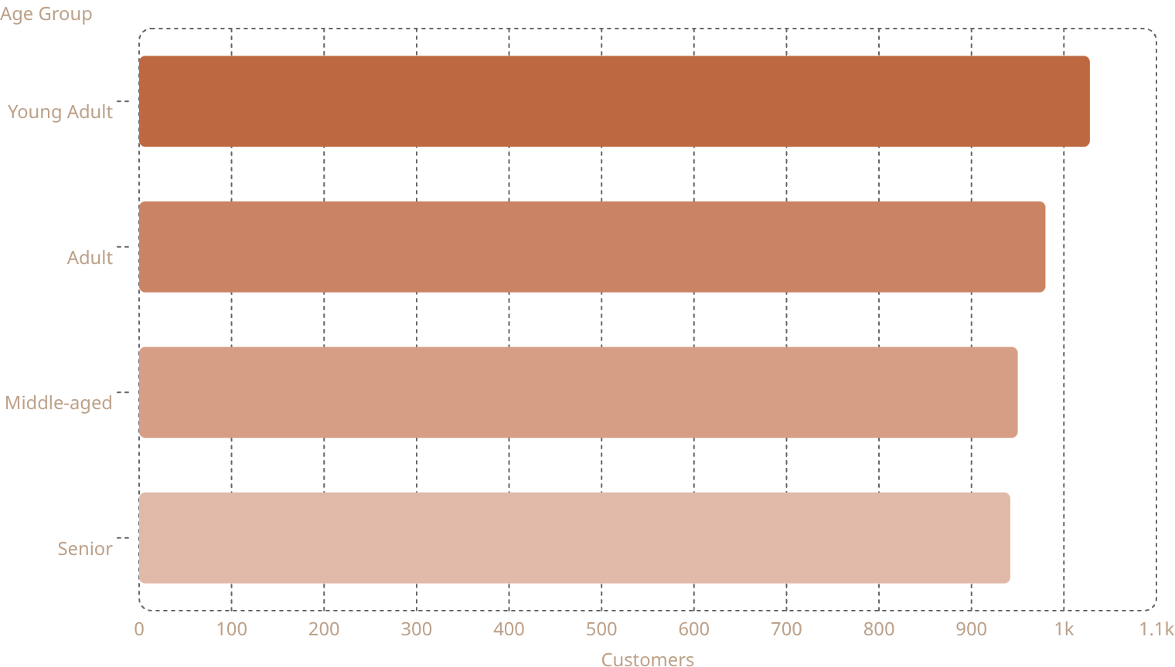
Customer Segmentation
Age, Loyalty, and Spending Power
Age Group Breakdown
Loyalty & Spend Tiers
The Regular and Loyal segments together account for nearly 2,300 customers — the backbone of recurring revenue.
The Premium tier represents 37.1% of the customer base, demonstrating a strong ability to attract and retain high-value shoppers.
Young Adults lead in headcount, while Adult and Middle-aged groups maintain the highest AOV at approximately $60.45.

Slide 5
Product Analysis
Hero Items, Trending Colors & Size Insights
Top Revenue Items
Trending Color: Olive
Size S Commands a Premium
Blouses, Shirts, and Dresses each surpass $10K in revenue. Clothing overall is the dominant category, mirroring the global average rating of 3.72/5.
Olive is the clear color preference across the customer base — a signal for inventory planning, visual merchandising, and seasonal campaigns.
Small (S) sizes yield the highest AOV at $61, suggesting either premium pricing on smaller apparel or a distinct high-value niche worth cultivating.

Slide 6

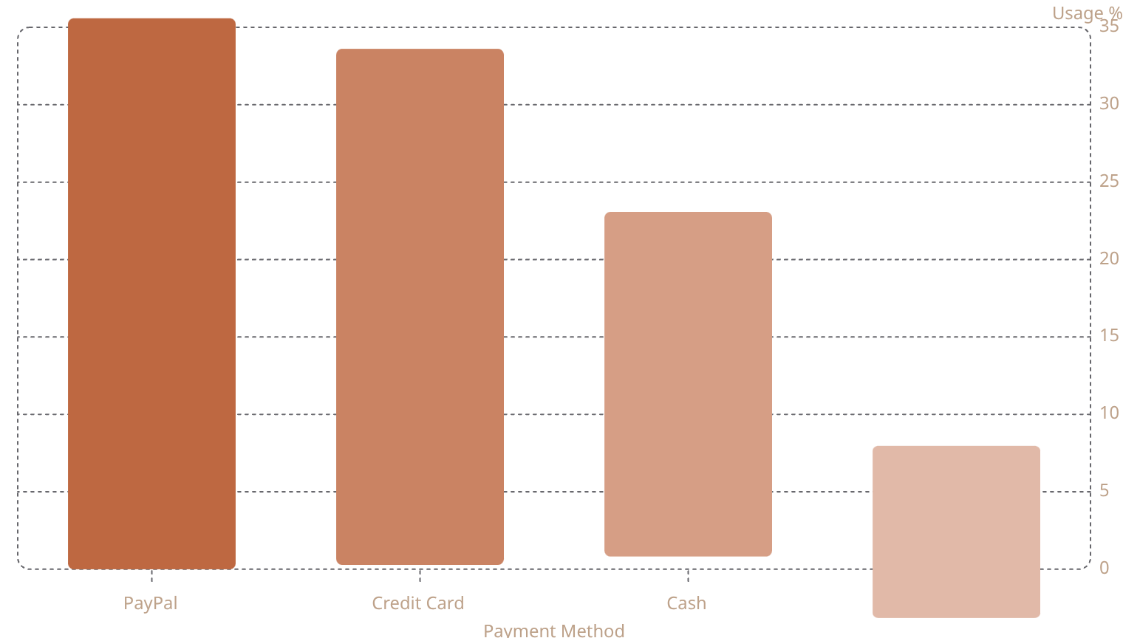

Behavioral Insights
How and When Customers Buy
Payment Preferences
Purchase Cadence
2-Day Shipping
Peaks every 3 months & annually
Highest AOV — $61
Discount Usage
43% use; AOV $59 vs $60
Discount Insight: Non-discounted AOV ($60) nearly equals discounted AOV ($59) — discounts are driving volume without meaningfully eroding order value. A healthy dynamic.

Slide 7

Subscription Performance
73% of Customers Are Not Yet Subscribers
The Subscriber Premium
Subscribers generate $62.65K in total revenue and show measurably higher satisfaction (3.8 vs. 3.7 for non-subscribers).
Non-Subscribers·73%
·73%
·
Subscribers·27%
·27%
·
The Middle-aged group leads in subscription adoption at 28.8%.
A significant cohort of Loyal and Champion customers remain unsubscribed — converting them is the single highest-leverage action for growing recurring revenue.

Slide 8
Technical Depth
Data Infrastructure: Python + PostgreSQL
How the Data Was Built
The dataset was cleaned and structured using Python for pre-processing and transformation, then loaded into PostgreSQL for relational querying and segment analysis.
Loyalty Segmentation Query
AOV & Revenue Aggregation
Custom SQL logic classified customers into Champions, Loyal, Regular, and New tiers based on purchase frequency and recency.
Grouped queries calculated per-category, per-size, and per-season revenue and average order values with full dimensional slicing.

Slide 9
Strategic Recommendations
Three Priorities to Drive the Next Phase of Growth
Close the Gender Gap
Convert Loyal Non-Subscribers
Push Ratings to "Excellent"
With Female customers at just 32%, a targeted acquisition and product strategy could meaningfully expand the addressable market without cannibalizing current revenue.
The current 3.75 average leaves headroom. Focus post-purchase experience improvements — faster resolution, loyalty perks — to shift the curve toward 4.5+.
Champion and Loyal customers who haven't subscribed represent the clearest upsell path. A personalized outreach campaign could move the 27% subscriber rate significantly higher.

Slide 10
A Healthy Foundation with Clear Growth Levers
With $233K in stable revenue, a predictable $59.76 AOV, and a loyal customer base of 3,900, the business is well-positioned. The next phase of growth lies in subscription conversion, gender diversification, and satisfaction elevation.
01
02
Activate the Subscriber Upsell
Expand the Female Segment
Target Loyal and Champion non-subscribers with personalized campaigns
Assess branding and product mix to attract and retain female shoppers
03
Elevate the Customer Experience
Close the gap from 3.75 to 4.5+ through post-purchase investment

