Slide 1
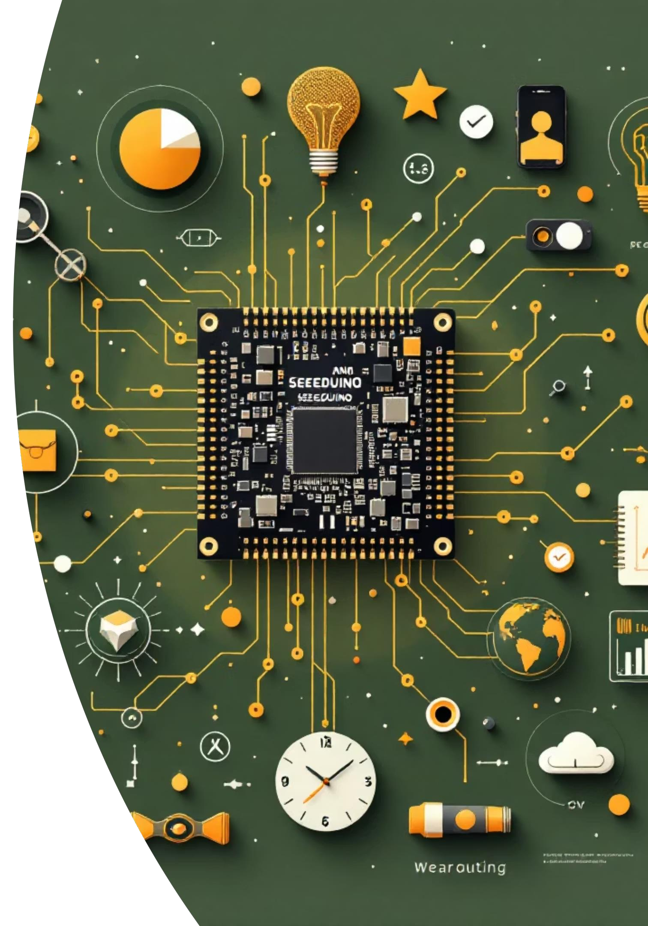
Athlete Insight System Using Seeeduino Nano
Empowering athletes with real-time data for peak performance and
preventive care.
Presented By:
MR. PRATHAM R. PASI
MR. PRANAY L. BHARIT
MR. ATHARVA P. KESARE
MR. KRISHNA S. DUBEY
Guide: Prof. Vijay G. Gupta
Institution: Shivajirao S. Jondhle College of Engg & Technology, University of Mumbai

Slide 2

Introduction: Bridging Tech and Wellness
This project introduces a "Smart Wearable Fitness Tracker" designed for real-time monitoring of physical and physiological metrics. Positioned at the convergence of digital technology and health sciences, it contributes to the era of personalized wellness.
"In the age of personalized wellness, precise data is paramount."
The Problem: Subjectivity and Inconsistency Inconsistency
Traditional fitness tracking methods are often subjective, inconsistent, and lack the precision of modern technology. This creates a critical need for a data-driven approach that empowers users with accurate, real-time health data.
Our solution aims to promote self-awareness, motivation, and proactive preventive healthcare.

Slide 3
Our Vision: Key Objectives
1
2
3
Wearable Design & Development
Sensor Integration & Data Collection
Integrate advanced sensors for comprehensive data collection on key metrics including steps, calories burned, heart rate, and temperature.
Seamless Connectivity
Establish robust Bluetooth connectivity between the wearable device and a dedicated mobile application for efficient data synchronization and intuitive visualization.
Design and develop a smart wearable fitness tracker utilizing a Seeeduino Nano microcontroller, ensuring a compact and efficient form factor.
4
5
Algorithm Development & Anomaly Detection
Employ advanced algorithms to process sensor data for enhanced accuracy and implement features like early health anomaly detection.
User-Centric Design
Create a user-centric device with paramount focus on comfort, extended battery efficiency, and ironclad data security for reliable long-term use.

Slide 4
Foundational Research: Literature Survey
High-Accuracy Step Counting Counting
The Bosch Sensortec BMA456 accelerometer is widely adopted in commercial smartwatches for its precision and ultra-low power consumption. This makes it an ideal choice for continuous activity tracking without significant battery drain, crucial for our design.
Wireless Health Data Transmission
Bluetooth modules like the HC-05 are industry standards in wearables for transmitting health data to smartphones. Their cost- effectiveness and ease of integration facilitate real-time feedback, a core feature of our system.
Advanced Gait Analysis
A 2021 study in the Journal of Medical Engineering & Technology highlighted the use of motion sensors embedded in footwear for gait analysis. This technology has diverse applications, from rehabilitation and fall risk assessment to enhancing sports biomechanics.

Slide 5
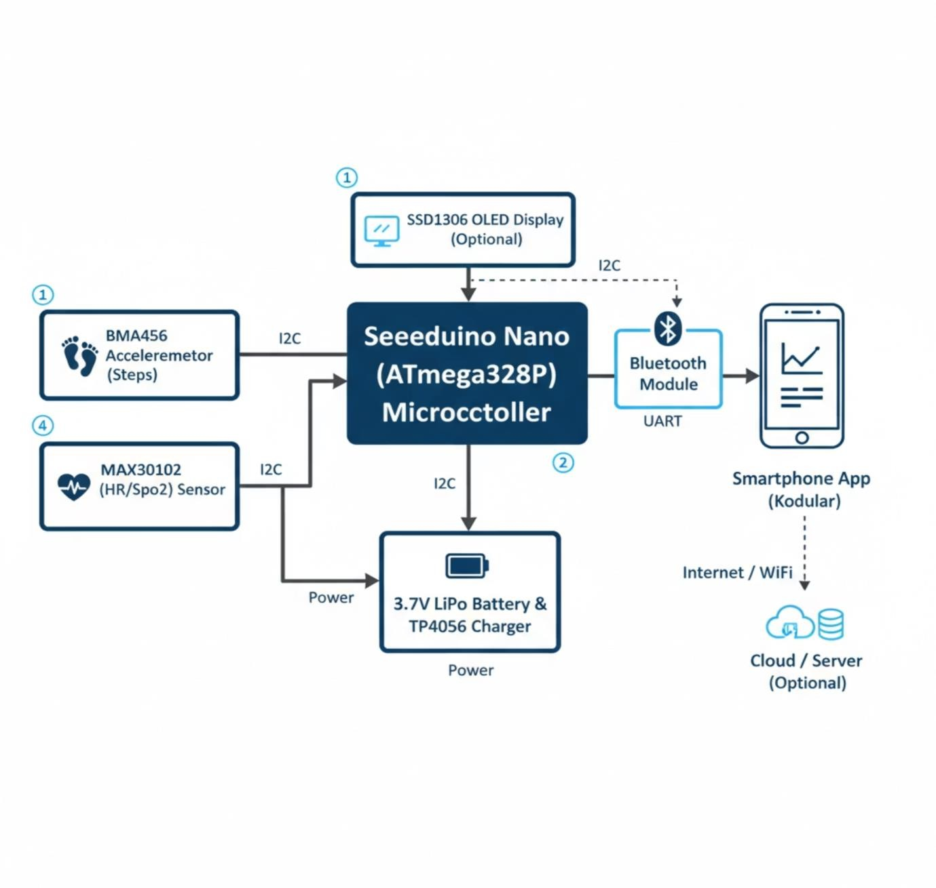
Foundational Research:Block Diagram

Slide 6













System Architecture: Innovation at Its Core
Our Athlete Insight System is meticulously engineered for efficiency, accuracy, and user experience.
Seeeduino Nano (ATmega328P)
The central processing unit handles all
local data processing and task
management.
Input Sensors
BMA456 accelerometer for step counting and MAX30102 for Heart Rate & SpO2 monitoring.
Data Transmission
Bluetooth (HC-05) UART module ensures seamless data transfer to a smartphone application.
Advanced Analytics (Optional)
Cloud/server component for machine learning and deeper data analysis.
On-Device Display
Optional SSD1306 OLED Display (I2C) for immediate, real-time feedback on the device.
Power Management
3.7V LiPo battery with TP4056 charging circuit for portability and extended use.

Slide 7
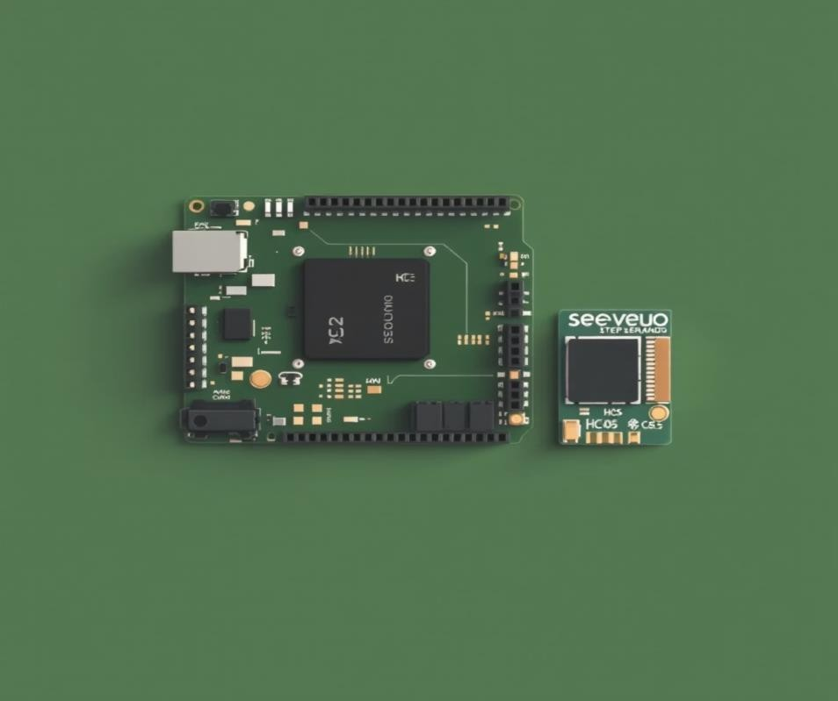

Implementation: Hardware & Software
Hardware Used
Software Used
Seeeduino Nano: An Arduino-compatible board with an ATmega328P microcontroller, serving as the brain of our system.
Grove Step Sensor (BMA456): A triaxial accelerometer with a built-in step
counter and an I²C interface for precise activity tracking.
Bluetooth HC-05 Module: A low-cost module enabling wireless serial
communication for data transmission.
Battery (3-5V): Provides the necessary power for portability and continuous operation, ensuring a truly wearable experience.
Arduino IDE: Utilized for robust firmware development in C/C++. This handles sensor initialization, accurate data acquisition, and reliable Bluetooth communication protocols.
Kodular: A powerful block-based programming platform for rapid development of the Android application. It manages the graphical user interface (GUI) and seamless Bluetooth data handling.

Slide 8
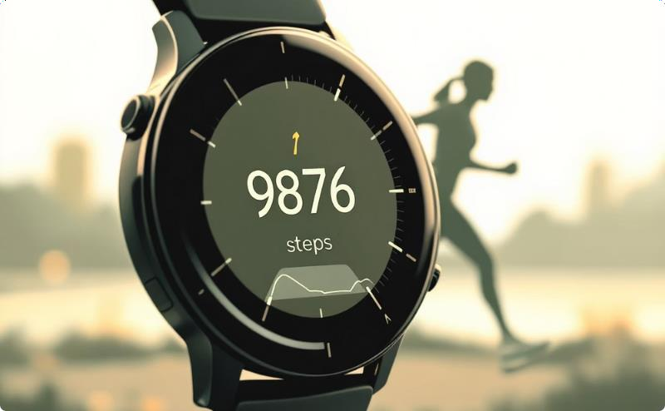
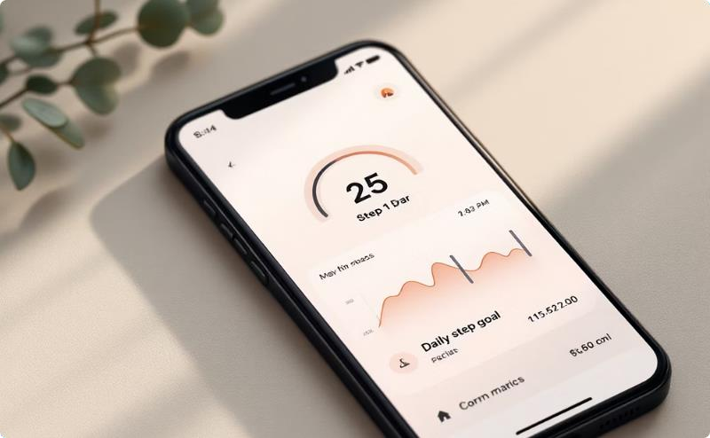
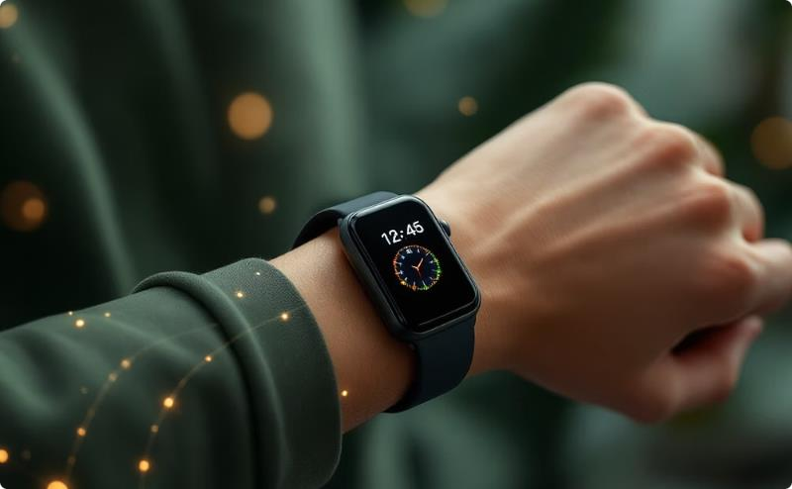
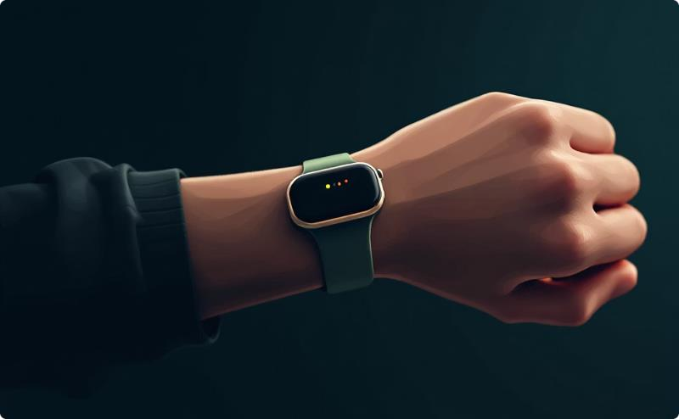
Anticipated Outcomes: Key Findings
Real-time Fitness Metrics Metrics
The system will accurately track and display key fitness metrics such as Step Count, Calories Burned, Heart Rate, and Distance Covered in real-time.
Intuitive Data Visualization
The developed Android application will provide a user-friendly interface to visualize this data, enabling users to monitor progress and set fitness goals effectively.
Stable Bluetooth Connectivity
The device will demonstrate robust and stable Bluetooth connectivity, ensuring reliable and uninterrupted data transmission to the smartphone application.
Ergonomic & Wearable Wearable Design
The final prototype will be a compact, wearable, and ergonomic device designed for comfort and continuous daily use, integrating seamlessly into daily life.

Slide 9

Conclusion: Bridging Technology and Well-being
This project successfully demonstrates the development of a smart wearable fitness tracker, effectively bridging the gap between cutting- edge technology and personal well-being.
Empowering Actionable Insights
By providing continuous monitoring of vital signs and activity, our system empowers users with actionable health data.
Contributing to Preventive Healthcare
This initiative significantly contributes to the rapidly growing field of
preventive healthcare, promoting proactive health management.

Slide 10





Future Scope: Evolving the Athlete Insight System
AI & Machine Learning Integration
Integrate AI and machine learning for predictive insights and adaptive health recommendations, moving beyond mere data collection.
Cloud Connectivity Enhancement
Enhance the system with robust cloud connectivity for advanced data analysis and comprehensive long-term health trend monitoring.
Advanced Sensor Integration
Incorporate more advanced sensors to track a wider array of physiological parameters, increasing utility in sports and medical rehabilitation.
Personalized User Experiences
Develop customizable dashboards and alerts tailored to individual athlete needs and performance goals.
Sustainable Power Solutions
Explore self-charging or highly efficient power solutions to further extend battery life and reduce environmental impact.

Slide 11
REFERENCES
Bartolini, G., et al., A Differential Inertial Wearable Device for Breathing Parameter Measurement, Sensors, vol. 22, no. 24, pp. 9953, 2022.
Credence Research, Smart Wearables for Sports and Fitness Market by Type..., Market Report, 2025.
Gomez, R. B., et al., Wearable Sensor Technology for Monitoring Training Load and Health in the Athletic Population, Frontiers in Physiology, vol. 11, 2020.
Rappaport, S. M., Wearable Technology and Mobile Innovations for Next-Generation Education, IGI Global, 2024.
Revolutionizing sports the impact of next-generation wearable..., Journal of Medical and Sports Sciences, Jan. 2025.
Sekeroglu, M., Pekgo, M., Algin, A., et al., Transdisciplinary Innovations in Athlete Health 3D-Printable Wearable Sensors for Health Monitoring and Sports Psychology, Sensors, vol. 25, no. 1453, 2025.
Towards Healthcare, Fitness Tracker Market Trends, Drivers and Forecasts 2024--2034, Market Report, 2025.
Wearable Bluetooth Fitness Tracking Device Electronics for you DIY.
Xu, X., et al., The application of smart wearable devices in the detection of sports energy consumption, ScienceDirect, 2025.

Slide 12
Thank You
Are there any questions?

