Slide 1
Network Intrusion Detection Using Machine Learning
CAPSTONE PROJECT
Presented By:
1. Pratham.r.pasi - SSJCET- EXTC

Slide 2
OUTLINE
Problem Statement (Should not include solution)
Proposed System/Solution
System Development Approach (Technology Used)
Algorithm & Deployment
Result (Output Image)
Conclusion
Future Scope
References

Slide 3
Problem Statement
Example: Modern digital infrastructure faces relentless threats from cyber-attacks that put sensitive data and organizational integrity at risk. As communication networks expand and traffic intensifies, the timely detection of malicious activity becomes crucial. Current systems often falter in recognizing sophisticated or novel intrusion patterns, leaving networks vulnerable. The challenge is to develop an intelligent, automated, and adaptive system that not only detects a spectrum of cyber-attacks—such as Denial-of-Service (DoS), Probing, Remote-to-Local (R2L), and User-to-Root (U2R)—but does so faster and more accurately than traditional approaches.

Slide 4
Proposed Solution
The proposed system leverages cutting-edge machine learning algorithms to build a robust Network Intrusion Detection System (NIDS). By continuously monitoring and analyzing network traffic, the model learns to recognize a broad spectrum of attack patterns as well as normal behavior. Training is conducted using the benchmark Kaggle dataset for network intrusion detection, ensuring model relevance and efficacy. Deployment on IBM Cloud Lite provides a scalable, easily accessible, and highly available environment, enabling real-time detection and rapid, automated responses to emerging network threats.
Key solution components include:
Comprehensive data ingestion
Rigorous data preprocessing and feature engineering
Advanced machine learning model training and optimization
Seamless deployment as a real-time cloud-based API

Slide 5
System Approach
Data Source: Network Intrusion Detection dataset from Kaggle
Platform: IBM Cloud Lite (mandatory per project requirements)
Programming Language & Libraries: Python, Pandas, Scikit-learn, XGBoost, IBM Watson Studio
Development Process: Data collection, cleaning, feature extraction, model training, validation, and deployment as a secure API on IBM Cloud Lite

Slide 6
Algorithm & Deployment
Algorithm Selection: Ensemble learning methods such as Random Forest or XGBoost are selected for their accuracy in multi-class classification of network intrusions.
Input Features: Diverse feature set encompassing protocol types, connection time, data throughput, flag status, and specific attack indicators.
Training & Validation: Systematic train-test split, stratified sampling, and hyperparameter optimization ensure model robustness and generalizability.
Deployment: The finalized model is containerized and exposed as a REST API on IBM Cloud Lite, allowing real-time querying and seamless integration with existing monitoring infrastructure.

Slide 7
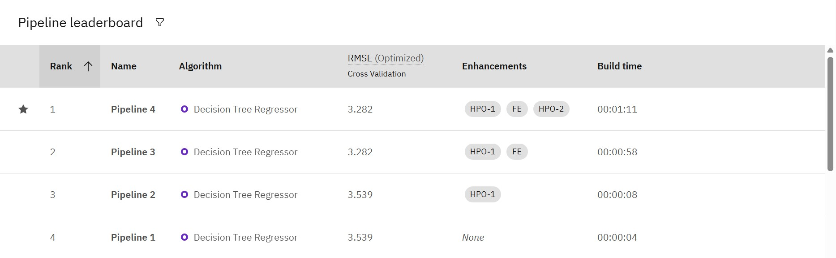
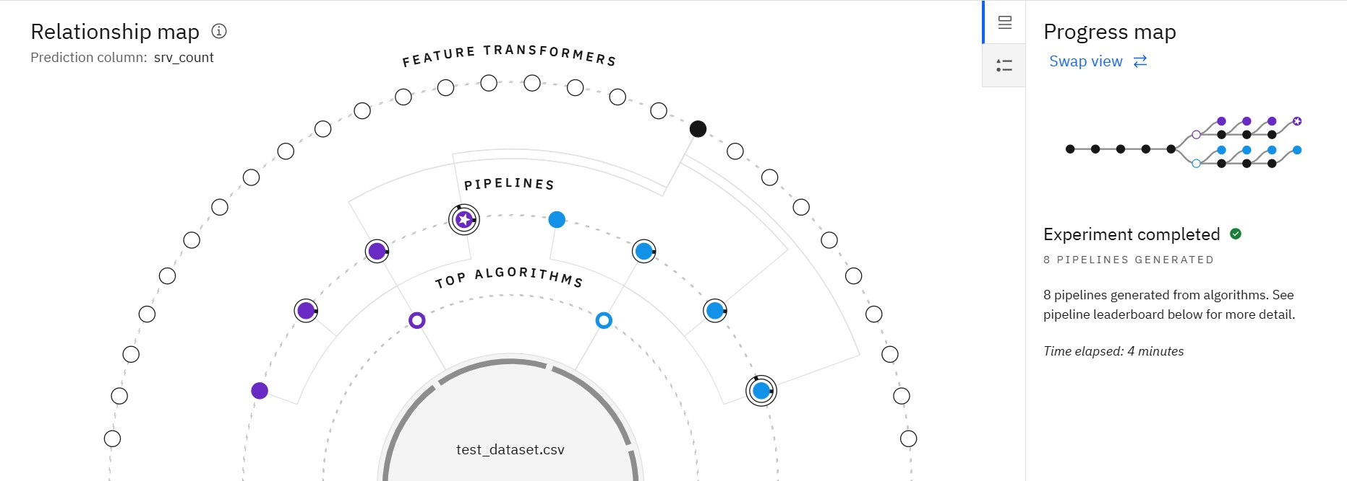
Result

Slide 8
Conclusion
This project demonstrates an effective and scalable artificial intelligence-driven solution for proactive network security. By combining state-of-the-art machine learning with IBM Cloud deployment, the system significantly improves threat detection capabilities and response times, substantially enhancing the cybersecurity posture of modern organizations.

Slide 9
Future scope
Expansion to larger, real-time datasets for even greater model accuracy
Integration of deep learning architectures for anomaly and zero-day attack detection
Deployment across multi-cloud and hybrid cloud environments
Automated incident response and feedback mechanisms for continuous system improvement

Slide 10
References
List and cite all relevant research papers, datasets (such as the Kaggle NIDS dataset), and IBM Cloud documentation leveraged throughout the project.

Slide 11
IBM Certifications

Slide 12
IBM Certifications

Slide 13
IBM Certifications

Slide 14
GIT-HUB Link
https://github.com/pratham133/network-intrusion-detection-ml.git

Slide 15
THANK YOU

