Slide 1




EMPLOYEE ATTRITION PREDICTION
Team members:
Raj Ojha - 202401100300192
Pratham Mishra - 202401100300180
Prateek Rai - 202401100300179
submitted to:
Mr.Mayank Lakhotia

Slide 2


PROBLEM STATEMENT
To develop a supervised machine learning model that accurately predicts whether an employee will leave the organization based on historical HR data. The classification outcome will help human resource departments in reducing attrition and improving employee engagement and satisfaction.

Slide 3

INTRODUCTION:
Employee attrition is a major concern for organizations, leading to high costs in hiring and training.
Predictive analytics can help identify employees at risk of leaving.
Objective: Build a machine learning model to predict attrition using IBM HR Analytics dataset.
Approach: Classification techniques (Logistic Regression, Random Forest, XGBoost) + Feature Importance Analysis.

Slide 4






Methodology
Data Collection:
The dataset used in this project is the IBM HR Analytics Employee Attrition dataset, publicly available on Kaggle. It includes various employee-related features such as job role, work environment, performance ratings, and satisfaction levels.

Slide 5

Data Preprocessing
Data Preprocessing Steps
🔧 Handling Imbalance: SMOTE oversampling (Attrition Yes: 16% → Balanced 50%).
🔧 Encoding: One-Hot for categories (Gender, Marital Status).
🔧 Scaling: StandardScaler for numerical features (Income, Age).

Slide 6

Dataset & EDA Highlights
01
02
03
04
35 features (Age, Income, Job Role, Overtime, etc.).
Target: Attrition (16% Yes, 84% No → Imbalanced).
Higher attrition in Sales & R&D departments.
Visual: Bar chart (Attrition by Department) + Correlation heatmap.
Dataset Link: https://www.kaggle.com/datasets/pavansubhasht/ibm-hr-analytics-attrition-dataset

Slide 7

Machine Learning Models
Model
Strengths
Key Metric (F1-Score)
Logistic Regression
Random Forest
XGBoost
Baseline, Interpretable
Handles non-linearity, Feature Importance
Best Performance, Gradient Boosting
0.55
0.63
0.66

Slide 8


AI
Real Implementation:
Neural network

Slide 9
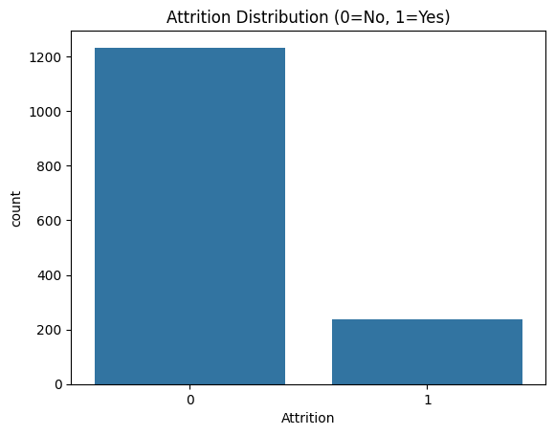
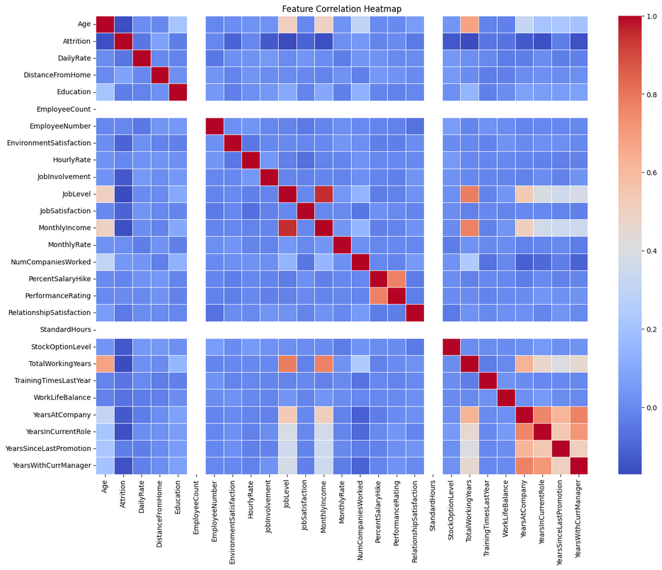
Output/Result

Slide 10
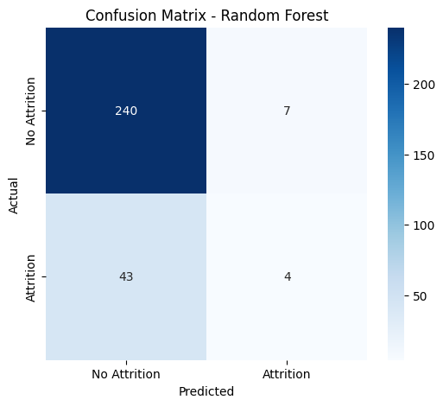
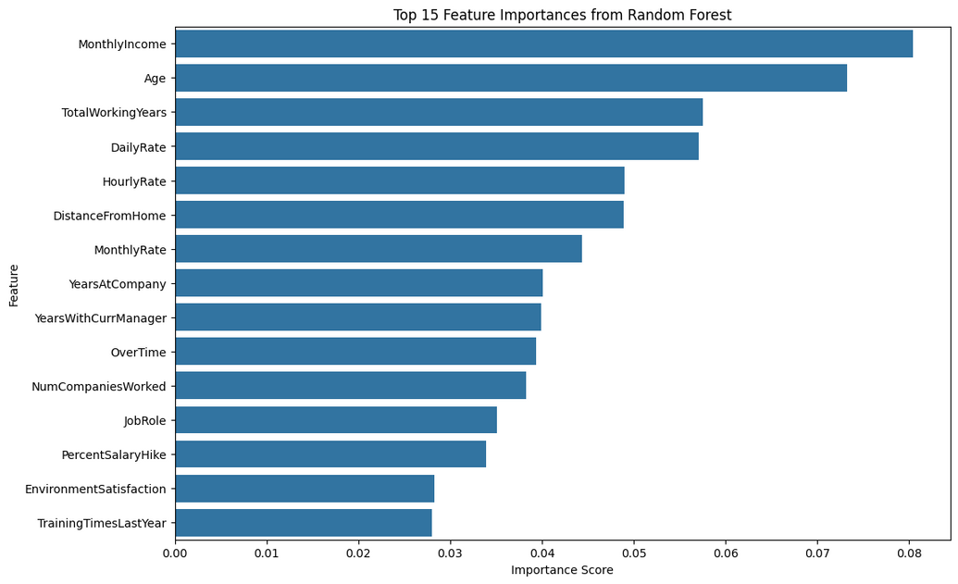
Output/Result

Slide 11
References
scikit-learn documentation – https://scikit-learn.org/
pandas documentation – https://pandas.pydata.org/
Seaborn visualization – https://seaborn.pydata.org/
Kaggle
Research papers on employee attrition and workforce analytics

Slide 12
Thank you very much!

