Slide 1
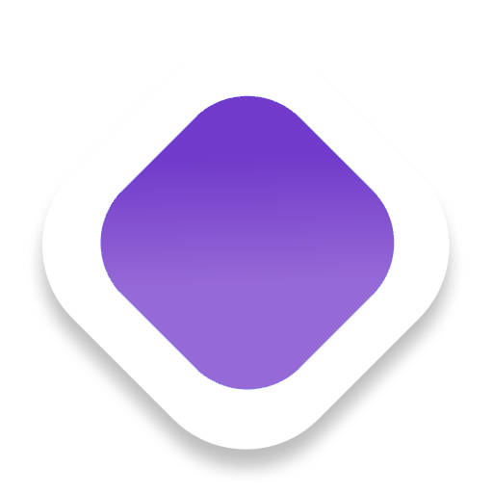
NeuroAccess
your-website.com
Privacy-first,
one-click accessibility
for the whole web.
🖼️
Continue
A browser extension that removes accessibility barriers in seconds — for blindness / low vision, color vision deficiency, dyslexia, and motor or cognitive challenges.
✓ AA contrast
ALT: golden retriever on beach
Chrome Extension
FastAPI Backend
Privacy by Design
NeuroAccess
01 / 10

Slide 2
THE PROBLEM
The web still isn't accessible to everyone
Missing image descriptions, poor contrast, weak keyboard navigation, and difficult reading interfaces make the web harder to use for millions of people.
These aren't edge cases — they affect school admissions, job applications, banking, healthcare forms, and daily communication.
🖼️
Missing alt text
Images and controls that screen readers can't describe
🎨
Poor contrast
16%
Small text and low-contrast color choices
⌨️
Weak keyboard nav
of the world's population lives with a significant disability — most websites still aren't built for them.
Precise clicking required, with no skip paths
📖
Reading fatigue
World Health Organization, 2023
Dense text, with no pacing or read-aloud support
NeuroAccess
02 / 10

Slide 3
HOW IT WORKS
From barrier to fix in one click
No sign-up and no configuration — NeuroAccess detects and repairs accessibility barriers the moment you land on a page.
1
2
3
4
👆
🔍
✨
✅
Click the icon
Instant audit
Safe auto-fixes
You're in control
Open NeuroAccess on any page — no sign-up, no setup required.
Scans the page for missing alt text, weak contrast, and navigation gaps.
Applies ARIA labels, contrast correction, and reading aids in real time.
Browse independently, with fixes that persist for the session.
⚡ Median time from page load to first fix: under 3 seconds — no configuration required.
NeuroAccess
03 / 10

Slide 4
WHO WE HELP
Designed for real, everyday barriers
Every group below maps to specific NeuroAccess features — not a generic accessibility toggle.
🦯
Blind users
👓
Low vision
🎨
Color vision deficiency
AI image labeling + OCR, ARIA fixes, voice commands
Smart contrast fixer, readability profiles, focus visibility
Color-blind presets + WCAG contrast adjustments
📚
Dyslexia
🖐️
Motor impairments
🧠
Cognitive / attention
Text-to-speech, paced reading, profile simplification
Voice navigation, keyboard enhancements, skip links
One-click mode, guided profiles, cleaner navigation
⏳
Age-related decline
⚡
Temporary impairments
👂
Deaf / hard-of-hearing
Personalized combinations of every profile above
Instant contrast, TTS, keyboard-first shortcuts
Caption/transcript-oriented, visual-first patterns
NeuroAccess
04 / 10

Slide 5
CORE FEATURES
What NeuroAccess does — and where it stands today
👆
PLANNED
🏷️
PARTIAL
🔊
PARTIAL
🎙️
PLANNED
One-Click Global Mode
AI Image Labeling & OCR
Text-to-Speech
Voice Commands
Full-page audit + safe auto-fixes with a before/after summary
Backend captioning + OCR ready; extension wiring in progress
Word-synced read-aloud, currently tied to reading mode
Hands-free navigation via speech recognition
🎨
BUILT
⌨️
PARTIAL
🧩
PLANNED
📊
PLANNED
Smart Contrast Fixer
Keyboard Navigation
Accessibility Profiles
Report Export
WCAG AA/AAA levels + color-blind presets
Skip links shipped; full focus/tab-flow polish next
One-click bundles: Default / Blind / Low Vision / Dyslexic
Machine-readable accessibility report output
NeuroAccess
05 / 10

Slide 6
ARCHITECTURE
Three modules, one privacy boundary
Extension and Website only reach the backend for AI calls and auth — everything else runs on-device.
Extension
Website
ON-DEVICE
ON-DEVICE
Plasmo · TypeScript · Tailwind
Vite + React · Tailwind v4
Core product — every on-device feature runs directly in the browser.
Marketing site plus account auth (login, signup, profile).
Backend
FastAPI (Python) · uv
Thin AI proxy — captioning, OCR, and JWT auth only.
AI Providers
MongoDB
HuggingFace BLIP · EasyOCR
pymongo
Image captioning + OCR fallback, opt-in only.
Stores authenticated users via JWT sessions.
NeuroAccess
06 / 10

Slide 7
SHIPPING TODAY
Five features, fully built in the extension
Contrast Fixer
WCAG-oriented contrast fixes and color-blind presets (protanopia, deuteranopia, tritanopia).
🎨
BUILT
Reading Ruler
Dims everything but the active line, with mouse, keyboard, or combined follow modes.
📏
BUILT
Syllable Highlighting
Highlights syllables in sync with read-aloud, powered by the browser's native speech engine.
🗣️
BUILT
Calm Theme
Muted colors, reduced motion, and decluttering for lower cognitive load.
🌿
BUILT
Skip Links
Landmark-based skip navigation to jump past repetitive content with the keyboard.
⏭️
BUILT
NeuroAccess
07 / 10

Slide 8
ROADMAP
What's shipping next
Four focused workstreams close the remaining gap to the full product vision.
1
2
3
4
👆
NEXT
🏷️
📊
🧩
One-Click Global Mode
AI Alt-Text + Voice
Report Export
Accessibility Profiles
Page audit + safe auto-fixes (alt text, ARIA, heading helpers) with a before/after summary.
Wire the extension to the existing captioning/OCR backend; add hands-free voice commands.
Machine-readable accessibility report, generated from the Global Mode audit.
One-click Default / Blind / Low Vision / Dyslexic presets bundling existing features.
🎯 Target: full parity with the product vision in the next milestone.
NeuroAccess
08 / 10

Slide 9
PRINCIPLES
Privacy and security, by design
🔒
Local-first by default
☁️
Optional cloud AI
Every shipped feature today runs entirely on-device — no data leaves the browser.
Image labeling and OCR are opt-in and proxied through our backend, never called directly.
🚫
No hidden tracking
🔑
Secure API key handling
No tracking of browsing content, ever — this is an assistive tool, not a data product.
Third-party keys stay server-side in the backend, never bundled into the extension.
NeuroAccess
09 / 10

Slide 10
Thank you
Independence, dignity, and speed — for every user, on every website.
TEAM LEAD
EXTENSION
BACKEND
WEBSITE
Pratishtha Mehra
Pratham Jain
Vaibhav Chaturvedi
Simrat Oberoi
github.com · NeuroAccess
NeuroAccess
10 / 10

