Slide 1

Building Plan Compliance Checker
Name | USN
Pratham H | 01fe24bcs404
MD Waseem | 01fe24bcs406
Prajwal | 01fe24bcs405
Abhishek | 01fe23bcs277

Slide 2
PROBLEM STATEMENT
Build a GenAI-powered Building Plan Compliance Checker that automatically analyzes building specifications against Development Control Regulations. The system should ingest regulation documents and building specification details, identify compliance violations, and generate a detailed assessment report with PASS/FAIL status and regulation citations for each parameter.

Slide 3
OBJECTIVES
Extract regulations from the Hubballi-Dharwad Master Plan 2031 PDF.
Create a searchable regulation knowledge base using FAISS and embeddings.
Accept building specifications such as FAR, setbacks, building height, usage type, and plot area.
Automatically compare proposed building parameters with applicable regulations.
Generate compliance results with PASS/FAIL status for each parameter.
Provide regulation citations and explanations for non-compliance.
Generate downloadable compliance reports for decision-making and documentation.

Slide 4
TECH STACK
Technologies Used
Frontend
AI / LLM
Vector Search
▸ Streamlit
▸ Google Gemini 2.5 Flash
▸ FAISS
▸ Sentence Transformers
PDF & Text
Rule Engine
Reports
▸ PyPDF2
▸ Python (custom logic)
▸ ReportLab
▸ LangChain
▸ Pandas

Slide 5
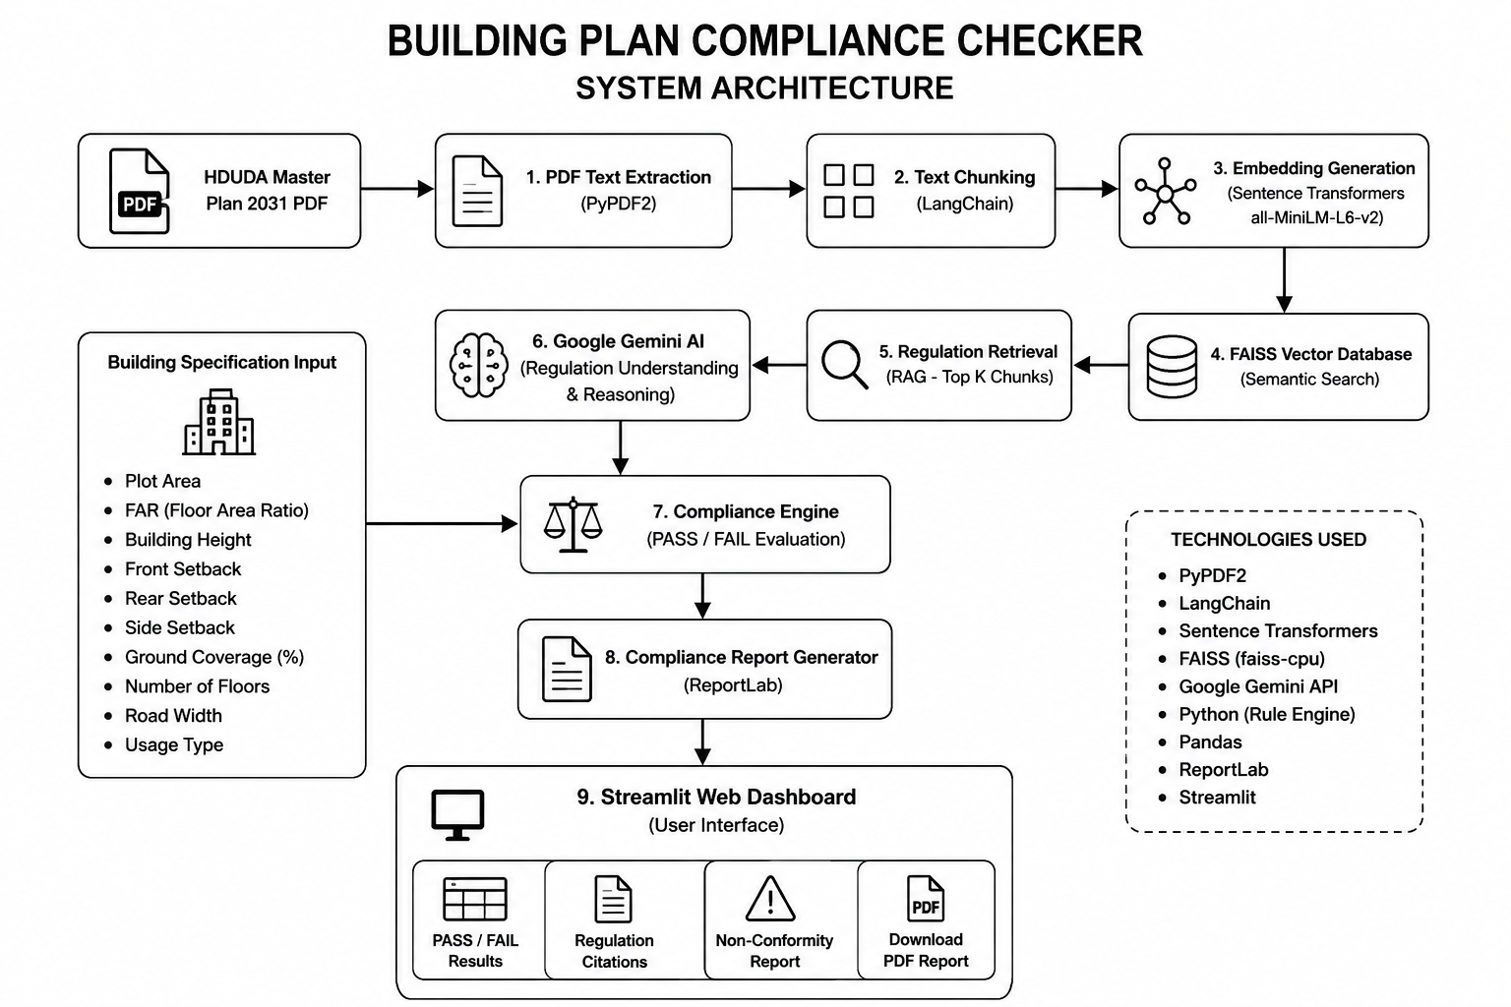
ARCHITECTURE

