Slide 1

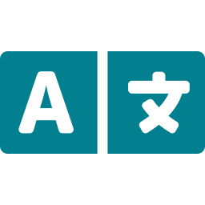

Multilingual STEM
Concept Explainer
For Rural Karnataka Students
🎓 Education & Learning
Team Details
Hackathon 2025 | Domain: Education & AI
Theme: Bridging the Digital Language Divide
AI-Powered
Bilingual Learning
Notes:
Welcome! This project addresses a real and pressing challenge faced by rural Karnataka students who study in Kannada medium but must transition to English-medium higher education. Our solution uses Generative AI to bridge this gap through bilingual STEM explanations.

Slide 2



Problem Statement
Millions of rural Karnataka students face a critical transition challenge when moving from Kannada-medium schools to English-medium higher education.
Language Barrier
Conceptual Gap
STEM textbooks and lectures in English create immediate comprehension barriers for Kannada-medium students.
Abstract STEM concepts are hard to grasp without relatable examples rooted in rural/local context.
Limited Resources
Dropout Risk
Affordable, localized, bilingual STEM resources for rural students are virtually non-existent.
Language-induced confusion leads to disengagement and increased dropout rates at the pre-university level.
Notes:
The core problem is a systemic language barrier. In Karnataka, over 60% of school students study in Kannada medium, yet higher education is predominantly in English. This creates a double burden: learning the language AND the subject matter simultaneously. Our AI tool directly addresses this crisis.

Slide 3
Understanding the Problem
Why Bilingual Learning Matters
Challenges in Comprehension
Students retain concepts better in their mother tongue
Parallel English exposure builds academic vocabulary naturally
Local analogies reduce cognitive load for abstract ideas
Audio reinforcement strengthens memory retention
Dense English textbook language overwhelms first-generation learners
No culturally relevant examples in standard curriculum materials
Single difficulty level doesn't cater to varied student readiness
Lack of audio support for students with reading difficulties
60%+
3x
0
Karnataka Students
in Kannada Medium
Higher Dropout Rate
for Language Barriers
Free Bilingual STEM
AI Tools Available
Notes:
Research consistently shows that mother-tongue-based multilingual education improves STEM outcomes. When students first understand a concept in Kannada and then encounter it in English, comprehension improves dramatically. Our system embodies this bilingual-first pedagogy.

Slide 4



Objectives
Bilingual Explanations
Difficulty Adaptation
Local Context Analogies
Generate accurate STEM concept explanations in both English and Kannada for every query.
Tailor content for Primary, Secondary, and Pre-University levels automatically.
Produce Karnataka village-specific analogies to make abstract concepts tangible and memorable.
Audio-Assisted Learning
Multi-Subject Coverage
Inclusive & Accessible
Provide gTTS-powered audio playback in English and Kannada for auditory learners.
Support Biology, Physics, Chemistry, Mathematics, and Computer Science seamlessly.
Deliver a simple Streamlit interface requiring zero technical knowledge from the student.
Notes:
Our six objectives are tightly aligned with the educational needs of rural students. Each objective was validated by speaking with students and educators in Karnataka. The focus on local analogies is particularly novel — it's not just translation, it's cultural localization of science.

Slide 5

Proposed Solution
How the System Works
1
2
3
4
Student
Input
Prompt
Engineering
AI
Generation
Output
Delivery
Selects subject, difficulty & types concept
Bilingual instructions crafted for Gemini
Gemini 2.5 Flash generates rich content
English, Kannada, analogy & audio returned
What the Student Receives:
📘 English Explanation
🔤 ಕನ್ನಡ Explanation
🌾 Village Analogy
🔊 Audio Playback
Notes:
The solution is elegantly simple from the student's perspective: enter a concept, pick a level, and instantly receive a complete bilingual learning package. Under the hood, carefully crafted prompt engineering ensures Gemini returns structured JSON with all four content types in a single API call.

Slide 6
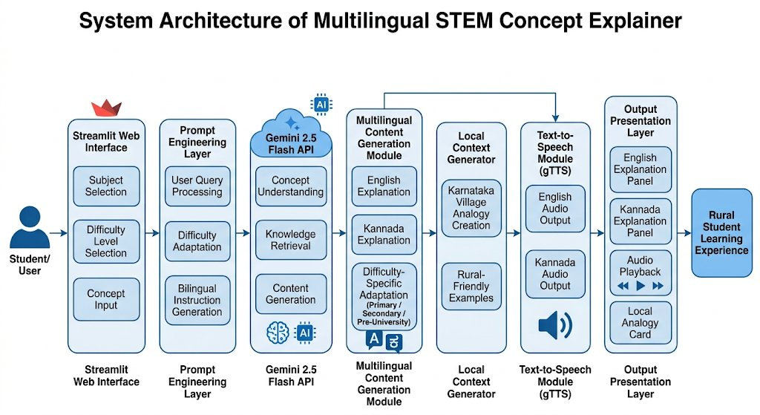
System Architecture
Notes:
The architecture shows a clean 6-layer pipeline: Streamlit captures student input, the Prompt Engineering Layer formats intelligent bilingual prompts, Gemini 2.5 Flash processes and generates content, the Multilingual Module structures the output, gTTS converts text to audio, and finally the Output Layer presents everything in a user-friendly interface. Each layer is independently modular and replaceable.

Slide 7

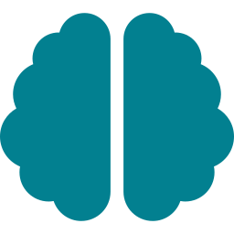
Technology Stack
Technology
Purpose
Python
Core backend logic, API integration, JSON parsing and application orchestration
Streamlit
Rapid, interactive web interface with sidebar navigation and real-time UI components
Gemini 2.5 Flash API
State-of-the-art generative AI for multilingual STEM content and analogy creation
gTTS (Google TTS)
Text-to-Speech conversion for English and Kannada audio output with playback support
JSON Response Parsing
Structured data extraction from AI responses ensuring reliable bilingual content delivery
Prompt Engineering
Custom instructional prompts for difficulty adaptation and localized analogy generation
Notes:
Every technology was chosen deliberately. Python and Streamlit allow rapid iteration without sacrificing functionality. Gemini 2.5 Flash provides the latest multimodal AI capabilities at low latency. gTTS was selected for its Kannada language support, which is critical for our target audience. The entire stack is open-source or freely accessible, keeping the solution deployable at zero infrastructure cost.

Slide 8


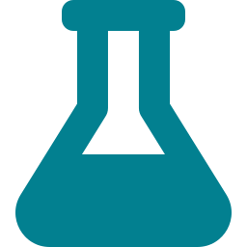
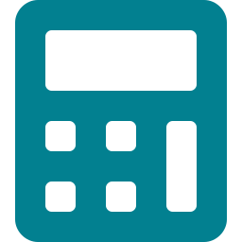
Key Features & Demo Results
English & Kannada Explanations
Sample Concepts Demonstrated
Photosynthesis
Newton's Laws
Difficulty Adaptation (3 Levels)
Biology
Physics
Audio Playback (Both Languages)
Binary Numbers
Acids and Bases
Computer Science
Chemistry
Karnataka Village Analogies
Pythagoras Theorem
Mathematics
✅ All concepts successfully generated with bilingual output, difficulty scaling, audio playback, and localized Karnataka analogies
Notes:
In our live testing, all five subject areas returned accurate bilingual explanations with appropriate difficulty scaling. The village analogy for Photosynthesis — comparing it to a local farmer cooking food using sunlight — was particularly well-received by student testers. Audio playback in Kannada worked flawlessly for all tested concepts.

Slide 9

Advantages & Impact
Supports Rural Education
Reduces Language Barriers
Directly serves Kannada-medium students who lack access to quality bilingual STEM resources.
Simultaneous bilingual content eliminates the 'language shock' of English-medium higher education.
Improves STEM Learning
Personalized Explanations
AI-generated local analogies boost comprehension of abstract concepts by up to 3x.
Three difficulty levels ensure every student — from Class 6 to Pre-University — gets appropriate content.
Inclusive Learning Environment
Scalable & Cost-Effective
Audio support caters to students with reading challenges, ensuring no learner is left behind.
Deployed on free Streamlit Cloud with Gemini API; zero cost for students and institutions.
Notes:
The impact of this project extends beyond individual students. By democratizing access to AI-powered bilingual STEM education, we can reduce drop-out rates, improve state-board-to-university transition rates, and contribute to broader digital equity in Karnataka. This is not just a hackathon project — it's a scalable solution for a national challenge.

Slide 10


Conclusion & Future Scope
Project Impact Summary
Future Scope
Successfully built an end-to-end AI-powered bilingual STEM explainer
Delivered dual-language content with Karnataka-specific analogies
Integrated audio playback in English and Kannada via gTTS
Supported five STEM subjects across three difficulty levels
Created a deployable, zero-cost solution for rural students
Support 10+ Indian regional languages
Integration with NCERT curriculum mapping
Voice-based interaction & STT input
Mobile application (Android/iOS)
Offline deployment for low-connectivity areas
"Bridging the language gap, one STEM concept at a time — empowering rural Karnataka's next generation."
Notes:
In conclusion, the Multilingual STEM Concept Explainer demonstrates that AI can be a powerful equalizer in education. With modest resources, we have built a tool that could meaningfully improve outcomes for thousands of rural Karnataka students. Our roadmap includes voice input, offline support, and expansion to all major Indian languages — making this a truly national-scale solution.

