Slide 1
Cold Chain Breach Alert and Insurance Claim Assistant
Guide: Dr. Guru Prasad
Team details:
Name | USN
Afrah Mohammad | 01FE23BCS200
Manasi | 01FE24BCS403
Ummeed | 01FE24BCS407
Pratibha | 01FE24BCS413

Slide 2
Introduction
Cold chain logistics is essential for transporting temperature-sensitive pharmaceutical products, vaccines, and perishable food items while maintaining the required temperature range.
Any temperature excursion during storage or transit can compromise product quality, cause regulatory non-compliance, and result in significant financial losses.
The proposed AI-powered Cold Chain Breach Alert and Insurance Claim Assistant automatically analyzes sensor data, detects temperature breaches, classifies their severity, and generates compliance reports and insurance claim documents with supporting evidence.

Slide 3
Motivation
Manual monitoring and documentation of cold chain breaches are time-consuming, error-prone, and often delay corrective actions.
Temperature excursions can lead to spoilage of pharmaceutical and food products, resulting in financial losses and safety risks.
There is a need for an intelligent system that can automatically detect breaches, ensure regulatory compliance, and simplify insurance claim processing through automated report generation.

Slide 4
Problem Statement
Cold Chain Breach Alert and Insurance Claim Assistant
Objectives
To ingest and process cold chain temperature sensor logs from CSV/JSON files.
To automatically detect temperature excursions and identify cold chain breaches.
To classify breaches based on their duration and severity levels.
To generate FDA/WHO-compliant cold chain deviation reports.
To create insurance claim documents with supporting evidence automatically.
To improve monitoring efficiency, regulatory compliance, and claim processing in cold chain logistics.

Slide 5
Proposed Solution
Develop an AI-powered platform that automatically monitors cold chain temperature data and identifies temperature excursions.
Detect and classify breaches based on duration and severity, enabling quick response to potential risks.
Generate FDA/WHO-compliant breach reports and insurance claim documents with supporting evidence automatically.
Provide an interactive dashboard for real-time monitoring, visualization, and report management.
Reduce manual effort, improve compliance, and accelerate insurance claim processing.

Slide 6
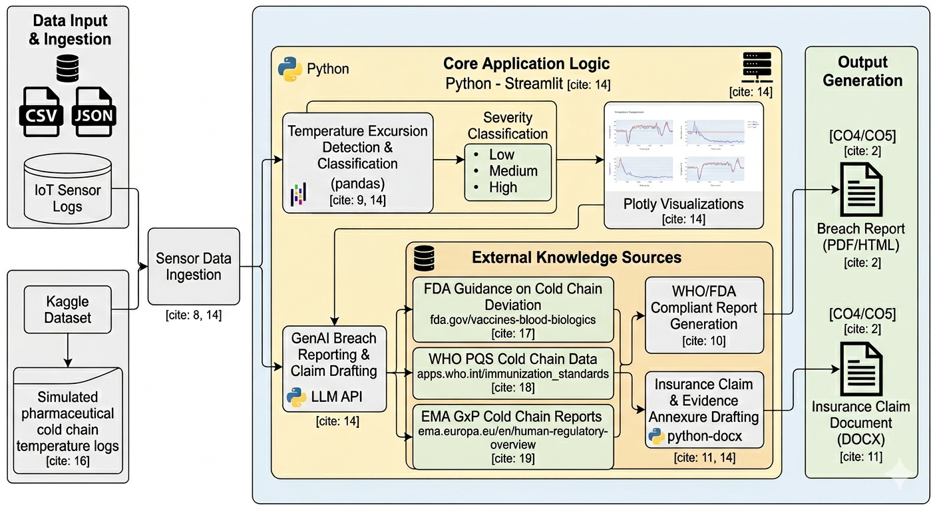
System Architecture

Slide 7
Proposed Workflow
Step 1: Data Ingestion
Upload cold chain temperature sensor logs in CSV format.
Extract timestamp, shipment details, and temperature readings.
Step 2: Data Preprocessing
Clean and validate the uploaded data.
Handle missing values and ensure data consistency for accurate analysis.
Step 3: Excursion Detection
Compare temperature readings against predefined safe temperature limits.
Identify temperature excursions and breach events automatically.
Step 4: Severity Assessment
Calculate breach duration and temperature deviation.
Classify each breach as Low, Medium, or High severity.
Step 5: Compliance Report Generation
Generate an FDA/WHO-compliant cold chain breach report.
Include excursion details, severity analysis, and supporting evidence.
Step 6: Insurance Claim Generation
Automatically create an insurance claim document with breach information and evidence annexure.
Export reports and claim documents for further review and submission.

Slide 8
Technologies Used
Technology | Purpose
Python | Core programming language used for data processing, analysis, and automation.
Pandas | Handles sensor log ingestion, data cleaning, validation, and analysis.
Streamlit | Develops the interactive web dashboard for monitoring and visualization.
Plotly | Creates dynamic graphs and temperature trend visualizations.
Generative AI / LLM | Generates FDA/WHO-compliant breach reports and insurance claim documents.
python-docx | Creates downloadable DOCX reports and claim letters automatically.
CSV Dataset | Stores and provides cold chain temperature sensor readings for analysis.

Slide 9
Real time applications
Dataset Name:
Cold Chain IoT Sensor Dataset (Healthcare IoT Temperature Monitoring Dataset)
The dataset contains time-stamped sensor readings collected from temperature-sensitive healthcare and pharmaceutical products during storage and transportation.
Key attributes include temperature values, timestamps, device information, and target labels indicating normal conditions or temperature excursion events.
The dataset is used to identify cold chain breaches, analyze excursion duration and severity, and validate the performance of the proposed detection system.
It simulates real-world cold chain monitoring scenarios, enabling automated breach reporting and insurance claim generation based on detected temperature deviations.

Slide 10
Excursion Detection Module
Continuously monitors temperature readings and compares them with predefined safe temperature thresholds.
Automatically identifies temperature excursions when readings exceed the acceptable range.
Determines the start time, end time, and total duration of each excursion event.
Analyzes temperature trends to detect potential cold chain breaches accurately.
Generates alerts and records excursion details for further reporting and compliance assessment.

Slide 11
Severity Classification
The detected temperature excursions are classified based on their duration and degree of deviation from the safe temperature range.
Low Severity
Minor temperature deviation for a short duration.
Low impact on product quality and safety.
Requires monitoring but may not need immediate action.
Medium Severity
Moderate temperature deviation or prolonged exposure.
Potential impact on product integrity.
Requires review and corrective measures.
High Severity
Significant temperature deviation and/or extended duration.
High risk of product spoilage or regulatory non-compliance.
Requires immediate investigation and corrective action.
Benefits of Classification
Prioritizes response efforts based on risk level.
Supports regulatory compliance and decision-making.
Provides structured evidence for report and insurance claim generation.

Slide 12
Automated Reporting & Decision Support
The system automatically generates FDA/WHO-compliant cold chain breach reports based on detected excursion events and severity analysis.
Summarizes key information such as breach duration, temperature deviations, severity level, and supporting evidence.
Automatically drafts insurance claim documents containing shipment details, excursion records, and relevant evidence.
Reduces manual documentation effort and accelerates claim processing workflows.
Provides downloadable reports and claim letters in a structured and professional format.
Integrated Streamlit dashboard visualizes temperature trends, breach events, severity distribution, and report summaries for effective decision-making.
Enables users to monitor cold chain performance, review alerts, and access generated documents through a single interface.

Slide 13
Results & Advantages
Results
Successfully detected temperature excursion events from cold chain sensor data.
Classified breaches based on severity level and duration of temperature deviation.
Generated FDA/WHO-compliant breach reports automatically.
Created structured insurance claim documents with supporting evidence.
Visualized temperature trends, alerts, and breach summaries through an interactive dashboard.
Advantages
Automates cold chain monitoring and breach detection.
Reduces manual documentation and reporting effort.
Improves accuracy and consistency in compliance reporting.
Accelerates insurance claim preparation and processing.
Enhances visibility and decision-making through real-time data visualization.

Slide 14
Conclusion & Future Work
Conclusion
Developed an AI-powered solution for automated cold chain breach detection, compliance reporting, and insurance claim generation.
The system improves operational efficiency, reduces manual effort, and supports regulatory compliance through intelligent data analysis and automated documentation.
Future Work
Integrate real-time IoT sensors for live temperature monitoring.
Implement email and SMS notifications for instant breach alerts.
Incorporate predictive analytics to identify potential risks before breaches occur.
Deploy the system on cloud platforms for large-scale logistics operations.
Enhance AI capabilities to provide advanced recommendations and decision support.

Slide 15
Thank you!

