Slide 1

loT Device Security Audit Report Generator
Guide : Dr. Guruprasad K
Team – D14
Roll no | Name | USN
413 | Pritesh Kotur | 01fe23bcs131
418 | Kavya Uppin | 01fe23bcs
433 | Vinay M Madgi | 01fe23bcs306
434 | Bhavana S | 01fe23bcs

Slide 2
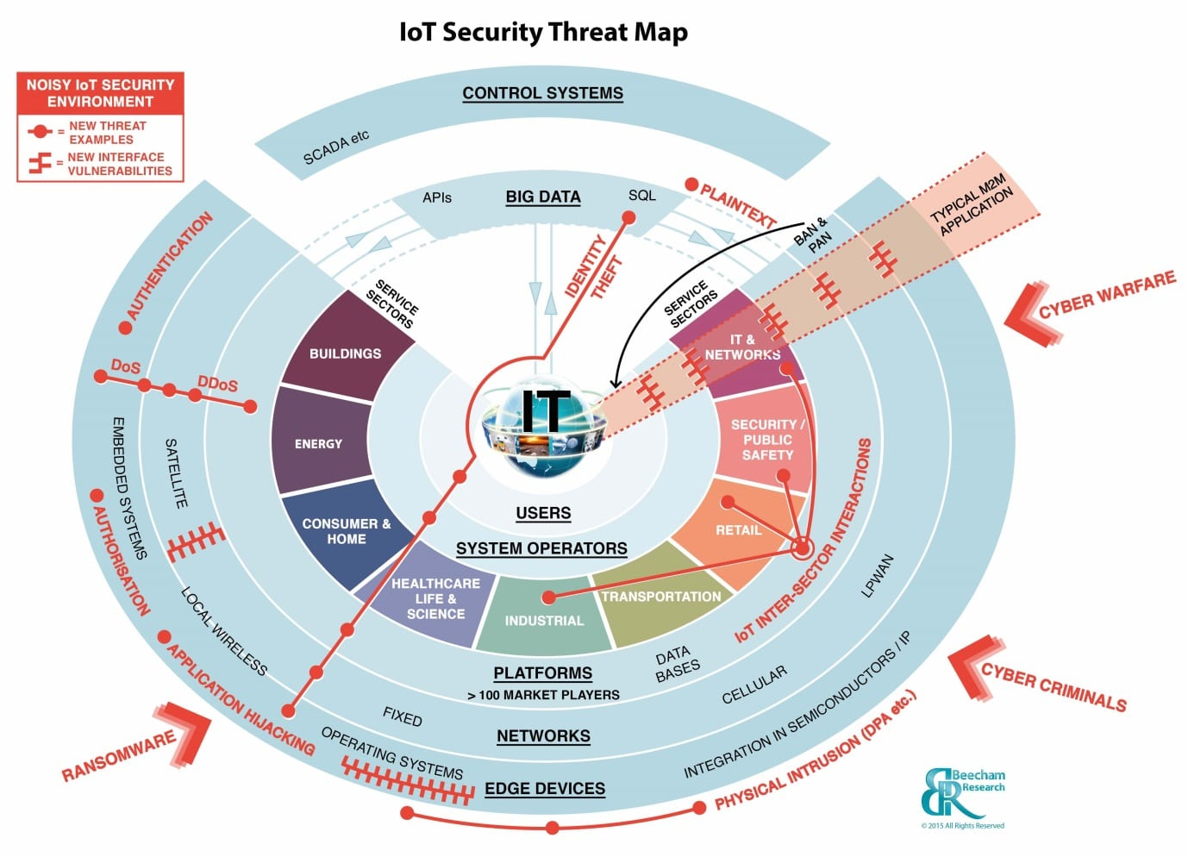
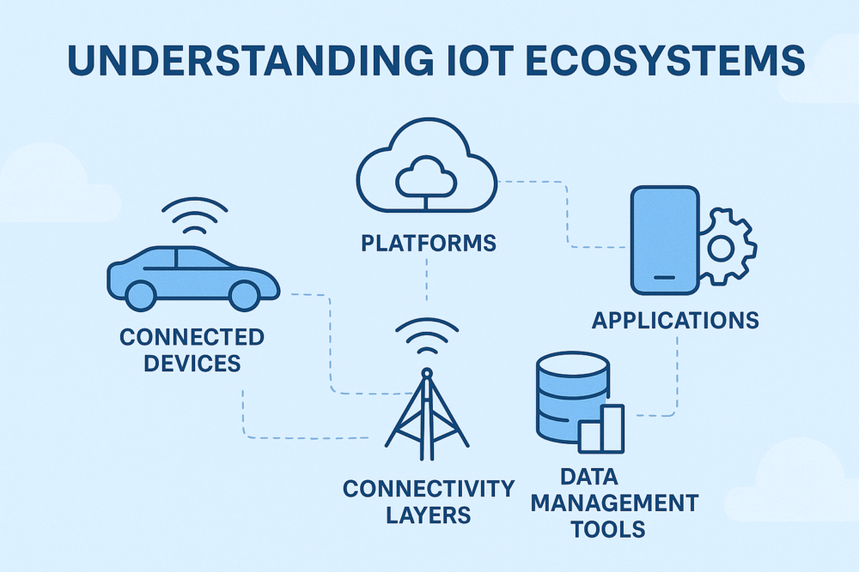
Introduction
IoT attacks surged 124% in 2024, with over 18.8 billion connected devices globally yet most organisations deploying cameras, smart meters, and industrial sensors have no automated way to assess their security posture.
Common vulnerabilities like weak authentication, lack of encryption, and outdated firmware persist across device fleets, while only 35% of IT leaders feel confident in their IoT vulnerability discovery methods
One in three breaches now involves an IoT device, yet security audits remain slow, manual, and inconsistent. This system replaces that process taking a device specification as input and instantly generating a structured audit report with OWASP IoT Top 10 findings, attack surface maps, and prioritised mitigations.

Slide 3
Problem Statement
Organizations deploying loT devices (cameras, sensors, smart meters) lack automated security posture assessments. Build a Gen Al system that takes an loT device specification sheet and generates a structured security audit report covering attack surface, OWASP IoT Top 10 vulnerabilities, recommended mitigations, and a device security score.
Objectives
To automatically assess IoT device security posture against the OWASP IoT Top 10 from a device specification sheet.
To map the full attack surface across communication, physical, and firmware layers with a quantified security score.
To generate a structured, downloadable mitigation report with prioritised remediation steps per vulnerability.

Slide 4
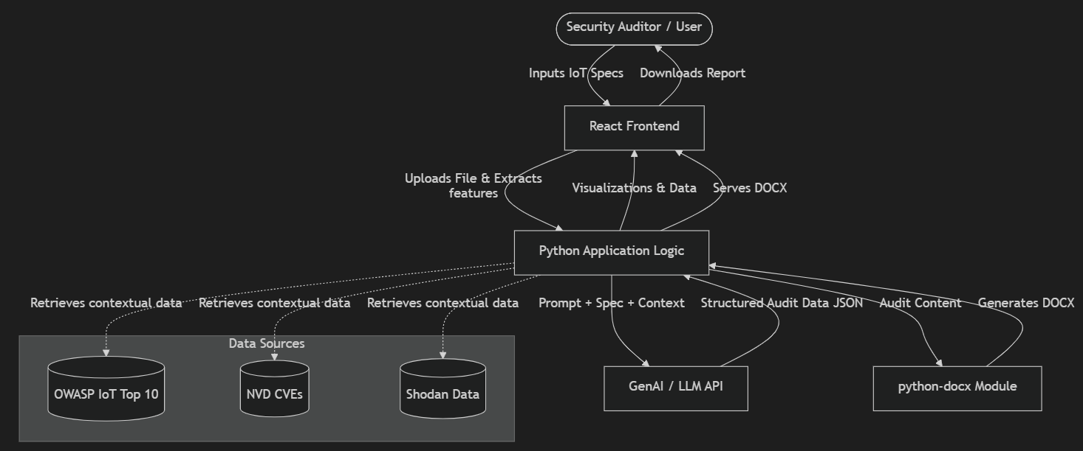
Architecture Diagram

Slide 5
Tech Stack
1. Frontend (User Interface)
React.js: The core framework for building the interactive dashboard and uploading documents.
Tailwind CSS: For rapidly styling a premium, modern, and responsive user interface.
Axios / Fetch API: For sending the uploaded PDF/DOCX files from the React UI to the Python backend and receiving the JSON data.
2. Backend (API & Orchestration)
Python 3: The core programming language for the backend logic.
FastAPI: A lightning-fast web framework to wrap your src Python logic into an API endpoint that the React app can talk to. (Flask is also an option, but FastAPI natively supports our Pydantic schemas).
Pydantic: Used to strictly define the data schemas (like IoT Specifications) and enforce the structure of the data flowing through the app.
3. AI & Data Extraction Pipeline (The Core Engine)
LlamaParse (by LlamaIndex): The specialized document parsing engine used to read complex PDFs and Word files, perfectly extracting text, tables, and images into clean Markdown.
Google Gemini API (gemini-2.5-flash): The Multimodal Large Language Model used as the "brain." It reads the parsed Markdown and uses "Structured Outputs" to deterministically extract the exact technical features we need.
4. Report Generation
python-docx: A Python library that you can use on the backend to dynamically generate a formatted Microsoft Word document containing the extracted features, allowing the user to download a final "Audit Report" from the React dashboard.

Slide 6
Thank you

