Slide 1
Secure RAG-Based Chatbot with Role-Specific Access Using LLMs
For Codebasics Gen AI & Data Science Resume Project

Slide 2
Problem Statement
FinSolve Technologies is facing delays in inter-department communication due to data silos. Teams like Finance, HR, and Marketing struggle to get timely access to relevant data. A secure, role-aware assistant is needed to solve this.

Slide 3
OBJECTIVE
To build a RAG-based chatbot with Role-Based Access Control (RBAC) that delivers department-specific answers securely using LLMs

Slide 4
User Roles and Access
Role | Access Scope
Finance | Financial reports, reimbursements, etc.
Marketing | Campaign metrics, customer feedback
HR | Employee data, payroll
C-Level Execs | Full access to all data
Employee | Only general company info

Slide 5
Tech Stack
UI | Streamlit
Backed | Python
Vector Store | FAISS (Facebook AI Similarity Search)
Embedding Model | Google
LLM | Google Gemini Flash 2.0

Slide 6
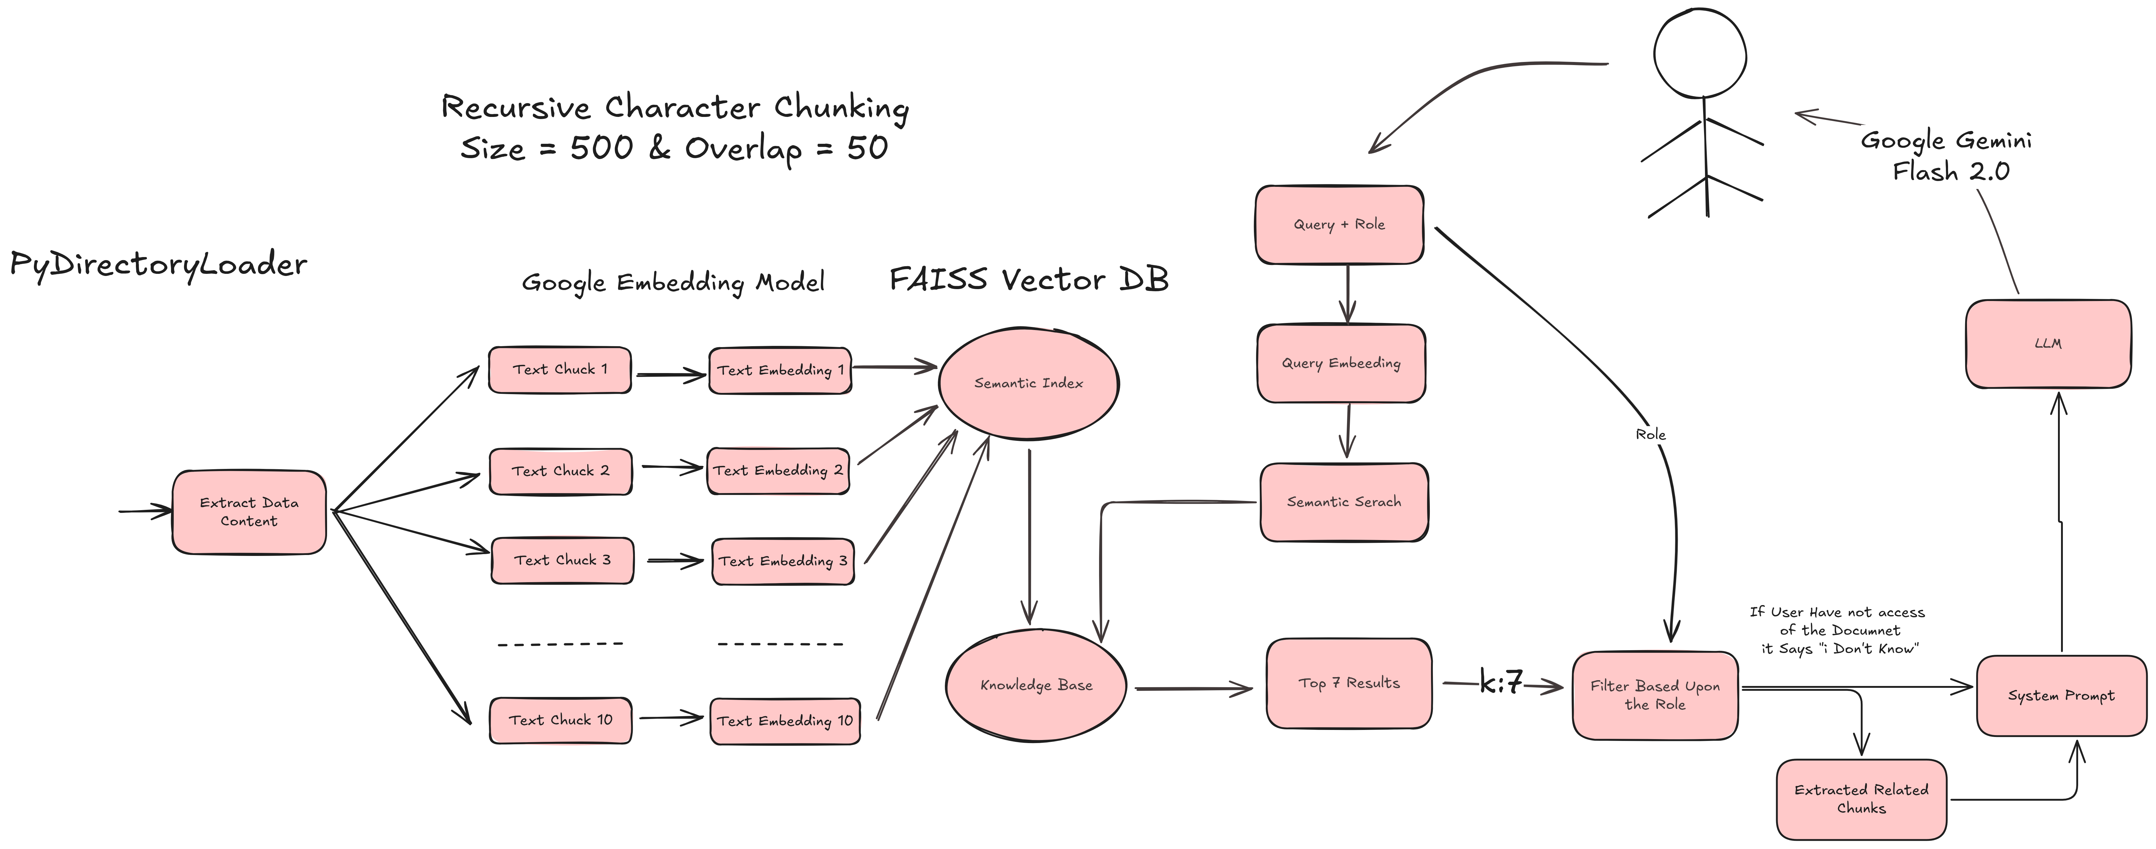
Workflow Diagram

Slide 7
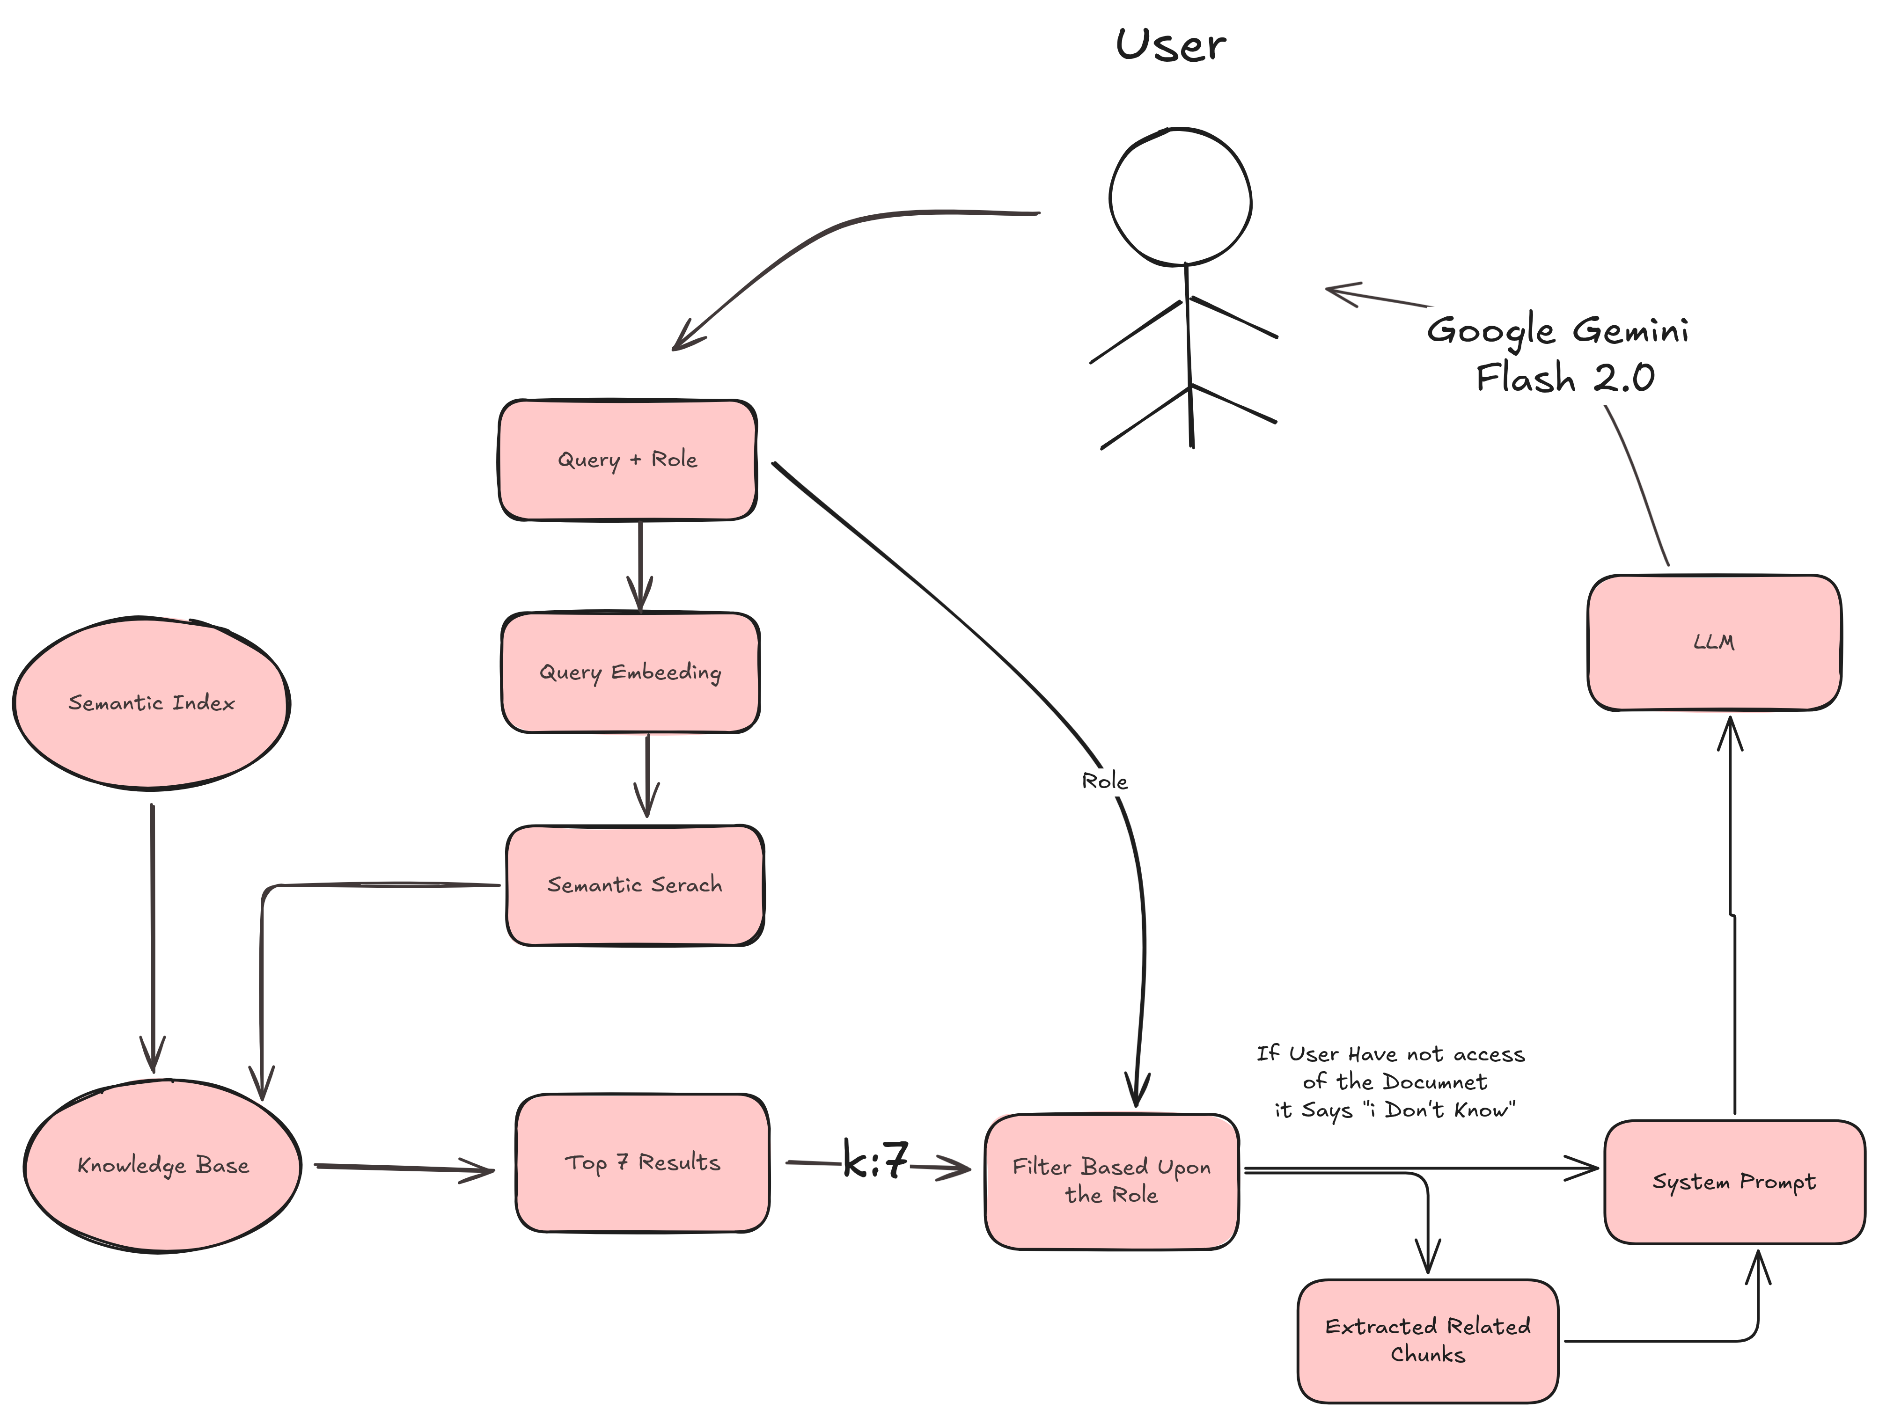
How Role-Based Filtering Works
User sends query with their assigned role
Semantic search retrieves only permitted documents
If no docs found → fallback message: “I don’t know”
If docs found → relevant chunks go to LLM for answer

Slide 8
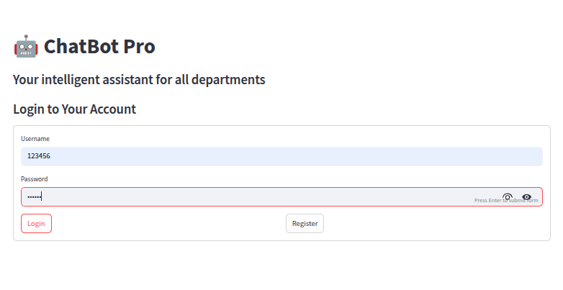
Live Demo
Live Link : https://role-base-chatbot-codebasics.streamlit.app/
GitHub Repo : https://github.com/pratham4544/ds-rpc-01

Slide 9
RESULTS
Ensures secure, private document access
Removes data silos between departments
Delivers real-time, relevant answers
Great use case for enterprise LLM integration

Slide 10


THANK YOU
Dhaval Patel
Hemanand Vadivel

Slide 11
RESULTS
Ensures secure, private document access
Removes data silos between departments
Delivers real-time, relevant answers
Great use case for enterprise LLM integration

