Slide 1

java Programming Project Presentation
Project Title: Visitor Entry Logging and Security Monitoring System
Course: Mini Project
Student Name & Roll No: Pratham.S & 25bcs139
Department: Computer Science
Mentor / Guide: Mr.Aravind

Slide 2
Introduction
java Programming Project Presentation
The Visitor Entry Logging and Security Monitoring System is a Java-based application developed using the Java Swing framework. It helps organizations maintain visitor records digitally instead of using manual registers. The system includes login authentication, visitor entry form, date and time tracking, mobile number validation, and search functionality. This application improves security monitoring and ensures proper tracking of visitors entering an organization. It is useful for offices, colleges, and small businesses.

Slide 3
Objective
JAVA Programming Project Presentation
To design a GUI-based visitor entry system
To implement login authentication
To record visitor details
To capture date and time automatically
To validate mobile numbers
To search visitor records efficiently

Slide 4
Problem Statement
JAVA Programming Project Presentation
Manual visitor registers are:
Time-consuming
Difficult to maintain
Hard to search records
Prone to data loss
No proper system to:
Track visitor details
Record entry time
Validate mobile numbers
Search visitor information
This project solves these issues using automation.

Slide 5
System Requirements
JAVA Programming Project Presentation
Hardware Requirements:
Processor: Intel i3 or higher
RAM: 4GB minimum
Storage: 500MB
Software Requirements:
OS: Windows / Linux
Language: Java
IDE: Eclipse / IntelliJ / NetBeans

Slide 6
System Design
JAVA Programming Project Presentation
The system consists of:
Login Page
Visitor Entry Form
Table Display
Search Module
Workflow:
User logs in
Enters visitor details
System captures date & time
Adds entry to table
User searches visitor records

Slide 7
Module Description
JAVA Programming Project Presentation
Login Module
Validates username and password
Input Module
Collects visitor name, mobile number, and purpose
Time Module
Displays current date and time automatically
Validation Module
Validates mobile number (10 digits)
Storage Module
Stores visitor details in table
Search Module
Searches visitor by name or mobile

Slide 8
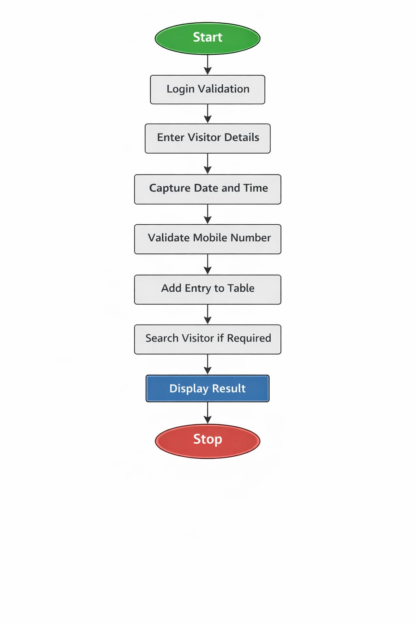
Algorithm / Flowchart
JAVA Programming Project Presentation
Start
Login validation
Enter visitor details
Capture date and time
Validate mobile number
Add entry to table
Search visitor if required
Display result
Stop

Slide 9
Implementation
JAVA Programming Project Presentation
Technologies used:
Java Swing GUI
Event Handling
JTable & DefaultTableModel
Features implemented:
Login authentication
Visitor entry form
Date & time tracking
Mobile validation
Search functionality
Table display

Slide 10
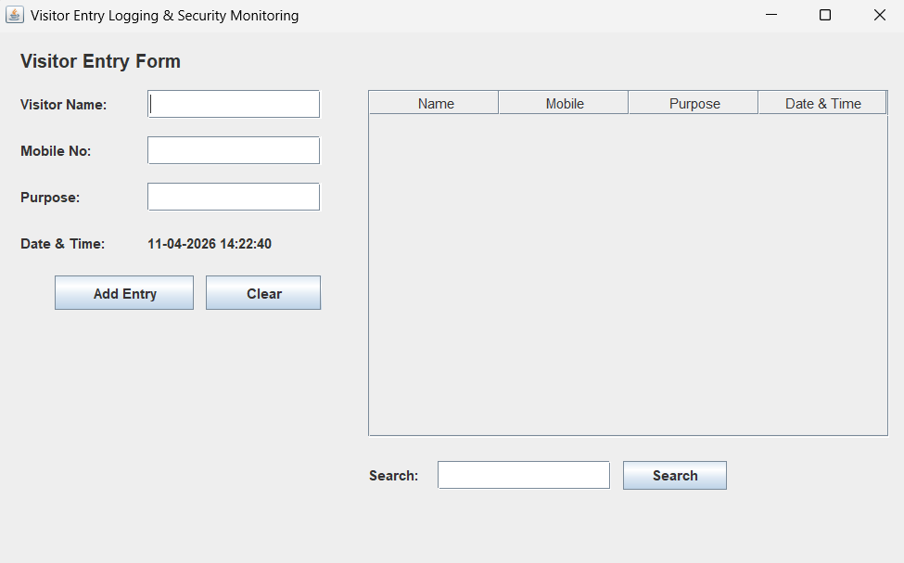
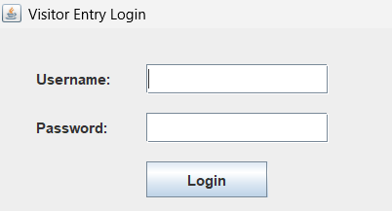
Output Screens
JAVA Programming Project Presentation

Slide 11
Results & Discussion
JAVA Programming Project Presentation
Successfully created visitor entry system.
Users can:
Add visitor entries
Track date and time
Search visitor records
Challenges faced:
GUI layout design
Timer implementation
System improves visitor management efficiency.

Slide 12
Conclusion & Future Enhancement
JAVA Programming Project Presentation
Conclusion:
Project meets objectives
Improved GUI programming knowledge
Provides secure visitor logging
Future Enhancements:
Add database support
Add photo capture
Add exit time tracking
Generate visitor reports

Slide 13
References / Acknowledgement
JAVA Programming Project Presentation
References:
Java Programming – E. Balagurusamy
Oracle Java Documentation
Online tutorials
Acknowledgement:
Thanks to guide and department
Special thanks to friends

Slide 14
Thank You
Questions & Discussions

