Slide 1

Web scraping to gain company insights
Pratham Busa - 03/29/2024

Slide 2
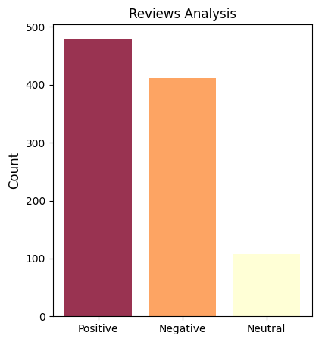
INSIGHTS FROM CUSTOMER REVIEWS
From cleaning 1000 reviews given by the customers, we obtained
Positive Reviews - 521
Negative Reviews - 374
Neutral Reviews – 105

Slide 3
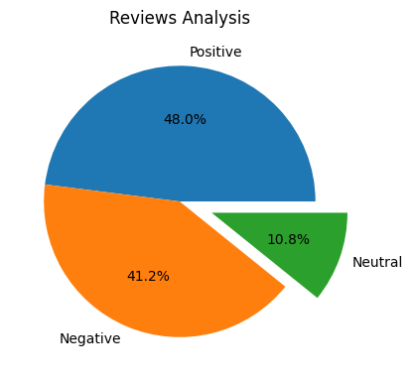
INSIGHTS FROM CUSTOMER REVIEWS

Slide 4
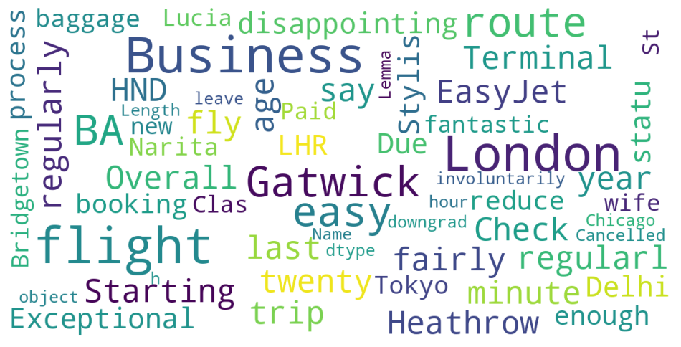
INSIGHTS FROM CUSTOMER REVIEWS
Word cloud of keywords used in reviews

