Slide 1

CSE 3124 : Computer Networks [2 1 0 3]

Slide 2
Module 1: Computer Networks & the Internet
our goal:
overview:
what’s the Internet? what’s a protocol?
Network edge; Hosts, Access net, Physical media
Network core: Packet/Circuit switching, Internet structure Performance: Loss, Delay,
Throughput
Protocol layers, Service Models
History
get “feel” and terminology
more depth, detail
later in course
approach:
– use Internet as example
•
•
•
•
•
•
•
•
•
Introduction

Slide 3
Computer Network
A computer network is a group of interconnected devices (such as computers, servers, and routers) that communicate and share resources using wired or wireless connections.
These networks allow data exchange, collaboration, and access to shared resources like printers, files, and the internet.
Notes:
3

Slide 4
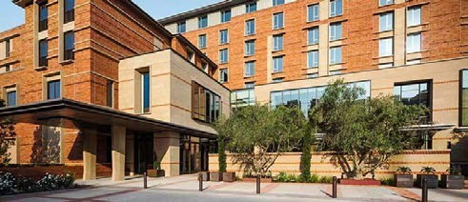

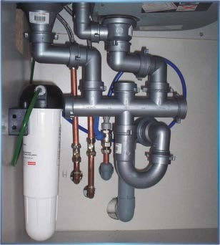
Networking = “Plumbing”
Networking is the “plumbing” of computing
Almost all areas of computing are network-based.
  Distributed computing
  Big Data
  Cloud Computing
  Internet of Things
  Smart Cities
Networking is the backbone of computing.

Slide 5
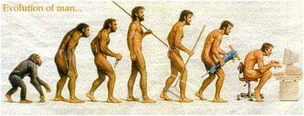
Internet Age
Distributed Computing
Cloud Computing
Mobile Computing ⇒ Smart Phones
Streaming Video ⇒ YouTube
Social Networking ⇒ FaceBook
Big Data
Machine Learning ⇒ Artificial Intelligence
Online Shopping ⇒ Amazon, eBay
Most fields today – Education, Health, Environment – are advancing simply because of advances in networking.

Slide 6

Current Hot Topics in Networking
Internet of Things (IoT)
Cybersecurity
Cloud Computing
Software Defined Networking
Wireless Networking
Streaming Media

Slide 7
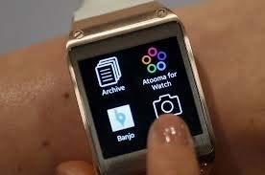
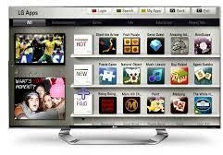


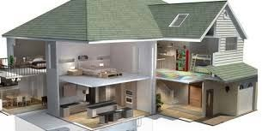


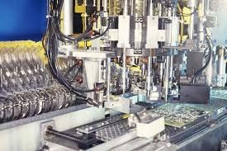

Trend: Smart Everything
Smart Watch | Smart TV | Smart Car
Smart Health | Smart Home | Smart Kegs
Smart Space | Smart Industries | Smart Cities

Slide 8

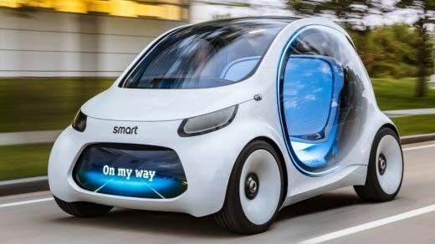

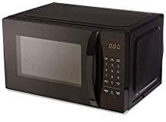
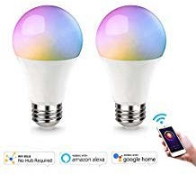


Trend: Smart to Intelligent
Intelligent Clock | Intelligent TV | Intelligent Car
Intelligent Health | Intelligent Home Security | Intelligent Microwave
Intelligent Light | Amazon Alexa | Google Assistant

Slide 9
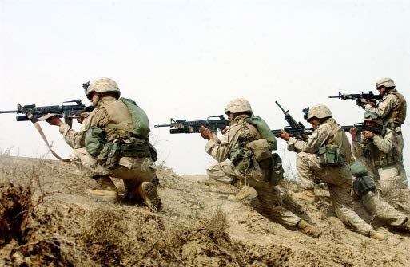
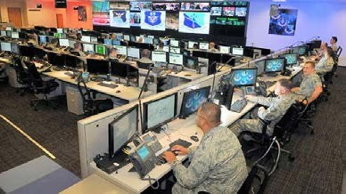
Trend: Security & Cyber Warfare
Security of computers, companies, smart grid, and nations
Nation States are penetrating other nations’ computers 5th domain of warfare (after land, sea, air, space)
In 2010, the US set up US Cyber Command
UK, China, Russia, Israel, and North Korea have similar centers
Many cyber wars: North Korea vs. USA, Israel vs. Syria, South Korea vs. North Korea, India vs. Pakistan, …
Old
New

Slide 10


























What’s the Internet: “nuts and bolts” view
millions of connected computing devices:
PC
server
mobile network
–
–
hosts = end systems
running network apps
wireless laptop
smartphone
global ISP
home network
regional ISP
wireless^{ϖ} communication links
links
fiber, copper, radio, satellite transmission rate: bandwidth
wired
links
♣
^{ϖ} Packet switches: forward packets (chunks of data)
routers and switches
router
institutional
network
Introduction

Slide 11

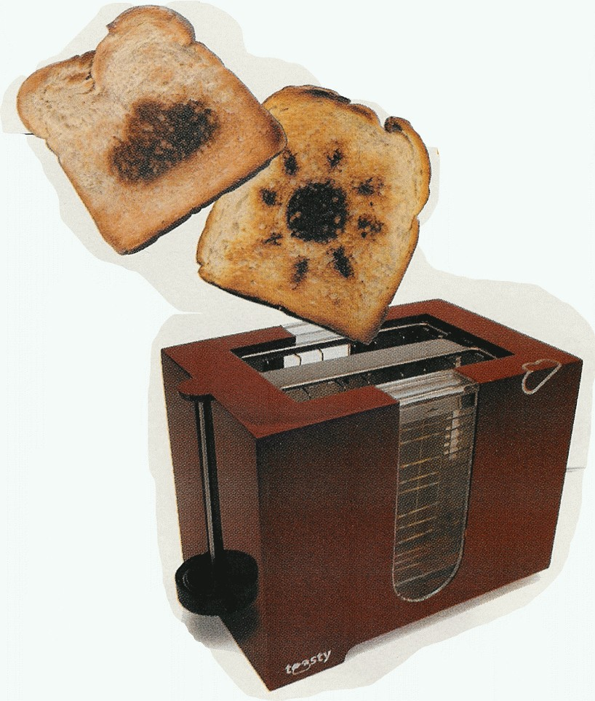
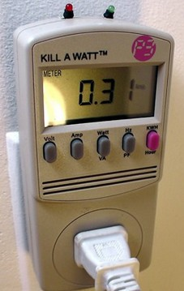
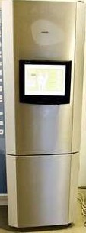


“Fun” internet appliances
Web-enabled toaster + weather forecaster
IP picture frame http://www.ceiva.com/
Tweet-a-watt: monitor energy use
Slingbox: watch,
control cable TV remotely
Internet refrigerator
Internet phones
Introduction

Slide 12





What’s the Internet: “nuts and bolts” view
Internet: “network of networks”
Interconnected ISPs
protocols control sending, receiving of msgs
e.g., TCP, IP, HTTP, Skype, 802.11
Internet standards
RFC: Request for comments
IETF: Internet Engineering Task Force
mobile network
•
global ISP
•
home network
regional ISP
•
institutional
network

Slide 13


What’s the Internet: a service view
mobile network
•
Infrastructure that provides services to applications:
– Web, VoIP, email, games, e-commerce, social nets, …
provides programming interface to apps
global ISP
home network
regional ISP
•
institutional
network

Slide 14
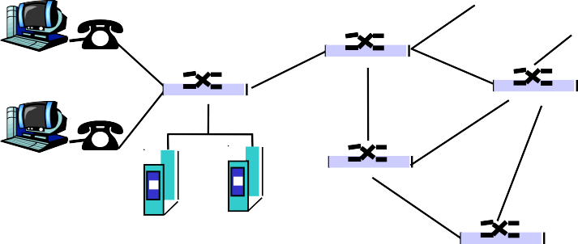
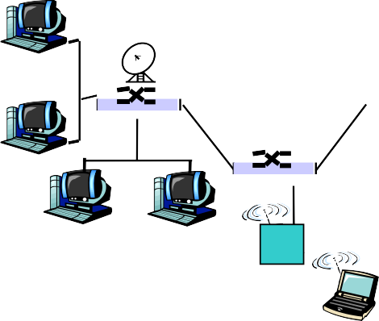




A closer look at network structure:
^{θ} network edge: applications and hosts
^{θ} network core:
^{μ} routers
^{μ} network of networks
^{θ} access networks, physical media: communication links

Slide 15
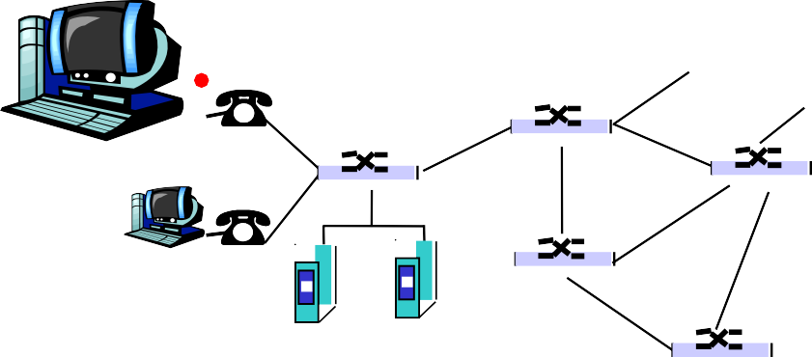

The network edge:
^{θ} end systems (hosts):
^{μ} run application programs
^{μ} e.g. Web, email
^{μ} at “edge of network”

Slide 16
The network edge:
^{θ} client/server model
^{μ} client host requests, receives service from always-on server
^{μ} e.g. Web browser/server; email client/server
^{θ} why such a popular model?

Slide 17
The network edge:
^{θ} peer-peer model:
μ
minimal (or no) use of
dedicated servers
^{μ} e.g. Gnutella, KaZaA
^{μ} SETI@home?

Slide 18
What’s a protocol?
human protocols:
^{θ} “what’s the time?”
^{θ} “I have a question”
^{θ} introductions
network protocols:
^{θ} machines rather than humans
^{θ} all communication activity in Internet governed by protocols
protocols define format, order of msgs sent and received among network entities, and actions taken on msg
transmission, receipt

Slide 19



What’s a protocol?
a human protocol and a computer network protocol:
Hi
Hi
Got the time? 2:00
TCP connection req
TCP connection response
Get http://www.awl.com/kurose-ross
<file>
time
Q: Why are protocols so important?

Slide 20
Internet Services Models
^{θ} Connection-oriented service
^{θ} Connectionless service
^{θ} Applications
^{μ} FTP, Internet Phone, Web, Internet radio, email

Slide 21
Connection-oriented service
^{θ} Goal: data transfer between end systems
^{θ} handshaking: setup (prepare for) data transfer ahead of time
^{θ} TCP - Transmission Control Protocol
^{μ} Internet’s connection-oriented service
^{μ} reliable, in-order byte-stream data transfer
loss: acknowledgements and retransmissions
^{μ} flow control:
sender won’t overwhelm receiver
^{μ} congestion control:
senders “slow down sending rate” when network
congested
Introduction
1-14

Slide 22
Connectionless service
Goal: data transfer between end systems
^{μ} same as before!
^{θ} UDP - User Datagram Protocol [RFC 768]:
^{μ}connectionless
^{μ}unreliable data transfer
^{μ}no flow control
^{μ}no congestion control
^{θ}What’s it good for?

Slide 23
A Comparison
App’s using TCP:
^{θ} HTTP (Web), FTP (file transfer), Telnet (remote login), SMTP (email)
App’s using UDP:
^{θ} streaming media, teleconferencing, DNS, Internet telephony

Slide 24
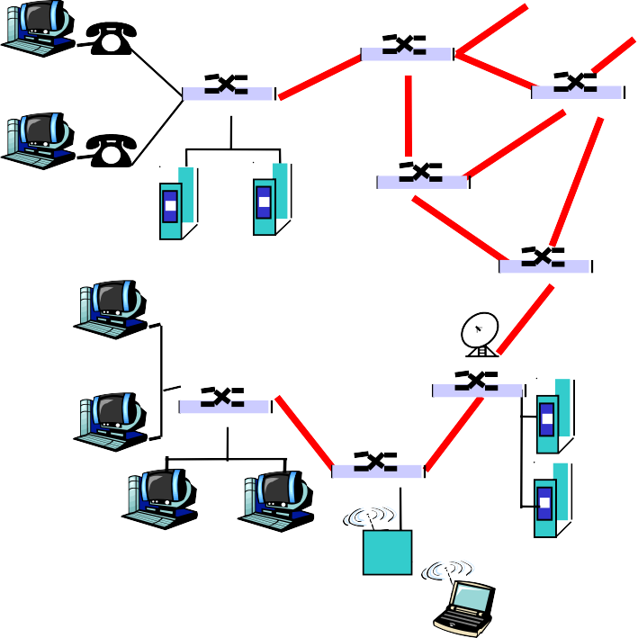


The Network Core
^{θ} mesh of interconnected routers
^{θ} the fundamental question: how is data transferred through net?
^{μ} circuit switching: dedicated circuit per call: telephone net
^{μ} packet-switching: data sent thru net in discrete “chunks”

Slide 25
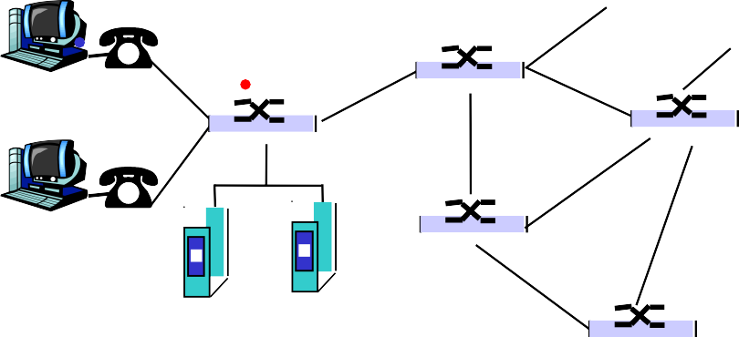




Network Core: Circuit Switching
End-end resources reserved for “call”
^{θ} link bandwidth, switch capacity
^{θ} dedicated resources: no sharing
^{θ} circuit-like (guaranteed) performance
^{θ} call setup required
^{θ} must divide link bw into pieces...

Slide 26
Circuit Switching: FDM and TDM
Example:
FDM
4 users
frequency
time
TDM
frequency
time

Slide 27
Circuit Switching: FDM and TDM
TDM (Time Division Multiplexing) and FDM (Frequency Division Multiplexing) both are multiplexing techniques where TDM is used in both analogue and digital signals.
Where as FDM used only in analogue signals.

Slide 28
Network Core: Packet Switching
each end-end data stream divided into packets
^{θ} user A, B packets share network resources
^{θ} each packet uses full link bandwidth
^{θ} resources used as needed
resource contention:
^{θ} aggregate resource demand can exceed amount available
^{μ} what happens if bandwidth is not available?
^{θ} congestion: packets queue, wait for link use
^{θ} store and forward: packets move one hop at a time
μ
Node receives complete packet before forwarding

Slide 29


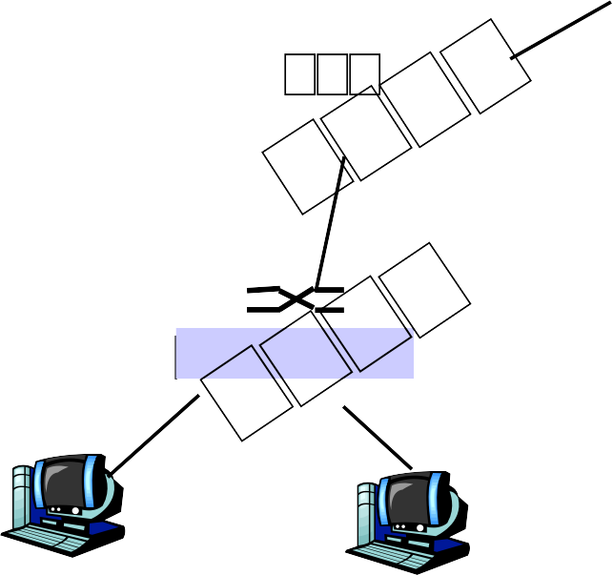

Packet Switching: Statistical Multiplexing
10 Mb/s
A
C
Ethernet
statistical multiplexing
1.5 Mb/s
B
queue of packets waiting for output link
D
E
Sequence of A & B packets does not have fixed pattern ⎝ statistical multiplexing.

Slide 30
Packet Switching: Statistical Multiplexing
In statistical multiplexing, packets from sources A and B are sent based on demand.
The sequence of packets (A, B, A, A, B, etc.) does not follow a fixed pattern—this is what makes it statistical.

Slide 31
Packet switching versus circuit switching
Packet switching allows more users to use network!
^{θ} 1 Mb/s link
^{θ} each user:
^{μ} 100 kb/s when “active”
^{μ} active 10% of time
N users
^{θ} circuit-switching:
^{μ} 10 users
^{θ} packet switching:
^{μ} with 35 users, probability > 10 active less than .0004
1 Mbps link

Slide 32
Packet switching versus circuit switching
Is packet switching a “slam dunk winner?”
^{θ} Great for bursty data
^{μ} resource sharing
^{μ} simpler, no call setup
^{θ} Excessive congestion: packet delay and loss
^{μ} protocols needed for reliable data transfer, congestion control
^{θ} Circuit Switching = Guaranteed behavior
^{μ} good for which apps?

Slide 33


Packet-switching: store-and-forward
L
R
^{θ} Takes L/R seconds to transmit (push out) packet of L bits on to link or R bps
R
R
Example:
^{θ} L = 7.5 Mbits
^{θ} R = 1.5 Mbps
^{θ} delay = 15 sec
^{θ} Entire packet must arrive at router before it can be transmitted on next link: store and forward
^{θ} delay = 3L/R

Slide 34
Packet-switched networks: forwarding
^{θ} Goal: move packets through routers from source to destination
^{μ} we’ll study several path selection (i.e. routing) algorithms (chapter 4)
^{θ} datagram network:
^{μ} destination address in packet determines next hop
^{μ} routes may change during session
^{μ} analogy: driving, asking directions
^{θ} virtual circuit network:
^{μ} each packet carries tag (virtual circuit ID), tag determines next hop
^{μ} fixed path determined at call setup time, remains fixed thru call
^{μ} routers maintain per-call state

Slide 35
Network Taxonomy
Telecommunication networks
Circuit-switched networks
Packet-switched networks
FDM
Networks with VCs
Datagram Networks
TDM
Datagram network is not either connection-oriented or connectionless.
Internet provides both connection-oriented (TCP) and connectionless services (UDP) to apps.

Slide 36
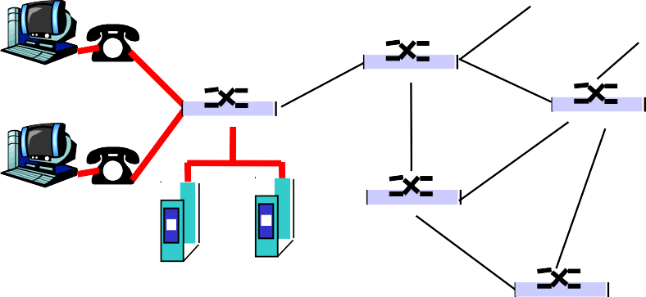
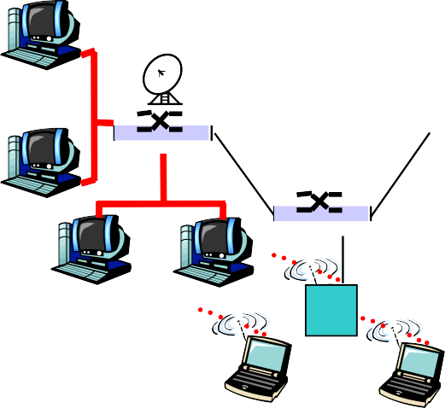


Access networks and physical media
Q: How to connect end systems to edge router?
^{θ} residential access nets
^{θ} institutional access networks (school, company)
^{θ} mobile access networks
Keep in mind:
^{θ} bandwidth (bits per second) of access network?
^{θ} shared or dedicated?

Slide 37
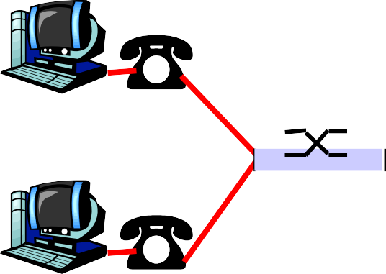
Residential access: point to point access
^{θ} Dialup via modem
^{μ} up to 56Kbps direct access to router (often less)
^{μ} Can’t surf and phone at same time: can’t be “always on”
^{θ} ADSL: asymmetric digital subscriber line
^{μ} up to 1 Mbps upstream (today typically < 256 kbps)
^{μ} up to 8 Mbps downstream (today typically < 1 Mbps)
^{μ} FDM: 50 kHz - 1 MHz for downstream
4 kHz - 50 kHz for upstream
0 kHz - 4 kHz for ordinary telephone

Slide 38
Residential access: cable modems
^{θ} HFC: hybrid fiber coax
^{μ} asymmetric: up to 30Mbps downstream, 2 Mbps upstream
^{θ} network of cable and fiber attaches homes to ISP router
^{μ} homes share access to router
^{θ} deployment: available via cable TV companies

Slide 39

Cable Network Architecture: Overview
Typically 500 to 5,000 homes
cable headend
cable distribution network (simplified)
home

Slide 40
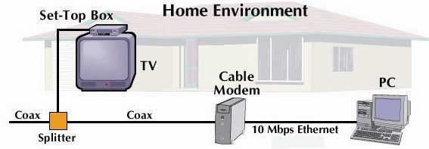
Cable Network Architecture: Overview
cable headend
cable distribution network (simplified)
home

Slide 41
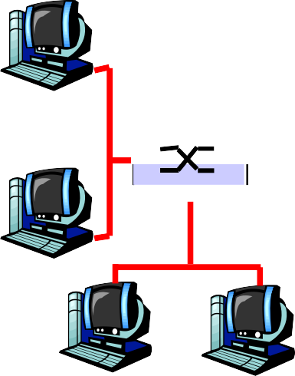
Company access: local area networks
^{θ} company/univ local area network (LAN) connects end system to edge router
^{θ} Ethernet:
^{μ} shared or dedicated link connects end system and router
^{μ} 10 Mbps, 100Mbps, Gigabit Ethernet
^{θ} LANs: chapter 5

Slide 42


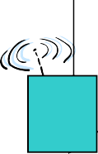



Wireless access networks
^{θ} shared wireless access network connects end system to router
^{μ} via base station aka “access point”
^{θ} wireless LANs:
^{μ} 802.11b (WiFi): 11 Mbps
^{θ} wider-area wireless access
^{μ} provided by telco operator
^{μ} 3G ~ 384 kbps
Will it happen??
^{μ} WAP/GPRS in Europe
router
base station
mobile hosts

Slide 43




Home networks
Typical home network components:
^{θ} ADSL or cable modem
^{θ} router/firewall/NAT
^{θ} Ethernet
^{θ} wireless access point
wireless laptops
to/from cable headend
cable modem
router/ firewall
wireless access point
Ethernet

Slide 44
Physical Media
^{θ} Bit: propagates between transmitter/rcvr pairs
^{θ} physical link: what lies between transmitter & receiver
^{θ} guided media:
^{μ} signals propagate in solid media: copper, fiber, coax
^{θ} unguided media:
^{μ} signals propagate freely, e.g., radio
Twisted Pair (TP)
^{θ} two insulated copper wires
^{μ} Category 3: traditional phone wires, 10 Mbps Ethernet
^{μ} Category 5: 100Mbps Ethernet

Slide 45


Physical Media: coax, fiber
Fiber optic cable:
^{θ} glass fiber carrying light pulses, each pulse a bit
^{θ} high-speed operation:
^{μ} high-speed point-to-point transmission (e.g., 5 Gps)
^{θ} low error rate: repeaters spaced far apart ; immune to electromagnetic noise
Coaxial cable:
^{θ} two concentric copper conductors
^{θ} bidirectional
^{θ} baseband:
^{μ} single channel on cable
^{μ} legacy Ethernet
^{θ} broadband:
μ
multiple channel on cable HFC
μ

Slide 46
Physical Media: coax, fiber
Feature | Fiber Optic Cable | Copper Coaxial Cable
Speed / Bandwidth | Much higher bandwidth (10 Gbps and beyond) | Lower bandwidth; suitable for limited-speed usage
Distance | Transmits over longer distances without signal loss | Signal degrades faster, needs frequent amplifiers
Interference | Immune to electromagnetic interference | Susceptible to EMI and radio frequency interference
Signal Quality | Very low loss and high-quality signal | More signal attenuation over distance
Security | Difficult to tap without detection (more secure) | Easier to tap into (less secure)
Size and Weight | Lighter and thinner | Thicker and heavier
Cost (initial) | Higher installation cost | Cheaper initially

Slide 47
Electromagnetic Spectrum
Radio link types:
^{θ} terrestrial microwave
^{μ} e.g. up to 45 Mbps channels
^{θ} LAN (e.g., Wifi)
^{μ} 2Mbps, 11Mbps
^{θ} wide-area (e.g., cellular)
^{μ} e.g. 3G: hundreds of kbps
^{θ} satellite
^{μ} up to 50Mbps channel (or multiple smaller channels)
^{μ} 270 msec end-end delay
^{μ} geosynchronous versus low altitude
^{θ} signal carried in electromagnetic spectrum
^{θ} no physical “wire”
^{θ} bidirectional
^{θ} propagation environment effects:
^{μ} reflection
^{μ} obstruction by objects
^{μ} interference

Slide 48
Physical media: radio
Radio link types:
^{θ} terrestrial microwave
^{μ} e.g. up to 45 Mbps channels
^{θ} LAN (e.g., Wifi)
^{μ} 2Mbps, 11Mbps
^{θ} wide-area (e.g., cellular)
^{μ} e.g. 3G: hundreds of kbps
^{θ} satellite
^{μ} up to 50Mbps channel (or multiple smaller channels)
^{μ} 270 msec end-end delay
^{μ} geosynchronous versus low altitude
^{θ} signal carried in electromagnetic spectrum
^{θ} no physical “wire”
^{θ} bidirectional
^{θ} propagation environment effects:
^{μ} reflection
^{μ} obstruction by objects
^{μ} interference

Slide 49
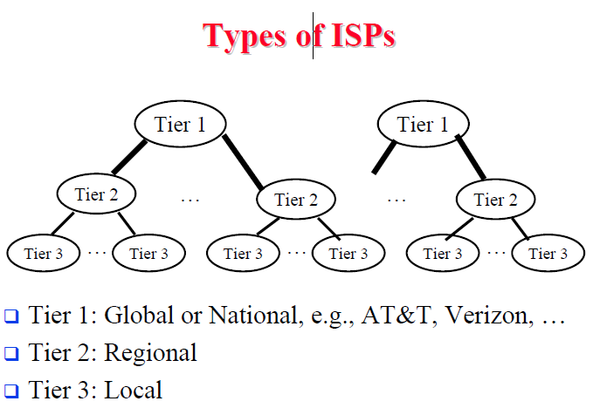

Internet structure: network of networks
^{θ} “Tier-3” ISPs and local ISPs
^{μ} last hop (“access”) network (closest to end systems)
local ISP
Tier 3 ISP
Tier-2 ISP
local ISP
local ISP
local ISP
Local and tier- 3 ISPs are customers of higher tier ISPs
connecting them to rest of Internet
Tier-2 ISP
NAP
Tier-2 ISP
local ISP
Tier-2 ISP
local ISP
Tier-2 ISP local ISP
local ISP
Introduction
1-41

Slide 50
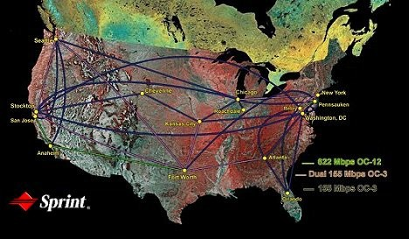
ISP: e.g., Sprint
Sprint US backbone network

Slide 51
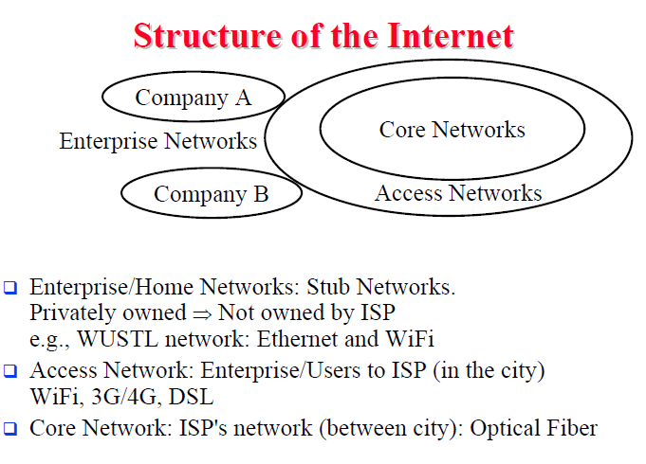


Internet structure: network of networks
^{θ} a packet passes through many networks!
local ISP
Tier 3 ISP
Tier-2 ISP
local ISP
local ISP
local ISP
Tier-2 ISP
NAP
Tier-2 ISP
local ISP
Tier-2 ISP local ISP
local ISP
1-42

Slide 52




How do loss and delay occur?
packets queue in router buffers
^{θ} packet arrival rate to link exceeds output link capacity
^{θ} packets queue, wait for turn
packet being transmitted (delay)
A
B
packets queueing (delay)
free (available) buffers: arriving packets dropped (loss) if no free buffers
Introduction
1-43

Slide 53



Four sources of packet delay
^{θ} 1. nodal processing:
^{μ} check bit errors
^{μ} determine output link
^{θ} 2. queueing
^{μ} time waiting at output link for transmission
^{μ} depends on congestion level of router
transmission
A
propagation
B
nodal processing
queueing
Introduction
1-44

Slide 54



Delay in packet-switched networks
3. Transmission delay:
^{θ} R=link bandwidth (bps)
^{θ} L=packet length (bits)
^{θ} time to send bits into link = L/R
4. Propagation delay:
^{θ} d = length of physical link
^{θ} s = propagation speed in medium (~2x10⁸ m/sec)
^{θ} propagation delay = d/s
Note: s and R are very
different quantities!
transmission
A
propagation
B
nodal processing
queueing
Introduction
1-45

Slide 55
Nodal delay
^{d}nodal ^{=d}proc ^{+d}queue ^{+d}trans ^{+d}prop
θ d_{proc} = processing delay
^{μ} typically a few microsecs or less
θ d_{queue} = queuing delay
^{μ} depends on congestion
θ d_{trans} = transmission delay
^{μ} = L/R, significant for low-speed links
θ d_{prop} = propagation delay
^{μ} a few microsecs to hundreds of msecs

Slide 56
Packet loss
^{θ} queue (aka buffer) preceding link in buffer has finite capacity
^{θ} when packet arrives to full queue, packet is dropped (aka lost)
^{θ} lost packet may be retransmitted by previous node, by source end system, or not retransmitted at all

Slide 57
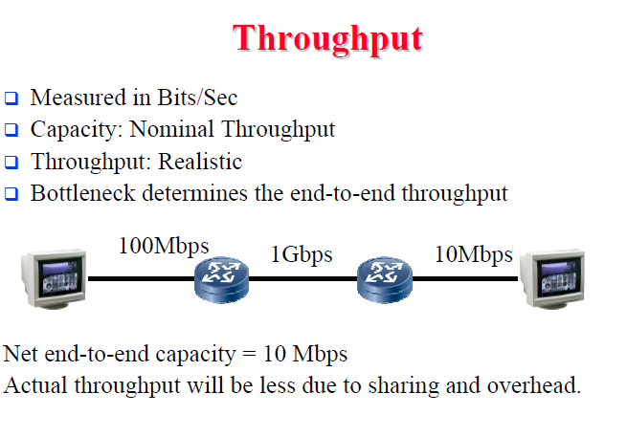
Network System Modularity
Like software modularity, but:
Implementation is distributed across many machines (routers and hosts)
Must decide:
  How to break system into modules
    Layering
  Where modules are implemented
    End-to-End Principle
  Where state is stored
    Fate-sharing

Slide 58
Network System Modularity
Like software modularity, but:
Implementation is distributed across many machines (routers and hosts)
Must decide:
  How to break system into modules
    Layering
  Where modules are implemented
    End-to-End Principle
  Where state is stored
    Fate-sharing

Slide 59
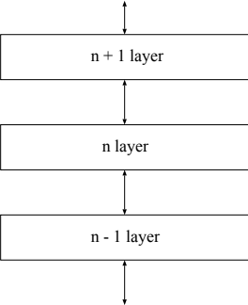
Layering Concept
A restricted form of abstraction: system functions are divided into layers, one built upon another
Often called a stack; but not a data structure!

Slide 60
Layers and Communications
Interaction only between adjacent layers
layer n uses services provided by layer n-1
layer n provides service to layer n+1
Bottom layer is physical media
Top layer is application

Slide 61
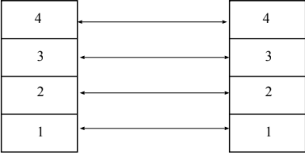
Entities and Peers
Entity – a thing (an independent existence) Entities interact with the layers above and below Entities communicate with peer entities
– same level but different place (eg different person, different box, different host)
Communications between peers is supported by entities at the lower layers

Slide 62
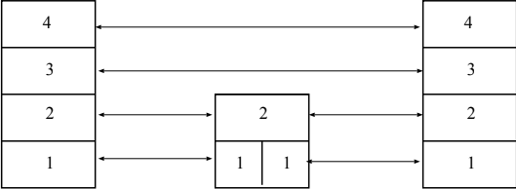
Entities and Peers
Entities usually do something useful
Encryption – Error correction – Reliable Delivery
Nothing at all is also reasonable
Not all communications is end-to-end Examples for things in the middle
IP Router – Mobile Phone Cell Tower
Person translating French to English

Slide 63
Protocol “Layers”
Networks are complex!
^{θ} many “pieces”:
^{μ} hosts
^{μ} routers
^{μ} links of various media
^{μ} applications
^{μ} protocols
^{μ} hardware,
software

Slide 64
Organization of air travel
ticket (purchase)
baggage (check) gates (load)
runway takeoff
airplane routing
ticket (complain)
baggage (claim)
gates (unload) runway landing airplane routing
airplane routing
^{θ} a series of steps

Slide 65

Layering of airline functionality
ticket (purchase)
baggage (check)
gates (load)
runway (takeoff)
airplane routing
ticket (complain)
baggage (claim
gates (unload)
runway (land)
airplane routing
ticket
baggage gate
takeoff/landing
airplane routing airplane routing
intermediate air-traffic control centers
airplane routing
departure airport
arrival airport
Layers: each layer implements a service
^{μ} via its own internal-layer actions
^{μ} relying on services provided by layer below

Slide 66
Why layering?
Layering is a design approach that divides the complex process of communication into simpler, well-defined steps (layers), where each layer performs a specific task.

Slide 67
Internet protocol stack
θ
application: supporting network applications
 | application
 | transport
 | network
 | link
 | physical
μ
ftp, smtp, http
θ
transport: host-host data transfer
μ
tcp, udp
θ
network: routing of datagrams from source to destination
Host
μ
ip, routing protocols
θ
link: data transfer between neighboring network elements
Router
μ
ppp, ethernet
θ
physical: bits “on the wire”, modulation scheme, line-coding format, electrical & physical specifications, etc.
Routers in the network operate only up to the Network Layer
¬

Slide 68

source
Encapsulation
message
M
application
transport
network
link
physical
segment
H_{t}
M
datagram frame
H_{n} | H_{t} | M
H_{l} | H_{n} | H_{t} | M
H_{l} | H_{n} | H_{t} | M
link
H_{l} | H_{n} | H_{t} | M
physical
switch
destination
H_{n} | H_{t} | M
network
H_{n} | H_{t} | M
M
application
transport
network
link
physical
H_{l} | H_{n} | H_{t} | M
link
H_{l} | H_{n} | H_{t} | M
H_{t}
M
physical
H_{n} | H_{t} | M
H_{l} | H_{n} | H_{t} | M
router
Introduction
1-59

Slide 69
1.9 Internet History
1961-1972: Early packet-switching principles
θ θ
1972:
^{μ} ARPAnet demonstrated publicly
^{μ} NCP (Network Control Protocol) first host- host protocol
^{μ} first e-mail program
^{μ} ARPAnet has 15 nodes
1961: Kleinrock - queueing theory shows effectiveness of packet- switching
1964: Baran - packet- switching in military nets
1967: ARPAnet conceived by Advanced Research Projects Agency
1969: first ARPAnet node operational
θ
θ
θ

Slide 70
Internet History
1972-1980: Internetworking, new and proprietary nets
θ
1970: ALOHAnet satellite network in Hawaii
1973: Metcalfe’s PhD thesis proposes Ethernet
1974: Cerf and Kahn - architecture for interconnecting networks
late70’s: proprietary architectures: DECnet, SNA, XNA
late 70’s: switching fixed length packets (ATM precursor)
1979: ARPAnet has 200 nodes
Cerf and Kahn’s internetworking principles:
^{μ} minimalism, autonomy - no internal changes required to interconnect networks
^{μ} best effort service model
^{μ} stateless routers
^{μ} decentralized control define today’s Internet
architecture
θ
θ
θ
θ
θ

Slide 71
Internet History
1980-1990: new protocols, a proliferation of networks
^{θ} 1983: deployment of TCP/IP
^{θ} 1982: smtp e-mail protocol defined
^{θ} 1983: DNS defined for name-to-IP-address translation
^{θ} 1985: ftp protocol defined
^{θ} 1988: TCP congestion control
^{θ} new national networks: Csnet, BITnet, NSFnet, Minitel
^{θ} 100,000 hosts connected to confederation of networks

Slide 72
Internet History
1990’s: commercialization, the WWW
θ
Early 1990’s: ARPAnet decommissioned
1991: NSF lifts restrictions on commercial use of NSFnet (decommissioned, 1995)
early 1990s: WWW
^{μ} hypertext [Bush 1945, Nelson 1960’s]
^{μ} HTML, http: Berners-Lee
^{μ} 1994: Mosaic, later Netscape
^{μ} late 1990’s: commercialization of the WWW
Late 1990’s & 2000’s:
θ
est. 50 million computers on Internet
est. 100 million+ users
backbone links running at 1 Gbps
θ
θ
θ
θ
You now hopefully have:
ρ
context, overview, “feel” of networking
more depth, detail later in course
ρ

