Slide 1

AquaSentinel AI
A Multi-Agent AI Platform for Smart Water Management
Submitted by : Pratham Deshmukh & Aryan Sable

Slide 2
📝 Problem Statement
Challenges Faced by Citizens :
💧 Unsafe drinking water
🚰 Choosing the right purifier
🌱 Water wastage
📋 Complicated complaint registration
Why it matters
📌 Information is scattered across multiple platforms.
🚰 Complaint reporting is slow and inconvenient.
🤖 Lack of a single intelligent assistant.
🔵 Problem: Water-related information and services are fragmented, making it difficult for citizens to get timely guidance and report issues efficiently.
🌍 WHO: Billions of people still lack access to safely managed drinking water.

Slide 3
💡 Introducing AquaSentinel AI
An Intelligent Multi-Agent AI System for Smart Water Assistance
🛡️ Water Safety
Quality analysis
Drinking water guidance
What is AquaSentinel AI ?
AquaSentinel AI is a multi-agent AI platform that helps citizens by providing reliable water-related guidance through specialized AI advisors. It understands the user's request, routes it to the appropriate expert, and automates complaint registration when required.
💧 Purification Advisor
RO, UV & UF guidance
TDS-based recommendations
🌱 Water Conservation
Water-saving tips
Sustainable practices
📋 Complaint Registration
Automated complaint filing
Google Sheets logging
Email confirmation
🧠 AquaSentinel AI brings water safety, purification guidance, conservation advice, and
complaint registration together in one intelligent platform.

Slide 4
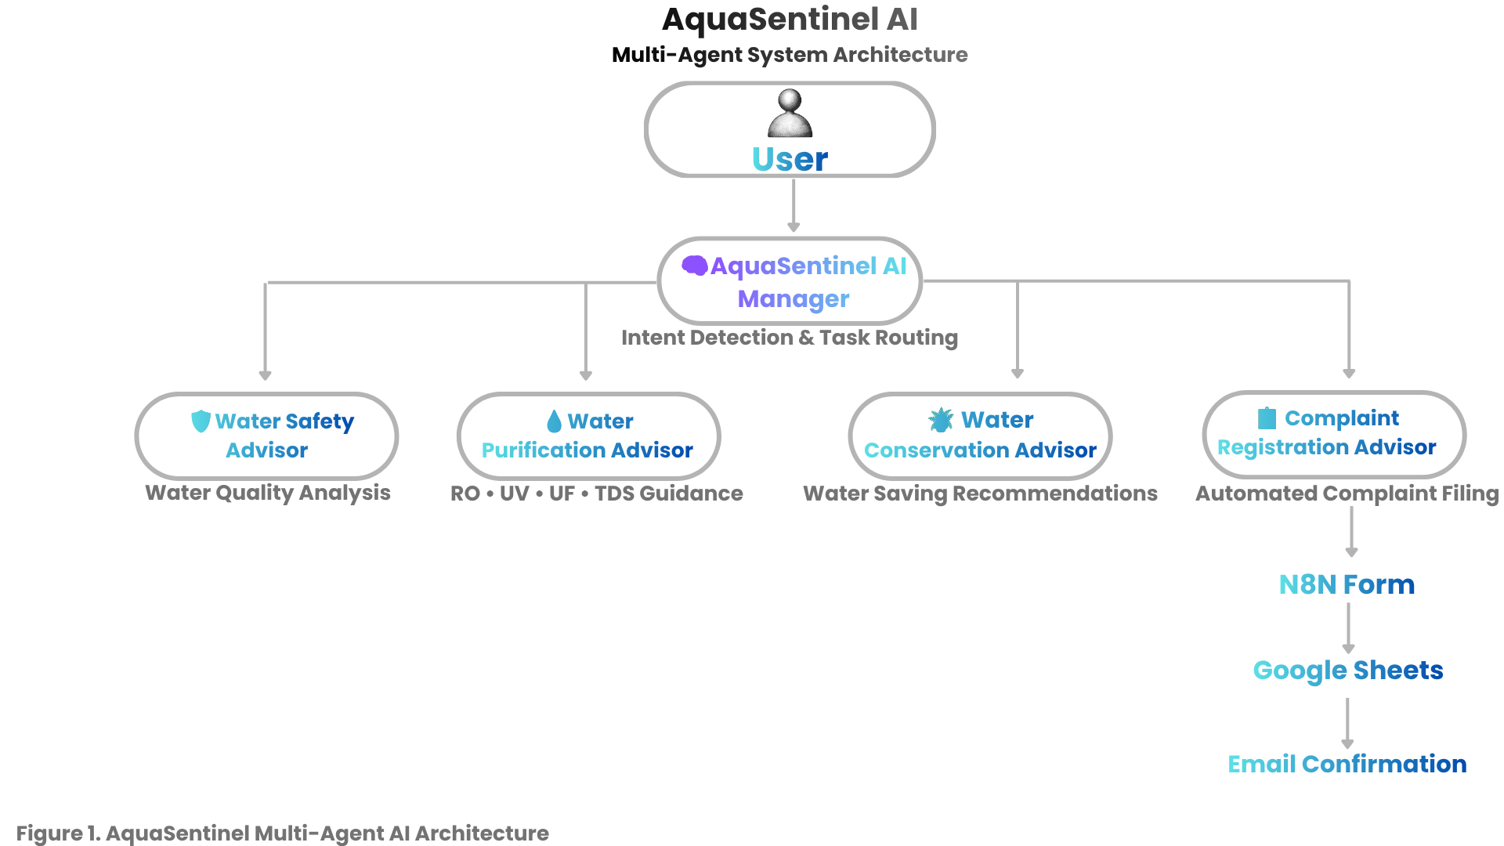
🏗️ System Architecture
How AquaSentinel AI Processes User Requests
👤 User Interaction
User enters a water-related query.
The AI Manager identifies the user's intent.
The request is routed to the appropriate specialist.
🤖 Response Generation
Specialist AI provides domain-specific guidance.
Complaint requests are sent to the
Complaint Registration module.
Complaint data is stored in Google Sheets and a
confirmation email is sent.
AI Manager intelligently routes every query to the right specialist, making responses more accurate and efficient.

Slide 5
⚙️ Project Workflow
How AquaSentinel AI Handles a User Query
.
👤 User
User Query: "My tap water is brown. I want to report it."
💬 User Query
AI Manager identifies:
Water Safety
Complaint Registration
Real-world Example →
🧠 AI Manager
(Intent Detection & Routing)
Water Safety Advisor provides safety recommendations.
🤖 Specialized AI Agent
Complaint Registration Advisor opens the complaint form.
📄 Personalized Response
Complaint is stored in Google Sheets.
Confirmation email is sent.
📧 Email + Google Sheets
(Only if Complaint is Submitted)
🧠 By combining multiple AI specialists into one workflow, AquaSentinel AI makes
water-related assistance simple, accessible, and efficient for everyone.

Slide 6


💻 Technology Stack
Technologies used to build AquaSentinel AI
Workflow Pipeline
Core Technologies
User
🤖 n8n
Workflow Automation
AI Agent Orchestration
🧠 Groq /Gemini API
Llama 3 Model
Fast AI Responses
n8n AI Workflow
AI Chat Model
📊 Google Sheets
Complaint Database
Data Logging
📧 Gmail
Automatic Email Confirmation
AI Response
🌐 n8n Chat
User Interaction
Complaint Form
Google Sheets
📁 GitHub
Version Control
Project Repository
Email Confirmation

Slide 7
🚀 Live Example
How AquaSentinel AI Solves a Real User Problem
👤 User asks
"My tap water is brown and smells like chlorine. My TDS is around 650. Is it safe to drink?
Should I buy a purifier? I also want to report this issue."
🧠 AquaSentinel AI Manager
Detects multiple intents and routes
the request to the correct AI specialists.
(Multi-Agent Decision)
🛡 Water Safety Advisor
✔ Explains possible causes
✔ Suggests immediate precautions
💧 Purification Advisor
✔ Recommends RO purifier
✔ Explains why based on TDS
📋 Complaint Advisor
✔ Opens complaint form
✔ Stores details in Google Sheets
✔ Sends confirmation email
💡 Result
The user receives safety advice, purifier recommendations, and completes complaint registration in a single conversation.

Slide 8
✨ Key Features & Benefits
🚀 What Makes AquaSentinel AI Useful?
🛡 Water Safety Analysis
Provides quick guidance on drinking water quality.
Identifies possible water quality concerns
Suggests immediate safety precautions
Helps users make informed decisions
💧 Personalized Purification Guidance
Recommends the most suitable purifier based on water conditions.
Uses TDS values for recommendations
Explains RO, UV, and UF technologies
Helps users avoid unnecessary expenses
📋 Smart Complaint Registration
Simplifies reporting water-related issues.
Generates complaint forms automatically
Stores records in Google Sheets
Sends instant email confirmation
🧠 Intelligent Multi-Agent System
Routes every request to the right AI specialist.
Detects user intent automatically
Assigns tasks to dedicated AI advisors
Delivers focused and accurate responses
🌍 Real-World Impact
✔ Makes water-related information easier to access
✔ Designed for future expansion with regional languages and voice interaction
✔ Encourages safe water practices and public awareness
✔ Reduces confusion by combining multiple services into one platform

Slide 9
🚀 Future Scope
Future enhancements to make water assistance smarter and more accessible.
🌐 Regional Language Support
Support Marathi, Hindi, Tamil and other Indian languages
Make the platform accessible to more citizens
🎙 Voice-Based Interaction
Allow users to speak instead of typing
Helpful for elderly and less literate users
📍 GPS-Based Complaint Registration
Automatically capture user location
Speed up issue reporting to local authorities
📊 Smart Water Analytics
Analyze complaint trends
Identify high-risk areas
Help authorities make better decisions
🌱 Long-Term Vision
Our vision is to develop AquaSentinel AI into a smart public assistant that helps citizens access safe
water information, report issues efficiently, and supports authorities with better decision-making.

Slide 10
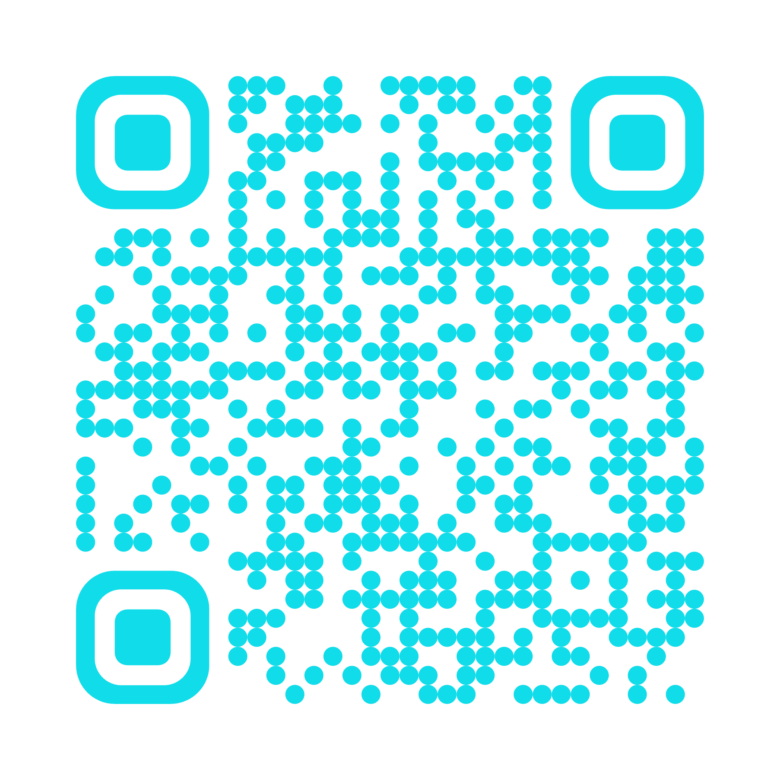
⭐️ Conclusion & Thank You
AquaSentinel AI – Smarter Water Assistance Through Multi-Agent AI
🎯 Project Summary
AquaSentinel AI combines specialized AI agents to provide reliable water guidance,
purifier recommendations, water conservation tips, and automated complaint registration
through a single intelligent platform.
🌍 Why It Matters
💧 Promotes safe water awareness
🤖 Makes water-related assistance simple and accessible
📋 Simplifies complaint reporting through automation
🌱 Designed for future expansion with regional languages and voice interaction
📱 Scan to view source code
& documentation
📂 Project Resources
GitHub Repository
https://github.com/prathamdesh07-afk/AquaSentinel-AI
Thank you for your time! We welcome your questions and feedback.

