Slide 1
Advance java
Servlet API

Slide 2
Servlet API
The javax.servlet and javax.servlet.http packages represent interfaces and classes for servlet api.
The javax.servlet package contains many interfaces and classes that are used by the servlet or web container. These are not specific to any protocol.
The javax.servlet.http package contains interfaces and classes that are responsible for http requests only.
Let's see what are the interfaces of javax.servlet package.

Slide 3
Interfaces in javax.servlet package
Servlet
ServletRequest
ServletResponse
RequestDispatcher
ServletConfig
ServletContext
SingleThreadModel
Filter
FilterConfig
FilterChain
ServletRequestListener
ServletRequestAttributeListener
ServletContextListener
ServletContextAttributeListener

Slide 4
Classes in javax.servlet package
GenericServlet
ServletInputStream
ServletOutputStream
ServletRequestWrapper
ServletResponseWrapper
ServletRequestEvent
ServletContextEvent
ServletRequestAttributeEvent
ServletContextAttributeEvent
ServletException
UnavailableException

Slide 5
Interfaces in javax.servlet.http package
HttpServletRequest
HttpServletResponse
HttpSession
HttpSessionListener
HttpSessionAttributeListener
HttpSessionBindingListener
HttpSessionActivationListener
HttpSessionContext (deprecated now)

Slide 6
Classes in javax.servlet.http package
HttpServlet
Cookie
HttpServletRequestWrapper
HttpServletResponseWrapper
HttpSessionEvent
HttpSessionBindingEvent
HttpUtils (deprecated now)

Slide 7
Servlet Interface
Servlet interface provides common behavior to all the servlets.
Servlet interface needs to be implemented for creating any servlet (either directly or indirectly).
It provides 3 life cycle methods that are used to initialize the servlet, to service the requests, and to destroy the servlet and 2 non-life cycle methods.

Slide 8
Methods of Servlet interface
There are 5 methods in Servlet interface.
public void init(ServletConfig config) : initializes the servlet. It is the life cycle method of servlet and invoked by the web container only once.
public void service(ServletRequest request,ServletResponse response) : provides response for the incoming request. It is invoked at each request by the web container.
public void destroy() : is invoked only once and indicates that servlet is being destroyed.
public ServletConfig getServletConfig() : returns the object of ServletConfig.
public String getServletInfo() : returns information about servlet such as writer, copyright, version etc.

Slide 9
Servlet Example by implementing Servlet interface
import java.io.*;
import javax.servlet.*;
public class First implements Servlet{
ServletConfig config=null;
public void init(ServletConfig config){
this.config=config;
System.out.println("servlet is initialized");
}

Slide 10
Continue…
public void service(ServletRequest req,ServletResponse res)
throws IOException,ServletException{
res.setContentType("text/html");
PrintWriter out=res.getWriter();
out.print("<html><body>");
out.print("<b>hello simple servlet</b>");
out.print("</body></html>");
}
public void destroy(){System.out.println("servlet is destroyed");}
public ServletConfig getServletConfig(){return config;}
public String getServletInfo(){return "copyright 2007-1010";}
}

Slide 11
GenericServlet class
GenericServlet class implements Servlet, ServletConfig and
Serializable interfaces.
It provides the implementation of all the methods of these interfaces except the service method.
GenericServlet class can handle any type of request so it is protocol-independent.
You may create a generic servlet by inheriting the GenericServlet class and providing the implementation of the service method.

Slide 12
Methods of GenericServlet class
public void init(ServletConfig config) is used to initialize the servlet.
public abstract void service(ServletRequest request, ServletResponse response) provides service for the incoming request. It is invoked at each time when user requests for a servlet.
public void destroy() is invoked only once throughout the life cycle and indicates that servlet is being destroyed.
public ServletConfig getServletConfig() returns the object of ServletConfig.
public String getServletInfo() returns information about servlet such as writer, copyright, version etc.
public void init() it is a convenient method for the servlet programmers, now there is no need to call super.init(config)
public ServletContext getServletContext() returns the object of ServletContext.

Slide 13
Continue..
public String getInitParameter(String name) returns the parameter value for the given parameter name.
public Enumeration getInitParameterNames() returns all the parameters defined in the web.xml file.
public String getServletName() returns the name of the servlet object.
public void log(String msg) writes the given message in the servlet log file.
public void log(String msg,Throwable t) writes the explanatory message in the servlet log file and a stack trace.

Slide 14
Servlet Example by inheriting the GenericServlet class
import java.io.*;
import javax.servlet.*;
public class First extends GenericServlet{
public void service(ServletRequest req,ServletResponse res)
throws IOException,ServletException{
res.setContentType("text/html");
PrintWriter out=res.getWriter();
out.print("<html><body>");
out.print("<b>hello generic servlet</b>");
out.print("</body></html>");
}
}

Slide 15
HttpServlet class
The HttpServlet class extends the GenericServlet class and implements Serializable interface. It provides http specific methods such as doGet, doPost, doHead, doTrace etc.

Slide 16
Methods of HttpServlet class
public void service(ServletRequest req,ServletResponse res) dispatches the request to the protected service method by converting the request and response object into http type.
protected void service(HttpServletRequest req, HttpServletResponse res) receives the request from the service method, and dispatches the request to the doXXX() method depending on the incoming http request type.
protected void doGet(HttpServletRequest req, HttpServletResponse res) handles the GET request. It is invoked by the web container.
protected void doPost(HttpServletRequest req, HttpServletResponse res) handles the POST request. It is invoked by the web container.
protected void doHead(HttpServletRequest req, HttpServletResponse res) handles the HEAD request. It is invoked by the web container.

Slide 17
Continue…
protected void doOptions(HttpServletRequest req, HttpServletResponse res) handles the OPTIONS request. It is invoked by the web container.
protected void doPut(HttpServletRequest req, HttpServletResponse res) handles the PUT request. It is invoked by the web container.
protected void doTrace(HttpServletRequest req, HttpServletResponse res) handles the TRACE request. It is invoked by the web container.
protected void doDelete(HttpServletRequest req, HttpServletResponse res) handles the DELETE request. It is invoked by the web container.
protected long getLastModified(HttpServletRequest req) returns the time when HttpServletRequest was last modified since midnight January 1, 1970 GMT.

Slide 18
Life Cycle of a Servlet (Servlet Life Cycle)
The web container maintains the life cycle of a servlet instance. Let's see the life cycle of the servlet:
Servlet class is loaded.
Servlet instance is created.
init method is invoked.
service method is invoked.
destroy method is invoked.

Slide 19
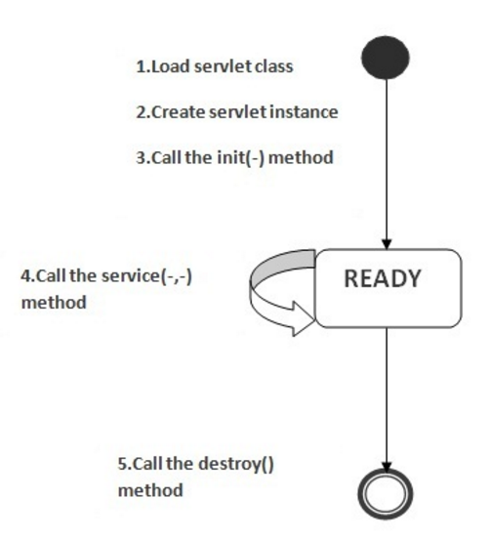
Image

Slide 20
Continue..
As displayed in the above diagram, there are three states of a servlet:
new
ready
end
The servlet is in new state if servlet instance is created.
After invoking the init() method, Servlet comes in the ready state.
In the ready state, servlet performs all the tasks. When the web container invokes the destroy() method, it shifts to the end state.

Slide 21
1) Servlet class is loaded
The classloader is responsible to load the servlet class. The servlet class is loaded when the first request for the servlet is received by the web container.

Slide 22
2) Servlet instance is created
The web container creates the instance of a servlet after loading the servlet class. The servlet instance is created only once in the servlet life cycle.

Slide 23
3) init method is invoked
3) init method is invoked
The web container calls the init method only once after creating the servlet instance. The init method is used to initialize the servlet. It is the life cycle method of the javax.servlet.Servlet interface. Syntax of the init method is given below: public void init(ServletConfig config) throws ServletException

Slide 24
4) service method is invoked
The web container calls the service method each time when request for the servlet is received. If servlet is not initialized, it follows the first three steps as described above then calls the service method. If servlet is initialized, it calls the service method. Notice that servlet is initialized only once. The syntax of the service method of the Servlet interface is given below:
public void service(ServletRequest request, ServletResponse response)
throws ServletException, IOException

Slide 25
5) destroy method is invoked
The web container calls the destroy method before removing the servlet instance from the service. It gives the servlet an opportunity to clean up any resource for example memory, thread etc. The syntax of the destroy method of the Servlet interface is given below:
public void destroy()

Slide 26
Now how many files we required for Servlet Program
Basically 4 files
1)index.html
2)servlet.java afterword class file of servlet
3)index.jsp
4)web.xml (deployment descriptor will instruct to webserver from where & how which file should be execute …)
(check steps to create servlet program using netbeans)

Slide 27
Technic used to create servlet
Mostly professional are using
HttpServlet classs to create .java servlet file
Again mostly HttpRequest & HttpResponse Interfaces used to work with request & response parameter with doGet() or doPost method of it
Lets understand this two interfaces.

Slide 28
ServletRequest Interface
An object of ServletRequest is used to provide the client request information to a servlet such as content type, content length, parameter names and values, header information's, attributes etc.

Slide 29
Methods of ServletRequest interface
There are many methods defined in the ServletRequest interface. Some of them are as follows:
public String getParameter(String name)is used to obtain the value of a parameter by name.
public String[] getParameterValues(String name)returns an array of String containing all values of given parameter name. It is mainly used to obtain values of a Multi select list box.
java.util.Enumeration getParameterNames()returns an enumeration of all of the request parameter names.
public int getContentLength()Returns the size of the request entity data, or -1 if not known.
public String getCharacterEncoding()Returns the character set encoding for the input of this request.

Slide 30
Continue…
public String getContentType()Returns the Internet Media Type of the request entity data, or null if not known.
public ServletInputStream getInputStream() throws IOExceptionReturns an input stream for reading binary data in the request body.
public abstract String getServerName()Returns the host name of the server that received the request.
public int getServerPort()Returns the port number on which this request was received.

Slide 31
Example of ServletRequest to display the name of the user
In this example, we are displaying the name of the user in the servlet. For this purpose, we have used the getParameter method that returns the value for the given request parameter name.
Index.html
<form action="welcome" method="get">
Enter your name<input type="text" name="name"><br>
<input type="submit" value="login">
</form>

Slide 32
Servlet file
import javax.servlet.http.*;
import javax.servlet.*;
import java.io.*;
public class DemoServ extends HttpServlet{
public void doGet(HttpServletRequest req,HttpServletResponse res)
throws ServletException,IOException
{
res.setContentType("text/html");
PrintWriter pw=res.getWriter();
String name=req.getParameter("name");//will return value
pw.println("Welcome "+name);
pw.close();
}}

Slide 33
Web.xml
Will generate automatically

Slide 34
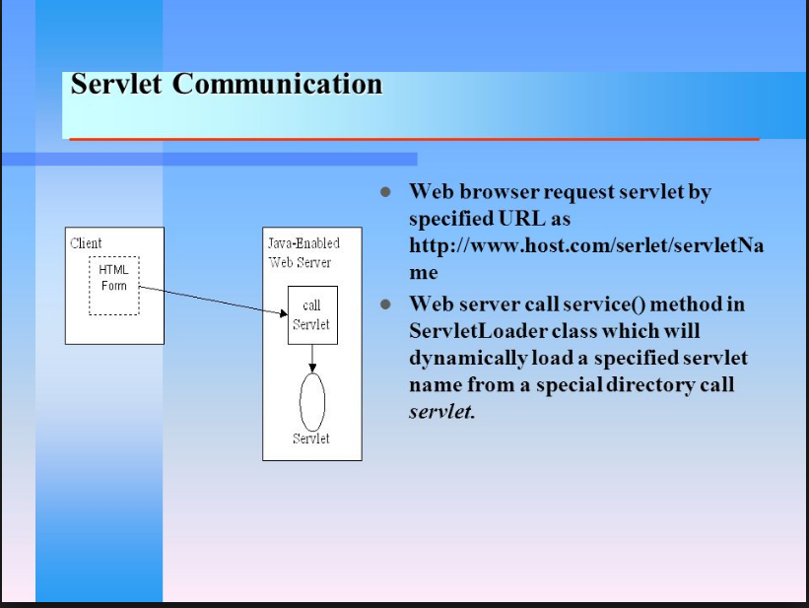

Slide 35
Displaying all the header information in the servlet
The getHeaderNames() of ServletRequest interface returns an Enumeration object, containing all the header names.
The getHeader() method of ServletRequest interface returns the header value for the given header name. In this example, we are displaying all the header information of a request in the servlet page.

Slide 36
Syntax of getHeaderNames() method
public Enumeration getHeaderNames()
Syntax of getHeader() method
public String getHeader(String headerName)

Slide 37
Example of displaying all the header information in the servlet
In this example, we are calling the getHeaderNames() method of the ServletRequest interface, which returns the Enumeration object containing all the header names.
By calling the getHeader() method, we are displaying all the header values.

Slide 38
Index.html
<a href="run"> click Here </a>

Slide 39
ShowHeaders.java
import java.io.*;
import javax.servlet.*;
import javax.servlet.http.*;
import java.util.*;
public class ShowHeaders extends HttpServlet {
public void doGet(HttpServletRequest request,
HttpServletResponse response)
throws IOException, ServletException {
response.setContentType("text/html");
PrintWriter out = response.getWriter();

Slide 40
Continue….
out.println("HTTP headers sent by your client:<br>");
Enumeration enum = request.getHeaderNames();
while (enum.hasMoreElements()) {
String headerName = (String) enum.nextElement();
String headerValue = request.getHeader(headerName);
out.print("<b>"+headerName + "</b>: ");
out.println(headerValue + "<br>");
}
}
}

Slide 41
Web.xml
<web-app>
<servlet>
<servlet-name>headerservlet</servlet-name>
<servlet-class>ShowHeaders</servlet-class>
</servlet>
<servlet-mapping>
<servlet-name>headerservlet</servlet-name>
<url-pattern>/run</url-pattern>
</servlet-mapping>
</web-app>

Slide 42
RequestDispatcher in Servlet
The RequestDispatcher interface provides the facility of dispatching the request to another resource it may be html, servlet or jsp.
This interface can also be used to include the content of another resource also. It is one of the way of servlet collaboration.
There are two methods defined in the RequestDispatcher interface.

Slide 43
Methods of RequestDispatcher interface
The RequestDispatcher interface provides two methods. They are:
public void forward(ServletRequest request,ServletResponse response)throws ServletException,java.io.IOException:Forwards a request from a servlet to another resource (servlet, JSP file, or HTML file) on the server.
public void include(ServletRequest request,ServletResponse response)throws ServletException,java.io.IOException:Includes the content of a resource (servlet, JSP page, or HTML file) in the response.

Slide 44
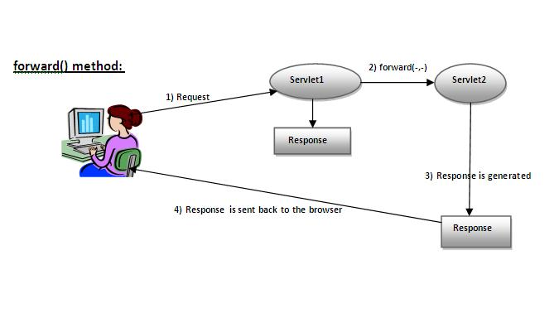
Forword() method
As you see in the above figure, response of second servlet is sent to the client. Response of the first servlet is not displayed to the user.

Slide 45
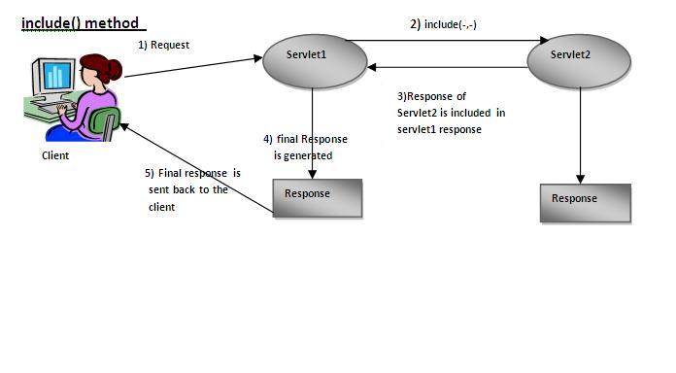
Include method()
As you can see in the above figure, response of second servlet is included in the response of the first servlet that is being sent to the client.

Slide 46
How to get the object of RequestDispatcher
The getRequestDispatcher()
method of ServletRequest interface returns the object of RequestDispatcher. Syntax:
public RequestDispatcher getRequestDispatcher(String resource);

Slide 47
Example of using getRequestDispatcher method
RequestDispatcher rd=request.getRequestDispatcher("servlet2");
//servlet2 is the url-pattern of the second servlet
rd.forward(request, response);//method may be include or forward

Slide 48
Example of RequestDispatcher interface
In this example, we are validating the password entered by the user. If password is servlet, it will forward the request to the WelcomeServlet, otherwise will show an error message: sorry username or password error!. In this program, we are cheking for hardcoded information. But you can check it to the database also that we will see in the development chapter. In this example, we have created following files:
index.html file: for getting input from the user.
Login.java file: a servlet class for processing the response. If password is servet, it will forward the request to the welcome servlet.
WelcomeServlet.java file: a servlet class for displaying the welcome message.
web.xml file: a deployment descriptor file that contains the information about the servlet.

Slide 49
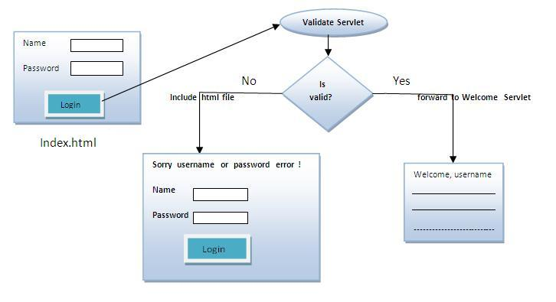
How it workd ?

Slide 50
index.html
<form action="servlet1" method="post">
Name:<input type="text" name="userName"/><br/>
Password:<input type="password" name="userPass"/><br/>
<input type="submit" value="login"/>
</form>

Slide 51
Login.java
import java.io.*;
import javax.servlet.*;
import javax.servlet.http.*;
public class Login extends HttpServlet {
public void doPost(HttpServletRequest request, HttpServletResponse response)
throws ServletException, IOException {
response.setContentType("text/html");
PrintWriter out = response.getWriter();

Slide 52
String n=request.getParameter("userName");
String p=request.getParameter("userPass");
if(p.equals("servlet"))
{
RequestDispatcher rd=request.getRequestDispatcher("servlet2");
rd.forward(request, response);
}
else{
out.print("Sorry UserName or Password Error!");
RequestDispatcher rd=request.getRequestDispatcher("/index.html");
rd.include(request, response);
}
}
}

Slide 53
WelcomeServlet.java
import java.io.*;
import javax.servlet.*;
import javax.servlet.http.*;
public class WelcomeServlet extends HttpServlet {
public void doPost(HttpServletRequest request, HttpServletResponse response)
throws ServletException, IOException {
response.setContentType("text/html");
PrintWriter out = response.getWriter();
String n=request.getParameter("userName");
out.print("Welcome "+n);
}
}

Slide 54
web.xml
<web-app>
<servlet>
<servlet-name>Login</servlet-name>
<servlet-class>Login</servlet-class>
</servlet>
<servlet>
<servlet-name>WelcomeServlet</servlet-name>
<servlet-class>WelcomeServlet
</servlet-class>
</servlet>

Slide 55
Continue…
<servlet-mapping>
<servlet-name>Login</servlet-name>
<url-pattern>/servlet1</url-pattern>
</servlet-mapping>
<servlet-mapping>
<servlet-name>WelcomeServlet</servlet-name>
<url-pattern>/servlet2</url-pattern>
</servlet-mapping>
<welcome-file-list>
<welcome-file>index.html</welcome-file>
</welcome-file-list>
</web-app>

Slide 56
SendRedirect in servlet
The sendRedirect() method of HttpServletResponse interface can be used to redirect response to another resource, it may be servlet, jsp or html file.
It accepts relative as well as absolute URL.
It works at client side because it uses the url bar of the browser to make another request. So, it can work inside and outside the server.

Slide 57
Difference between forward() and sendRedirect() method
There are many differences between the forward() method of RequestDispatcher and sendRedirect() method of HttpServletResponse interface. They are given below:

Slide 58
Continue….
forward() method | sendRedirect() method
The forward() method works at server side. | The sendRedirect() method works at client side.
It sends the same request and response objects to another servlet. | It always sends a new request.
It can work within the server only. | It can be used within and outside the server.
Example: request.getRequestDispacher("servlet2").forward(request,response); | Example: response.sendRedirect("servlet2");

Slide 59
Syntax of sendRedirect() method
public void sendRedirect(String URL)throws IOException;
Example of sendRedirect() method
response.sendRedirect("http://www.google.com");

Slide 60
DemoServlet.javas
import java.io.*;
import javax.servlet.*;
import javax.servlet.http.*;
public class DemoServlet extends HttpServlet{
public void doGet(HttpServletRequest req,HttpServletResponse res)
throws ServletException,IOException
{
res.setContentType("text/html");
PrintWriter pw=res.getWriter();
response.sendRedirect("http://www.google.com");
pw.close();
}}

Slide 61
Creating custom google search using sendRedirect index.html
<!DOCTYPE html>
<html>
<head>
<meta charset="ISO-8859-1">
<title>sendRedirect example</title>
</head>
<body>
<form action="MySearcher">
<input type="text" name="name">
<input type="submit" value="Google Search">
</form>
</body>
</html>

Slide 62
MySearcher.java
import java.io.IOException;
import javax.servlet.ServletException;
import javax.servlet.http.HttpServlet;
import javax.servlet.http.HttpServletRequest;
import javax.servlet.http.HttpServletResponse;
public class MySearcher extends HttpServlet {
protected void doGet(HttpServletRequest request, HttpServletResponse response)
throws ServletException, IOException {
String name=request.getParameter("name");
response.sendRedirect("https://www.google.co.in/#q="+name);
}
}

Slide 63
Web.xml
<servlet>
<description></description>
<display-name>MySearcher</display-name>
<servlet-name>MySearcher</servlet-name>
<servlet-class>MySearcher</servlet-class>
</servlet>
<servlet-mapping>
<servlet-name>MySearcher</servlet-name>
<url-pattern>/MySearcher</url-pattern>
</servlet-mapping>
<display-name>GoogleSearcher</display-name>
<welcome-file-list>
<welcome-file>index.html</welcome-file>
</welcome-file-list>
</web-app>

Slide 64
ServletConfig Interface
An object of ServletConfig is created by the web container for each servlet. This object can be used to get configuration information from web.xml file.
If the configuration information is modified from the web.xml file, we don't need to change the servlet. So it is easier to manage the web application if any specific content is modified from time to time.

Slide 65
Advantage of ServletConfig
The core advantage of ServletConfig is that you don't need to edit the servlet file if information is modified from the web.xml file.

Slide 66
Methods of ServletConfig interface
public String getInitParameter(String name):Returns the parameter value for the specified parameter name.
public Enumeration getInitParameterNames():Returns an enumeration of all the initialization parameter names.
public String getServletName():Returns the name of the servlet.
public ServletContext getServletContext():Returns an object of ServletContext.

Slide 67
How to get the object of ServletConfig
getServletConfig() method of Servlet interface returns the object of ServletConfig.
Example
ServletConfig config=getServletConfig();

Slide 68
Web.xml
<servlet>
<servlet-name>DemoServlet</servlet-name>
<servlet-class>DemoServlet</servlet-class>
<init-param>
<param-name>username</param-name>
<param-value>system</param-value> </init-param>
<init-param>
<param-name>password</param-name>
<param-value>oracle</param-value>
</init-param>
</servlet>
<servlet-mapping>
<servlet-name>DemoServlet</servlet-name>
<url-pattern>/servlet1</url-pattern>
</servlet-mapping>
</web-app>

Slide 69
Index.html
<a href="servlet1">click here</a>

Slide 70
DemoServlet.java
import java.io.IOException;
import java.io.PrintWriter;
import java.util.Enumeration;
import javax.servlet.ServletConfig;
import javax.servlet.ServletException;
import javax.servlet.http.HttpServlet;
import javax.servlet.http.HttpServletRequest;
import javax.servlet.http.HttpServletResponse;
public class DemoServlet extends HttpServlet {
public void doGet(HttpServletRequest request, HttpServletResponse response)
throws ServletException, IOException {
response.setContentType("text/html");
PrintWriter out = response.getWriter();
ServletConfig config=getServletConfig();
Enumeration<String> e=config.getInitParameterNames();
String str="";
while(e.hasMoreElements()){
str=e.nextElement();
out.print("<br>Name: "+str);
out.print(" value: "+config.getInitParameter(str));
}
out.close();
}
}

Slide 71
ServletContext Interface
An object of ServletContext is created by the web container at time of deploying the project.
This object can be used to get configuration information from web.xml file.
There is only one ServletContext object per web application.
If any information is shared to many servlet, it is better to provide it from the web.xml file using the <context-param> element.

Slide 72
Advantage of ServletContext
Easy to maintain if any information is shared to all the servlet, it is better to make it available for all the servlet. We provide this information from the web.xml file, so if the information is changed, we don't need to modify the servlet. Thus it removes maintenance problem.

Slide 73
Usage of ServletContext Interface
There can be a lot of usage of ServletContext object. Some of them are as follows:
The object of ServletContext provides an interface between the container and servlet.
The ServletContext object can be used to get configuration information from the web.xml file.
The ServletContext object can be used to set, get or remove attribute from the web.xml file.
The ServletContext object can be used to provide inter-application communication.

Slide 74
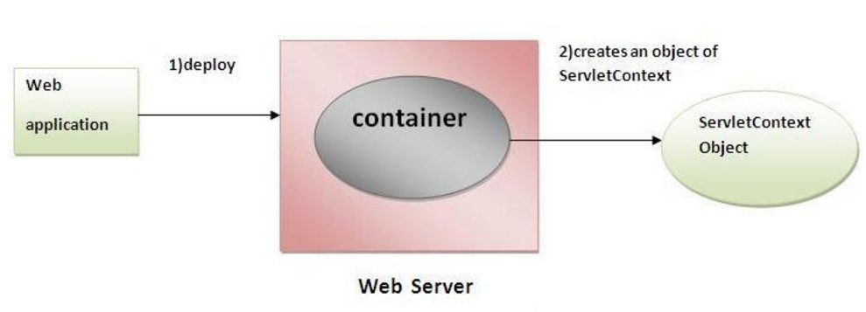

Slide 75
Commonly used methods of ServletContext interface
There is given some commonly used methods of ServletContext interface.
public String getInitParameter(String name):Returns the parameter value for the specified parameter name.
public Enumeration getInitParameterNames():Returns the names of the context's initialization parameters.
public void setAttribute(String name,Object object):sets the given object in the application scope.
public Object getAttribute(String name):Returns the attribute for the specified name.
public Enumeration getInitParameterNames():Returns the names of the context's initialization parameters as an Enumeration of String objects.
public void removeAttribute(String name):Removes the attribute with the given name from the servlet context.

Slide 76
How to get the object of ServletContext interface
getServletContext() method of ServletConfig interface returns the object of ServletContext.
getServletContext() method of GenericServlet class returns the object of ServletContext.

Slide 77
Example of getServletContext() method
/We can get the ServletContext object from ServletConfig object
ServletContext application=getServletConfig().getServletContext();
//Another convenient way to get the ServletContext object
ServletContext application=getServletContext();

Slide 78
Syntax to provide the initialization parameter in Context scope
Syntax to provide the initialization parameter in Context scope
The context-param element, subelement of web-app, is used to define the initialization parameter in the application scope.
The param-name and param-value are the sub-elements of the context-param.
The param-name element defines parameter name and and param-value defines its value.
<context-param>
<param-name>parametername</param-name>
<param-value>parametervalue</param-value>
</context-param>
<context-param>
<param-name>parametername</param-name>
<param-value>parametervalue</param-value>
</context-param>

Slide 79
Example of ServletContext to get the initialization parameter
In this example, we are getting the initialization parameter from the web.xml file and printing the value of the initialization parameter. Notice that the object of ServletContext represents the application scope.
So if we change the value of the parameter from the web.xml file, all the servlet classes will get the changed value. So we don't need to modify the servlet.
So it is better to have the common information for most of the servlets in the web.xml file by context-param element. Let's see the simple example:

Slide 80
DemoServlet.java
import java.io.*;
import javax.servlet.*;
import javax.servlet.http.*;
public class DemoServlet extends HttpServlet{
public void doGet(HttpServletRequest req,HttpServletResponse res)
throws ServletException,IOException
{
res.setContentType("text/html");
PrintWriter pw=res.getWriter();
//creating ServletContext object
ServletContext context=getServletContext();
//Getting the value of the initialization parameter and printing it
String driverName=context.getInitParameter("dname");
pw.println("driver name is="+driverName);
pw.close();
}}

Slide 81
web.xml
<web-app>
<servlet>
<servlet-name>servlet</servlet-name>
<servlet-class>DemoServlet</servlet-class>
</servlet>
<context-param>
<param-name>dname</param-name>
<param-value>sun.jdbc.odbc.JdbcOdbcDriver</param-value>
</context-param>
<servlet-mapping>
<servlet-name>servlet</servlet-name>
<url-pattern>/context</url-pattern>
</servlet-mapping>
</web-app>

Slide 82
Example of ServletContext to get all the initialization parameters
In this example, we are getting all the initialization parameter from the web.xml file. For getting all the parameters, we have used the getInitParameterNames() method in the servlet class.

Slide 83
DemoServlet.java
import java.io.*;
import javax.servlet.*;
import javax.servlet.http.*;
public class DemoServlet extends HttpServlet{
public void doGet(HttpServletRequest req,HttpServletResponse res)
throws ServletException,IOException
{
res.setContentType("text/html");
PrintWriter out=res.getWriter();
ServletContext context=getServletContext();
Enumeration<String> e=context.getInitParameterNames();
String str="";
while(e.hasMoreElements()){
str=e.nextElement();
out.print("<br> "+context.getInitParameter(str));
}
}}

Slide 84
web.xml
<web-app>
<servlet>
<servlet-name>servlet</servlet-name>
<servlet-class>DemoServlet</servlet-class>
</servlet>
<context-param>
<param-name>dname</param-name>
<param-value>sun.jdbc.odbc.JdbcOdbcDriver</param-value>
</context-param>
<context-param>
<param-name>username</param-name>
<param-value>system</param-value>
</context-param>
<context-param>
<param-name>password</param-name>
<param-value>oracle</param-value>
</context-param>
<servlet-mapping>
<servlet-name>servlet</servlet-name>
<url-pattern>/context</url-pattern>
</servlet-mapping>
</web-app>

Slide 85
Attribute in Servlet
An attribute in servlet is an object that can be set, get or removed from one of the following scopes:
request scope
session scope
application scope
The servlet programmer can pass informations from one servlet to another using attributes. It is just like passing object from one class to another so that we can reuse the same object again and again.

Slide 86
Attribute specific methods of ServletRequest, HttpSession and ServletContext interface
There are following 4 attribute specific methods. They are as follows:
public void setAttribute(String name,Object object):sets the given object in the application scope.
public Object getAttribute(String name):Returns the attribute for the specified name.
public Enumeration getInitParameterNames():Returns the names of the context's initialization parameters as an Enumeration of String objects.
public void removeAttribute(String name):Removes the attribute with the given name from the servlet context.

Slide 87
Example of ServletContext to set and get attribute
In this example, we are setting the attribute in the application scope and getting that value from another servlet.

Slide 88
DemoServlet1.java
import java.io.*;
import javax.servlet.*;
import javax.servlet.http.*;
public class DemoServlet1 extends HttpServlet{
public void doGet(HttpServletRequest req,HttpServletResponse res)
{
try{
res.setContentType("text/html");
PrintWriter out=res.getWriter();
ServletContext context=getServletContext();
context.setAttribute("company","IBM");
out.println("Welcome to first servlet");
out.println("<a href='servlet2'>visit</a>");
out.close();
}catch(Exception e){out.println(e);}
}}

Slide 89
DemoServlet2.java
import java.io.*;
import javax.servlet.*;
import javax.servlet.http.*;
public class DemoServlet2 extends HttpServlet{
public void doGet(HttpServletRequest req,HttpServletResponse res)
{
try{
res.setContentType("text/html");
PrintWriter out=res.getWriter();
ServletContext context=getServletContext();
String n=(String)context.getAttribute("company");
out.println("Welcome to "+n);
out.close();
}catch(Exception e){out.println(e);}
}}

Slide 90
Web.xml
<web-app>
<servlet>
<servlet-name>s1</servlet-name>
<servlet-class>DemoServlet1</servlet-class>
</servlet>
<servlet-mapping>
<servlet-name>s1</servlet-name>
<url-pattern>/servlet1</url-pattern>
</servlet-mapping>
<servlet>
<servlet-name>s2</servlet-name>
<servlet-class>DemoServlet2</servlet-class>
</servlet>
<servlet-mapping>
<servlet-name>s2</servlet-name>
<url-pattern>/servlet2</url-pattern>
</servlet-mapping>
</web-app>

Slide 91
Difference between ServletConfig and ServletContext
The servletconfig object refers to the single servlet whereas servletcontext object refers to the whole web application.

