Slide 1


Student Details
Name : PAGALE PRATHAMESH SANTOSH
Skill build email ID : prathamesh.pagale.aids.2021@vpkbiet.org
College name : VIDYA PRATISHTHAN’S KAMALNAYAN BAJAJ INSTITUTE OF ENGINEERING & TECHNOLOGY
College state : MAHARASHTRA
Internship domain : ARTIFICIAL INTELLIGENCE
Start date-end date : 18/08/2023 -30/09/2023

Slide 2
SENTIMENT ANALYSIS
OF
RESTAURANT REVIEWS

Slide 3
PROJECT TITLE:- SENTIMENT ANALYSIS OF RESTAURANT REVIEWS PROBLEM STATEMENT:- This project aims to analyze restaurant reviews using sentiment analysis. The goal is to develop a model that can automatically classify reviews as positive, negative, or neutral. This will help restaurant owners make data-driven improvements based on customer feedback. This project aims to analyze restaurant reviews accurately. Challenges include dealing with unstructured text and understanding language intricacies.

Slide 4
AGENDA
The project encompasses an introduction to the significance of sentiment analysis in the restaurant industry, followed by a literature review on existing sentiment analysis methods and related studies. It then delves into data collection and preprocessing, detailing sources, cleaning processes, and data labeling. The methodology section discusses the sentiment analysis approach, including feature extraction, machine learning or deep learning algorithm selection, and model evaluation. Implementation covers model development and coding specifics, while evaluation focuses on performance metrics and validation. Challenges and potential solutions are explored, and results are presented, offering insights into sentiment distributions in restaurant reviews and implications for improving customer experiences. The agenda concludes with discussions on future work and a list of references used in the project.

Slide 5
PROJECT OVERVIEW
Sentiment Analysis of Restaurant Reviews is dedicated to enhancing the restaurant industry's decision-making processes by employing sentiment analysis techniques on customer reviews. It starts with an introduction emphasizing the importance of sentiment analysis in improving customer experiences and business strategies. A literature review informs the chosen methodology, which includes data collection, preprocessing, and the application of machine learning or deep learning algorithms. Implementation involves building the sentiment analysis model, and its performance is evaluated and validated. Challenges and solutions are discussed, and the results provide insights into sentiment patterns within restaurant reviews. The project concludes by highlighting the practical implications and applications for restaurant owners, offering a roadmap for future work and a list of references used.

Slide 6
YOUR SOLUTION AND ITS VALUE PROPOSITION
Developing an accurate sentiment classification model, enables restaurant owners to automatically categorize reviews as positive, negative, or neutral. This automation streamlines decision-making, allowing restaurants to enhance customer experiences, allocate resources more efficiently, and gain a competitive edge. The value proposition centers on informed decision-making, improved customer satisfaction, resource optimization, competitive advantage, and sustained business growth, ultimately facilitating better responsiveness to customer feedback and market dynamics

Slide 7
WHO ARE THE END USERS of this project?
The project's end users, primarily restaurant owners and managers, benefit from data-driven decisions and improved customer experiences. Restaurant staff can enhance service and adapt offerings. Market analysts, investors, and researchers find valuable insights for strategic planning, investment, and research in the restaurant industry.
Restaurant Owners and Managers
Restaurant Staff
Market Analysts
Investors
Researchers

Slide 8
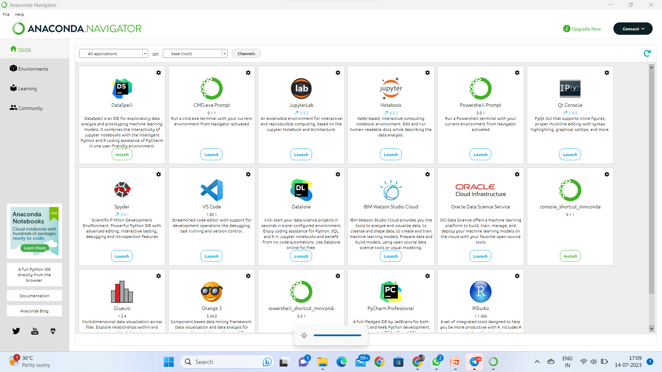
Installation of Anaconda Navigator
Open Google Chrome in system.
Type “Anaconda” in the search bar and press Enter.
Click on first link in anaconda navigator.
Select Windows if your system is windows 64-bit / Linux / Mac.
After download go to file manager and click on it.
Click on Next, Next , Next .
Wait for sometime.
The Anaconda Navigator will be installed.
After installation in windows search bar type “Anaconda Navigator “. Press enter
The page will be open .

Slide 9
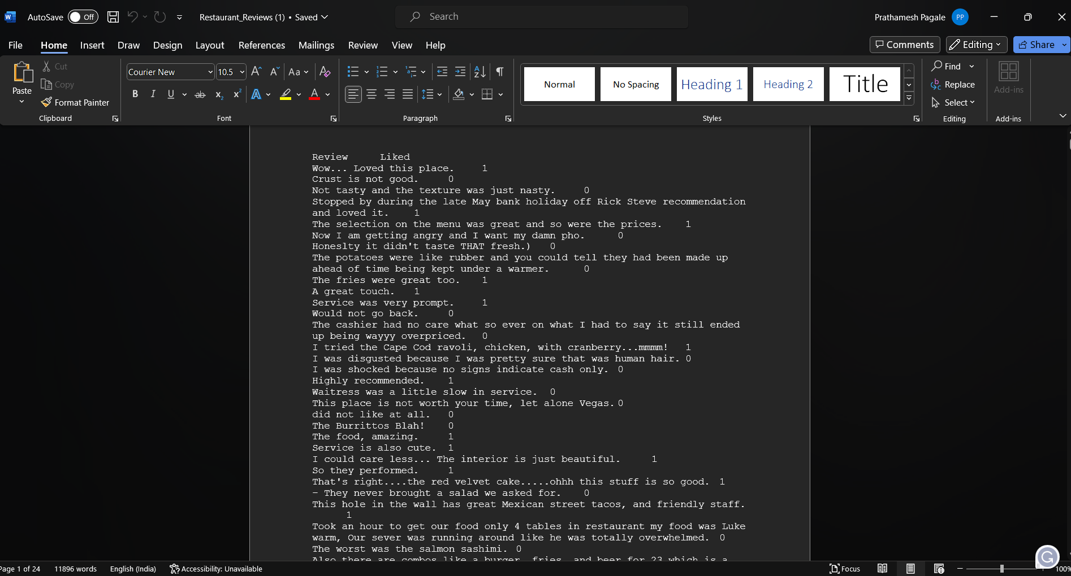
Dataset of Employees burnout analysis and prediction
/content/Restaurant_Reviews.tsv

Slide 10
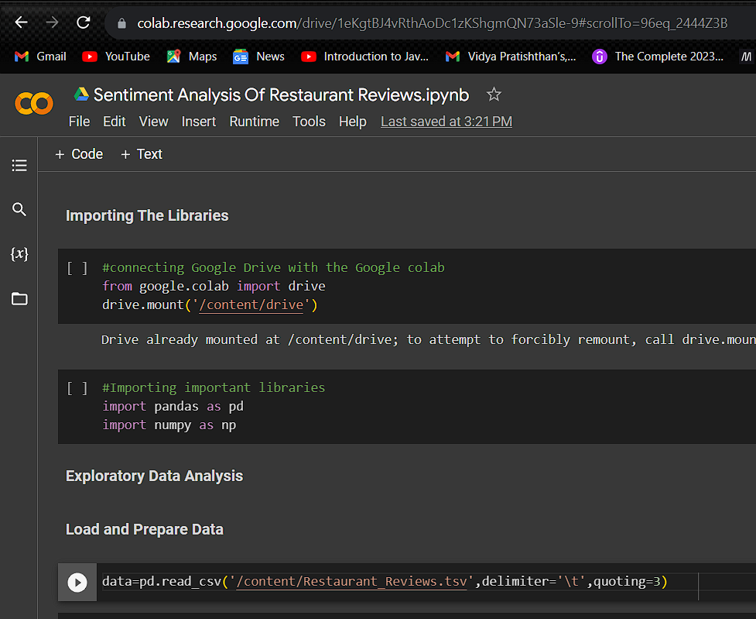
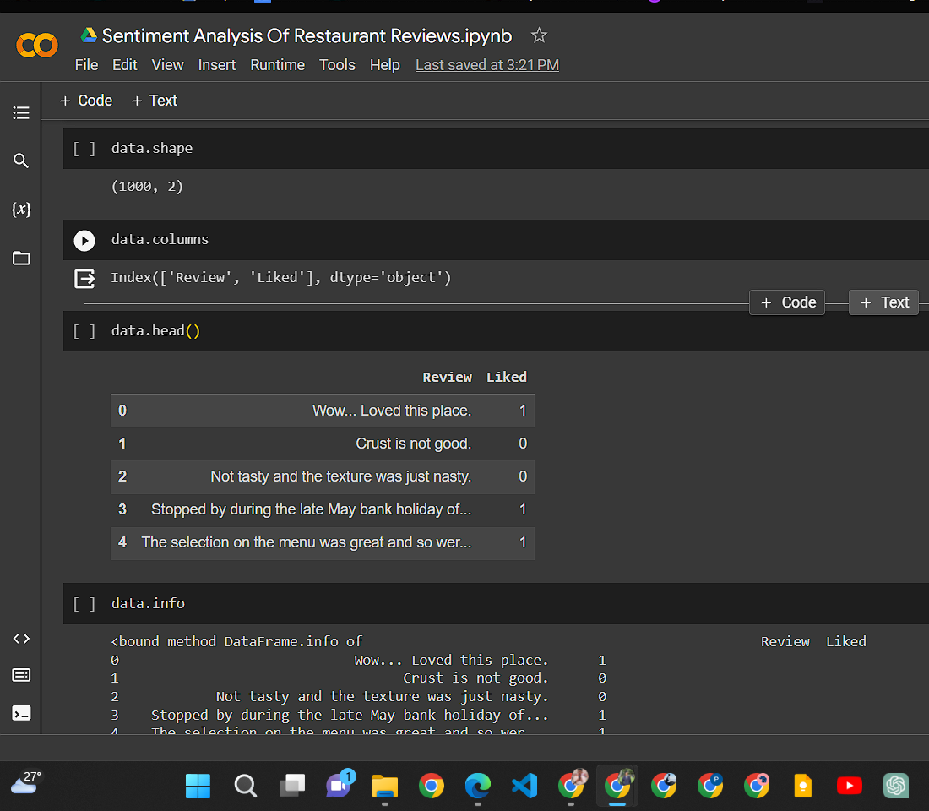
How did you customize the project and make it your own

Slide 11
MODELLING
Models Used
Logistic Regression
Naïve Baise Classifier
Tree
Classifier
Support Vector Classifier
Kneighbours Classifier
Extra
Random Forest
Decision

Slide 12
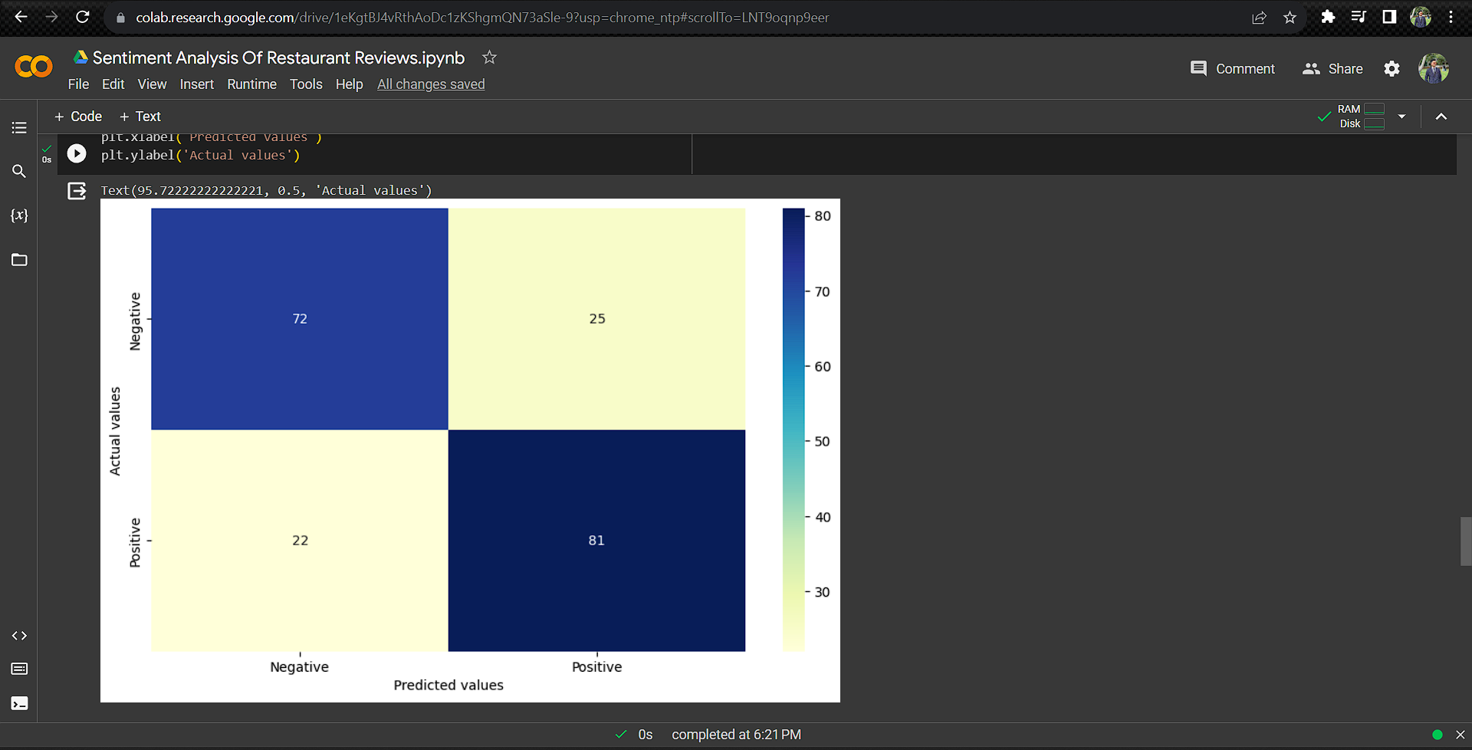
Modelling

Slide 13
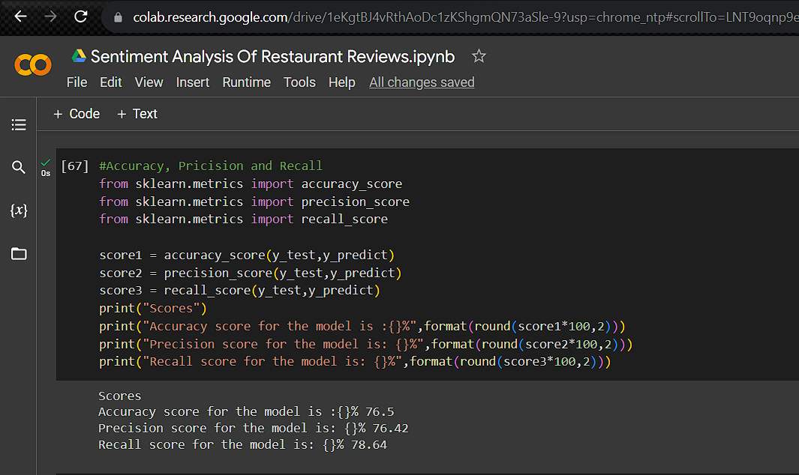
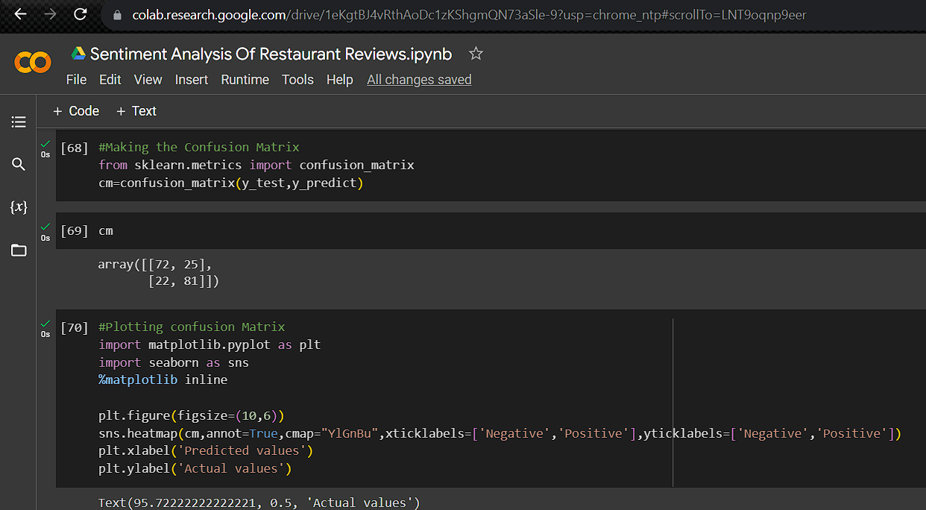
Modelling

Slide 14
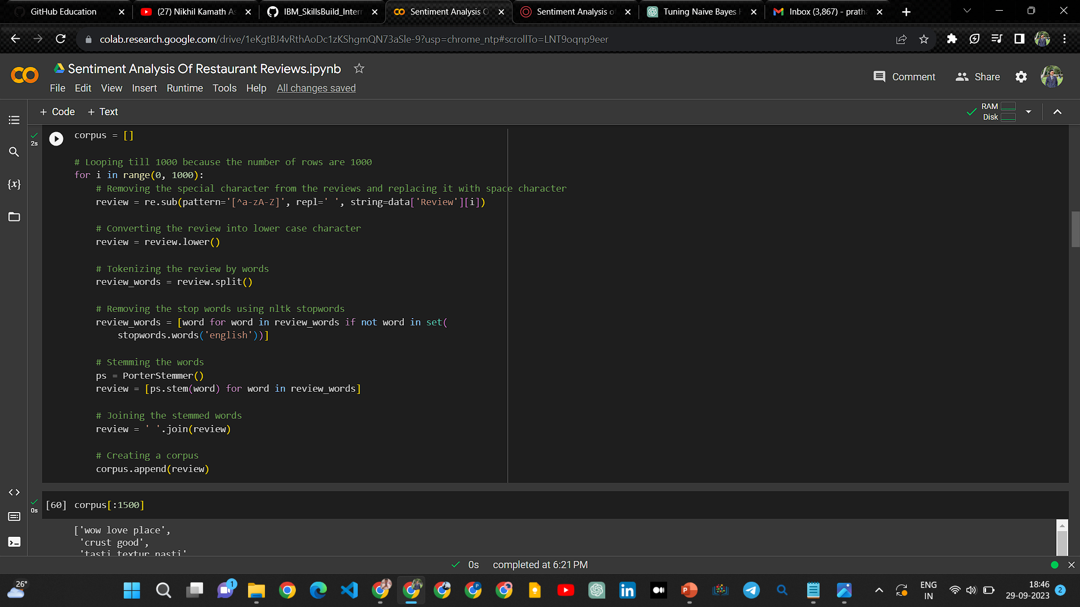
Modelling:-
Data Cleaning

Slide 15
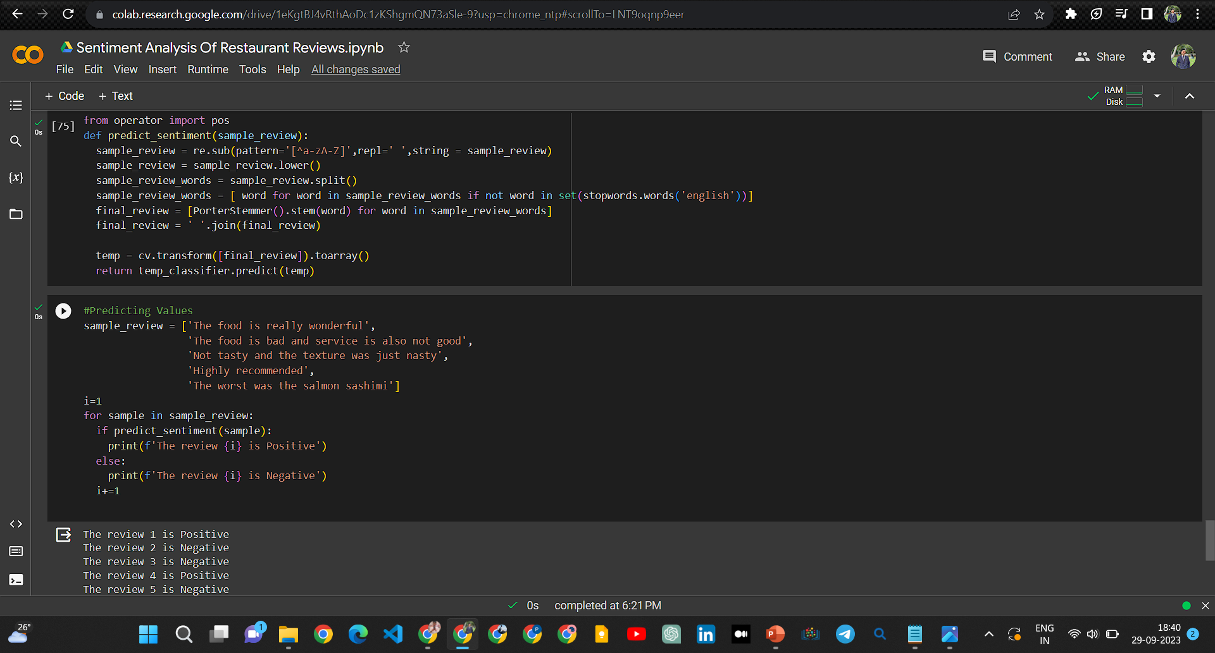
Results

Slide 16
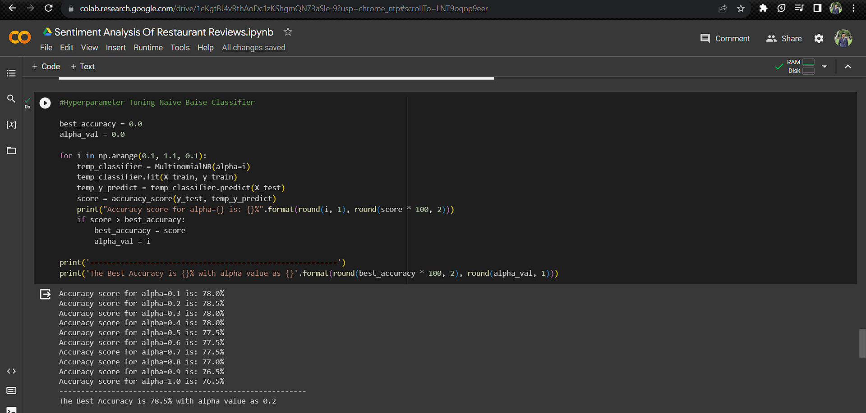
Results Hyperparameter Tuning

Slide 17
links
The Google Colab Link :-
https://colab.research.google.com/drive/1eKgtBJ4vRthAoDc1zKShgmQN73aSle9?usp=sharing
Github link :-https://github.com/prathamesh223/IBM_SkIllBuid_Internship_2023.git

Slide 18


