Slide 1
Unicorn Startups Data Analysis
CAPSTONE PROJECT
Presented By:- Prathamesh Santosh Pagale
College name:- Vidya Pratishathan’s Kamalnayan Bajaj institute of engineering and technology , Baramati
Department:– Artificial intelligence and data science

Slide 2
OUTLINE
Problem Statement
Proposed System/Solution
System Development Approach
Algorithm & Deployment
Result
Conclusion
Future Scope
References

Slide 3
Problem Statement
Unicorn startups are privately held companies valued at over $1 billion, and they are a significant focus in the global business landscape. Analyzing data related to unicorn startups provides a valuable opportunity to understand the factors contributing to their success. The aim of this data analysis project is to discover patterns, trends, and key indicators that set unicorn startups apart from other companies..

Slide 4
Proposed Solution
To address the outlined problem statement, a comprehensive data analysis approach will be undertaken. The solution involves a series of steps and methodologies to extract meaningful insights from the dataset of unicorn startups. Here is a proposed solution:
Data Collection:
Gather a diverse dataset of unicorn startups, including information on funding rounds, investor details, geographical location, industry, financial metrics, exit strategies, and any relevant risk factors.
Data Preprocessing:
Clean the dataset by handling missing values, removing duplicates, and standardizing formats.
Convert categorical variables into numerical formats if necessary.
Exploratory Data Analysis (EDA):
Conduct EDA to gain a preliminary understanding of the dataset.
Explore basic statistics, distributions, and visualizations to identify patterns and outliers .
Geographic and Industry Analysis :
Use geographical and industry segmentation to analyze the distribution of unicorn startups. Apply visualization techniques to highlight concentrations in specific regions or industries

Slide 5
System Approach
System requirements :- Windows 10 or ubuntu or linux operating system , 4GB RAM, 256 GB storage
Library required to build the model:- pandas , numpy , seaborn , matplotlib , scipy , math

Slide 6
Algorithm & Deployment
Data Collection:
Gather data on unicorn startups from diverse sources, including financial reports, investment databases, and reputable business news outlets.
Data Cleaning and Preprocessing::
Handle missing values, remove duplicates, and standardize data formats.
Convert categorical variables into numerical formats if necessary.
Perform exploratory data analysis (EDA) to understand the distribution and characteristics of the data.Data Input:.
Feature Engineering:
Consider generating features related to funding rounds, investor profiles, market trends, and technological innovations.
Identification of Success Factors::
Conduct statistical analysis to identify key success factors.
Explore correlations between success metrics and various features..

Slide 7
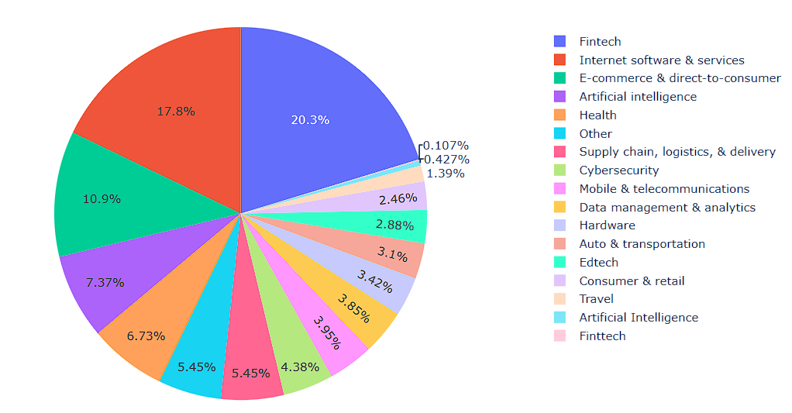
Result

Slide 8
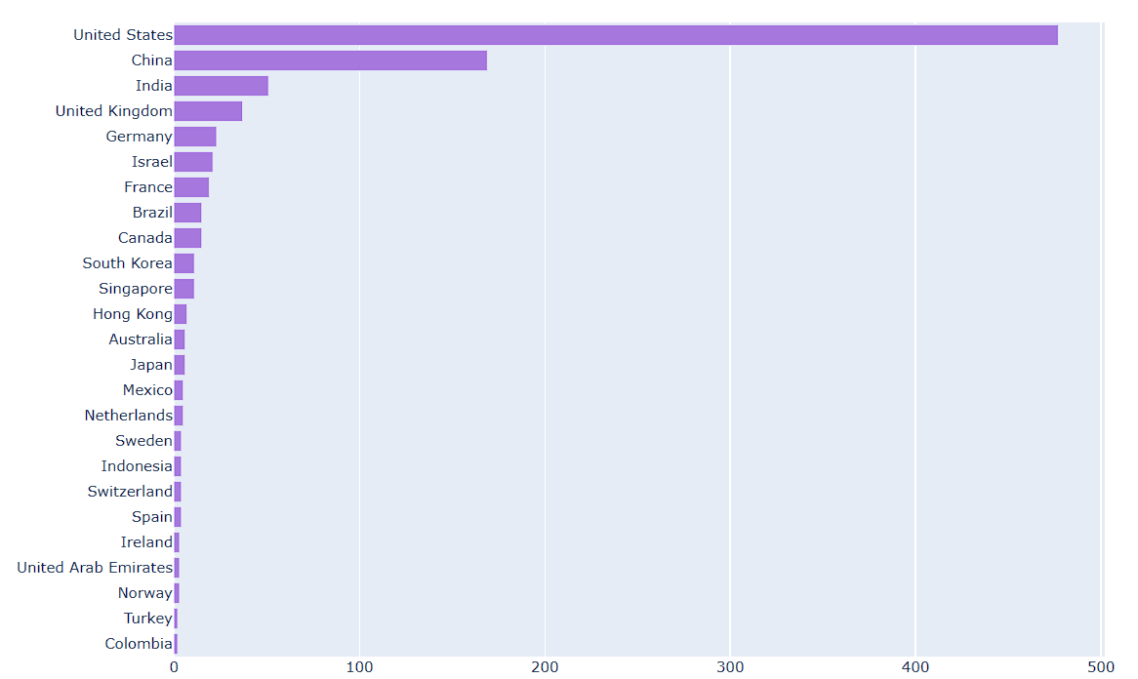
Result

Slide 9
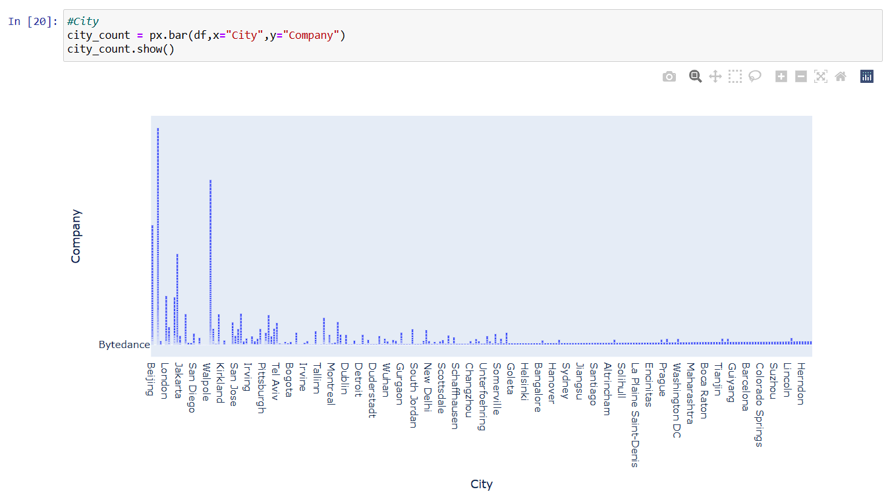
Result

Slide 10
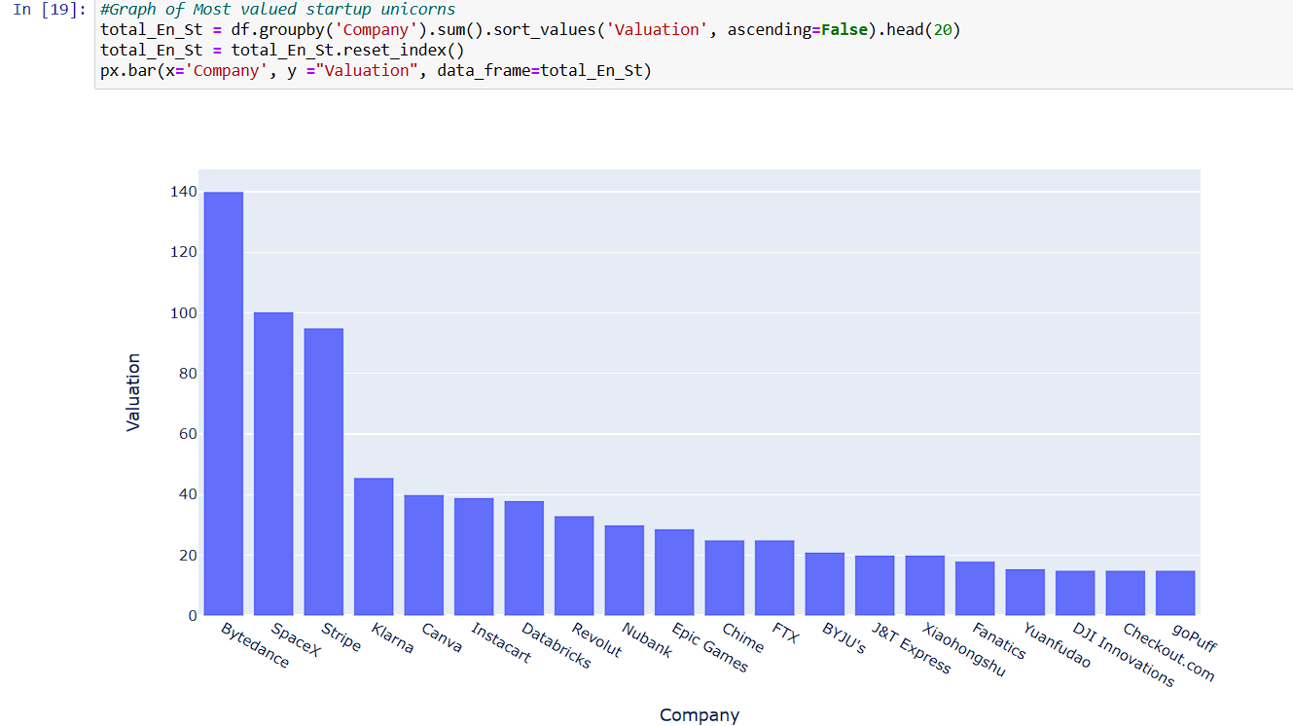
Result

Slide 11
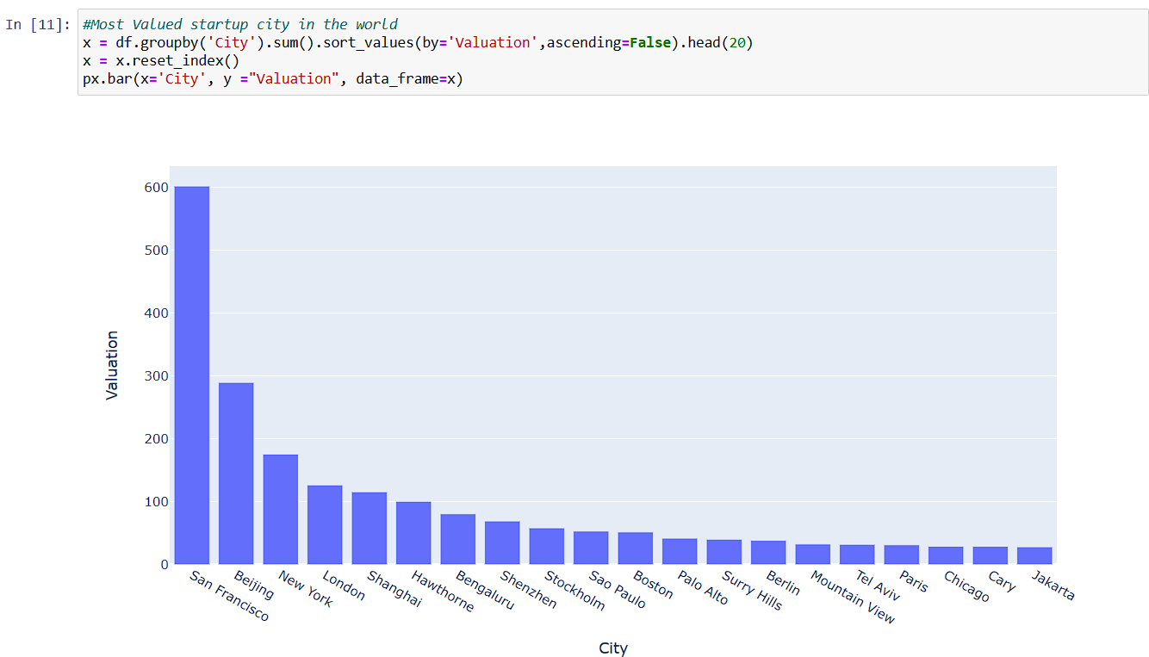
Result

Slide 12
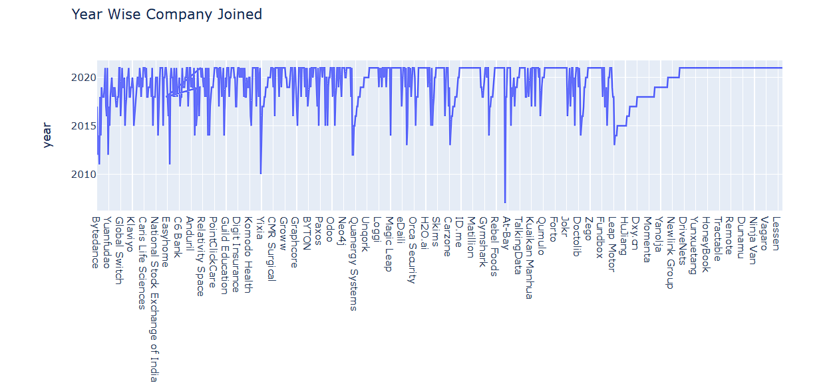
Result

Slide 13
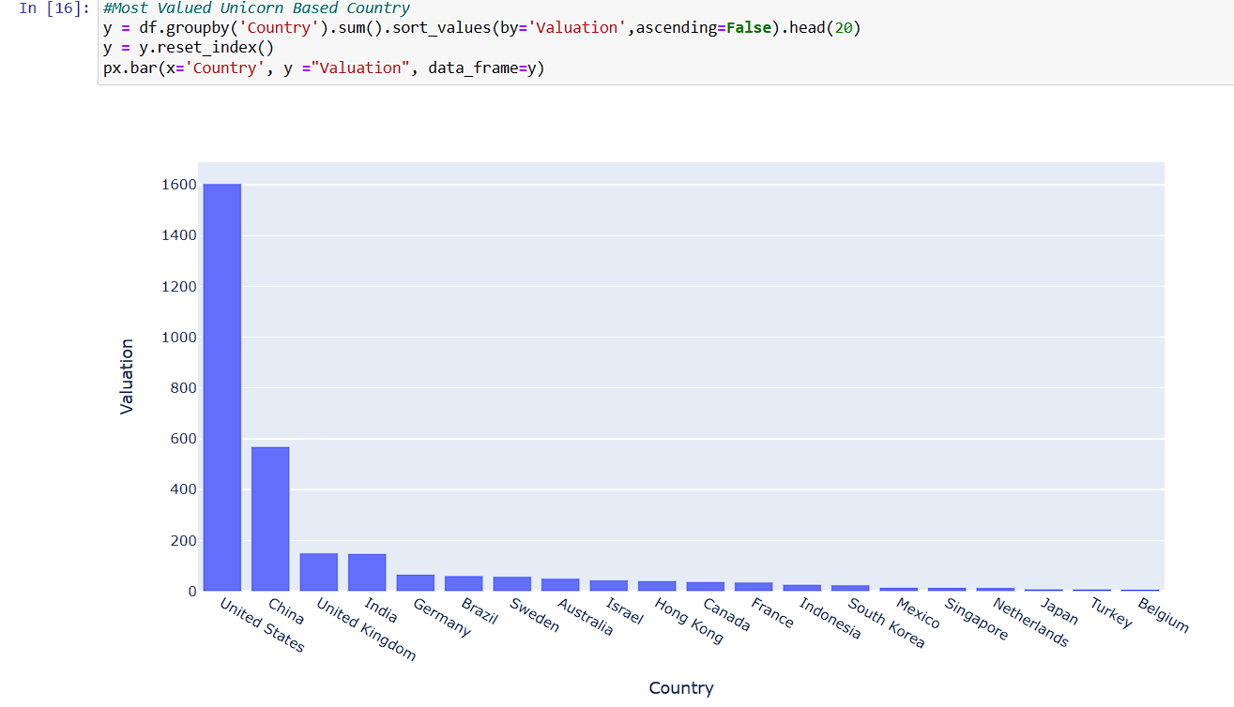
Result

Slide 14
Conclusion
In conclusion, the Unicorn Startups Data Analysis project aimed to uncover patterns, trends, and key indicators that distinguish successful startups with valuations exceeding $1 billion. The comprehensive analysis revealed several noteworthy insights that contribute to a deeper understanding of the factors driving unicorn startup success.

Slide 15
Unicorn Startup Data Analysis's future includes using real-time predictions, ethical considerations, and diverse data sources. Emerging technologies and collaborations between different industries will be essential for providing straightforward insights to those involved in the ever-changing startup scene.
Future scope

Slide 16
References
Deloitte India | Audit, Consulting, Financial Advisory, Risk Advisory, Tax services
Google Books
The Wall Street Journal - Breaking News, Business, Financial & Economic News, World News and Video (wsj.com)
Wellfound (formerly AngelList Talent) - Startup Job Search
Harvard Business Review - Ideas and Advice for Leaders (hbr.org)

Slide 17
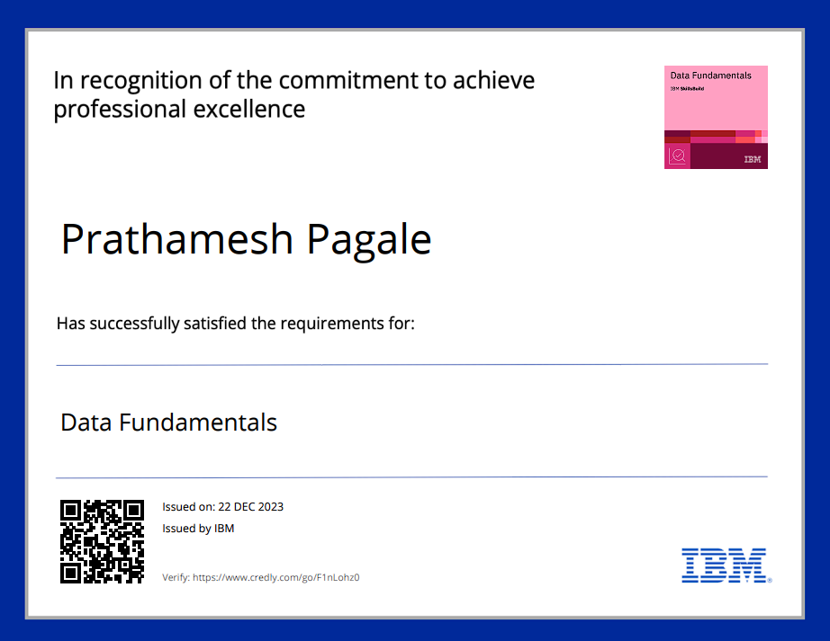
course certificate 1
CredlyLink:-https://www.credly.com/badges/5290b336-9315-4097-8e07-a814e7420301/public_url

Slide 18
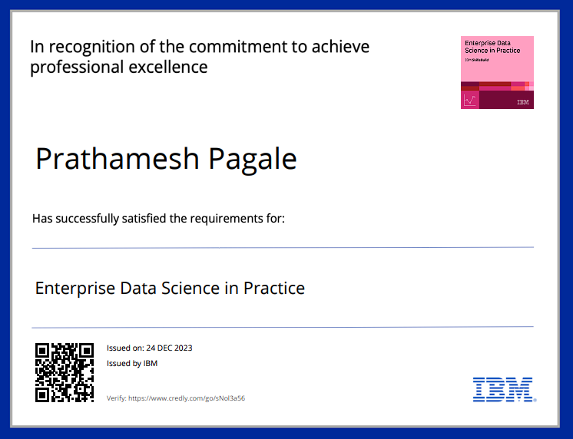
course certificate 2
CredlyLink:-https://www.credly.com/badges/7e741dbf-ac62-47be-ad57-f1fe6f141887/public_url

Slide 19


