Slide 1

EDA PROJECT
Exploratory Data
Analysis
on Used Car Dataset
Insights from CarDekho Dataset using Python
Prathamesh Dilip Talele B.Tech — CSE

Slide 2
The Challenge
Business
Problem
❓
Pricing Uncertainty
Buyers & sellers lack transparency on fair market value
Understanding
Used Car Market: A growing $100B+ industry with complex pricing dynamics.
📉
Depreciation Patterns
No structured way to understand how age/km affects value
🔍
Hidden Influencers
Fuel type, transmission & ownership history are overlooked

Slide 3
Agenda
Project Walkthrough
01
02
03
Business Problem
Objective
Dataset Overview
04
05
06
Data Cleaning
Data Manipulation
Univariate Analysis
07
08
09
Bivariate Analysis
Key Insights
Business Questions
10
11
12
Conclusion
Challenges
Q & A

Slide 4
Project Objective
What We Aim to Discover
1
2
Analyze Dataset
Discover Trends
Thoroughly explore the CarDekho dataset structure, types, and distributions
Identify pricing patterns across vehicle age, fuel, transmission & ownership
3
4
Key Influencers
Actionable Insights
Pinpoint the top factors that drive used car resale value up or down
Generate business-ready findings useful for buyers, sellers & dealers

Slide 5
Dataset Overview
CarDekho Used Cars — Kaggle Dataset
~14,000+
13
₹Lakh
Key
Stats
Kaggle
Records
Features
Target Unit
Source
~5%
Missing
Values
Feature | Type | Description
selling_price | Numerical | Target — resale price in ₹
vehicle_age | Numerical | Age of car in years
fuel_type | Categorical | Petrol / Diesel / CNG / Electric
transmission_type | Categorical | Manual / Automatic
km_driven | Numerical | Total kilometers driven
engine | Numerical | Engine capacity in CC
max_power | Numerical | Max power in BHP
seats | Numerical | Number of seats
seller_type | Categorical | Dealer / Individual / Trustmark
~2%
Duplicate
Rows
IQR
Outlier
Method
₹5-20L
Most Cars
Price Range

Slide 6
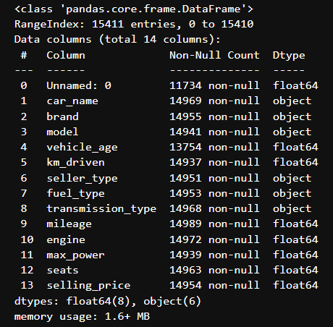
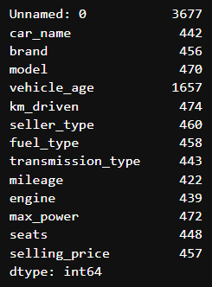
Before Data Cleaning
Data Completeness Before Cleaning
Total Number of NaN values present before cleaning
Duplicates
Present
Outliers in
km_driven
Price in
Raw ₹

Slide 7
Data Manipulation
Transformations & Feature Engineering
1
2
Column Drop
Price Conversion
Removed auto-index & car_name columns to streamline the dataset
selling_price → price_lakh for easier human-readable analysis
Data Types
4
Engine Categorize
3
KM Binning
Ensured numeric columns are float/int, categoricals are strings
km_driven grouped into 5 equal bins for bivariate comparison
Groupby Analysis
5
Used groupby on fuel_type, transmission, vehicle_age vs price_lakh

Slide 8
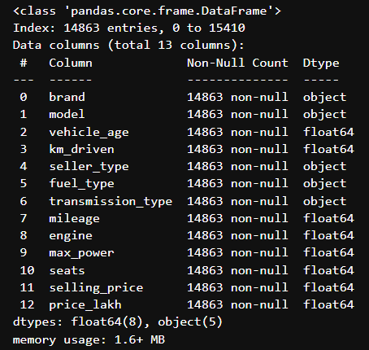
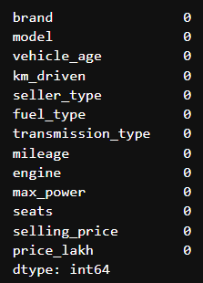
After Data Cleaning
Clean Dataset — Ready for Analysis
Data Completeness After Cleaning
Total Number of NaN values present after cleaning
NaN → Median
/ Mode / Unknown
Duplicates
Removed
km_driven
IQR Capped

Slide 9
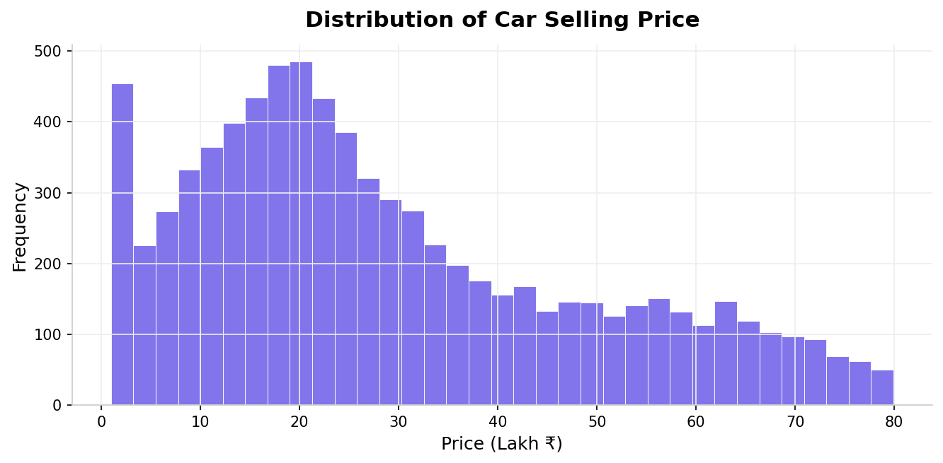
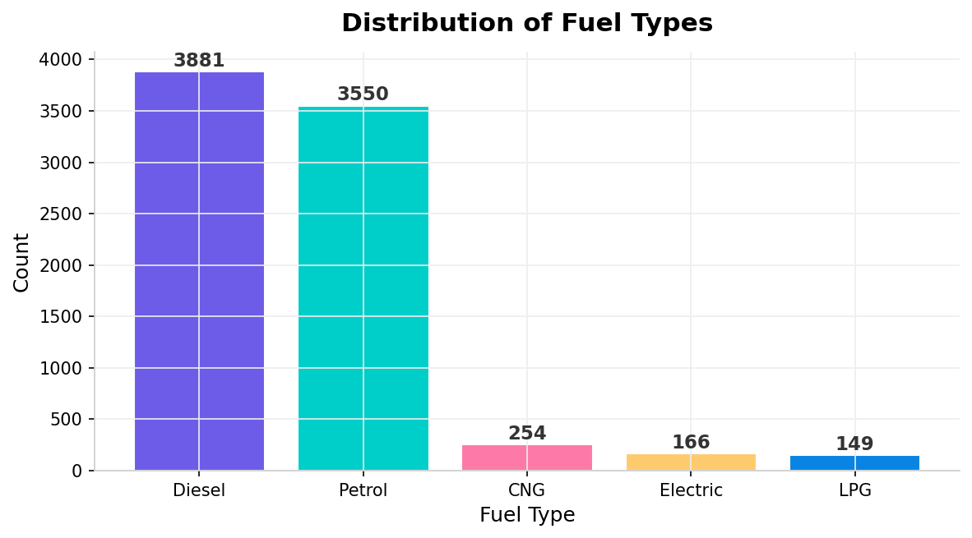
Univariate Analysis
Understanding Individual Variable Distributions
📊
⛽
⚙️
👤
Right-Skewed Prices
Diesel & Petrol Lead
Transmission Split
Ownership Pattern
Most cars priced ₹5–20L. Luxury cars >₹50L are rare outliers in the dataset.
Diesel + Petrol make up ~93% of listings. Electric cars are a very small segment.
Manual cars significantly outnumber automatic — ~72% vs ~28% of listings.
1st owner cars dominate dataset (~68%), indicating better resale confidence.

Slide 10
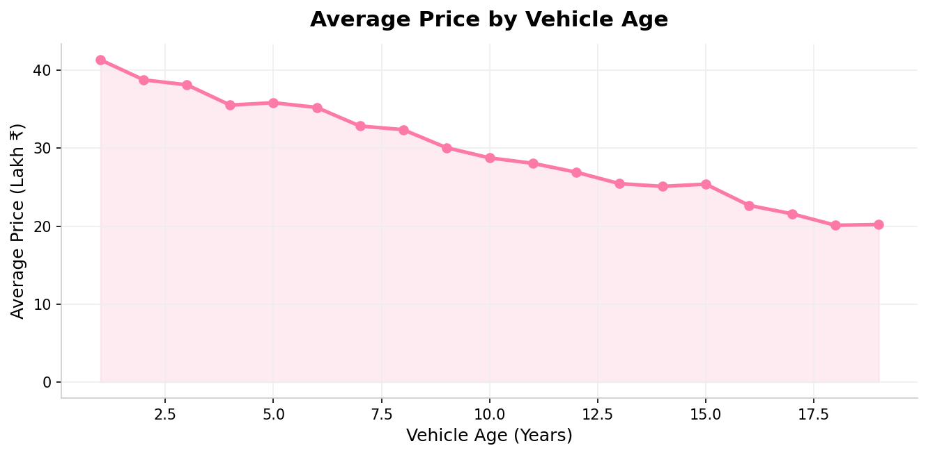
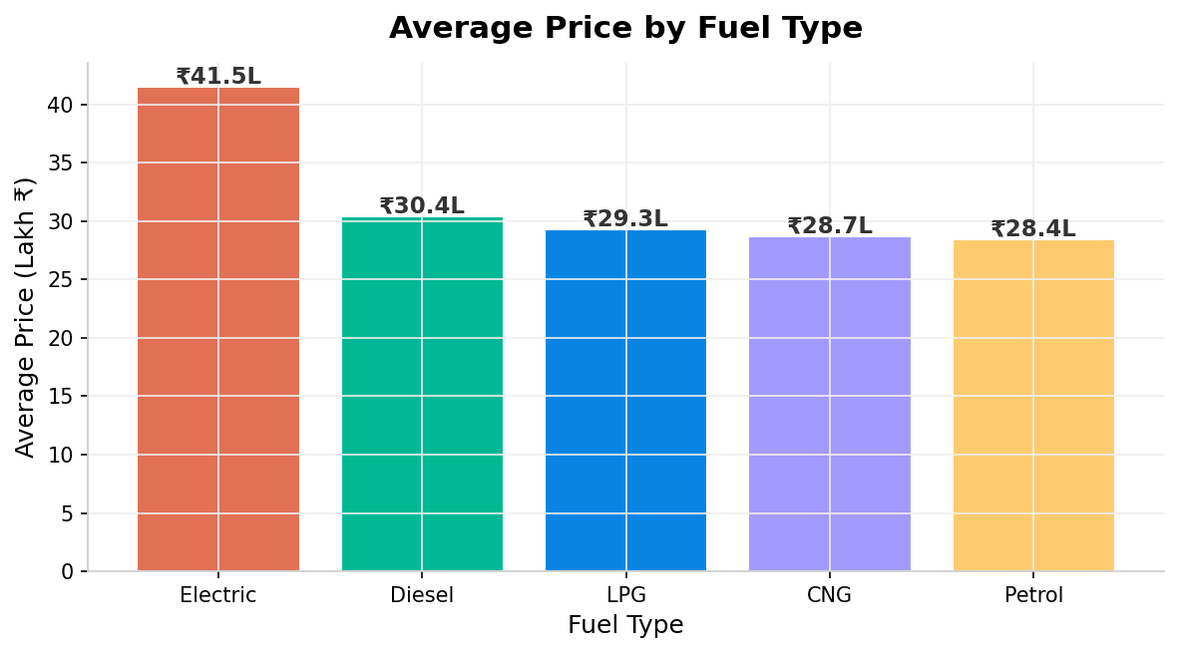
Bivariate Analysis
How Features Relate to Selling Price
📅
🔋
⚙️
🔧
Price drops ~55% from year 1 to year 10. Vehicle age has the strongest negative impact.
Price drops ~55% from year 1 to year 10. Vehicle age has the strongest negative impact.
Automatic cars average 40-50% more than manual cars across all fuel types.
Large engines (1800cc+) average ₹22L vs ₹8L for small engines — 3x difference.

Slide 11
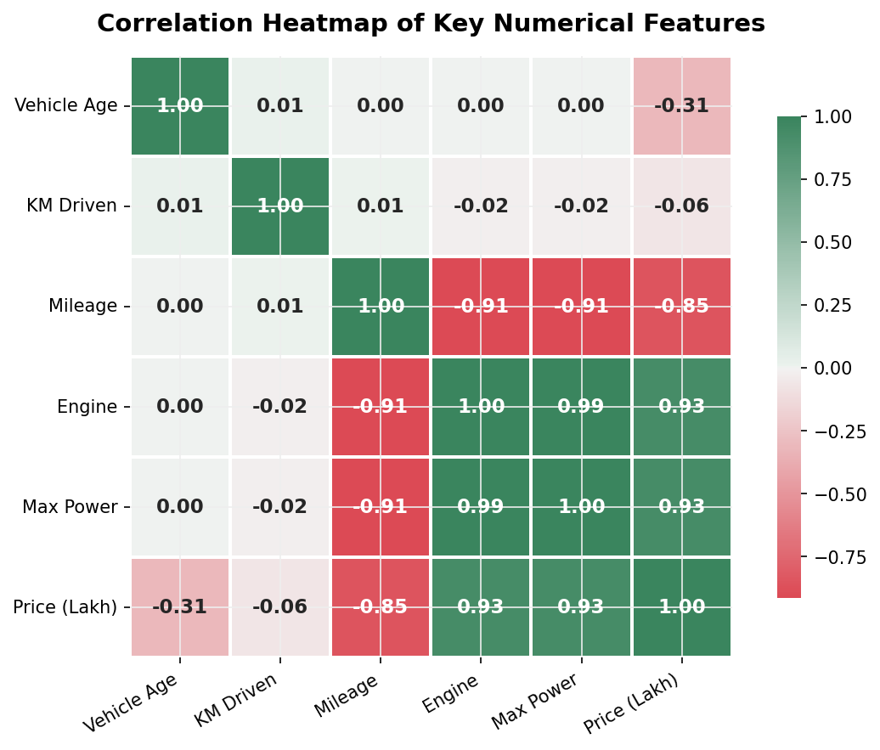
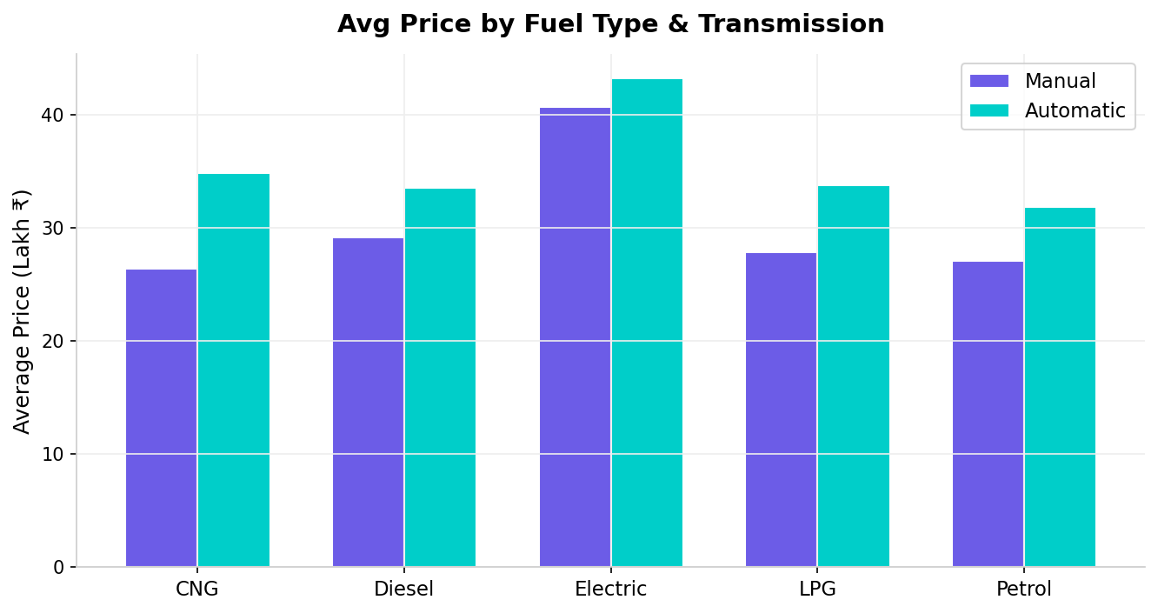
Multivariate Analysis
Relationships Between Multiple Features & Selling Price
Correlation Heatmap — max_power & engine strongest price predictors
Price by Fuel & Transmission — Automatic adds ~40-50% premium
Key Takeaway: Engine power (max_power r=0.82) is the strongest price driver. Vehicle age & mileage negatively impact value. Electric & Automatic cars command a consistent premium across all fuel segments.

Slide 12
Correlation Analysis
Feature Relationships with Selling Price
Key Takeaways
+0.82
max_power
Engine power is the STRONGEST driver of used car price
+0.74
engine CC
Bigger engines command significantly higher resale value
-0.61
vehicle_age
Older cars depreciate sharply — age kills resale value
-0.38
km_driven
Higher mileage = lower price. Buyers prefer lower km cars
-0.22
mileage
Better fuel efficiency (km/L) slightly reduces price

Slide 13
Major Insights
Executive Summary of Findings
🚗
⚡
⚙️
Newer = Higher Value
Electric Leads
Automatic Premium
Cars under 3 years old retain 70%+ of their original value. After 7 years, prices drop sharply below ₹10L.
Electric cars command the highest avg resale price (₹28.5L), 2x above diesel and 2.4x above petrol.
Automatic transmission adds a consistent 40-50% price premium over manual gearbox cars.
🔧
📍
📉
Engine Power Matters
Diesel Still Dominates
KM Driven Hurts Value
max_power has the highest correlation (r=0.82) with price. High-BHP cars are always more valuable.
Diesel holds the top share (~48%) and mid-range dominance (₹10–20L segment).
Cars driven 50,000–100,000+ km lose significant value. Low-km cars are preferred in resale.

Slide 14
Conclusion
What the Data Told Us
✅ EDA Successfully Completed
The CarDekho dataset was thoroughly explored — 8000+ records, 13 features, cleaned and analyzed from scratch.
✅ Pricing Factors Identified
max_power, engine, vehicle_age, and km_driven are the 4 key determinants of used car resale price.
✅ Business Value Generated
Insights reveal actionable pricing patterns useful for buyers, sellers, and automotive dealers.
✅ Statistical Rigor Applied
IQR-based outlier handling, correlation analysis, and feature engineering ensure reliable findings.

Slide 15
Challenges Faced
Learning Through Problem-Solving
⚠️ Handling Outliers
🔧 Missing Data Strategy
The Challenge:
The Challenge:
selling_price had extreme luxury car values. Decision: retain as genuine — removing would bias results.
6 columns had null values. Different columns needed different imputation strategies.
✅ Retained in target; IQR only applied to km_driven.
✅ Median for numeric, mode for categorical, 'Unknown' for text.
📊 Visualization Tuning
🔗 Correlation Interpretation
The Challenge:
The Challenge:
Getting interpretable and clean charts from highly skewed price data.
Understanding multicollinearity between engine, max_power, and price.
✅ Price filtered to ≤300L; log scale tested; bins tuned to 30.
✅ Computed individual Pearson correlations with the target variable.

Slide 16
Thank You
Questions & Answers
"Turning data into decisions — one insight at a time."

