Slide 1

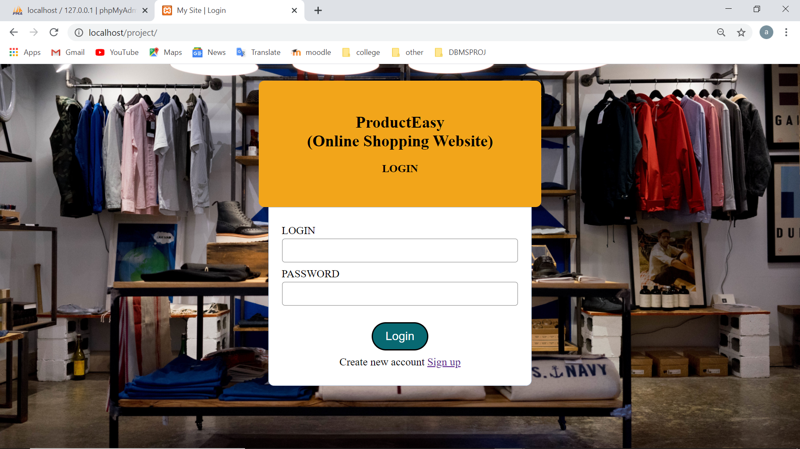
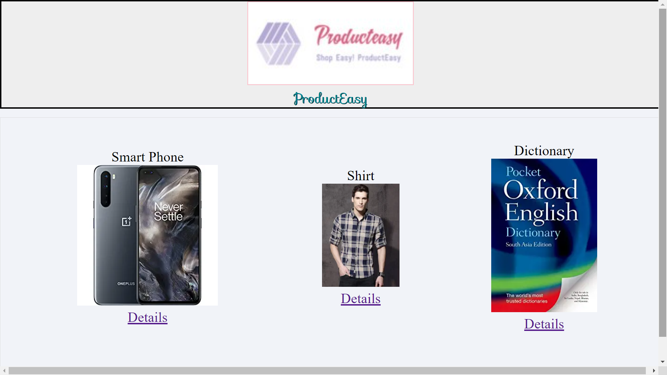
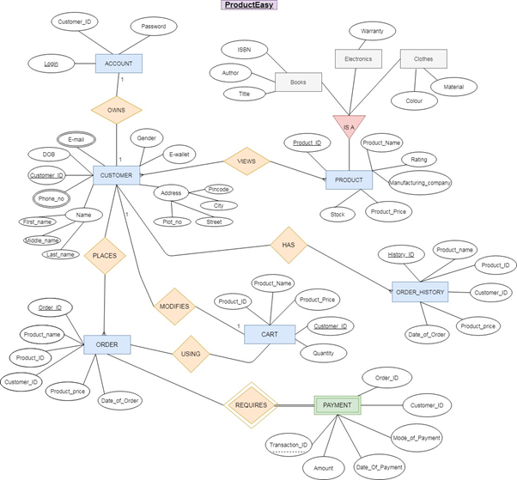
Online Shopping Management System- ProductEasy
SE IT
Prathamesh Bhoi 08, Anushka Agrawal 02, Aditi Bhosale 09
Sardar Patel Institute of Technology, Munshi Nagar, Andheri West, Mumbai.
Introduction
In this project, our aim is to implement a basic online shopping system,, as we know nowadays how important e-commerce has become in the world.
Problem Statement:
In online shopping, the products are made available for customers. Their pictures and details are made available on site. Customer, on the basis of it purchases the product. Then they are delivered to customers by third party.
Objectives:
Create database to store all the necessary data such as customer details, order details, cart, payment details etc.
To create user login page and help the customer by giving him a user friendly interface to browse through the products available for purchase, and add them to cart.
Outcomes:
We created a database having all necessary information, on which we were successfully able to run many queries.
We created a user login page which verifies the login credential and creates a new account if customer doesn’t have one. with database.
Products details stored in database were displayed on webpage. along with the current stock.
Methods and Materials
In order to execute this project we made use of Visual Studio Code as text editor for the Front-end part of the project.We also used a software Xampp (which had inbuild MYSQL)for creation of database and execution of queries,which constitues to Back-end part of project.We also used MYSQL software for execution of some queries. PHP was used to connect front end and back end
Results
Conclusions
This project has been a really insightful journey and has helped us learn a lot about front end, back end and how databases work. It was a really interesting project to work on, and helped further build our interest in the DBMS subject. We were successfully able to implement a basic online shopping system and run queries related to it
.References
For learning/tutorials
www.w3schools.com
tutorials on youtube
To help in solving errors
www.stackoverflow.com
For ideas to help our project:
amazon
flipkart

