Slide 1

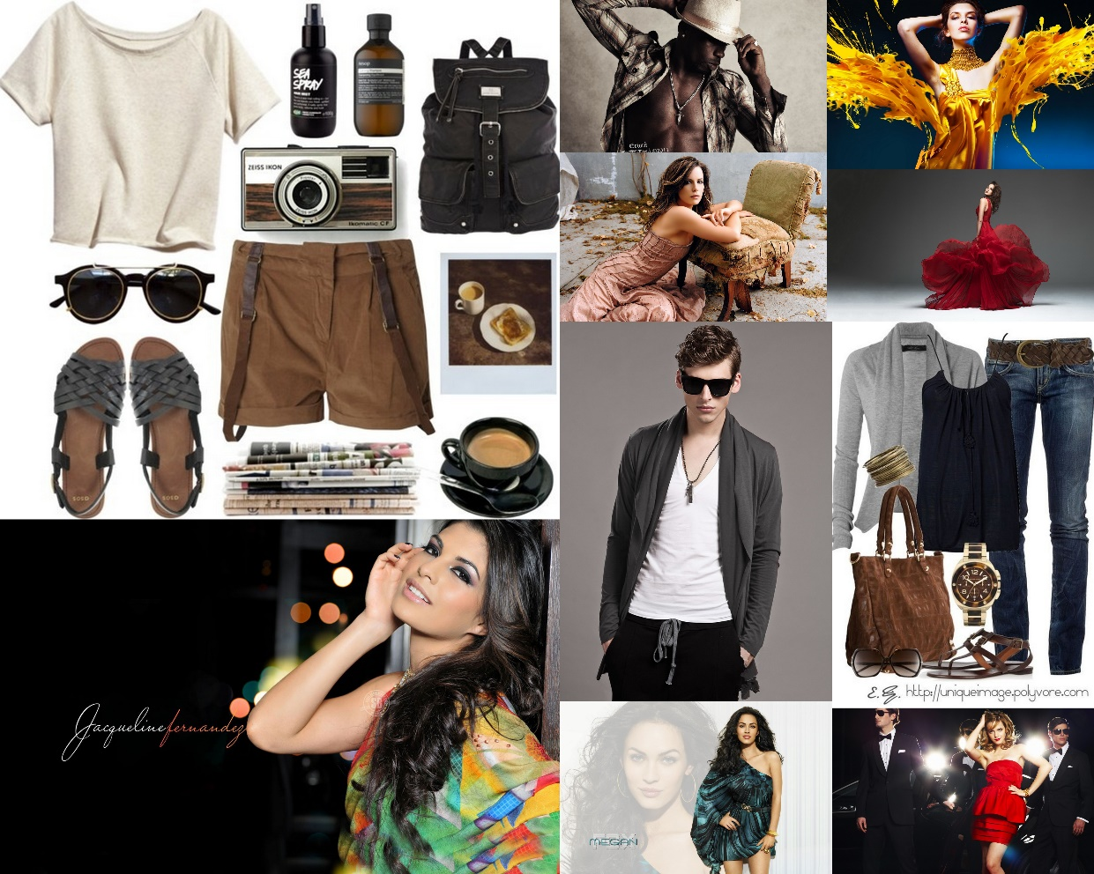
ITS ALL ABOUT LOOKING GOOD
Notes:
Put our sites image or this….

Slide 2
Project Objective
In US average individual spends 3.8-4% of income on fashion
One stop location for all things “FASHION”
Huge market can be tapped
No current portal for designers and fashion enthusiast to interact
Fashion information updates for users
Help launch upcoming designers
Provides platform for designers and customers to interact
Analyzing fashion trends based sentiments on Social Media

Slide 3
Our Target Audience
High end fashion customers
Upcoming designers, photographers
Aspiring Fashion enthusiast

Slide 4

Market Landscape
Criteria | Snapette | Chicisimo | FashionPedia | Stylopedia
Display latest fashion items
Shopping from site
Newsletter
Live chat with designer/ photographer
Weekly Fashion Trends
Fashion Networking platform

Slide 5
Revenue Model
Freemium Model
Free users
Platform to interact with other fashion enthusiasts
Information of Weekly Fashion Trends
Paid users
Live Chat with designers : Style Notes
Live Chat with Photographers: Style Portfolio
Special Newsletter of latest Deals
Shopsense API generates $0.05 per click
Advertisements

Slide 6




Paid Users
Silver Account:
100 $ Annual Subscription*
Access to Tier 1 Designers & Photographers
Gold Account:
150 $ Annual Subscription*
Access to Tier 2 Designers & Photographers
Platinum Account:
200 $ Annual Subscription*
Access to Tier 3 Designers & Photographers
* Sample Cost

Slide 7
Business Case
Search latest fashion Trends
Platform for designers to sell merchandise
Live-chat with designers for paid users for more personalized experience
Latest fashion videos
Latest fashion news updates
Mobile compatible application
Display Top brands based on Sentiment Analysis

Slide 8
Novelty
Fashion Trend analysis using twitter sentiments
Live chat with designers & photographers
Platform for fashion enthusiast to interact with their favorite fashion designers, photographers and take style notes
Display latest trend based on Gender and color preferences of the user
PCI Compliant Credit Card Processing
Cloud Based

Slide 9






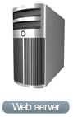













System Design
Web APIS
Amazon EC2 Cloud
Web Browser
Database
Web Scraped data

Slide 10
API’s Implemented
Shopsense
PayPal Checkout
Flickr
RSS Feeds
Pinterest
Google custom search
Facebook Like
Twitter Follow
Twitter Share
Google+ Share
Facebook Login
Google+

Slide 11


Analytics
Twitter sentiment analysis using Live Twitter Streams
Analytics using R
Preprocessing of data
Naïve Bayes Algorithm
Simple probabilistic model that tends to work well on text classifications with high degrees of accuracy
Fashion trends and Brands of the week displayed based on Twitter sentiments
Display latest trends based on Gender and color preference of user

Slide 12

Future Plan
User profiling
Recommendations based on user preferences
Analytics based on multiple social platforms
Target International audience
Video Chat
Collaborate with “Share this deal” to display discounts and offers

Slide 13
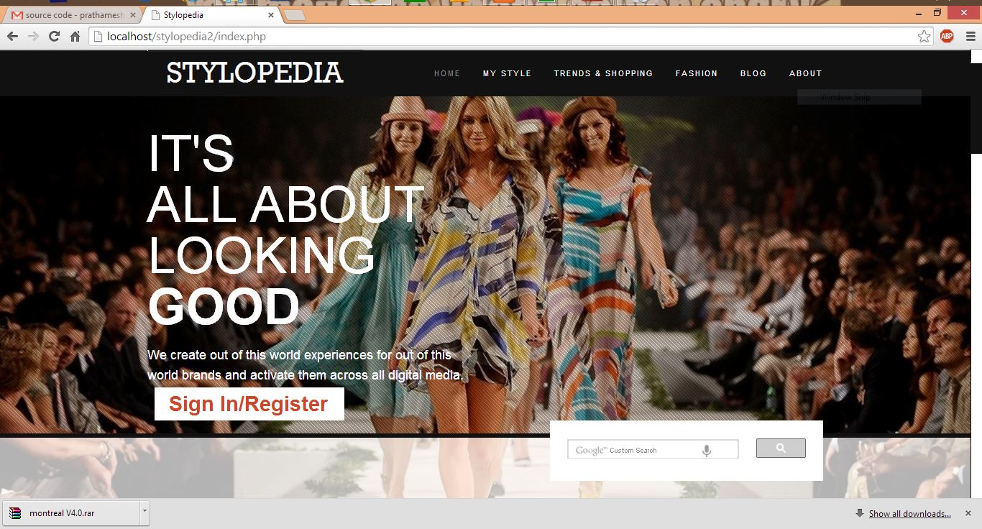
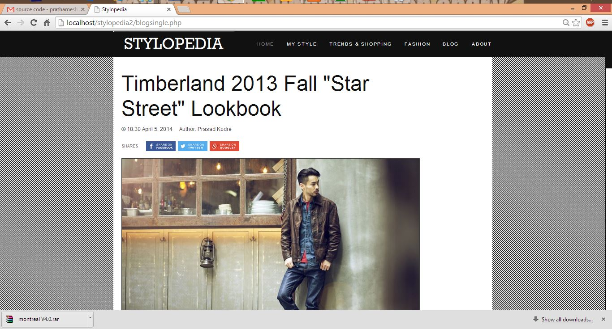
Appendix- 1

Slide 14
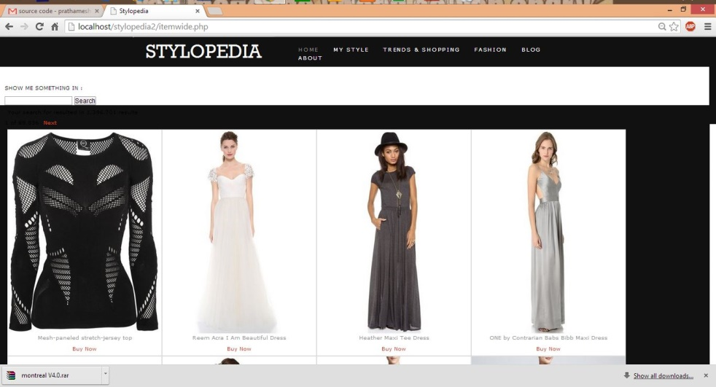
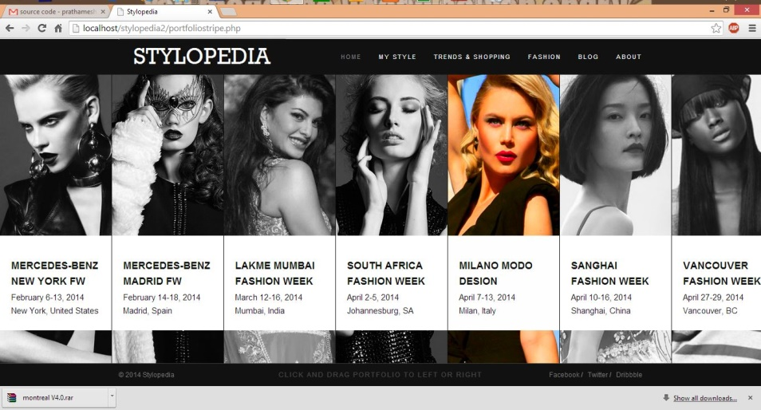
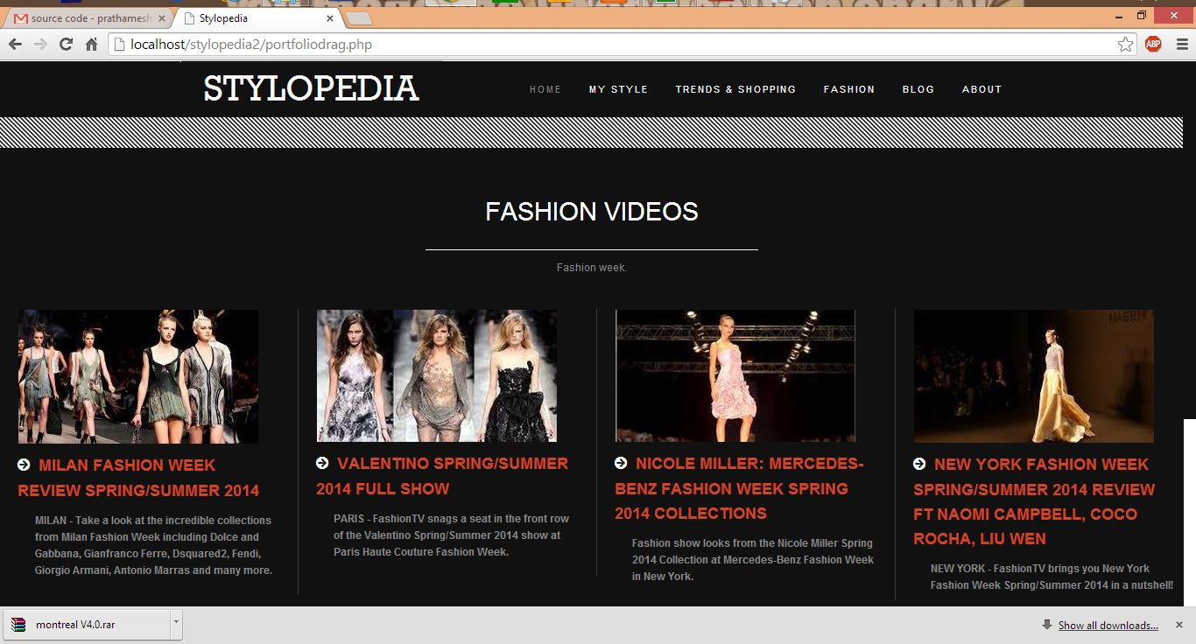
Appendix- 2

Slide 15
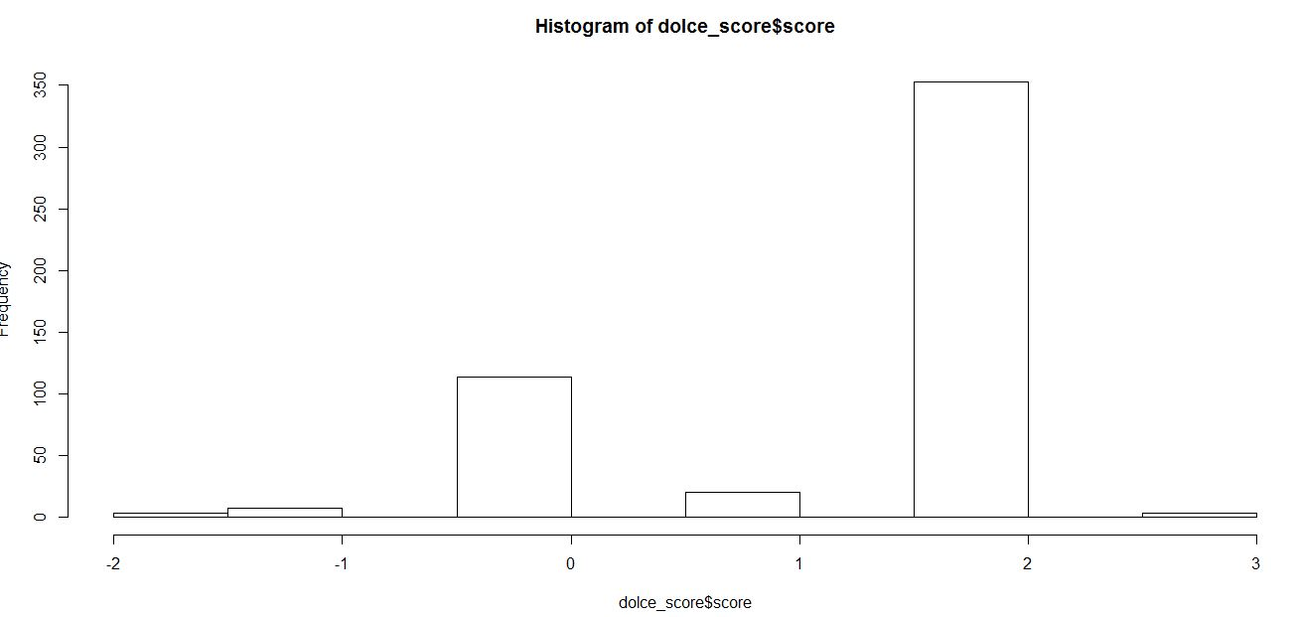
Appendix -3

