Slide 1
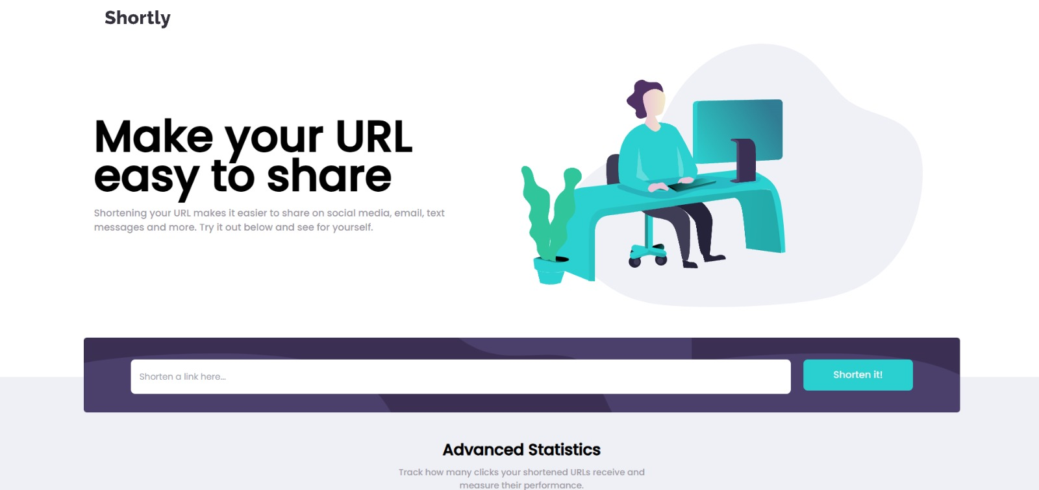
URL Shortener
Make URLs easy to share
A full-stack web application that converts long links into short, clean and shareable URLs using React.js, Node.js, Express and MongoDB.
Presented by
Abhishek Poonia
Submitted to Nivotech Solutions
Date: 21-04-26
React.js • Node.js • Express • MongoDB • Tailwind CSS
1/11

Slide 2
Presentation Agenda
A quick walkthrough of the project, its technology, and how it works.
01
02
03
04
Project Overview
Core Features
Tech Stack
Architecture
What the application does and why it is useful.
The main user-facing functions of the app.
Frontend, backend, database, and styling tools.
How the UI, API, and database communicate.
05
Demo & Conclusion
Screenshots, learnings, and future scope.
2/11

Slide 3
Project Overview
URL Shortener helps users convert long links into compact URLs that are easy to share and remember.
What the project does
Why it is useful
• Accepts a valid long URL from the user. • Generates a shortened version of the link. • Stores the mapping in MongoDB for future access. • Shows the shortened links even after refreshing the page.
• Makes URLs cleaner for social media and messaging. • Improves sharing convenience for users. • Provides a neat history of shortened links. • Demonstrates practical full-stack development skills.
In short, this project solves a simple but common problem: long URLs are difficult to share. By making a short link, the user gets a faster, cleaner, and more professional sharing experience.
Full-stack + Responsive UI
3/11

Slide 4
Core Features
The application was built around a simple, user-friendly workflow.
01
Responsive Layout
02
URL Validation
Works well on desktop, tablet, and mobile screens.
Shows an error when the input is not a valid URL.
03
Link History
04
One-Click Copy
Displays shortened links even after the browser refreshes.
Lets users copy the short link quickly to the clipboard.
05
Persistent Storage
06
Clean Interface
Saves URL mappings in the MongoDB database.
Uses a modern design inspired by the Frontend Mentor challenge.
4/11

Slide 5
Technology Stack
The project uses modern web technologies across the front end, back end, and database layer.
RE
React.js
NO
Node.js
EX
Express.js
Builds the interactive user interface and handles client-side state.
Provides the JavaScript runtime for server-side development.
Creates routes and REST APIs for link shortening requests.
MO
MongoDB
TA
Tailwind CSS
HT
HTML5 + CSS3
Stores long-to-short URL mappings in a flexible NoSQL format.
Helps style the UI quickly with responsive utility classes.
Forms the structure and visual styling of the web pages.
5/11

Slide 6
System Architecture
The request flows through the UI, API, and database before the short link is returned.
User
React Frontend
Express API
MongoDB
Short Link
Workflow summary
1) User pastes a long URL. 2) Frontend validates and sends the request. 3) Backend creates the short code. 4) MongoDB stores the mapping. 5) The UI displays the shortened link for copying.
6/11

Slide 7
How the App Works
A simple user journey from entering a URL to copying the final shortened link.
1
2
3
4
5
Paste URL
Validate
Shorten
Save
Copy & Share
The user enters a valid long link in the input field.
The app checks the input and shows an error for invalid entries.
The backend generates a short identifier for the URL.
The mapping is stored in MongoDB.
The user copies the new link with a single click.
The app is designed to feel instant and simple. The user only needs to paste a link, click a button, and receive a neat shareable URL.
7/11

Slide 8
User Interface Screenshot
The screenshot below shows the hero section, input field, and the modern responsive design of the project.
Hero Area
Shorten Link Button
Input Field
8/11

Slide 9
Backend and Database Design
The server handles link creation while MongoDB keeps the mappings safe for later use.
Backend responsibilities
Example database record
• Receive shortening requests from the React app. • Validate the incoming URL and create a short identifier. • Store and retrieve records through API endpoints. • Return short URLs back to the frontend in JSON form. • Handle error cases such as invalid input or duplicates.
{
longUrl: "https://www.example.com/very/long/link",
shortCode: "a1B9x",
shortUrl: "https://short.ly/a1B9x",
clicks: 0,
createdAt: "2026-04-21"
}
9/11

Slide 10
Challenges and Learnings
The project was a good practice exercise in full-stack integration and UI design.
Challenges faced
What I learned
• Keeping the UI responsive across different screen sizes. • Handling invalid URLs gracefully. • Maintaining link data after page refresh. • Connecting the React frontend with the backend API.
• How to design a clean and practical user interface. • How REST APIs connect frontend and backend layers. • How MongoDB helps store dynamic application data. • How to organise a full-stack project in a structured way.
This project strengthened both frontend and backend skills while showing how a simple idea can become a complete real-world application.
10/11

Slide 11
Conclusion
The URL Shortener project is a complete full-stack application built to create simple, shareable, and persistent short links. It combines an attractive frontend with reliable backend logic and database storage.
Thank you
Date: 21-04-26
Future enhancements
• Custom short aliases
• Click analytics dashboard
• QR code generation
• User authentication
• Link expiry and management
Presented by Abhishek Poonia
Submitted to Nivotech Solutions
11/11

