Slide 1


Exploratory Data Analysis of Sales Data
(Patterns and Trends
finding )

Slide 2
Introduction
Exploratory Data Analysis (EDA) is an essential process in data analysis that involves examining and visualizing data to understand its underlying patterns, distributions and relationships between variables.
Importance-
Identifying Patterns and Trends
Understanding Customer behavior
Detecting Anomalies and Outliers
Determine Relationships between variables
Decision making

Slide 3
About Dataset -
The sales dataset consist of monthly sales data about electronic products that were sold in a year.
Dataset consist of information like :
'Order ID', 'Product', 'Quantity Ordered', 'Price Each', 'Order Date’, 'Purchase Address’
Following the newly created columns like :
‘Total Price', 'Year', 'Category', 'Month', 'City
Which can be used to find patterns and trends within the data.

Slide 4
Univariate Analysis
Univariate analysis involves examining individual variables to understand their distribution.
Histplot or Boxplots can be used to analyze them
Variables for Analysis:
Quantity Ordered
Price Each
City

Slide 5
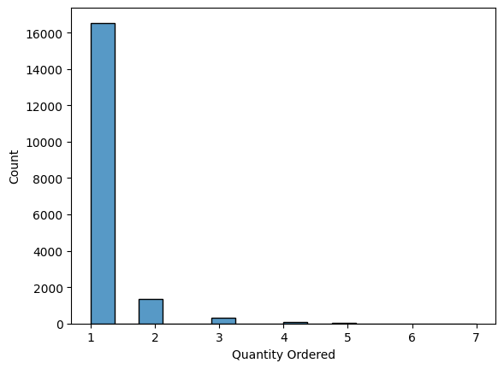
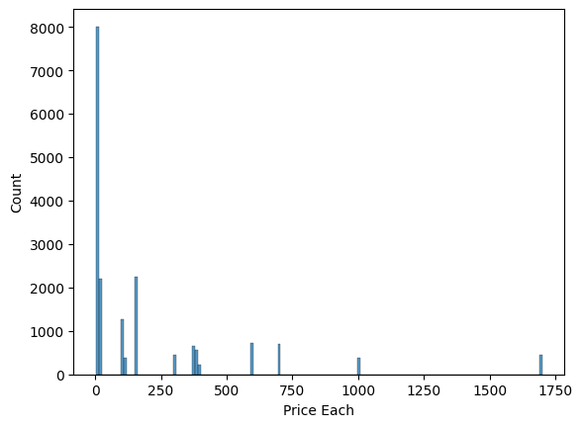

Slide 6
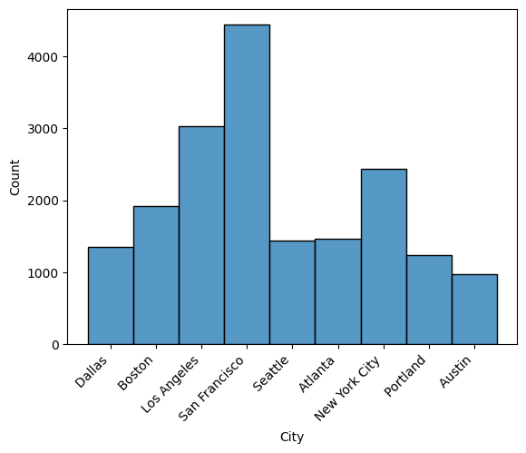
Frequency of cities using newly created city column

Slide 7
Bivariate Analysis
Examining the relationships between pairs of variables to understand how they depend on each other.
This can be analyzed using scatterplots or boxplots
Variables for Bivariate Analysis:
Quantity Ordered vs. Price Each
Month vs. Total Price
Category vs. City

Slide 8
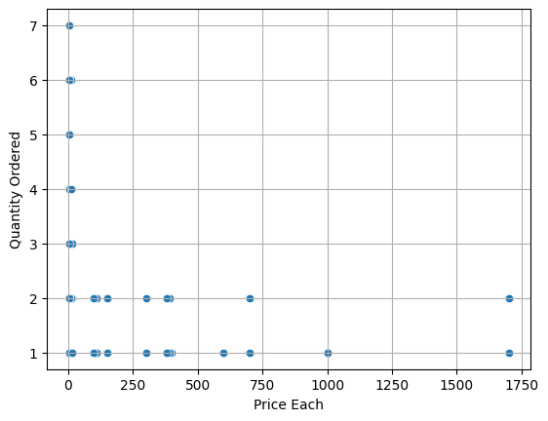
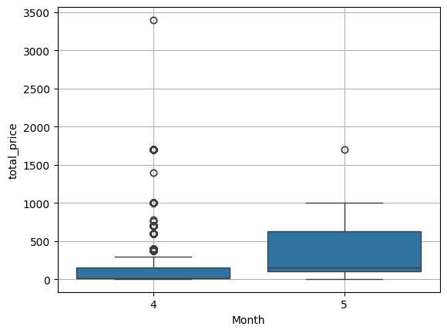

Slide 9
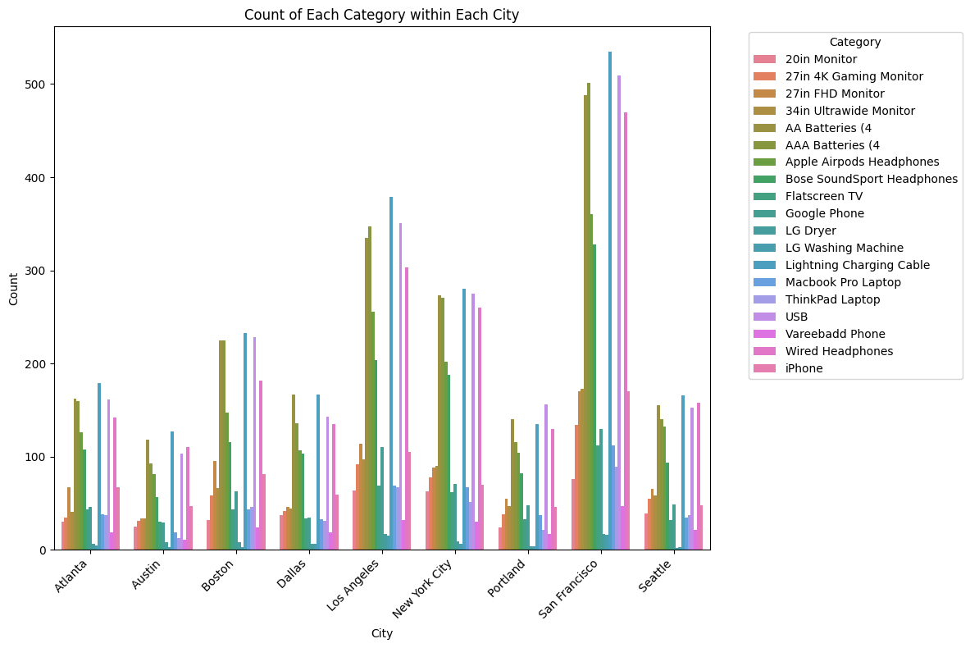

Slide 10
Correlation Analysis using Heatmap
Denotes the correlation value for each feature with each corresponding feature
A positive correlation means that as one variable increases, the other variable increase.
A negative correlation means that as one variable increases, the other variable decrease.
When corr = 0 change in one variable do not correspond to change in the other variable.

Slide 11
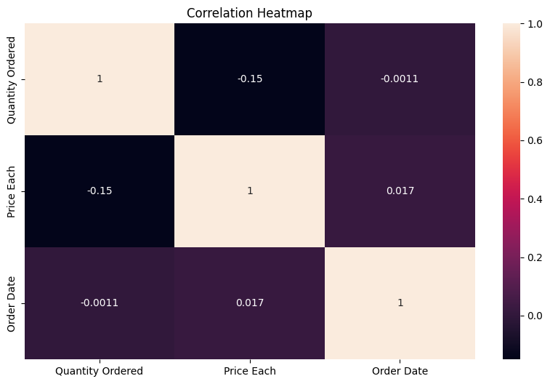

Slide 12
Conclusion / Insights
Highest sold product :
Product iPhone
Total Price 773500.0
Top selling product quantities:
AAA Batteries (4-pack) 2936
AA Batteries (4-pack) 2822
Average order value wrt quantity ordered- 185.68
Correlation betwn ‘ Price Each’ and ‘Ordered Quantity’ is : -0.1504
i.e Negative correlation (inversely related).

Slide 13
Total order value per city
City
Atlanta 193.243832
Austin 177.475427
Boston 184.504776
Dallas 187.289237
Los Angeles 182.220446
New York City 183.478956
Portland 194.929757
San Francisco 184.150275
Seattle 191.407933

Slide 14
Overall analysis for each column
 | Quantity Ordered | Price Each | Order Date | Total price | Year | Month
count | 18289.00000 | 18289.000000 | 18289 | 18289.000000 | 18289.0 | 18289.000000
mean | 1.12461 | 184.431026 | 2019-04-16 03:16:12.443545344 | 185.688617 | 2019.0 | 4.001531
min | 1.00000 | 2.990000 | 2019-04-01 03:09:00 | 2.990000 | 2019.0 | 4.000000
25% | 1.00000 | 11.950000 | 2019-04-08 17:09:00 | 11.950000 | 2019.0 | 4.000000
50% | 1.00000 | 14.950000 | 2019-04-16 00:47:00 | 14.950000 | 2019.0 | 4.000000
75% | 1.00000 | 150.000000 | 2019-04-23 15:18:00 | 150.000000 | 2019.0 | 4.000000
max | 7.00000 | 1700.000000 | 2019-05-01 04:25:00 | 3400.000000 | 2019.0 | 5.000000
std | 0.43641 | 330.913377 | NaN | 332.225363 | 0.0 | 0.039099

