Slide 1

Task-2
DIABETES PREDICTION ANALYSIS
Name :- Prathamesh Kshirsagar
Email :- get.prathameshk@gmail.com

Slide 2
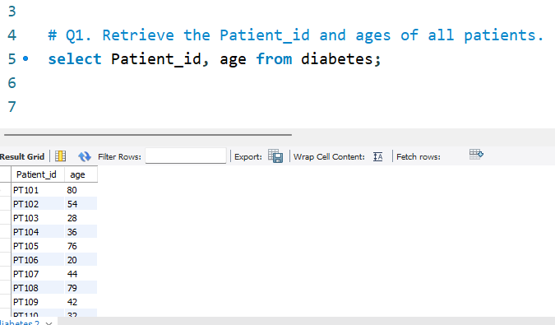
Retrieve the Patient_id and ages of all patients.

Slide 3
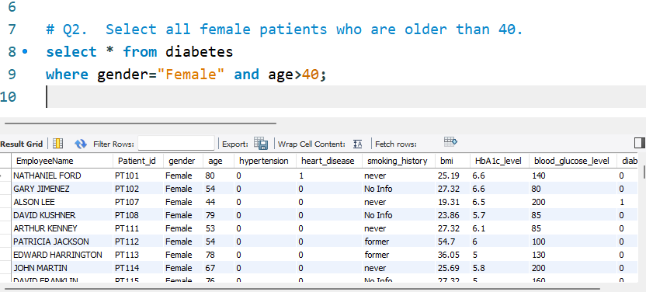
Select all female patients who are older than 40.

Slide 4
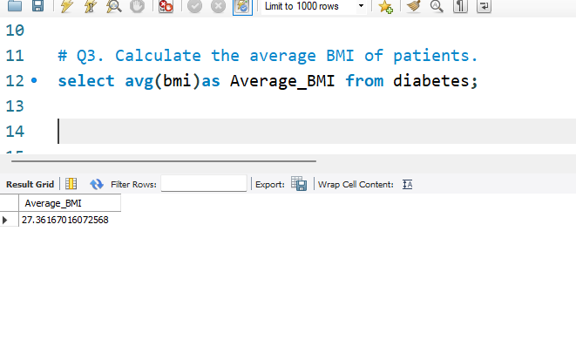
Calculate the average BMI of patients.

Slide 5
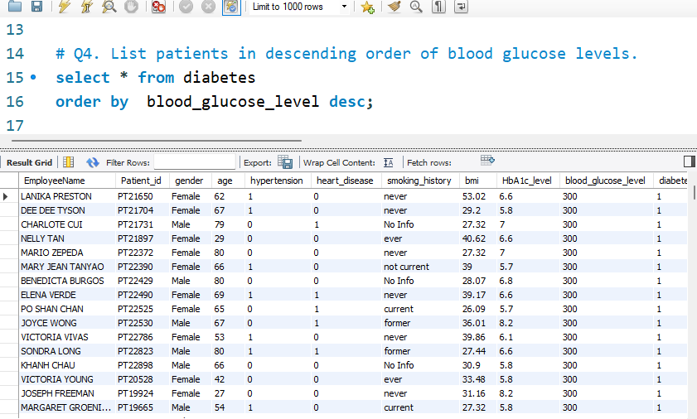
List patients in descending order of blood glucose levels..

Slide 6
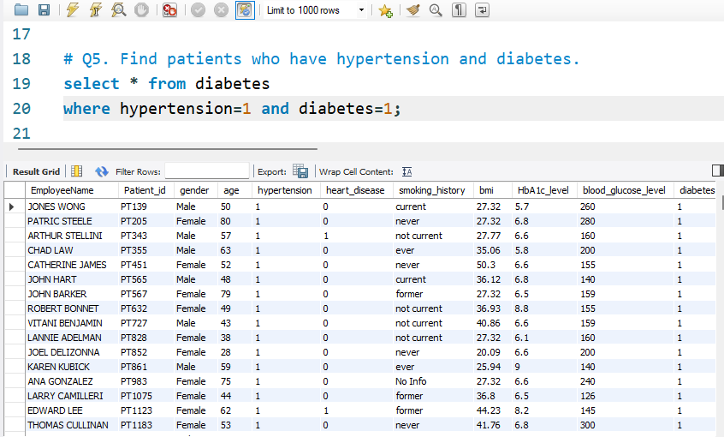
Find patients who have hypertension and diabetes.

Slide 7
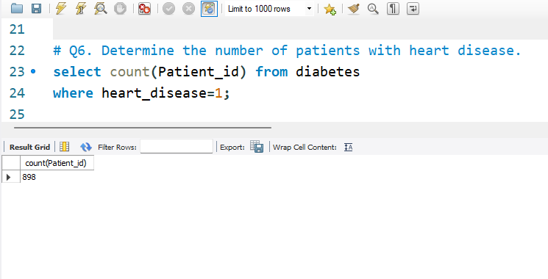
Determine the number of patients with heart disease..

Slide 8
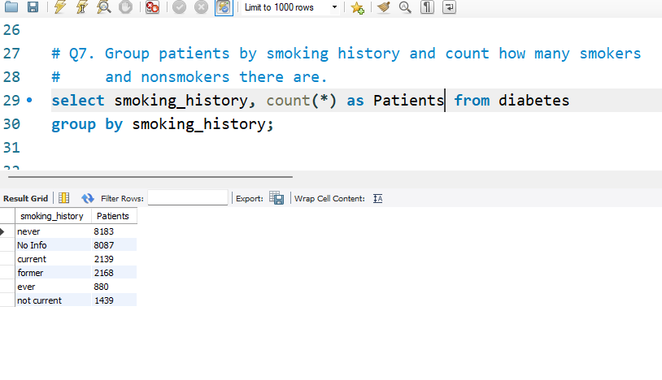
Group patients by smoking history and count how many
smokers and non smokers there are.

Slide 9
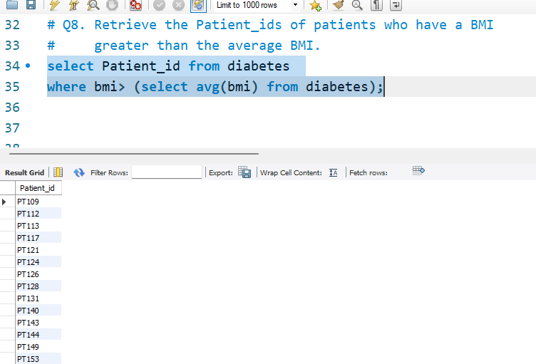
Retrieve the Patient_ids of patients who have a BMI greater
than the average BMI.

Slide 10
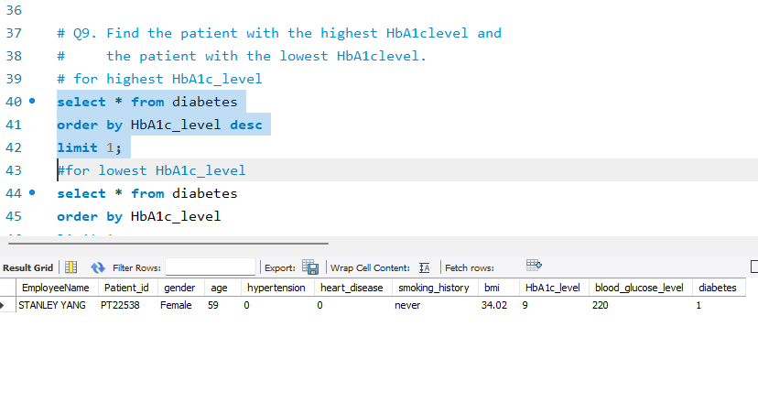
Find the patient with the highest HbA1c level and the patient
with the lowest HbA1c Level.

Slide 11
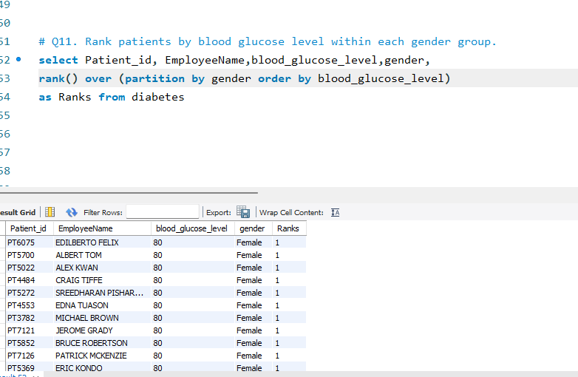
Rank patients by blood glucose level within each gender group.

Slide 12
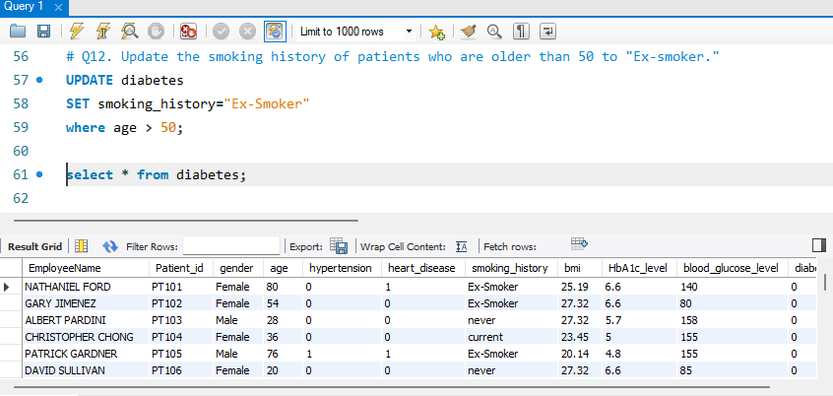
Update the smoking history of patients who are older than 50
to "Ex-smoker.".

Slide 13
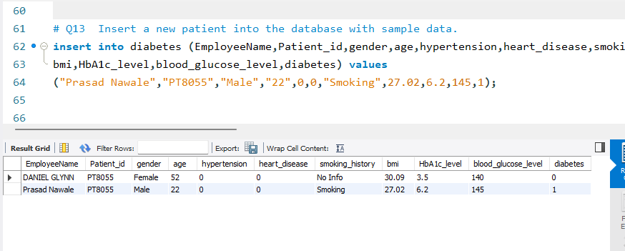
Insert a new patient into the database with sample data

Slide 14
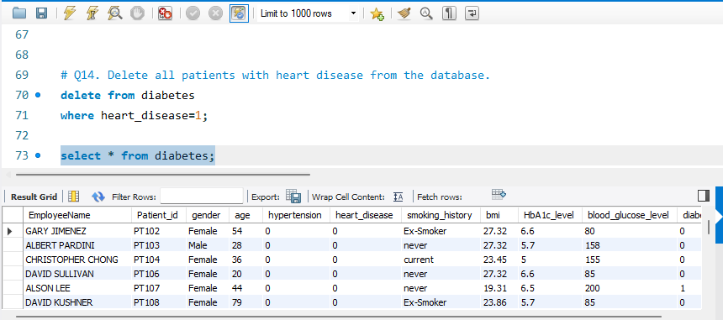
Delete all patients with heart disease from the database.

Slide 15
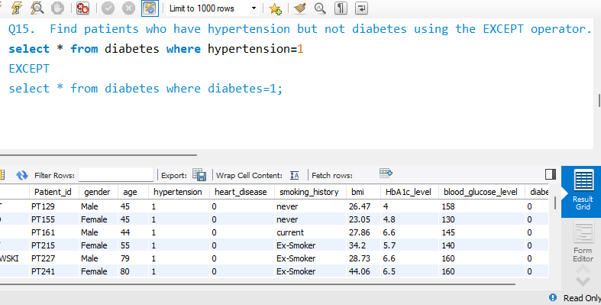
Find patients who have hypertension but not diabetes using
the EXCEPT operator.

Slide 16
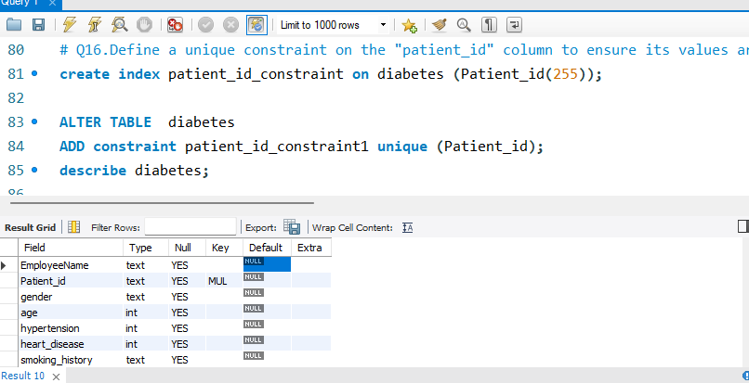
Define a unique constraint on the "patient_id" column to ensure
its values are unique.

Slide 17
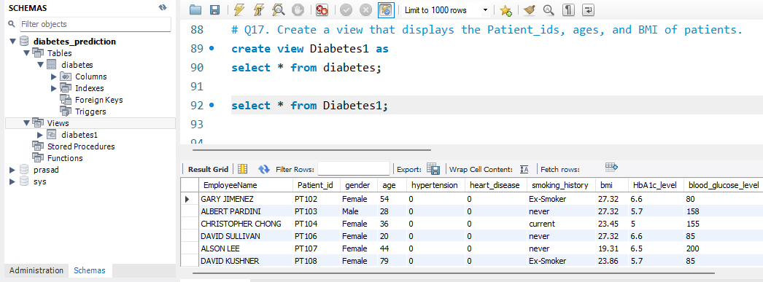
Create a view that displays the Patient_ids, ages, and
BMI of patients.

Slide 18
Suggest improvements in the database schema to reduce
data redundancy and improve data integrity.
There are some best practices given below for suggesting the improvements in
a database schema for reducing data redundancy and improving data integrity.
Normalization :- Normalization is a process of organizing data in database
and used normalization techniques such as 1NF,2NF,3NF for organize data
efficiently. it divides larger table into smaller tables and connected them
using relationship to minimize data redundancy
Primary Keys :- Ensure that each table has primary key that has unique
values to represent each record. Avoid the volatile data such as names,
address as primary key.
Foreign Key :- Used to established connection between tables using foreign
key to maintain data integrity. Use foreign key to links related tables and
preventing inconsistent data.
Unique Constraints :- Apply unique constraints to column when necessary
to prevent duplicate values.
Data types :- use appropriate data type for each column to optimize
storage and improve accuracy.

Slide 19
Explain how you can optimize the performance of SQL
queries on this dataset
optimizing the performance of SQL queries on this dataset involves various
strategies the given query optimizing technique is given below.
Normalization :- Apply normalization techniques to reduce data redundancy
and improve performance and storage efficiency
Use EXISTS instead of using IN/JOIN :- Use EXISTS for sub-queries when
the checking of existence of rows as it can be more efficient than IN,JOIN.
Avoid Wildcard characters at the start of LIKE:- avoid using % at the start
of LIKE pattern as it may prevent the query from using indexes.
Proper Joins:- use INNER JOIN,LEFT JOIN,RIGHT JOIN appropriately based
on the desired result set.
Limit result set size :- if we don't need entire dataset then Use LIMIT or TOP
to restrict the no. of rows we want.
Avoiding nested queries :- Minimize the use of nested queries because they
are less efficient than JOIN operations.
Use Stored Procedures :- Using stored procedure for frequently executed
queries as they can precompiled and optimized.

