Slide 1
Library Management Microservices
Build, deploy and analyse a containerized microservice application under varying workloads
Book Service
port 8001
Member Service
port 8002
Borrow Service
port 8003
Notification Service
port 8004
Cloud Computing Lab Evaluation · FastAPI · SQLite · Docker Compose · Locust · Streamlit
Notes:
Opening (script.md section 1). One-sentence summary: four FastAPI microservices, each with its own SQLite database, containerized with Docker, deployed with Compose, load-tested with Locust at 1/2/4/8/16 concurrent requests while monitoring with docker stats.

Slide 2
Five checkpoints, shown in order
CP1
CP2
CP3
CP4
CP5
Design & develop
Containerize & deploy
Communicate
Load & monitor
Analyse
4 FastAPI services, own DB each, REST APIs tested in Swagger
Dockerfile per service, 5 images, one docker compose up
library-net network, calls by service name, end-to-end borrow
Locust W1–W5 (1–16 users) + docker stats on every container
Observation table, 9 graphs, bottleneck and degradation explained
Screens 01–22
Screens 23–26
Screens 27–34
Screens 35–45
Figures 1–9
DEVELOP
CONTAINERIZE
DEPLOY
CONNECT
LOAD TEST
MONITOR
ANALYZE
DEMONSTRATE
Notes:
Roadmap. The manual says each checkpoint must be demonstrated before the next. This deck and script.md follow that order.

Slide 3
Aim and the four services
AIM
1
Book Service
2
Member Service
Develop a microservice application, containerize and deploy it with Docker, connect the services, generate varying workloads, monitor resource use and analyse performance.
port 8001
port 8002
Book catalogue and availability
Library members (active or not)
own DB: books.db
own DB: members.db
DOMAIN
Library Management: few tables, and one natural request (borrow a book) that crosses several services.
3
Borrow Service
4
Notification Service
port 8003
port 8004
Issue / return books — entry point, calls the other three
Stores messages sent to members
Manual asks for 3 services. The required path Client → Borrow → Member / Book is complete and is the one we load-tested; Notification is an extension.
own DB: borrows.db
own DB: notifications.db
Notes:
Aim is from the manual. Explain each service's single job and that each owns its database. If asked about 3 vs 4 services: the required Client → Borrow → Member/Book path is complete and is the one we load-tested; Notification is an extension.

Slide 4
Architecture: one entry point, three services behind it
Docker network library-net (bridge, 172.18.0.0/16) · DNS by service name
Borrow calls the others by service name (http://book-service:8001 …), never by IP
Member Service
member-service:8002 · members.db
Streamlit client
browser :8501 → Borrow :8003
Borrow Service
borrow-service:8003 · borrows.db
Book Service
book-service:8001 · books.db
Locust
load generator → :8003
Notification Service
notification-service:8004 · notifications.db
Load test path (3 services): Locust → Borrow → Member + Book
Notes:
Point at the flow. The client (Streamlit, or Locust during the load test) calls Borrow on the published port 8003. Inside the Docker network Borrow calls the others by service name. Each service has its own SQLite file on its own volume.

Slide 5
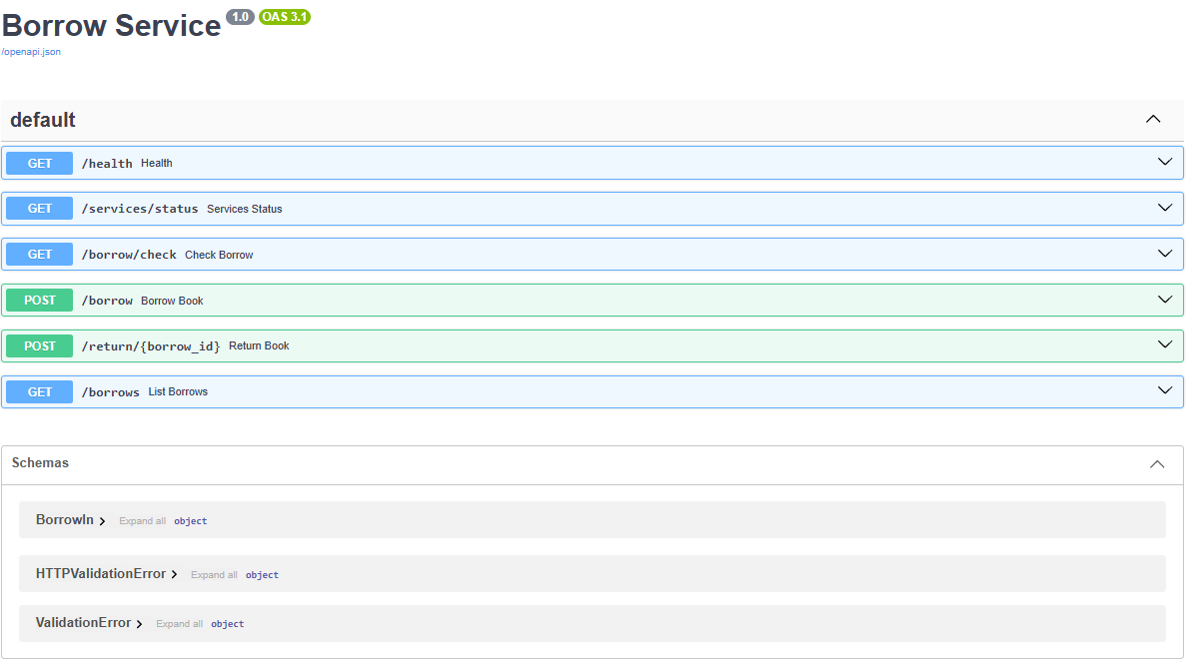
Each service runs and answers on its own
CP1 · SERVICES
Service | Endpoints (REST)
Book :8001 | GET /books · GET /books/{id} · POST /books · PATCH /books/{id}/availability
Member :8002 | GET /members · GET /members/{id} · POST /members
Borrow :8003 | GET /services/status · GET /borrow/check · POST /borrow · POST /return/{id} · GET /borrows
Notification :8004 | POST /notifications · GET /notifications
Swagger UI of the Borrow Service (screenshot 16)
Every service also has GET /health
cd services\book_service
python -m uvicorn main:app --port 8001
python scripts\test_services.py → ALL CHECKS PASSED
Notes:
script.md 2.1–2.4. Run each with python -m uvicorn main:app --port 800X in its own terminal (Borrow last). Show Swagger at /docs, run GET /books, POST /books (201), Borrow GET /services/status. Then python scripts\test_services.py → ALL CHECKS PASSED. Stop with Ctrl+C before Docker.

Slide 6
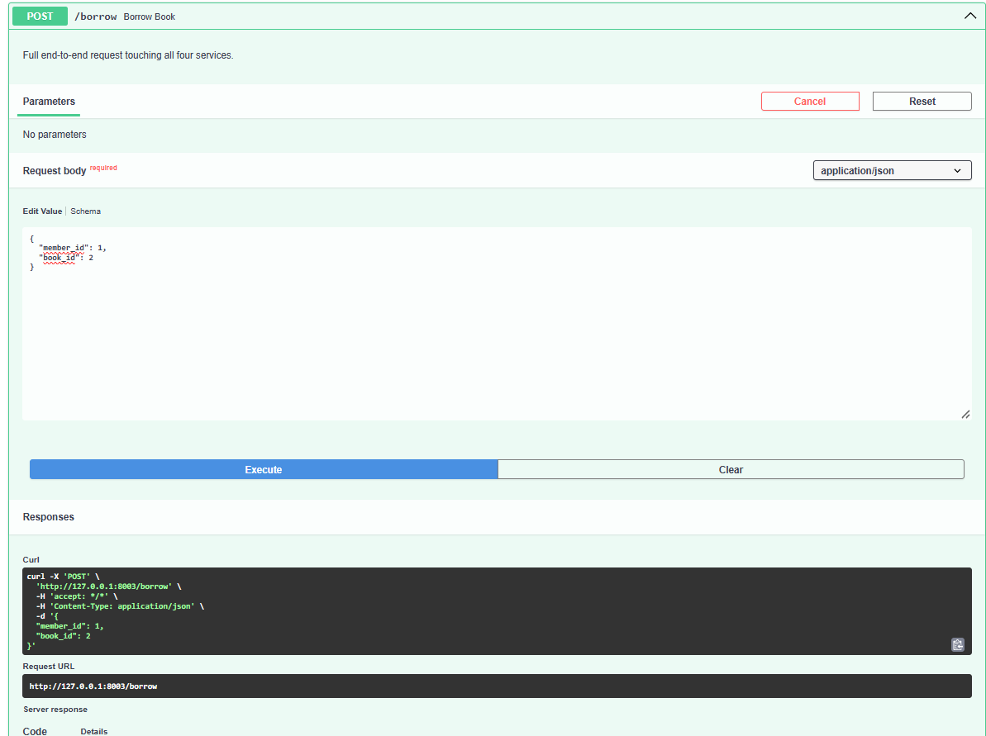
One borrow request touches all four services
CP1 · SERVICES
1
Client → Borrow
POST /borrow {member_id, book_id}
2
Borrow → Member
GET /members/{id} — exists and active?
3
Borrow → Book
GET /books/{id} — exists and available?
4
Borrow → Book
PATCH availability = false
5
Borrow (own DB)
INSERT row into borrows.db
6
Borrow → Notification
POST /notifications — message saved
POST /borrow in Swagger → 201 (screenshot 20)
Reply: 201 Created {borrow_id, member, book, notification}
Notes:
POST /borrow walkthrough. Steps 1–6. Point at the four terminals: each prints a log line for its part. If Notification is down, the borrow still succeeds (best-effort message); if Book or Member is down, it fails with 503 and nothing is saved.

Slide 7
A Dockerfile packages each service into an image
CP2 · DOCKER
FROM python:3.12-slim
WORKDIR /app
ENV PYTHONDONTWRITEBYTECODE=1 \
PYTHONUNBUFFERED=1
COPY requirements.txt .
RUN pip install --no-cache-dir \
-r requirements.txt
COPY main.py .
EXPOSE 8001
CMD ["uvicorn", "main:app",
"--host", "0.0.0.0",
"--port", "8001"]
Small base python:3.12-slim — Python on a small Debian Linux
Layer cache requirements.txt is copied and installed before main.py, so a code change rebuilds in seconds
Logs in real time PYTHONUNBUFFERED=1 → docker logs shows lines immediately
Listen on 0.0.0.0 Inside a container 127.0.0.1 is only the container itself; 0.0.0.0 lets port-mapped traffic in
EXPOSE ≠ publish EXPOSE only documents the port; ports: "8001:8001" in Compose publishes it
docker compose build
docker images "library-app/*" → 5 images, services ≈ 212 MB
Notes:
script.md 3.2–3.3. Explain line by line. Key points: slim base; copy requirements before code so the pip layer is cached; 0.0.0.0 so forwarded traffic reaches the server; EXPOSE is documentation, ports: publishes. Then docker compose build (shows CACHED) and docker images "library-app/*".

Slide 8
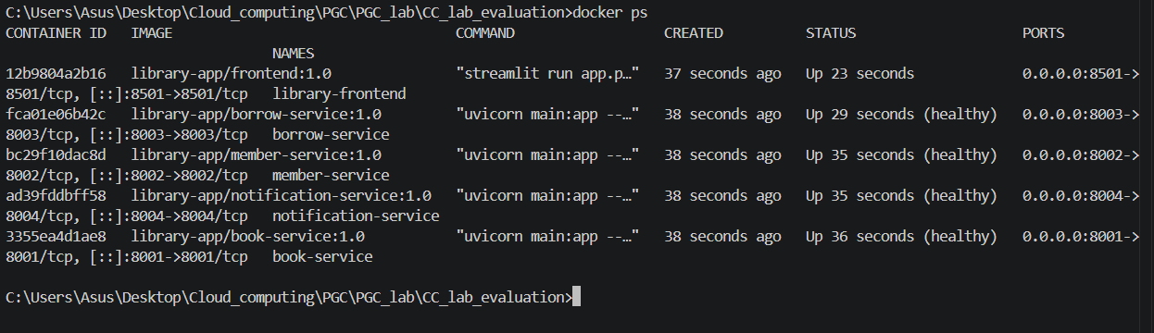
Docker Compose deploys all five containers
CP2 · DOCKER
ports
environment
volumes
"8003:8003" laptop → container
BOOK_SERVICE_URL=http://book-service:8001
borrow-data:/data — DB survives rebuilds
networks
healthcheck
depends_on
library-net — one private network
GET /health every 5 s, timeout 3 s, 10 retries
Borrow starts only when the other 3 are healthy
docker compose up -d
docker ps
-d = detached (runs in the background). STATUS shows (healthy); PORTS shows 0.0.0.0:8001->8001/tcp.
docker ps: 4 services (healthy) + frontend (screenshot 26)
Notes:
script.md 3.4–3.5. Walk through borrow-service in docker-compose.yml. docker compose up -d: creates network and volumes, starts Book/Member/Notification, waits until healthy, then Borrow, then the frontend. docker ps shows (healthy) and the port mappings.

Slide 9
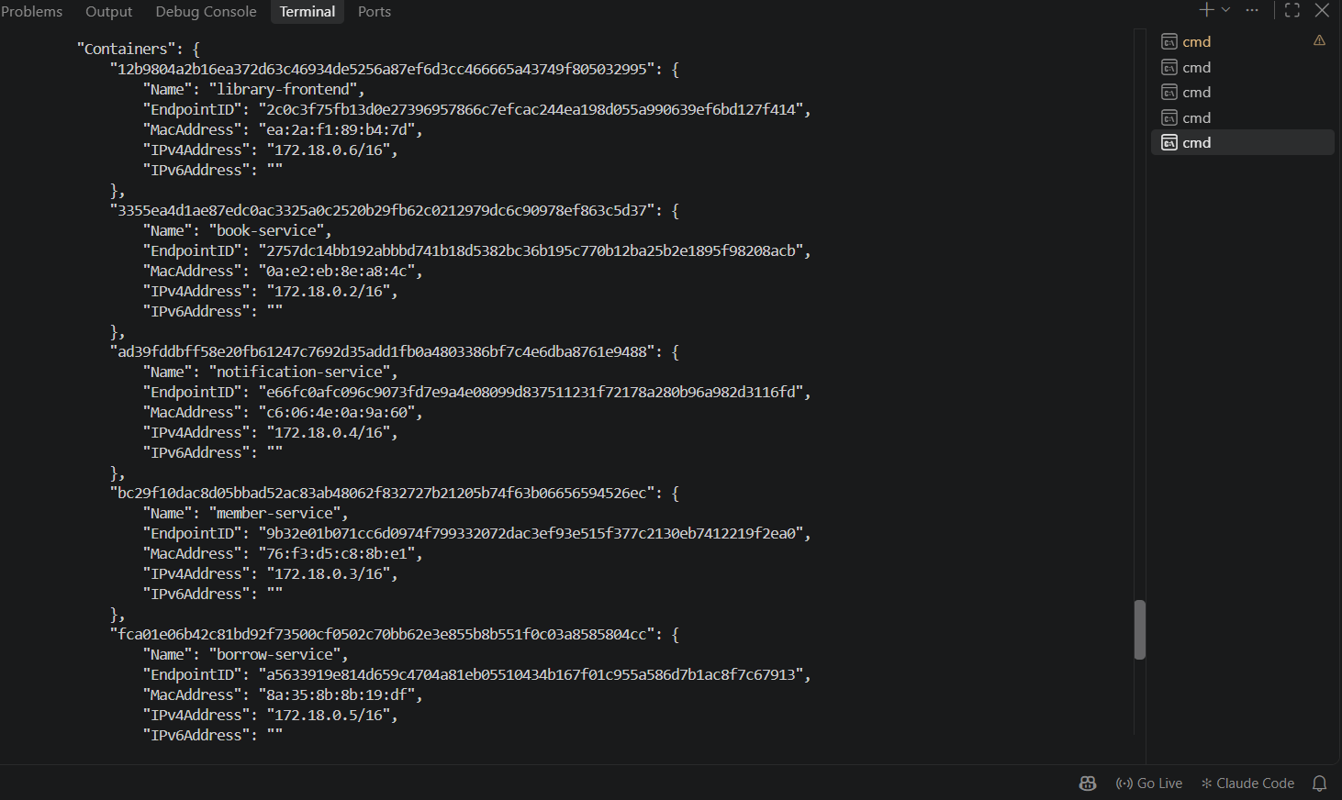
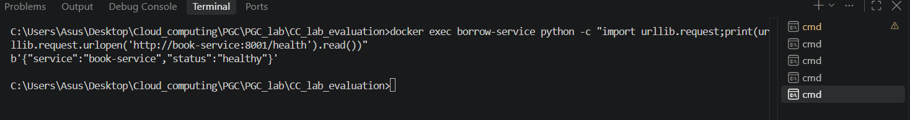
Services find each other by name, not by IP
CP3 · NETWORK
docker exec … call by service name (screenshot 29)
Compose creates a user-defined bridge network, library-net; all 5 containers join it
Docker's built-in DNS turns book-service into the container's IP
The URL comes from an environment variable, so the same code runs locally (127.0.0.1) and in Docker (service name)
Inside a container, localhost means that container only — so names are required
docker network inspect library-net (screenshot 28)
book-service
172.18.0.2
member-service
172.18.0.3
notification-service
172.18.0.4
borrow-service
172.18.0.5
library-frontend
172.18.0.6
Notes:
script.md 4.1–4.2. docker network inspect library-net → all 5 containers with IPs. docker exec borrow-service python -c ... opens http://book-service:8001/health from inside the Borrow container; Docker's DNS resolves the name. IPs can change; names do not.

Slide 10
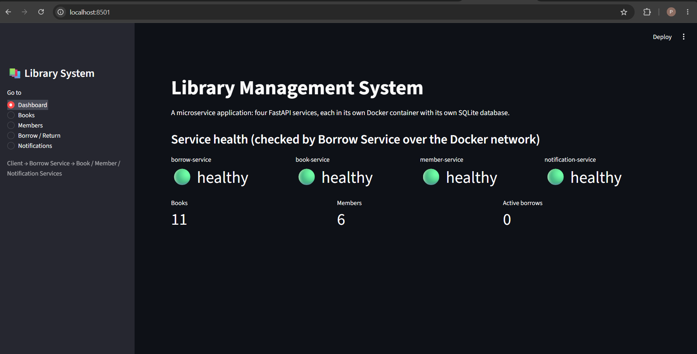
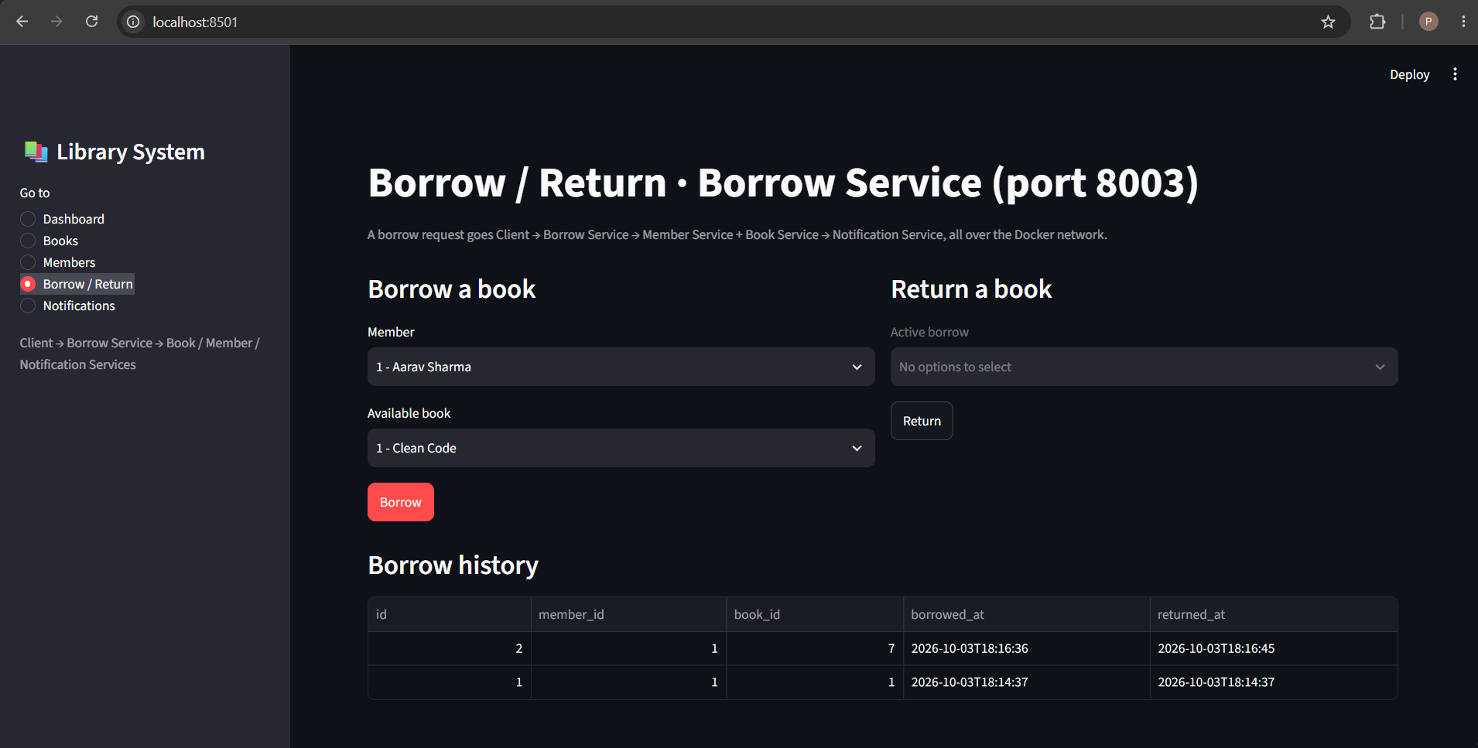
End-to-end: a borrow from the browser
CP3 · NETWORK
Dashboard: health of all services, checked by Borrow (screenshot 30)
Borrow / Return page (screenshot 33)
One click = Client → Borrow → Member → Book → Borrow DB → Notification → reply to client. Proof: docker compose logs --tail 5 borrow-service book-service member-service notification-service
Notes:
script.md 4.3–4.4. Open http://localhost:8501. Dashboard: Borrow checked the other three over the network. Borrow / Return: borrow a book, show success + notification. docker compose logs --tail 5 ... proves the request passed through each container. Optional: docker stop notification-service → borrow still works.

Slide 11
Workload design: one API, five levels, 60 s each
CP4 · WORKLOAD
API under test
Test | Concurrent requests | Duration
W1 | 1 | 60 s
W2 | 2 | 60 s
W3 | 4 | 60 s
W4 | 8 | 60 s
W5 | 16 | 60 s
GET /borrow/check?member_id=1-5&book_id=1-10
1
Crosses services
Each request: Borrow → Member + Book. Tests containers and the network — the manual's Client → S1 → S2 / S3 path.
2
Read-only
No data changes, so all five levels run under identical conditions. POST /borrow would borrow all 10 books in the first second, then fail with 409.
wait_time = constant(0)
Each Locust user sends its next request the moment the reply arrives, so it always has exactly one request in flight.
Users = concurrent requests. 10 s pause between levels.
3
Real work
2 outgoing HTTP calls, 2 SQLite reads, JSON parsing per request.
Notes:
script.md 5.1. Why /borrow/check: crosses services (Borrow → Member + Book), read-only so every level has identical conditions (POST /borrow would run out of books in a second), does real work. Levels are exactly the manual's suggestion. wait_time = constant(0) makes users = concurrent requests.

Slide 12
locustfile.py — what one simulated user does
CP4 · WORKLOAD
class LibraryUser(HttpUser):
wait_time = constant(0)
@task
def check_borrow(self):
member_id = random.randint(1, 5)
book_id = random.randint(1, 10)
self.client.get(
f"/borrow/check?member_id={member_id}"
f"&book_id={book_id}",
name="/borrow/check")
HttpUser
One simulated user. Locust starts -u copies of it.
constant(0)
No pause between requests → users = concurrency.
@task
The action each user repeats in a loop.
randint
Random existing member (1–5) and book (1–10), so every reply should be 200.
client.get
Sends the request and times it until the full reply arrives. Non-2xx or error = failure.
name=
Groups every URL into one statistics row.
python -m locust -f loadtest\locustfile.py --host http://127.0.0.1:8003
Notes:
script.md 5.2. Line by line. HttpUser = one simulated user; Locust makes -u copies. @task repeats forever. self.client.get measures the time from send to full reply and counts non-2xx or errors as failures. name= groups all URLs into one statistics row. Host is given on the command line.

Slide 13
run_workloads.py — 5 levels + monitoring in one run
CP4 · WORKLOAD
Main thread
for W1 … W5
1, 2, 4, 8, 16 users; 10 s cooldown between
Locust headless, 60 s
writes raw/W3_4u_stats.csv …
Read 'Aggregated' row
requests, failures, avg, median, 95 %, max, req/s
Outputs
observation_table.csv
one row per level; CPU & memory = sum of 4 containers
container_usage.csv
per container, per level
raw/
Locust CSVs + every sample
Background thread
StatsSampler
docker stats --no-stream every ~2 s, tagged W1…W5
~30 samples / container / level
pause samples discarded
Group by workload + container
avg CPU, max CPU, avg MiB
python -m locust -f loadtest\locustfile.py --headless -u 4 -r 4 -t 60s --host http://127.0.0.1:8003 --csv results\raw\W3_4u --only-summary --stop-timeout 5
--headless
no web UI
-u 4
4 users
-r 4
start 4 users/s
-t 60s
run 60 s
--csv
save CSV files
--only-summary
final table only
--stop-timeout 5
let in-flight finish
Notes:
script.md 5.3. Two things run at the same time: Locust (main thread) and a sampler thread calling docker stats --no-stream every ~2 s (~30 samples per container per level; samples during the 10 s pause are discarded). After each level the Aggregated row of the Locust CSV is read. At the end, samples are grouped and summed to make the two result CSVs. Explain every flag in the command.

Slide 14
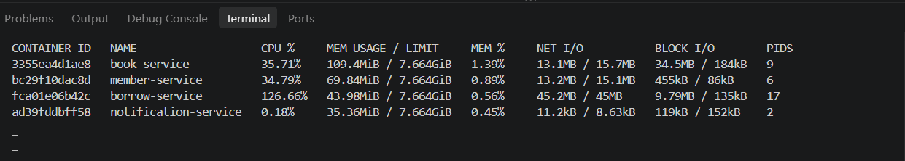
Monitoring every container with docker stats
CP4 · WORKLOAD
docker stats book-service member-service borrow-service notification-service — during W5, 16 users (screenshot 43)
CPU %
100 % = one core. Borrow 126.66 % ≈ 1.27 cores
MEM USAGE
RAM in MiB; limit 7.664 GiB (no limit set)
NET I/O
Running total in / out since start — not a rate
PIDS
Threads: Borrow 3 (W1) → 17 (W5), Uvicorn thread pool
Moment | book | member | borrow | notification | Screenshot
Idle, before test | 0.18 % | 0.32 % | 0.18 % | 0.24 % | 37
During W1 (1 user) | 36.74 % | 35.03 % | 54.03 % | 15.27 % | 38
During W5 (16 users) | 35.71 % | 34.79 % | 126.66 % | 0.18 % | 43
Notes:
script.md 5.4. Read the W5 screenshot column by column. CPU% is per core (100% = 1 core, 16 logical CPUs → max 1600%). NET I/O is a running total. PIDS 3 → 17 for Borrow: Uvicorn runs def endpoints in a thread pool. Notification is near 0 in this snapshot because /borrow/check never calls it.

Slide 15
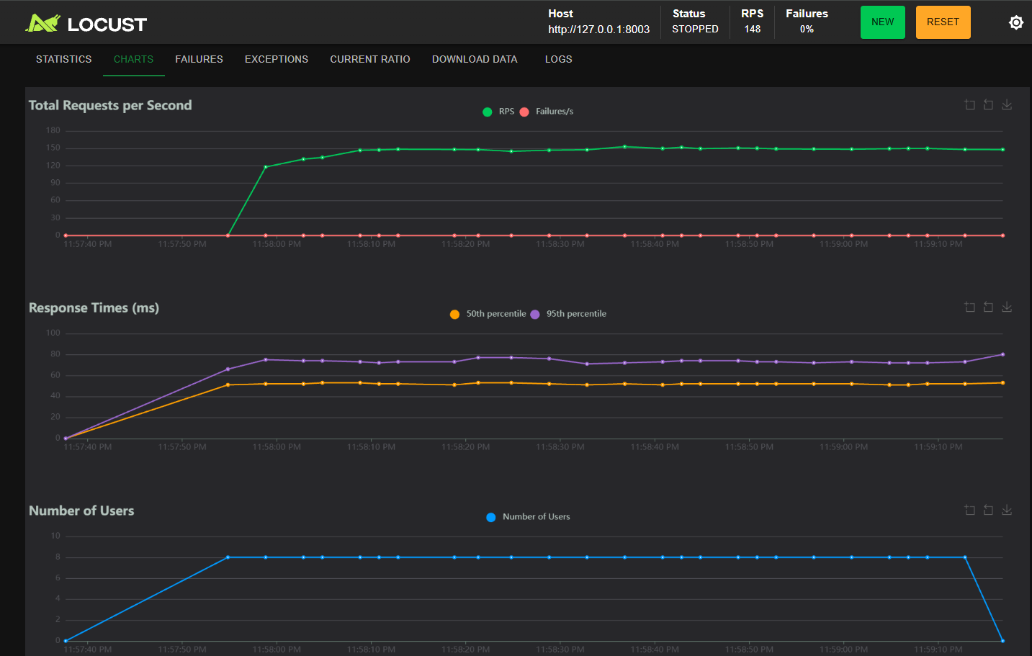
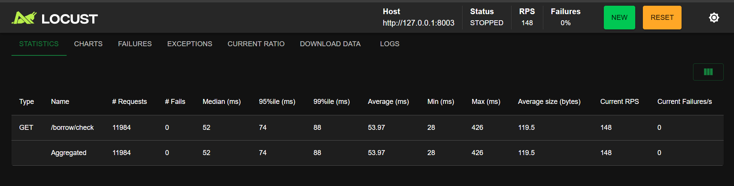
Locust web UI at 8 users repeats the result
CP4 · WORKLOAD
Statistics tab, 8 users (screenshot 35)
148
53.97
0
req/s (UI)
ms average
failures of 11,984
Charts tab: RPS, response times, users (screenshot 36)
Same load, scripted W4 (8 users): 149.9 req/s, 53.2 ms.
Two separate runs agree within 1–2 % → the measurement repeats well.
Notes:
Screenshots 35–36, from python -m locust -f loadtest\locustfile.py --host http://127.0.0.1:8003, then http://localhost:8089 with 8 users. 148 RPS / 53.97 ms vs scripted W4 (8 users) 149.9 / 53.2 → the measurement repeats. Charts: RPS flat ~148, median ~52 ms, 95th ~74 ms, failures 0.

Slide 16
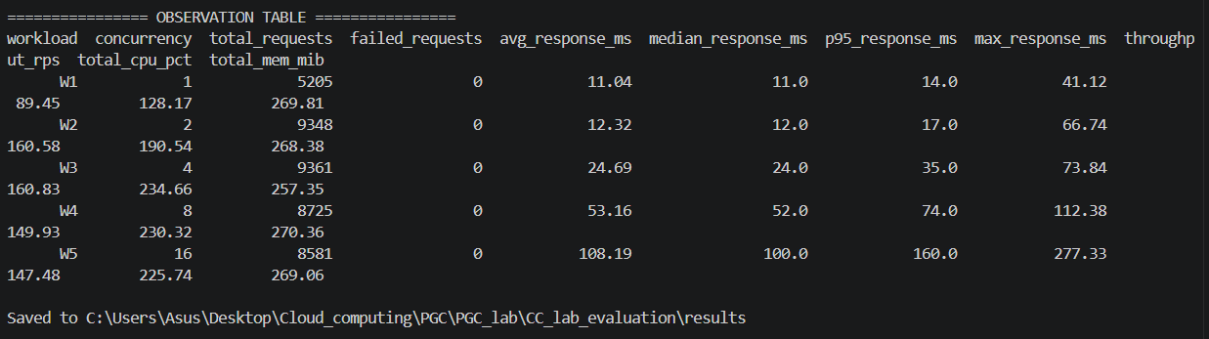
Which command produced each screenshot
CP4 · WORKLOAD
Screens | Command | What it shows
35 – 36 | python -m locust -f loadtest\locustfile.py --host http://127.0.0.1:8003 | Locust web UI, 8 users
37, 38, 43 | docker stats book-service member-service borrow-service notification-service | CPU / memory: idle, W1, W5
39 – 42, 44 | python loadtest\run_workloads.py | Console output of each level W1–W5
45 | python loadtest\run_workloads.py (end of run) | Final observation table
Console vs CSV
Console W1: 5,228 requests. CSV: 5,205. The CSV is saved ~0.3 s before the console summary. Difference < 1 %. We report the CSV.
Final table printed by run_workloads.py (screenshot 45)
Notes:
script.md 5.5. Know this table by heart. Console vs CSV: the CSV is written ~0.3 s before the console summary, so the console shows slightly more requests (W1 5,228 vs 5,205, <1 %). The report uses the CSV values.

Slide 17
Observation table — all measured values
CP5 · ANALYSIS
Workload | Users | Requests | Avg (ms) | Median | 95th pct | Throughput (req/s) | Failed | CPU, 4 svc (%) | Memory (MiB)
W1 | 1 | 5,205 | 11.04 | 11 | 14 | 89.45 | 0 | 128.2 | 269.8
W2 | 2 | 9,348 | 12.32 | 12 | 17 | 160.58 | 0 | 190.5 | 268.4
W3 | 4 | 9,361 | 24.69 | 24 | 35 | 160.83 peak | 0 | 234.7 | 257.4
W4 | 8 | 8,725 | 53.16 | 52 | 74 | 149.93 | 0 | 230.3 | 270.4
W5 | 16 | 8,581 | 108.19 | 100 | 160 | 147.48 | 0 | 225.7 | 269.1
41,220
0
160.8 req/s
11 → 108 ms
requests in total
failed at every level
peak throughput (W3, 4 users)
avg response, W1 → W5
Requests, response times, throughput, failures: Locust CSV (Aggregated row). CPU and memory: average of ~30 docker stats samples per container, summed over the 4 services (100 % = one core).
Notes:
script.md 6.1. Locust columns come from the Aggregated row of each W*_stats.csv; CPU and memory are the average of ~30 docker stats samples per container, summed over the 4 containers. Read top to bottom: W1→W2 +80% throughput at same speed; W3 peak and saturation; W4–W5 only waiting; 0 failures; memory flat.

Slide 18
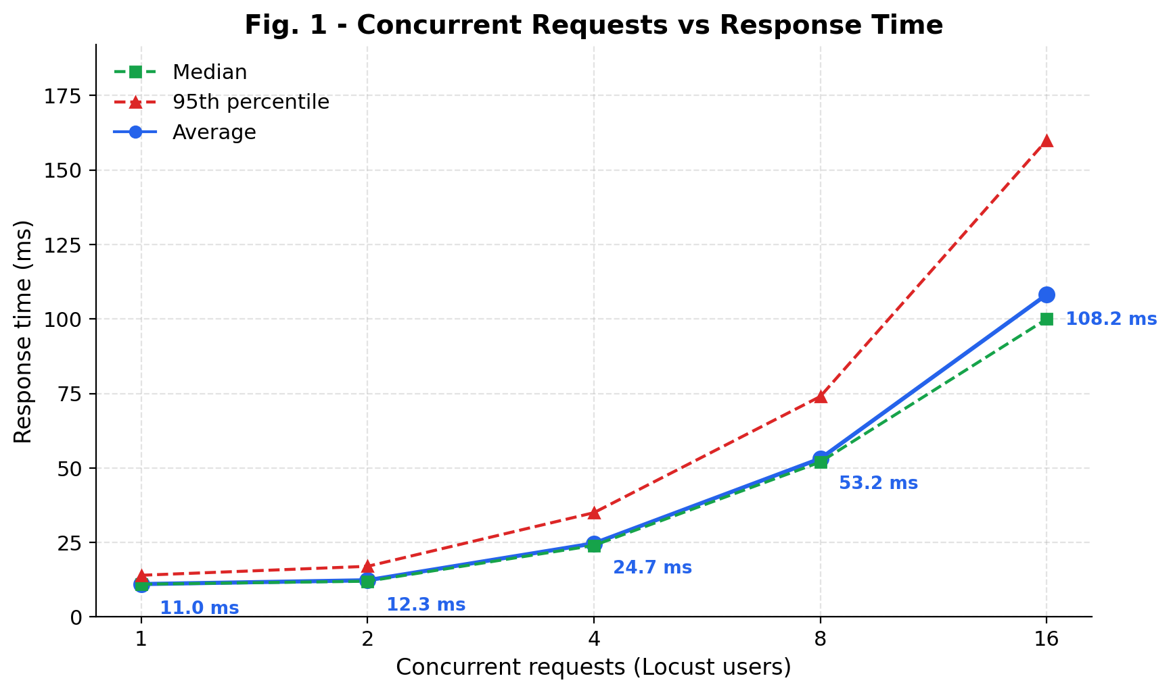
Fig. 1 — Response time doubles after saturation
CP5 · ANALYSIS
11 → 108 ms
average, 1 → 16 users
12 → 25 → 53 → 108
ms: ×2 per doubling after W2
1 → 2 users: almost flat. Spare capacity, no waiting.
From 2 users on, doubling users doubles the time: requests wait in a queue.
95th percentile (red) rises fastest: 14 → 160 ms.
Notes:
Manual graph 1. x-axis log base 2 (1,2,4,8,16 evenly spaced). Average (blue), median (green dashed), 95th percentile (red dashed). Median: half faster. 95th: 95% faster. W5 avg 108 > median 100 because of a slow tail (max 277 ms).

Slide 19
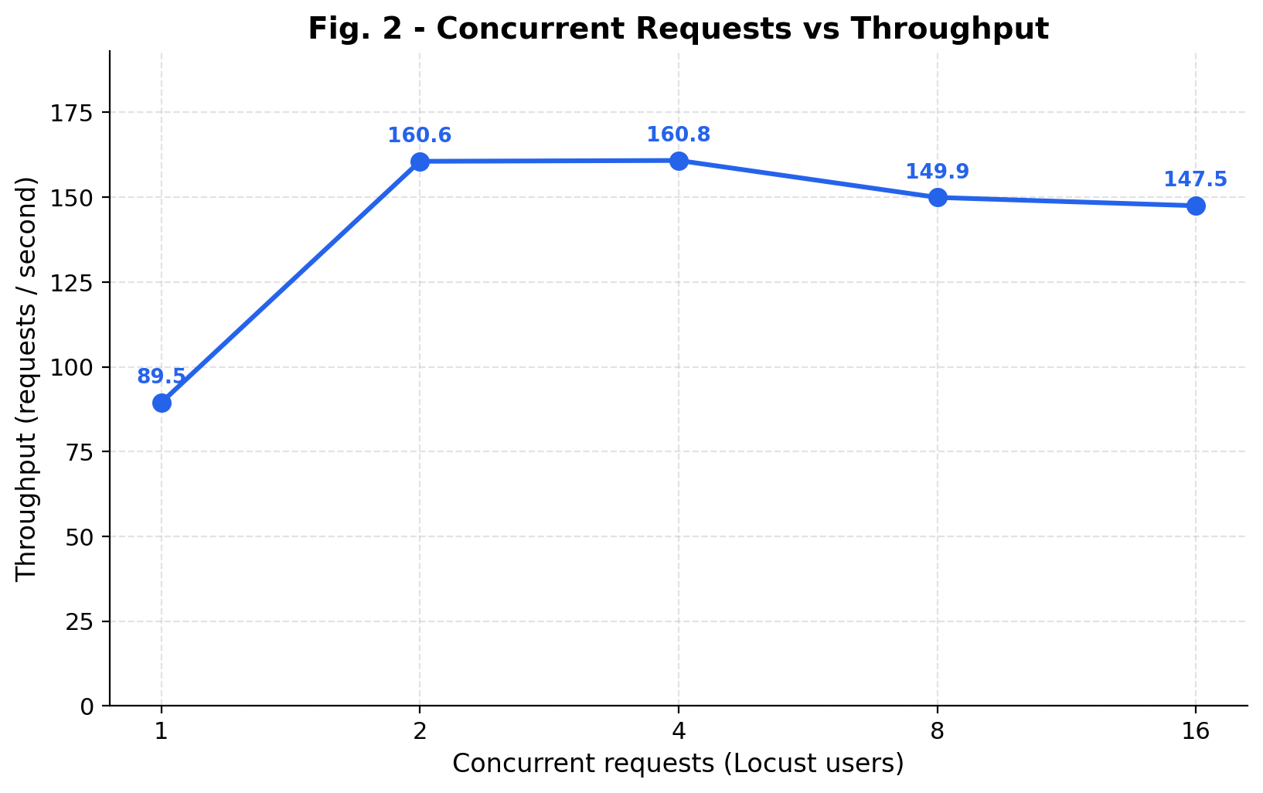
Fig. 2 — Throughput peaks at about 160 req/s
CP5 · ANALYSIS
160.8 req/s
peak at 4 users (W3)
89.5 → 147.5
req/s at 1 and 16 users
1 user: one request at a time, ~11 ms each → 1000 ÷ 11 ≈ 90 req/s.
2 users: +80 %. 4 users: peak, the system's capacity.
8–16 users: −8 %. More threads fight over the busy Borrow process.
Notes:
Manual graph 2. Per-user throughput: 89, 80, 40, 19, 9 req/s — the total is fixed, shared by more users. Drop after peak: PIDS 3→17 in Borrow, threads compete for the GIL.

Slide 20
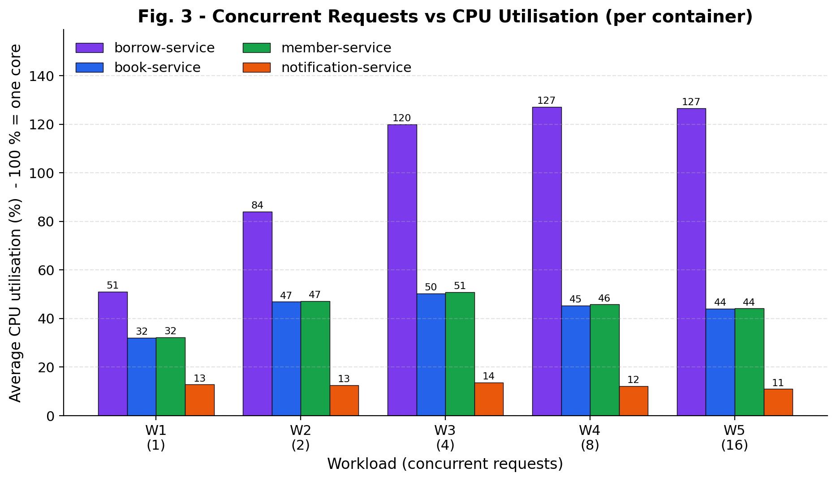
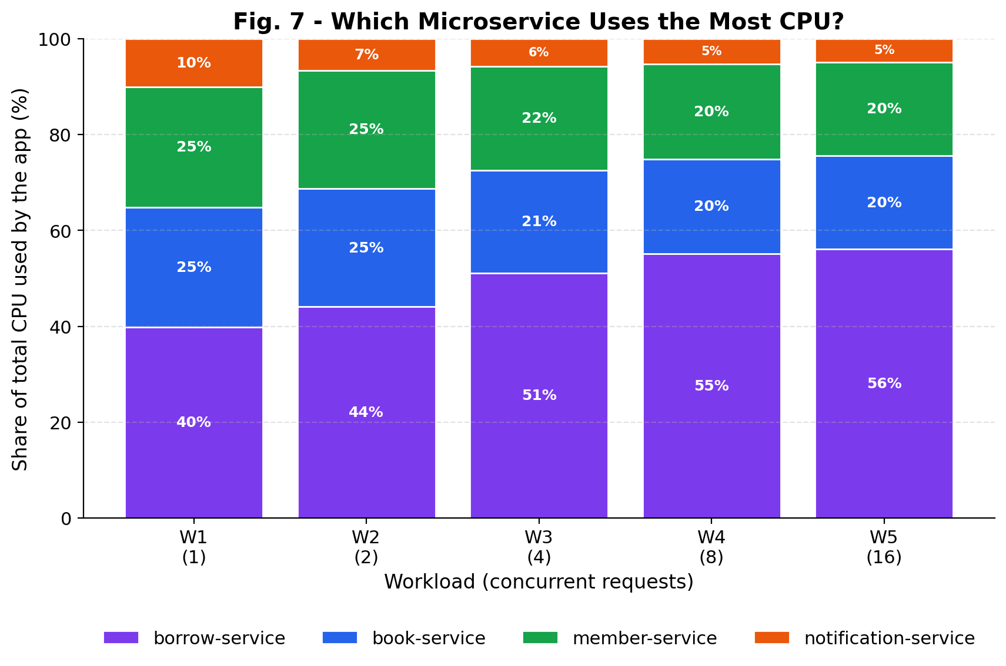
Fig. 3 & 7 — Borrow's CPU is the bottleneck
CP5 · ANALYSIS
51 → 127 %
≈ 45–50 %
40 % → 56 %
11–14 %
Borrow CPU; flat from W3, where throughput stopped
Book & Member: waiting for Borrow
Borrow's share of app CPU
Notification: healthcheck only
Notes:
Manual graph 3 + share. Borrow 51→84→120→127→127 %: stops rising exactly where throughput stops (W3). Book/Member ~45–50 %, waiting for Borrow. Notification 11–14 % = healthcheck only (never called by /borrow/check). Share: Borrow 40 % → 56 % of the app's CPU.

Slide 21
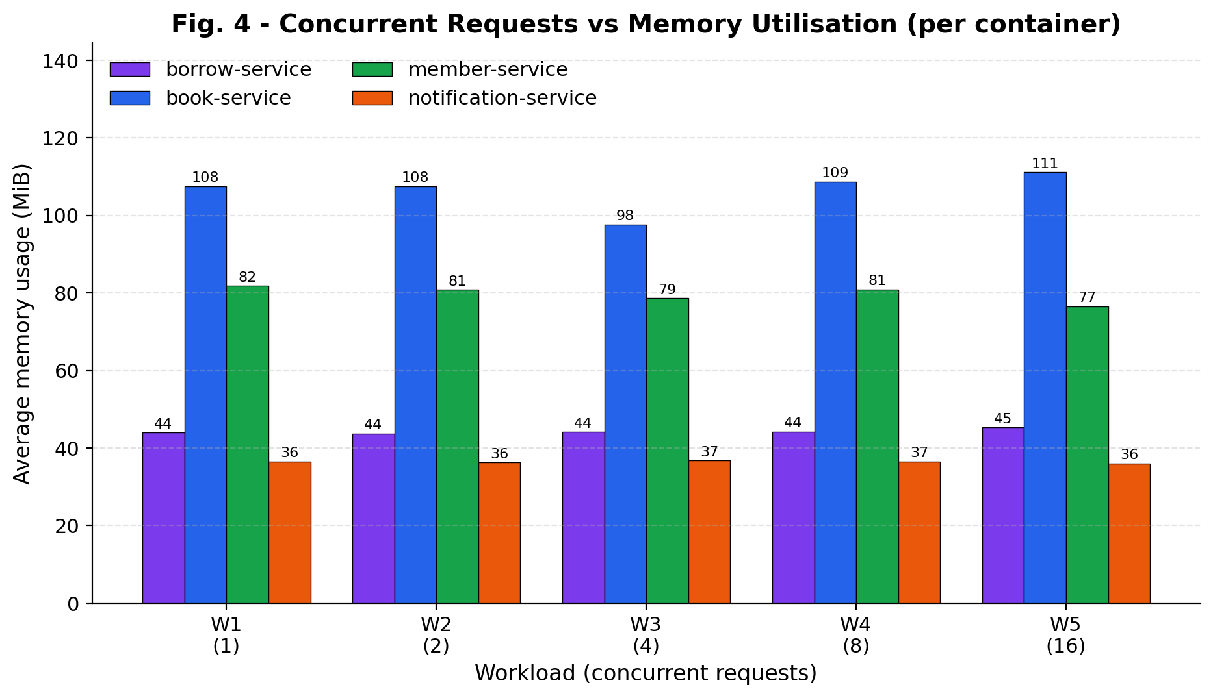
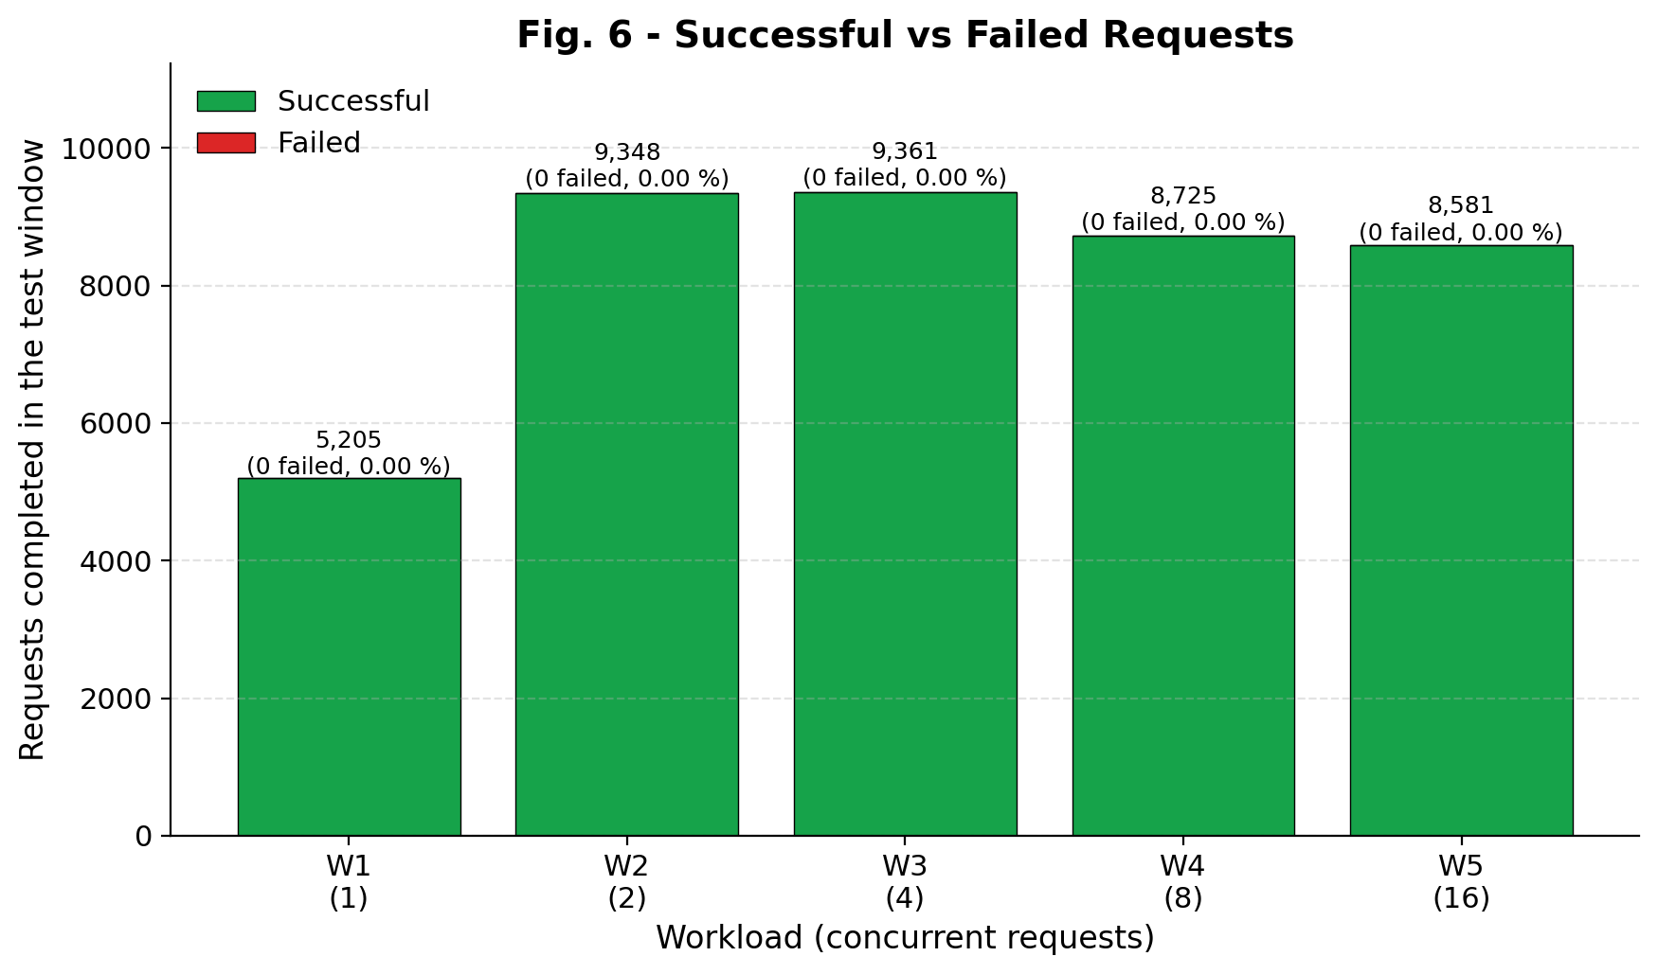
Fig. 4 & 6 — Memory flat, zero failures
CP5 · ANALYSIS
257–270 MiB
< 300 MiB
41,220
0 failed
total memory, 1 → 16 users
of 7.66 GiB — CPU limits, not memory
requests completed
slower under load, never broke
Notes:
Manual graph 4 + failures. Memory per container is the same at every level and was already there at idle (screenshot 37: 104.7/78.1/42.5/35.4 MiB). Under 300 MiB of 7.66 GiB. All 41,220 requests succeeded; bar heights differ only because throughput differs. Max single response 277 ms vs 5 s timeout.

Slide 22
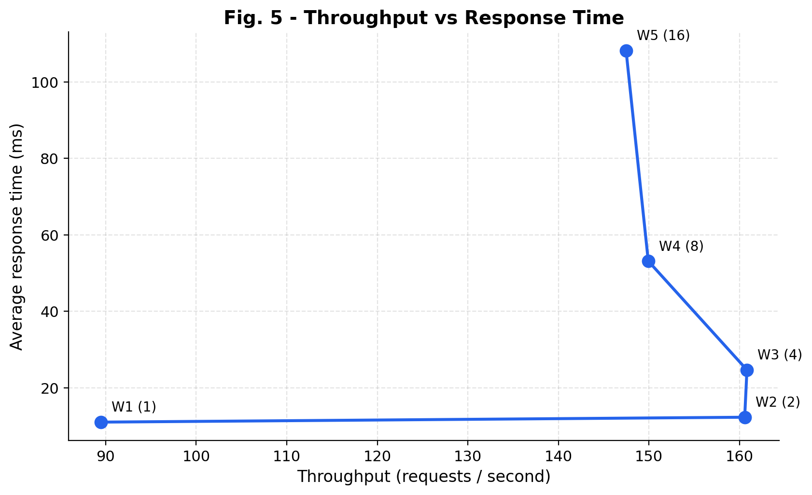
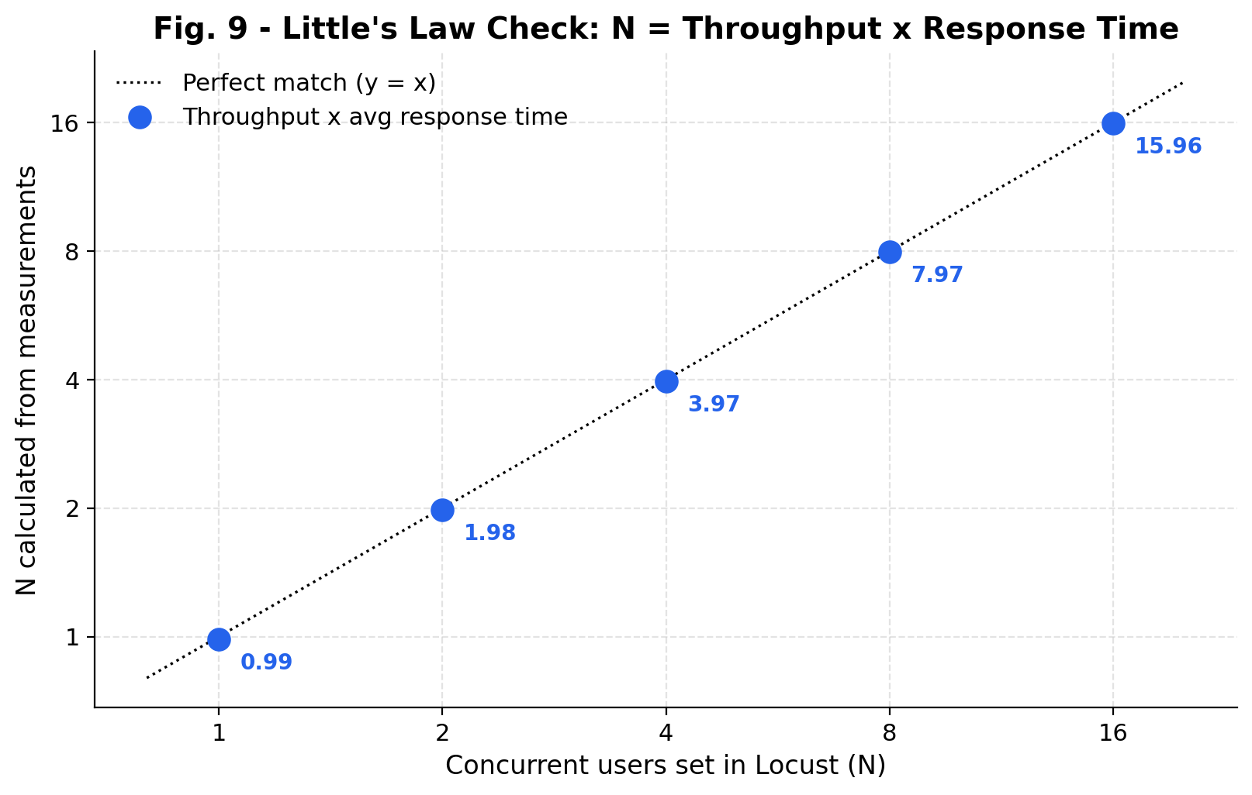
Fig. 5 & 9 — The knee and Little's Law
CP5 · ANALYSIS
Knee: right = more work at the same speed; up = only waiting. Best operating point: 2–4 concurrent requests (max throughput at 12–25 ms).
N = X × R (users = throughput × response time)
 | W1 | W2 | W3 | W4 | W5
Users N | 1 | 2 | 4 | 8 | 16
X × R | 0.99 | 1.98 | 3.97 | 7.97 | 15.96
Notes:
Fig 5: x throughput, y response time. Moves right W1→W2 (useful work), then straight up (only queueing). Best point 2–4 concurrent requests. Fig 9: N = X × R. W3: 160.83 × 0.02469 = 3.97. All points on the diagonal within 1 % → throughput and response time are consistent; and R = N / X explains the doubling.

Slide 23
Why the Borrow Service limits the whole system
CP5 · ANALYSIS
1
2
3
Most work per request
One process + Python GIL
Too many threads
Receives the request, makes 2 outgoing HTTP calls (Member, Book), parses 2 JSON replies, builds its reply. Book and Member do one SQLite lookup each.
One Uvicorn worker. The GIL lets one Python process run Python code on about one core. Borrow tops out at ~1.27 cores while 16 logical CPUs exist.
Past the peak, Uvicorn's thread pool grows (PIDS 3 → 17). Threads compete for the GIL, so throughput drops 8 % (160.8 → 147.5).
Hidden overhead we found: Docker healthchecks
Every 5 s Docker starts a new Python interpreter in each container to call /health. Notification gets no test traffic, yet uses 11–14 % CPU on average (samples spike to 66–69 %). Fix: 30 s interval or a lighter check such as curl.
Notes:
script.md 6.12 Q5/Q6. Three reasons + the hidden healthcheck cost. If asked how CPU > 100% with the GIL: the GIL is released while waiting on the network, so a bit more than one core is used.

Slide 24
Removing the bottleneck, and our limitations
CP5 · ANALYSIS
Next steps (not implemented)
Limitations
uvicorn --workers 4 for Borrow
several processes → several cores
Locust on the same laptop
shares the CPU; small effect with 16 logical CPUs
↑
!
Several Borrow containers + load balancer
same idea at container level
One 60 s run per level
UI repeat at 8 users agreed within 1–2 %
↑
!
async def + httpx.AsyncClient
call Member and Book in parallel
docker stats every ~2 s
~30 snapshots per level; short spikes sampled unevenly
↑
!
Lighter / slower healthchecks
frees 11–14 % CPU per container
No CPU / memory limits
results depend on this laptop
↑
!
Short cache of member / book lookups
fewer downstream calls
Docker Desktop uses a WSL2 VM
small virtualisation overhead
↑
!
Notes:
script.md 6.13–6.14. These were not implemented; they are next steps. Say the limitations before the evaluator finds them.

Slide 25
Conclusion
CP1
4 independent FastAPI services, own database each, REST APIs tested on their own
CP2
One Dockerfile per service, 5 images, deployed with one docker compose up -d
CP3
Services talk over library-net by name; one borrow passes through all four
CP4
Load-tested at 1, 2, 4, 8, 16 concurrent requests with every container monitored
CP5
Peak ≈ 160 req/s; Borrow's CPU is the bottleneck; memory flat; 0 of 41,220 failed
Thank you — questions welcome
Notes:
script.md section 7. Five sentences, one per checkpoint, then stop and invite questions. Section 8 of script.md lists 20 hard questions with answers.

