Slide 1

Department of Computer Science and Engineering - AI
Dependency Aware Parallel Build System
Gate 1 — S1 Functional Requirements Engineering | Theme: System Software and Developer Tools
E1 Build Graph Engine | E2 Incremental Rebuild Engine | E3 Parallel Execution Engine | E4 Build Telemetry Engine
Sl. No. | Name | SRN | Engine Owned
1. | Sunayana Kamath | 01fe24bci073 | E1 Build Graph Engine
2. | Bachu Venkata Siva Jaideep | 01fe24bci084 | E2 Incremental Rebuild Engine
3. | Prathamesh Eedigi | 01fe24bci006 | E3 Parallel Execution Engine
4. | Nilaksha Nath | 01fe24bci087 | E4 Build Telemetry Engine
Guide: ____________________ , Department of CSE-AI

Slide 2
Where Our Engine Sits
OUR PROJECT
CMakeLists.txt
written by the developer
CMake
generates build.ninja
Converter (E1)
build.ninja → YAML task file
Our engine (E1–E4)
orders, skips, runs tasks in parallel, reports
GCC / Clang
compiles and links one command at a time
Our project is the execution layer of a build system, the same layer as Ninja and Make.
It does not generate the build description (that is CMake's job) and does not compile code (that is GCC's and Clang's job).
It decides three things for every build: in which order the tasks must run, which tasks can be skipped because nothing they depend on changed, and which tasks can run at the same time.
In the terms of "Build Systems à la Carte": a topological scheduler (order) combined with a verifying-trace rebuilder (content hashes decide what to skip).

Slide 3
Stakeholders and Needs (S0)
Need | Stakeholder | Need statement
N1 | Developer | A command runs only after every file it reads has been produced.
N2 | Developer | The tool refuses an input that cannot be built correctly and says exactly what is wrong.
N3 | Developer | The developer does not wait for commands whose output cannot have changed.
N4 | Developer | A command is skipped only if its output would be exactly the same, including header changes.
N5 | Developer | Independent commands run at the same time, but never more than the machine can handle.
N6 | Developer | On failure, nothing new starts, running work finishes, and failures and missing outputs are reported.
N7 | Developer | The developer sees what ran, what was skipped and how long each command took.
N8 | CI / Release Engineer | A pipeline knows success or failure, and which command failed, from the tool's result alone.
Developer = direct user. CI / Release Engineer = indirect stakeholder: an automated pipeline that runs builds without a person watching.

Slide 4
Scope Decisions Behind the Requirements
Input
Language scope
Failure policy
CMake writes the build description (build.ninja). A converter turns it into our own YAML task file, so the engine works on its own simple format and can be tested with hand-written task files.
C and C++ projects only: the compile, link and archive commands that CMake produces. Header dependencies are read from the dependency file each compiler writes.
When a command fails, no new commands start. Commands already running are allowed to finish and their results are kept, so the next build does not redo valid work.

Slide 5
Functional Requirements (1/2)
FR ID | Description (the system shall …) | Priority | Need | Engine
FR-01 | Convert CMake's build.ninja into the YAML task file: expanded command, inputs, outputs, wait-for list and dependency-file path for every step. Stop and name any unsupported construct. | Mandatory | N1, N2, N4 | E1
FR-02 | Before running anything, refuse a task file with a task without command or output, two tasks with the same output, or a needed file that nothing produces; name the task and reason. | Mandatory | N2 | E1
FR-03 | Before running anything, refuse a task file whose tasks form a cycle, and print the cycle's tasks in order. | Mandatory | N1, N2 | E1
FR-04 | Start a task only after every task it depends on has completed successfully or been skipped. | Mandatory | N1 | E1
FR-05 | Run ready tasks at the same time as separate OS processes, never more than the worker limit (default = number of CPU cores). | Mandatory | N5 | E3
FR-06 | Capture each command's output; a task succeeds only if it exits with code 0 and every declared output exists. | Mandatory | N4, N6 | E3
FR-07 | On failure, start no new tasks, let running tasks finish and keep their results, and mark tasks never started as not run. | Mandatory | N6 | E3
A functional requirement is a behaviour of the system that can be tested as pass or fail. Each one traces to at least one need.

Slide 6
Functional Requirements (2/2)
FR ID | Description (the system shall …) | Priority | Need | Engine
FR-08 | Skip a task only if its command, input contents (including recorded headers) and output contents are unchanged since its last success. | Mandatory | N3, N4 | E2
FR-09 | After a compile succeeds, read the compiler's dependency file and record every header in it as an input of that task. | Mandatory | N4 | E2
FR-10 | Keep skip information between runs, save it only after success, and run every task if it is missing or unreadable. | Mandatory | N3, N4 | E2
FR-11 | Report each task as run, skipped, failed or not run, with its time, the total time and the error output of failed tasks. | Mandatory | N6, N7 | E4
FR-12 | Exit with status 0 only if every task succeeded or was skipped, and write a machine-readable report naming every failed task. | Mandatory | N8 | E4
FR-13 | Allow tasks to be marked heavy, with a separate limit on how many heavy tasks run at once. | Challenge | N5 | E3
FR-14 | Treat order-only dependencies exactly: wait for them, but do not rerun only because they changed. | Challenge | N3 | E2
A functional requirement is a behaviour of the system that can be tested as pass or fail. Each one traces to at least one need.

Slide 7
Non-Functional Requirements
NFR ID | Category | Requirement | Measurable Target | Engine
NFR-01 | Reliability | An incremental build produces exactly the same outputs as a clean build. | 7 of 7 single-change experiments give output hashes identical to a clean build. | E2
NFR-02 | Reliability | Killing the engine mid-build never leads to wrong outputs on the next build. | 60 of 60 random-moment kill -9 trials end with outputs identical to a clean build. | E2
NFR-03 | Reliability | On a failed command, the engine stops by itself, leaves no compiler processes and reports failure. | 60 of 60 failure runs exit within 2 × clean-build time, leave no gcc/cc1 process, exit non-zero. | E3
NFR-04 | Performance | A clean build is nearly as fast as Ninja on the same project. | Median of 5 timed runs ≤ 1.10 × Ninja's median (same machine, same worker count). | E3
NFR-05 | Performance | A build with nothing changed finishes quickly and runs no command. | Median of 5 timed runs ≤ 1 s, with 0 commands run. | E2
NFR-06 | Usability | Every refusal names the task and the broken rule. | 6 of 6 faulty inputs give a message naming the task or construct and the rule. | E1
NFR-07 | Portability | The engine works correctly with GCC and with Clang. | The NFR-01 suite passes 7 of 7 with each compiler. | E2
A non-functional requirement is a quality (how correct, how fast, how usable) with a target that is measured. The test setup is on the next slide.

Slide 8
How the NFRs Are Measured
Test project and machine
Reference tool
Clean build
One real CMake C project with at least 15 .c files and 2 shared headers (proposal: zlib), on one team laptop whose CPU, cores and RAM are recorded.
Ninja runs the same CMake output with the same worker count, so any time difference comes from our engine, not from the compiler.
Every output and the saved state of both tools is deleted first, so every command runs.
Timed measurement
Why 60 trials
7 change experiments (NFR-01)
One untimed warm-up run (files cached in memory), then 5 timed runs; the result is the median (3rd of 5 sorted), so up to 2 disturbed runs cannot change it.
Timing-dependent errors appear only in some runs. If an error appears in 1 of 20 runs, 60 trials all miss it with probability 0.95⁶⁰ ≈ 5%.
Edit a .c file; edit a shared header; touch only; change a flag and regenerate; delete a .o; corrupt a .o; revert an edit. Each compared with a clean build by SHA-256.

Slide 9
Use Cases / User Stories
ID | Actor | User Story | Main Flow | Exception Flow
UC-01 | Developer | Build my CMake project for the first time with one command and get a working program. | Convert and check the task file; run tasks in order, independent ones in parallel; record headers; save records; report; exit 0. | Invalid input or cycle → UC-04. A command fails → UC-03.
UC-02 | Developer | After an edit, only the affected work runs again. | Compare command, inputs (with headers) and outputs to saved records; rerun changed tasks and their dependents; skip the rest. | Records missing or unreadable → run everything. Output deleted or edited → that task runs.
UC-03 | Developer | A failed build stops safely and says exactly what went wrong. | No new starts; running tasks finish and are kept; report failed task, its error output and tasks not run; exit non-zero. | Two running tasks fail → both are reported.
UC-04 | Developer | An input that cannot be built correctly is refused before any work starts. | Conversion or checking finds a problem; nothing runs; the task or construct and the broken rule are printed. | Several problems → all reported in one run.
UC-05 | CI / Release Engineer | My pipeline knows from the result alone whether the build passed and which task failed. | Pipeline runs CMake and our tool; exit status 0 and the machine-readable report → continue. | Non-zero exit → read failed tasks from the report and mark the commit failed.

Slide 10
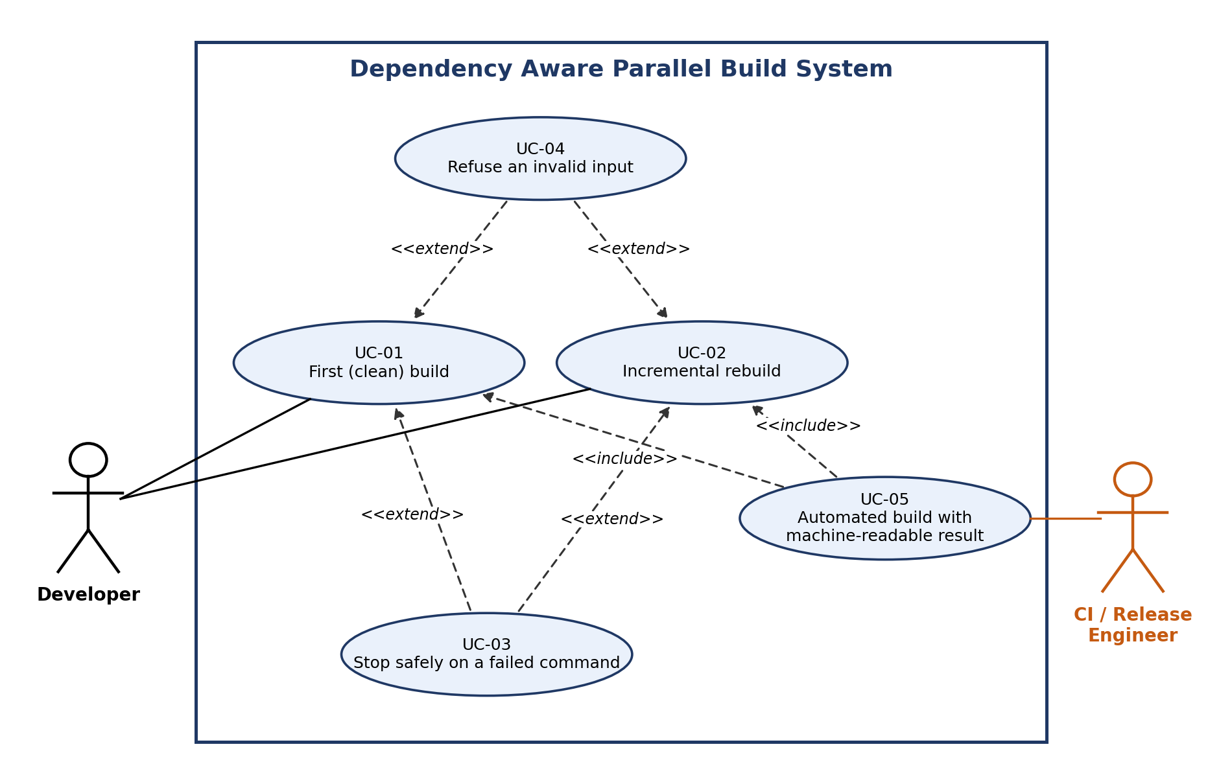
Use Case Diagram
Developer starts UC-01 (first build) and UC-02 (incremental rebuild).
CI / Release Engineer starts UC-05 (automated build).
UC-04 «extend» UC-01 and UC-02: refusal happens only when an input is invalid.
UC-03 «extend» UC-01 and UC-02: safe stop happens only when a command fails.
UC-05 «include» UC-01 and UC-02: the pipeline always runs a build.

Slide 11
Engine Decomposition: Requirement Clusters
Cluster | Responsibility Area | Requirements | Common Technical Responsibility | Engine
C1 | Build graph construction and validation | FR-01, FR-02, FR-03, FR-04, NFR-06 | Build the task graph from CMake's output, refuse invalid graphs before anything runs, and decide when each task may start. | E1 Build Graph
C2 | Incremental rebuild decisions | FR-08, FR-09, FR-10, FR-14, NFR-01, NFR-02, NFR-05, NFR-07 | Decide whether each task can be skipped by comparing current contents with saved records, and keep those records correct. | E2 Incremental Rebuild
C3 | Parallel process execution | FR-05, FR-06, FR-07, FR-13, NFR-03, NFR-04 | Run tasks as OS processes within a worker limit, judge each result, and apply the stop policy on failure. | E3 Parallel Execution
C4 | Build telemetry and result reporting | FR-11, FR-12 | Collect what happened to every task and report it to the developer and the CI pipeline. | E4 Build Telemetry
Rule: requirements are grouped when they need the same data and the same algorithm. Requirement → Cluster → Technical Responsibility → Engine → Owner.

Slide 12
Engine Decomposition: One Build, Four Engines
build.ninja
E1 Build Graph
owns: task graph, waiting counts
ready task
E3 Parallel Execution
owns: running processes, worker slots
skip? / save record
E2 Incremental Rebuild
owns: saved records (hashes)
task finished
skip or run
E1 checks the task file and releases a task when its waiting count reaches 0.
E3 asks E2 "can this be skipped?"; if not, it runs the task in a free worker slot.
On success E3 asks E2 to save the record; every event goes to E4.
events
E4 Build Telemetry
owns: event list, report
report + exit status

Slide 13
E1: Build Graph Engine
Requirements: FR-01, FR-02, FR-03, FR-04, NFR-06
Responsibility Convert CMake's build.ninja into the YAML task file, build and validate the task graph, and decide during the build when each task may start.
Core mechanism
Converter for the subset of Ninja syntax CMake produces: variable expansion, explicit / implicit / order-only edges, depfile paths.
YAML parsing; validation with a map from each output file to the task that produces it.
Cycle detection by depth-first search with three markings; the tasks still "in progress" are exactly the loop, so it can be printed in order. O(V+E).
Readiness by waiting counts (Kahn's method): a task is released when its count reaches 0.
Inputs / Outputs / State
In: build.ninja from CMake; "task finished" messages from E3.
Out: YAML task file; validated graph; ready tasks to E3; refusal messages.
State owned: task list, dependency edges, waiting count of every task.
Failure / boundary case | Handling | KPI (how we prove it)
Unsupported build.ninja construct | Stop, name the construct, run nothing | Converted build's outputs = Ninja's (AT-FR-01)
Invalid task file | Refuse; name the task and the rule | 6 of 6 faulty inputs correct (NFR-06)
Cycle in the graph | Refuse; print the cycle in order | 3 of 3 cycle fixtures (AT-FR-03)

Slide 14
E2: Incremental Rebuild Engine
Requirements: FR-08, FR-09, FR-10, FR-14, NFR-01, NFR-02, NFR-05, NFR-07
Responsibility Decide whether each task can be skipped by comparing current contents with the record saved after its last success, and keep those records correct between runs.
Core mechanism
SHA-256 of the command text and of every input and output file's contents.
Skip only if every hash equals the saved record; any difference means the task runs.
Reads the dependency file the compiler writes, so header edits are detected even though CMake does not list headers.
Record saved only after success; missing or unreadable records mean "never built", so a crash can cause extra work but never a wrong skip.
Inputs / Outputs / State
In: skip requests and "task succeeded" messages from E3; compiler dependency files.
Out: skip or run answer to E3; saved records; skip events to E4.
State owned: per-task record of hashes (command, inputs with headers, outputs); storage format fixed in S2.
Failure / boundary case | Handling | KPI (how we prove it)
Records missing or unreadable | Treat every task as never built | 7 of 7 change experiments identical (NFR-01)
Engine killed mid-build | Interrupted task has no record → reruns | 60 of 60 kill trials correct (NFR-02)
Nothing changed | Every task skipped | No-op build ≤ 1 s, 0 commands (NFR-05)

Slide 15
E3: Parallel Execution Engine
Requirements: FR-05, FR-06, FR-07, FR-13, NFR-03, NFR-04
Responsibility Run tasks as operating-system processes within a worker limit, judge each result, and apply the stop policy when a task fails.
Core mechanism
Python asyncio starts processes and waits for whichever ends first.
Counting semaphore with N slots (N = worker limit, default = CPU cores): never more than N processes, so the CPU is not oversubscribed.
Success = exit code 0 and every declared output exists.
Stop policy: after a failure, no new starts; running tasks finish and are kept. Heavy-task semaphore is a Challenge (FR-13).
Inputs / Outputs / State
In: ready tasks from E1; skip or run answers from E2.
Out: processes and captured output; "task finished" to E1; "task succeeded" to E2; events to E4.
State owned: running processes, free worker slots, the "stop started" flag.
Failure / boundary case | Handling | KPI (how we prove it)
Command fails or output missing | Task failed; stop policy applied | 60 of 60 clean stops (NFR-03)
Command cannot be started | Treated as a failed task | Reported correctly (AT-FR-06)
More ready tasks than slots | Wait for a slot; never more than N | Clean build ≤ 1.10 × Ninja (NFR-04)

Slide 16
E4: Build Telemetry Engine
Requirements: FR-11, FR-12
Responsibility Collect what happened to every task and report it to the developer and to the CI pipeline, without ever changing how the build runs.
Core mechanism
Every event is timestamped with a monotonic clock, so durations stay correct if the system clock changes.
Each task gets exactly one final status: run, skipped, failed or not run.
Exit status 0 only if every task succeeded or was skipped; the report names every failed task.
Inputs / Outputs / State
In: start, finish, skip, failure and refusal events from E1, E2 and E3.
Out: report on screen; machine-readable report file (format fixed in S2); exit status.
State owned: event list of the current build.
Failure / boundary case | Handling | KPI (how we prove it)
Many events at the same moment | Each event stored once with its time | Every task has one status (AT-FR-11)
Report file cannot be written | Print an error, exit non-zero | Exit status correct in every test (AT-FR-12)
A task failed or was not run | Exit non-zero, name it in the report | Report parses and names it (AT-FR-12)

Slide 17
Engine KPIs: How Each Engine Is Proven
Engine | KPI | Target | Measured by
E1 | Refusal accuracy | 6 of 6 faulty inputs refused with task and rule named | NFR-06 faulty-input set
E1 | Conversion fidelity | Converted build's output hashes equal Ninja's | AT-FR-01
E2 | Incremental correctness | 7 of 7 change experiments identical to a clean build | NFR-01 experiments
E2 | Crash safety | 60 of 60 kill trials end with correct outputs | NFR-02 trials
E2 | No-op build time | Median ≤ 1 s with 0 commands run | NFR-05 timed measurement
E3 | Clean-build time vs Ninja | Median ≤ 1.10 × Ninja's median | NFR-04 timed measurement
E3 | Clean stop on failure | 60 of 60 runs: no hang, no leftover process, non-zero exit | NFR-03 runs
E4 | Report completeness and exit status | Every task has exactly one status; exit status correct in every run | AT-FR-11, AT-FR-12
Sources for what to measure: Ninja's author used no-op build time as his main benchmark; Bazel's benchmarks track wall time and compare clean with incremental builds.

