Slide 1



Loan Data Analysis
Authors:
Aashay Bhujbal
Abishek Balaji
Bhavana Balagopal
Dhruv Shah
Mahadevan Ramanan
Prathamesh P Nagraj
Shruthi Elanchezhian
Smriti Manivannan
Vandan Raval

Slide 2


Agenda
01 | Introduction
02 | Data Description
03 | Data Summary
04 | Data Analysis
05 | Simple Linear Regression Model
06 | Multiple Linear Regression Model
07 | Influential Points Removal and Model Refinement
08 | Testing and Addressing Heteroskedasticity
09 | Multicollinearity Analysis and Model Refinement.
10 | Conclusion

Slide 3
Research Question
How do key economic factors such as Debt-to-Income (DTI) ratio, FICO score, and annual income influence the interest rate across various loan utilization purposes?

Slide 4

Introduction
Background of the analysis: The dataset used for this analysis comprises lending data from 2007 to 2010, sourced from Lending Club. Lending Club connects borrowers with investors.
Goal: To analyze the impact of the debt-to-income ratio on interest rates across various loan utilization purposes using an OLS model and to assess the influence of other attributes on interest rates.
Question of Interest: Does Debt to Income factor impact the interest rate across loan utilization purposes?
Expected Outcome: The analysis is expected to determine the impact of the debt-to-income ratio on interest rates and reveal how additional attributes improve the model's ability to explain interest rate variations.

Slide 5
Data Description
credit.policy
Indicates if the borrower meets LendingClub's credit underwriting criteria (1) or not (0).
purpose
The reason behind taking a loan.
Int.rate
The loan's interest rate, with higher rates assigned to riskier borrowers.
Installment
The monthly payment the borrower owes if the loan is approved.
revol.bal
The amount of credit card debt left unpaid at the end of a billing cycle.
fico
The borrower's FICO credit score, indicating creditworthiness.
log.annual.inc
The natural logarithm of the borrower's self-reported annual income.
days.with.cr.line
The total number of days the borrower has had a credit line open.
delinq.2yrs
The number of times the borrower was over 30 days late on payments in the last two years.
dti
The borrower's debt-to-income ratio, calculated as total debt divided by annual income.
inq.last.6mths
The number of credit inquiries made by lenders in the past six months.
revol.util
The percentage of available credit currently being used by the borrower.
not.fully.paid
attribute indicates whether a loan was not fully repaid, with 1 representing non-payment and 0 representing full repayment.​
​
pub.rec
The number of derogatory public records for the borrower.

Slide 6
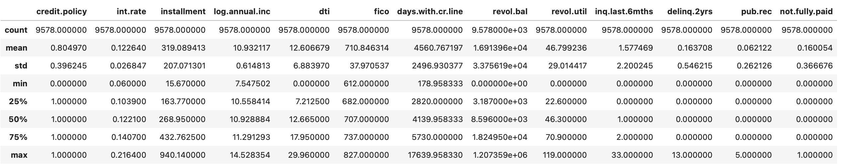
Data Summary
Credit Underwriting: About 81% of borrowers meet the lender's credit underwriting criteria, as reflected in the credit.policy data.
DTI Overview: Debt-to-Income (DTI) ratios range from 0 to nearly 30, with an average of 12.61.
Risk Assessment: Higher interest rates and lower FICO scores correlate with increased credit risk, as indicated by non-payment rates and credit policy adherence.
Creditworthiness: The data highlights diverse creditworthiness among borrowers, with FICO scores ranging from 612 to 827, crucial for risk management and loan pricing strategies.
Financial Behavior Insights: Borrowers’ DTI, revolving balance, and credit utilization offer valuable insights into financial management, enabling tailored loan products.

Slide 7
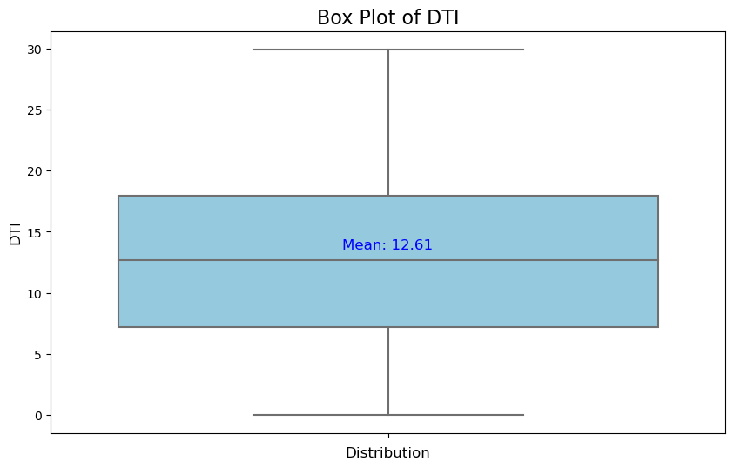
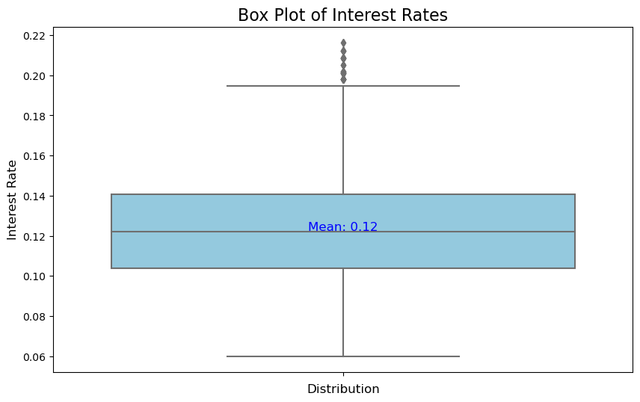
Box Plot Analysis: Debt-to-Income Ratio and Interest Rates
This box plot represents the distribution of the Debt-to-Income (DTI) ratio among borrowers, with a mean value of 12.61. The interquartile range (IQR) shows that most borrowers have a DTI ratio between approximately 7 and 18, while the whiskers indicate the minimum and maximum DTI values without significant outliers. This suggests a relatively even spread of DTI values across the dataset.
This box plot displays the distribution of interest rates in the dataset, with a mean value of 0.12 (12%). The interquartile range (IQR) shows that most interest rates fall between 0.10 and 0.14, with a few outliers reaching up to 0.22, indicating some high-interest loans. The plot suggests a concentration of loans with moderate interest rates.

Slide 8
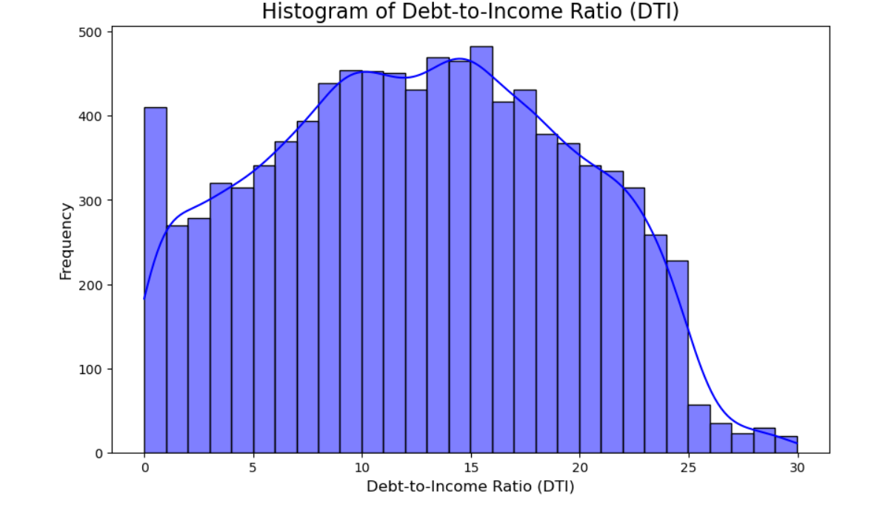
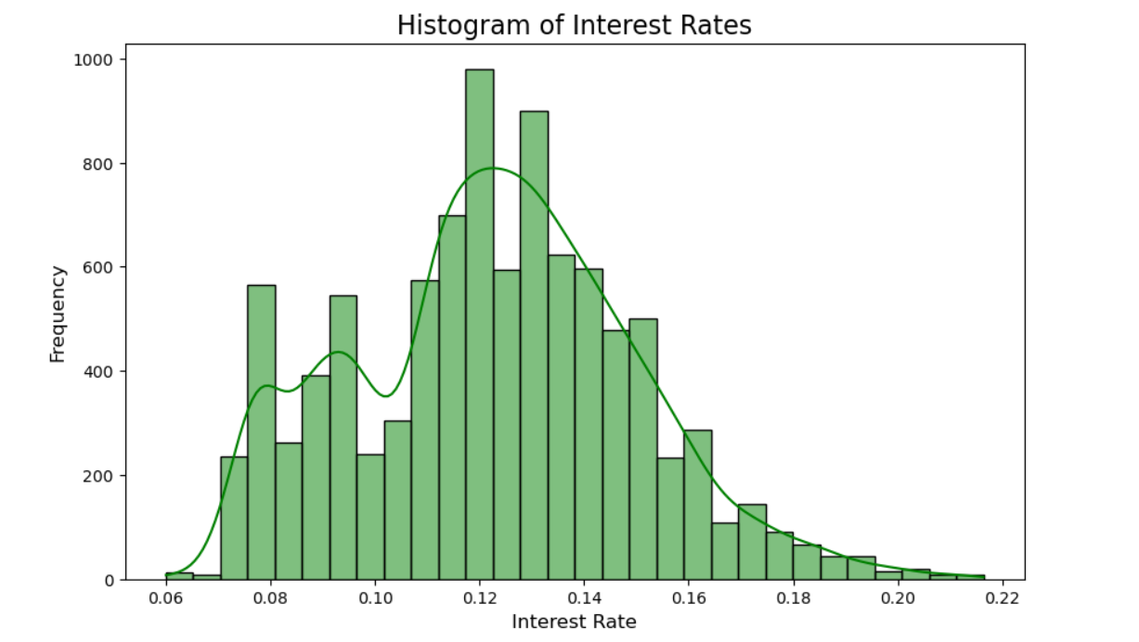
Distribution Analysis: Debt-to-Income Ratio and Interest Rates
The histogram illustrates the distribution of Debt-to-Income (DTI) ratios, with most borrowers falling between 10 and 15, indicating moderate debt levels. The DTI values range from 0 to 30, capturing a wide variety of financial situations, while extreme low or high DTIs are less common.
The histogram shows the distribution of interest rates, primarily concentrated between 10% and 14%, which is typical for most loans. Higher interest rates, above 14%, occur less frequently and are generally associated with higher-risk borrowers. This reflects lenders' risk-based pricing strategies.

Slide 9

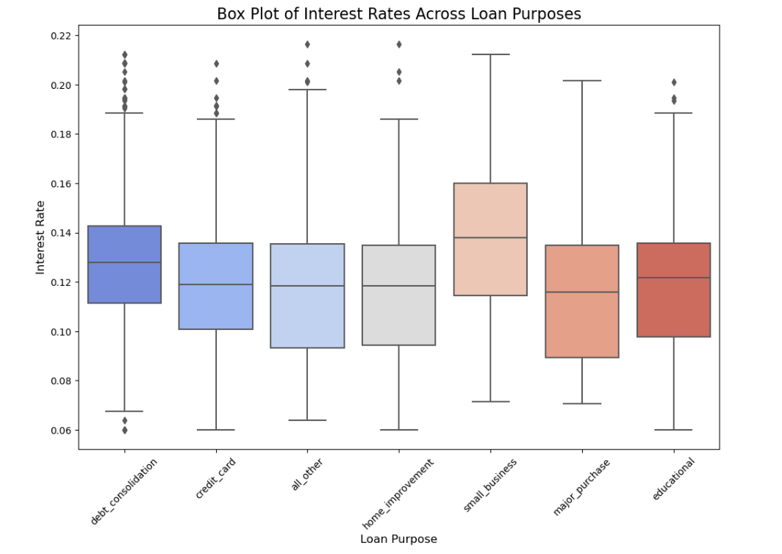
Interest Rate Variations Across Loan Purposes
The box plot highlights the variation in interest rates across different loan purposes. Loans for debt consolidation, credit cards, and other purposes show consistent interest rates with narrower interquartile ranges, while small business and educational loans have higher medians and greater variability, reflecting higher lending risks. Outliers are observed across all categories, especially for debt consolidation and small business loans, indicating some borrowers face significantly higher rates. These trends suggest that loan purposes influence interest rates, with riskier purposes often associated with higher and more variable rates.

Slide 10
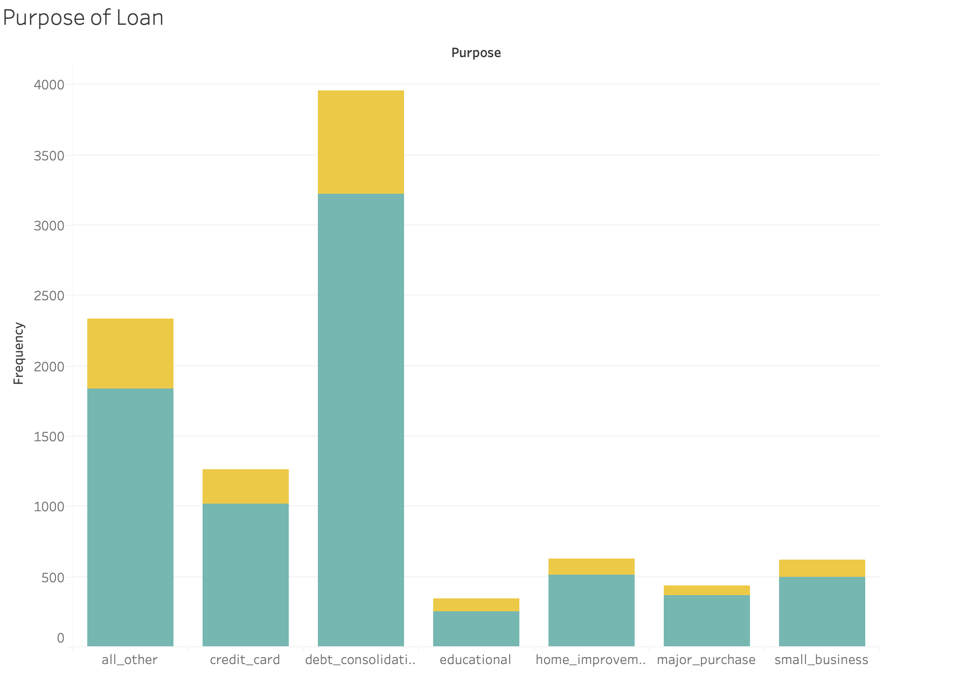
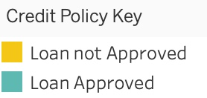
Loan Approval and Rejection Distribution Across Loan Purposes
Dominant Loan Purpose
Debt consolidation is the most common loan purpose, followed by loans for "all other" and credit card purposes.
Approval Trends
Debt consolidation loans have the highest approval rate, while educational and small business loans see a relatively higher rejection rate.
Balanced Categories
Home improvement and major purchase loans show a more balanced approval-to-rejection ratio, reflecting stricter evaluation or borrower-specific factors.
Key Takeaway
Loan approval likelihood varies significantly with the loan purpose, highlighting the role of credit policies and associated risk assessments.

Slide 11
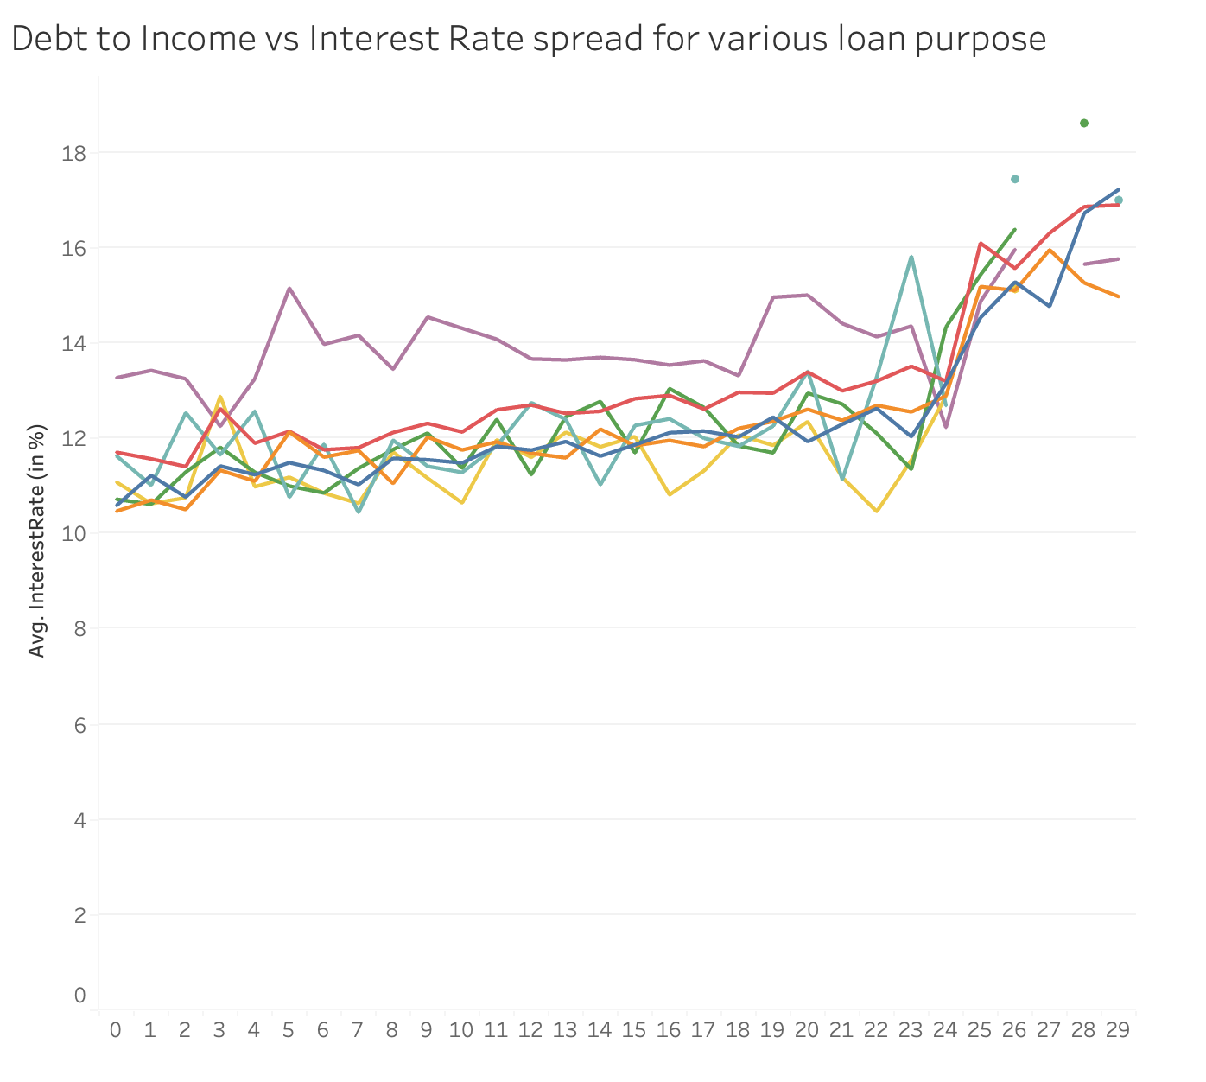
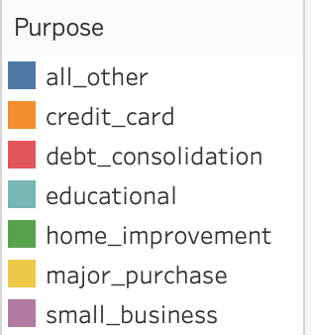
DTI vs Interest Rate
The chart highlights how interest rates increase with rising Debt-to-Income (DTI) ratios, reflecting lenders' risk assessment practices. Loan purposes such as small business and debt consolidation exhibit higher interest rates at elevated DTI levels, indicating greater perceived risk. In contrast, categories like educational loans and major purchases show more stability, with less fluctuation in rates. This insight underscores the influence of loan purpose on interest rate determination and risk-based pricing.

Slide 12
OLS Model
The OLS model is a crucial first step in identifying key relationships and setting up a framework for advanced regression techniques.
Quantifies Relationships: Measures the impact of the Debt-to-Income (DTI) ratio on interest rates, providing clear numerical insights.
Identifies Trends: Highlights whether higher DTI ratios correlate with increased interest rates, reflecting lending risk patterns.
Baseline Analysis: Establishes a starting point for understanding the linear relationship between DTI and interest rates.
Ensures Statistical Significance: Confirms the relationship is meaningful and not due to chance.
Supports Model Enhancement: Lays the groundwork for incorporating additional variables like FICO scores and loan purposes for a more comprehensive analysis.

Slide 13
About the Model
This OLS regression model aims to analyze the relationship between the Debt-to-Income (DTI) ratio and interest rates. The independent variable (X) is the borrower's DTI, with a constant term added to account for the model's intercept. The dependent variable (Y) is the loan's interest rate. The results summary provides key metrics such as coefficients, R-squared, and p-values, offering insights into the statistical significance and strength of the relationship.

Slide 14
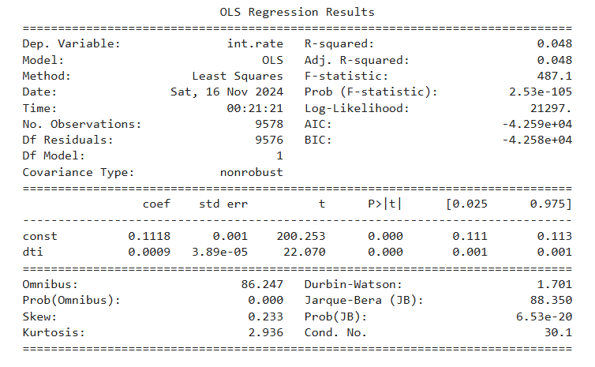
Result Interpretation
Key Insights from OLS Results
Regression Coefficient (DTI): A positive coefficient indicates that higher DTI ratios lead to slightly higher interest rates.
R-squared (0.048): Explains 4.8% of the variance in interest rates, showing that other factors also influence interest rates.
Statistical Significance: The p-value (<0.05) confirms the relationship between DTI and interest rates is statistically significant.

Slide 15
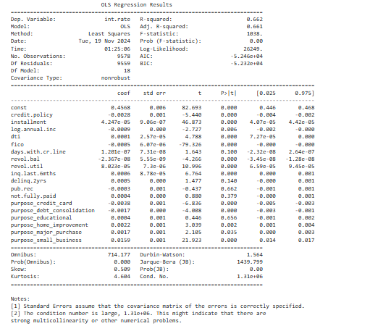
Multiple Linear Regression Results
The goal is to predict the dependent variable by analyzing the influence of the independent variables and estimating their coefficients.
Key Results of Multiple Linear Regresssion
R-squared (0.662):
Indicates that 66.2% of the variation in interest rate (int.rate) is explained by the independent variables.
Adjusted R-squared (0.661):
Adjusted for the number of predictors, ensuring a more accurate assessment of model fit.
P-values:
Predictors with p < 0.05 (e.g., installment, fico, days.with.cr.line) are statistically significant and strongly influence the dependent variable.
Predictors with p > 0.05 (e.g., not.fully.paid) are not statistically significant.
F-statistic (1038):
A high F-statistic with p < 0.05 confirms that the model as a whole is significant.

Slide 16

Possible Issues in Model
Outliers and High-Leverage Points:
Can disproportionately influence the model, distorting coefficients and overall fit.
Addressing these points and refitting the model ensures a more stable and reliable assessment.
Heteroskedasticity:
Uneven variance of residuals can lead to inefficient and biased estimates.
Testing for heteroskedasticity and applying robust standard errors corrects for variability.
Multicollinearity:
High correlations among predictors inflate variances, reducing model stability.
Checking Variance Inflation Factor (VIF) helps identify and mitigate multicollinearity issues.
Model Assumptions Validation:
Key assumptions such as independence, normality, and randomness of residuals must hold.
Validating these assumptions refines the model for greater accuracy and insights.

Slide 17
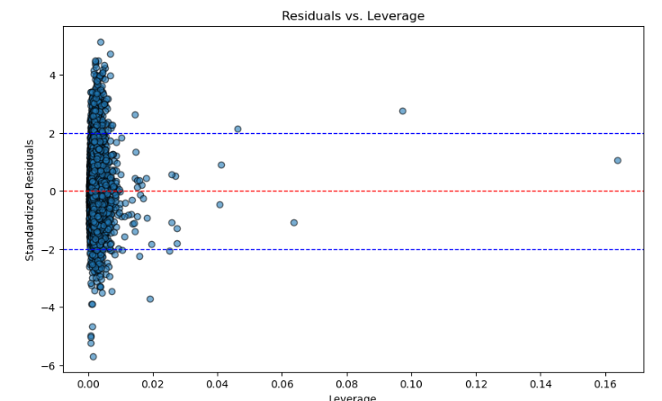
Identifying and Removing Influential Points
Objective:
Ensure the regression model is robust by addressing data points that disproportionately impact the fit.
Calculate Diagnostic Measures:
Leverage values to identify points far from the mean of predictors.
Cook's Distance to measure each point’s influence on the regression coefficients.
Identify Influential Points:
Use thresholds for leverage (2 * (p/n)) and Cook's Distance (4/n) to flag high-impact observations.
Combine Influential Observations:
Merge high-leverage and high Cook’s Distance points into a single set for removal.
Remove and Refit:
Eliminate identified influential points and refit the regression model to reassess performance.
Visualize Residuals vs. Leverage:
Inspect patterns and confirm influential points are appropriately removed.

Slide 18
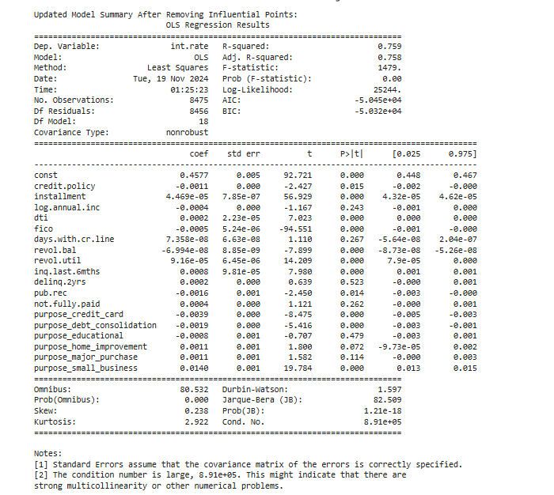
Result
Improved Model Performance:
R-squared: Increased from 0.662 to 0.759, indicating that the predictors explain a larger proportion of the variance in interest rates.
Adjusted R-squared: Improved to 0.758, confirming better model fit with adjusted predictors.
Predictor Significance:
Key variables like installment, fico, and purpose_small_business remain statistically significant (p < 0.05).
Variables like not.fully.paid remain insignificant (p > 0.05) and may warrant further review.
Further steps include checking for heteroskedasticity and multicollinearity to refine the model further.

Slide 19
Testing and Addressing Heteroskedasticity
To test for heteroskedasticity, the Breusch-Pagan test was performed to evaluate whether the residuals exhibit constant variance, a key assumption of homoscedasticity in linear regression. The test provided a p-value to determine if heteroskedasticity exists, indicating variability in the residuals across the range of predictors.
Purpose of Breusch-Pagan Test:
Validates if residuals have constant variance (homoscedasticity).
The Breusch-Pagan test regresses the squared residuals on the predictors to check for patterns in residual variance and provides a p-value. A p > 0.05 indicates no evidence of heteroskedasticity (variance is constant), while a p < 0.05 suggests heteroskedasticity (variance changes with predictors).
The Breusch-Pagan test resulted in a p-value = 2.1085469535315136e-87, which is extremely small (p < 0.05). To address this issue, the regression model was refitted using robust standard errors (HC3), ensuring that coefficient estimates and hypothesis tests remain reliable despite potential violations of the homoscedasticity assumption.

Slide 20
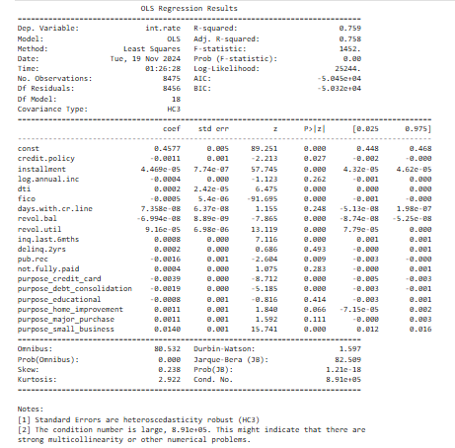
Result
Key Insights:
The R-squared (0.759) and Adjusted R-squared (0.758) remain consistent, confirming that 75.9% of the variation in interest rates is explained by the predictors.
Key predictors like installment, fico, and purpose_small_business continue to show statistical significance (p < 0.05).
Robust Standard Errors (HC3): Address heteroskedasticity, ensuring reliable p-values and coefficient estimates.
Some predictors, such as not.fully.paid, remain insignificant (p > 0.05) and may need further review.
Next, it would be beneficial to check for multicollinearity among the predictors by analyzing the Variance Inflation Factor (VIF). Multicollinearity, if present, can distort coefficient estimates and reduce the model’s interpretability, as highly correlated predictors inflate standard errors. By evaluating VIF values, we can assess the degree of multicollinearity and plan appropriate steps.

Slide 21
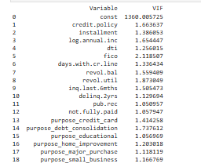
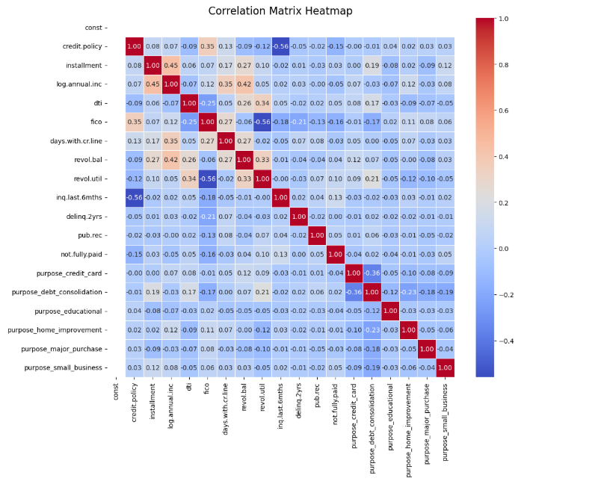
Multicollinearity Analysis
What was done?
Calculated VIF for each predictor to assess multicollinearity.
All predictors have VIF values below 5, indicating no severe multicollinearity.
Visualized pairwise correlations between predictors.
Most variables show low to moderate correlations, confirming independence among predictors.
Key Insights:
The low VIF values (< 5) and weak correlations suggest multicollinearity is not a concern in this model.
Predictors are sufficiently independent to ensure stable coefficient estimates and accurate interpretations.

Slide 22
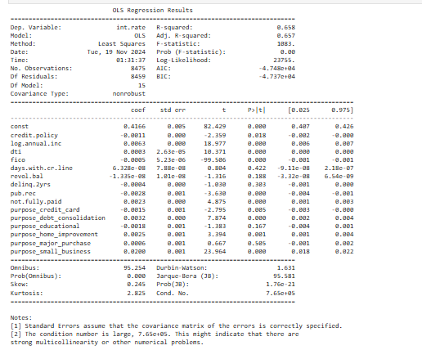
Refining Model after Feature Selection
The regression model was refitted after dropping specific predictors (installment, revol.util, inq.last.6mths) to address their potential multicollinearity or lack of statistical significance. This step aims to simplify the model and improve interpretability while retaining essential predictors.
Key Results:
R-squared (0.658): The model explains 65.8% of the variation in interest rates.
Adjusted R-squared (0.657): Remains consistent, indicating the model maintains a good fit with fewer predictors.
Significant Predictors: Variables like fico, credit.policy, and purpose_small_business continue to have p-values < 0.05, demonstrating their strong impact on int.rate.

Slide 23

Conclusion
The analysis confirms the relationship between DTI and interest rates but highlights the need for a more comprehensive model. The low R-squared value suggests that other significant factors influencing interest rates are missing from the current model.
Enhanced the model by adding additional predictors through Multiple Linear Regression to account for more variance in int.rate.
Identified and removed influential points using Cook’s Distance and leverage thresholds to improve model reliability. Refit the model with the cleaned dataset, resulting in an R-squared of 0.759.
Addressed multicollinearity (via VIF) and heteroskedasticity (via robust standard errors), further strengthening the model.
After addressing multicollinearity using VIF, dropping features resulted in an R-squared of 0.658, lower than the cleaned model's R-squared of 0.759.
The model with removed influential points (R-squared: 0.759) outperforms the dropped features model (R-squared: 0.658) in explaining the variance in interest rates.
The model which addresses heteroskedasticity and outliers satisfies the Gauss-Markov Theorem by ensuring independence, minimal multicollinearity, and efficient estimations through robust standard errors.
The model shows strong explanatory power (Adjusted R^2 = 0.758) and statistical significance (F-statistic p-value = 0.00).
Low AIC (-50,450) and BIC (-50,320) indicate an efficient balance between fit and complexity.
Some variability (24.2%) remains unexplained, suggesting room for improvement.
Overall, the model is robust and suitable for prediction or inference.

Slide 24
Thank You

