Slide 1

Basic Details of the Team and Problem Statement
Theme Name: Smart Education
Problem Statement Title: Bringing power of AI/ML to aid of teacher in a classroom
Team Name: Ikshana
Team Leader Name: Hrushikesh Kachgunde
Institute Name: Dr. D Y Patil Institute of Engineering Management and Research

Slide 2
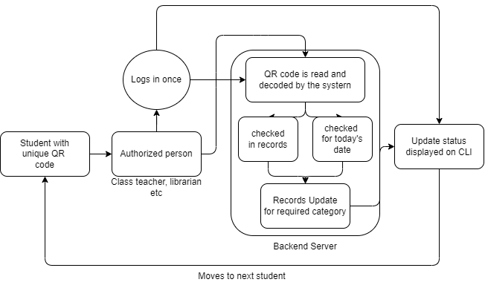
Idea/Approach Details
Describe your idea/Solution/Prototype here:
Generate QR codes for each individual student.
The UI will be a website where the authorized person will log in and start scanning QR codes.
Records will be updated and maintained digitally.
Time and resource efficient.
Describe your Technology stack here:
Python for system building; html, css and js for web front end.
Pandas and Numpy for record manipulation.
Opencv, Pyzbar and Qrcode libraries to generate qrcodes and read data from them.

Slide 3
Idea/Approach Details
Describe your Use Cases here
Describe your Dependencies / Show stopper here
The student will carry his unique QR code printed behind his ID card.
This QR code will be scanned by authorized person.
Authorized person logs in to access the QR code scanning functionality on his phone.
The records are updated automatically and saved for later reference.
Authorized person needs an access to a mobile phone and internet connection.
If the student loses his QR/ID card and the authorities are not informed about this, the QR can be misused.
Students have a habit of forgetting things.

Slide 4
Team Member Details
Team Leader Name: Hrushikesh Kachgunde
Branch (Btech/Mtech/PhD etc): B.E. Stream (ECE, CSE etc): AI & Data Science Year (I,II,III,IV): II
Team Member 1 Name: Prathamesh Parit
Branch (Btech/Mtech/PhD etc):B.E. Stream (ECE, CSE etc): AI & Data Science Year (I,II,III,IV): II
Team Member 2 Name: Riddhi Gujarathi
Branch (Btech/Mtech/PhD etc): B.E. Stream (ECE, CSE etc): AI & Data Science Year (I,II,III,IV): II
Team Member 3 Name: Type Rupesh Suryawanshi
Branch (Btech/Mtech/PhD etc): B.E. Stream (ECE, CSE etc): AI & Data Science Year (I,II,III,IV): II
Team Member 4 Name: Type Saniya Mulla
Branch (Btech/Mtech/PhD etc): B.E. Stream (ECE, CSE etc): AI & Data Science Year (I,II,III,IV): II
Team Member 5 Name: Type Sukanya Biradar
Branch (Btech/Mtech/PhD etc): B.E. Stream (ECE, CSE etc): AI & Data Science Year (I,II,III,IV): II
Team Mentor 1 Name: Chaitali Shewale
Category (Academic/Industry): Academic Expertise DS & data structures Domain Experience (in years): 7 yrs
Team Mentor 2 Name: Suvarna Patil
Category (Academic/Industry): Expertise (AI/ML/Blockchain etc): Domain Experience (in years):

Slide 5
Technology Stack
Please mention the technology stack
Python, Html, css and javascript
Flask
Sql_alchemy
Pandas, Numpy & Matplotlib
Opencv
Qrcode, Pyzbar

