Slide 1

An approach by Team 13

Slide 2

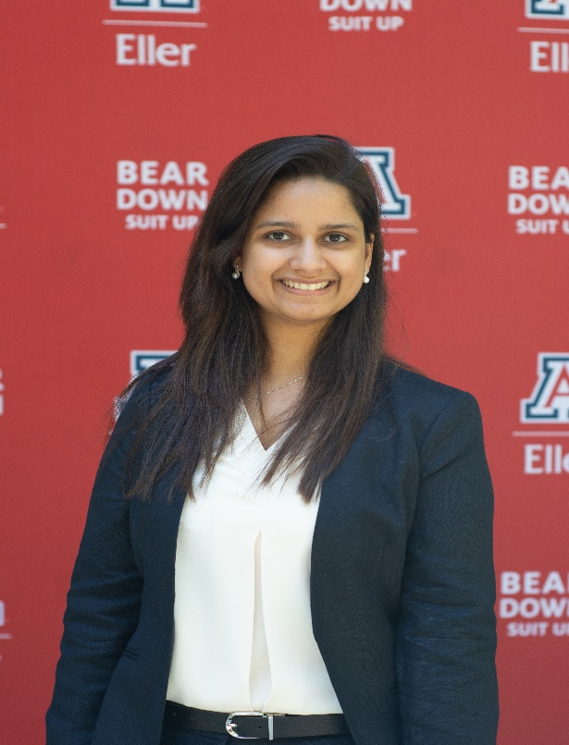

TEAM
PRATHAMESH
Riya Shah
Pooja Tyagi
Prathamesh Ranade

Slide 3






AGENDA
PRATHAMESH
Client
Dataset Description
Business Problem Description
Solutions
Analysis/Results and Findings
Next Steps

Slide 4


CLIENT
PRATHAMESH
Operates grocery pick-up and delivery service in US and Canada
Can deliver grocery in two hours
Doesn’t own stores and dependent on local grocery retailers for fulfilling the demand
Offers membership option: Instacart Express
Monthly Web visitors 16 Million
Caters to 300 grocers/food retailers in the U.S.

Slide 5




DATASET DESCRIPTION
PRATHAMESH
3 MN Instances
4 Files
4 Variables
Aisles
Department
Orders
Products
Order ID
Product ID
Product Name
User ID
Anonymized sample of over 3 million grocery orders from over 200,000 Instacart users

Slide 6
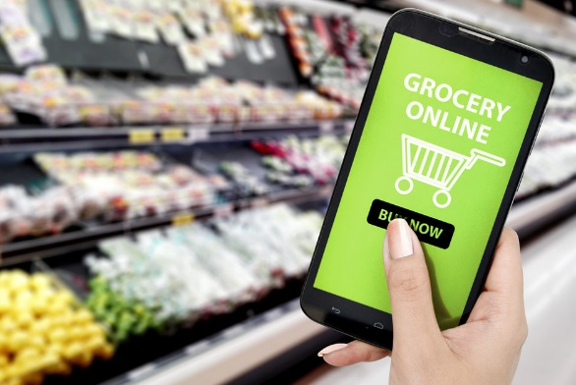
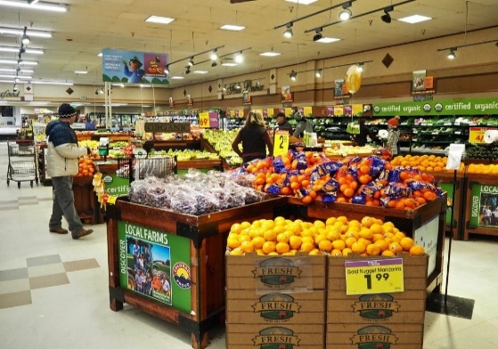
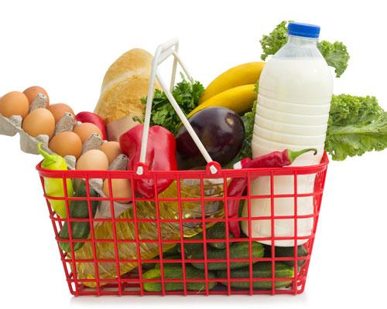
BUSINESS PROBLEM
PRATHAMESH
Increase Customer + Retailer engagement
Enhancing User Experience
Managing Store Inventory
Increasing basket size

Slide 7
BUSINESS PROBLEM
PRATHAMESH
Scenario
Patricia Quillen, owner of ‘Country Discount Grocery’ finds that 50% of her stock is outdated and 15% is close to its best.
– A Forbes report on what happens to old and expired supermarket food
Is there any way to tackle it?
Can we increase sales of this 15% of inventory by user friendly discounts?
Can we estimate inventory requirements?
Can we increase visibility of items low in demand?
Can we improve user experience by recommending items they would like to buy, thereby increasing basket size?

Slide 8

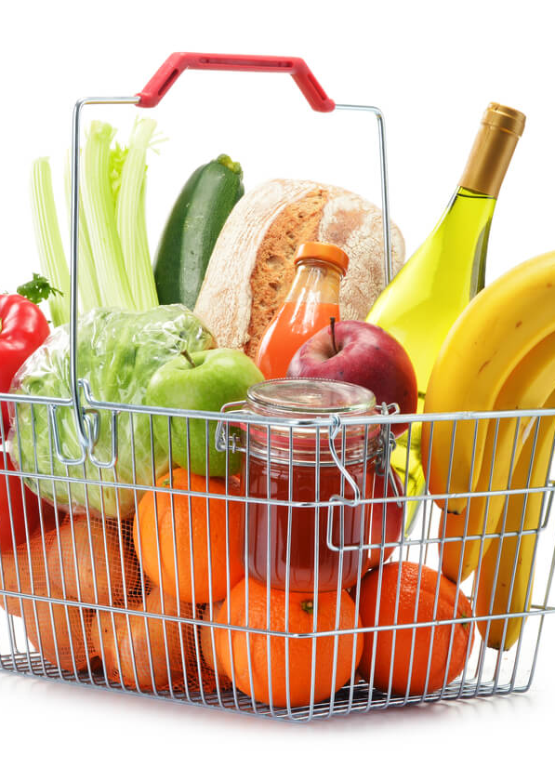
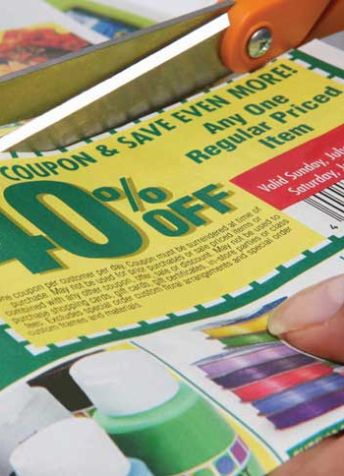
SOLUTION
RIYA
Inventory Management by Customer behavior Analysis
Customer Engagement by Frequently bought together items
User friendly efficient marketing campaigns

Slide 9

FREQUENTLY BROUGHT TOGETHER ITEMS
– BY MARKET BASKET ANALYSIS

Slide 10
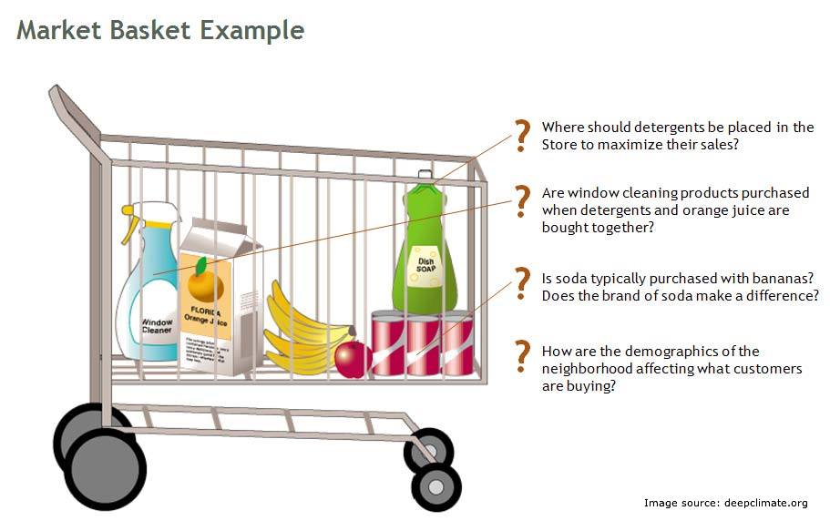
MARKET BASKET ANALYSIS
RIYA

Slide 11
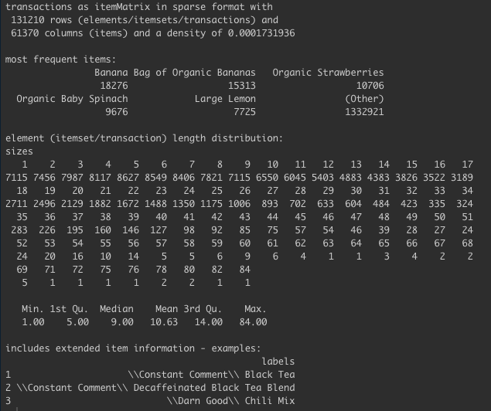
BASKET ANALYSIS– APRIORI ALGORITHM
RIYA
Market Basket Analysis

Slide 12
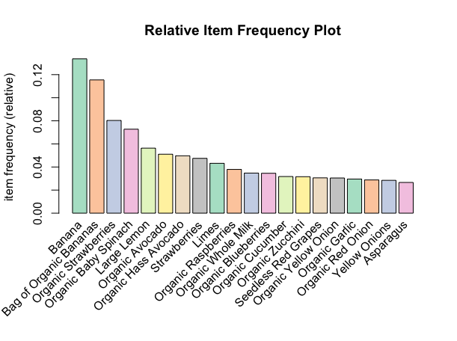
PURCHASE FREQUENCY OF MOST-SELLING ITEMS
RIYA
Relative Itemset Frequency Plot

Slide 13
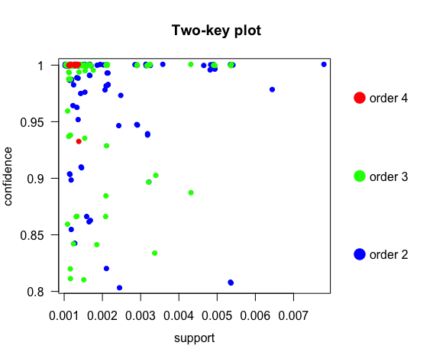
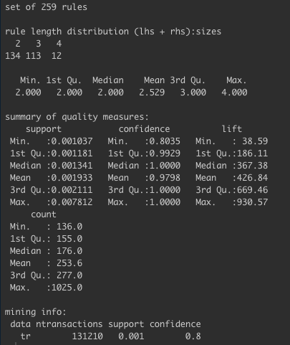
RESULTS AND FINDINGS – APRIORI ALGORITHM
RIYA
Analysis of Rules
Two-key plot of Rules

Slide 14
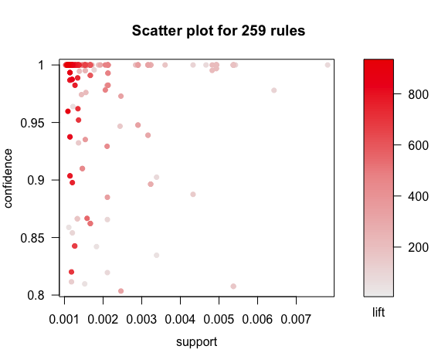
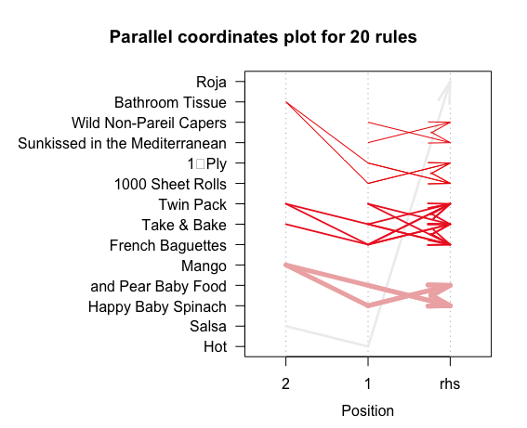
RESULTS AND FINDINGS – ASSOCIATION RULES
RIYA

Slide 15
Pooja
ASSOCIATION RULES AND CUSTOMER BEHAVIOR ANALYSIS- IN SOFTWARE

Slide 16
Summary
PRATHAMESH
Discounts based on day of the week
Product bundling of high selling and low selling products in discount campaigns
Recommending frequently bought together items
Hour of the day for employee management
Aisle refilling based on sales trends

Slide 17
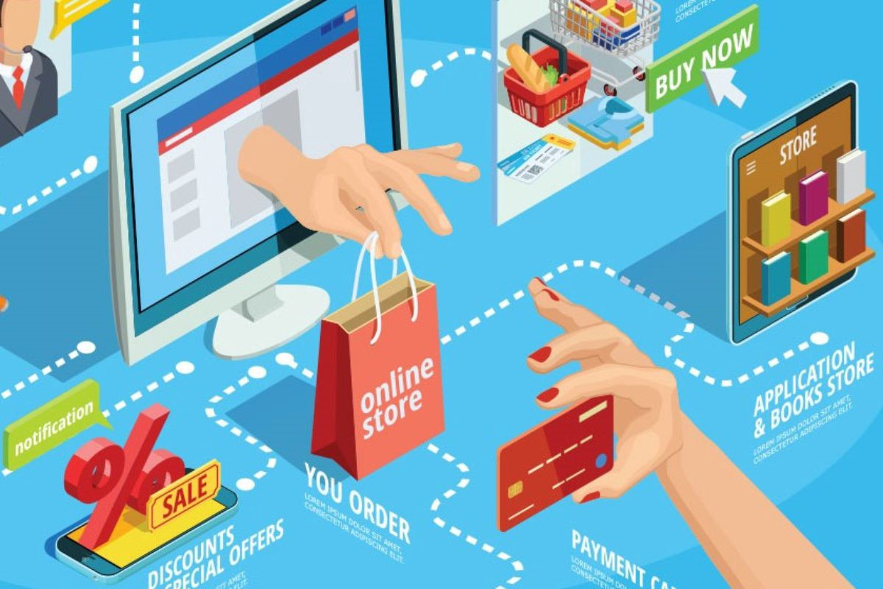
NEXT STEPS
Pooja
Customized User Recommendation

Slide 18
Pooja
Thank You!

