Slide 1

An approach by Team 13
Notes:
Hello, good afternoon all! We are team 13 and through our project we have tried to solve a common problem that grocery vendors face. Before going into those details, I’d like to introduce my team.

Slide 2

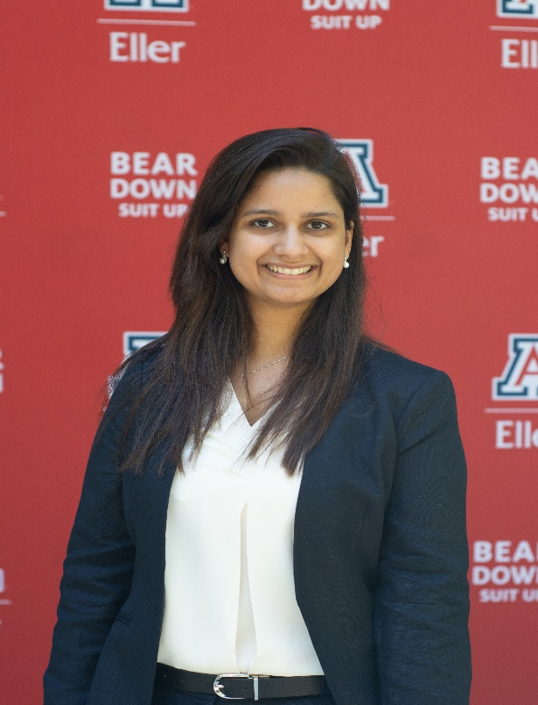

TEAM
PRATHAMESH
Riya Shah
Pooja Tyagi
Prathamesh Ranade
Notes:
That is Riya, Pooja, and Prathamesh. Coming to today’s Agenda

Slide 3






AGENDA
PRATHAMESH
Client
Dataset Description
Business Problem Description
Solutions
Analysis/Results and Findings
Next Steps
Notes:
We will start with some information about our client, the dataset we have used, our business problem, its solution, the analysis, results and findings of our effort and the next steps.

Slide 4
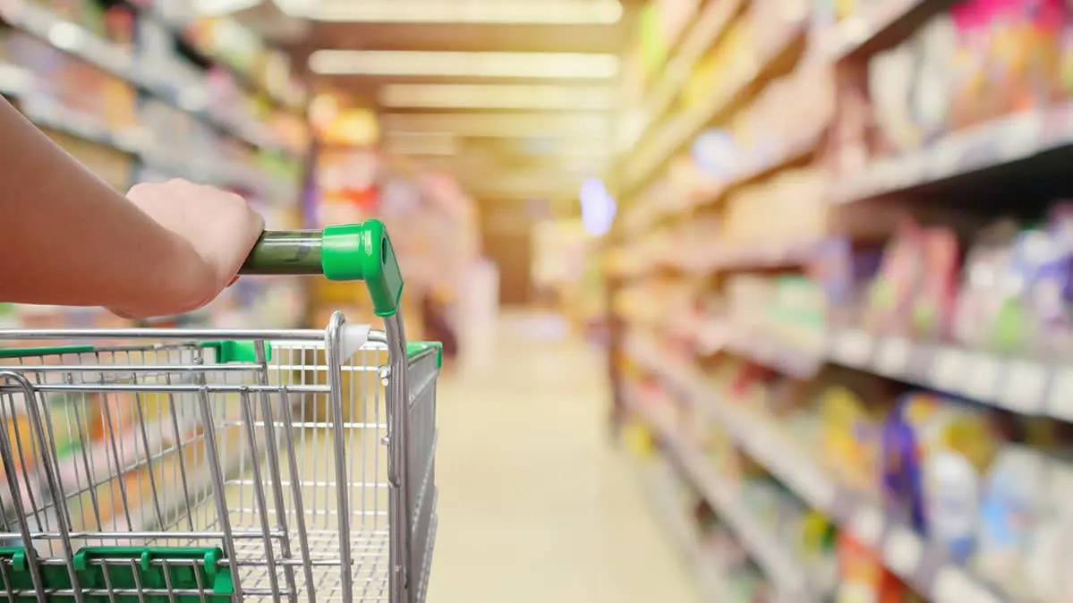

CLIENT
PRATHAMESH
Operates grocery pick-up and delivery service in US and Canada
Can deliver grocery in two hours
Doesn’t own stores and dependent on local grocery retailers for fulfilling the demand
Offers membership option: Instacart Express
Monthly Web visitors 16 Million
Caters to 300 grocers/food retailers in the U.S.
Notes:
Our virtual client is Instacart. As many of you know, Instacart is grocery pick-up and delivery service company operating in US and Canada. It doesn’t own any stores and is dependent on close to 300 grocers and food retailers in the US which it also caters. So it is a partner/client relationship. Instacart has around 16 million monthly visitors on its app and website.
In our project, we are using dataset generated by these users’ online orders which will see next.

Slide 5




DATASET DESCRIPTION
PRATHAMESH
3 MN Instances
4 Files
4 Variables
Aisles
Department
Orders
Products
Order ID
Product ID
Product Name
User ID
Anonymized sample of over 3 million grocery orders from over 200,000 Instacart users
Notes:
So like I said, our dataset is an anonymized sample of over … It was made available on Kaggle as part of a competition. The dataset is made up of 4 excel files each with many variables. OrderID, Product ID, Prod Name and User ID are a few of the variables we used in the project.. Our dataset was pretty much clean, so we didn’t have to do much data preprocessing except a few data transformation for time and weekday
On the basis of this data we have attempted to solve a 2 pronged problem.(Next slide)

Slide 6
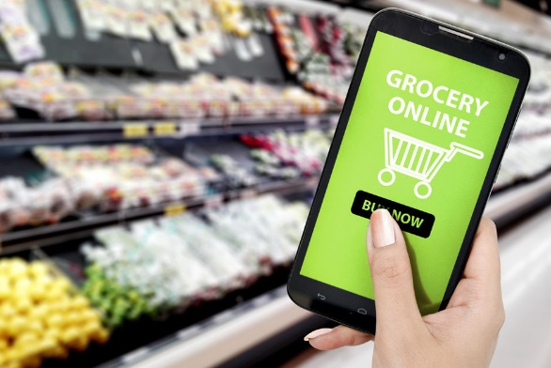
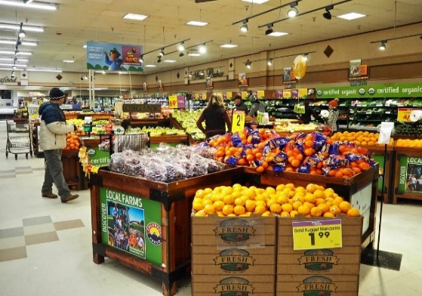
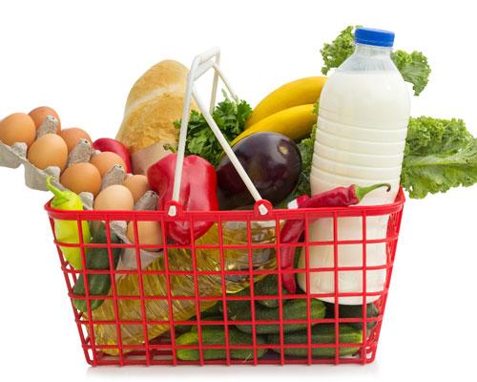
BUSINESS PROBLEM
PRATHAMESH
Increase Customer + Retailer engagement
Enhancing User Experience
Managing Store Inventory
Increasing basket size
Notes:
That is how to increase customer as well as retailer engagement with Instacart. That includes how to improve the user experience, how to help the retailer manage its store’s inventory better and based on these two, how to increase the overall basket size of the customer.
Let’s drill down on the problem a bit more..

Slide 7
BUSINESS PROBLEM
PRATHAMESH
Scenario
Patricia Quillen, owner of ‘Country Discount Grocery’ finds that 50% of her stock is outdated and 15% is close to its best.
– A Forbes report on what happens to old and expired supermarket food
Is there any way to tackle it?
Can we increase sales of this 15% of inventory by user friendly discounts?
Can we estimate inventory requirements?
Can we increase visibility of items low in demand?
Can we improve user experience by recommending items they would like to buy, thereby increasing basket size?
Notes:
Patrici….
So can we increase …
And to look at our solutions to answer these questions I would like to give it to Riya

Slide 8

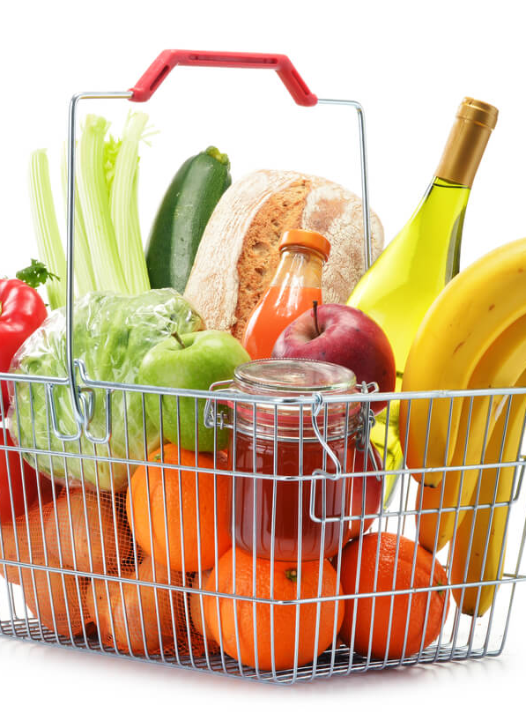
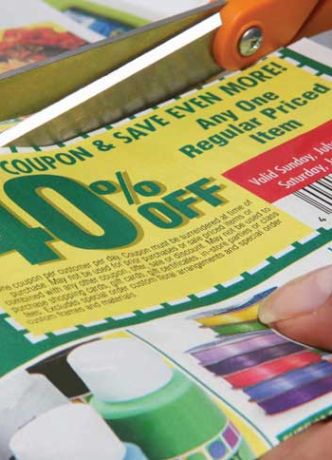
SOLUTION
RIYA
Inventory Management by Customer behavior Analysis
Customer Engagement by Frequently bought together items
User friendly efficient marketing campaigns

Slide 9

FREQUENTLY BROUGHT TOGETHER ITEMS
– BY MARKET BASKET ANALYSIS

Slide 10
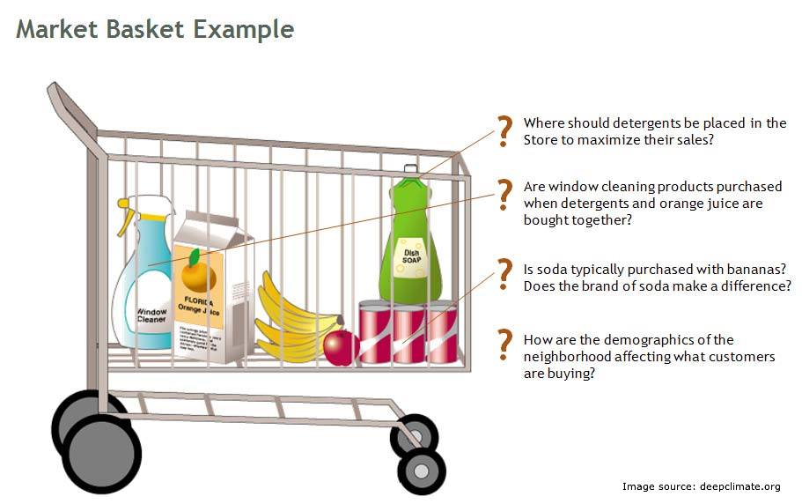
MARKET BASKET ANALYSIS
RIYA

Slide 11
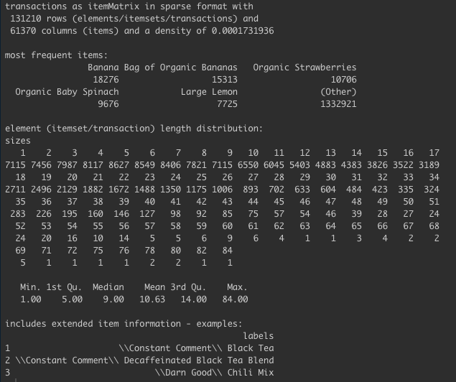
BASKET ANALYSIS– APRIORI ALGORITHM
RIYA
Market Basket Analysis

Slide 12
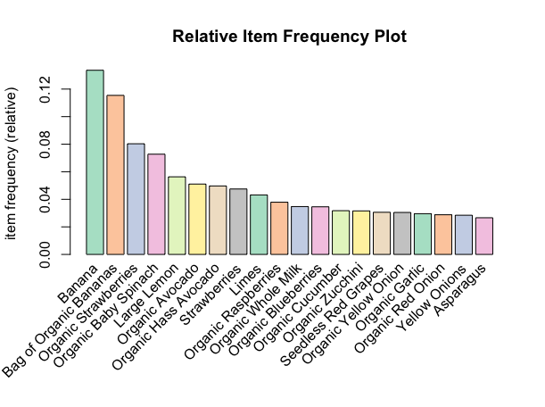
PURCHASE FREQUENCY OF MOST-SELLING ITEMS
RIYA
Relative Itemset Frequency Plot

Slide 13
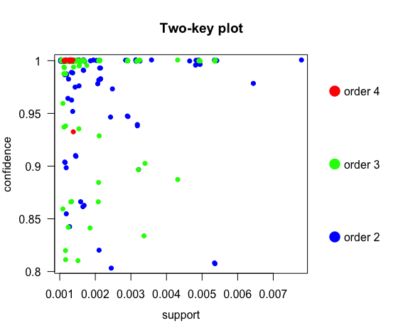
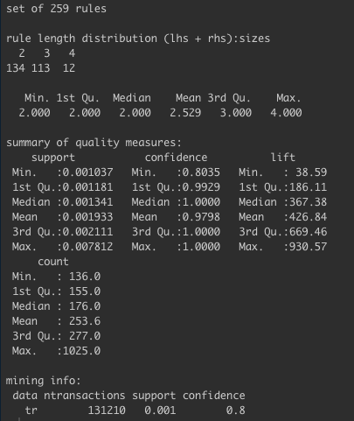
RESULTS AND FINDINGS – APRIORI ALGORITHM
RIYA
Analysis of Rules
Two-key plot of Rules

Slide 14
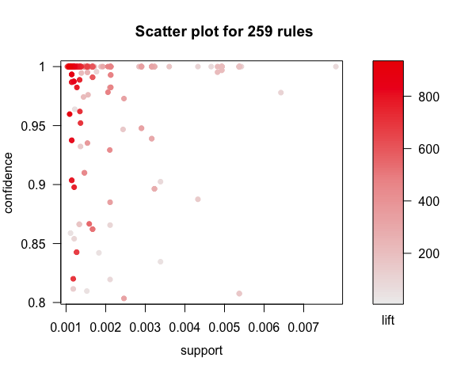
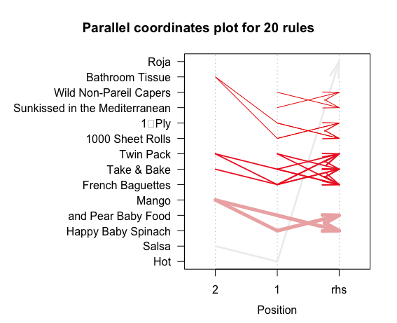
RESULTS AND FINDINGS – ASSOCIATION RULES
RIYA

Slide 15
Pooja
ASSOCIATION RULES AND CUSTOMER BEHAVIOR ANALYSIS- IN SOFTWARE

Slide 16
Summary
PRATHAMESH
Discounts based on day of the week
Product bundling of high selling and low selling products in discount campaigns
Recommending frequently bought together items
Hour of the day for employee management
Aisle refilling based on sales trends

Slide 17
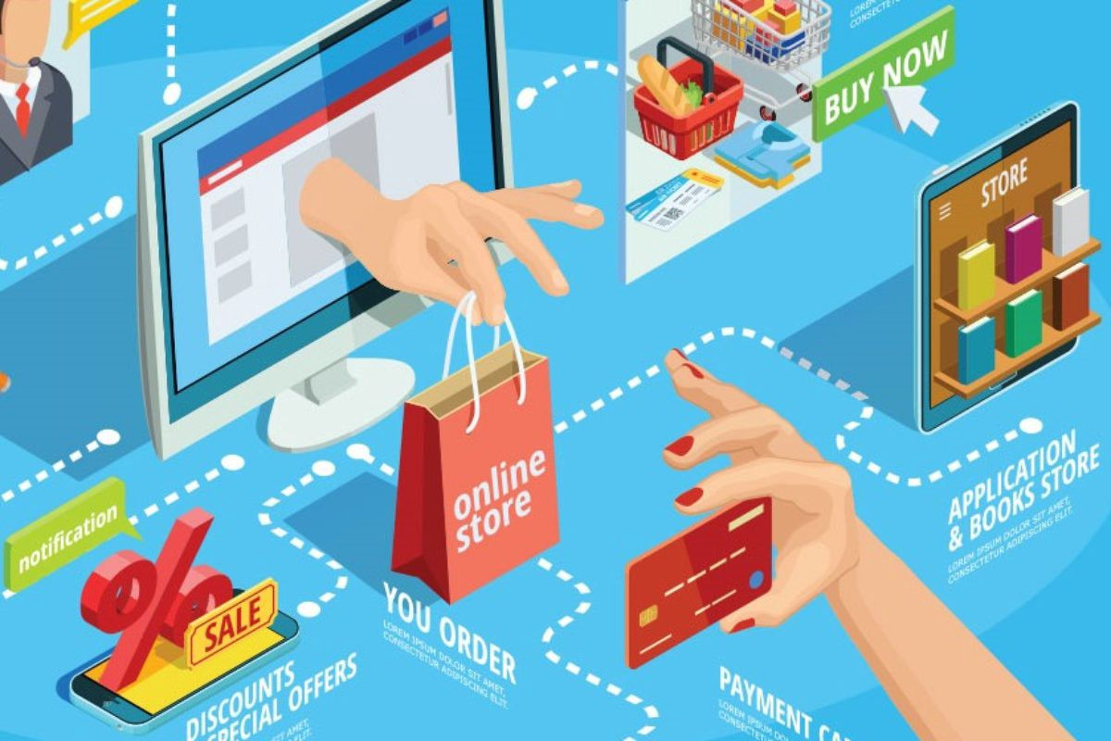
NEXT STEPS
Pooja
Customized User Recommendation

Slide 18
Pooja
Thank You!

